Slide 1

THE RAPID RISE OF
EXOPLANET DISCOVERIES
Story arc
What changed after the 1990s?
How advances in space telescopes turned a few detections into a catalog of thousands of worlds
Which methods and telescopes drove the boom?
6,147
What kinds of planets are filling the archive?
confirmed planets
on the archive homepage
(Mar 12, 2026)
Why this changes how we think about planetary systems
For centuries, humanity knew only the planets in our own solar system.
Now the archive updates weekly as new worlds keep arriving.
Venu Bandi
DATA 607 / Data Story Presentation
Data Source: NASA Exoplanet Archive (exoplanetarchive.ipac.caltech.edu) | Visualization: Python (Pandas, Matplotlib, Seaborn)
Source: NASA Exoplanet Archive (website and TAP query)
Venu Bandi | Individual Data Story Presentation
Notes:
[Sources]
NASA Exoplanet Archive homepage, accessed 2026-03-12: https://exoplanetarchive.ipac.caltech.edu/ (homepage shows 6,147 confirmed planets and 760 TESS confirmed planets on 03/12/2026; describes TESS, Kepler, and K2 mission context).
Assignment structure followed from user-provided brief, not an external source.
[/Sources]

Slide 2
The question
A good data story needs a single question, not a list of facts.
How did exoplanet discovery go from rare announcements to a steadily expanding catalog of thousands?
Headline numbers from the site
The archive itself points to the answer: new survey missions scaled observation, especially Kepler and later TESS.
6,147
2,783
All confirmed planets
Confirmed planets discovered by Kepler
What the archive tells us
Mission context on the homepage
95% of confirmed planets in the query were discovered in 2009 or later
TESS
Launched in April 2018, TESS surveys the sky to find transiting exoplanets around the brightest stars near Earth.
760
4,515
Transit detections account for roughly three-quarters of the archive
Kepler
The archive describes Kepler as the first space mission to search for Earth-sized and smaller planets in habitable zones nearby.
Confirmed planets discovered by TESS
Transit discoveries
Kepler, TESS, and K2 together contribute about two-thirds of confirmed planets
This presentation turns those archive facts into a narrative: scale, method, mission, and consequence.
Data Source: NASA Exoplanet Archive (exoplanetarchive.ipac.caltech.edu) | Visualization: Python (Pandas, Matplotlib, Seaborn)
Source: NASA Exoplanet Archive (website and TAP query)
Venu Bandi | Individual Data Story Presentation
Notes:
[Sources]
NASA Exoplanet Archive homepage: https://exoplanetarchive.ipac.caltech.edu/ (homepage mission descriptions and current counts accessed 2026-03-12).
Exoplanet and Candidate Statistics page: https://exoplanetarchive.ipac.caltech.edu/docs/counts_detail.html (Kepler, TESS, and transit counts).
TAP query used for derived percentages on this slide: https://exoplanetarchive.ipac.caltech.edu/TAP/sync?format=csv&query=select+disc_year%2Cdiscoverymethod%2Cdisc_facility%2Cpl_rade%2Cpl_bmasse%2Cpl_orbper+from+pscomppars
[/Sources]

Slide 3
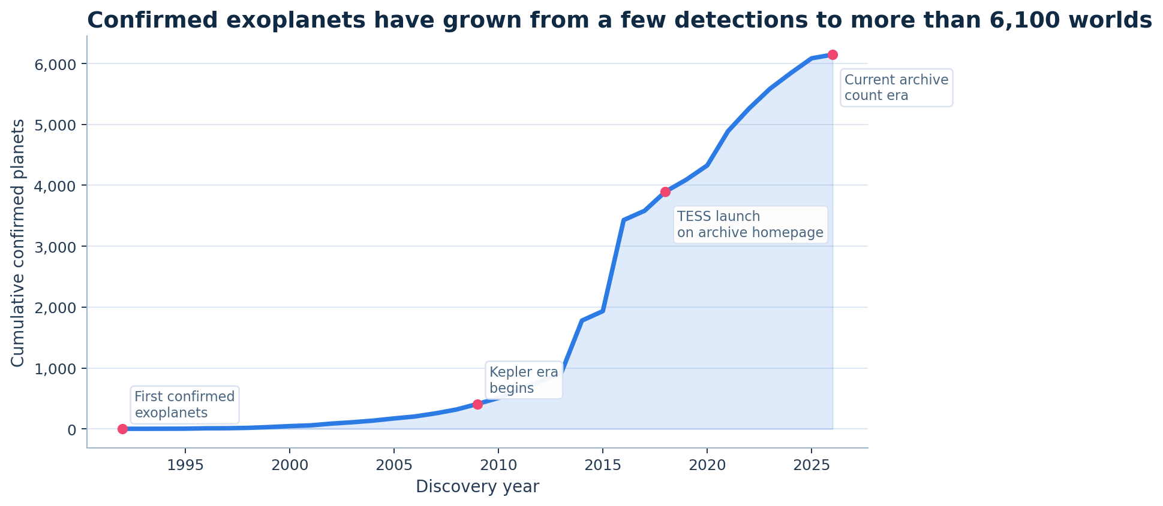
1. The curve bends upward fast
The first visual should answer the big question immediately.
Cumulative confirmed exoplanets by discovery year
What to say out loud
The early years add planets slowly.
The slope steepens after the Kepler era begins.
By the 2020s the archive is no longer growing by single discoveries - it grows by waves.
Key takeaway
Exoplanet discovery behaves like a technology curve, not a slow linear crawl.
Data Source: NASA Exoplanet Archive (exoplanetarchive.ipac.caltech.edu) | Visualization: Python (Pandas, Matplotlib, Seaborn)
Source: NASA Exoplanet Archive (website and TAP query)
Venu Bandi | Individual Data Story Presentation
Notes:
[Sources]
Chart derived from NASA Exoplanet Archive TAP query on pscomppars: https://exoplanetarchive.ipac.caltech.edu/TAP/sync?format=csv&query=select+disc_year%2Cdiscoverymethod%2Cdisc_facility%2Cpl_rade%2Cpl_bmasse%2Cpl_orbper+from+pscomppars
Mission timing context from NASA Exoplanet Archive homepage: https://exoplanetarchive.ipac.caltech.edu/
[/Sources]

Slide 4
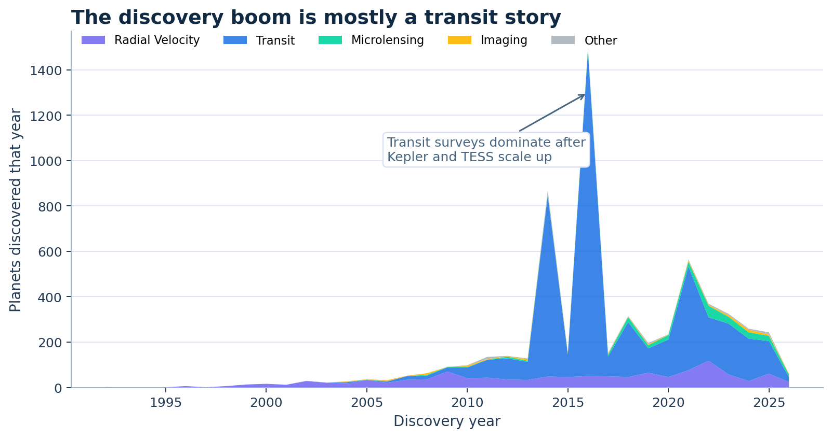
2. The boom is mostly a transit story
Not all discovery methods scale the same way.
Planets discovered per year, grouped by discovery method
Why this matters
Radial velocity mattered early, but the later surge is driven by transit surveys.
Transit works well for scanning very large numbers of stars at once.
That is why mission design and method design reinforce each other.
Transit share: 4,515 of 6,147 confirmed planets on the archive statistics page.
Data Source: NASA Exoplanet Archive (exoplanetarchive.ipac.caltech.edu) | Visualization: Python (Pandas, Matplotlib, Seaborn)
Source: NASA Exoplanet Archive (website and TAP query)
Venu Bandi | Individual Data Story Presentation
Notes:
[Sources]
Chart derived from NASA Exoplanet Archive TAP query on pscomppars: https://exoplanetarchive.ipac.caltech.edu/TAP/sync?format=csv&query=select+disc_year%2Cdiscoverymethod%2Cdisc_facility%2Cpl_rade%2Cpl_bmasse%2Cpl_orbper+from+pscomppars
Method totals cross-checked against Exoplanet and Candidate Statistics page: https://exoplanetarchive.ipac.caltech.edu/docs/counts_detail.html
[/Sources]

Slide 5
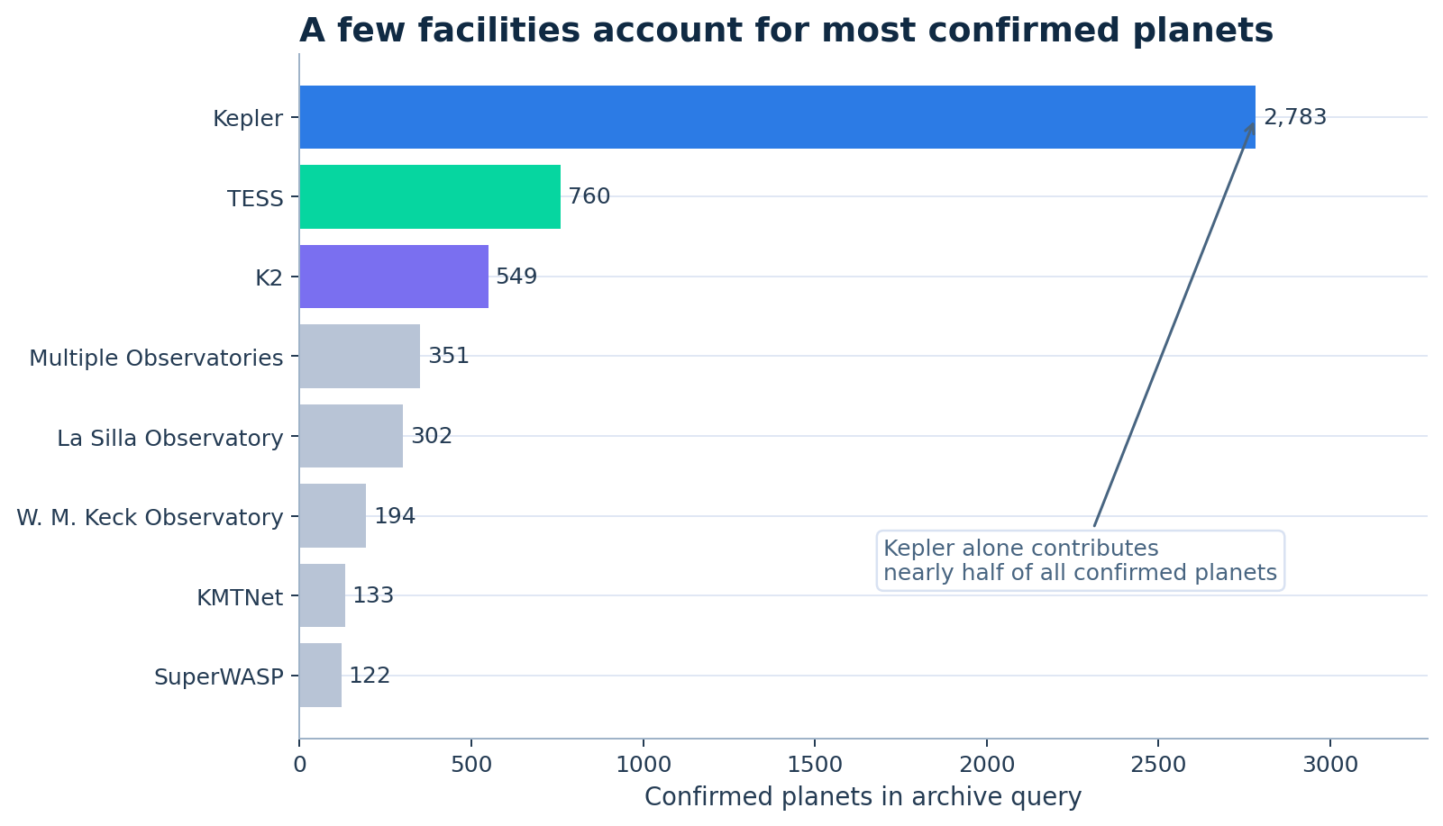
3. A few facilities changed the scale of the field
Mission-level concentration makes the trend easier to explain to a non-technical audience.
Top facilities in the archive query by confirmed planet count
Narrative frame
Kepler dominates because it turned detection into a large survey operation.
TESS keeps the pipeline active by surveying bright nearby stars.
K2 extends the Kepler story rather than starting from zero.
Together, Kepler + TESS + K2 contribute about two-thirds of confirmed planets in the TAP query.
Data Source: NASA Exoplanet Archive (exoplanetarchive.ipac.caltech.edu) | Visualization: Python (Pandas, Matplotlib, Seaborn)
Source: NASA Exoplanet Archive (website and TAP query)
Venu Bandi | Individual Data Story Presentation
Notes:
[Sources]
Chart derived from NASA Exoplanet Archive TAP query on pscomppars: https://exoplanetarchive.ipac.caltech.edu/TAP/sync?format=csv&query=select+disc_year%2Cdiscoverymethod%2Cdisc_facility%2Cpl_rade%2Cpl_bmasse%2Cpl_orbper+from+pscomppars
Kepler and TESS mission descriptions from the NASA Exoplanet Archive homepage: https://exoplanetarchive.ipac.caltech.edu/
Current mission counts cross-checked on the statistics page: https://exoplanetarchive.ipac.caltech.edu/docs/counts_detail.html
[/Sources]

Slide 6
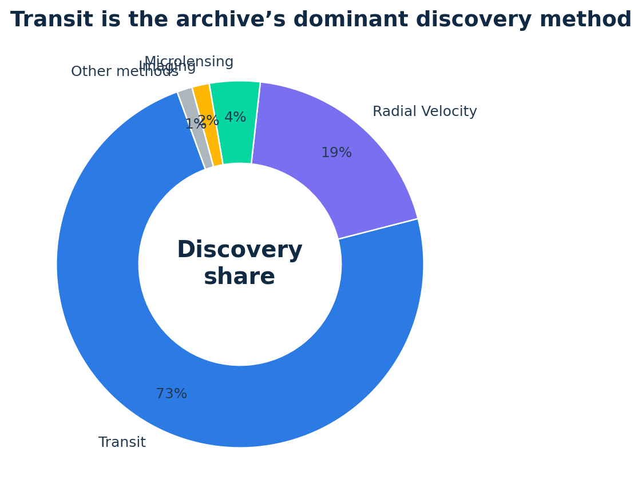
4. Discovery is concentrated in one method
A cleaner breakdown helps the audience remember the main mechanism.
Share of confirmed planets by discovery method
What the archive is really showing
Exoplanet discovery did not become easy. It became scalable.
Transit detections dominate because repeated brightness dips can be searched systematically across many stars.
Older methods like radial velocity remain important, but they do not explain the modern growth curve by themselves.
The story is not simply “better telescopes”; it is “better telescopes paired with a method that scales to survey astronomy.”
Memorable line for delivery: “The archive’s growth is what happens when one discovery method becomes industrial-scale.”
Data Source: NASA Exoplanet Archive (exoplanetarchive.ipac.caltech.edu) | Visualization: Python (Pandas, Matplotlib, Seaborn)
Source: NASA Exoplanet Archive (website and TAP query)
Venu Bandi | Individual Data Story Presentation
Notes:
[Sources]
Donut chart derived from NASA Exoplanet Archive TAP query on pscomppars: https://exoplanetarchive.ipac.caltech.edu/TAP/sync?format=csv&query=select+disc_year%2Cdiscoverymethod%2Cdisc_facility%2Cpl_rade%2Cpl_bmasse%2Cpl_orbper+from+pscomppars
Method totals cross-checked against Exoplanet and Candidate Statistics page: https://exoplanetarchive.ipac.caltech.edu/docs/counts_detail.html
[/Sources]

Slide 7
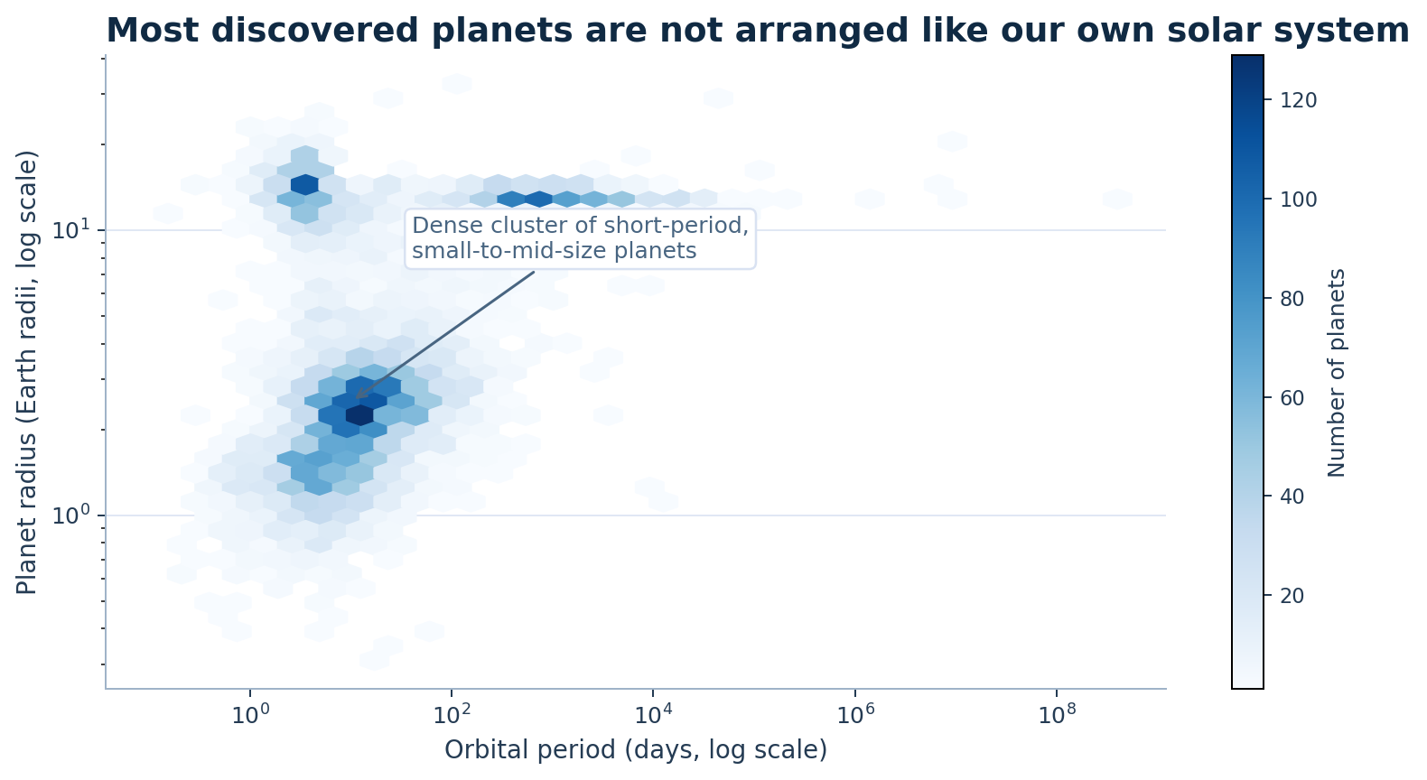
5. The archive is filling with worlds unlike the textbook solar system
Once discovery scales up, the catalog reveals unfamiliar planetary architectures.
Planet radius versus orbital period (log scales)
Interpretation
The dense cluster sits at short periods and modest radii.
That makes the archive feel less like a copy of our solar system and more like a much broader design space.
The discovery boom changes not only how many planets we know - it changes what kinds of planets we expect to exist.
Data Source: NASA Exoplanet Archive (exoplanetarchive.ipac.caltech.edu) | Visualization: Python (Pandas, Matplotlib, Seaborn)
Source: NASA Exoplanet Archive (website and TAP query)
Venu Bandi | Individual Data Story Presentation
Notes:
[Sources]
Hexbin chart derived from NASA Exoplanet Archive TAP query on pscomppars: https://exoplanetarchive.ipac.caltech.edu/TAP/sync?format=csv&query=select+disc_year%2Cdiscoverymethod%2Cdisc_facility%2Cpl_rade%2Cpl_bmasse%2Cpl_orbper+from+pscomppars
[/Sources]

Slide 8
What the audience should remember
End with one idea, not one more chart.
Exoplanet discovery accelerated because telescope missions and scalable detection methods changed astronomy from targeted searching to high-volume surveying.
Three takeaways
Call to action
Professional close
The trend is exponential-like, not incremental.
Think differently about the night sky:
This is a data story about scientific scale-up: better tools produced better counts, and better counts changed scientific imagination.
the question is no longer whether planets beyond our solar system exist. The better question is how quickly new missions can deepen, classify, and reinterpret the worlds already appearing in the archive.
Transit plus Kepler/TESS is the central engine of growth.
A bigger catalog also means a stranger and more varied universe.
Main point to say in your final 15 seconds: “Thousands of exoplanets were not revealed by one lucky breakthrough - they were revealed when discovery itself became scalable.”
Data Source: NASA Exoplanet Archive (exoplanetarchive.ipac.caltech.edu) | Visualization: Python (Pandas, Matplotlib, Seaborn)
Source: NASA Exoplanet Archive (website and TAP query)
Venu Bandi | Individual Data Story Presentation
Notes:
[Sources]
Synthesis slide based on the archive homepage, statistics page, and TAP-derived charts used throughout the presentation.
Homepage: https://exoplanetarchive.ipac.caltech.edu/
Statistics page: https://exoplanetarchive.ipac.caltech.edu/docs/counts_detail.html
TAP query: https://exoplanetarchive.ipac.caltech.edu/TAP/sync?format=csv&query=select+disc_year%2Cdiscoverymethod%2Cdisc_facility%2Cpl_rade%2Cpl_bmasse%2Cpl_orbper+from+pscomppars
[/Sources]

Slide 9
Source list
Strictly limited to the NASA Exoplanet Archive website for topic evidence and data.
Archive pages used
1. NASA Exoplanet Archive homepage - current counts and mission descriptions.
URLs used in notes
for reproducibility
Homepage:
https://exoplanetarchive.ipac.caltech.edu/
Statistics page:
https://exoplanetarchive.ipac.caltech.edu/docs/counts_detail.html
TAP docs:
https://exoplanetarchive.ipac.caltech.edu/docs/TAP/usingTAP.html
CSV query:
https://exoplanetarchive.ipac.caltech.edu/TAP/sync?format=csv&query=select+disc_year%2Cdiscoverymethod%2Cdisc_facility%2Cpl_rade%2Cpl_bmasse%2Cpl_orbper+from+pscomppars
2. Exoplanet and Candidate Statistics page - summary counts for confirmed planets, methods, and mission totals.
3. TAP documentation - how the archive exposes queryable tables.
4. TAP query on pscomppars - data used to build the custom charts in this deck.
Data Source: NASA Exoplanet Archive (exoplanetarchive.ipac.caltech.edu) | Visualization: Python (Pandas, Matplotlib, Seaborn)
Source: NASA Exoplanet Archive (website and TAP query)
Venu Bandi | Individual Data Story Presentation
Notes:
[Sources]
This slide repeats the same four archive sources used across the deck.
[/Sources]

