Slide 1

DEPARTMENT OF COMPUTER SCIENCE AND ENGINEERING
PROJECT PHASE-II
REVIEW1
Predictive Analytics for Energy Consumption Using XGBoost
PROJECT STUDENTS GUIDE
DWARAMPUDI D V S NARAYANA REDDY, Dr. J. JABEZ ,M.E.,PhD.,
42110325 Professor,CSE
DUBAGUNTLA VENU LAKSHMI SAI,
42110321

Slide 2
AGENDA
Abstract
Objective(s)
Literature Survey
Inferences from Literature Survey
Proposed System
Modules
Result and Discussion
References

Slide 3
ABSTRACT
This project aims to solve the growing challenge of forecasting energy consumption due to increasing global demand, climate variation, and the need for sustainable energy use. Accurate energy prediction helps reduce waste, enhance efficiency, and ensure proper energy distribution. To tackle this, we use XGBoost (Extreme Gradient Boosting)—a powerful and scalable machine learning algorithm known for handling complex, non-linear patterns in data.

Slide 4
OBJECTIVE(S)
To develop a high-accuracy predictive model using XGBoost (Extreme Gradient Boosting).
Forecast energy consumption based on environmental and operational variables.
Improved energy efficiency and reduced waste lead to cost savings for utility companies and consumers.

Slide 5
LITERATURE SURVEY(1/5)
S. No | Paper Title | Authors | Publisher /Year | Key Contributions
1 | Energy Consumption Prediction Using XGBoost and Time-Series Feature Engineering | R. Prakash, S. Nair | 2022 | Developed a load forecasting model using XGBoost. Incorporated time-series feature engineering to improve prediction accuracy. Demonstrated superior performance compared to baseline models.

Slide 6
LITERATURE SURVEY(2/5)
S. No | Paper Title | Authors | Publisher /Year | Key Contributions
2 | Machine Learning-Based Prediction of Urban Energy Consumption with Weather Data Fusion | L. Gómez, R. A. Reátegui, M. Ortega | 2021 | Proposed a machine learning framework integrating weather and urban data. Enhanced prediction reliability for urban energy consumption. Showed effectiveness of data fusion techniques in ML-based forecastin

Slide 7
LITERATURE SURVEY(3/5)
S. No | Paper Title | Authors | Publisher /Year | Key Contributions
3 | An Application of Ensemble Machine Learning for Forecasting Electrical Demand | A. Torres, A. Colominas, J. Schlotthauer, M. E. Torres | 2019 | Applied ensemble machine learning methods for electrical load forecasting. Demonstrated improved accuracy over single-model approaches. Validated the approach using real electricity demand datasets.

Slide 8
LITERATURE SURVEY(4/5)
S.No | Project Title | Authors | Publisher /Year | Key Contributions
4 | Short-Term Residential Load Forecasting Based on LSTM Recurrent Neural Network | W. Kong, Z. Y. Dong, D. J. Hill, F. Luo, X. Ma | 2019 | Introduced LSTM networks for residential load forecasting. Captured temporal dependencies in electricity usage data. Achieved better performance than conventional neural networks and statistical models.

Slide 9
LITERATURE SURVEY(5/5)
S. No | Paper Title | Authors | Publisher /Year | Key Contributions
5 | XGBoost: A Scalable Tree Boosting System | A. Sharma & N. Patel | 2016 | Proposed XGBoost, a scalable and efficient gradient boosting framework. Optimized for speed and performance on large datasets. Widely adopted in energy forecasting and other regression/classification tasks.

Slide 10
INFERENCES FROM LITERATURE SURVEY
XGBoost is highly effective
Environmental and temporal features Gradient Boosting models
Time-series forecasting
Ensemble learning methods

Slide 11
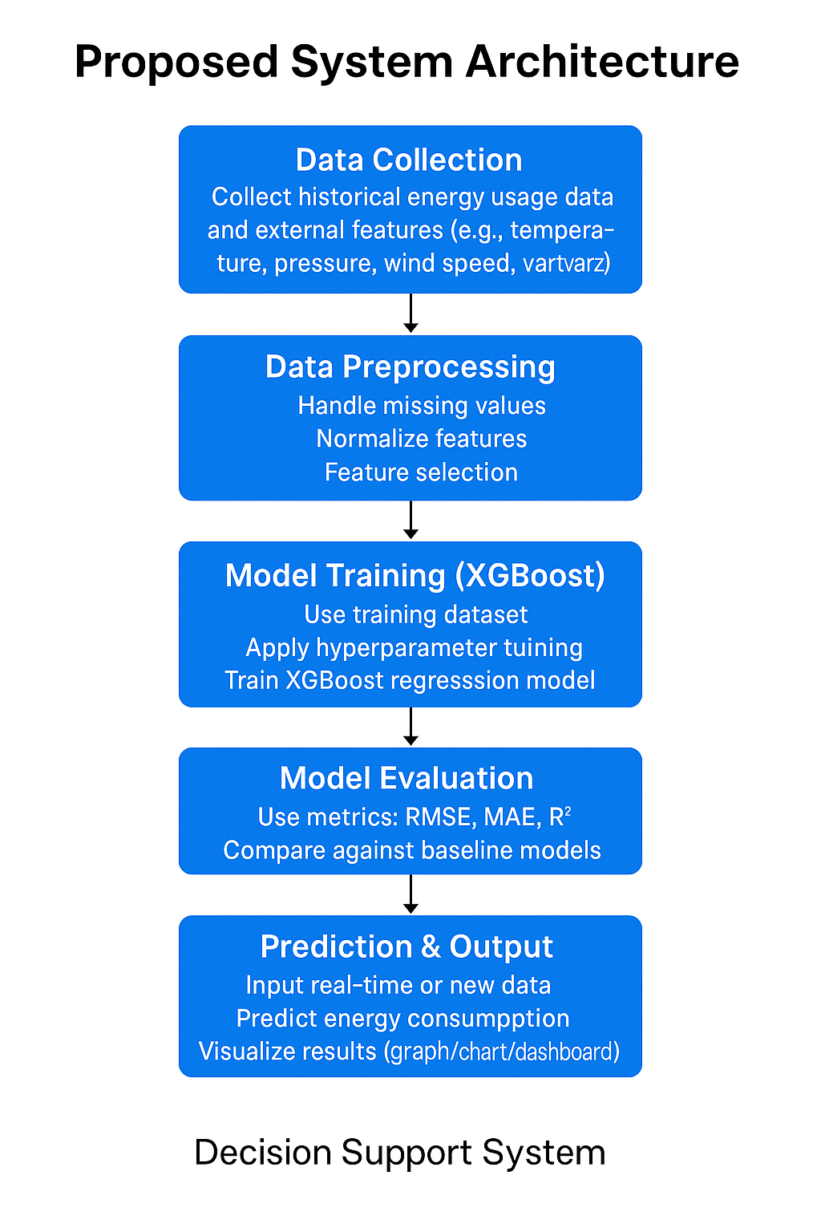
PROPOSED SYSTEM(1/2)
System Architecture

Slide 12
PROPOSED SYSTEM(2/2)
Advantages of Proposed System :
High Accuracy
XGBoost handles complex patterns and delivers precise predictions.
Fast & Scalable
Efficient for large datasets and real-time applications.
Handles Missing Data
Robust even when some inputs are incomplete or noisy.
Feature Importance Insight
Identifies which factors (like temperature or pressure) influence energy usage the most.
Improved Resource Management
Helps in better planning and reduces energy wastage.
Supports Smart Grid Systems
Enables data-driven decision-making for utilities and policymakers.

Slide 13
MODULES(1/2)
1. Data Handling & Computation
pandas → import pandas as pd Used for loading the CSV, manipulating dataframes, creating new features, and preprocessing.
numpy → import numpy as np Used for numerical operations such as log transformation, scaling, and computing RMSE.
2. Machine Learning
sklearn.model_selection → train_test_split Used to split the dataset into training and testing sets.
sklearn.metrics → mean_absolute_error, mean_squared_error, r2_score Used for evaluating the regression model performance.
xgboost → import xgboost as xgb Used for building and training the XGBoost regression model.

Slide 14
MODULES(2/2)
3. Data Visualization
matplotlib.pyplot → import matplotlib.pyplot as plt Used for plotting graphs, histograms, and scatter plots.
seaborn → import seaborn as sns Used for statistical visualizations like histograms, heatmaps, and line plots.
4. Miscellaneous / Settings
sns.set(style="whitegrid") Sets the Seaborn plot style for better aesthetics.
5.Modules Imported
pandas
numpy
sklearn.model_selection
sklearn.metrics
xgboost
matplotlib.pyplot
seaborn

Slide 15
RESULTS AND DISCUSSION
Reduced Energy Consumption: By predicting energy demand accurately, energy waste can be minimized.
Cost Savings: Improved energy efficiency and reduced waste lead to cost savings for utility companies and consumers.
Environmental Benefits: By promoting sustainable energy use, the solution contributes to a reduction in greenhouse gas emissions and environmental pollution.

Slide 16
REFERENCES(1/2)
A. Torres, A. Colominas, J. Schlotthauer, and M. E. Torres, “An Application of Ensemble Machine Learning for Forecasting Electrical Demand,” Applied Energy, vol. 253, p. 113596, 2019.
D. Li and T. Hong, “Load Forecasting Using Gradient Boosted Regression Trees,” Energy Procedia, vol. 88, pp. 109–114, 2016.
H. S. Hippert, C. E. Pedreira, and R. C. Souza, “Neural Networks for Short-Term Load Forecasting: A Review and Evaluation,” IEEE Transactions on Power Systems, vol. 16, no. 1, pp. 44–55, 2001.
J. W. Taylor, “Short-Term Load Forecasting with Exponential Smoothing Models,” International Journal of Forecasting, vol. 19, no. 3, pp. 435–446, 2003.
K. Kandananond, “Forecasting Electricity Demand in Thailand with an Artificial Neural Network Approach,” Energies, vol. 4, no. 8, pp. 1246–1257, 2011.
L. Gómez, R. A. Reátegui, and M. Ortega, “Machine Learning-Based Prediction of Urban Energy Consumption with Weather Data Fusion,” Sustainable Cities and Society, vol. 74, p. 103204, 2021.
M. Amjady and E. Keynia, “Short-Term Load Forecasting of Power Systems by Combination of Wavelet Transform and Neuro-Evolutionary Algorithm,” Energy, vol. 36, no. 5, pp. 2866–2877, 2011.

Slide 17
REFERENCES(2/2)
R. Prakash and S. Nair, “Energy Consumption Prediction Using XGBoost and Time-Series Feature Engineering,” Journal of Energy Informatics, vol. 5, no. 2, pp. 1–14, 2022.
T. Chen and C. Guestrin, “XGBoost: A Scalable Tree Boosting System,” Proceedings of the 22nd ACM SIGKDD International Conference on Knowledge Discovery and Data Mining, pp. 785–794, 2016.
W. Kong, Z. Y. Dong, D. J. Hill, F. Luo, and X. Ma, “Short-Term Residential Load Forecasting Based on LSTM Recurrent Neural Network,” IEEE Transactions on Smart Grid, vol. 10, no. 1, pp. 841–851, 2019.

Slide 18
THANK YOU
We thank God, Our Department, Guide, Panel Members, Supportive Professors and all Technical and non Technical staff who helped us in our Project.

