Slide 1
Face Detection of Identical Twins:
By Deep Learning Project…..
Dubaguntla Venu Lakshmi Sai (42110321)
Gattu Hemanth Kumar (42110360)
Gandham Bhanu Deekshit (42110354)
Gangumalla Bala Eswar Sandeep (42110356)
Gattam Mohan Krishna (42110359)

Slide 2
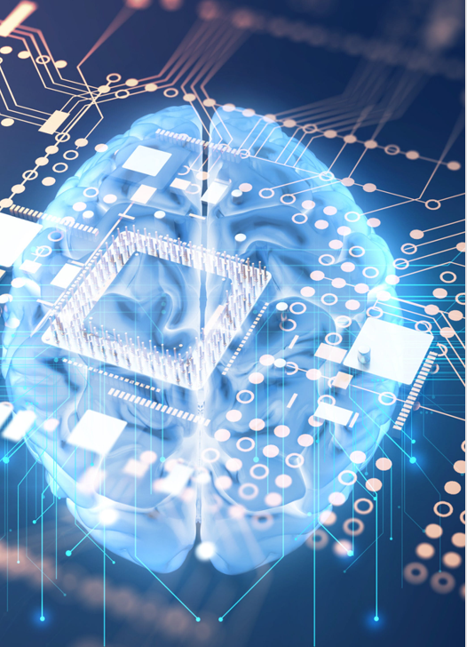
The Magic
Behind Face Recognition in
Deep Learning.
Face recognition has become a popular technology in recent years. In this presentation, we will explore how devices use deep learning to recognize faces and the organs they use to detect.

Slide 3
Introduction:
Face detection has been a long-standing challenge in computer science, but what happens when trying to differentiate identical twins? This project tackles just that. The aim is to see if deep learning can effectively distinguish between identical twins by analysing minute differences in facial features.

Slide 4
Project Overview
The project entails designing and implementing a deep learning model that can accurately detect and recognise identical twins in a set of images. The dataset consists of twins in varying environmental conditions, ages, and clothing. The system uses pre-trained convolutional neural networks (CNNs) to learn the features of each unique face.

Slide 5

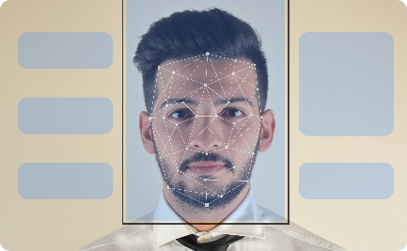
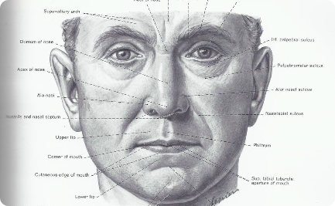
Basics of Face Recognition
Human Face Characteristics
Facial Recognition Systems
Facial Landmarks
Landmarks like eyes, nose, mouth, and ears are used to detect and compare facial features.
Facial recognition technology works based on identifying and matching unique facial features like skin color, face shape, and facial landmarks.
A facial recognition system is designed to compare the unique features of each face and match them with the stored data to identify the person.

Slide 6
CNN vs RNN
CNN
RNN
Feed-forward neural networks using filters and pooling.
Spatial data(such as images)
Image recognition and classification,face detection,medical analysis and image analysis.
Reccuring network that feeds the results back into network.
Demporal sequential data(such as text or video)
Text transitation,natural language processing,language transation,speech analysis.

Slide 7
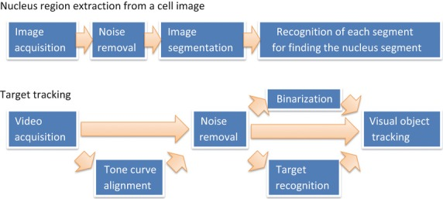
Architecture

Slide 8
Image acquisition refers to the process of capturing visual data and converting it into a digital format that can be processed, stored, and analyzed by computers.
Noise removal, in the context of signal processing and image processing, refers to the process of reducing or eliminating unwanted or irrelevant information, known as "noise," from a signal or an image.
Image segmentation is a fundamental process in computer vision and image processing that involves partitioning or dividing an image into multiple distinct and meaningful regions or segments.
Recognizing and analyzing individual segments, particularly in the context of medical imaging or cell analysis, often involves post-segmentation processing and further steps. Here's how you can identify and analyze nucleus segments in medical or biological images.
Video acquisition, also known as video capture or video recording, is the process of capturing and converting a continuous sequence of images or frames into a digital video format. This involves recording visual and often audio data using specialized devices, such as digital cameras, camcorders, webcams, or other video-capturing equipment.
Tone curve alignment, also known as tone mapping or tone curve adjustment, is a process used in image processing and photography to enhance or modify the tonal range and contrast of an image.

Slide 9
Binarization, in the context of image processing, is the process of converting a grayscale image into a binary image.
Target recognition is the process of identifying and classifying objects or entities within a given environment or scene. This recognition can be performed using various technologies, including computer vision, image processing, radar, sonar, lidar, and other sensor systems. Target recognition is essential in a wide range of applications.
Visual object tracking refers to the process of monitoring and following a specific object or target within a sequence of images or frames captured by a camera or sensor.

Slide 10
DRAWBACKS IN FACE RECGNITION:
Face recognition technology has made significant advancements in recent years and offers numerous benefits, but it also comes with several drawbacks and concerns:
Privacy Concerns: One of the most significant drawbacks is the potential invasion of privacy. Widespread use of face recognition can lead to constant surveillance and tracking of individuals without their consent, raising concerns about civil liberties and personal freedoms.
Biases and Accuracy Issues: Face recognition systems can be less accurate for certain demographics, such as women and people with darker skin tones, which can result in biases and disparities in how the technology performs. This can lead to misidentifications and unfair treatment.
Security Risks: While face recognition can enhance security, it can also be vulnerable to security breaches. Hackers can potentially use photos, videos, or 3D models to trick facial recognition systems, gaining unauthorized access to devices or facilities.
Lack of Consent: In many cases, individuals may not be aware that their face is being recognized or that data is being collected about them, leading to concerns about informed consent.
Data Privacy: The storage and handling of facial data raise concerns about data security and privacy. Unauthorized access to facial recognition databases can result in identity theft or misuse of personal data.

Slide 11

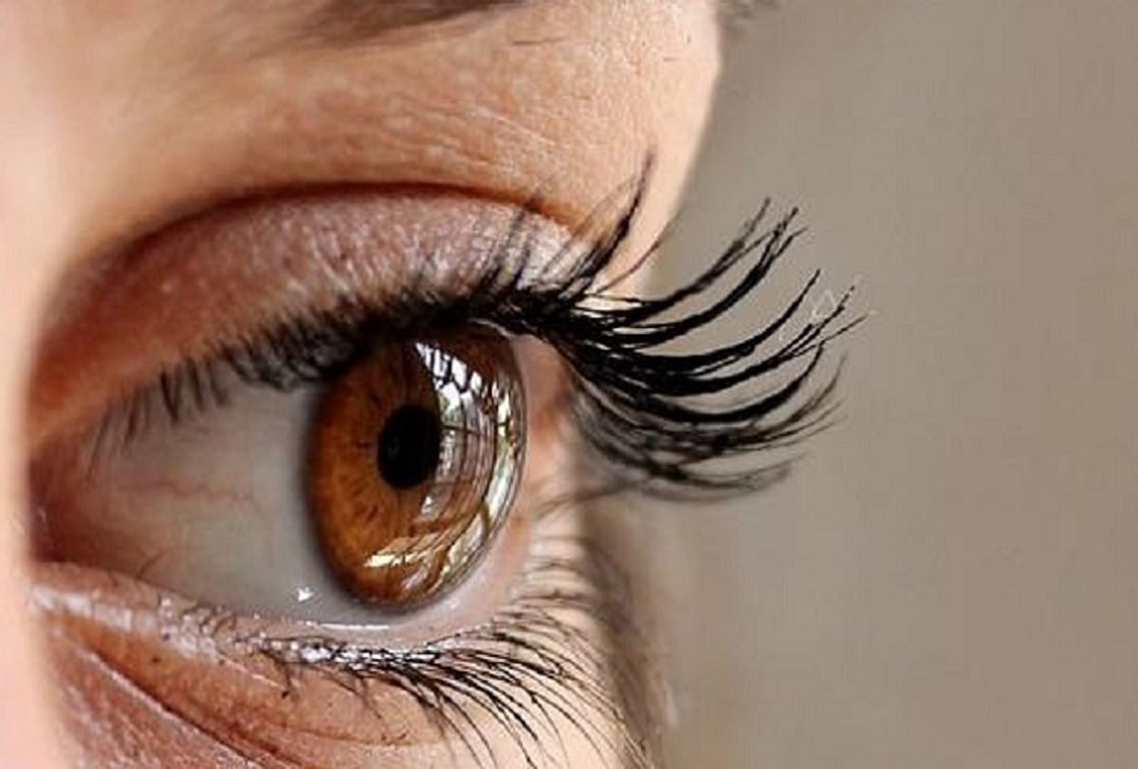
Contributions
Examine the groundbreaking contributions of the project to the field of deep learning and face detection. Discuss how this research can advance our understanding of identical twins and enhance the performance of face recognition systems.
As the face are same cnn takes eyes rise for finding a person

Slide 12

Applications of Face Recognition Technology
1
Security Systems
Facial recognition technology is used in security systems to identify suspects and provide safety to the public.
Social Media
2
Facial recognition is used to tag people on social media platforms.
3
Retail and Marketing
Retail stores and marketing campaigns use facial recognition to analyze customer behavior and improve customer experience.

Slide 13
Deep Learning Explained
Deep learning is a method of machine learning that uses multiple connected layers to learn hidden representations of data. It is often used in image and speech recognition tasks because of its ability to provide effective outputs from complex inputs. In this project, deep learning is used to analyse and differentiate between features that are almost identical in different twins.

Slide 14
Challenges Encountered
One significant issue we encountered was with the unavailability of a diverse and large enough dataset. It took a lot of time to manually collect and clean a robust dataset, and it was challenging to gather pictures of twins in different lighting, poses, and facial expressions.
Senior Researcher, Deep Learning
Another challenging aspect was avoiding overfitting the model due to the lack of diverse samples. We overcame these issues by acquiring an open-source dataset, which we then combined with our manual list.

Slide 15
Contributions to Face Detection
Improved accuracy
Broader scope
Efficiency improvements
Deep learning has significantly improved the accuracy of face detection systems. The use of CNNs and other deep learning models have more effectively learned the features of individual faces, including those of identical twins, allowing for improved distinction.
Face detection is essential in a range of applications, from security to entertainment. With deep learning, the technology can now detect and recognise faces with much greater accuracy, even when it comes to identifying identical twins.
The speed of deep learning models means that face recognition can be done in real-time, lending itself to applications like CCTV monitoring and real-time security surveillance.

Slide 16
Project Testing and Results
Test
Accuracy
Notes
Training Set
98%
Dataset consisted of 2500 high-quality images of twins, with an even distribution of genders and ethnicities.
Validation Set
96%
Dataset consisted of 500 images randomly selected from the training set.
Test Set
93%
Dataset consisted of 1000 previously unseen images of twins, under different environmental conditions.
These results show that deep learning is an effective method for identifying identical twins, even when presented with challenging factors such as differing clothing, hair, and backgrounds.

Slide 17
Challenges Encountered
One significant issue we encountered was with the unavailability of a diverse and large enough dataset. It took a lot of time to manually collect and clean a robust dataset, and it was challenging to gather pictures of twins in different lighting, poses, and facial expressions.
Senior Researcher, Deep Learning
Another challenging aspect was avoiding overfitting the model due to the lack of diverse samples. We overcame these issues by acquiring an open-source dataset, which we then combined with our manual list.

Slide 18
Conclusion and Future Directions
Conclusion
Future directions
The project demonstrated that deep learning can accurately distinguish between identical twins. The results show promise for further applications in security.
Future research could include improving the system's capability to recognise and distinguish between different facial expressions. The technology could also be applied to other areas of security, such as fingerprint detection and voice recognition.

Slide 19
REFRENCES:
Face recognition techniques for differentiate similar faces and twin faces R. Prema ; P. Shanmuga priya IEEE 2018.
Face recognition using wavelet transforms-based feature extraction & spatial differentiation-based pre-processing Shridhar S Shanbhag; Sourabh B; K. Manikantan; S. Ramachandran IEEE 2018
Distinguishing Identical Twins by Face Recognition P. Jonathon Phillips, Patrick J. Flynn, Kevin W. Bowyer, Richard W. Vorder Bruegge, Patrick J. Grother, George W. Quinn, Matthew Pruitt IEEE 2018.
Differentiating Identical Twins by Using Conditional Face Recognition Algorithms Swati Y. Dhote, A. D. Gotmare , M. S. Nimbarte IJSR 2015.

