Slide 1
Collection Framework
Wrapper classes
Collection Framework
List interface and its implementations
Iterable interface
•
•
Collections utility class Set Interface
Implementation classes
Overriding equals and hashCode methods
•
Map interface
Implementations
Concurrent Collections
ConcurrentHashMap
Fail-fast and Fail-safe Iterators

Slide 2
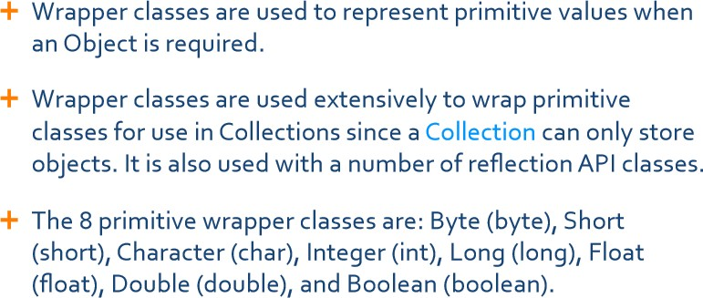
Wrapper Classes

Slide 3
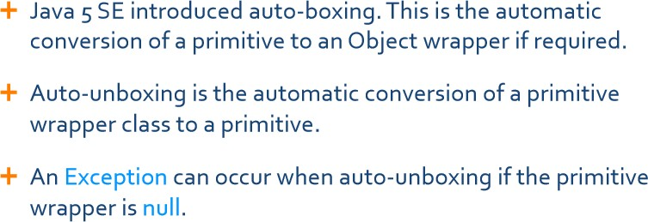
Auto-boxing & Auto-unboxing

Slide 4
Auto-boxing & Auto-unboxing
Introduced in java 5 release
Auto boxing:
Implicit Conversion of primitive type to object type:
int a =100;
Integer iObj = a; same as Integer iObj = new Integer(a);
Auto unboxing :
Implicit Conversion of object type to primitive type :
int x = iobj; same as int x = iobj.intValue()
Auto-Boxing
double d = 3.14;
Double dObj = new Double(d);
double r = Double.parseDouble(dObj);
same as
double r = dObj.doubleValue();
double d = 3.14; Double dObj = d; double r = dObj;
Auto-Unboxing
4

Slide 5
Converting String objects to primitive types
Converting String objects to primitive types:
Use static method, parsexxx() of the wrapper classes, where xxx indicates wrapper class name.
Ex. To convert String object to double type, String string="3.14";
double x = Double.parseDouble(string);
5

Slide 6
Collection Framework
A collection is a container that represents a group of objects .
Java 1.2 provided Collection Framework , a unified architecture for representing and manipulating collections in a standard way.
The initial version of Java 1.1 came up with few Collection classes such as Vector, Stack, Hashtable & Properties.
The primary advantages of a collections framework are that it:
Reduces programming effort by providing data structures and algorithms so you don't have to write them yourself.
Increases performance by providing high-performance implementations of data structures and algorithms.
Note: Collection Framework was introduced in Java 1.2. The legacy classes, Vector , Stack, Hashtable, Properties which were prior to Java 1.2 release are retro-fitted into the Collection
6

Slide 7
Collection Framework API
Interface Abstract Class
 | Concrete Class
Collection (interface)
extends
implements
Set (interface)
List (interface)
SortedSet (interface)
Legacy Classes
ArrayList
LinkedList
Vector
TreeSet
LinkedHashSet
HashSet
Stack
TreeSet

Slide 8
Collection Framework
Map (interface)
SortedMap (interface)
Legacy Classes
TreeMap
HashMap
LinkedHashMap
Hashtable
Properties

Slide 9
Collection Framework
The Java Collection Framework contains two high level interfaces: Collection<T> and Map<T>
java.util.Collection<T> interface
A collection represents a group of objects, known as its elements.
List<T> interface extends Collection<T> interface
The main implementation classes are: ArrayList and LinkedList
In case of an ArrayList:
An ordered collection also known as a sequence where the element present at a particular index is known.
Values are stored in the order in which they are added unless manipulated.
List allows duplicate objects.
Differences between ArrayList and LinkedList
Set<T> interface extends Collection<T> interface
SortedSet<T> interface extends Set<T> interface
The main implementation classes are: HashSet, LinkedHashList and TreeSet
A collection does not contain duplicate entries, and at the most ne null value allowed.
Objects being added to a set should implement equals and hashCode methods otherwise it is possible to add multiple objects to Set which may be intrinsically equivalent.
9

Slide 10
Collection Framework
The Deque<T> interface extends Collection<T> interface
This interface is pronounced as "deck", represents a double-ended queue.
The Deque interface implementations are grouped into general-purpose and concurrent implementations.
General-Purpose Deque Implementations
The Deque interface supports insertion, removal and retrieval of elements at both ends.
The ArrayDeque class is the resizable array implementation of the Deque interface, efficient than
LinkedList.
java.util.Map<T> interface
SortedMap<T> interface extends Map<T> interface
The main implementation classes are HashMap, LinkedHashMap and TreeMap
Map is a top-level interface that provides a key-value capability
A map stores values by key.
The keys must be unique, but the same value can be assigned to multiple keys.
Warning: do not use mutable objects for keys!.
10

Slide 11
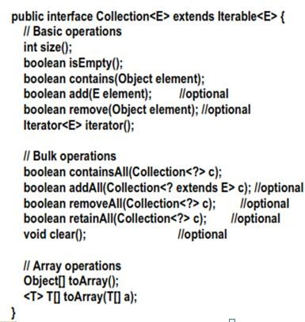
Collection Interface
11

Slide 12
Collection Interface
java.util.Collection<E> (an interface)
public int size();
Return number of elements in collection
public boolean isEmpty();
Return true if collection holds no elements
public boolean add(E x);
Make sure the collection includes x; returns true if collection has changed (some collections allow duplicates, some don’t)
public boolean contains(Object x);
Returns true if collection contains x (uses equals( ) method)
public boolean remove(Object x);
Removes a single instance of x from the collection; returns true if collection has
changed
public Iterator<E> iterator();
Returns an Iterator that steps through elements of collection

Slide 13
java.util.Iterator<E> interface
public boolean hasNext();
Returns true if the iteration has more elements
public E next();
Returns the next element in the iteration
Throws NoSuchElementException if no next element
public void remove();
The element most recently returned by next() is removed from the underlying collection
Throws IllegalStateException if next() not yet called or if remove() already called since last next()
Throws UnsupportedOperationException if remove() not supported

Slide 14
Generics
Code that uses generics has many benefits over non-generic code:
Elimination of casts.
The following code snippet without generics requires casting:
List list = new ArrayList();
list.add("hello");
String s = (String) list.get(0);
Object java.util.List.get(int index)
When re-written to use generics, the code does not require casting:
//List<String> list = new ArrayList<String>(); JDK 6 List<String> list = new ArrayList<>(); // JDK 7
list.add("hello");
String s = list.get(0); // no casting is required
14

Slide 15
Generics
Stronger type checks at compile time.
A Java compiler applies strong type checking to generic code and issues errors if the code violates type safety. Fixing compile-time errors is easier than fixing runtime errors, which can be difficult to find.
The following code compiles fine but throws ClassCastException at runtime because we are trying to cast Object in the list to String whereas one of the element is of type Integer
List list = new ArrayList(); // non-generic declaration of a list
list.add("abc");
list.add(new Integer(5)); //OK
for(Object obj : list){
String str=(String) obj; //ClassCastException at runtime
}
15

Slide 16
Generics
Now let us use generics while declaring a list
//List<String> list = new ArrayList<String>(); // Java 6
List<String> list1 = new ArrayList<>(); // Java 7
list.add("abc");
//list.add(new Integer(5)); //compiler error
for(String str : list){
//no type casting needed, avoids ClassCastException runtime exception
}
Notice that at the time of list creation, we have specified that the type of elements in the list will be String. So if we try to add any other type of object in the list, the program will throw compile time error.
Also notice that in for loop, we don’t need to type cast the element, hence eliminating
ClassCastException at runtime.
16

Slide 17
Additional Methods of Collection<E>
public Object[] toArray()
Returns a new array containing all the elements of this collection
public <T> T[] toArray(T[] dest)
Returns an array containing all the elements of this collection, dest
Bulk Operations:
public boolean containsAll(Collection<?> c);
public boolean addAll(Collection<? extends E> c
public boolean removeAll(Collection<?> c);
public boolean retainAll(Collection<?> c);
public void clear();
ArrayList<String> arrayList = new ArrayList<>(); arrayList.add("element_1"); arrayList.add("element_2"); arrayList.add("element_3");
);
Iterator<String> iterator = arrayList.iterator(); while(iterator.hasNext()){
System.out.println(iterator.next());
}

Slide 18
Traversing through Collection Object
Enumeration and Iterator interfaces provides capability to iterate through a collection
New implementations should preferably use Iterator or ListIterator( traverse either way)
Iterator interface methods
boolean hasNext()
Object next()
void remove()
ListIterator interface methods
boolean hasNext();
boolean hasPrevious() ;
Object next();
Object previous();
void remove() ;
Enumeration interface methods
hasMoreElements () to check for the existence of elements in the collection
nextElement () to retrieve the next element
Enumeration<String> enumeration = Collections.enumeration(arrayList); while(enumeration.hasMoreElements()){
System.out.println(enumeration.nextElement());
}

Slide 19
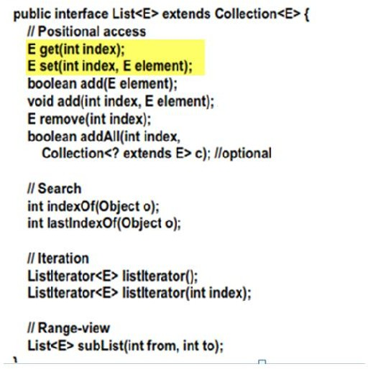
List interface
The user of a List generally has precise control over where in the list each element is inserted and can access elements by their integer index (position).
Additional
Methods
19

Slide 20
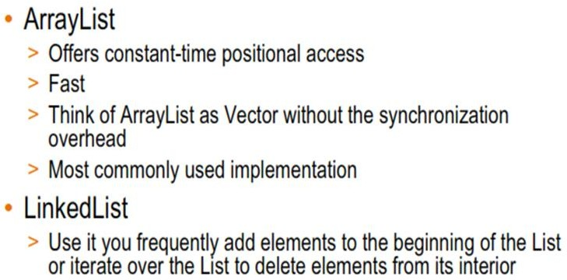
Implementations of List interface
ArrayList default capacity is 10 and default capacity increment is 50 %
LinkedList by nature does not have "capacity", since it does not allocate memory to the items before the items are added to the list. Each item in a LinkedList holds a pointer to the next in the list.
20

Slide 21
Collections utility class
This class consists exclusively of static methods that operate on or return collections.
The methods of this class all throw a NullPointerException if the collections or class objects provided to
them are null.
Method Signature | Description
Collections.sort(List myList) | Sort the myList (implementation of any List interface) provided in argument in natural ordering.
Collections.sort(List, comparator c) | Sort the myList(implementation of any List interface) as per comparator c ordering (c class should implement comparator interface)
Collections.shuffle(List myList) | Puts the elements of myList ((implementation of any List interface)in random order
Collections.reverse(List myList) | Reverses the elements of myList ((implementation of any List interface)
Collections.binarySearch(List mlist, T key) | Searches the mlist (implementation of any List interface) for the specified object using the binary search algorithm.
Collections.copy(List dest, List src) | Copy the source List into dest List.
Collections.frequency(Collection c, Object o) | Returns the number of elements in the specified collection class c (which implements Collection interface can be List, Set or Queue) equal to the specified object
Collections.synchronizedCollection(Collectio n c) | Returns a synchronized (thread-safe) collection backed by the specified collection.

Slide 22
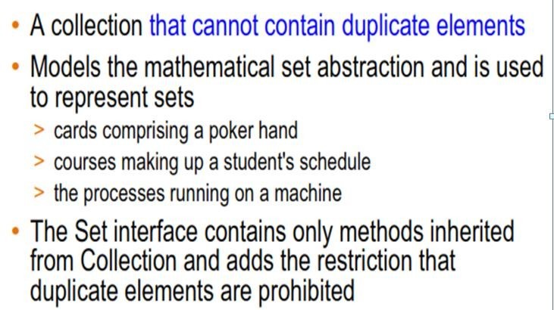
Set<E> interface
22

Slide 23
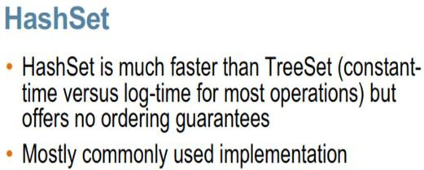
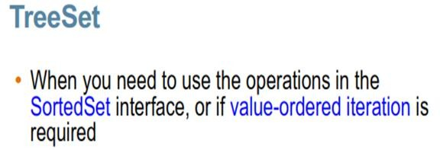
Implementation classes of Set<K> interface
HashSet. Constructs a new, empty set; the backing HashMap instance has default initial capacity (16) , load factor (0.75) and capacity increment is 100%.
For example product of capacity and load factor as 16 * 0.75 = 12. This represents that after filling up 12th slot into the HashSet , its capacity becomes 32.
LinkedHashSet
LinkedHashSet maintains a linked list of the entries in the
set, in the order in which they were inserted.
This allows insertion-order iteration over the set.
23

Slide 24
HashSet class
This class implements the Set interface, backed by a hash table (actually a HashMap instance).
It makes no guarantees as to the iteration order of the set; in particular, it does not guarantee that the order will remain constant over time.
This class permits the null element.
This class offers constant time performance for the basic operations (add, remove, contains and size), assuming the hash function disperses the elements properly among the buckets.

Slide 25
Implementing Hashing Technique
The hash function is applied on the object’s hashCode and the result of that is taken as a slot or bucket. This will be the index (the hash) of an array element( HashMap instance) where the corresponding value is to be sought.
Ideally, the hash function should map each possible key to a unique slot index, but is rarely achievable in practice.
Instead, most hash table designs assume that hash collisions—different keys that map to the same hash value—will occur and must be accommodated in some way.
25

Slide 26
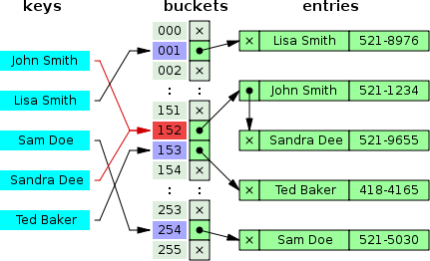
Implementing Hashing Technique
A small phone book as a hash table, where Hash collisions are resolved by separate chaining
For example, We want to retrieve the value using the key, Sandra Dee by calling the get() method, when we retrieve a value it will compute the hash code by implicitly calling the hashCode() and direct us to a bucket which has two elements.
Those two elements are scanned sequentially by comparing the keys using their equals() method.
When the key matches we get the respective value. This is the reason why the class PhoneBook must override hashCode() and equals() methods.
26

Slide 27
HashSet Example
public class HashSetDemo {
public static void main(String[] args) {
Set<String> courseSet=new HashSet<>();
courseSet.add("Core Java-I"); courseSet.add("Core Java-II");
courseSet.add("Java EE");
courseSet.add("Core Java-I");
3
[Java EE, Core Java-I, Core Java-II]
System.out.println(courseSet.size());
System.out.println(courseSet);
}
}
27

Slide 28
HashSet Example
Effect of not overriding hashCode() method
Consider the following class, Student that doesn’t override hashCode() method
public class Student {
private Integer admissionCode; private String studentName; private Integer marks;
public Student(){
}
public Student(Integer admissionCode, String studentName, Integer marks) {
super();
this.admissionCode = admissionCode; this.studentName = studentName; this.marks = marks;
}
//getter and setter methods
// override toString method
}
28

Slide 29
HashSet Example contd..
public class StudentSet {
public static void main(String[] args) { try{
Student student1=new Student(10110,"Ravi Kumar",96); Student student2=new Student(10111,"Jones",78); Student student3=new Student(10110,"Ravi Kumar",96);
Set<Student> studentSet=new HashSet<>();
Output:
3
true
studentSet.add(student1);
studentSet.add(student2);
boolean flag=studentSet.add(student3);
System.out.println(studentSet.size( System.out.println(flag);
));
For each new object, default hashCode() method generates a
unique hash code.
}
catch(Exception exception){
}
All the three objects are placed in the HashSet even though
data is same for student1 and student2 objects
}}
29

Slide 30
HashSet Example contd..
Now override equals() and hashCode() methods of Student class and run again the tester class
Output this time will be:
2
false
The overridden hashCode method generate same integer value for two equal objects.
Since hashcode generated for student3 is same as student1, student3 object is not placed in the HashSet
30

Slide 31
Exception in thread "main" java.lang.ClassCastException: com.lnt.businesstier cannot be cast to java.lang.Comparable
 |  | TreeSet Example
try{ Student | student1=new | Student(10115,"Ravi Kumar",96);
Student | student2=new | Student(10113,"Jones",78);
Student | student3=new | Student(10110,"Ravi Kumar",96);
Set<Student> studentSet=new TreeSet<>();
studentSet.
add(student1);
studentSet.
add(student2);
boolean fl
ag=studentSet.
add(student3);
System.out.println(studentSet.size()); System.out.println(flag); System.out.println(studentSet);
}
catch(Exception exception){
}
Note: If Student objects are stored in TreeSet , Student class must implement Comparable interface.
Not necessary in case of HashSet and LinkedHashSet.
31

Slide 32
TreeSet Example
Modify Student class by implementing Comparable interface and re-run the tester class.
public class Student implements Comparable<Student>{
………………..
@Override
public int compareTo(Student student2) {
Student student1=this; if(student1.getAdmissionCode()<student2.getAdmissionCode()){ return -1;
}else if(student1.getAdmissionCode()>student2.getAdmissionCode()){
return 1;
}else{ return 0;
}
}
}
32

Slide 33
Map<K,V> Interface
Map
A collection that provides a key-value capability
Set
List
Key | Value
A | Apple
B | Banana
C | Cat
D | Dog
java.util.Map<K,V>
Maps keys to values.
A Map cannot contain duplicate keys; each key can map to at most one value
Map implementations except TreeMap allow only one null key ( Since Map does not allow duplicate keys) but a Map can have more than one null values
Default initial capacity of the HashMap takes is 16 and load factor is 0.75 (i.e 75% of current map size) and capacity increment is 100%. The load factor represents at what level the HashMap capacity should be doubled.
For example product of capacity and load factor as 16 * 0.75 = 12. This represents that after storing the 12th key – value pair into the HashMap , its capacity becomes 32.
33

Slide 34
HashMap
The Map interface provides three collection views, which allow a map's contents to be viewed as a set of keys, collection of values, or set of key-value mappings
a set of keys -> Use keySet() to retrieves only keys
collection of values -> Use values() to retrieves only values
set of key-value mappings -> Use entrySet() to retrieve entire Map
The key is usually a non-mutable object.
The value object however can be a mutable object.

Slide 35
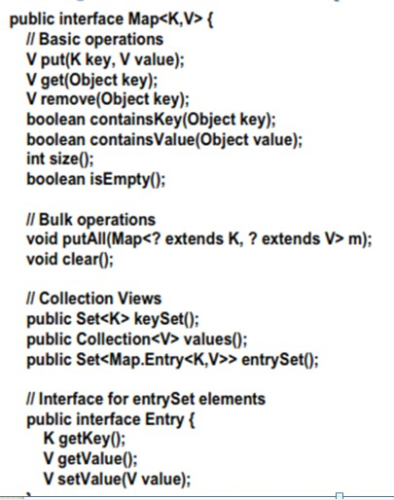
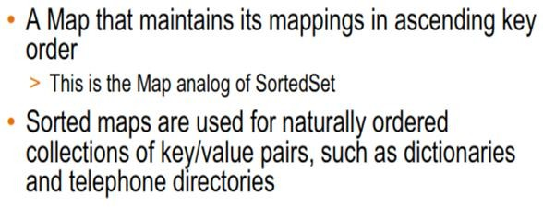
Map<K,V> and SortedMap<K,V> Interfaces
Map<K,V> Interface
SortedMap<K,V> extends Map<K,V> Interface
The Map.Entry interface enables you to work with a map entry.
The entrySet( ) method declared by the Map interface returns a
Set containing the map entries.
Each of these set elements is a Map.Entry object.
35

Slide 36
Implementations of Map interface
HashMap
makes absolutely no guarantees about the iteration order. It will even change completely when new elements are added.
Use it when you want maximum speed and don’t care about iteration order
This is the most commonly used implementation
TreeMap
Iterates according to the natural ordering of the keys according to their compareTo()method (or an externally supplied Comparator).
Additionally, it implements the SortedMap interface, which contains methods that depend on
this sort order.
LinkedHashMap
iterates in the order in which the entries were put into the map.
Use this implementation if u want near-HashMap performance and insertion-order iteration.
36

Slide 37
Iterating through a Map<K,V>
Map<String,String> hashMap = new HashMap<>();
for (Map.Entry<String,String> entry : hashMap.entrySet())
{
System.out.println("Key = "+ entry.getKey() +",Value = "+ entry.getValue());
}
or
Set s = hashMap.entrySet(); Iterator i = s.iterator(); while(i.hasNext() ) {
Map.Entry entry = (Map.Entry)i.next();
Iterator i =
hashMap.entrySet().iterator();
System.out.println(entry.getKey() + ":" + entry.getValue());
}
37

Slide 38
Hashtable – Legacy class
Hashtable stores data in form of key/value pairs.
Using the key, the value can be retrieved from the data structure.
Properties of Hashtable
Following are the properties of Hashtable.
Hashtable is a legacy class introduced with JDK 1.0.
Stores data in form of key/value pairs.
It does not accept duplicate keys. If the same key is added twice, the earlier one is replaced (overwritten), that is old value is lost.
Value can be same for different keys (like value red can be there for keys tomato and apple or two students with roll number 40 and 50 may have the same birthday).
Key and value cannot be null and if added, JVM throws NullPointerException.
Hashtable methods are synchronized (like Vector).
Hashtable can be designed for generics to accept same type of data.
Its equivalent in Collection framework is HashMap.
Unlike the new collection implementations, Hashtable is synchronized.
38

Slide 39
Synchronized Collections
By default Collection Framework implementations are not thread-safe.
By using static methods of utility class, Collections, we can convert unsynchronized implementations to synchronized implementations.
Collections.synchronizeList(); Collections.synchronizeMap(); Collections.synchronizeSet();
Though both Synchronized and Concurrent Collection classes provide thread-safety, the differences between them comes in performance, scalability and how they achieve thread- safety.
Synchronized collections like synchronized HashMap, Hashtable, HashSet, Vector, and
synchronized ArrayList are much slower than their concurrent counterparts
e.g. ConcurrentHashMap, CopyOnWriteArrayList, and CopyOnWriteHashSet.
Main reason for this slowness is locking; synchronized collections locks the whole collection
while concurrent collections do not lock the whole Map or List.

Slide 40
Concurrent Collections
The java.util.concurrent package includes a number of additions to the Java Collections Framework.
These are categorized by the collection interfaces provided:
BlockingQueue defines a first-in-first-out data structure that blocks or times out when you attempt to add to a full queue, or retrieve from an empty queue.
ConcurrentMap is a sub interface of java.util.Map that defines useful atomic operations. These operations remove or replace a key-value pair only if the key is present, or add a key-value pair only if the key is absent. Making these operations atomic helps avoid synchronization.
The standard general-purpose implementation of ConcurrentMap is ConcurrentHashMap, which
is a concurrent analog of HashMap.
40

Slide 41
ConcurrentHashMap
In Map implementations, If multiple threads access it, for ex., when one thread is reading the HashMap instance while other thread is writing to it, throws ConcurrentModificationException.
To resolve this, use ConcurrentHashMap
ConcurrentHashMap allows multiple threads to work on its implementation.
In normal HashMap, there will be only one thread per one implementation.
For ConcurrentHashMap, there will be one lock per bucket. Default number of buckets are
16.
So a ConcurrentHashMap implementation has 16 monitors(locks). Hence 16 threads at a time can access it.
Ex.
private static Map<Long,Address> addressMap=new ConcurrentHashMap<>();

Slide 42
Fail-safe and fail-fast iterators
Java Collections supports two types of Iterators, fail-safe and fail-fast.
The main distinction between a fail-fast and fail-safe Iterator is whether or not the underlying collection can be modified while its being iterated.
If Iterator detects any structural change after iteration has begun for ex. adding or removing a new element then it throws ConcurrentModificationException, this is known as fail-fast behavior and these iterators are called fail-fast iterator because they fail as soon as they detect any modification.

Slide 43
Fail-safe and fail-fast iterators
Most of the Collection classes from Java 1.4 e.g. Vector, ArrayList, HashMap, HashSet has fail- fast iterators.
Fail-safe iterators were introduced in Java 1.5 when concurrent collection classes e.g.
ConcurrentHashMap, CopyOnWriteArrayList and CopyOnWriteArraySet was introduced.
Fail-safe iterators use a view of original collection for iteration and that is why they do not throw ConcurrentModificationException even when original collection is modified after iteration has begun.

Slide 44
Fail-Fast Example
HashMap before iterator: {1=1, 2=1, 3=1, 4=1, 5=1,
6=1}
Exception in thread "main" java.util.ConcurrentModificationException
at java.util.HashMap$HashIterator.nextNode(Unknown Source)
at java.util.HashMap$KeyIterator.next(Unknown
Source)
at com.lnt.presentationtier.HashMapFailFast.main(HashMa pFailFast.java:18)
public class HashMapFailFast {
public static void main(String[] args) {
Map<String,String> myMap = new HashMap<>();
myMap.put("1", "1");myMap.put("2", "1");
myMap.put("3", "1");myMap.put("4", "1");
myMap.put("5", "1");myMap.put("6", "1");
System.out.println("HashMap before iterator: "+myMap); Iterator<String> iterator = myMap.keySet().iterator(); while(iterator.hasNext()){
String key = iterator.next();
if(key.equals("3")) {
myMap.put(key+"new", "new3");
}
}
System.out.println("HashMap after iterator: "+myMap);
}
}

Slide 45
Fail-Safe Example
public class ConcurrentHashMapFailSafe {
public static void main(String[] args) {
Map<String,String> myMap = new ConcurrentHashMap<String,String>();
myMap.put("1", "1"); myMap.put("2", "1");
myMap.put("3","3");myMap.put("4", "1");
myMap.put("5", "1");
System.out.println("ConcurrentHashMap before iterator: "+myMap);
Iterator<String> iterator = myMap.keySet().iterator();
while(iterator.hasNext()){ String key = iterator.next(); if(key.equals("3")) {
myMap.put(key+"new", "new3");
}
}
System.out.println("ConcurrentHashMap after iterator: "+myMap);
}
}

Slide 46
Exception handling and fail- fast/ fail-safe
Exception handling in java introduces us to design our programs to be fail safe. Use exception handling to fail gracefully and quickly.
Exception should not be carried around in the sequence flow for too long. Golden rule with
exception handling is, throw early and catch late.
When we hit an exception, it should be thrown immediately. We should not catch an exception unless we are sure what to do with it and the action we take by catching it should negate the failure.

Slide 47

Thank You!

