Slide 1
Multithreading
Multithreading
About Concurrency
Thread and Runnable objects
Object sharing by multiple threads
Race Condition
Synchronization
Deadlock
Inter-thread communication
Thread Life Cycle
java.util.concurrent package

Slide 2
Concurrency
Concurrency is the ability to run several programs or several parts of a program concurrently (simultaneously).
Multi-tasking operating systems can run multiple applications concurrently where each application runs in a separate window.
Even a single application is often expected to do more than one thing at a time
(multithreading).
For ex. a streaming audio application must simultaneously read the digital audio off the network, decompress it, manage playback, and update its display.
2

Slide 3
Task Scheduling
Modern operating systems use preemptive multitasking to allocate CPU time to applications. There are two terms we need to know:
1. Process:
A process is an area of memory that contains both code and data.
A process has a thread of execution that is scheduled to receive CPU time slices.
Processes are often seen as synonymous with programs or applications
Most implementations of the Java virtual machine run as a single process.
2. Thread:
A thread is a path of execution within a process. It is a scheduled execution of a process.
Concurrent threads are possible.
All threads for a process share the same data memory but may be following different paths through a code section.
Threads are sometimes called lightweight processes.

Slide 4
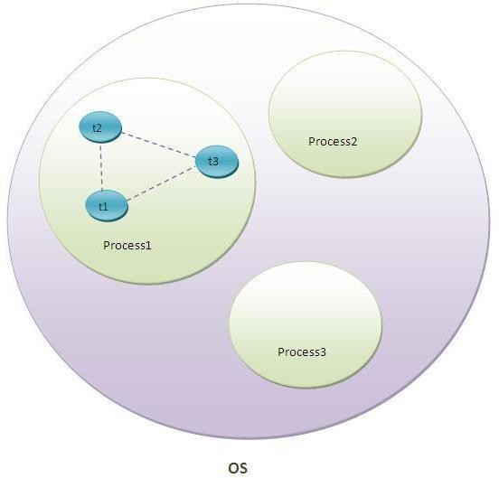
Processes & Threads
Threads exist within a process — every process has at least one thread.
Threads share the process's resources, including memory and
open files. This makes for efficient, but potentially problematic.
Multithreaded execution is an essential feature of the Java platform.
Every application has at least one thread , called the main thread. This thread has the ability to create additional threads.
4

Slide 5
Implementing multithreaded Programming
An application that creates an thread instance must provide the code that will run in that thread.
There are two ways to do this:
Provide a Runnable object to Thread class constructor
Extending Thread class
5

Slide 6
Implementing Runnable Interface
Provide a Runnable object to Thread class constructor
A Runnable object is an instance of a class that implements Runnable interface
•
The Runnable interface declares a single method, run(). The implementation class
should define this method, run().
•
Then the runnable object is passed to the Thread class constructor and then invoke the start() method of thread instance, as shown below:
Thread thread = new Thread(runnable object); thread.start(); // implicitly invokes run() method
6

Slide 7
Extending Thread class
Extending Thread class
The Thread class itself implements Runnable, though its run method does nothing.
An application can subclass Thread, providing its own implementation of run() method
Thread class constructors:
Thread t1 = new Thread();
Thread t2 = new Thread(runnableObject);
Thread t3 = new Thread(object,"thread-name");
Thread t4 = new Thread ("thread-name");
7

Slide 8
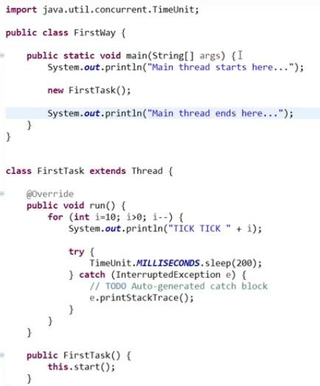
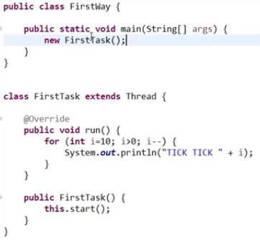
Executor Interfaces

Slide 9
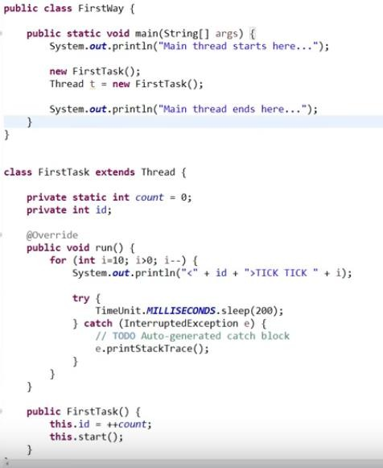
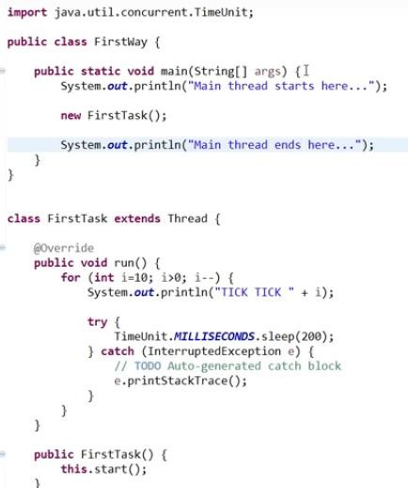
Executor Interfaces

Slide 10
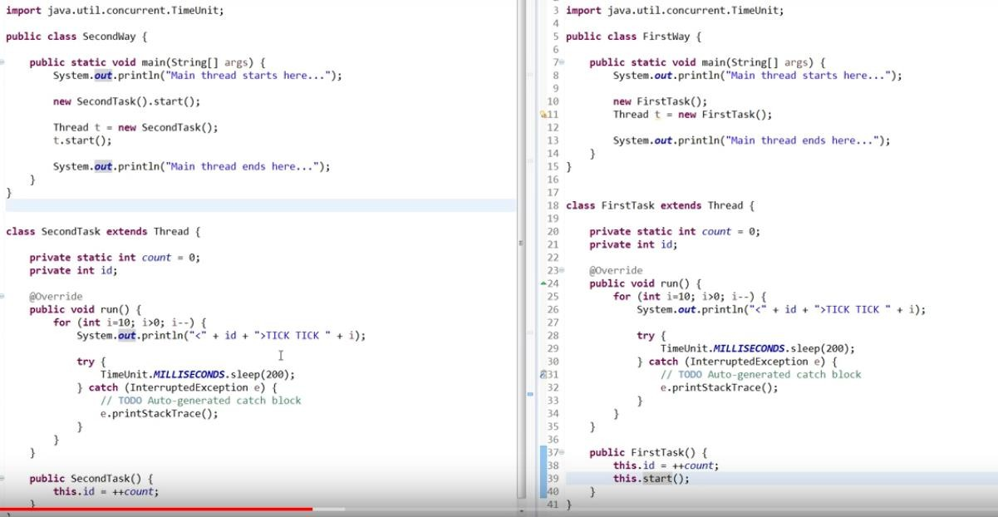
Executor Interfaces

Slide 11
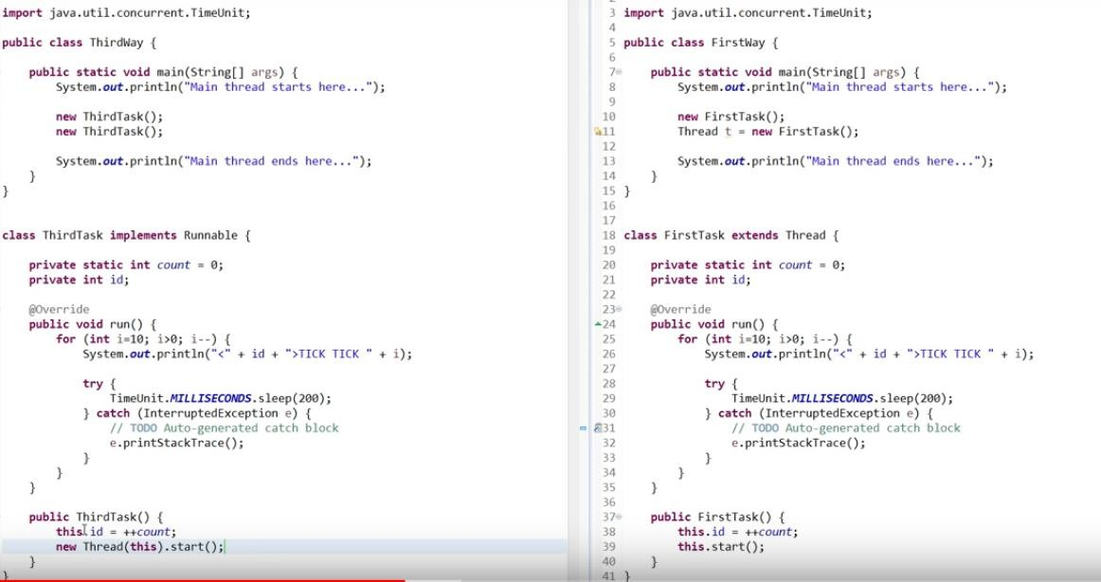
Executor Interfaces

Slide 12
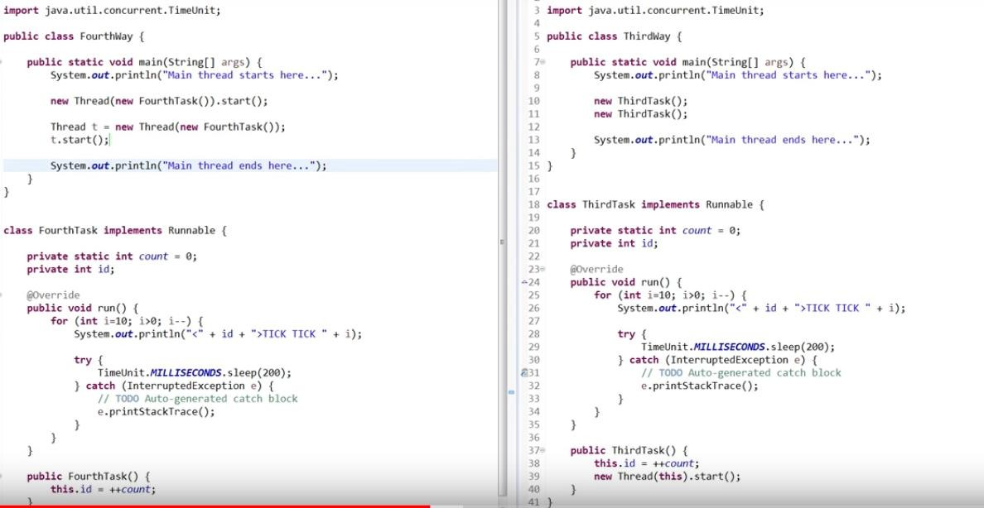
Executor Interfaces

Slide 13
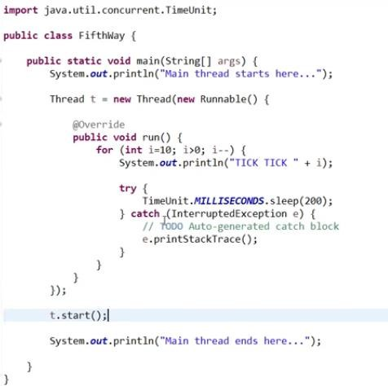
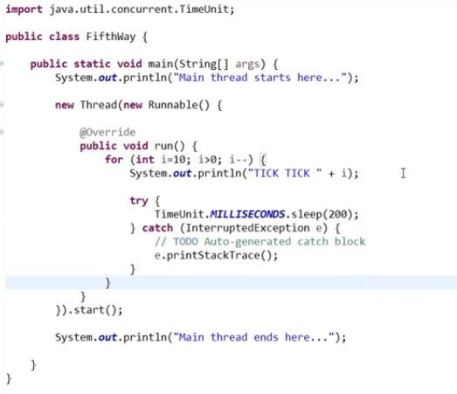
Providing Inline task to thread object

Slide 14
Implementation through both the methods
public class HelloRunnable implements Runnable{
public void run() {
System.out.println("Hello from a thread!");
}
}
public class HelloThread extends Thread{
public HelloThread() {
super();
this.start();
}
Class HelloRunnableDemo {
public static void main(String args[]) {
@Override
Runnable runnableObject = new HelloRunnable(); ^{public void run() {}
System.out.println("Thread Name: "+ this.getName());
}}
Thread t = new Thread(runnableObject);
t.start();
}
}
public class HelloThreadDemo {
public static void main(String[] args) { System.out.println("Main Thread Name: "+ Thread.currentThread().getName());
new HelloThread();
The start() method of thread object implicitly
invokes run() method.
}
}
Main Thread Name: main Thread Name: Thread-0
14

Slide 15
Current Thread Details
public class CurrentThreadDetails{
public static void main(String [] args){
Thread thread = Thread.currentThread(); System.out.println(thread); System.out.println(thread.getName());
}
}
// The first println() output:
Thread[main,5,main]
The first main indicates name of the thread
5 indicates priority number
The second main indicates name of the thread group
// The second println() output:
main
15

Slide 16
Thread class methods
Thread thread = Thread.currentThread() : returns current thread object String s = thread.getName() : returns thread name thread.setName("thread-name") : To set a name to the user-thread thread.start() : invokes run() method
Thread.sleep(milliseconds ) : The current thread will into sleep state for specified number
of milliseconds, 1000 ms is 1 sec
int priorityNumber= thread.getPriority() : returns priority of the thread,
1.
2.
3.
4.
5.
6.
Note: priority range: 0 (Min) to 10(Max). We can provide any number from 0 to 10 or use constants, MIN_PRIORITY whose value is 0 , MAX_PRIORITY is 10 and NORM_PRIORITY value is 5
thread.setPriority(priorityNumber) : sets the priority of a thread
Boolean thread.isAlive() : returns true if thread is alive else returns false.
thread.join() : The caller thread waits till the thread dies i.e. caller thread joins after
thread completes its execution
7.
8.
9.

Slide 17
join() method
The join method allows one thread to wait for the completion of another thread.
If any executing thread t1 calls join() on t2 i.e; t2.join() then t1 will immediately enter into waiting state until t2 completes its execution.
public class JoinDemo implements Runnable{ public void run() {
System.out.println(Thread.currentThread().getName()+" is alive: "+Thread.currentThread().isAlive());
try{
Thread.sleep(1000);
}
catch(InterruptedException ie){}
Without thread.join() statement:
MyThread is alive: true MyThread is alive: true
}
public static void main(String args[]) throws Exception {
Thread thread = new Thread(new JoinDemo(),"MyThread");
thread.start();
With thread.join() statement: MyThread is alive: true MyThread is alive: false
thread.join();
System.out.println(thread.getName()+" is alive: "+thread.isAlive());
}
}
17

Slide 18
Compute-intensive task allocated to a separate thread
A Thread class for sorting a List in the background
public class Worker implements Runnable{
public class WorkerTester {
public static void main(String[] args) throws InterruptedException {
List<Integer> myList = new ArrayList<>();
List<Integer> list;
for(int i=0;i<10000;i++){
myList.add(new Random().nextInt());
}
System.out.println(myList);
//Collections.sort(myList);
long start=System.currentTimeMillis(); Worker worker =new Worker(myList); Thread t = new Thread(worker); t.start();
t.join();
public Worker(List<Integer> list) {
super();
this.list = list;
}
@Override
public void run() {
Collections.sort(list);
}
}
main thread waits until worker thread completes its run()
method
System.out.println("Time taken to sort: " + (System.currentTimeMillis()- start)+ " milliseconds");
//System.out.println(myList);}}
18

Slide 19
Multiple threads working on shared object
public class SharedObject implements Runnable{
private static StringBuilder message=new StringBuilder("Welcome");
@Override
public void run() {
int size=message.length();
for(int i=0;i<size;i++){
public class SharedObjectTester {
public static void main(String[] args) throws InterruptedException {
SharedObject sharedObject=new SharedObject();
Thread t1=new Thread(sharedObject);
System.out.println(Thread.currentThread().getName() Thread t2 = new Thread(sharedObject);
+":"+ message.append('x'));
}
Thread t3 = new Thread(sharedObject);
t1.start();
t2.start();
t3.start();
}
}
}
}
The above program leads to race condition as all the 3 threads are trying to access the shared object at a time.

Slide 20
Race Condition
The situation where more than one thread competes for the same resource, where the sequence in which the resource is accessed is significant, is called race condition.
Without synchronization, it is possible for one thread to modify a shared resource while another thread is in the process of using or updating that resource. This is called as thread interference.
•
The section of the code that leads to race conditions is called a critical section.
Race conditions can lead to unpredictable results and subtle program bugs.
Race conditions can be avoided by proper thread synchronization in critical sections.

Slide 21
Synchronization
The synchronization is the capability to control the access of multiple threads to shared resources.
The mechanism that Java uses to support synchronization is the monitor (also called a semaphore).
Each object in Java is associated with a monitor, which a thread can lock or unlock.
A monitor is used as a mutually exclusive lock( mutex ) which enables multiple threads to independently work on shared data without interfering with each other.
Only one thread can own a monitor at a given time. When a thread acquires a lock, it is said to have entered the monitor.

Slide 22
Synchronized Method & Synchronized Block
There two synchronization syntaxes in Java Language.
Synchronized method
Synchronized block
The practical differences are in controlling scope and the monitor.
With a synchronized method, the lock is obtained for the duration of the entire method.
With synchronized blocks you can specify exactly when the lock is needed.
class Program {
public synchronized void f() {
.........
}
}
class Program { public void f() { synchronized(this){
...
}
}
}

Slide 23
Synchronized Method
A synchronized method synchronizes on the object instance or the class. A thread only executes a synchronized method after it has acquired the lock for the method's object or class.
static synchronized methods synchronize on the class object. If one thread is executing a static synchronized method, all other threads trying to execute any static synchronized methods, in the same class, will block.
non-static synchronized methods synchronize on "this" (the instance object). If one thread is executing a synchronized method, all other threads trying to execute any synchronized methods, in the same class, will block.

Slide 24
Multiple threads working on shared object
public class SharedObject implements Runnable{
private static StringBuilder message=new StringBuilder("Welcome");
@Override
public void run() {
int size=message.length();
synchronized(this){ for(int i=0;i<size;i++){
System.out.println(message.append('x'));
}
}
}
}
After modifying the SharedObject class, re-run SharedObjectTester class and check the output.

Slide 25
volatile
In a multithreaded program , when two or more threads are sharing the same instance variable, for
efficiency considerations, each thread keeps its own private copy of such a shared variable.
The real( or master) copy of the variable is updated at various times. So, when a thread is updating the value, it is actually updating in the local cache but not the main copy.
The other thread which is using the same variable but local copy does not know anything about the
value changed by the another thread in its local copy.
While this approach works fine, it may be inefficient in cases where the master copy should always
reflects its current state.
If a variable is declared with the volatile keyword then it is guaranteed that any thread that reads the field will see the most recently written value.
volatile datatype variablename;
25

Slide 26
Inter Thread Communication
Inter thread communication is about making synchronized threads communicate with each other.
It is implemented by the following methods of Object class:
wait()
notify()
notifyAll()
1. wait() : Causes the current thread to release the lock and wait until either another thread invokes
the notify() method or the notifyAll() method for this object, or specified amount of time has
elapsed. The current thread must own this object’s monitor.
Syntax:
public final wait() throws InterruptedException
public final wait(long timeout) throws InterruptedException
Note: The wait() method can be invoked only within synchronized method or block. If used in
normal methods, java.lang.IllegalMonitorStateException exception is thrown.
26

Slide 27
Inter Thread Communication
2. notify() : Wakes up a single thread that is waiting on this object’s monitor. If many
threads are waiting on this object, one of them is chosen to be awaken or resurrected.
Syntax :
public void notify()
3. notifyAll() : Wakes up all threads that are waiting on this object’s monitor
Syntax :
public final notifyAll()
27

Slide 28
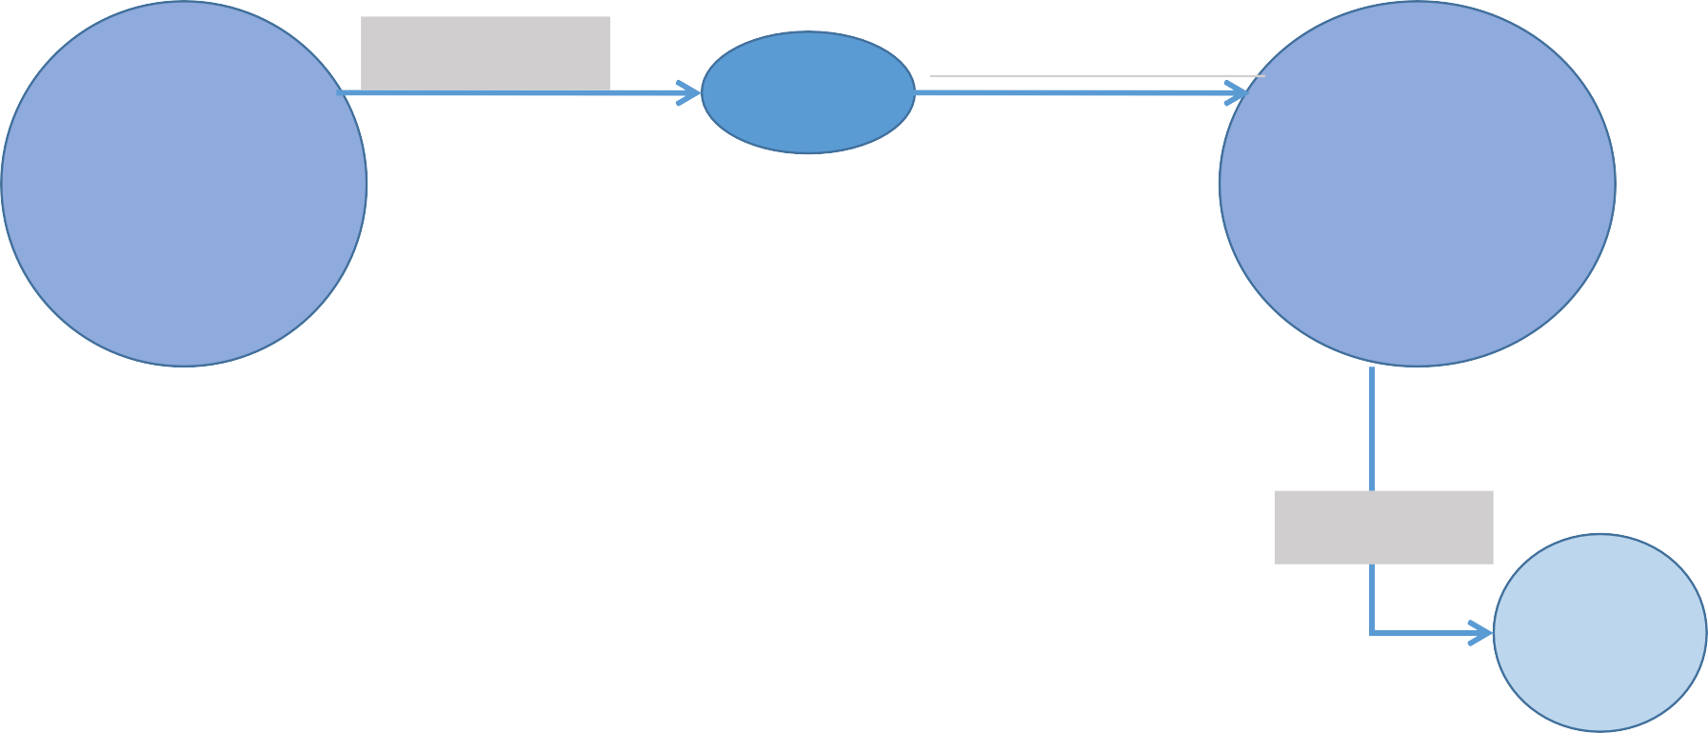
Inter Thread Communication Example
Producer
Consumer
produces
consumes
produces
consumes
item
producer
consumer
notifies
notifies
notifies
notifies
Goes to
Goes to
Goes to
After receiving notification
After receiving
notification
wait state
wait
state
After receiving notification
28

Slide 29
Inter Thread Communication Example
Item
Producer Consumer
ProducerConsumerTester

Slide 30
Deadlock
Deadlock describes a situation where two or more threads are blocked forever, waiting for each other. To analyse a deadlock, we need to look at the java thread dump of the application
Java VisualVM is a tool that provides a visual interface for viewing detailed information about Java
applications while they are running on a Java Virtual Machine
To start VisualVM on Windows, run the visualvm.exe program that is in the \bin folder of your JDK folder
Starvation
Livelock
30

Slide 31
Daemon and User Threads
Daemon and User Threads
Daemon threads in Java are those threads which run in background and mostly created by JVM for performing background tasks like garbage collection and other house keeping tasks.
A call to setDaemon() method, with the argument true , makes the thread that is created a daemon thread.
Daemon thread dies if the thread that created it dies.
Non-daemon threads are called as user threads.
A user thread has a life of its own that is not dependent on the thread that creates it. It can continue execution after the thread that created it has ended.
Note: main thread is a non-daemon thread.
31

Slide 32
Daemon Thread Example
public class DaemonThreadDemo implements Runnable{ public void run(){
while(true){
System.out.println(Thread.currentThread().getName());}
}
public static void main(String[] args) { System.out.println(Thread.currentThread().getName()); Thread t1 = new Thread(new DaemonThreadDemo()); Thread t2 = new Thread(new DaemonThreadDemo());
//t1.setDaemon(true); t2.setDaemon(true);
We cannot make a thread daemon if it has already started. For example we cannot make main thread a daemon thread. The following code throws exception at runtime. (java.lang.IllegalThreadStateException )
public static void main(String[] args) throws InterruptedException{
Thread t = Thread.currentThread(); t.setDaemon(true);
}
t1.start(); t2.start(); try{ Thread.sleep(100);
}catch(InterruptedException ioe){}
System.out.println("End of main thread");
}
}
32

Slide 33
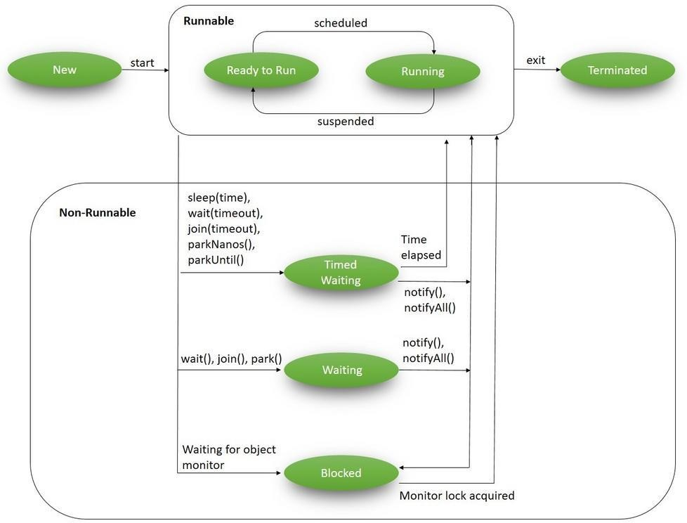
Multithread Lifecycle

Slide 34
Multithread Lifecycle
Runnable runnable = new NewState(); Thread t = new Thread(runnable); System.out.println(t.getState); //New t.start();
System.out.println(t.getState()); //Runnable

Slide 35
New and Runnable State
Runnable runnable = new NewState(); Thread t = new Thread(runnable); System.out.println(t.getState); //New t.start();
System.out.println(t.getState()); //Runnable

Slide 36
Blocked State
public class BlockedState {
public static void main(String[] args) throws InterruptedException { Thread t1 = new Thread(new DemoThreadB());
Thread t2 = new Thread(new DemoThreadB());
class DemoThreadB implements Runnable {
@Override
public void run() { commonResource();
}
t1.start();
t2.start();
Thread.sleep(1000);
public static synchronized void
commonResource() {
while(true) {
// Infinite loop to mimic heavy processing
// 't1' won't leave this method
// when 't2' try to enters this
}
}
}
System.out.println(t2.getState()); System.exit(0);
}
}

Slide 37
Waiting State
public class WaitingState implements Runnable {
public static Thread t1;
public static void main(String[] args) {
t1 = new Thread(new WaitingState());
t1.start();
}
public void run() {
Thread t2 = new Thread(new DemoThreadWS());
t2.start();
try {
t2.join();
} catch (InterruptedException e) { Thread.currentThread().interrupt();
}
}
}
class DemoThreadWS implements Runnable {
public void run() {
try {
Thread.sleep(1000);
} catch (InterruptedException e) { Thread.currentThread().interrupt();
}
System.out.println(WaitingState.t1.getState());
}
}

Slide 38
Timed Waiting State
public class TimedWaitingState {
public static void main(String[] args) throws InterruptedException {
DemoThread obj1 = new DemoThread();
Thread t1 = new Thread(obj1); t1.start();
// The following sleep will give enough time for ThreadScheduler
// to start processing of thread t1 Thread.sleep(1000); System.out.println(t1.getState());
class DemoThread implements Runnable { @Override
public void run() {
try {
Thread.sleep(5000);
} catch (InterruptedException e) {
Thread.currentThread().interrupt();
}
}
}
}
}

Slide 39
Terminated State
public class TerminatedState implements Runnable {
public static void main(String[] args) throws InterruptedException { Thread t1 = new Thread(new TerminatedState());
t1.start();
// The following sleep method will give enough time for
// thread t1 to complete Thread.sleep(1000); System.out.println(t1.getState());
}
@Override public void run() {
// No processing in this block
}
}

Slide 40
Delay Code Execution
1. Using Thread.sleep
A quick and dirty way to pause in Java is to tell the current thread to sleep for a specified amount of time. This can be done using Thread.sleep(milliseconds):
It is good practice to wrap the sleep method in a try/catch block in case another thread interrupts the sleeping thread. In this case, we catch the InterruptedException and explicitly interrupt the current thread, so it can be caught later and handled. This is more important in a multi-threaded program, but still good practice in a single-threaded program in case we add other threads later.
try {
Thread.sleep(secondsToSleep * 1000);
} catch (InterruptedException ie) { Thread.currentThread().interrupt();
}

Slide 41
Using TimeUnit.sleep
For better readability, we can use TimeUnit.XXX.sleep(y), where XXX is the time unit to sleep for (SECONDS, MINUTES, etc.), and y is the number of that unit to sleep for. This uses Thread.sleep behind the scenes.
try {
TimeUnit.SECONDS.sleep(secondsToSleep);
} catch (InterruptedException ie) { Thread.currentThread().interrupt();
}

Slide 42
ExecutorService-Based Approach
Java provides the ScheduledExecutorService interface, which is a more robust and precise solution. This interface can schedule code to run once after a specified delay or at fixed time intervals.
To run a piece of code once after a delay, we can use the schedule method:
ScheduledExecutorService executorService = Executors.newSingleThreadScheduledExecutor();
executorService.schedule(Classname::someTask, delayInSeconds, TimeUnit.SECONDS);
To run a task at fixed time intervals, we can use the scheduleAtFixedRate method:
ScheduledExecutorService executorService = Executors.newSingleThreadScheduledExecutor();
executorService.scheduleAtFixedRate(Classname::someTask, 0, delayInSeconds, TimeUnit.SECONDS);

Slide 43
Concurrency

Slide 44
java.util.concurrent package
The multithreading APIs covered so far are adequate for very basic tasks, but higher-level building blocks are needed for more advanced tasks.
This is especially true for massively concurrent applications that fully exploit today's multiprocessor and multi-core systems.
Most of the high-level concurrency features are implemented in the new java.util.concurrent packages.

Slide 45
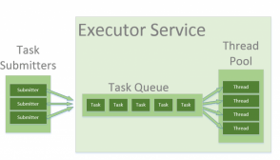
The Thread Pool
In Java, threads are mapped to system-level threads which are operating system’s resources. If you create threads uncontrollably, you may run out of these resources quickly.
The context switching between threads is done by the operating system as well – in order to emulate parallelism. A simplistic view is that – the more threads you spawn, the less time each thread spends doing actual work.
The Thread Pool pattern helps to save resources in a multithreaded application, and also to contain the parallelism in certain predefined limits.

Slide 46
Executor Interfaces
Executor Interfaces
The java.util.concurrent package defines three executor interfaces:
Executor, a simple interface that supports launching new tasks.
ExecutorService, a sub interface of Executor, which adds features that help manage the lifecycle, both of the individual tasks and of the executor itself.
ScheduledExecutorService, a sub interface of ExecutorService, supports future and/or periodic
execution of tasks.
The Executor Interface
The Executor interface provides a single method, execute, designed to be a drop-in replacement for
a common thread-creation idiom.
If r is a Runnable object, and e is an Executor object you can replace (new Thread(r)).start(); with e.execute(r);
Executor executor = Executors.newSingleThreadExecutor();
executor.execute(() -> System.out.println("Hello World"));
46

Slide 47
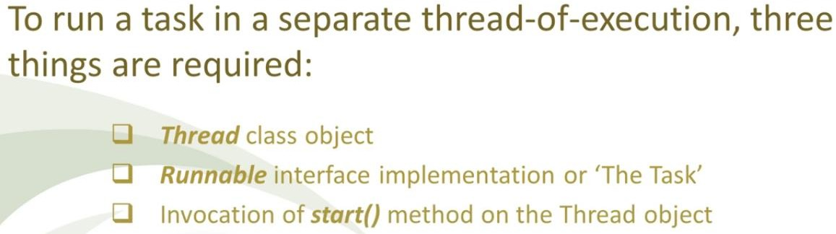
Without Executor Interfaces
Without Executor Interfaces

Slide 48

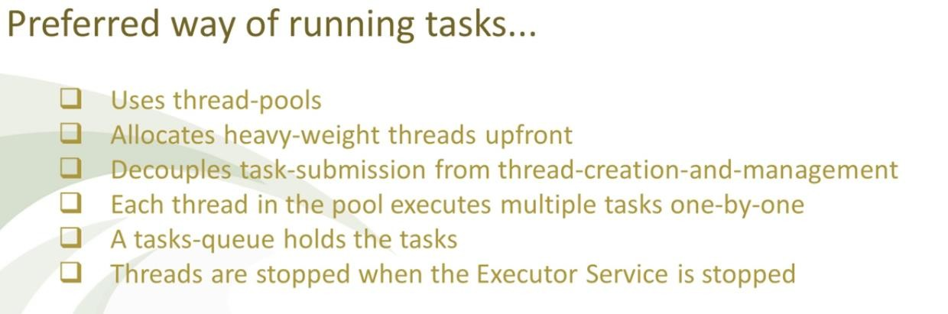
Running Threads Using Executors API

Slide 49

Important Classes /Interfaces of Executors framework
public class Invoker implements Executor { @Override
public void execute(Runnable r) {
r.run();
}
}
public void execute() {
Executor executor = new Invoker(); executor.execute( () -> {
// task to be performed
});
}

Slide 50

ExecutorService Interface
ExecutorService which extends Executor interface is a complete solution for asynchronous processing.
It manages an in-memory queue and schedules submitted tasks based on thread availability. To use ExecutorService, we need to create one Runnable class.
shutdown() waits till the all submitted task finish executing. The other method
is shutdownNow() which immediately terminates all the pending/executing tasks.
There is also another method awaitTermination(long timeout, TimeUnit unit) which forcefully blocks until all
tasks have completed execution after a shutdown event triggered or execution-timeout occurred, or the
execution thread itself is interrupted,
50

Slide 51
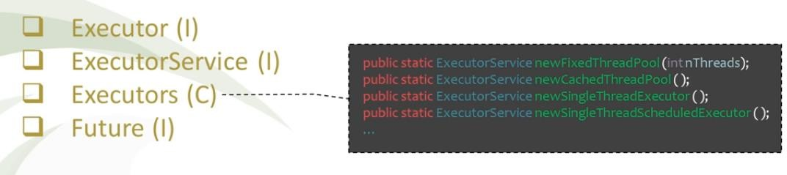
Executors Class
51

Slide 52
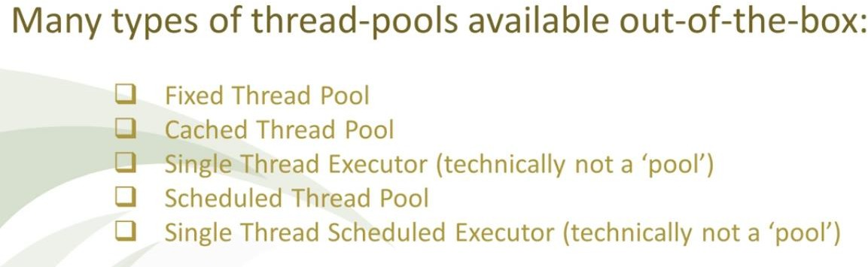
Available thread pools
Most of the executor implementations in java.util.concurrent use thread pools, which consist of worker threads.
Using worker threads minimizes the overhead due to thread creation. Thread objects use a significant amount of memory, and in a large-scale application, allocating and deallocating many thread objects creates a significant memory management overhead.
One common type of thread pool is the fixed thread pool. This type of pool always has a specified number of threads running; if a thread is somehow terminated while it is still in use, it is automatically replaced with a new thread.
Tasks are submitted to the pool via an internal queue.
52

Slide 53
Available Thread pools
newFixedThreadPool(int nThreads) – n threads will process tasks at the time, when the pool is saturated, new tasks will get added to a queue without a limit on size. Good for CPU intensive tasks.
newSingleThreadExecutor() – creates an newFixedThreadPool(1), only one thread will process everything. Good when you really need predictability and sequential tasks completion.
newCachedThreadPool() – doesn’t put tasks into a queue. So this pool doesn’t have task queue. For a submitted task, if there no free thread, new thread is spawned. When all current threads are busy, it creates another thread to run the task. Sometimes it can reuse threads.
So for almost all purposes, Executors::newFixedThreadPool(int nThreads) should be your choice when
you need a thread pool.
53

Slide 54
Threads pools with the Executor Framework
// MyRunnable is the task to be performed // run the runnables with the executor framework.
public class MyRunnable implements Runnable { public class Main {
private final long countUntil;
public MyRunnable(long countUntil) { this.countUntil = countUntil;
}
@Override
public void run() {
long sum = 0;
for (long i = 1; i < countUntil; i++) { sum += i;
}
System.out.println(sum);
}
private static final int NTHREADS = 10;
public static void main(String[] args) throws InterruptedException{ ExecutorService executor = Executors.newFixedThreadPool(NTHREADS);
for (int i = 0; i < 500; i++) {
Runnable task = new MyRunnable(10000000L + i); executor.execute(task);
}
// This will make the executor accept no new runnable objects
// and finish all existing runnable objects already placed in the queue
executor.shutdown();
}
// Wait until all threads are finish executor.awaitTermination(5, TimeUnit.MINUTES); System.out.println("Finished all threads");
}
}
54

Slide 55
Future
The Future class represents a future result of an asynchronous computation – a result that will eventually appear in the Future after the processing is complete.
Long running methods are good candidates for asynchronous processing and the Future interface. This enables
us to execute some other process while we are waiting for the task encapsulated in Future to complete.
Some examples of operations that would leverage the async nature of Future are:
computational intensive processes (mathematical and scientific calculations)
manipulating large data structures (big data)
remote method calls (downloading files, HTML scrapping, web services).
public class SquareCalculator {
Consuming Futures
private ExecutorService executor
= Executors.newSingleThreadExecutor();
Future<Integer> future = new SquareCalculator().calculate(10);
while(!future.isDone()) {
public Future<Integer> calculate(Integer input) { return executor.submit(() -> {
Thread.sleep(1000);
return input * input;
});
}
System.out.println("Calculating..."); Thread.sleep(300);
}
Integer result = future.get();
}
55

Slide 56
Future
public class Task implements Callable<Integer>{
@Override
public Integer call() throws Exception {
return new Random().nextInt();
}
}
public class CallableTester {
public static void main(String[] args) {
ExecutorService service= Executors.newFixedThreadPool(10);
//submit task and accept the placeholder object for return value
Future<Integer> future = service.submit(new Task()); try {
//get the task return value
Integer result=future.get();//blocking System.out.println("Result from task is "+result);
}catch(InterruptedException | ExecutionException e) {
e.printStackTrace();
}
}
}
56

Slide 57
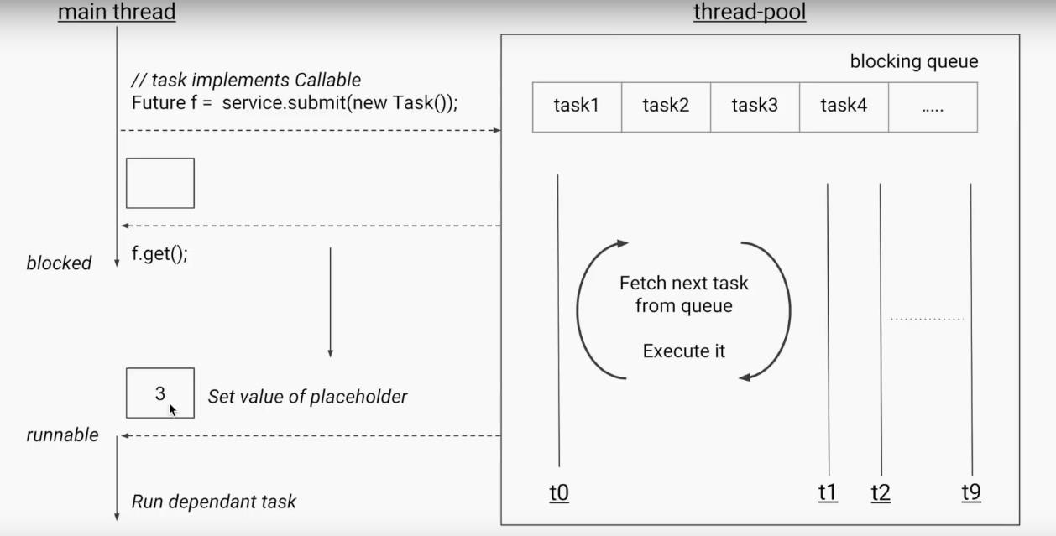
Blocked get()
57

Slide 58
Runnable Vs Callable
Both interfaces are designed to represent a task that can be executed by multiple threads. Runnable tasks can be run using the Thread class or ExecutorService whereas Callables can be run only using the latter.
The Runnable interface is a functional interface and has a single run() method which doesn’t accept any parameters and does not return any values.
This is suitable for situations where we are not looking for a result of the thread execution,
public interface Runnable {
public void run();
}
public void executeTask() {
executorService = Executors.newSingleThreadExecutor(); Future future = executorService.submit(Runnable object); executorService.shutdown();
}
Future object will not hold any value

Slide 59
Runnable Vs Callable
The Callable interface is a generic interface containing a single call() method – which returns a generic
value V:
public interface Callable<V> { V call() throws Exception;
}
public class FactorialTask implements Callable<Integer> { int number;
// standard constructors
public Integer call() throws InvalidParamaterException {
int fact = 1;
// ...
for(int count = number; count > 1; count--) { fact = fact * count;
}
return fact;
}
}
The result of call() method is returned within a Future object:

Slide 60

Thank You!

