Slide 1
Core Java
Exception Handling
What are Exceptions
try .. catch .. finally blocks
Runtime Exceptions
Unchecked exceptions
Checked exceptions
throws and throw keywords
User-defined exceptions

Slide 2


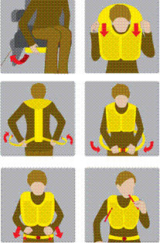

Scenario
Meera is flying to NewYork
What are these?
This an air hostess giving a
demonstration of steps that we have to take as passengers, in case of emergency. Why this demonstration is important?
Why the air line staff insists on fastening our seat belts?

Slide 3
Exception Handling
Similarly, when we write programs as part of an application, we may have to visualize the challenges that can disrupt the normal flow of execution of the code.
Once we know what are the different situations that can disrupt the flow of execution, we can take preventive measures to overcome these disruptions.
In java, this mechanism comes in the form of Exception Handling.

Slide 4
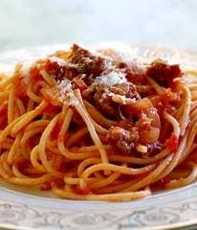
What is an Exception?
In procedural programming, it is
the responsibility of the programmer to ensure that the programs are error- free in all aspects
Errors have to be checked and
handled manually by using some error codes
But this kind of programming was
very cumbersome and led to spaghetti code
Java provides an excellent
mechanism for handling runtime errors

Slide 5
What is an Exception? (Contd.).
An exception is an event that occurs during the execution of a program that disrupts the normal flow of instructions
The ability of a program to intercept run-time errors, take corrective measures and continue execution is referred to as exception handling

Slide 6
What is an Exception? (Contd.).
There are various situations when an exception could occur:
Attempting to access a file that does not exist
Inserting an element into an array at a position that is not in its bounds
Performing some mathematical operation that is not permitted
Declaring an array using negative values

Slide 7
Uncaught Exceptions
class Demo {
public static void main(String args[]) {
int x = 0; int y = 50/x;
System.out.println(“y = “ +y);
}
}
Although this program will compile, but when you execute it, the Java run-time- system will generate an exception and displays the following output on the console :
java.lang.ArithmeticException: / by zero at Demo.main(Demo.java:4)

Slide 8
Uncaught Exceptions
What happens when you run the program without passing any command line arguments?
class ExceptionDemo {
public static void main (String args[]) { System.out.println(args[0]); System.out.println(args[1]);
}
}
java.lang.ArrayIndexOutOfBoundsException exception is thrown at run time
8

Slide 9
Exception Handling Keywords

Slide 10
Exception-handling in Java
1
0
Java’s exception handling is managed using the following keywords: try, catch, throw, throws a nd finally.
try {
statement(s)
}
catch (ExceptionType name) {
statement(s)
}
finally {
statement(s)
}
A program can catch exceptions by using a combination of the try, catch, and finally blocks.
Program statements that you want to monitor for exceptions are contained within a try block .
The catch block identifies a block of code, known as
an exception handler, that can handle a particular type of exception.
A single try block can have more than one catch blocks.
The optional finally block identifies a block of code that is guaranteed to execute, and is the right place to close files, recover resources, and otherwise clean up after the code enclosed in the try block.

Slide 11
How to Handle exceptions
class ExceptionDemo{
public static void main(String args[]){
int x, a;
try{
x = 0;
a = 22 / x;
System.out.println("This will be bypassed.");
}
catch (ArithmeticException e){
System.out.println("Division by zero.");
}
System.out.println("After catch statement.");
}
}

Slide 12
Handling Runtime Exceptions
Whenever an exception occurs in a program, an object representing that exception is created and thrown in the method in which the exception occurred
Either you can handle the exception, or ignore it
In the latter case, the exception is handled system and the program terminates by the Java runtime-
However, handling the exceptions will allow you to fix it, and prevent the p rogram from terminating abnormally

Slide 13
Handling Runtime Exceptions
An Exception is a run-time error i.e. exception that occurs at the time of running the program.
It is an event that occurs during the execution of a program that disrupts the normal flow of execution.
Exception Handler is a set of instructions that handles an exception.
The Java programming language provides a mechanism to help programs report and
handle errors.
When an exceptional condition arises, an object representing that exception is created and thrown in the method that caused the error.
The method may choose to handle the exception itself, or pass it on. Either way, at some point, the exception is caught and processed.

Slide 14
Exception Types
There are several built-in exception classes that are used to handle the very fundamental errors that may occur in your programs
You can create your own exceptions also by extending the Exception class
These are called user-defined exceptions, and will be used in situations that are unique to your applications

Slide 15
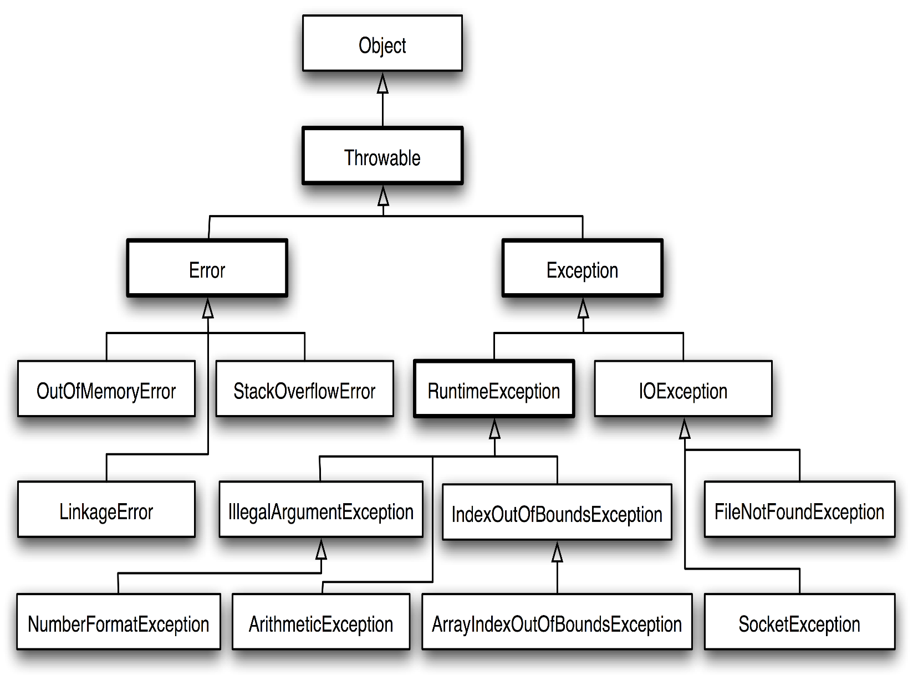
The Exception Class Hierarchy
Errors indicate serious problems and abnormal
conditions that are out of programmer’s reach.
Exceptions are situations within the control of an application, that can be handled.

Slide 16
Exception types
Exceptions are of two types:
Unchecked Exceptions
It is not mandatory to handle unchecked exceptions. Java compiler does not check to see if a method handles or throws these exceptions.
RuntimeException is the super class for all the classes that come under unchecked exceptions.
ArithmeticException, ArrayIndexOutOfBoundsException, NullPointerException, NumberFormatException etc. are some unchecked exceptions.
Checked Exceptions
Checked exceptions are bound to be handled. Java compiler checks to see if a method handles or throws these exceptions. If not handled, it leads to compilation error.
Exception is the super class for all the classes that come under checked exceptions.
ClassNotFoundException, IOException, FileNotFoundException, InterruptedException etc. are
16
some checked exceptions.

Slide 17
Execution Flow
Once an exception object is thrown in a try block, control stops executing remaining statements of the try block and enters into its catch block.
Once the catch statement is executed, program control executes the statements in finally block if present and then continues with the next line of the program following the try/catch block.
A try block is always followed by a catch block, which handles the exception or a try block can be followed by finally block which is generally used to release the resources allocated in the try block.
The catch block is not executed if no exception is thrown.

Slide 18
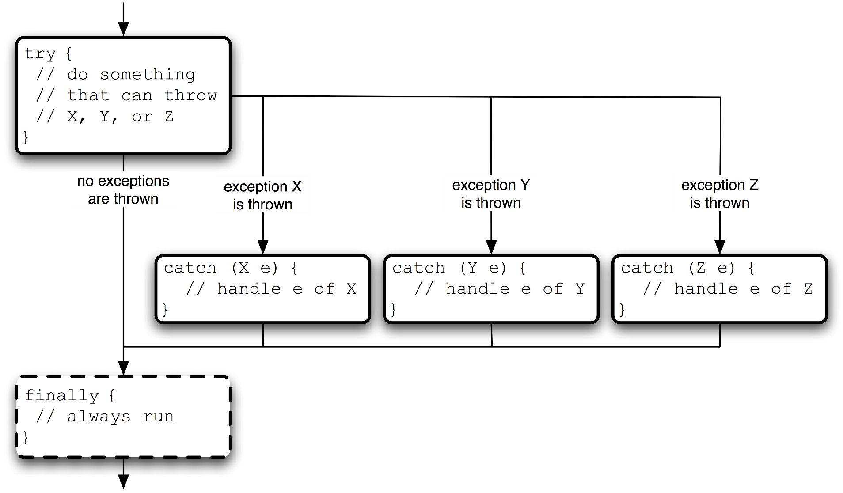
Handling Exceptions- Method I
There are two ways of handling exceptions:
Handle within the method by try .. catch block
Method 1
try {
…………..
}
catch (ExceptionTypeX e) {
// Exception handling code
}
catch (ExceptionTypeY e) {
// Exception handling code
}
catch (ExceptionTypeZ e) {
// Exception handling code
}
finally {
// clean-up code
}

Slide 19
Handling Exceptions-Method II
Method 2
Method specifying that it throws the exception object to the caller rather than
handling it.
public void someMethod() throws ExceptionTypeX, ExceptionTypeY {
// method body throws ExceptionTypeX and ExceptionTypeY
}

Slide 20
Handling Un-Checked Exceptions
Handling Unchecked exceptions is not mandatory for a compiler, but if not handled in the program, exception is thrown at run-time.
public class SumOfTwoIntegers {
public static void main(String[] args) { try{
int number1=Integer.parseInt(args[0]);
int number2=Integer.parseInt(args[1]);
……
}
catch(NumberFormatException nfe){
System.out.println("Invalid Data");
}
}
}
If the exception is not handled, program will compile but following exception is thrown at run-
time.
java.lang.ArrayIndexOutOfBoundsException
20

Slide 21
Not Handling Checked Exception
Handling checked exceptions is mandatory.
Java compiler returns an error and no class file is generated
public class BufferedReaderDemo {
public static void main(String[] args) {
String myName= getMyName();
System.out.println("My Name: "+ myName);
}
private static String getMyName() {
BufferedReader bufferedReader = new BufferedReader(new InputStreamReader(System.in));
System.out.println("Enter your name: ");
String name = bufferedReader.readLine();
return name;
Compile-time error
}
}
21

Slide 22
Handling Checked Exception: Method- I
public class BufferedReaderDemo { public static void main(String[] args) { String myName= getMyName();
System.out.println("My Name: "+ myName);
}
private static String getMyName() {
try{
BufferedReader bufferedReader = new BufferedReader(new InputStreamReader(System.in));
System.out.println("Enter your name: "); String name = bufferedReader.readLine(); return name;
}catch(IOException ioe){
System.out.println("Error while reading: \n"+ioe.getMessage());}
return null;
}
}
22

Slide 23
Handling Checked Exception: Method- II
public class BufferedReaderDemo1 {
public static void main(String[] args) throws IOException {
String myName= getMyName();
System.out.println("My Name: "+ myName);
}
private static String getMyName() throws IOException{
BufferedReader bufferedReader = new BufferedReader(new InputStreamReader(System.in));
System.out.println("Enter your name: ");
String name = bufferedReader.readLine();
return name;
}
}
23

Slide 24
Core Java
Handling Multiple Exceptions
Exception Life Cycle
Nested try..catch blocks
try.. with resources

Slide 25
Handling Multiple Exceptions
5
Multiple Exceptions
If there are multiple exception classes that might arise in the try block, then several catch blocks are allowed to handle them separately, each handling different exception type.
After one catch statement executes, the others are bypassed, and execution continues after the try/catch block.
The catch blocks must be in sequence with the most derived type first, and the
most basic type last. Otherwise, code will not compile

Slide 26
Handling Multiple Exceptions
6
try{
// try block code
}
catch(Exception e){
// Generic handling of exceptions
}
catch(ArithmeticException e){
// Specialized handling for these exceptions
}
try{
// try block code
}
catch(ArithmeticException e){
// Specialized handling for these exceptions
}
catch(Exception e){
// Generic handling of exceptions
}

Slide 27
Handling Multiple Exceptions in a single catch block: JDK 7 Onwards
7
public class ExceptionDemo {
public static void main(String[] args) {
try {
int x=Integer.parseInt(args[0]); int y=Integer.parseInt(args[1]); double average=divide(x,y);
System.out.println("Average Value: "+average);
String s1=null; System.out.println(s1.length());
}catch(NumberFormatException | ArrayIndexOutOfBoundsException | ArithmeticException e ) {
e.printStackTrace();
}catch(Exception e) {
System.out.println("Exception Trapped in Exception Type");
e.printStackTrace();
}
System.out.println("End of main() method");
private static double divide(int x, int y) {
double z; try { z=x/y; return z;
} catch (ArithmeticException e) {
//e.printStackTrace();
}
return 0;
}
}
}

Slide 28
try…with resource
The try-with-resources statement is a try statement that declares one or more resources.
Syntax:
try(<declare resource>){
} catch(…){
}
A resource is an object that must be closed after the program is finished with it.
The try-with-resources statement ensures that each resource is closed at the end of the statement.
Any object that implements java.lang.AutoCloseable, which includes all objects which implement java.io.Closeable, can be used as a resource.
Prior to Java SE 7, we use finally block to ensure that a resource is closed regardless of whether the try statement completes normally or abruptly.

Slide 29
try…with resource
private static String getName() {
String name=""; BufferedReader br=null;
System.out.println("Enter your name: ");
try {
Re-write the following code using try…with resources
br=new BufferedReader(new InputStreamReader(System.in));
name=br.readLine();
}
catch (IOException e) {
e.printStackTrace();
}
finally{ try { br.close();
} catch (IOException e) {
e.printStackTrace();
}
}
return name;
}

Slide 30
Exception Call Stack
0
After an exception object is created, it is handed off to the runtime system (thrown).
The runtime system attempts to find a handler for the exception by backtracking the ordered list of methods that had been called.
This is known as the call stack.
If a handler is found, the exception is caught. It is handled, or possibly re-thrown.
If the handler is not found (the runtime backtracks all the way to the main() method), the exception stack trace is printed to the standard error channel (stderr) and the application aborts execution.

Slide 31
Call Stack Example
1
public class ExceptionCallStackDemo {
Input 20 and 0 as command-line arguments
public static void main (String[] args) {
System.out.println(divideArray(args));
}
Exception in thread "main" java.lang.ArithmeticException: / by zero
at com.lnt.presentationtier.ExceptionDemo.divideInts(ExceptionDe mo.java:22)
at com. lnt.presentationtier.ExceptionDemo.divideStrings(ExceptionDem o.java:18)
at com. lnt.presentationtier.ExceptionDemo.divideArray(ExceptionDemo. java:12)
at com.digitech.presentationtier.ExceptionDemo.main(ExceptionDem o.java:6)
private static int divideArray(String[] array) {
String s1 = array[0];
String s2 = array[1];
return divideStrings(s1, s2);
}
private static int divideStrings(String s1, String s2) {
int i1 = Integer.parseInt(s1); int i2 = Integer.parseInt(s2); return divideInts(i1, i2);
}
private static int divideInts(int i1, int i2) { return i1 / i2;
}
}

Slide 32
Nested Try – Catch block
try-catch block within a try-catch block and so on are called as nested try-catch blocks.
Propagation of exception objects
If an inner try block does not have a matching catch statement for a particular exception, control is transferred to its outer try block’s catch handler that is expected to contain matching catch statement. If found, the exception object is trapped and the control continues with the executable part of the outer try block
If not found, control will continue searching for appropriate catch handler in the next outer block(s) and if found the exception object will be trapped.
If none of the outer blocks have appropriate catch handler, then the exception object is thrown to Java run-time system.
32

Slide 33
Nested Try – Catch block example
3
public class NestedTryExample{
public static void main(String args[]) {
try {
int a=args.length;
int b= (int)20/a; System.out.println("b= "+ b); try {
if(a==1) a=a/(a-a);
if(a==2) {
int c[]={1}; c[1]=2;
}
}
catch(ArrayIndexOutOfBoundsException oe) {
System.out.println("Array index out of bounds");
}
System.out.println("In outer try block");
}
catch(ArithmeticException ae) {
System.out.println("Divide by 0"); }
}
}

Slide 34
Core Java - II
User-defined/Custom Exceptions
Usage of throw keyword

Slide 35
User Defined/Custom Exceptions
Java provides extensive set of in-built exceptions
But there may be cases where we
may have to define our
own exceptions which are application specific.
For ex: If we have are creating an application for handling the database of eligible voters, the age should be greater than or equal to 18
In this case, we can create a user defined exception, which will be thrown in case the age entered is less than 18.

Slide 36
User defined exceptions contd..
Creating our own Exception classes is known as custom exceptions or user-defined exceptions.
Java custom exceptions are used to customize the exception according to user need.
Steps:
Create a class which extends the Exception class for creating user-defined checked exception or create a class which extends RuntimeException for creating user-defined unchecked exception.
The toString() method should be overridden in the user defined exception class in order to display meaningful information about the exception.
Override methods of Throwable class (optional)
In the application
Create an instance of the user-defined exception class.
Use the throw keyword to throw the instance created.
throw new <exception_classname(<parameters>)>
36

Slide 37
User Defined/Custom Exceptions
Custom Exceptions should be checked or unchecked?
If the exception is recoverable - it should be checked. If the exception is not recoverable and the program must halt - it should be unchecked.

Slide 38
Significance of printStackTrace() method
We can use the printStackTrace() method to print the program’s execution stack
This method is used for debugging
public void printStackTrace() is a method of Throwable class.
Throwable is super class for all errors and exceptions but is not abstract class
public class Throwable extends Object implements Serializable

Slide 39
User defined exception: Example
9
package com.capgemini.it.service;
public class CredentialException extends Exception{ private String name;
public CredentialException() {
}
public CredentialException(String name) {
this.name=name;
}
@Override
public String getMessage() {
return "Invalid Credentials";
}
@Override
public String toString() {
return "Userid: "+this.name+" is invalid";
}
}

Slide 40
User defined exception: Example
0
package com.capgemini.it.ui;
import java.io.BufferedReader; import java.io.IOException;
import java.io.InputStreamReader;
import com.capgemini.it.service.CredentialException; public class CredentialTester {
public static void main(String[] args) { try {
getCredentials();
System.out.println("Welcome to the App");
}catch(CredentialException e) {
System.out.println(e);
}
}

Slide 41
User defined exception: Example
private static void getCredentials() throws CredentialException{ try(
BufferedReader reader=
new BufferedReader(new InputStreamReader(System.in));
){
System.out.println("Enter userId: "); String userid=reader.readLine(); if(!userid.equals("admin")) {
throw new CredentialException(userid);
}
}catch(IOException e) {
}
}
}
41

Slide 42
Re-throwing an exception object
A method can re-throw an exception object it has caught.
Mainly applied in layered architecture based applications.
A method in data layer may catch an exception and throw it to service layer which in turn
re-throws to UI layer. The exception is handled in UI layer.
42

Slide 43
Custom Exception in Layered Architecture
package com.capgemini.it.service;
public class AdmissionCodeException extends
Exception{
private String code="";
public AdmissionCodeException() {
}
public AdmissionCodeException(String code) {
this.code=this.code+code;
}
@Override
public String toString() {
return code;
}
}

Slide 44
Custom Exception in Layered Architecture: data layer
public class StudentService {
public String getStudentName(String admissionCode) throws
AdmissionCodeException {
String [][] names= {
{ "1101","Ravi Kumar"},
{ "1102","Lakshmi"},
{ "1103","Madhavi"}
};
for(int i=0;i<names.length;i++) { if(names[i][0].equals(admissionCode)) { return names[i][1];
}
}
String error=admissionCode+"\nNo such admission code in our records";
throw new AdmissionCodeException(error);
}
}

Slide 45
Custom Exception in Layered Architecture: service layer
public class StudentManager {
public String getStudentName(String admissionCode) throws
AdmissionCodeException{
String error="Admission code is null";
try {
StudentService service=new StudentService();
if(admissionCode !=null) {
return service.getStudentName(admissionCode);
}
}catch(AdmissionCodeException e) {
error= e+"\nErrors trapped in service layer";
}
throw new AdmissionCodeException(error);
}
}

Slide 46
Custom Exception in Layered Architecture: UI layer
public class StudentTester {
public static void main(String[] args) {
String code="1108";
try {
String name=getStudentName(code); System.out.println(name);
}catch(AdmissionCodeException e) {
System.out.println(e);
}
}
private static String getStudentName(String code) throws AdmissionCodeException{
StudentManager manager=new StudentManager();
return manager.getStudentName(code);
}
}

Slide 47
Constructors and methods throwing exceptions in super class.
Handling in sub classes.

Slide 48
Constructors & Methods throwing exceptions
public class SuperClass {
public SuperClass() throws java.io.IOException{ System.out.println("Hi");
}
public void show() throws RuntimeException{
If a constructor method in super class throws an checked
exception, then the sub class constructor method should throw
same type of exception or its super type.
If a constructor method in super class throws an unchecked
exception, then the constructor method in the sub class has
System.out.println("I'm in super class show() method"); _{following options:}
} }
a. Can throw same type of exception
public class SubClass extends SuperClass {
// or throws java.io.Exception
b. Can throw its super type exception
c. Can ignore throwing an exception
public SubClass() throws java.io.IOException System.out.println("Welcome");
}
// valid , we can ignore throwing an exception
public void show() throws ArithmeticException{ super.show();
If a instance method in super class throws an unchecked
exception, then the overridden method in the sub class
has following options:
a. Can throw same type of exception
b. Can throw its sub type exception
c. Can ignore throwing an exception
System.out.println("I'm in sub class show() method");
}
If a instance method in super class throws an
}
public static void main(String[] args) throws Exception{ new SubClass().show();
checked exception, then the overridden method in
the sub class has to throw same exception type or its
}
sub-type.

Slide 49
Constructors & Methods throwing exceptions
9
class Parent{ protected int a;
Parent() throws Exception{
System.out.println(“Parent class");
}
public void getData() {
System.out.println("Hi");
}
public void showData(){ System.out.println("a= " + a);
}}
class Child extends Parent{
Child() throws Exception{
super();
System.out.println("Child class");
}
@Override
public void getData() throws IOException{
BufferedReader bufferedReader =
new BufferedReader(new InputStreamReader(System.in));
System.out.println("Enter a number ");
int a = Integer.parseInt(br.readLine());
}}
Note: public void getData() throws RuntimeException is valid
If getData() of super class does not declare throws IOException and if the overridden method in subclass declares, it
leads to compile error.
The following exception is throw:
Exception IOException is not compatible with throws clause in Parent.getData()

Slide 50
Quiz
What will be the result, if we try to compile the following code (FileNotFoundException is a subclass of IOException)
import java.io.*;
class Super {
void m1() throws FileNotFoundException {
FileInputStream fx = new FileInputStream("Super.txt");
}
}
class Sub extends Super {
void m1() throws IOException {
Yes, it will throw compilation Error
FileInputStream fx = new FileInputStream("Sub.txt");
}
}

Slide 51
Quiz (Contd.).
What will be the result, if we try to compile the following code (FileNotFoundException is a subclass of IOException)
import java.io.*;
class Super {
void m1() throws IOException {
FileInputStream fx = new FileInputStream("Super.txt");
}
}
class Sub extends Super {
No Compilation Error
void m1() throws FileNotFoundException { FileInputStream fx = new FileInputStream("Sub.txt");
}
}

Slide 52
Quiz (Contd.).
What will be the result, if we try to compile the following code
class Super {
void m1() throws ArithmeticException { int x = 100, y=0;
int z=x/y;
System.out.println(z);
}
}
class Sub extends Super {
No Error! Compilation successful
void m1() throws NumberFormatException { System.out.println("Wipro");
}
}

Slide 53
Quiz (Contd.).
What will be the result, if we try to compile (FileNotFoundException & SQLException are not related hierarchically)
the following code
import java.io.*; import java.sql.*; class Super {
void m1() throws FileNotFoundException {
FileInputStream fx = new FileInputStream("Super.txt");
}
}
class Sub extends Super {
void m1() throws SQLException {
It will throw compilation Error
FileInputStream fx = new FileInputStream("Sub.txt");
}
}

Slide 54

Thank You!

