Slide 1
Synthetic Data Generation
using ChatGPT

Slide 2
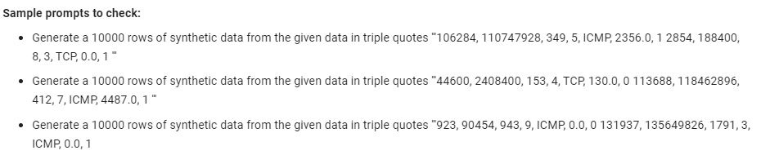
Prompt Specification
Data generated: 5406 After preprocessing: 5361
Difficulty
Max token restriction appears to be the problem

Slide 3
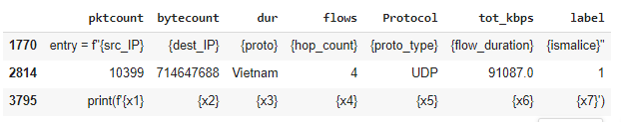
Incorrect data
Datatype conversion issue

Slide 4
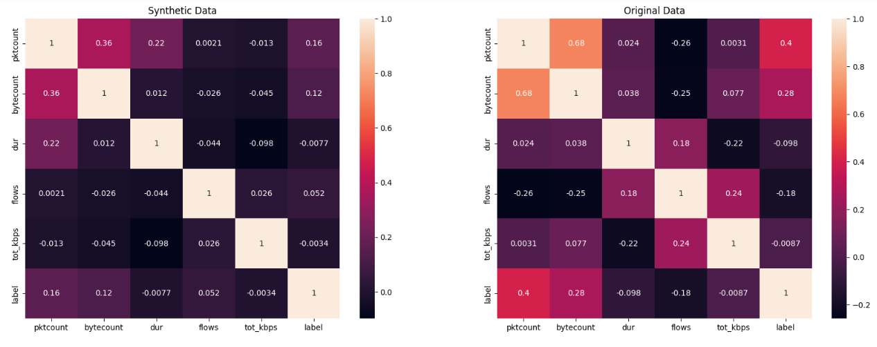
Correlation Comparison

Slide 5
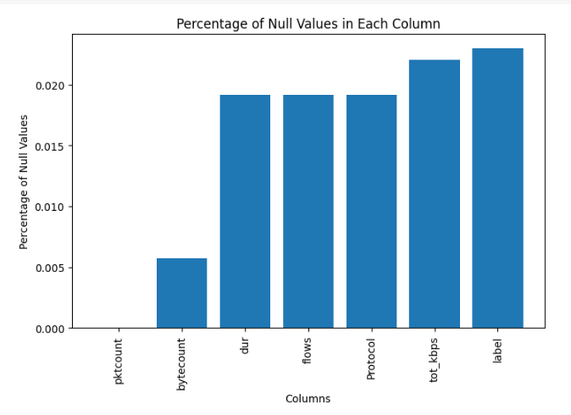
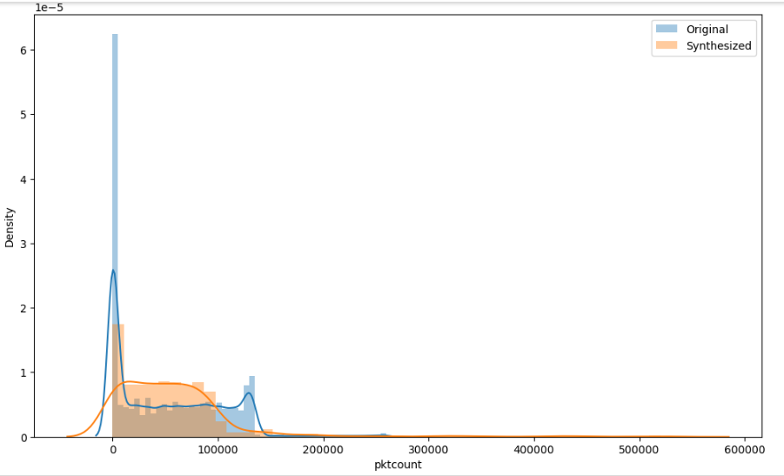
Data Comparison

Slide 6
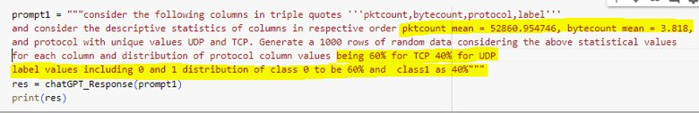
Modified Prompt
Prompt with Statistics mentioned
The Generated data is all same as mean
Able to get different data with prompt modification.

Slide 7
Modified Prompt
Prompt = Generate a 10000 rows of synthetic data from the given data in triple quotes '''"RandomExample"'''"
RandomExamples is sampled and stratified
Experimented different no. of samples
Calculated input token count and specified output token count
Experimented in the iterations

