Slide 1
Synthetic Data Generation
Using OpenAI

Slide 2
Prompt tuning
consider the columns in triple backticks
```column names```
and its statistics in triple quotes
"""Statistics of the original data"""
and consider the following examples in triple quotes
"""randomly picked 10 rows"""
Generate a 10000 rows of a data in csv format, label including 0 and 1 classes with equal distribution, consider the max token as 4000 - input tokens after calculation.

Slide 3
Prompt tuning
column names: all 23 columns are selected including target
Statistics of the original data: Statistics measured only for continuous variables
randomly picked 10 rows
Balanced data (50-50 ratio in labels)
Outliers removed
Null values removed
Max token Issue: max token as 4000 - input tokens after calculation

Slide 4
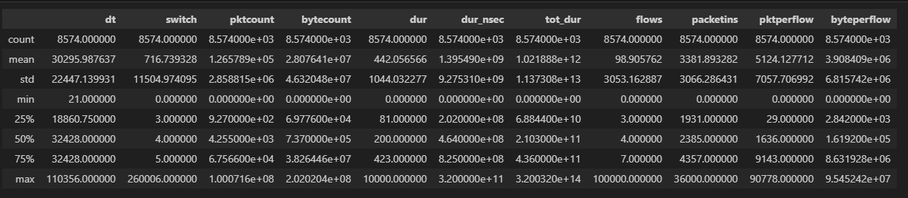
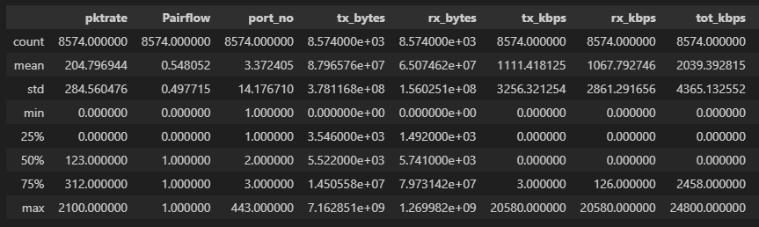
Statistics of the Data

Slide 5
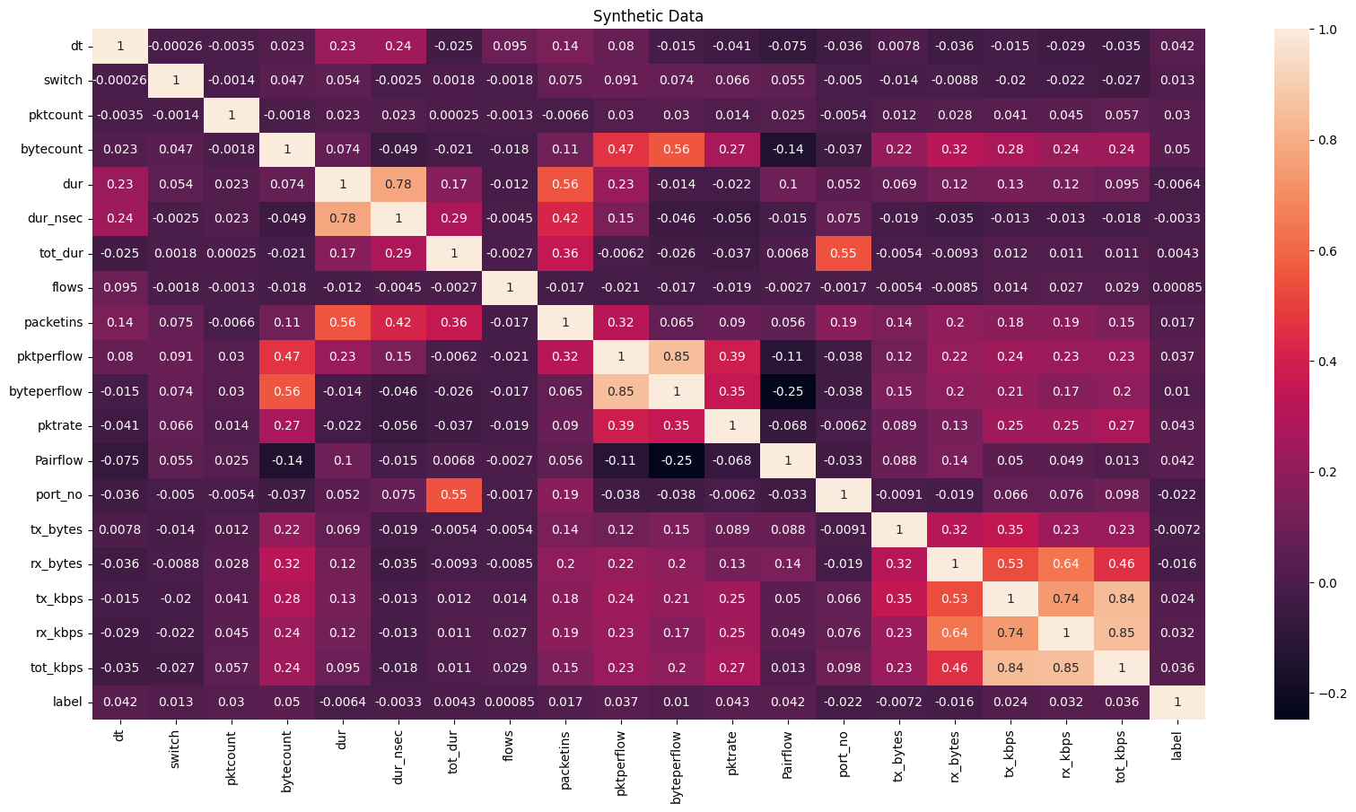
Heatmap: Correlation of generated columns

Slide 6
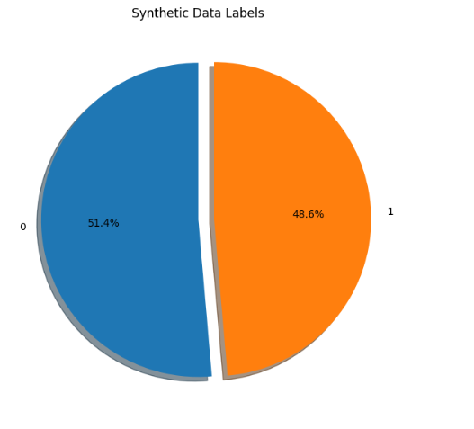
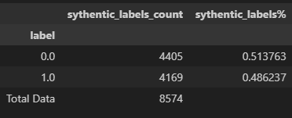
Synthetic Data Labels

