Slide 1
Artificial Intelligence DA - 1
Team Members
Ramireddy Jeevan Reddy – 21BCE5163
B.Venu Vihari Yadav – 21BCE5232

Slide 2
Selected Algorithms
1. Histogram of Oriented Gradients (HOG)
2.

Slide 3
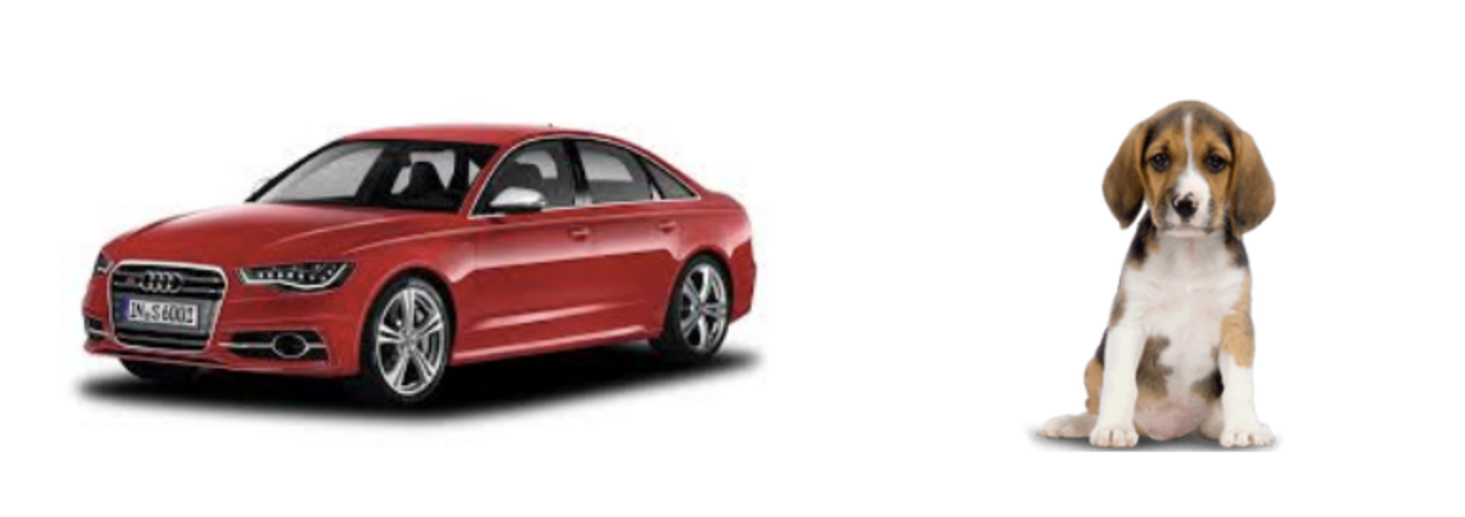
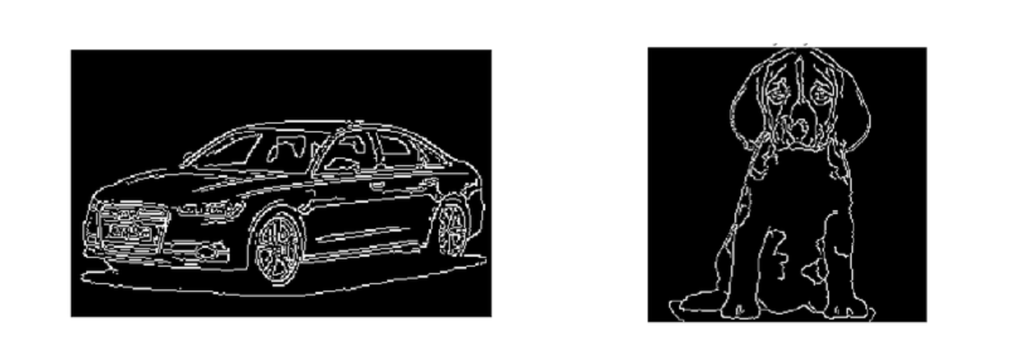
Histogram of Oriented Gradients (HOG)
What is a Feature Descriptor?
You might have had this question since you read the heading. So let’s clear that up first before we jump into the HOG part of the article.

Slide 4
What is Histogram of Oriented Gradients?
The Histogram of Oriented Gradients (HOG) is a popular feature descriptor technique in computer vision and image processing. It analyses the distribution of edge orientations within an object to describe its shape and appearance. The HOG method involves computing the gradient magnitude and orientation for each pixel in an image and then dividing the image into small cells.

Slide 5
Introduction to the HOG Feature Descriptor
The HOG descriptor focuses on the structure or the shape of an object. Now you might ask, how is this different from the edge features we extract for images? In the case of edge features, we only identify if the pixel is an edge or not. HOG is able to provide the edge direction as well. This is done by extracting the gradient and orientation (or you can say magnitude and direction) of the edges
Additionally, these orientations are calculated in ‘localized’ portions. This means that the complete image is broken down into smaller regions and for each region, the gradients and orientation are calculated. We will discuss this in much more detail in the upcoming sections
Finally the HOG would generate a Histogram for each of these regions separately. The histograms are created using the gradients and orientations of the pixel values, hence the name ‘Histogram of Oriented Gradients’

Slide 6
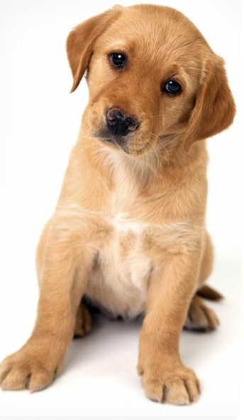
Process of Calculating the Histogram of Oriented Gradients (HOG)
Consider the below image of size (180 x 280)

Slide 7
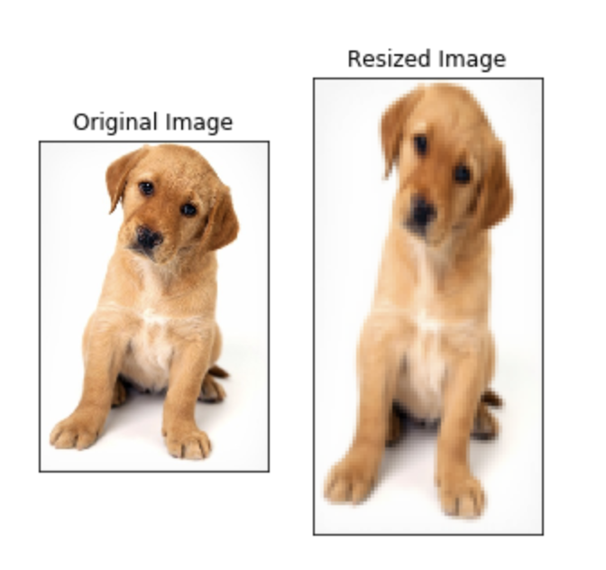
Step 1: Pre Process the Data (64 x 128)
We need to Pre Process the image and bring down the width to height ratio to 1:2
The image size should preferably be 64 x 128. This is because we will be dividing the image into 8*8 and 16*16 patches to extract the features.
This is because we will be dividing the image into 8*8 and 16*16 patches to extract the features.

Slide 8
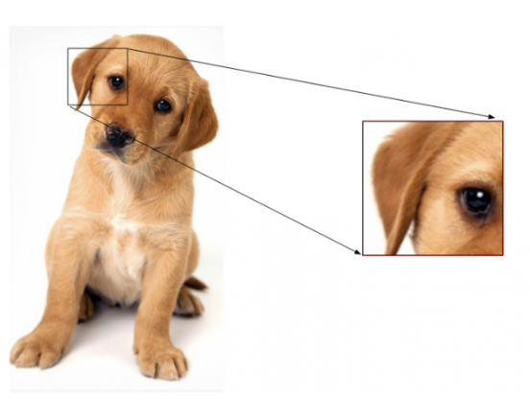
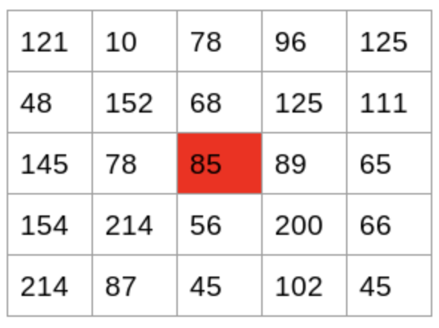
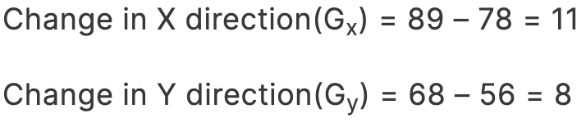
Step 2: Calculating Gradients (direction x and y)
Gradients are the small change in the x and y directions.
Now, to determine the gradient (or change) in the x-direction, we need to subtract the value on the left from the pixel value on the right
to calculate the gradient in the y-direction, we will subtract the pixel value below from the pixel value above the selected pixel.
This process will give us two new matrices – one storing gradients in the x-direction and the other storing gradients in the y direction.

Slide 9
Step 3: Calculate the Magnitude and Orientation
we will be using the Pythagoras theorem
magnitude:
Total Gradient Magnitude = √[(G_{x})²+(G_{y})²]
Total Gradient Magnitude = √[(11)²+(8)²] = 13.6
Next, calculate the orientation (or direction) for the same pixel. We know that we can write the tan for the angles:
tan(Φ) = Gy / Gx
Hence, the value of the angle would be:
Φ = atan(Gy / Gx)
Φ = 36

Slide 10
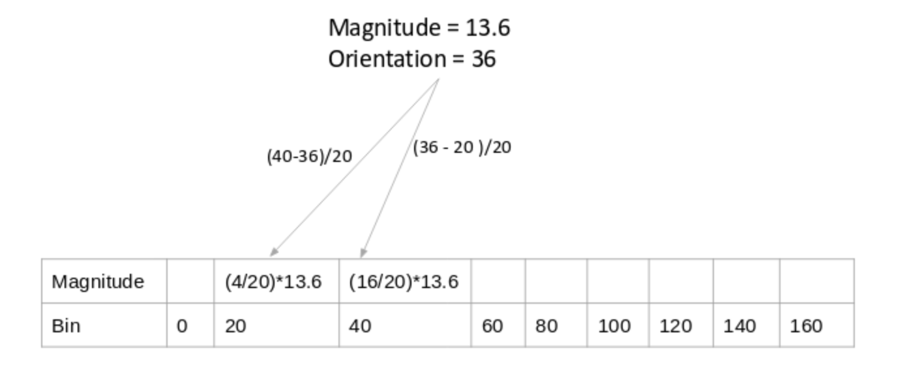
Create Histograms using Gradients and Orientation

Slide 11
Step 4: Calculate Histogram of Gradients in 8×8 cells (9×1)
If we divide the image into 8×8 cells and generate the histograms, we will get a 9 x 1 matrix for each cell. This matrix is generated using method 4 that we discussed in the previous section.
Once we have generated the HOG for the 8×8 patches in the image, the next step is to normalize the histogram.

Slide 12
Step 5: Normalize gradients in 16×16 cell (36×1)
Although we already have the HOG features created for the 8×8 cells of the image, the gradients of the image are sensitive to the overall lighting. This means that for a particular picture, some portion of the image would be very bright as compared to the other portions.
we can reduce this lighting variation by normalizing the gradients by taking 16×16 blocks.
So, we would have four 9×1 matrices or a single 36×1 matrix.

Slide 13
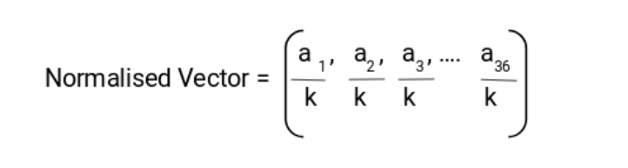
V=we would have four 9×1 matrices or a single 36×1 matrix.
V = [a1, a2, a3, ….a36]
We calculate the root of the sum of squares:
k = √(a1)2+ (a2)2+ (a3)2+ …. (a36)2
And divide all the values in the vector V with this value k:

Slide 14
Step 6: Features for the complete image
we have created features for 16×16 blocks of the image. Now, we will combine all these to get the features for the final image.
We would have 105 (7×15) blocks of 16×16.
each of these 105 blocks has a vector of 36×1 as features.
Hence, the total features for the image would be 105 x 36×1 = 3780 features.

Slide 15
Algorithm
#importing required libraries
from simg.shape import imread, imshow
from skimage.transform import resize
from skimage.feature import hog
from skimage import exposure
import matplotlib.pyplot as plt
%matplotlib inline
#reading the image
img = imread('puppy.jpeg')
imshow(img)
print(img.shape)
#resizing image
resizeresized_img.shapeg, (128,64))
imshow(resized_img)
print(resized_img.shape)

Slide 16
#creating hog features
fd, hog_image = hog(resized_img, orientationvisualizels_per_cell=(8, 8),
cells_per_block=(2, 2), visualize=True, multichannel=True)
fd.shape
This output will be : 3780

