Slide 1




Special Topics in Data Science
SCENARIO
SILENT
Captured operative on enemy media broadcast
SIGNAL
Watched — cannot speak freely
Gesture Recognition System
9 silent gestures encode critical intel
Motion BiLSTM · MediaPipe · Jetson Edge AI
Jetson AI decodes signals in real-time
Venu Bandi

Slide 2






“I should let them know!”
Goal: Real-Time Silent Gesture Recognition
9 Emergency Action Classes
DANGER
HELP
ABORT
NEED BACKUP
SAFE
STAY
PROCEED
WATCHED
NO GESTURE
Each class represents a real emergency signal — not just a random label.

Slide 3


“I am the data”
Data: Custom Gesture Dataset
Custom recorded video sequences — each gesture captured as a short action clip
9
Gesture Classes
Each video processed into structured keypoints (not raw pixels)
30
Face mesh · Hand landmarks · Upper-body posture extracted per frame
Frames per Sequence
Personalized dataset = strong proof-of-concept, clear path to scale
Keypoints
Input Type

Slide 4
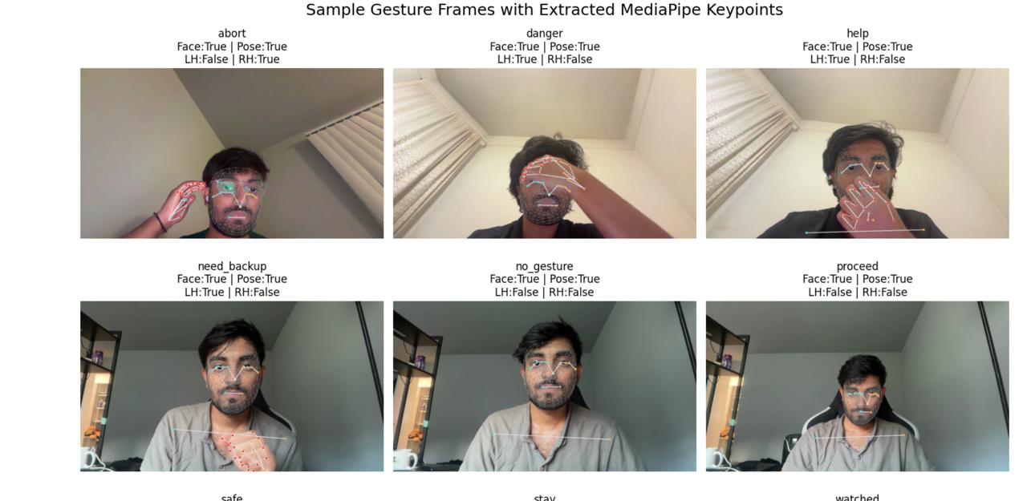

Slide 5
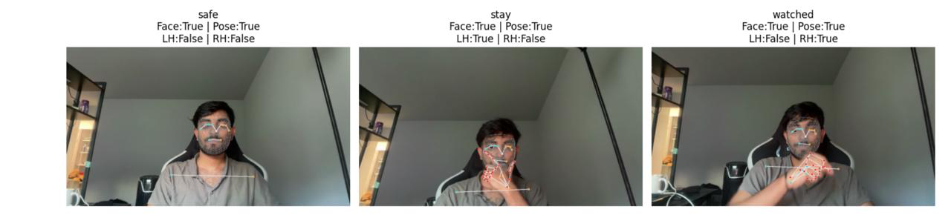

Slide 6

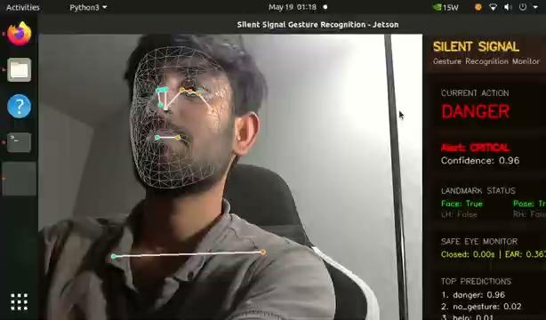
“You cant see me”
What the System Sees: Face, Hands & Posture
Camera Input
MediaPipe
Face Mesh
Hand Landmarks
Pose Keypoints
Live video feed
Landmark extraction
468 landmarks
42 points (L+R)
Upper body
WHY THIS MATTERS
Focused input — only movement regions that matter for silent gestures
Lightweight pipeline — structured keypoints instead of raw pixel data
Model receives face + hand + body positions as a sequence over time

Slide 7

“I am not perfect”
Model: Motion BiLSTM Architecture
Video Input
30 frames
MediaPipe
Keypoints
Selected Features
+ Motion Δ
Motion
BiLSTM
Gesture
Class
WHAT THE MODEL LEARNS
Selected Pose Landmarks
Upper-body anchor points
Selected Face Landmarks
Expression & orientation cues
Hand Landmarks
Full 21-point hand pose (L+R)
Motion Deltas (Δ)
Frame-to-frame movement patterns
05 / 11

Slide 8
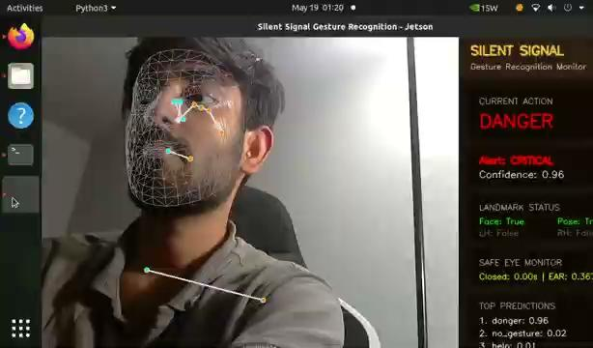
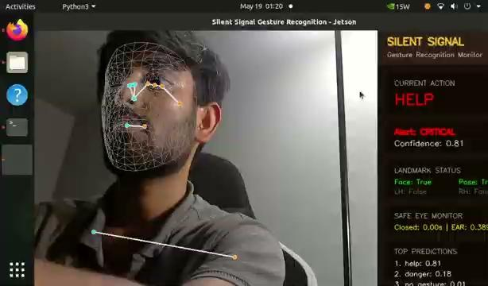

Slide 9
“My model is generalizing , not bluffing”
“My model - generalizing not bluffing”
Results: Model Performance
76.85%
67.59%
9
Best Validation Accuracy
Test Accuracy
Action Classes
F1 SCORE BY CLASS (illustrative ranking)
danger
91%
help
88%
abort
84%
need_backup
80%
watched
74%
proceed
68%
safe
60%
stay
55%
no_gesture
48%
06 / 11

Slide 10
“With great power comes great responsibility.”
Metrics: Stability & Error Analysis
STRONG CLASSES
WEAKER CLASSES
DANGER
STAY
Clear hand-to-face pattern
Subtle — overlaps with help
HELP
SAFE
Distinct upper-body raise
Low motion delta signature
ABORT
PROCEED
Strong lateral motion
Frames ambiguity
NEED BACKUP
NO GESTURE
Unique hand twist posture
Ambiguous — no clear motion
System mitigations: confidence ranking · detection logs · SAFE eye-closure override (2-sec rule)
07 / 11

Slide 11
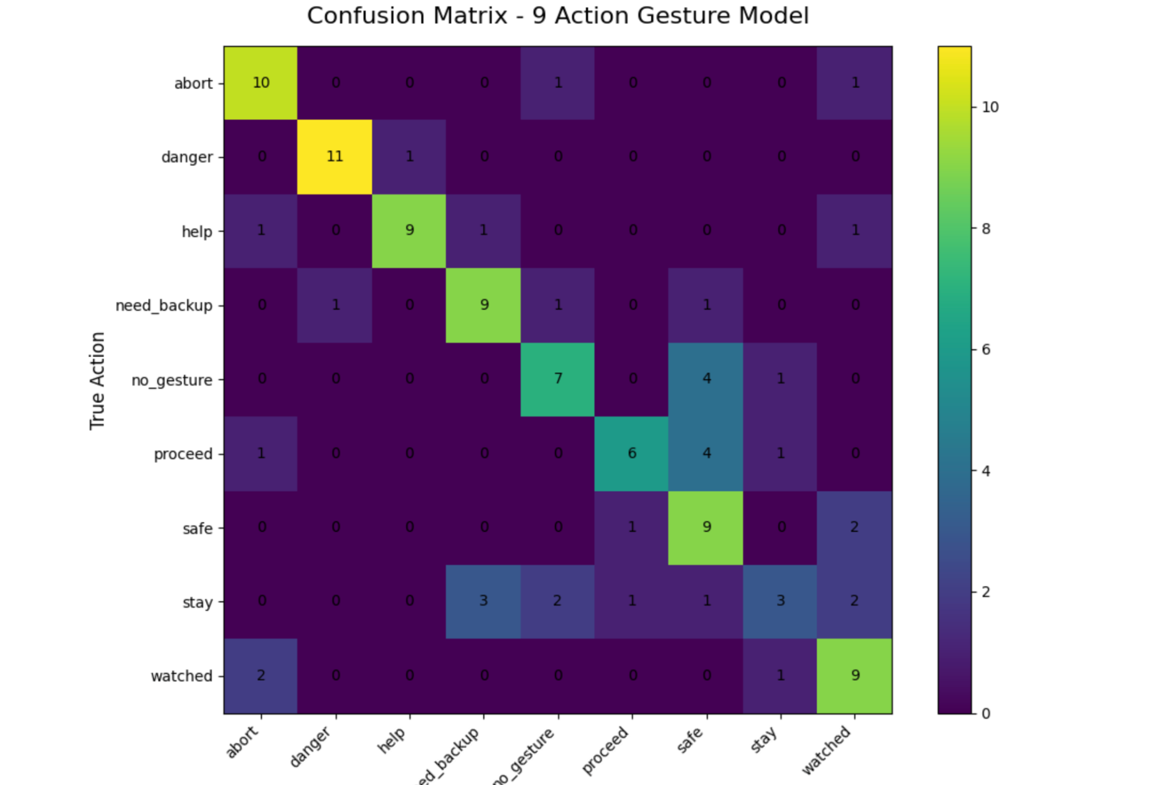

Slide 12
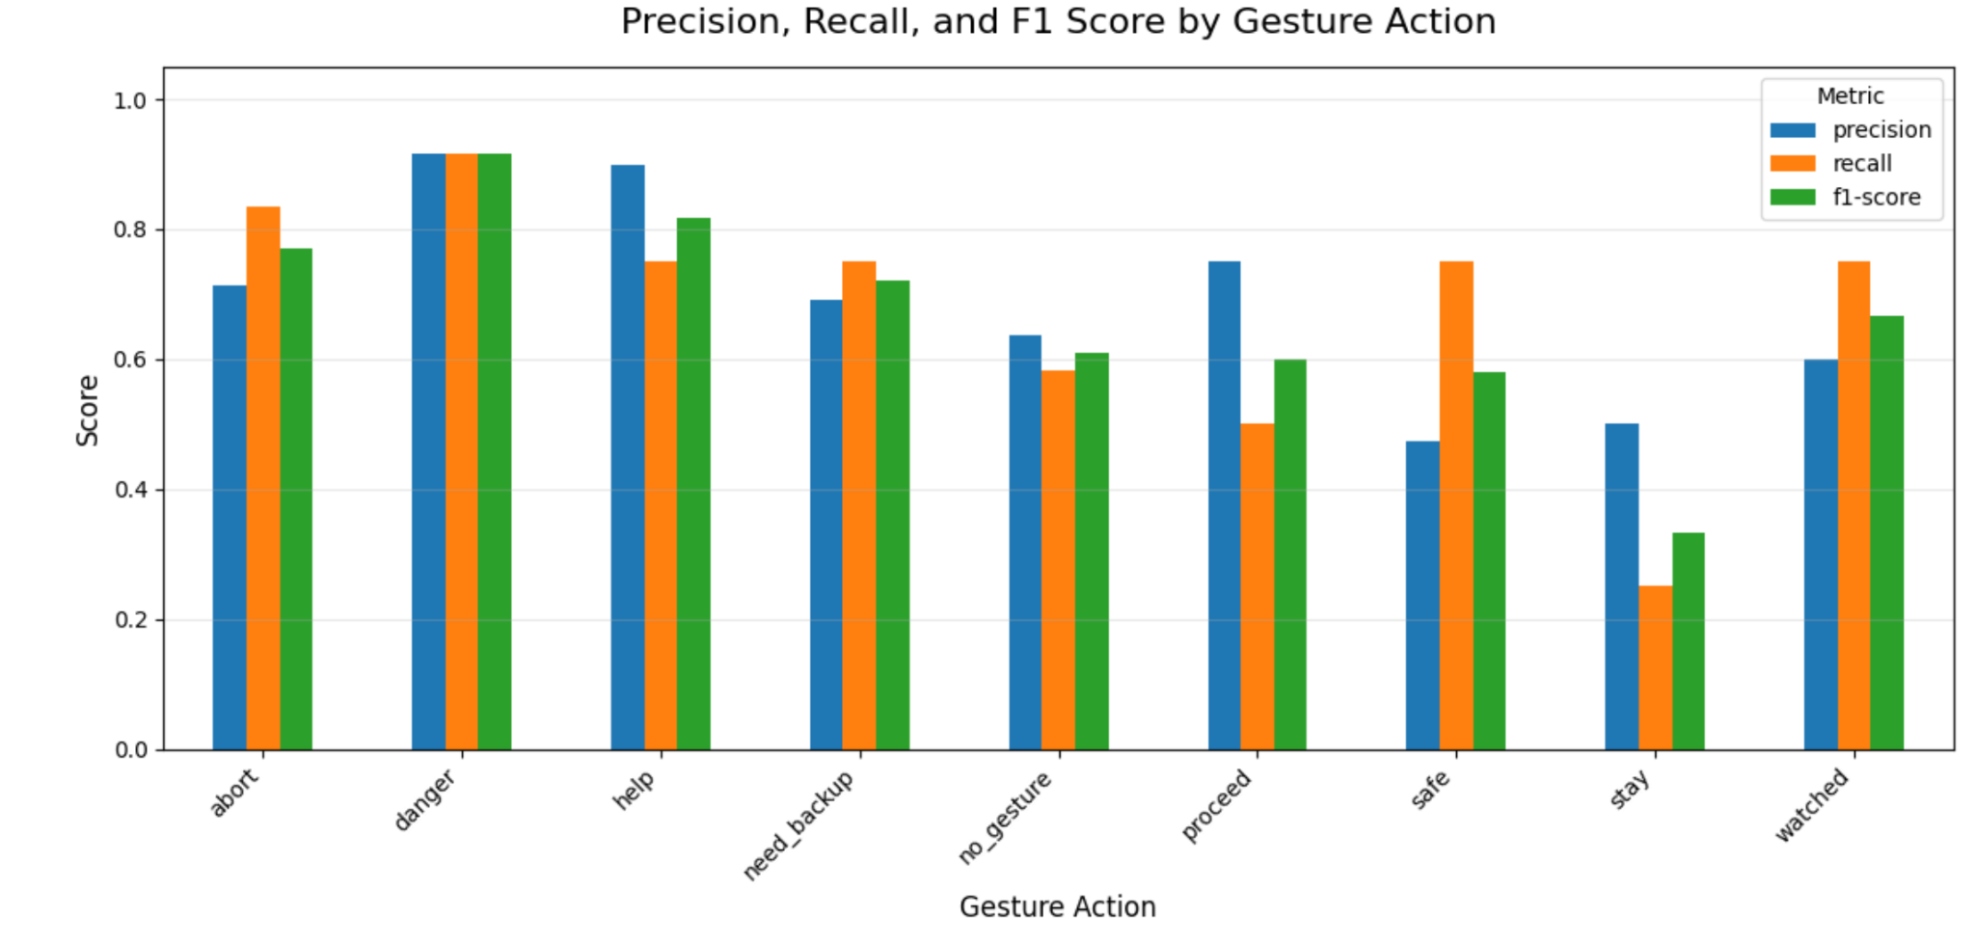

Slide 13

Dashboard
JETSON EDGE
Live camera feed
Current detected action + confidence score
Alert level indicator
Landmark status display
Recent detection logs
Eye-closure SAFE override (2s timer)
Together: a complete working monitoring prototype.

Slide 14
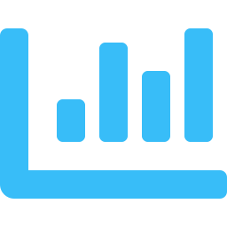
“End of the beginning? No!”
Conclusion: Silent Gesture → Actionable Alert
Silent emergency
gesture captured
Converted to
structured keypoints
Classified by
temporal model
Displayed as
real-time alert
KEY ACHIEVEMENT
Not just model accuracy — a complete working prototype that connects gesture recognition with a practical monitoring interface. Camera-based AI turning silent physical signals into actionable alerts.
09 / 11

Slide 15
“Feed me More!”
Next Steps: Path to Generalization
Scale the Dataset
01
More users · diverse lighting conditions · varied camera angles · additional gesture variations → better generalization beyond the personalized prototype
Improve Weak Classes
02
Focus on stay · safe · proceed · no_gesture — which showed highest confusion. Targeted data collection and class-specific augmentation strategies.
Optimize Edge Deployment
03
Make the full camera + model + dashboard pipeline efficient for real-time Jetson deployment. Model quantization and pipeline compression.
Long-term goal: move from a personalized prototype to a generalized silent-signal recognition system.
10 / 11

Slide 16
Q & A
Silent Signal Gesture Recognition System
Motion BiLSTM · MediaPipe · Jetson Edge AI
Small personalized dataset
Similar gesture confusion
MediaPipe dependency
Edge deployment constraints

