Slide 1
PROFOUND CODERS
VENUCHAITANYA DIGVIJAY SINGH TANWAR ABHISHEK NYATI

Slide 2
Because of expiry of medicines, delayed delivery(Causes damage to medicines), carrying medicines on low-temperature, Low-supply & High-demand, emergency-needs of Blood-bottles

Slide 3
# SOLUTUONS
A proper supply management system is critical for the efficient and effective operation of a hospital. Here are some steps that can be taken to maintain such a system:

Slide 4
Technology used:
The Healthcare supply chain can be improved by infusing the latest technologies such as AI, Blockchain, data analytics, etc., to supply chain management in hospitals

Slide 5
Connection reach :-
Patient Access
patient-access-with-connectivityNot all patients have equal access to health care. Some people live in rural areas, far from big hospitals and specialists. Other patients have busy schedules that make it difficult to attend regular appointments. Still others may have trouble getting around because they are disabled or lack transportation. In recognition of this problem, the chairman of the Federal Communications Commission (FCC) recently announced that the organization will increase funding for rural health care programs by $171 million to help finance telemedicine.
Connectivity makes it possible for patients to schedule web consultations with doctors. These web consultations enable the patient and doctor to confer face to face no matter where they are located. The doctor can use web video to see any visual symptoms. With a high-speed network, these interactions between patient and doctor take place in real time. The images and audio are high-resolution and don’t experience any jitter.

Slide 6
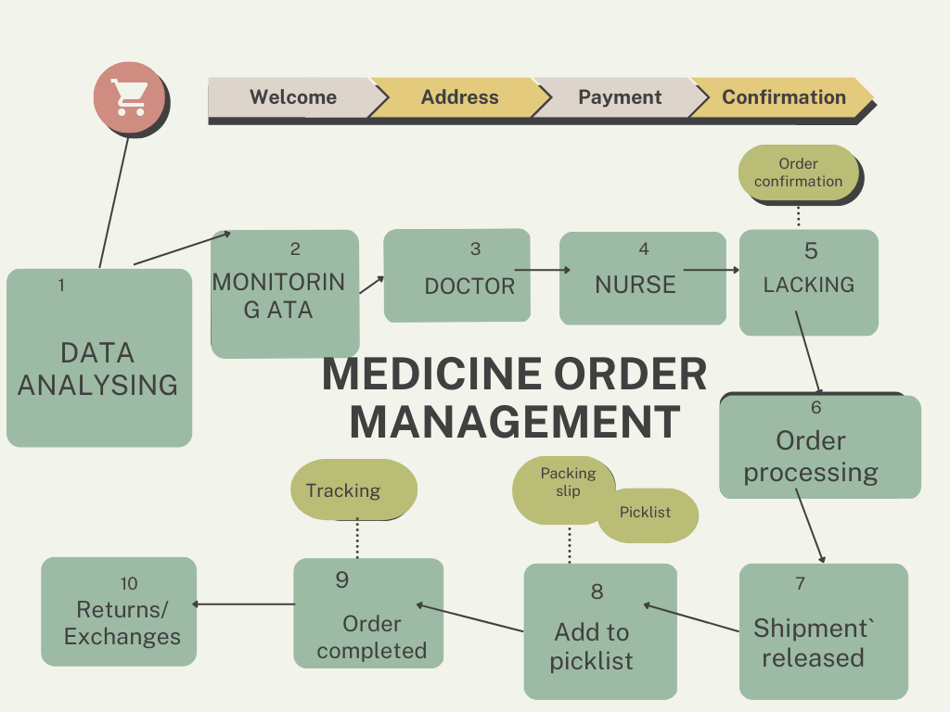

Slide 7
SOLUTUON 2
Establish a system for tracking inventory: A hospital should have a system in place for tracking inventory levels of medical supplies, equipment, and pharmaceuticals. This can be done manually or through the use of automated inventory management software.

Slide 8
SOLUTUON 3
Develop a procurement plan: The procurement plan should be based on the hospital's needs, budget, and patient volume. It should also take into account the lead time required for ordering and receiving supplies.

Slide 9
SOLUTUON 4
Maintain accurate records: The hospital should keep accurate records of all supplies received and used. This information can be used to identify trends, adjust procurement plans, and reduce waste.

Slide 10
SOLUTUON 5
Use a centralized storage system: A centralized storage system can help ensure that supplies are stored properly and are easily accessible to those who need them. It also makes it easier to track inventory levels and avoid stockouts.

Slide 11
SOLUTUON 6
Implement a system for identifying and disposing of expired or damaged supplies: Expired or damaged supplies can pose a risk to patients and staff. A system should be in place for identifying and disposing of these supplies safely.

Slide 12
SOLUTUON 7
Establish clear protocols for requesting and using supplies: Clear protocols should be established for requesting and using supplies to ensure that they are used appropriately and efficiently.

