Slide 1
Design Engineering
Design process and Design quality
Design concepts
Design models

Slide 2
Design Engineering
Design engineering encompasses the set of principals, concepts, and practices that lead to the development of a high- quality system or product.
Design principles establish an overriding philosophy that guides the designer in the work that is performed.
Design concepts must be understood before the mechanics of design practice are applied and
Design practice itself leads to the creation of various representations of the software that serve as a guide for the construction activity that follows.

Slide 3
What is design:
Design is what virtually every engineer wants to do. It is the place where creativity rules – customer’s requirements, business needs, and technical considerations all come together in the formulation of a product or a system. Design creates a representation or model of the software, but unlike the analysis model, the design model provides detail about software data structures, architecture, interfaces, and components that are necessary to implement the system.

Slide 4
Why is it important:
Design allows a software engineer to model the system or product that Is to be built. This model can be assessed for quality and improved before code is generated, tests are conducted, and end – users become involved in large numbers. Design is the place where software quality is established.

Slide 5
The goal of design engineering is to produce a model or representation that exhibits firmness, commodity, and delight. To accomplish this, a designer must practice diversification and then convergence. Another goal of software design is to derive an architectural rendering of a system. The rendering serves as a framework from which more detailed design activities are conducted.

Slide 6
Design Process And Design Quality:
Software design is an iterative process through which requirements are translated into a “blueprint” for constructing the software.

Slide 7
Goals of design:
McGlaughlin suggests three characteristics that serve as a guide for the evaluation of a good design.
The design must implement all of the explicit requirements contained in the analysis model, and it must accommodate all of the implicit requirements desired by the customer.
The design must be a readable, understandable guide for those who generate code and for those who test and subsequently support the software.
The design should provide a complete picture of the software, addressing the data, functional, and behavioral domains from an implementation perspective.

Slide 8
Quality guidelines:
In order to evaluate the quality of a design representation we must establish technical criteria for good design. These are the following guidelines:
A design should exhibit an architecture that
has been created using recognizable architectural styles or patterns
is composed of components that exhibit good design characteristics and
can be implemented in an evolutionary fashion, thereby facilitating implementation and testing.

Slide 9
A design should be modular; that is, the software should be logically partitioned into elements or subsystems.
A design should contain distinct representation of data, architecture, interfaces and components.
A design should lead to data structures that are appropriate for the classes to be implemented and are drawn from recognizable data patterns.
A design should lead to components that exhibit independent functional characteristics.

Slide 10
A design should lead to interface that reduce the complexity of connections between components and with the external environment.
A design should be derived using a repeatable method that is driven by information obtained during software requirements analysis.
A design should be represented using a notation that effectively communication its meaning.

Slide 11
Quality attributes
The attributes of design name as 'FURPS' are as follows:
Functionality is assessed by evaluating the feature set and capabilities of the program, the generality of the functions that are delivered, and the security of the overall system.
Usability is assessed by considering human factors, overall aesthetics, consistency and documentation.
Reliability is evaluated by measuring the frequency and severity of failure, the accuracy of output results, and the mean – time –to- failure (MTTF), the ability to recover from failure, and the predictability of the program.

Slide 12
Performance is measured by processing speed, response time, resource consumption, throughput, and efficiency
Supportability combines the ability to extend the program (extensibility), adaptability, serviceability- these three attributes represent a more common term maintainability

Slide 13
DESIGN CONCEPTS
The set of fundamental software design concepts are as follows: 1. Abstraction 7. Refinement
2. Architecture 8. Refactoring
3. Patterns 9. Design classes
4. Modularity
5. Information hiding
6. Functional independence

Slide 14
1. Abstraction
A solution is stated in large terms using the language of the problem environment at the highest level abstraction.
The lower level of abstraction provides a more detail description of the solution.
A sequence of instruction that contain a specific and limited function refers in a procedural abstraction.
A collection of data that describes a data object is a data abstraction.

Slide 15
2. Architecture
The complete structure of the software is known as software architecture.
Structure provides conceptual integrity for a system in a number of ways.
The architecture is the structure of program modules where they interact with each other in a specialized way.
The components use the structure of data.
The aim of the software design is to obtain an architectural framework of a system.
The more detailed design activities are conducted from the framework.

Slide 16
3. Patterns A design pattern describes a design structure and that structure solves a particular design problem in a specified content. 4. Modularity
A software is separately divided into name and addressable components. Sometime they are called as modules which integrate to satisfy the problem requirements.
Modularity is the single attribute of a software that permits a program to be managed easily.

Slide 17
5. Information hiding Modules must be specified and designed so that the information like algorithm and data presented in a module is not accessible for other modules not requiring that information. 6. Functional independence
The functional independence is the concept of separation and related to the concept of modularity, abstraction and information hiding.
The functional independence is accessed using two criteria i.e Cohesion and coupling.

Slide 18
cohesionCohesion is an extension of the information hiding concept.
A cohesive module performs a single task and it requires a small interaction with the other components in other parts of the program.
Coupling Coupling is an indication of interconnection between modules in a structure of software.

Slide 19
7. Refinement
Refinement is a top-down design approach.
It is a process of elaboration.
A program is established for refining levels of procedural details.
A hierarchy is established by decomposing a statement of function in a stepwise manner till the programming language statement are reached.

Slide 20
8. Refactoring
It is a reorganization technique which simplifies the design of components without changing its function behaviour.
Refactoring is the process of changing the software system in a way that it does not change the external behaviour of the code still improves its internal structure.

Slide 21
9. Design classes
The model of software is defined as a set of design classes.
Every class describes the elements of problem domain and that focus on features of the problem which are user visible.

Slide 22
Design model
The design model is an abstraction of the implementation of the system. It is used to conceive as well as document the design of the software system. It is a comprehensive, composite artifact encompassing all design classes, subsystems, packages, collaborations, and the relationships between them.

Slide 23
The design model
The design model can be viewed in two different dimensions.
(Horizontally) The process dimension
It indicates the evolution of the parts of the design model as each design task is executed.
(Vertically) The abstraction dimension
It represents the level of detail as each element of the analysis model is transformed into the design model and then iteratively refined.

Slide 24
The elements of the design model use many of the same UML diagrams that were used in the analysis model.
The difference is that these diagrams are
Refined and elaborated as part of design;
More implementation-specific detail is provided,
Architectural structure and style, components that reside within the architecture,
Interfaces between the components and with the outside world are all emphasized.

Slide 25
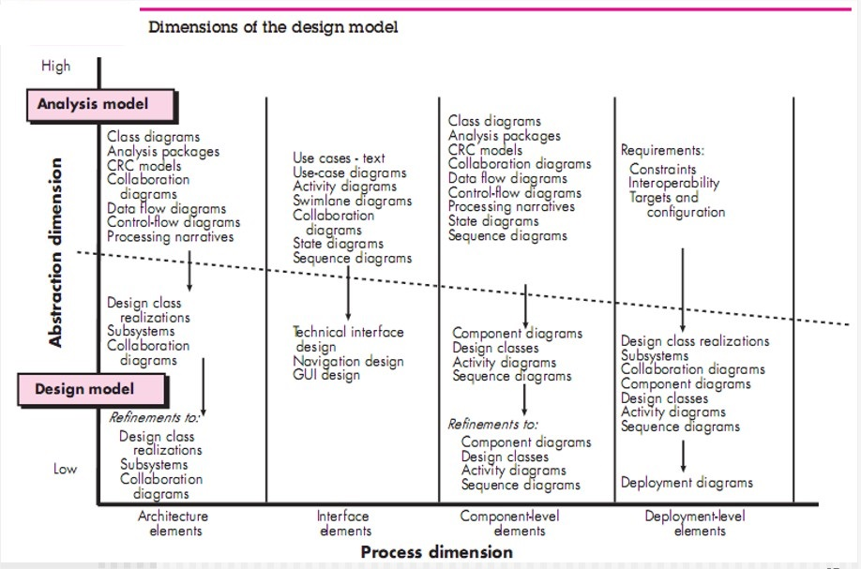

Slide 26
Following are the types of design elements:
1. Data design elements
2. Architectural design elements
3. Interface design elements
4. Component level diagram elements
5. Deployment level design elements

Slide 27
Data design elements:
The data design element produced a model of data that represent a high level of abstraction.
This data model is then refined into progressively more implementation-specific representations that can be processed by the computer-based system.
The structure of data has always been an important part of software design.

Slide 28
Program Component Level: The design of Data structure & algorithms.
Application Level: Translate Data Model into a database.
Business Level: Data warehouse(Reporting & Analysis of DB) & Data mining(Analysis).
At last it means creation of Data Dictionary.

Slide 29
Architectural design elements:
Provides an overall view of the software product(Similar like Floor Plan of house)
The architectural model is derived from three sources:
(1) Information about the application domain for the software to be built;
(2) Specific requirements model elements such as data flow diagrams or analysis classes, their relationships and collaborations for the problem at hand;
(3) The availability of architectural styles and patterns

Slide 30
Difference: An architectural style is a conceptual way of how the system will be created / will work.
An architectural pattern describes a solution for implementing a style at the level of subsystems or modules and their relationships.

Slide 31
Interface design elements
The interface design elements for software represent information flows into and out of the system and how it is communicated among the components defined as part of the architecture.
For example : A set of detailed drawings (and specifications) for the doors, windows, and external utilities of a house. These drawings describe the size and shape of doors and windows, the manner in which they operate, the way in which utility connections (e.g., water, electrical, gas, telephone) come into the house and are distributed among the rooms depicted in the floor plan.

Slide 32
There are 3 important elements of interface design:
1) The user interface(UI);
2) External interfaces to other systems, devices, networks, or other produces or consumers of information; and
3) Internal interfaces between various design components.

Slide 33
These interface design elements allow the software to communicated externally and enable internal communication and collaboration among the components that populate the software architecture.

Slide 34
UI design is a major software engineering action.
The design of a UI incorporates aesthetic elements (e.g., layout, color, graphics, interaction mechanisms), ergonomic elements (e.g., information layout and placement, metaphors, UI navigation), and technical elements (e.g., UI patterns, reusable components). In general, the UI is a unique subsystem within the overall application architecture.
The design of external interfaces requires definitive information about the entity to which information is sent or received. The design of external interfaces should incorporate error checking and appropriated security features

Slide 35
UML defines an interface in the following manner:”an interface is a specifier for the externally- visible operations of a class, component, or other classifier without specification of internal structure

Slide 36
Component- level design elements
The component level design for software is similar to the set of detailed specification of each room in a house.
The component level design for the software completely describes the internal details of the each software component.
The processing of data structure occurs in a component and an interface which allows all the component operations.
In a context of object-oriented software engineering, a component shown in a UML diagram..

Slide 37

The UML diagram is used to represent the processing logic

Slide 38
Deployment level design elements
The deployment level design element shows the software functionality and subsystem that allocated in the physical computing environment which support the software.
Following figure shows three computing environment as shown. These are the personal computer, the CPI server and the Control panel.

Slide 39
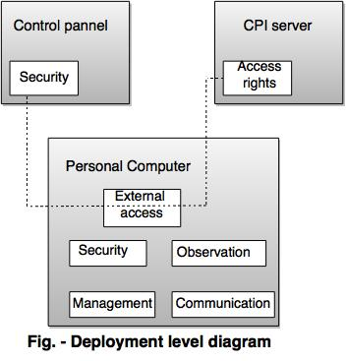

Slide 40
Creating an architecture
Software architecture
Data design
Architectural styles and Patterns
Architectural design
Conceputal model of uml
Basic structural modeling

Slide 41
What is Architecture?
Architectural design represents the structure of data and program components that are required to build a computer-based system. It considers
the architectural style that the system will take,
the structure and properties of the components that constitute the system, and
the interrelationships that occur among all architectural components of a system.

Slide 42
The architecture is a representation that enables a software engineer to
analyze the effectiveness of the design in meeting its stated requirements,
consider architectural alternatives at a stage when making design changes is still relatively easy,
reducing the risks associated with the construction of the software

Slide 43
The design of software architecture considers two levels of the design pyramid
data design
architectural design.
Data design enables us to represent the data component of the architecture.
Architectural design focuses on the representation of the structure of software components, their properties, and interactions.

Slide 44
Why is Architecture Important?
Representations of software architecture are an enabler for communication between allparties (stakeholders) interested in the development of a computer-based system.
The architecture highlights early design decisions that will have a profound impact on all software engineering work that follows and, as important, on the ultimate success of the system as an operational entity.
Architecture “constitutes a relatively small, intellectually graspable model of how thesystem is structured and how its components work together”

Slide 45
Data Design:
The data design activity translates data objects as part of the analysis model into data structures at the software component level and, when necessary, a database architecture at the application level.
At the program component level, the design of data structures and the associated algorithms required to manipulate them is essential to the creation of high-quality applications.
At the application level, the translation of a data model (derived as part of requirements engineering) into a database is pivotal to achieving the business objectives of a system.

Slide 46
At the business level, the collection of information stored in disparate databases and reorganized into a “data warehouse” enables data mining or knowledge discovery that can have an impact on the success of the business itself.

Slide 47
Data design at the Architectural Level:
The challenge for a business has been to extract useful information from this data environment, particularly when the information desired is cross functional.
To solve this challenge, the business IT community has developed data mining techniques, also called knowledge discovery in databases (KDD), that navigate through existing databases in an attempt to extract appropriate business-level information.
.

Slide 48
Data design at the Component Level:
An alternative solution, called a data warehouse, adds an additional layer to the data architecture. a data warehouse is a large, independent database that encompasses some, but not all, of the data that are stored in databases that serve the set of applications required by a business

Slide 49
Data design at the Component Level:
Data design at the component level focuses on the representation of data structures that are directly accessed by one or more software components. The following set of principles for data speciﬁcation:
The systematic analysis principles applied to function and behavior should also be applied todata.
All data structures and the operations to be performed on each should be identiﬁed.
A data dictionary should be established and used to deﬁne both data and program design.
Low-level data design decisions should be deferred until late in the designprocess.

Slide 50
The representation of data structure should be known only to those modules that must make direct use of the data contained within the structure.
A library of useful data structures and the operations that may be applied to them should be developed.
A software design and programming language should support the speciﬁcation and realization of abstract data types.

Slide 51
Architectural styles and patterns:
The builder has used an architectural style as a descriptive mechanism to differentiate the house from other styles (e.g., A-frame, raised ranch, Cape Cod).
The software that is built for computer-based systems also exhibits one of many architectural styles.

Slide 52
Each style describes a system category that encompasses
A set of components (e.g., a database, computational modules) that perform a function required by a system;
A set of connectors that enable “communication, coordinations and cooperation” among components;
Constraints that deﬁne how components can be integrated to form the system; and
Semantic models that enable a designer to understand the overall properties of a system by analyzing the known properties of its constituent parts.

Slide 53
An architectural pattern, like an architectural style, imposes a transformation the design of architecture. However, a pattern differs from a style in a number of fundamental ways:
The scope of a pattern is less broad, focusing on one aspect of the architecture rather thanthe architecture in its entirety.
A pattern imposes a rule on the architecture, describing how the software will handle someaspect of its functionality at the infrastructure level.
Architectural patterns tend to address specific behavioral issues within the context of the architectural

Slide 54
Conceptual model of uml
The Unified Modeling Language (UML) is a standard visual language for describing and modelling software blueprints.
The UML is more than just a graphical language. Stated formally, the UML is for: Visualizing, Specifying, Constructing, and Documenting. The artifacts of a software-intensive system (particularly systems built using the object-oriented style).

Slide 55
why a conceptual model is required?
A conceptual model can be defined as a model which is made of concepts and their relationships.
A conceptual model is the first step before drawing a UML diagram. It helps to understand the entities in the real world and how they interact with each other.

Slide 56
As UML describes the real-time systems, it is very important to make a conceptual model and then proceed gradually. The conceptual model of UML can be mastered by learning the following three major elements −
UML building blocks
Rules to connect the building blocks
Common mechanisms of UML

Slide 57
The building blocks of UML can be defined as
Things
Relationships
Diagrams
Things are the most important building blocks of UML. Things can be −
Structural
Behavioral
Grouping
Annotational

Slide 58
Structural Things
Structural things define the static part of the model. They represent the physical and conceptual elements. Following are the brief descriptions of the structural things.

Slide 59


Class − Class represents a set of objects having similar responsibilities.
Interface − Interface defines a set of operations, which specify the responsibility of a class.

Slide 60


Use case −Use case represents a set of actions performed by a system for a specific goal.
Collaboration −Collaboration defines an interaction between elements.

Slide 61


Component −Component describes the physical part of a system.
Node − A node can be defined as a physical element that exists at run time.

Slide 62

Behavioral Things
A behavioral thing consists of the dynamic parts of UML models. Following are the behavioral things −
Interaction − Interaction is defined as a behavior that consists of a group of messages exchanged among elements to accomplish a specific task.

Slide 63

State machine − State machine is useful when the state of an object in its life cycle is important. It defines the sequence of states an object goes through in response to events. Events are external factors responsible for state change

Slide 64

Grouping Things
Grouping things can be defined as a mechanism to group elements of a UML model together. There is only one grouping thing available −
Package − Package is the only one grouping thing available for gathering structural and behavioral things.

Slide 65

Annotational Things
Annotational things can be defined as a mechanism to capture remarks, descriptions, and comments of UML model elements.
Note - It is the only one Annotational thing available. A note is used to render comments, constraints, etc. of an UML element.

Slide 66

Relationship
Relationship is another most important building block of UML. It shows how the elements are associated with each other and this association describes the functionality of an application.
There are four kinds of relationships available.
Dependency
Dependency is a relationship between two things in which change in one element also affects the other.

Slide 67


Association
Association is basically a set of links that connects the elements of a UML model. It also describes how many objects are taking part in that relationship.
Generalization
Generalization can be defined as a relationship which connects a specialized element with a generalized element. It basically describes the inheritance relationship in the world of objects.

Slide 68

Realization
Realization can be defined as a relationship in which two elements are connected. One element describes some responsibility, which is not implemented and the other one implements them. This relationship exists in case of interfaces.

Slide 69
UML Diagrams
UML diagrams are the ultimate output of the entire discussion. All the elements, relationships are used to make a complete UML diagram and the diagram represents a system.
The visual effect of the UML diagram is the most important part of the entire process. All the other elements are used to make it complete.
UML includes the following nine diagrams, the details of which are described in the subsequent chapters.

Slide 70
class diagram
Object diagram
Use case diagram
Sequence diagram
Collaboration diagram
Activity diagram
Statechart diagram
Deployment diagram
Component diagram

Slide 71
Interaction diagrams are used to represent how one or more objects in the system connect and communicate with each other. Interaction diagrams focus on the dynamic behavior of a system. An interaction diagram provides us the context of an interaction between one or more lifelines in the system.

Slide 72
Purpose of Interaction Diagrams
The purpose of interaction diagrams is to visualize the interactive behavior of the system. Visualizing the interaction is a difficult task. Hence, the solution is to use different types of models to capture the different aspects of the interaction.

Slide 73
The purpose of interaction diagram is −
To capture the dynamic behaviour of a system.
To describe the message flow in the system.
To describe the structural organization of the objects.
To describe the interaction among objects.

Slide 74
Interaction diagrams can be used −
To model the flow of control by time sequence.
To model the flow of control by structural organizations.
For forward engineering.
For reverse engineering.

Slide 75
sequence diagram
A sequence diagram simply depicts interaction between objects in a sequential order i.e. the order in which these interactions take place. We can also use the terms event diagrams or event scenarios to refer to a sequence diagram. Sequence diagrams describe how and in what order the objects in a system function.

Slide 76
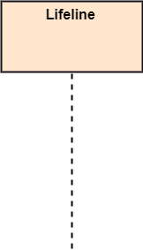
Notations of a Sequence Diagram
Lifeline
An individual participant in the sequence diagram is represented by a lifeline. It is positioned at the top of the diagram.

Slide 77
Actor
A role played by an entity that interacts with the subject is called as an actor. It is out of the scope of the system. It represents the role, which involves human users and external hardware or subjects. An actor may or may not represent a physical entity, but it purely depicts the role of an entity. Several distinct roles can be played by an actor or vice versa.

Slide 78


Slide 79
Activation
It is represented by a thin rectangle on the lifeline. It describes that time period in which an operation is performed by an element, such that the top and the bottom of the rectangle is associated with the initiation and the completion time, each respectively.

Slide 80
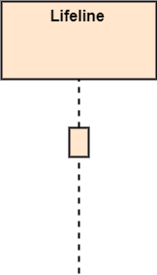

Slide 81
Messages
The messages depict the interaction between the objects and are represented by arrows. They are in the sequential order on the lifeline. The core of the sequence diagram is formed by messages and lifelines.
Following are types of messages enlisted below:

Slide 82
Call Message: It defines a particular communication between the lifelines of an interaction, which represents that the target lifeline has invoked an operation.

Slide 83
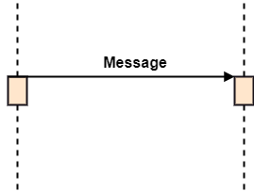

Slide 84
Return Message: It defines a particular communication between the lifelines of interaction that represent the flow of information from the receiver of the corresponding caller message.

Slide 85
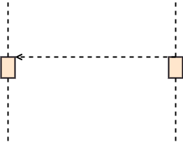

Slide 86
Self Message: It describes a communication, particularly between the lifelines of an interaction that represents a message of the same lifeline, has been invoked.

Slide 87


Slide 88

Recursive Message: A self message sent for recursive purpose is called a recursive message. In other words, it can be said that the recursive message is a special case of the self message as it represents the recursive calls.

Slide 89
Create Message: It describes a communication, particularly between the lifelines of an interaction describing that the target (lifeline) has been instantiated.

Slide 90
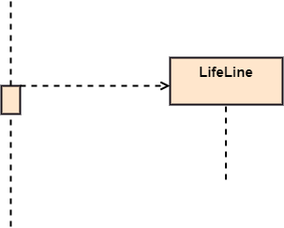

Slide 91
Destroy Message: It describes a communication, particularly between the lifelines of an interaction that depicts a request to destroy the lifecycle of the target.

Slide 92
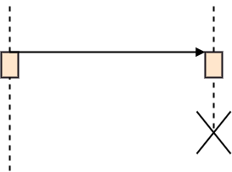

Slide 93
Duration Message: It describes a communication particularly between the lifelines of an interaction, which portrays the time passage of the message while modeling a system.

Slide 94
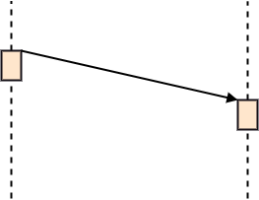

Slide 95
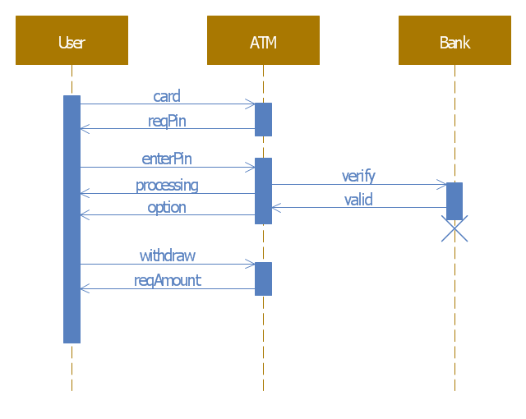
Atm example

Slide 96
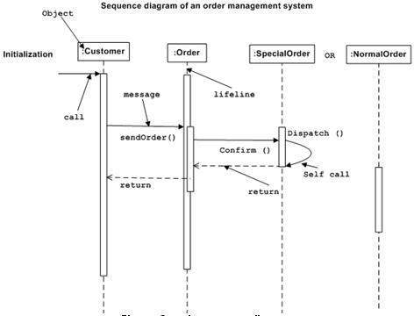

Slide 97
Benefits of a Sequence Diagram
It explores the real-time application.
It depicts the message flow between the different objects.
It has easy maintenance.
It is easy to generate.
Implement both forward and reverse engineering.
It can easily update as per the new change in the system.

Slide 98
Collaboration Diagram
The collaboration diagram is used to show the relationship between the objects in a system. Both the sequence and the collaboration diagrams represent the same information but differently. Instead of showing the flow of messages, it depicts the architecture of the object residing in the system as it is based on object-oriented programming.

Slide 99
Notations of a Collaboration Diagram
Objects: The representation of an object is done by an object symbol with its name and class underlined, separated by a colon. In the collaboration diagram, objects are utilized in the following ways:The object is represented by specifying their name and class.
It is not mandatory for every class to appear.
A class may constitute more than one object.
In the collaboration diagram, firstly, the object is created, and then its class is specified.
To differentiate one object from another object, it is necessary to name them.

Slide 100
Actors: In the collaboration diagram, the actor plays the main role as it invokes the interaction. Each actor has its respective role and name. In this, one actor initiates the use case.
Links: The link is an instance of association, which associates the objects and actors. It portrays a relationship between the objects through which the messages are sent. It is represented by a solid line. The link helps an object to connect with or navigate to another object, such that the message flows are attached to links.

Slide 101
Messages: It is a communication between objects which carries information and includes a sequence number, so that the activity may take place.
It is represented by a labeled arrow, which is placed near a link. The messages are sent from the sender to the receiver, and the direction must be navigable in that particular direction. The receiver must understand the message.

Slide 102
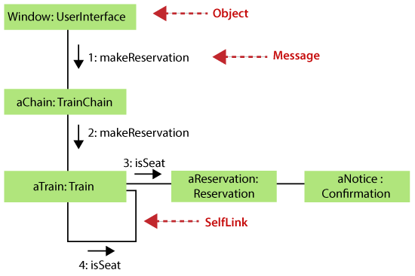
Example of a Collaboration Diagram

Slide 103
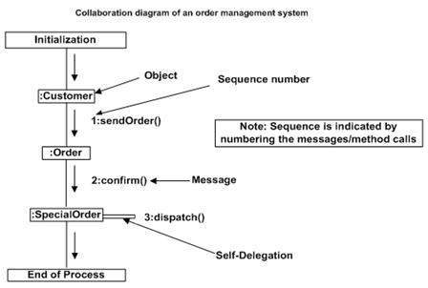

Slide 104
Benefits of a Collaboration Diagram
The collaboration diagram is also known as Communication Diagram.
The syntax of a collaboration diagram is similar to the sequence diagram; just the difference is that the lifeline does not consist of tails.
The messages transmitted over sequencing is represented by numbering each individual message.
Since the collaboration diagrams are not that expensive, the sequence diagram can be directly converted to the collaboration diagram.

Slide 105
component diagram
A component diagram is used to break down a large object-oriented system into the smaller components, so as to make them more manageable.
It models the physical view of a system such as executables, files, libraries, etc. that resides within the node. It visualizes the relationships as well as the organization between the components present in the system.
It helps in forming an executable system. A component is a single unit of the system, which is replaceable and executable. The implementation details of a component are hidden, and it necessitates an interface to execute a function.
It is like a black box whose behavior is explained by the provided and required interfaces.

Slide 106
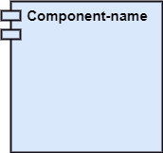
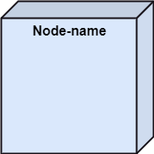
Notation of a Component Diagram
a) A component
b) A node

Slide 107
Interfaces in component diagrams show how components are wired together and interact with each other.
The assembly connector allows linking the component’s required interface (represented with a semi-circle and a solid line) with the provided interface (represented with a circle and solid line) of another component.

Slide 108
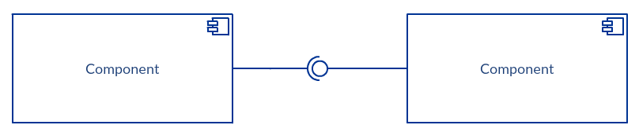

Slide 109
Purpose of a Component Diagram
Since it is a special kind of a UML diagram, it holds distinct purposes.
It describes all the individual components that are used to make the functionalities, but not the functionalities of the system.
It visualizes the physical components inside the system. The components can be a library, packages, files, etc.
The component diagram also describes the static view of a system, which includes the organization of components at a particular instant. The collection of component diagrams represents a whole system.

Slide 110
The main purpose of the component diagram are enlisted below:
It envisions each component of a system.
It constructs the executable by incorporating forward and reverse engineering.
It depicts the relationships and organization of components.

Slide 111
When to use a Component Diagram?
It represents various physical components of a system at runtime. It is helpful in visualizing the structure and the organization of a system.
It describes how individual components can together form a single system. Following are some reasons, which tells when to use component diagram:
To divide a single system into multiple components according to the functionality.
To represent the component organization of the system.

Slide 112
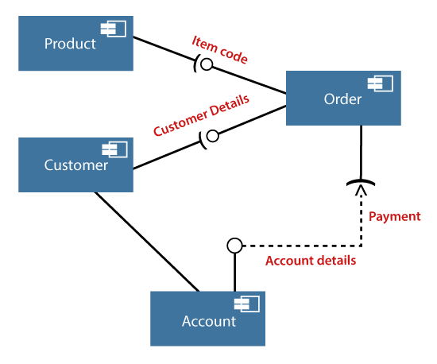
Example of a Component Diagram A component diagram for an online shopping system

