Slide 1

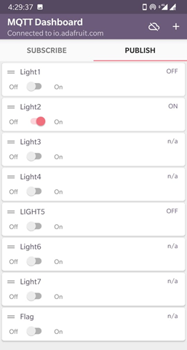
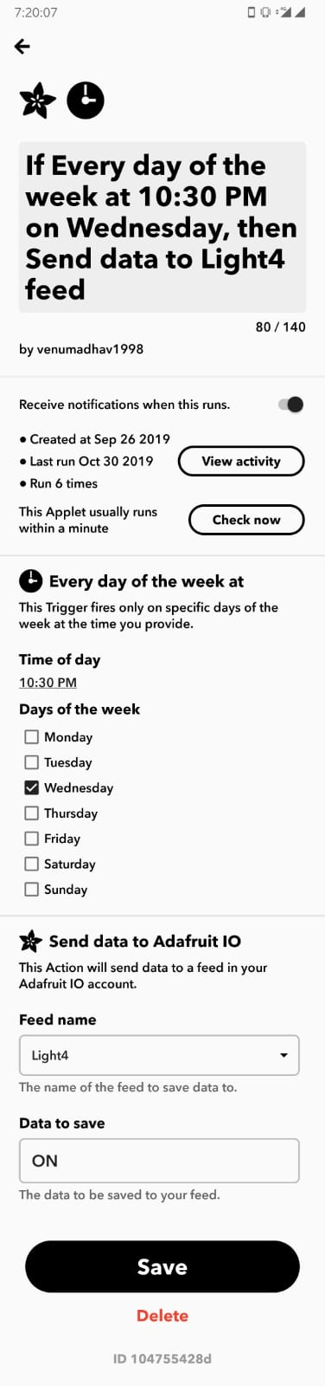
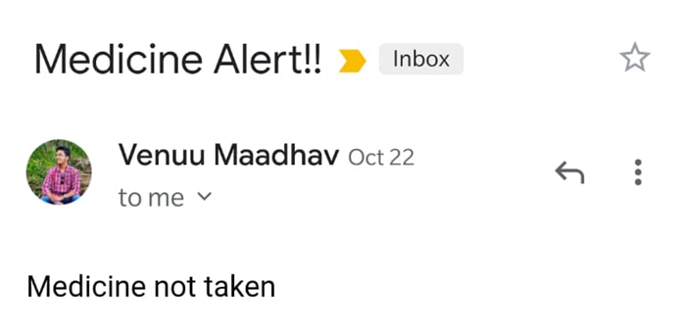
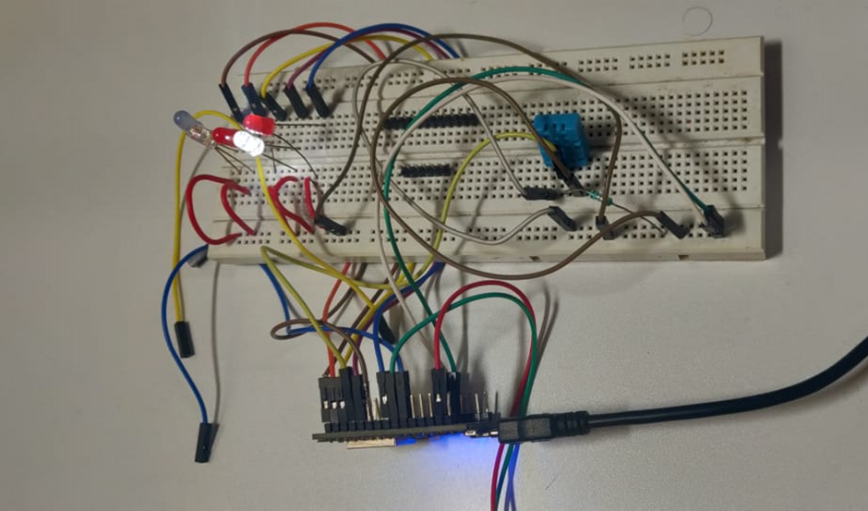
MEDICATION TRACKER
Sai Ganesh, Venuu Maadhav, Rana Simha Reddy, Sriram, Rahul| Vairamuthu S | Scope
Introduction
People suffering from diseases like Alzheimer’s, Huntington’s disease, Corticobasal Degeneration etc. often experience with memory loss and difficulty in remembering things. Such people and old age people often forget to take their regular medication which might affect their physical as well as mental health. A working model with the help of IFTTT and Adafruit Cloud helps patients keep track of their medicine consumption on daily basis and reminds them to take medicines on time and also refill the medicines on weekly basis via an Audio-Visual Stimuli.
MQTT dashboard for the model to control the led lights and alarm manually
Motivation
The main objective of the project is to provide a remedy to Old-age people who forget to take their medicines on-time which might affect their physical and mental health. We will consider Alzheimer’s patients in the process of crafting the solution. In the real world there is no remedy which are focused on the above-mentioned problems and also which might be a hardware solution integrated with IoT.
Scope of the Project
IFTTT dashboard to set alarm periodically and conditionally
Medication Tracker requires Node MCU, DHT11 and other basic electronic equipment like LED’s, buzzers, resistor to build the project. This project uses Adafruit cloud to store the information and IFTTT to communicate with the email services. This project is intended for persons with problems related to memory. Therefore, the limitations of the project are it can’t distinguish between deliberate misuse of machine, and proper use of machine and it can’t be used by other physically disabled persons e.g. blind etc.
Methodology
Message received through email on not taking the medicine
1. First Step, we created a cloud account in Adafruit.io
2. We will be using Adafruit for storing the User Input feed.
3. We have created an applet with IFTTT with the same credentials and also integrate the Arduino code with it.
4. IFTTT will help in determining if the medication is taken or not.
5. In response to that, Adafruit will store that information in the created cloud account.
6. The reminders will send either as email or messages via Mobile application.
7. If necessary, we can attach a GSM module to the device, so that we can generate a SMS message.
Conclusion
In this project we developed a prototype of a medication tracker that can track the usage of medicines by the patients / people and keep their guardians informed of their irregular usage. The project worked fine and was in reach of our expectations. In future we will try to expand the tracker system so that it can be used by other physically challenged persons.
References
[1] J. Benson and N. Britten, “Primary care antihypertensive drugs : qualitative study,” vol. 325, no. October, pp. 1–5, 2002.
[2] C. M. J. Cline, “Non-compliance and knowledge of prescribed medication in elderly patients with heart failure,” pp. 0–4, 1999.
[3] T. L. Hayes, J. M. Hunt, A. Adami, J. A. Kaye, and A. Requirements, “An Electronic Pillbox for Continuous Monitoring of Medication Adherence,” 2006 Int. Conf. IEEE Eng. Med. Biol. Soc., pp. 6400–6403, 2006.
[4] L. Tang et al., “MHS : A Multimedia System for Improving Medication Adherence in Elderly Care,” IEEE Syst. J., vol. 5, no. 4, pp. 506–517, 2011.
[5] D. Demeo and M. Morena, “Medication Adherence Using a Smart Pill Bottle,” 2014 11th Int. Conf. Expo Emerg. Technol. a Smarter World, pp. 1–4, 2014.
[6] C. E. M. Gomes, V. F. L. Jr, S. Member, F. Yazdi, and P. Göhner, “Extending an Intelligent Medicine Cabinet through the Use of Consumer Electronic Devices in order to Increase the Medication Adherence,” pp. 98–102, 2015.
[7] B. Abbey et al., “A Remotely Programmable Smart Pillbox for Enhancing Medication Adherence Department of Occupational Therapy , lili.liu@ualberta.ca,” 2012 25th IEEE Int. Symp. Comput. Med. Syst., pp. 1–4
Results
Project setup with node MCU

