Slide 1
ENTERPRISE SOLUTION ARCHITECTURE
Enterprise Autonomous ITSM Platform
Multi-Agent AI Incident Triage, Vector RAG (ChromaDB 4096-D), SSH ReAct Execution & HITL Control Tower Governance
Client Technical & Executive Architecture Presentation • Production Build v2.5

Slide 2
ENTERPRISE AGENTIC ITSM PLATFORM
Executive Overview & Business Value Proposition
⚡ 85% Auto-Triage Rate
• AI Router Service scans queue every 2 seconds.
• Categorizes P1 Critical to P4 Low tickets automatically.
• Predicts operational assignment groups with ≥ 85% confidence.
• Eliminates L1 helpdesk triage backlog entirely.
🎯 Sub-30s Resolution MTTR
• Dense Vector RAG store with 4096-D embeddings.
• HyDE Dual-Vector Query Normalization matching.
• Quantity Mismatch Guard prevents over-provisioning.
• Dynamic SSH Parallel Worker Pool executes in seconds.
🛡️ Enterprise Governance
• Agent Control Tower HITL Dashboard (:5173).
• Real-time approval cards for AI-synthesized SOPs.
• Single-instance host execution locks prevent race conditions.
• 100% full execution proof work notes & audit logs.

Slide 3
ENTERPRISE AGENTIC ITSM PLATFORM
End-to-End Multi-Agent System Architecture
1. API & Queue
• NestJS REST API (:4000)
• PostgreSQL 15 DB
• 1,079 Pre-Seeded Tickets
• Prisma ORM Layer
2. AI Router
• scanAndRouteQueue()
• Priority Classifier
• Confidence Evaluator
• Auto-Assign IN_PROGRESS
3. Vector RAG
• ChromaDB 4096-D Store
• Dual Query Normalizer
• Quantity Mismatch Guard
• 0.65 Score Threshold
4. HITL Tower
• Control Tower (:5173)
• Live Approval Cards
• RAG Miss Self-Synthesis
• Human Approval Gate
5. SSH Execution
• Paramiko Async Pool
• Target OS Probe
• Physical HTTP Probe
• State = RESOLVED

Slide 4
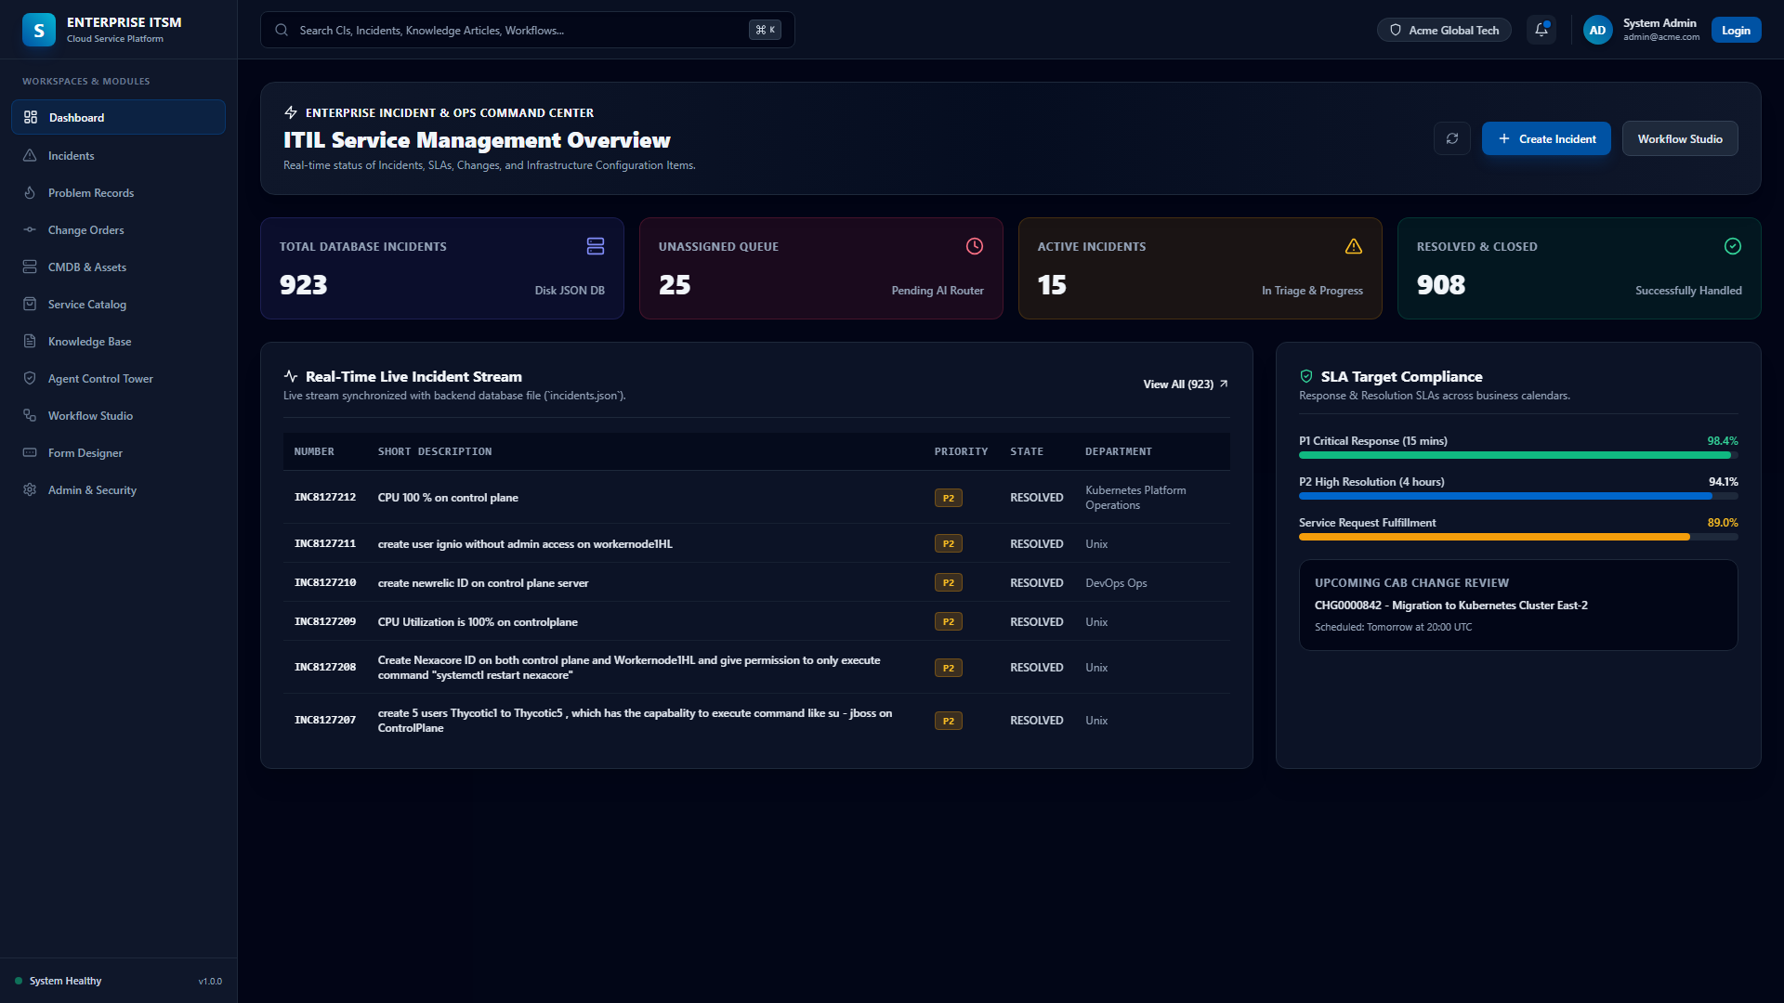
ENTERPRISE AGENTIC ITSM PLATFORM
Helpdesk Portal & Incidents Console (Next.js :3000)
UI Capabilities
• Live Incident Stream (1,079 Incidents).
• Real-time ticket lifecycle (NEW → IN_PROGRESS → RESOLVED).
• Priority matrix visualization (P1 Critical to P4 Low).
• Instant REST API sync with NestJS backend.

Slide 5
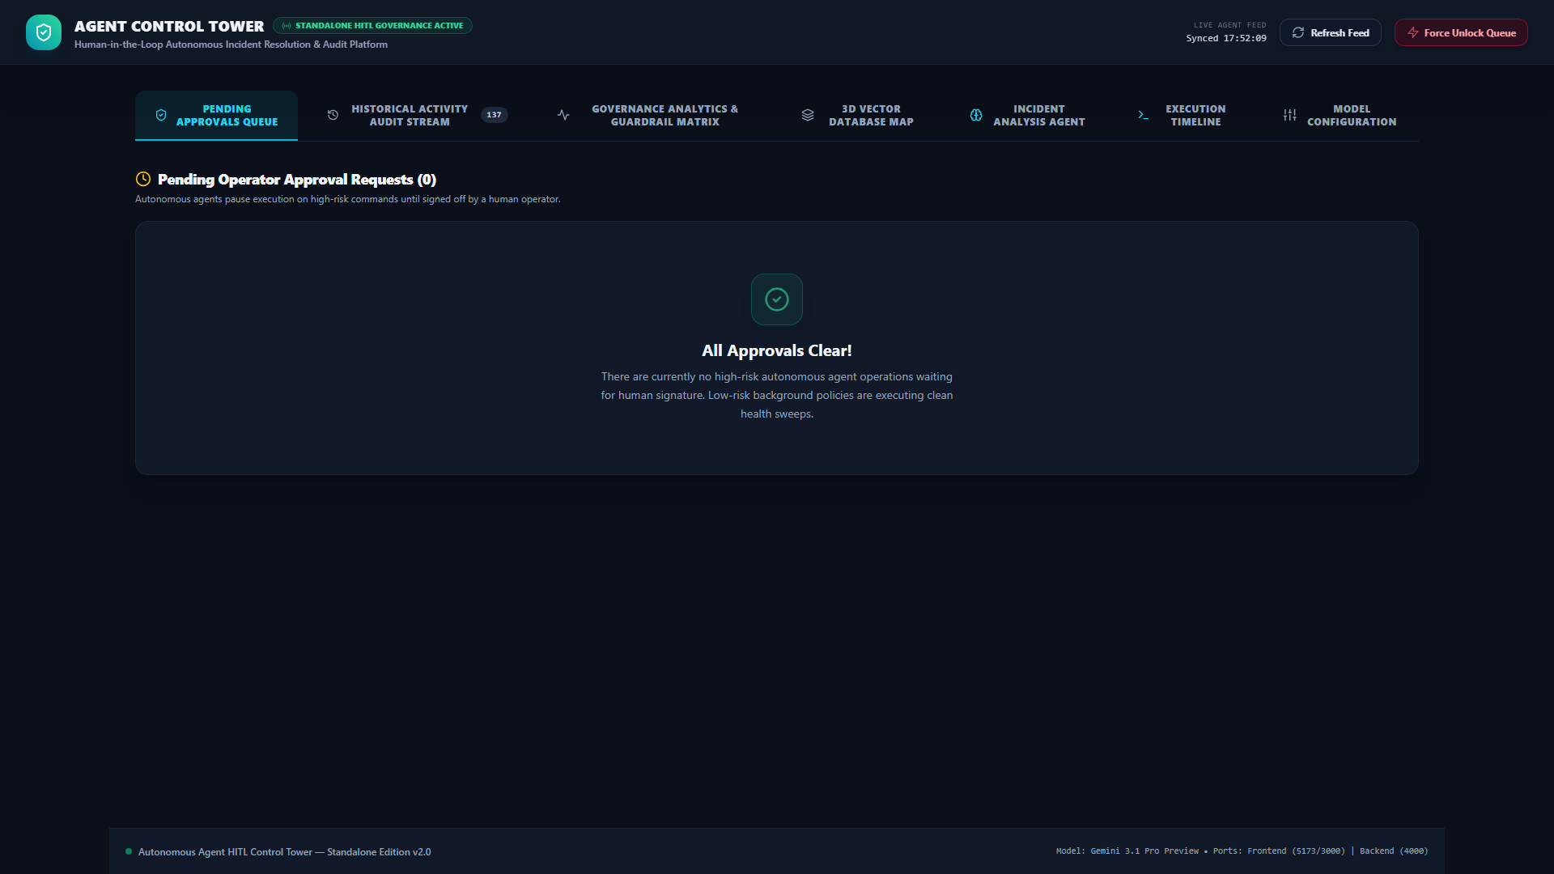
ENTERPRISE AGENTIC ITSM PLATFORM
Agent Control Tower & HITL Governance (:5173)
Control Tower Features
• Human-in-the-Loop approval cards.
• RAG Miss Self-Synthesis Preview.
• Confidence score metrics & thresholding.
• 100% audit log traceability.

Slide 6
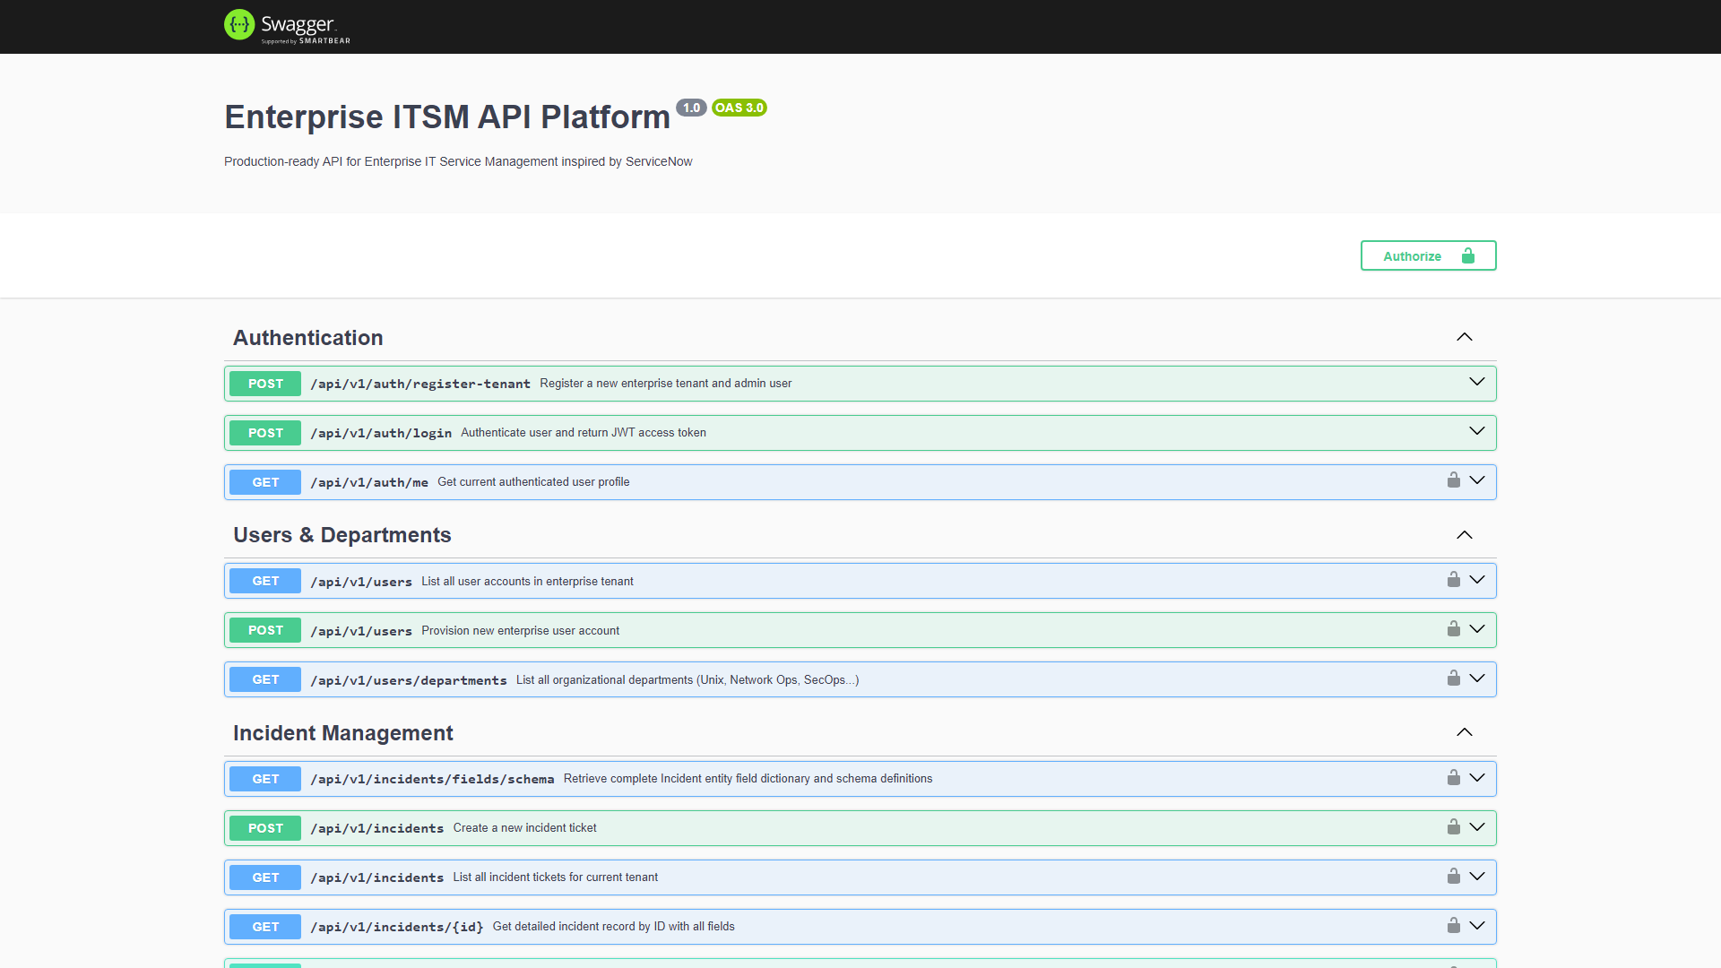
ENTERPRISE AGENTIC ITSM PLATFORM
Enterprise REST API & Swagger Documentation (:4000)
API Architecture
• NestJS Modular REST Architecture.
• Swagger OpenAPI Specification.
• Prisma ORM for PostgreSQL 15.
• MCP (Model Context Protocol) ready.

Slide 7
ENTERPRISE AGENTIC ITSM PLATFORM
Proven Enterprise Operational Use Cases
1. Unprivileged User Creation (KB0000037)
• Idempotent user creation (`useradd -m -s /bin/bash`).
• Sets user password via `chpasswd` non-interactively.
• Zero sudo privileges delegated — 100% security safe.
2. Restricted Sudoers Delegation (KB0000036)
• Provisions user accounts with SSH keys.
• Locks `/etc/sudoers.d/99-<user>` to `NOPASSWD: su - jboss`.
• Validates syntax via `visudo -c` before applying.
3. Containerized IBM DB2 Setup (KB0000033)
• Executes container commands (`podman exec db2server`).
• Grants database `CONNECT` & schema privileges.
• Configures CloudBeaver UI web access.
4. Outage Recovery & Probing (KB0000003)
• Remediates blocked ports / crashed services.
• Executes `systemctl restart Nexacore`.
• Runs physical HTTP probes against `http://<ip>:8080`.

Slide 8
ENTERPRISE AGENTIC ITSM PLATFORM
Enterprise Safety & Guardrail Architecture
🛡️ Quantity Mismatch Guard
• Detects single-user requests matching bulk 20-user SOPs.
• Automatically omits bulk SOPs (`KB0000046`).
• Inspects next-best candidate SOP to prevent over-provisioning.
🔒 Offboarding Safety Guard
• Detects user deprovisioning & deletion intents.
• Enforces mandatory Human-in-the-Loop signoff.
• Prevents accidental account deletion.
🔑 Host Execution Locks
• Acquires thread locks per target host IP (`192.168.100.101`).
• Prevents concurrent SSH race conditions.
• Ensures linear execution integrity.
💾 Database Integrity Directive
• Preserves all existing PostgreSQL DB state & 1,079 tickets.
• Zero destructive seeds or table wipes during rebuilds.
• Full audit log history maintained.

Slide 9
FUTURE VISION & INNOVATION ROADMAP
Strategic Roadmap & Future Enhancements
☁️ Multi-Cloud Connectors
• AWS Systems Manager (SSM) integration.
• Azure Automation Runbooks connector.
• GCP Cloud Functions agent execution.
📈 Predictive SLA Analytics
• ML anomaly detection before tickets are filed.
• Predictive MTTR threshold alerts.
• Proactive server load balancing.
💬 Omnichannel Interfaces
• Microsoft Teams helpdesk bot.
• Slack Enterprise Grid Integration.
• Voice AI Helpdesk call resolution.
🔄 Self-Healing CI/CD Pipelines
• Automated Kubernetes pod crash loop backoff recovery.
• Autonomous Root Cause Analysis (RCA) report generation.
• Self-updating GitOps deployment manifests.
🔐 Zero-Trust Identity Integration
• Okta & Entra ID (Azure AD) automated SCIM sync.
• CyberArk Privileged Access Management (PAM) vault integration.
• Just-In-Time (JIT) temporary admin access delegation.

