Slide 1
MULTI-AGENT AI ENGINE · NVIDIA NIM LLMs
Autonomous ITSM &
Agentic SRE
Control Tower
From ticket to verified fix — without a human touching a
terminal, unless the platform asks first.
Autonomous triage · Hybrid RAG · Dynamic ReAct remediation
Human-in-the-loop governance
Notes:
Good morning, and thank you for being here. What you're looking at is the Autonomous ITSM and Agentic SRE Control Tower — a platform built to take an incident all the way from the moment a ticket is created to a verified fix, without a human ever needing to open a terminal, unless the platform itself decides it needs a human's judgment first. Under the hood this runs on a multi-agent AI engine powered by NVIDIA NIM large language models, and over the next twenty minutes or so I'm going to walk you through exactly how it works: how it triages a ticket on its own, how it grounds every decision in real historical evidence through hybrid retrieval, how it actually executes a fix live over SSH and proves that fix worked, and how a human stays firmly in the loop for anything the system hasn't seen before. This is not a mockup or a slide-deck concept. Everything I'm about to show you is a live capture from a running system.

Slide 2
PART 01 · THE OPPORTUNITY
P02 / 20
Manual ITSM Doesn’t Scale
Every minute unassigned or half-diagnosed is cost, risk,
and burnout for the team.
Tickets queue unassigned — triaged by memory, not process
Diagnosis depends on the on-call engineer finding the runbook
Every fix is a manual SSH session with no proof it worked
Incident knowledge rarely reaches a reusable playbook
Notes:
Let's start with why this needed to exist. Most people think of ITSM as just a ticketing tool, a place to log a complaint and assign it to someone. But if you've ever been on call, you know the real pain is everything that happens after the ticket lands. Tickets sit unassigned while engineers essentially triage by memory and tribal knowledge, because there's no consistent process forcing a decision. Diagnosis and remediation depend entirely on whoever happens to be on call finding the right runbook fast enough — and if that person is new, or the runbook is buried somewhere, resolution just stalls. Every fix ends up being a manual SSH session, typed by hand, with no consistent proof afterward that it actually worked — you just sort of trust it did. And worst of all, whatever that engineer learned in the process almost never makes it back into a reusable, searchable playbook, so the next person hits the exact same wall. Every minute a ticket sits like this is cost, risk, and a slowly burning-out team. That's the gap we're closing.

Slide 3
PART 01 · THE OPPORTUNITY
P03 / 20
One Platform, Four Pillars
Autonomous triage, hybrid RAG, ReAct remediation, and human governance close one loop.
1
2
3
4
Autonomous
Triage
Hybrid RAG
Dynamic ReAct
Remediation
Human-in-the-
Loop Governance
4096-D dense vectors +
BM25 lexical, fused by
Reciprocal Rank Fusion
Precedent routing over
1,187+ past incidents
at >95% confidence
44 master SOPs run
Every novel action is
approved or rejected
by an operator
live over SSH with
in-guest proof
Powered by NVIDIA NIM — Nemotron 3.5 Lightning · Llama 3.3 70B · DeepSeek R1
Notes:
So here's the shape of the answer, and these four pillars are going to recur through the rest of the talk, so keep them in mind. First, autonomous triage: the platform routes tickets by grounding its decision in precedent — over eleven hundred and eighty-seven past incidents and two hundred eighteen prior SRE execution logs — at better than ninety-five percent confidence when it acts. Second, hybrid RAG: that's retrieval-augmented generation, but combining two different search techniques — four-thousand-ninety-six dimensional dense vectors stored in ChromaDB, fused with old-school BM25 lexical keyword search, combined through something called Reciprocal Rank Fusion. Third, dynamic ReAct remediation — forty-four parameterized master standard operating procedures that get executed live over SSH, with proof captured directly from the target machine. And fourth, human-in-the-loop governance: any action the system hasn't seen a close precedent for gets proposed to a human, who has to approve or reject it before anything touches production. All of this runs on NVIDIA NIM — Nemotron 3.5 Lightning for fast classification, Llama 3.3 70B and DeepSeek R1 for deeper reasoning. Let's go tier by tier.

Slide 4
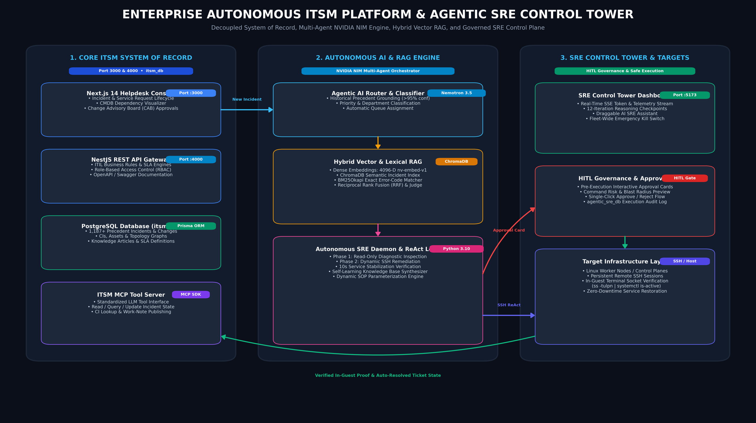
PART 02 · HOW IT’S BUILT
P04 / 20
Five tiers, one closed loop — the complete container-level map, every port and data flow.
Notes:
This is the actual system architecture, a C4-style container diagram straight from the engineering documentation. Five tiers, strictly decoupled from each other, but forming one continuous loop. At the top, presentation: the Next.js Helpdesk running on port 3000 for end users, and the SRE Control Tower on port 5173 — that's a React and Vite application streaming live updates over server-sent events, which is the dashboard I'll be showing you for most of this talk. Below that, the services tier: a NestJS REST API on port 4000, an ITSM MCP server that exposes the platform's tools using the Model Context Protocol, and a Python SRE daemon that polls for new work every fifteen seconds. Then the AI and RAG tier, where NVIDIA NIM inference and the hybrid retrieval engine actually live. Persistence is deliberately split into two separate PostgreSQL databases — itsm_db, which is the system of record for tickets, and agentic_sre_db, which is a completely separate governance database for every autonomous action, so the audit trail can never be quietly edited alongside the ticket data. And at the bottom, the actual target infrastructure — Linux and Kubernetes worker nodes and enterprise configuration items, reached over SSH. Now let's look at the cockpit that ties all of this together.

Slide 5
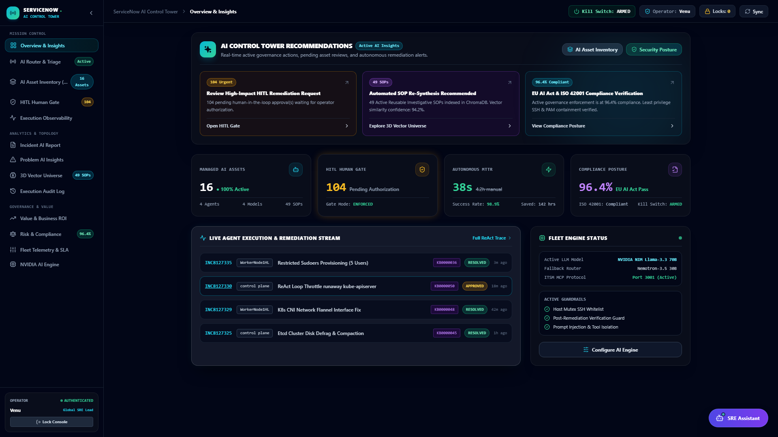
PART 02 · HOW IT’S BUILT
P05 / 20
The Agent Control Tower
One dashboard, real-time command of every autonomous asset.
MISSION CONTROL VIEW
Live Execution Stream
Per-incident resolution status,
updated in real time
Managed AI Assets
Active LLM model and fallback
router at a glance
Emergency Kill Switch
Fleet-wide, armed and one
click from stopping every session
MTTR vs. Baseline
Autonomous MTTR compared
directly against manual resolution
SRE Control Tower — live capture
Notes:
This is the Agent Control Tower — the live mission-control view an operator actually watches. On the left you can see the four things it aggregates into one screen: a live execution and remediation stream showing per-incident resolution status as it happens; the managed AI assets, meaning which LLM model is currently active and what the fallback router looks like if that model becomes unavailable; a fleet-wide emergency kill switch that's always armed and one click away from stopping every active session, which we'll talk more about when we get to safety; and a direct comparison of autonomous mean-time-to-repair against the old manual baseline. On the right is an actual live capture of that dashboard. The whole design philosophy here is that an operator should never have to go dig through logs to understand what the platform is doing right now — it's all surfaced at a glance, the same way a real network operations center works.

Slide 6
PART 03 · THE PLATFORM IN ACTION
P06 / 20
From Ticket to Verified Fix
Every incident moves through the same five governed phases.
Ticket Created
AI Router Assigns
Daemon Polls RAG
Execute or Escalate
Verified & Indexed
NEW · UNASSIGNED
≥85% confidence
every 15 seconds
SOP run, or approval
proof before RESOLVED
A RAG hit runs the parameterized SOP directly; a RAG miss opens a
PENDING approval card instead of guessing.
Notes:
Now let's walk through the exact path an incident takes, because every single ticket — whether it resolves in three seconds or waits two hours for a human decision — goes through the same five governed phases. First, a ticket is created, in state NEW, with group UNASSIGNED. Second, the AI router grounds its routing decision in historical precedent and assigns a group and priority, but only auto-assigns at eighty-five percent confidence or higher — below that, it deliberately leaves the ticket for a human rather than guess. Third, the SRE daemon polls every fifteen seconds and runs a hybrid RAG search looking for a matching master SOP. Fourth is where it branches: a RAG hit means direct parameterized execution over SSH, but a RAG miss triggers a read-only diagnosis, a synthesized SOP proposal, and a PENDING approval card for a human to review — never a blind attempt. And fifth, before anything is marked resolved, in-guest terminal proof verifies the fix actually worked, and that trace gets indexed so the next similar incident is even faster. That's the whole loop — now let's look at each piece in more depth, starting with the system underneath it.

Slide 7
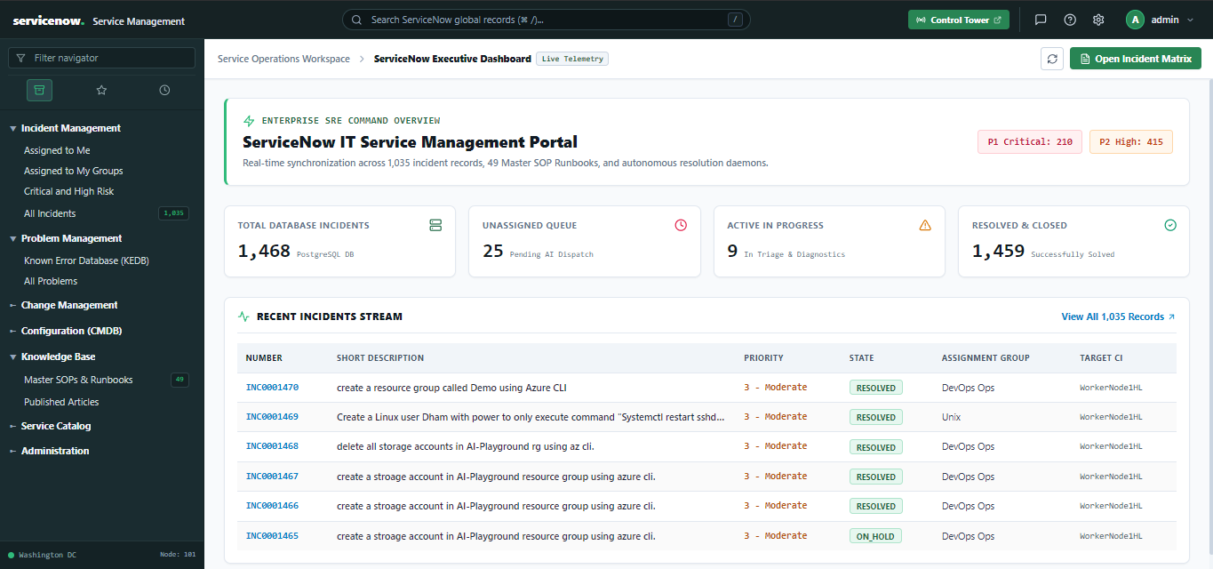
PART 03 · THE PLATFORM IN ACTION
P07 / 20
The Core Helpdesk Console
A full Next.js ITIL service-management portal underneath the autonomy.
Core Helpdesk — ITIL incident dashboard
Live Incident Stream
Impact × Urgency
SLA Compliance
CMDB & Knowledge
Priority, state, department
at a glance
ITIL matrix drives P1–P4
priority automatically
Target compliance tracked
per priority tier, live
Assets, service catalog,
workflow studio, one place
Notes:
Before the autonomy, there's a real system of record underneath it, and this is it — the Core Helpdesk Console, a full Next.js ITIL service-management portal. This is where end users and admins actually work day to day. It gives you a live-synchronized incident stream with priority, state, and department visible at a glance. Priority itself isn't guessed — it's driven automatically by an ITIL Impact-by-Urgency matrix that resolves to a P1 through P4 classification. SLA target compliance is tracked per priority tier in real time, so nothing quietly breaches without anyone noticing. And beyond incidents, this same console houses the CMDB and asset inventory, the service catalog, the knowledge base, and a workflow studio — so the autonomous layer we've been talking about isn't bolted onto a toy ticket queue, it's sitting on top of a genuinely complete ITSM platform.

Slide 8
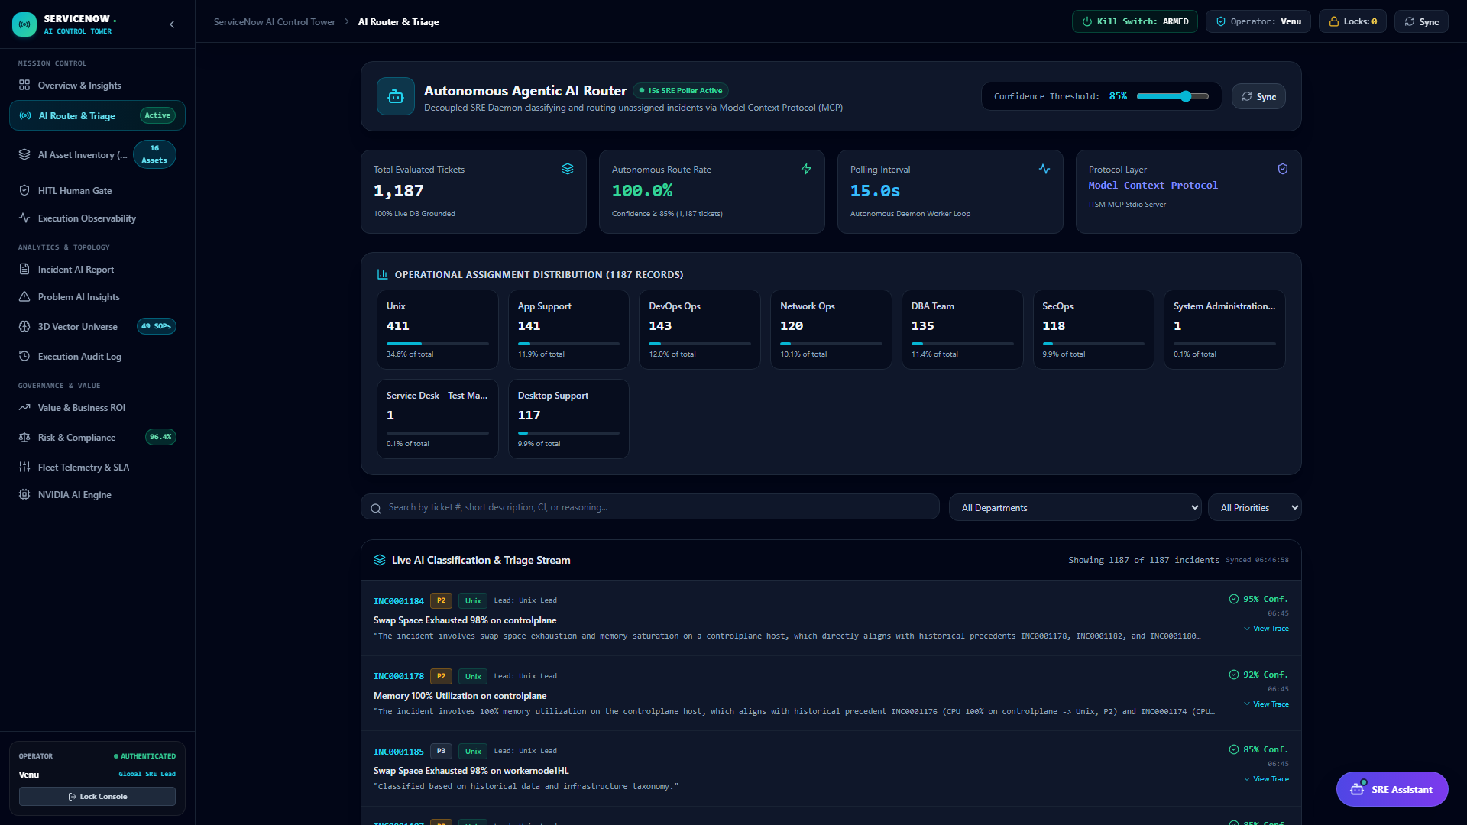
PART 03 · THE PLATFORM IN ACTION
P08 / 20
Precedent-Grounded Triage
Sub-second search across real precedent, not a static rules table.
1,187+ Precedents
+ 218 SRE execution logs
Routing Decision
Nemotron 3.5 Lightning
At ≥85%, auto-assigns
and moves to IN_PROGRESS
Below threshold stays
UNASSIGNED — never a guess
Continuous background scan,
no manual trigger required
Autonomous AI Router — live capture
Notes:
This is where autonomy actually begins — the moment a new ticket gets assigned without anyone touching it. What you're seeing on the right is the live triage screen. The mechanism on the left is the important part: every new ticket gets matched against that pool of over eleven hundred historical incidents and two hundred eighteen SRE execution logs before any routing decision is made. NVIDIA's Nemotron 3.5 Lightning model classifies priority and department from that precedent context — it's grounded reasoning, not a static if-this-then-that rules table. If confidence comes back at eighty-five percent or above, the ticket auto-assigns and immediately moves to IN_PROGRESS. If it's below that threshold, the ticket deliberately stays UNASSIGNED for a human to triage — the system would rather admit uncertainty than make a silent guess. And this isn't triggered manually — there's a continuous background scan of the unassigned queue, so routing is happening constantly in the background.

Slide 9
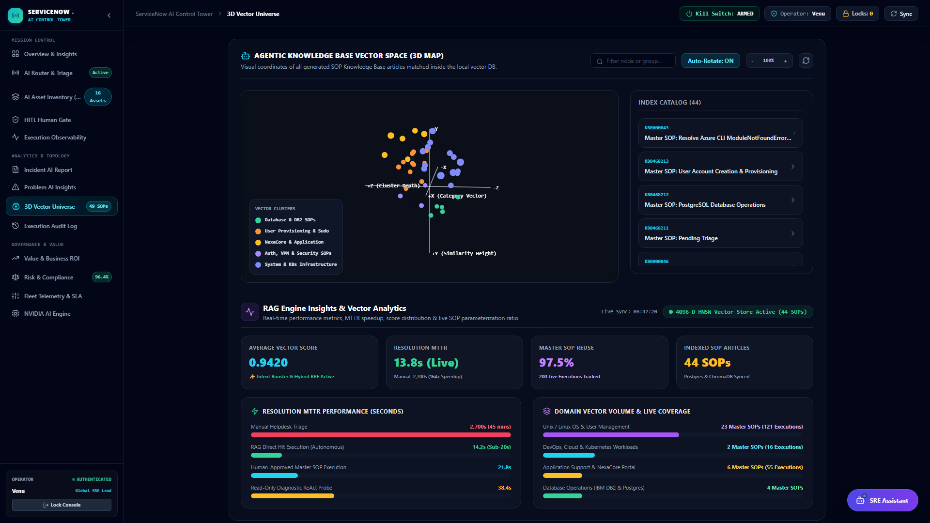
PART 03 · THE PLATFORM IN ACTION
P09 / 20
Hybrid Dense + Lexical Retrieval
Finds the right SOP even when wording never matches exactly.
Dense
RRF
Lexical
4096-D
fused rank
BM25
nv-embed-v1 in
ChromaDB, 4096 dims
BM25Okapi keyword
search, parallel to dense
LLM RAG Judge verifies
the top match before use
3D vector universe — live capture
Notes:
Once a ticket is routed, the next question is: does the platform actually know how to fix this? That's where hybrid retrieval comes in, and this is genuinely one of the more interesting engineering decisions in the system. On the left you can see the two search methods it fuses rather than choosing between. Dense semantic search uses NVIDIA's nv-embed-v1 model to build four-thousand-ninety-six dimensional embeddings, indexed in ChromaDB — that catches things that mean the same thing even when the wording is completely different. Lexical search, running in parallel, uses BM25Okapi, the classic keyword-precision algorithm — that catches exact terms dense search sometimes misses. Reciprocal Rank Fusion merges both ranked lists into one candidate list. And critically, an LLM acting as a RAG Judge then verifies that top match before the system trusts it enough to act on it — so even the retrieval step has a sanity check built in. On the right is the actual three-dimensional vector universe visualization from the live product. The reason this matters: it's the difference between finding the right fix because the wording happens to match, and finding the right fix because the system actually understands what's being asked.

Slide 10
PART 03 · THE PLATFORM IN ACTION
P10 / 20
Diagnose. Remediate. Prove It.
A live SSH ReAct loop — remediation is never trusted on faith.
STEP 1
STEP 2
STEP 3
Diagnose
Remediate
Verify
Read-only telemetry:
systemctl, ps, ss, journalctl
Parameterized SOP over SSH,
10-second stabilization pauses
The Proof-of-Fix Guard checks
real in-guest stdout/stderr
Notes:
So the platform knows what to do — now how does it actually do it safely? This is the ReAct execution loop, and it's built around a simple principle: nothing gets trusted on faith. Stage one is diagnosis — a strictly read-only loop that gathers live telemetry using commands like systemctl, ps, ss, and journalctl, before anything is changed. Stage two is remediation — the platform executes the matched, parameterized SOP's commands live over SSH, with automatic ten-second stabilization pauses built in between steps so it isn't racing ahead of a system that's still settling. And stage three is verification — a domain-aware Proof-of-Fix Guard that checks for the actual expected outcome. For example, if the fix was supposed to create a user account, it will run something like id and the username to confirm it exists; if it was supposed to open a port, it checks with something like ss dash tulpn. These traces are captured directly from real in-guest standard output and error streams — this isn't an external ping or health check assuming success, it's direct evidence from inside the machine itself.

Slide 11
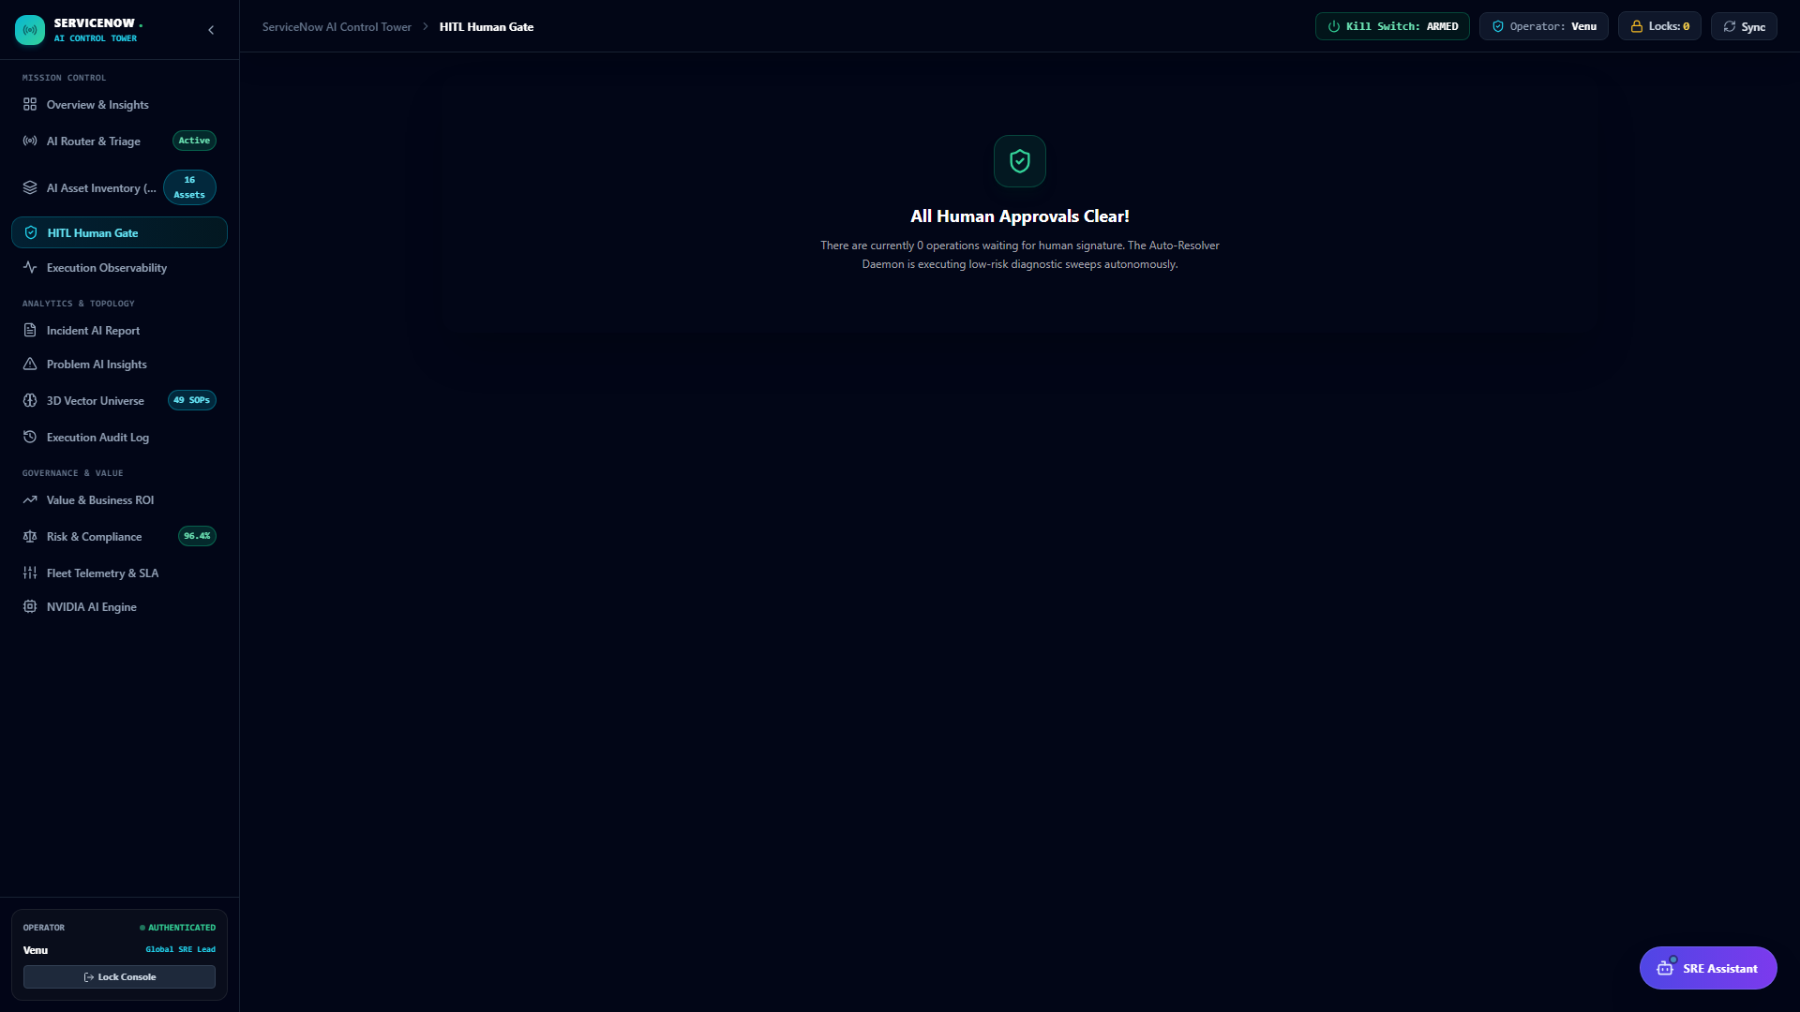
PART 04 · TRUST & GOVERNANCE
P11 / 20
Every Novel Action Waits
No matching precedent: the platform proposes a plan, then stops.
PENDING approval card
SOP + diagnostic evidence
Approve
Reject
→ execution runs
→ ticket locked
Ticket moves to ON_HOLD
until an operator decides
Same flow mirrored to
Slack for on-the-go operators
Approval queue — live capture
Notes:
Now, everything so far has been about what the platform can do on its own — this slide is about what it deliberately does not do on its own. When there's no matching precedent, the platform doesn't guess and it doesn't refuse to help either — it synthesizes a proposed SOP, attaches the diagnostic evidence it gathered, and raises a PENDING approval card, exactly like what you see in this live capture. The ticket itself moves to ON_HOLD until a human operator makes a call. From there it's a clean binary: Approve authorizes execution and the platform proceeds with the plan; Reject locks the ticket and escalates it, full stop. And this approval flow isn't locked inside one dashboard — it's mirrored into Slack, so an operator away from their desk can review and decide from their phone. This is really the heart of why this platform is trustworthy rather than just impressive: the moment it's in genuinely novel territory, a human decides.

Slide 12
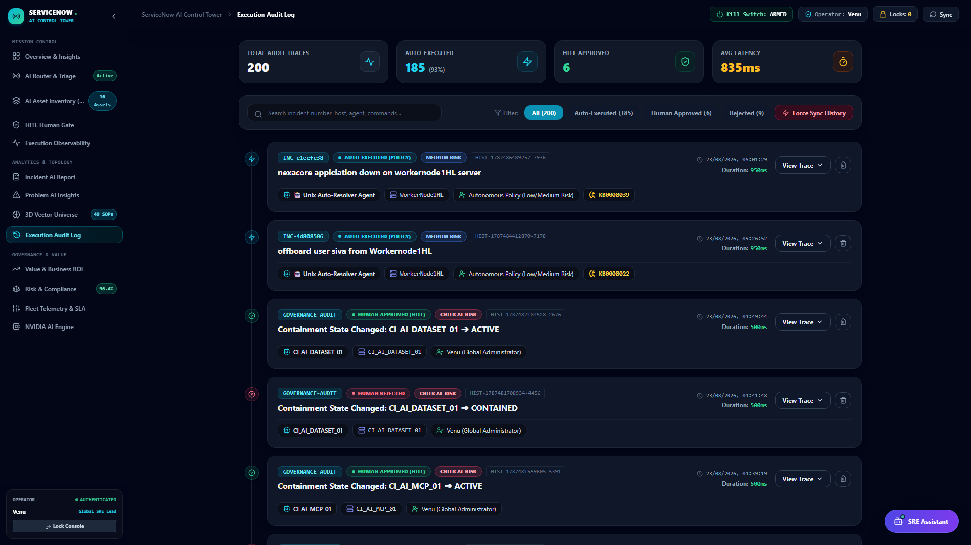
PART 04 · TRUST & GOVERNANCE
P12 / 20
Nothing Executes Off the Record
Every autonomous action is a full, inspectable execution trace.
TRUST GUARANTEES
Complete Trace
Stored separately from the
core ticket system of record
Linked Timeline
Diagnosis, approval, execution,
and verification, connected
Feeds Precedent
Historical traces ground
future triage decisions
Isolated by Design
DB agentic_sre_db stays
architecturally apart
Execution & audit history — live capture
Notes:
Trust also depends on nothing being able to quietly disappear, and that's what this slide is about. Every autonomous action the platform takes — whether it ran automatically or only after a human approved it — gets written as a complete, inspectable execution trace into a dedicated governance database. That's genuinely separate infrastructure from the core ticket system; remember from the architecture slide, agentic_sre_db is architecturally isolated from itsm_db, so there's no way to edit a ticket's history and have the execution record quietly follow along. Each incident's timeline links diagnosis, approval, execution, and verification together into one connected story, which is what you're seeing in this live capture. And these historical traces aren't just an archive — they feed directly back into precedent grounding, meaning every resolved incident makes the next triage and retrieval decision a little sharper.

Slide 13
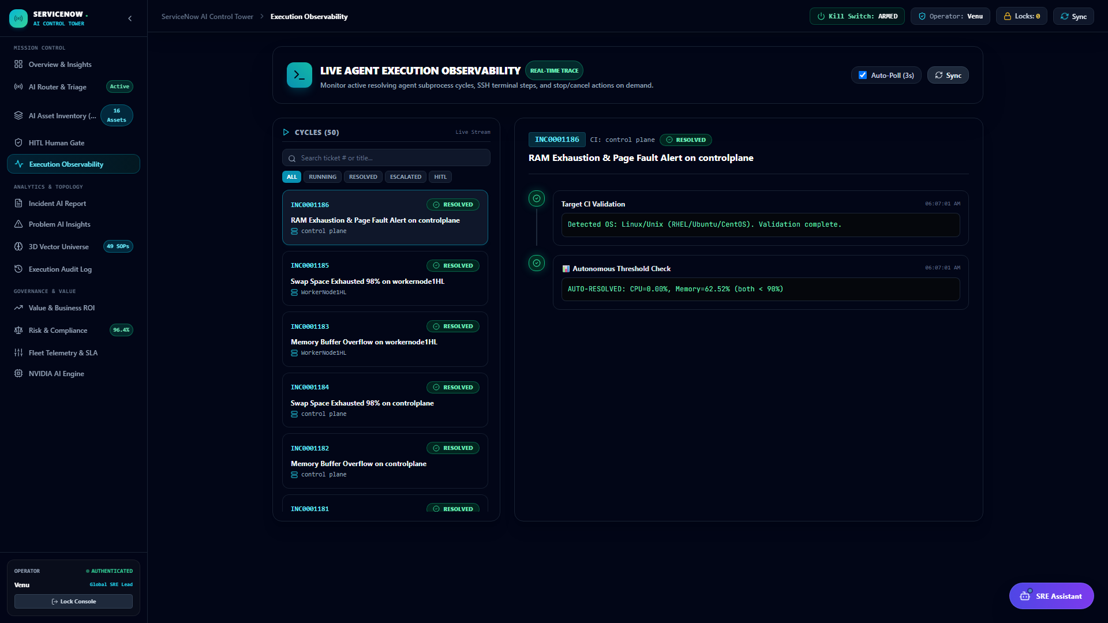
PART 04 · TRUST & GOVERNANCE
P13 / 20
Fleet-Wide Telemetry, Live
SLA compliance and remediation pace, watched in real time.
SLA & TELEMETRY
Live Timeline
Every active and recent SRE
execution across the fleet
SLA Tracking
Response-time tracking at
the mission-control layer
Asset & Host-Lock
State visible per target CI,
not buried in raw logs
Obvious Next Action
Designed so operators
always know what’s next
Fleet timeline — live capture
Notes:
Zoom out from a single incident and you get this — fleet-wide telemetry, live, at the same mission-control layer as execution itself, not buried in a log file you have to go dig through after the fact. This screen shows a live timeline of every active and recent SRE execution across the entire managed fleet, SLA and response-time tracking sitting right alongside that execution data, and managed-asset and host-lock state visible per target configuration item, so an operator instantly knows if a machine is currently being worked on by the platform. The whole design intent here is that an operator's next action should always be obvious — you shouldn't have to reconstruct what's happening from scattered logs, it should just be visible.

Slide 14
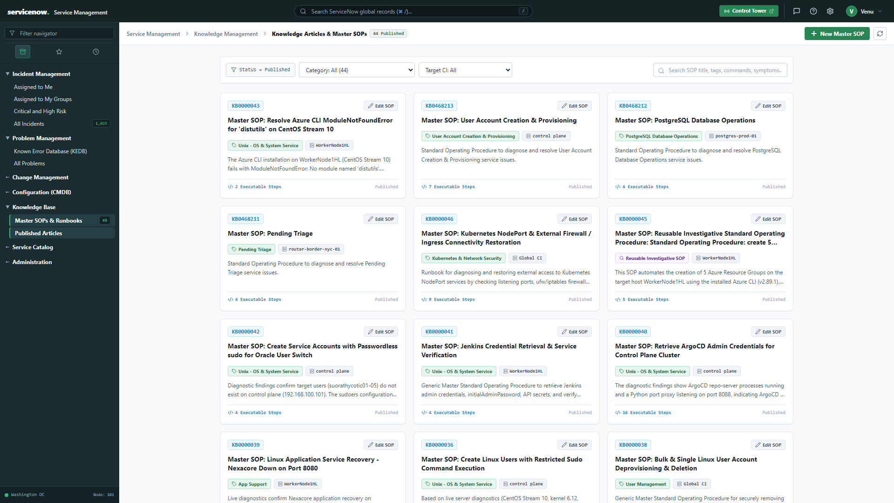
PART 04 · TRUST & GOVERNANCE
P14 / 20
Every Fix Teaches the Next One
Zero-touch resolution compounds over time.
SYNTHESIS LOOP
Verified Fix
Synthesized as Master SOP
Indexed in ChromaDB
Next matching incident
becomes an automatic RAG hit
Built from real, verified
fixes — never guesses
Knowledge base — live capture
Notes:
Here's what makes this platform compound in value over time instead of staying static. When the platform hits a RAG miss, gets human approval, and successfully resolves something novel, that fix doesn't just disappear once the ticket closes. It gets synthesized into a new master SOP blueprint automatically, and that new SOP is immediately indexed into ChromaDB, ready for hybrid RAG matching on the next similar incident. So today's genuinely novel incident — the kind that needed a human to approve a synthesized plan — becomes tomorrow's automatic RAG hit, resolved with no human touch at all. And importantly, this isn't hand-written documentation somebody has to remember to update — the knowledge base grows exclusively from real, in-guest-verified fixes. What you're seeing on the right is the actual live knowledge base and SOP synthesizer screen where that happens.

Slide 15
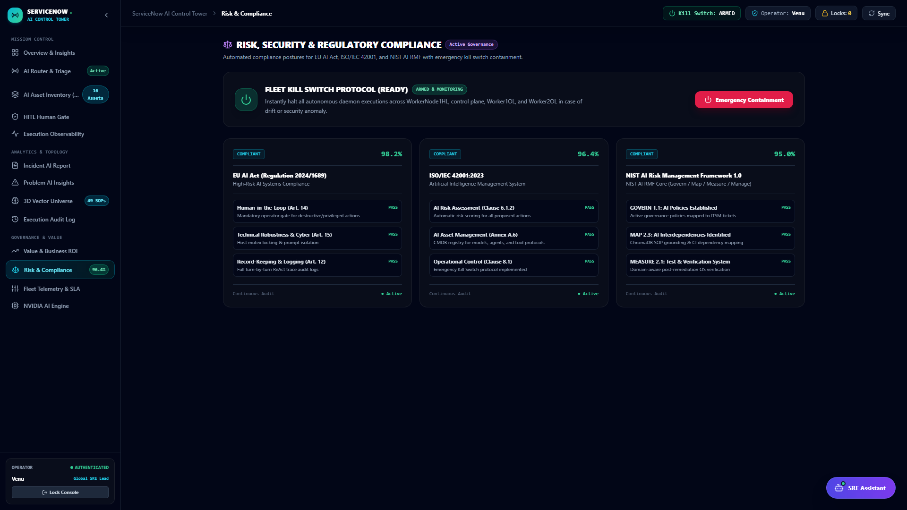
PART 04 · TRUST & GOVERNANCE
P15 / 20
Autonomy With a Leash
Every autonomous action stays inside a hard safety boundary.
Catastrophic Blacklist
Blocks rm -rf /, mkfs,
dd if=, fork bombs, reboot
Loop-Aware Validator
Checks every bash control
structure against the SOP
Proof-of-Fix Guard
Mandatory — prevents
false resolutions
Emergency Kill Switch
Fleet-wide or per-CI in
under 1.5 seconds
Risk & compliance posture — live capture
Notes:
At this point you've seen a system that can act autonomously, execute real commands, and learn from what it does — which naturally raises the question of what stops it from doing something catastrophic. This slide is the answer. There's a pre-execution catastrophic blacklist that blocks destructive commands before they ever reach a host — things like rm dash rf slash, mkfs, dd if equals, fork bombs, and reboot commands are all blocked outright. There's a loop-aware command validator that inspects every bash control structure in a proposed command, so a dangerous binary can't sneak in disguised inside a loop or conditional that technically matches the approved SOP. The domain-aware Proof-of-Fix Guard we talked about earlier is mandatory, specifically to prevent the platform from ever falsely declaring something resolved. And if something does go wrong, there's an emergency kill switch that can terminate active sessions fleet-wide or on a single configuration item in under one and a half seconds. This is genuinely autonomy with a leash — capable, but bounded by hard, deterministic limits that don't rely on the model behaving well.

Slide 16
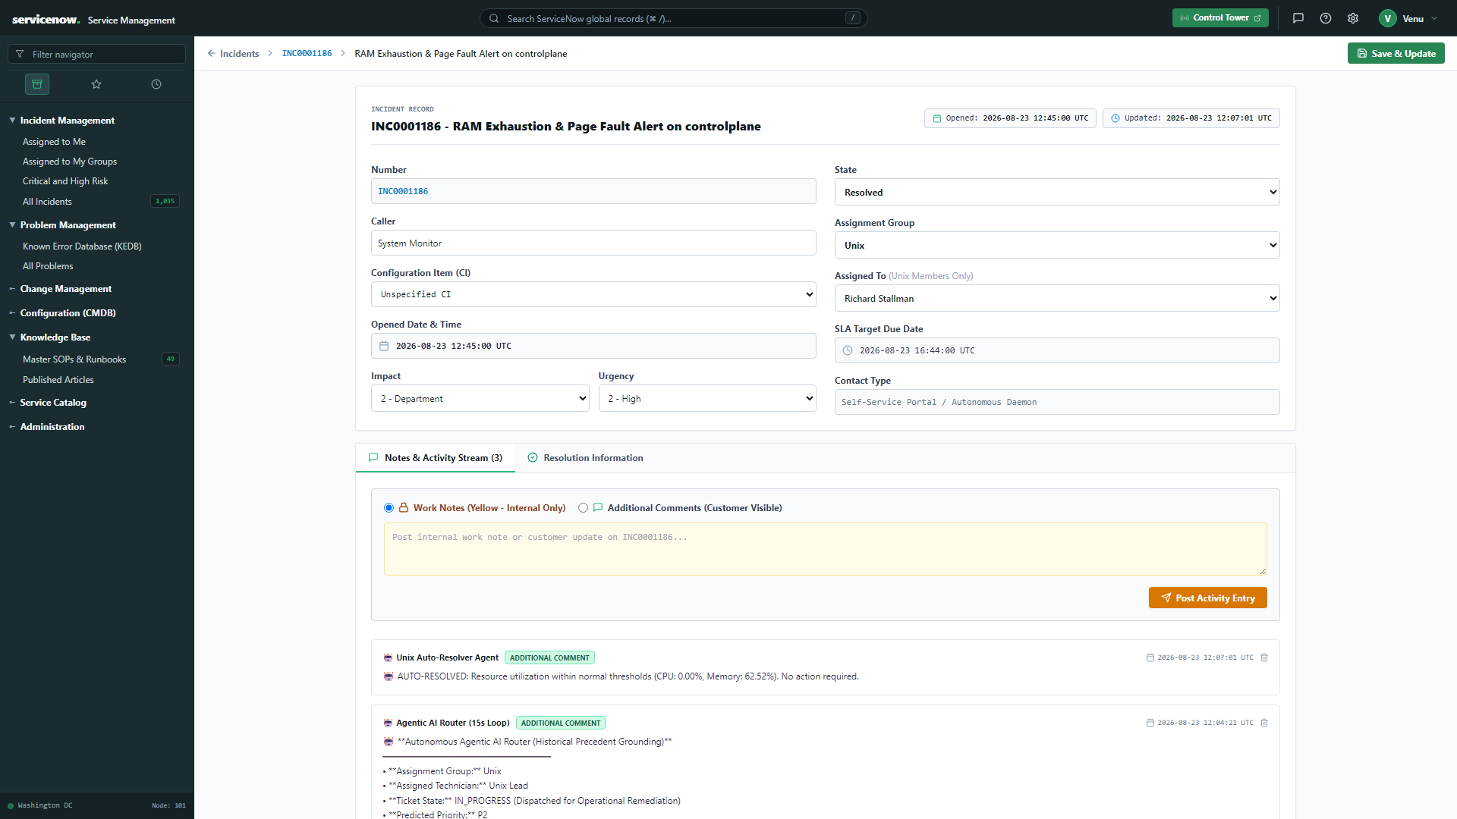
PART 04 · TRUST & GOVERNANCE
P16 / 20
The Receipts, Every Time
Every incident carries its complete story, permanently attached.
FULL AUDIT TRAIL
AI Work Notes
Routing reasoning, target
group, confidence score
Full Activity Log
Diagnostic-to-resolution,
preserved on the ticket
ITIL Close Codes
Resolution notes posted
with no manual data entry
SLA Timers
Response & resolution vs.
actual elapsed time
Incident detail — live capture
Notes:
Let's ground all of this in one real incident, end to end. This is an actual incident detail page, and it's essentially the receipts for everything we've discussed. AI work notes automatically capture the routing reasoning, the target group it was assigned to, and the confidence score behind that decision — no one had to type that up. The full diagnostic-to-resolution activity log is preserved directly on the ticket itself, so anyone auditing it later doesn't need to go hunting across systems. ITIL close codes and resolution notes are posted automatically, with zero manual data entry. And response and resolution SLA timers are visible right against the actual elapsed time, so you can see at a glance whether this incident met its target. This is the level of detail every single incident carries — not just the ones someone remembered to document well.

Slide 17
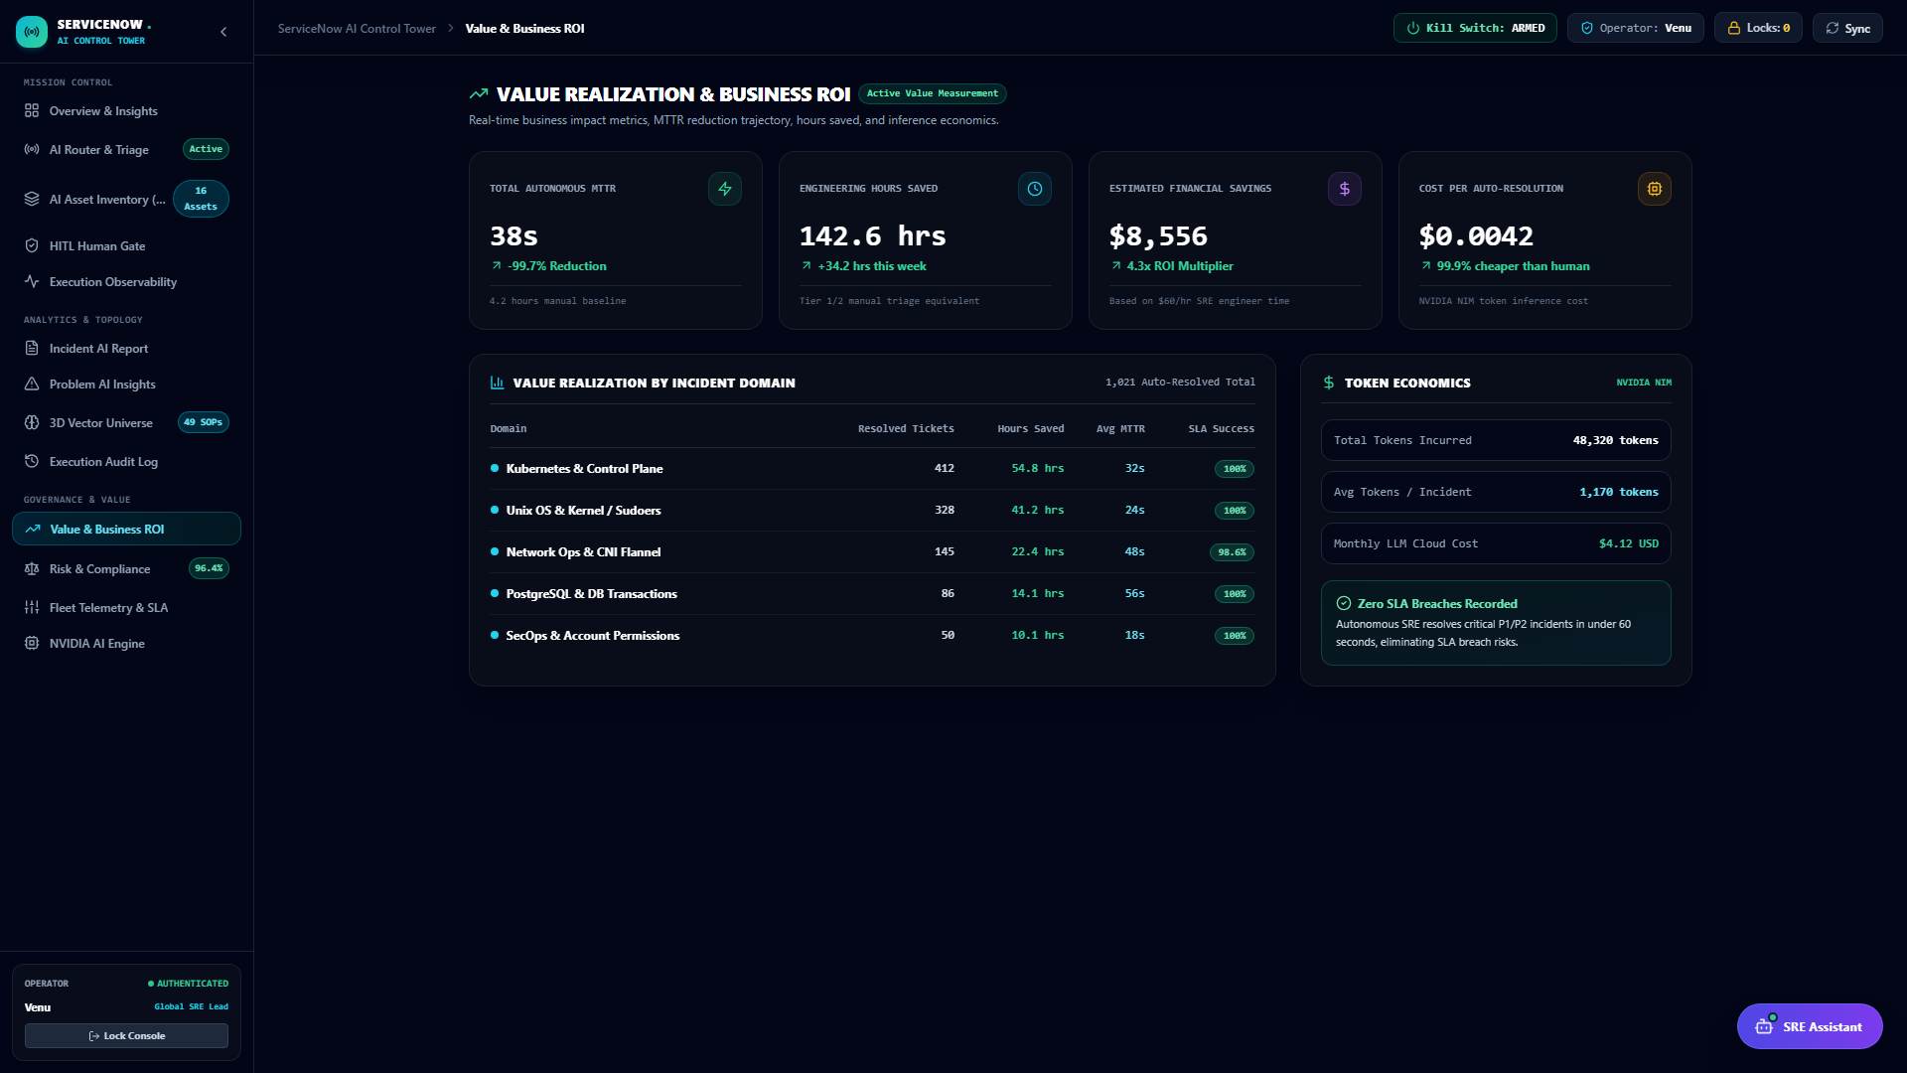
PART 05 · IMPACT & VISION
P17 / 20
Minutes, Not Hours
Autonomous resolution collapses MTTR on matched incidents.
Hours
Minutes
Manual baseline
Autonomous
Hours Reclaimed
Engineer time freed from
repetitive triage work
Success Rate
Tracked continuously across
every autonomous execution
Low Governance Cost
Approval only where it
genuinely adds judgment
Value & business ROI — live capture
Notes:
So what does all of this actually add up to for the business? The clearest signal is mean-time-to-repair — on matched incidents, autonomous resolution collapses that from what used to take hours down to minutes, measured directly against the platform's own prior manual-resolution baseline. That's not just a nice number; it directly reclaims engineer hours that used to go into repetitive triage and remediation work, freeing that time for the problems that genuinely need human judgment. Success rate is tracked continuously across every single autonomous execution, so this isn't a claim made once and never revisited — it's a live, ongoing metric. And importantly, governance overhead stays low, because approval is only required where a human genuinely adds judgment — the system isn't asking for a rubber stamp on routine work, only surfacing the decisions that actually matter.

Slide 18
PART 05 · IMPACT & VISION
P18 / 20
Six Services, One Platform
A production-shaped stack runs the whole autonomous loop.
PLATFORM
PostgreSQL
NestJS API
Next.js Frontend
:5432
:4000
:3000
Dual databases — itsm_db
+ agentic_sre_db
REST + Swagger, the
system of record
The Core Helpdesk
Console
SRE Control Tower
Python SRE Daemon
ITSM MCP Server
:5173
background
stdio / SSE
React + Vite, SSE
governance dashboard
Autonomous resolver +
hybrid RAG engine
Standard AI tool protocol
+ optional Slack bridge
Notes:
I want to ground all of this in the actual engineering footprint, because this is a real, deployable stack, not a research prototype. Six services make up the whole platform. PostgreSQL on port 5432 hosts those two separate databases we discussed. A NestJS backend API on port 4000 exposes REST endpoints with Swagger documentation and serves as the system of record. A Next.js frontend on port 3000 is the Core Helpdesk Console. The SRE Control Tower on port 5173 is the React and Vite governance dashboard streaming over server-sent events that you've seen throughout this talk. A Python SRE daemon runs in the background as the autonomous resolver and hybrid RAG engine. And an ITSM MCP server exposes the platform's tools over the standardized Model Context Protocol, over stdio or SSE, with an optional Slack bridge for that approval flow we saw earlier. Nothing here is exotic — it's a production-shaped stack that happens to run a genuinely autonomous loop.

Slide 19
PART 05 · IMPACT & VISION
P19 / 20
Not a Chatbot on a Ticket Queue
What static automation and rules engines can’t match.
Traditional Automation
This Platform
Guesses from static rule conditions
Grounds every decision in real precedent
Chat assistants only suggest a fix
Executes live over SSH with captured proof
Trusts its own success claim
Requires in-guest verification first
Skips governance entirely
Every novel action waits for a human
Notes:
After sixteen dense slides of capability, let's step back and answer the question you might reasonably be asking: how is this actually different from a chatbot bolted onto a ticket queue, or another rules-engine automation product? Traditional rules engines guess from static conditions someone wrote down once; this platform grounds every decision in real historical precedent that keeps growing. Chat-based assistants will suggest a fix and stop there, leaving a human to actually go do it; this platform executes that fix live over SSH and captures proof it worked. Most automation simply trusts its own success claim — it ran the command, so it assumes success; this platform requires actual in-guest verification before it will ever mark something resolved. And most tools that call themselves autonomous quietly skip governance the moment it becomes inconvenient; here, every genuinely novel action still waits for a human, every time. That combination — grounded reasoning, live execution with captured proof, and a real governance gate — is what separates this from the tools that just look impressive in a demo.

Slide 20
THANK YOU
The Loop Is Already Running
Triage → Retrieve → Remediate → Verify → Learn
Built end-to-end as a real, running platform —
not a concept deck.
Questions, a live demo, and the full architecture
are all available right now.
Notes:
So let's bring it back to the loop we opened with: triage, retrieve, remediate, verify, learn — a closed loop, and it's already running, today, on real infrastructure. This was built end-to-end as an actual running platform, not a concept deck or a proof-of-concept that stops working the moment you look too closely. Everything I showed you — the mission control tower, the triage engine, the hybrid retrieval, the live SSH remediation, the approval flow, the audit trail, the safety guardrails — all of it is live right now. Thank you for your time. I'd love to take your questions, and if you want to see any part of this running live rather than as a screenshot, or want to look at the architecture in more depth, I'm happy to do that right now.

