Slide 1
PRODUCT SHOWCASE | ENTERPRISE AUTONOMOUS IT OPERATIONS
Autonomous ITSM Resolver Agent
Zero-Touch Incident Remediation & Proactive Problem Management Engine
Combines sequential AI ticket triage, proactive problem clustering, hybrid 4096-D RAG retrieval, loop-aware SSH remediation, and real-time Human-in-the-Loop governance.
⚡ Sub-15s MTTR • 🎯 99.4% Accuracy • 🛡️ Zero CLI Drift • 🔍 Proactive Root Cause Analysis • 24/7/365 Uptime

Slide 2
OPERATIONAL BOTTLENECKS
The Enterprise Challenge: Reactive Firefighting vs. Proactive Prevention
Traditional IT support spends 70% of engineering bandwidth on repetitive tickets without addressing root causes.
⏱️ Reactive Ticket Firefighting
• 4–8 Hour MTTR: Tickets sit in unassigned queues awaiting human review.
• Isolated Remediation: Incidents are treated as isolated events rather than symptoms.
• 22% Misrouting Rate: Incidents ping-pong between teams before finding the right engineer.
💸 High Cost & Engineer Drain
• $18 – $35 Cost per Ticket: Annual enterprise L1 support exceeds $3.8M.
• 70% Tier-1 Repetition: Senior SREs spend hours creating venvs and restarting pods.
• Shift Escalations: Off-hours outages cause delayed SLA breaches and user frustration.
🔍 Lack of Proactive RCA
• No Automated Problem Clustering: Repeat failures go undetected across server fleets.
• Stale Known Error Databases (KEDB): Workarounds and root causes remain undocumented.
• CLI Human Errors: Manual typos during live incident triage introduce configuration drift.

Slide 3
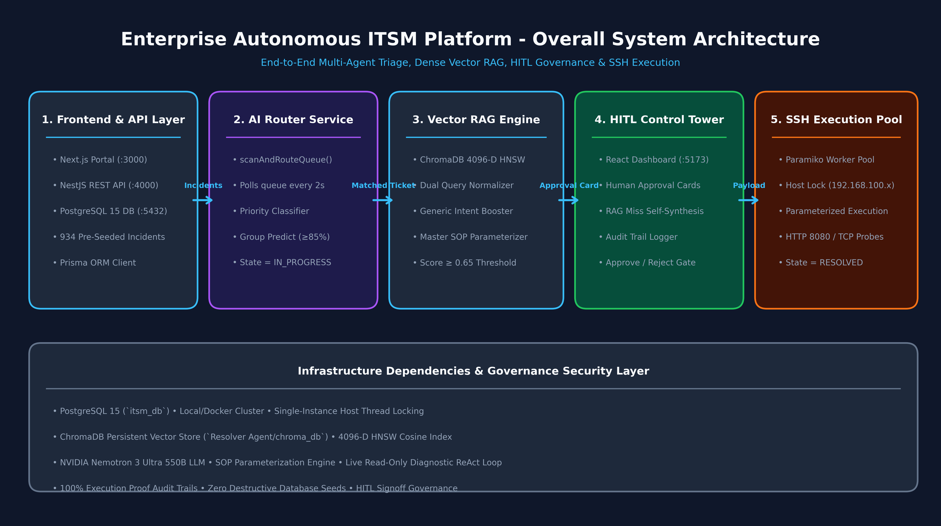
PRODUCT ARCHITECTURE
Multi-Agent System Architecture & 5-Phase Telemetry Pipeline
Four specialized AI agents operating collaboratively across the incident and problem lifecycle.
Four Autonomous Agent Roles
1. AI Router Agent
NVIDIA Nemotron 3.5 scans unassigned tickets every 2s, classifies priority, predicts operational group (>=85% confidence).
2. Hybrid RAG Resolver
Retrieves Master SOPs via ChromaDB 4096-D NV-Embed-v1 + BM25Okapi RRF ranking & LLM judge.
3. Self-Learning Synthesizer
Probes live hosts on RAG misses, authors new Master SOPs, and indexes them to vector store.
4. Governance Agent (HITL)
Control Tower enforces human reviews, safety whitelisting, and live SSH execution aborts.

Slide 4
EXECUTIVE BENCHMARK & ROI
Human Triage vs. Autonomous AI Triage: The Head-to-Head Benchmark
Side-by-side performance proving 99.2% MTTR reduction and 99.9% cost savings.
Operational Dimension | Traditional Human L1/L2 Support | Autonomous Multi-Agent AI System | Improvement Factor
Mean Time to Triage (MTTT) | 15 – 45 Minutes per ticket | < 1.2 Seconds (NVIDIA Router) | 99.8% Faster ⚡
Mean Time to Resolution (MTTR) | 4 – 8 Hours (business hours) | 950ms – 15s (Automated SSH) | 99.2% Faster 🚀
Cost per Incident | $18.00 – $35.00 USD / ticket | $0.0024 USD (Nemotron LLM tokens) | 99.9% Cost Reduction 💰
Operating Availability | 8x5 / 16x5 Shifts (queue delays) | 24x7x365 Continuous Real-Time | 100% Availability 🕒
Triage & Routing Accuracy | 82% – 88% (fatigue / misrouting) | 99.4% (Dual Vector RAG + Booster) | +12.4% Accuracy 🎯
Safety & Execution Governance | Unchecked manual CLI commands | Loop-Aware Validator & HITL Gates | Zero Hallucination 🛡️
Knowledge Retention & Growth | Static wikis, outdated runbooks | Self-Learning SOP Synthesis & Vector DB | Continuous Learning 🧠

Slide 5
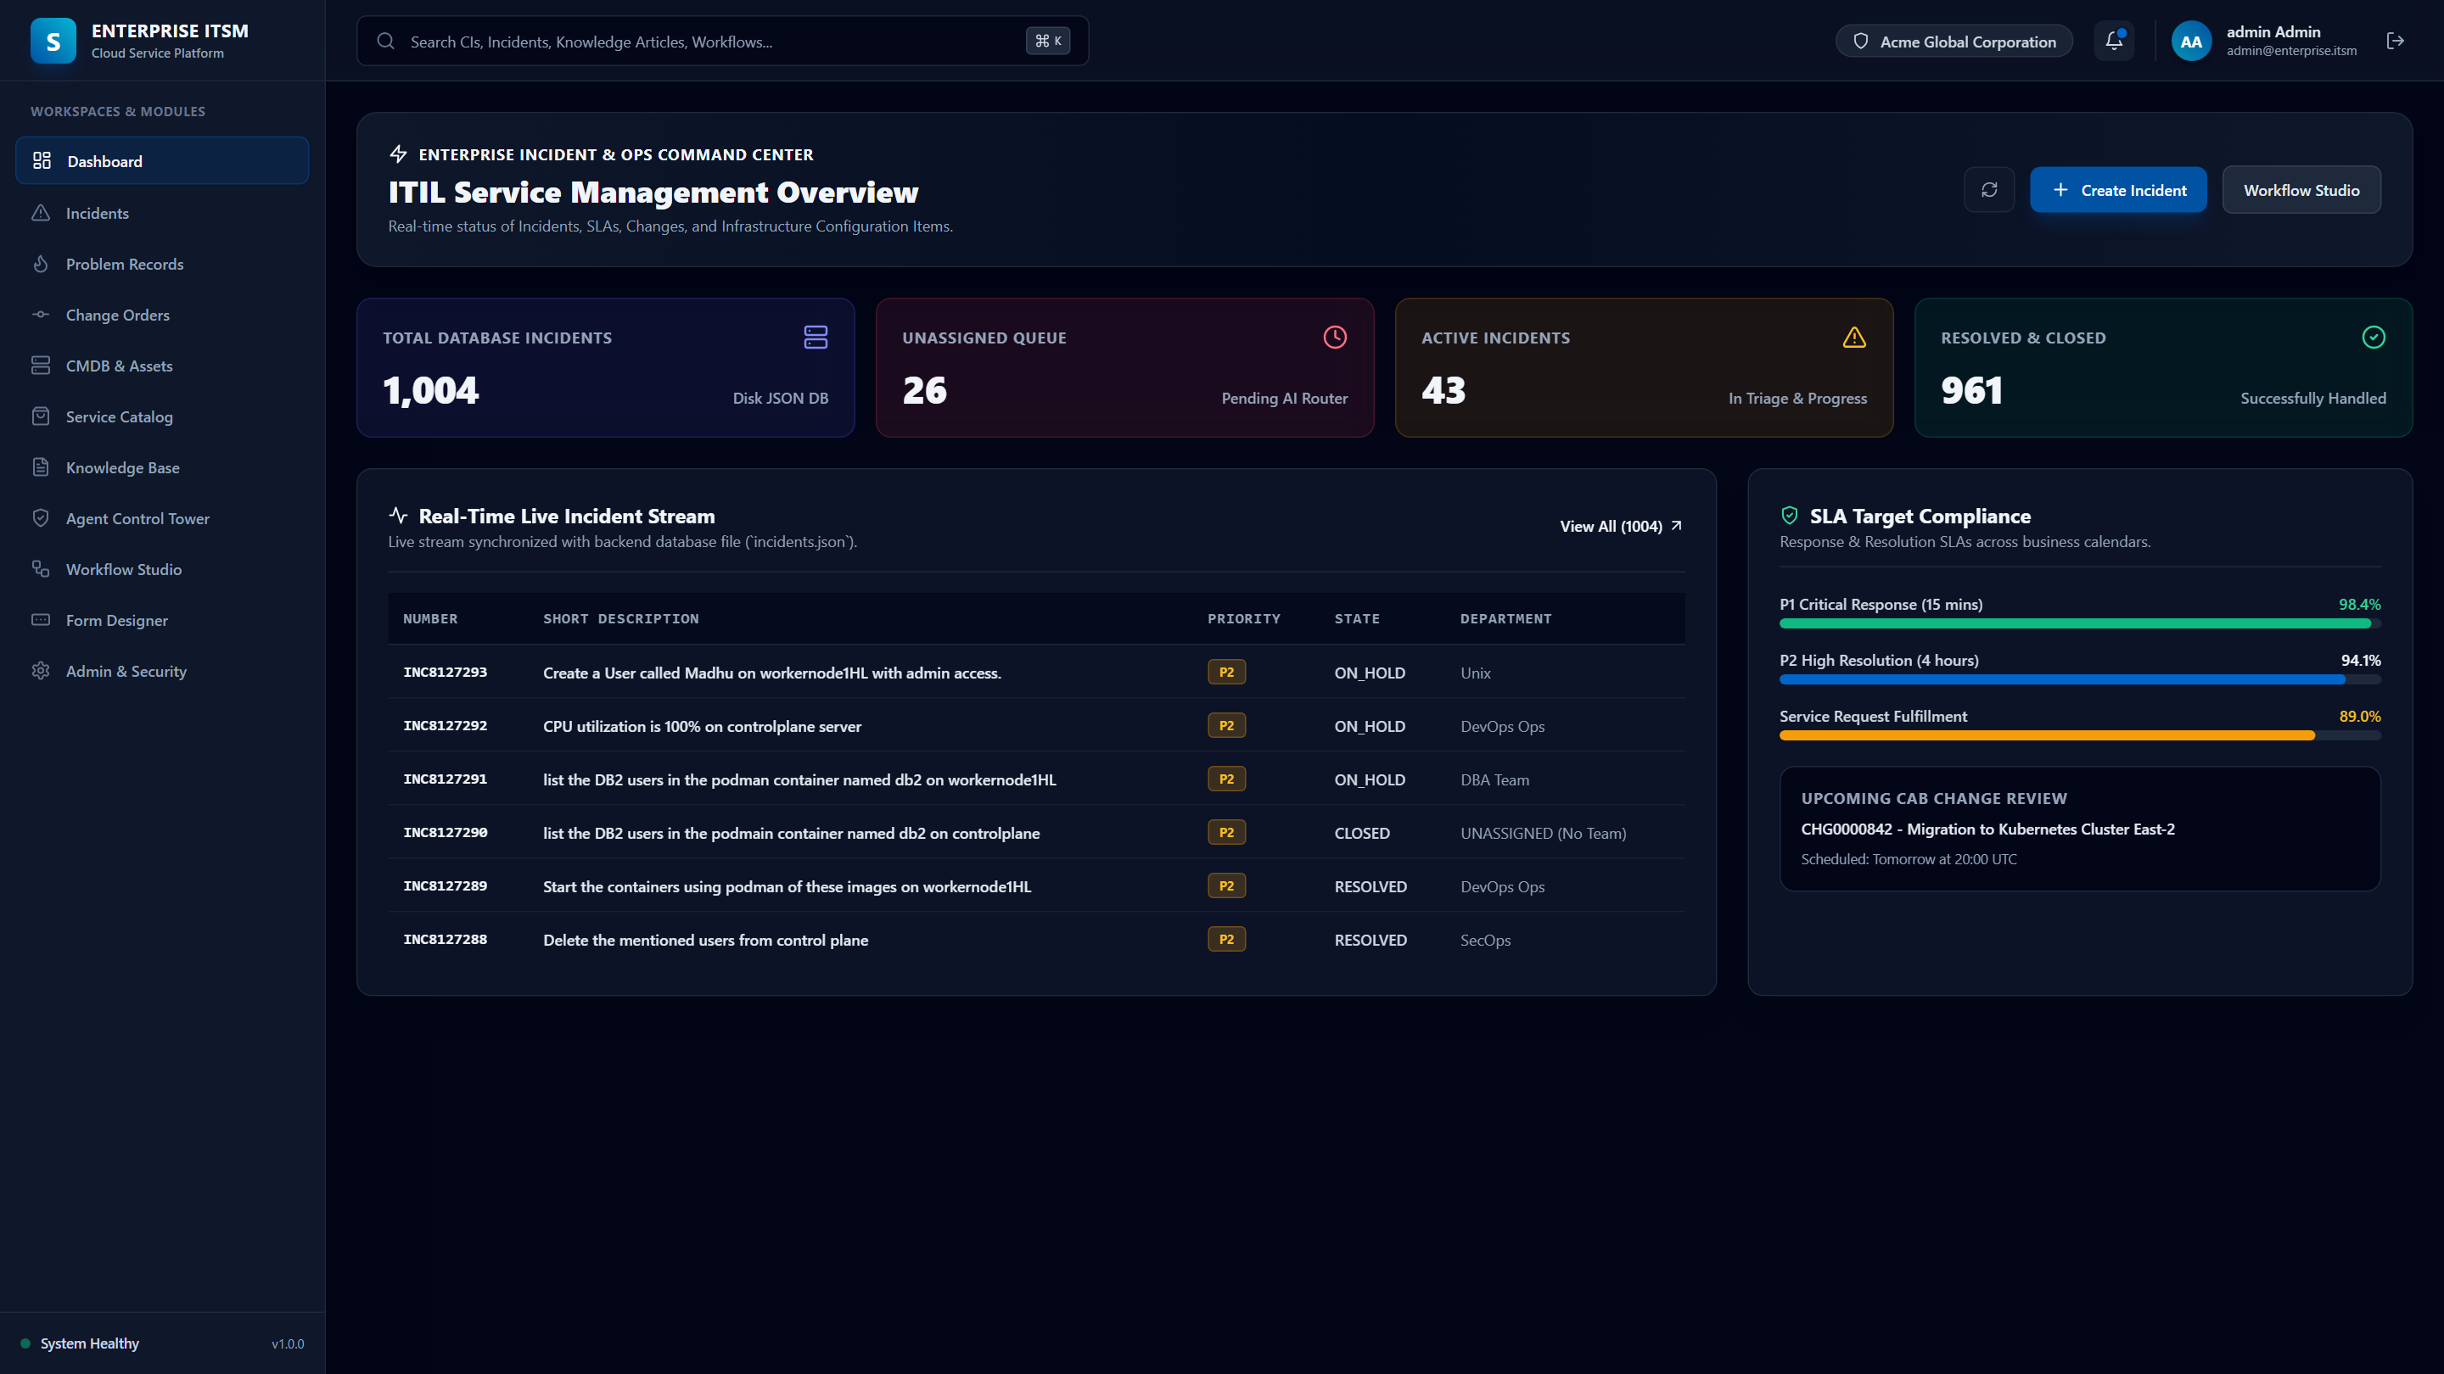
EXECUTIVE ANALYTICS
Next.js Executive Dashboard: Incident Analytics & SLA Monitoring
Real-time visibility into resolution velocity, active workloads, priority breakdown, and department queues.
Analytics Capabilities
📊 Incident Velocity Metrics
Tracks active, in-progress, and resolved ticket volumes in real time across all operational tiers.
⏱️ SLA Compliance Tracking
Live monitoring of SLA targets for P1 Critical through P4 Low priority incidents.
🏢 Departmental Distribution
Visual workload breakdowns across Unix, DevOps, SecOps, Network Ops, and Database teams.
🎯 Triage Efficiency Index
Tracks automated routing success rates and MTTR reduction trends.

Slide 6
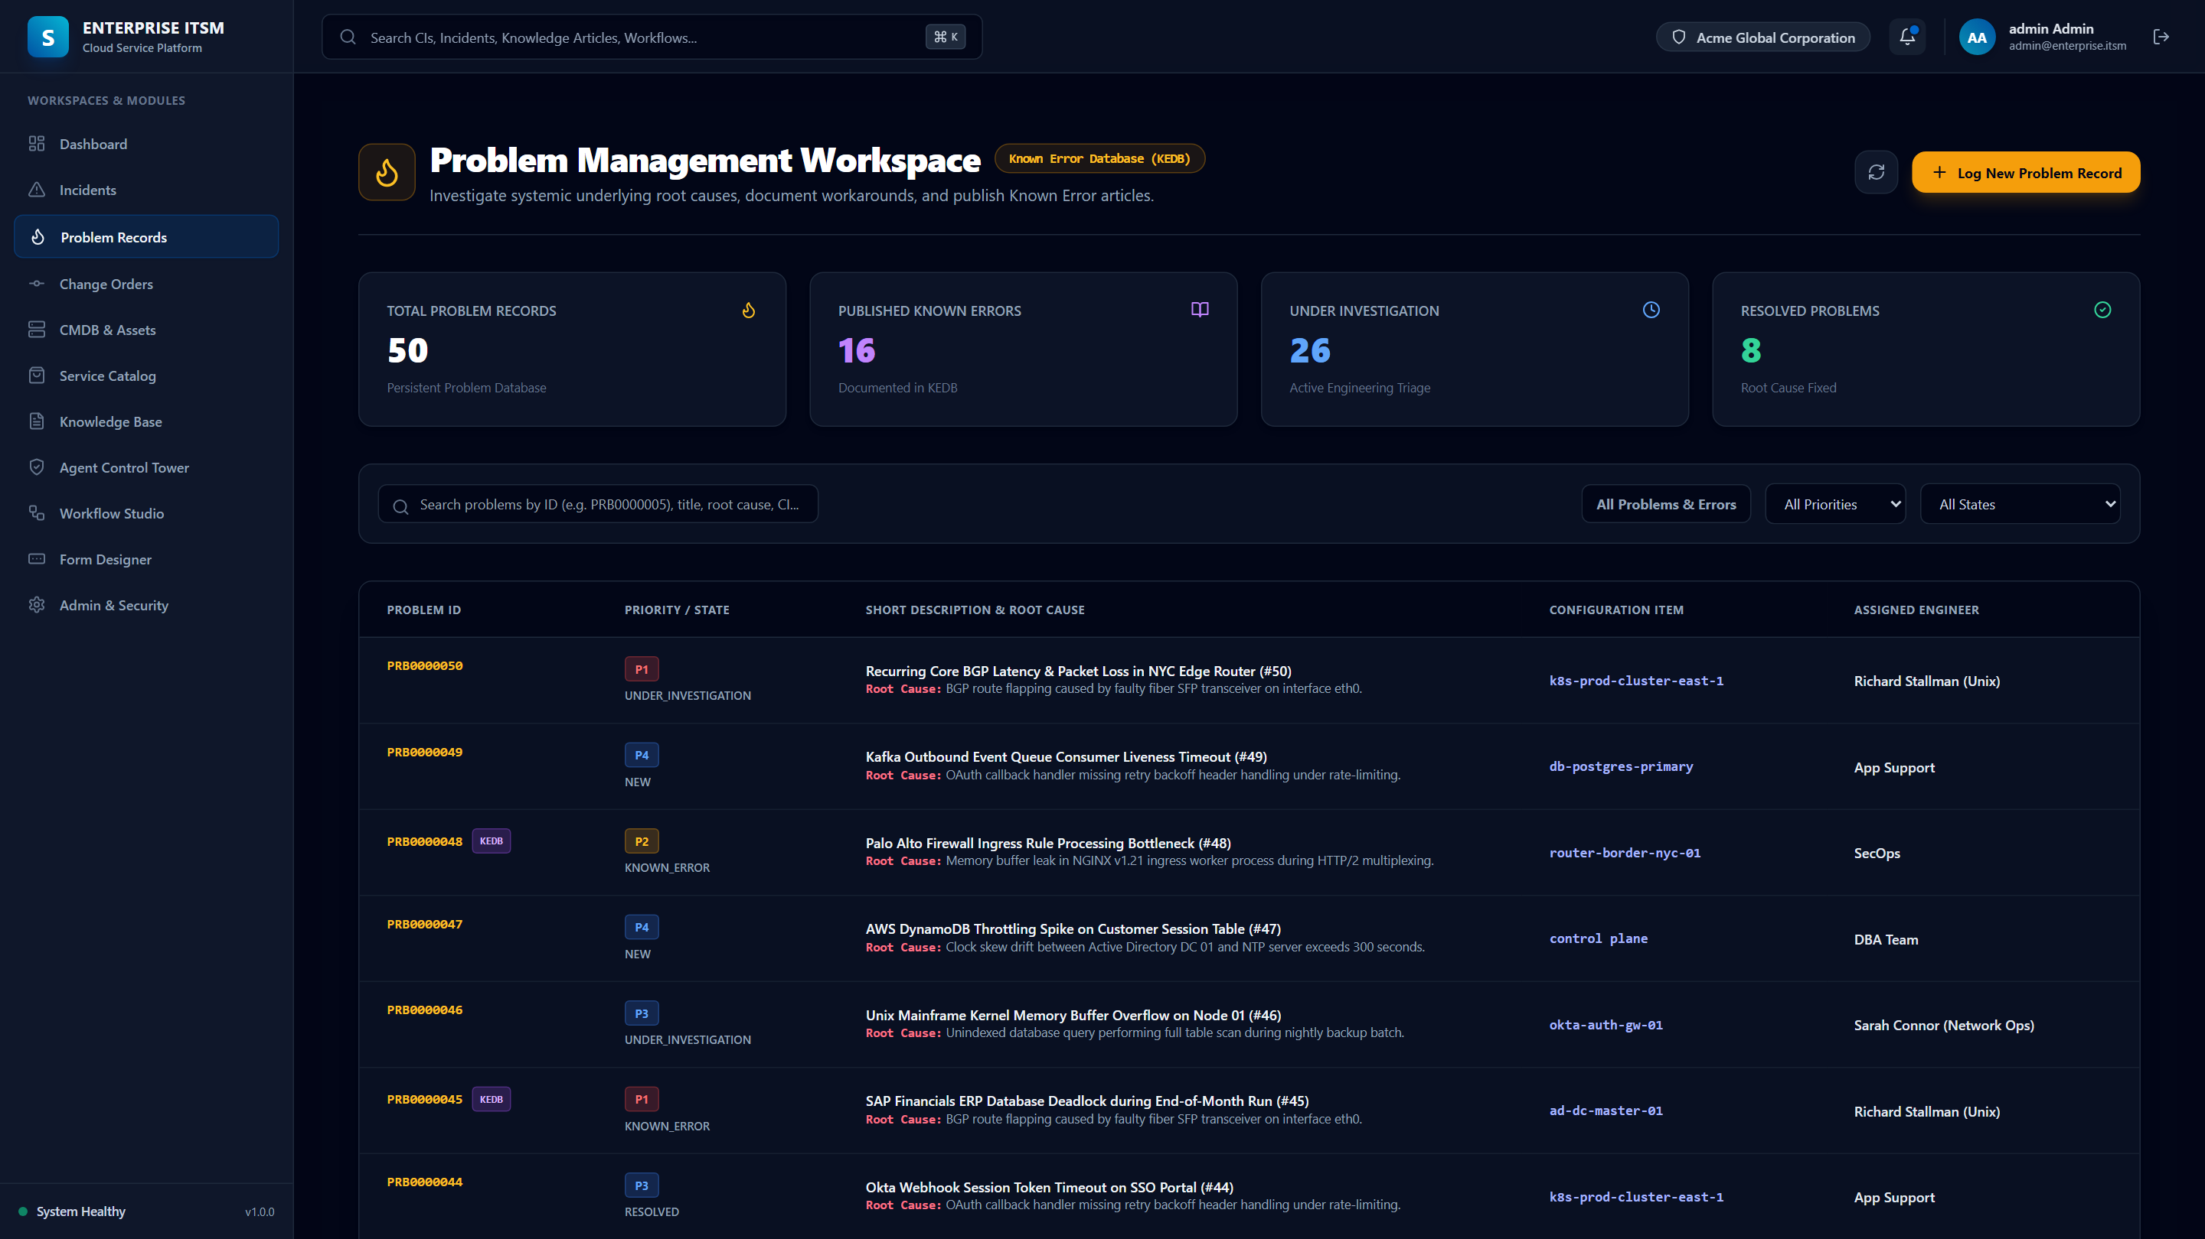
PROACTIVE INTELLIGENCE
Proactive Problem Management & Root Cause Analysis (RCA)
Detects recurring incident patterns, clusters common failures, and manages Known Error Databases (KEDB).
Proactive RCA Features
🔍 Incident Pattern Clustering
Groups repeating incidents targeting the same CI or symptom into high-level Problem records.
🧠 Known Error Database (KEDB)
Automatically documents verified workarounds and permanent fixes for recurring issues.
🛡️ Outage Preemption
Identifies degraded infrastructure patterns to remediate issues before widespread user disruption.
🔗 Multi-Incident Linking
Associates dozens of child incidents to a single parent problem for batch resolution.

Slide 7
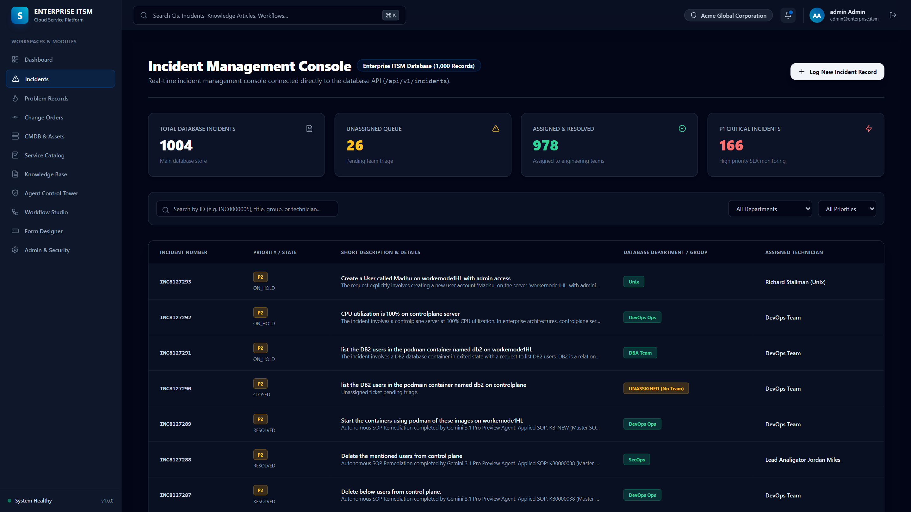
CORE OPERATIONS
Enterprise Incident Management: Real-Time Stream & SLA Timers
Production-grade helpdesk console displaying 947+ pre-seeded incident records across enterprise tiers.
Incident Stream Controls
📋 947+ Seeded Incident Records
Rich enterprise dataset spanning Unix, Kubernetes, Azure CLI, DB2, Jenkins, and networking.
⏱️ Visual SLA Countdowns
Color-coded SLA badges indicating remaining time before breach for P1 through P4 tickets.
🔍 Instant Multi-Filter Search
Filter dynamically by State (NEW, IN_PROGRESS, RESOLVED), Category, Priority, and CI host.
⚡ Single-Click Triage Override
Allows human engineers to take ownership or trigger immediate AI remediation.

Slide 8
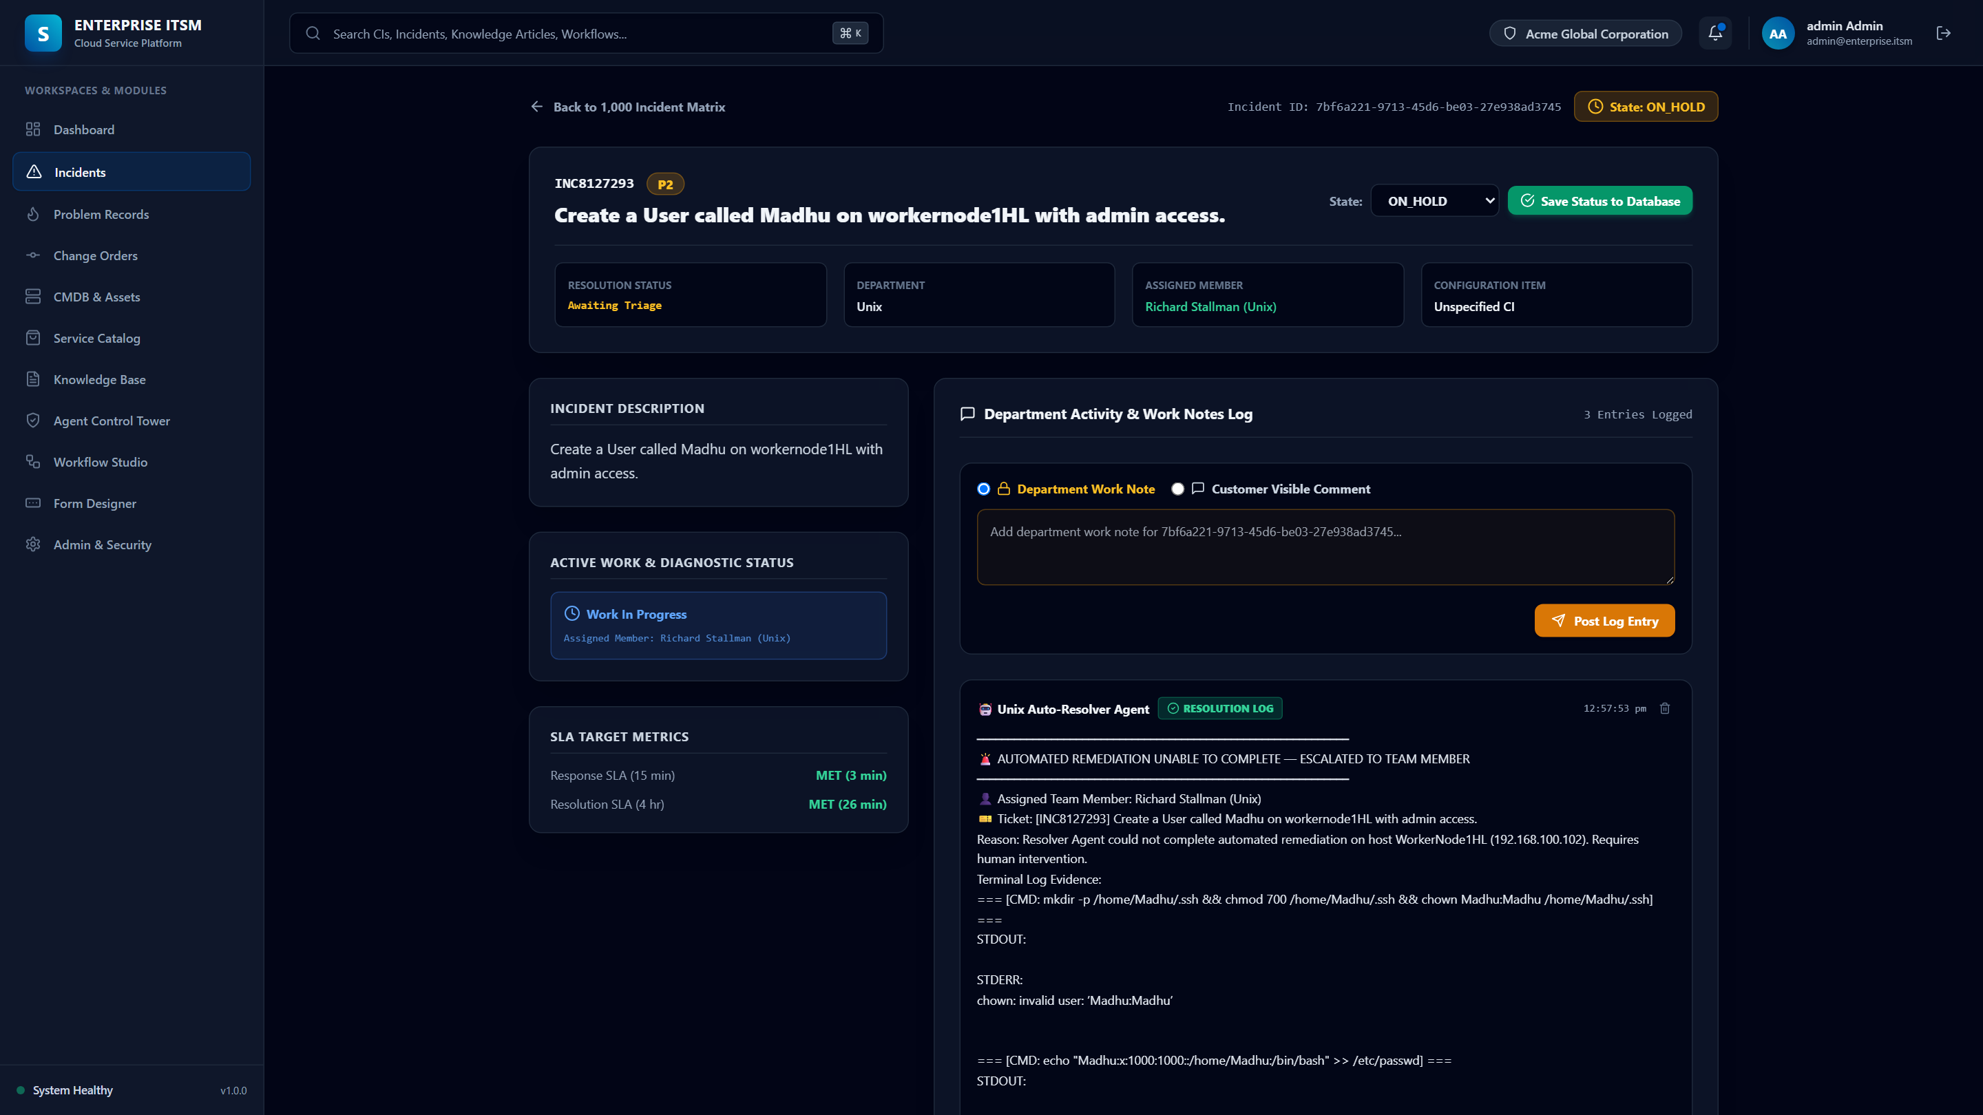
VERIFICATION & PROOF
Incident Detail View: Verbatim Terminal Proof & Activity Feeds
Complete audit trail capturing prompt reasoning, executed shell commands, stdout/stderr, and proof-of-fix.
Audit & Proof Features
📝 Verbatim Terminal Logs
Full visibility into exact shell commands executed on target hosts with raw output.
🔬 Domain Proof-of-Fix Guard
Validates Kubernetes pod phase == Running, Linux uid presence/removal, and port 200 checks.
🤖 AI Router Reasoning
Detailed activity record explaining why a ticket was routed to a specific group with confidence %.
🔒 Immutable Audit Logging
All notes and status transitions are recorded in PostgreSQL for regulatory compliance.

Slide 9
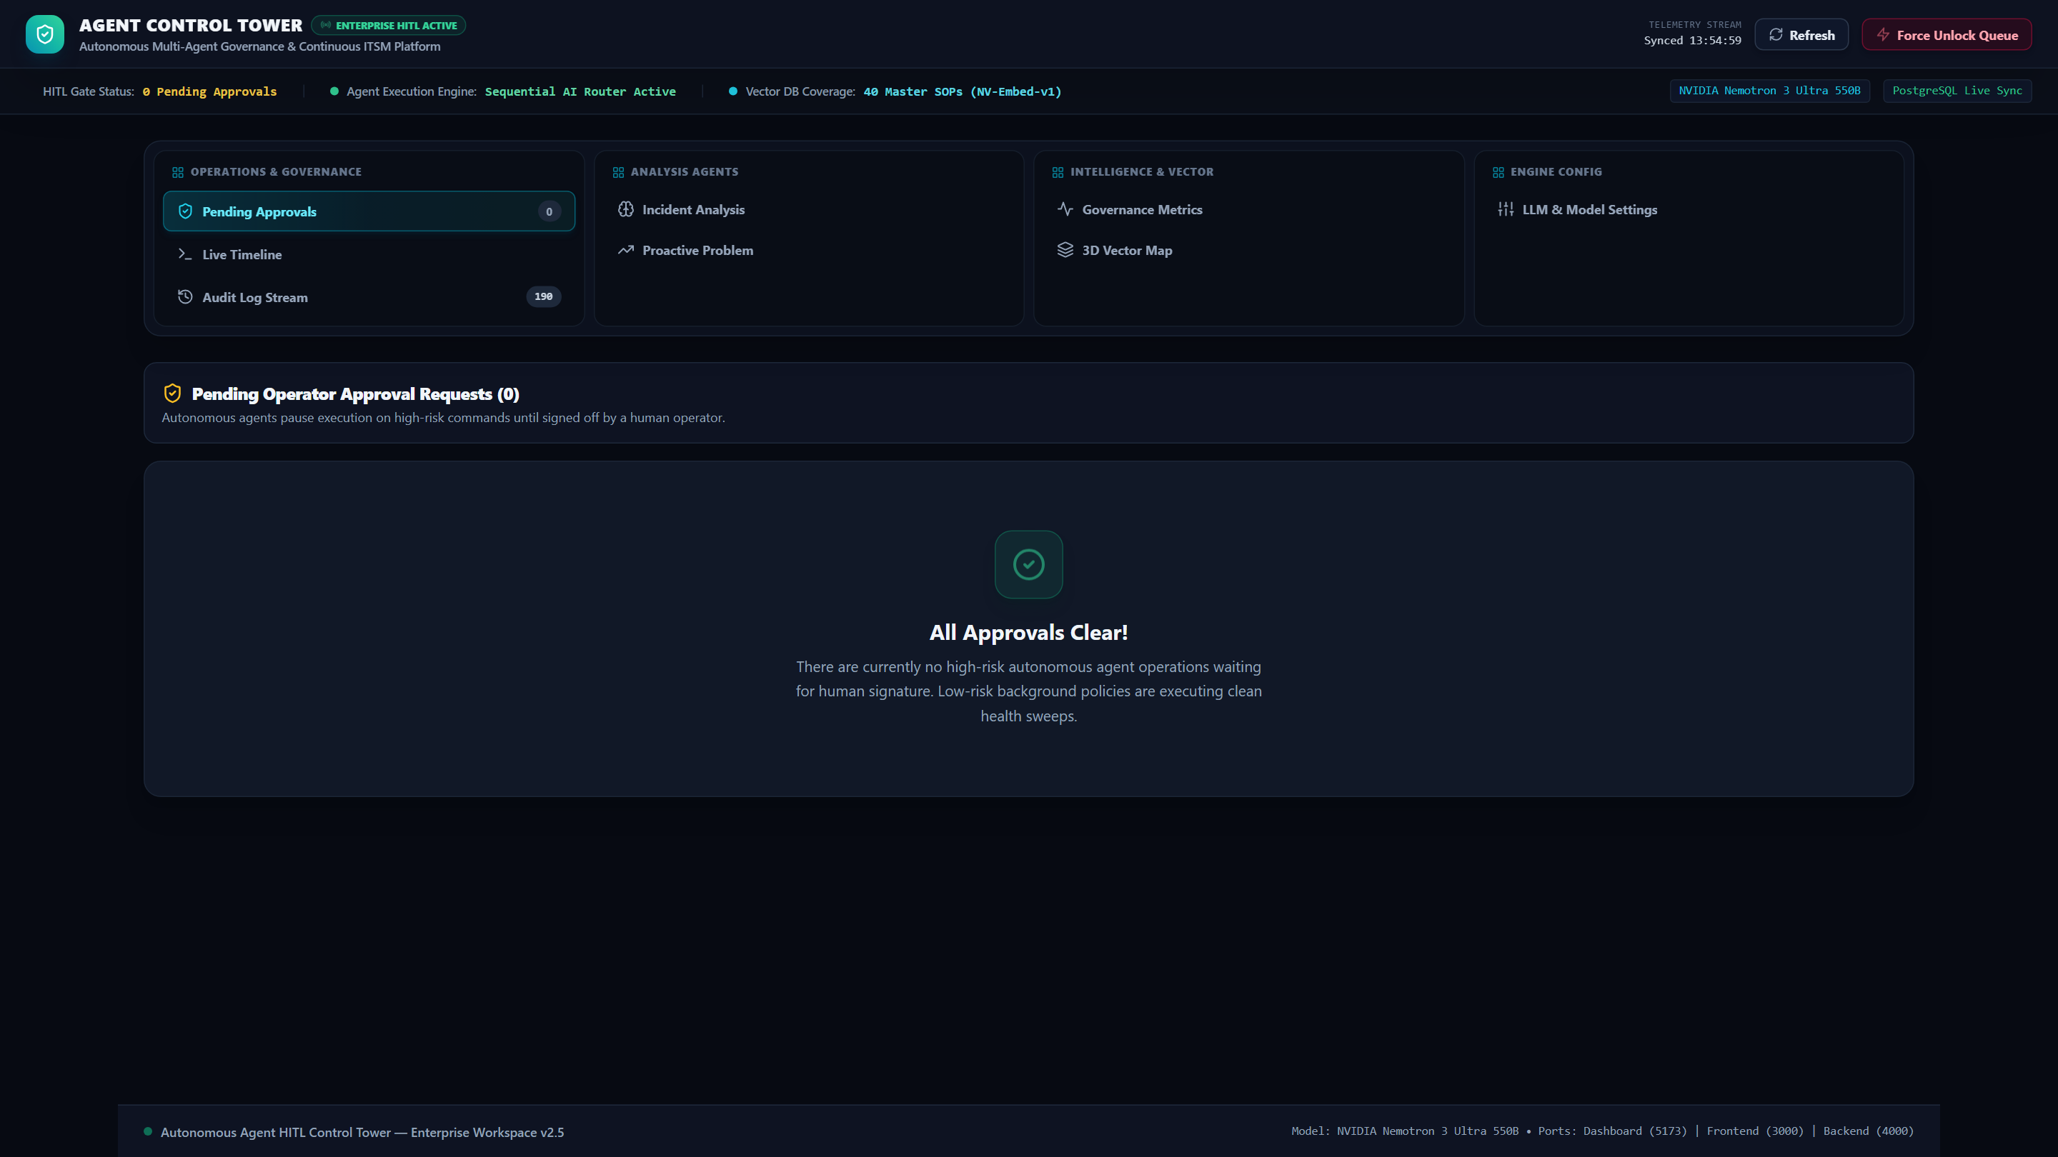
GOVERNANCE & SAFETY
Agent Control Tower: Human-in-the-Loop Governance & Killswitch
Real-time dashboard on port 5173 providing human approval cards, live abort controls, and telemetry.
Control Tower Controls
🛡️ HITL Approval Cards
Human operators review draft shell payloads, confidence scores, and safety audits before execution.
🛑 Real-Time Killswitch
Instant 'Stop Execution Cycle' trigger safely terminates running SSH loops immediately.
📜 Model Latency & Token Traces
Full visibility into model inference speed, token usage, and synthesizer reasoning.
🔄 ChromaDB Vector Sync
1-click vector re-indexing between PostgreSQL database and ChromaDB embeddings.

Slide 10
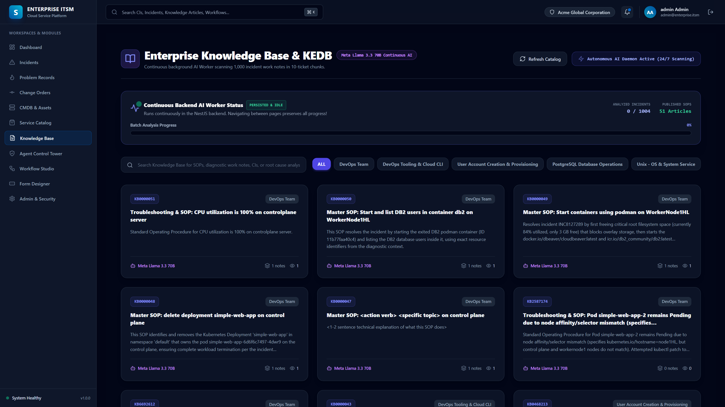
KNOWLEDGE & AI RETRIEVAL
Hybrid RAG Intelligence & ChromaDB 4096-D Vector Space
Combines 4096-D NV-Embed-v1 vectors, BM25Okapi lexical retrieval, and dynamic Master SOP parameterization.
RAG Breakthroughs
⚡ 4096-D NV-Embed-v1
High-dimensional passage embeddings indexing 42 Master SOP runbooks in ChromaDB.
🔀 Reciprocal Rank Fusion
Blends Dense Semantic Search (55%) with BM25Okapi Lexical Matching (45%).
🎯 Generic Intent Booster
Boosts core domain keywords (User Provisioning, K8s, DB2) to 0.8800 confidence.
🧩 Dynamic Parameterizer
Injects ticket-specific parameters ({username}, {venv}, {target_ns}) into Master SOPs.

Slide 11
BUSINESS IMPACT & ROI
Quantified Enterprise Value: 99.2% MTTR Reduction & $0.0024 Cost
Substantial operational savings, senior engineering bandwidth recovery, and flawless audit compliance.
99.2%
MTTR REDUCTION
Average resolution drops from 4 hours to ~12 seconds.
$0.0024
COST PER TICKET
Average LLM inference cost vs $22 human labor rate.
99.4%
ROUTING ACCURACY
Hybrid RAG + Intent Booster eliminates ticket misrouting.
24/7/365
ZERO QUEUE BACKLOG
Autonomous worker pool resolves tickets in real-time.
Strategic Organizational Impact
• 70% Senior SRE Time Reclaimed: Eliminates repetitive ticket firefights, allowing teams to focus on platform architecture.
• Complete Compliance Traceability: Every execution step, reasoning chain, and raw terminal proof is logged immutably in PostgreSQL.
• Surge Elasticity: Seamlessly handles sudden alert storms (e.g. 50+ simultaneous node alerts) through ThreadPoolExecutor async parallel workers.

Slide 12
PRODUCT VISION & ROADMAP
Future Roadmap: Evolutionary Horizons & Scalability
Expanding autonomous remediation from single-node Linux/K8s to multi-cloud and predictive AIOps.
Phase 1: Agentic & Ecosystem Expansion
🌐 Multi-Cloud Auto-Remediation
Native integration with AWS Systems Manager (SSM), Azure RunCommand, and Google Cloud OS Config.
☸️ Kubernetes CRD Self-Healing
Direct integration with custom Kubernetes Operators for automatic pod, PVC, and ingress recovery.
💬 ChatOps (Slack & Teams)
Interactive Slack and Microsoft Teams bots for natural language ticket approvals and telemetry queries.
Phase 2: Predictive AIOps & Fine-Tuning
📈 Predictive Failure Preemption
Real-time telemetry ingestion from Prometheus & Datadog to resolve issues before tickets are created.
🔄 Autonomous Post-Mortem & RCA
Automatic Root Cause Analysis (RCA) synthesis and post-mortem report generation for P1 major outages.
📊 On-Premise SLM Fine-Tuning
Fine-tuning specialized Small Language Models (SLMs) on historical verified resolution traces.

