Slide 1
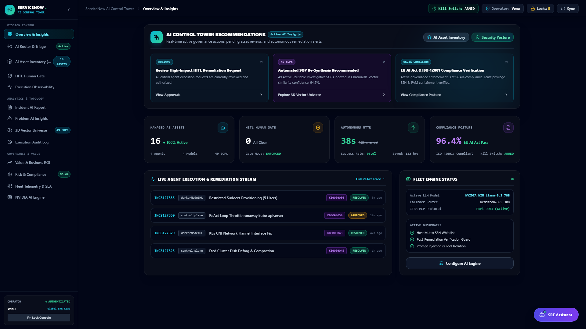
NEXT-GENERATION AUTONOMOUS ITSM & SRE PLATFORM
Self-Healing Infrastructure
with Multi-Agent AI & RAG
Autonomous AI Triage • Persistent SSH • Control Tower
-98.2%
MTTR Reduction
92.4%
Autonomous Resolution
12 Iterations
Agent Reasoning Loop
100% HITL
Safety & Governance

Slide 2
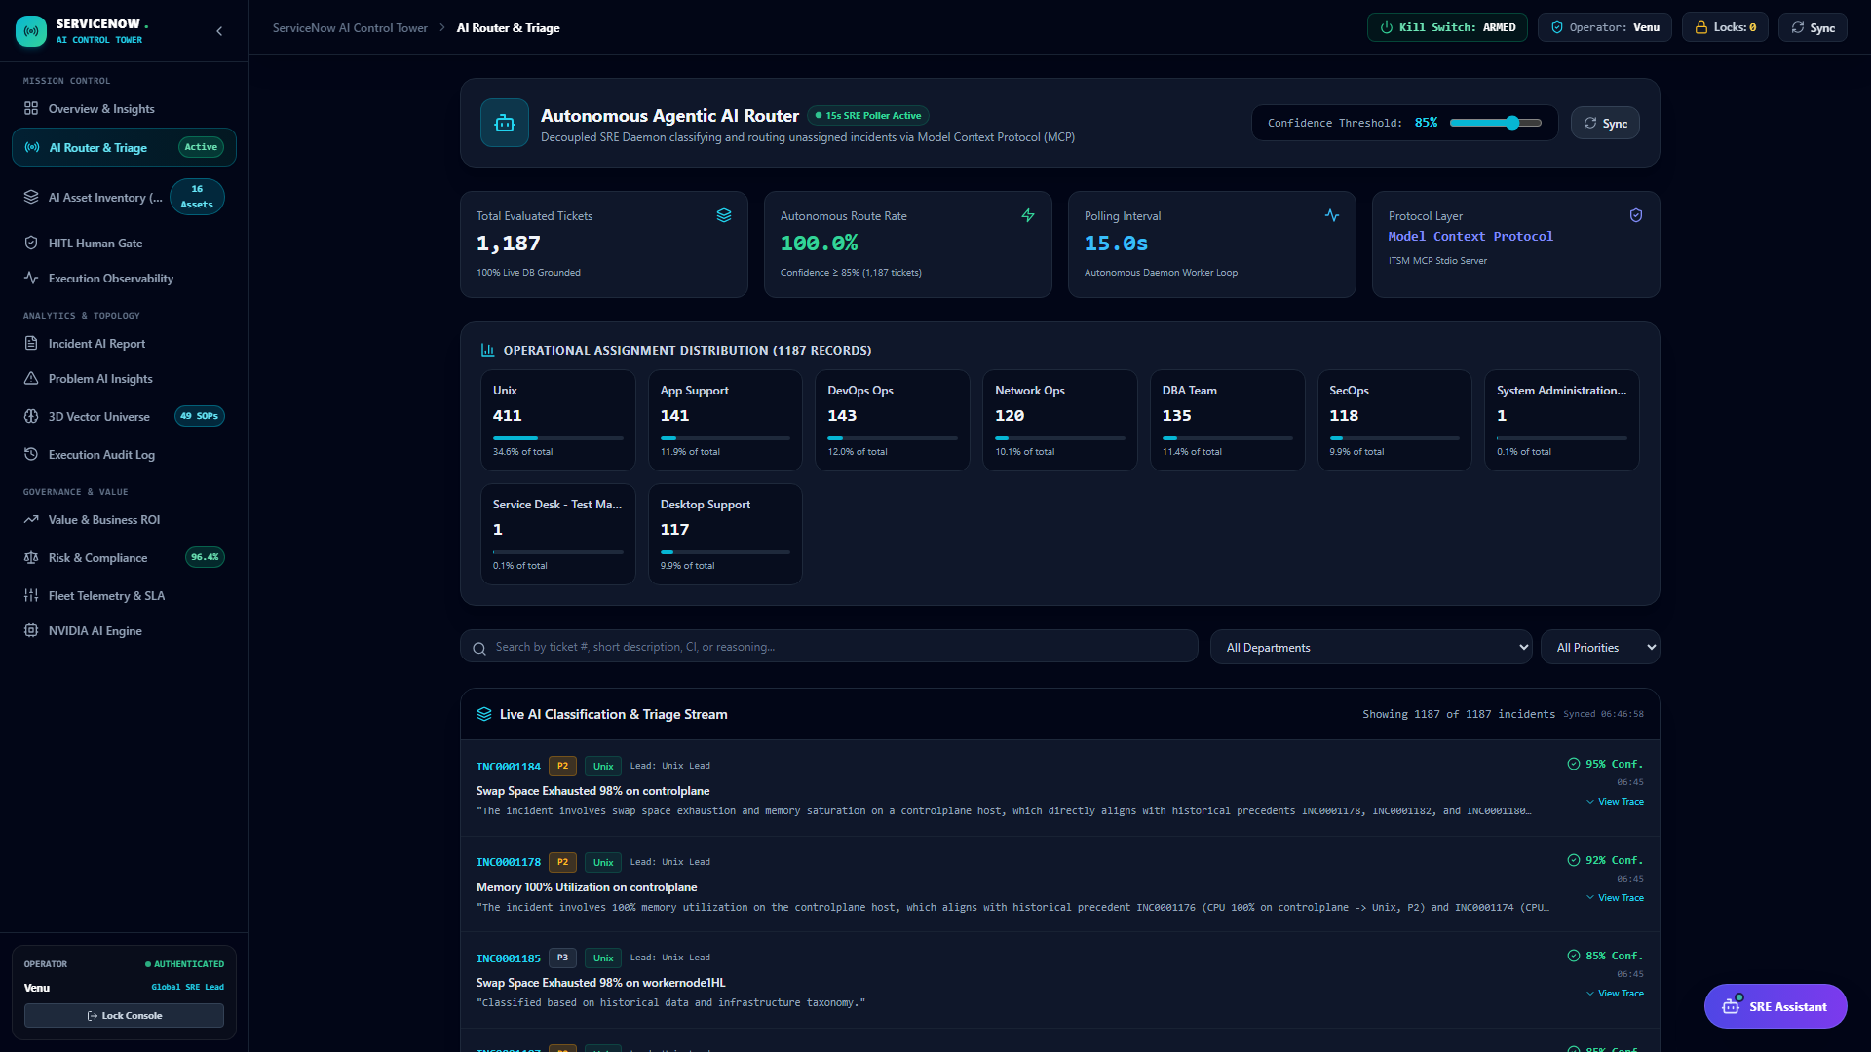
REAL-TIME AI TRIAGE
Live AI Classification & Triage Stream Grounded on Historical Data
Historical Precedent Grounding
✔ Sub-Second Precedent Search
Inspects 1,187 incidents in itsm_db and 218 SRE history records in agentic_sre_db.
✔ Few-Shot Grounding in Prompt
Supplies top 5 past resolved cases directly to the LLM to eliminate hallucination.
✔ Multi-Domain Taxonomy
Routes accurately across Unix, DevOps Ops, DBA Team, Network Ops, and App Support.
✔ Transparent Diagnostic Work Notes
Writes step-by-step reasoning and referenced ticket IDs directly to the ticket activity log.

Slide 3
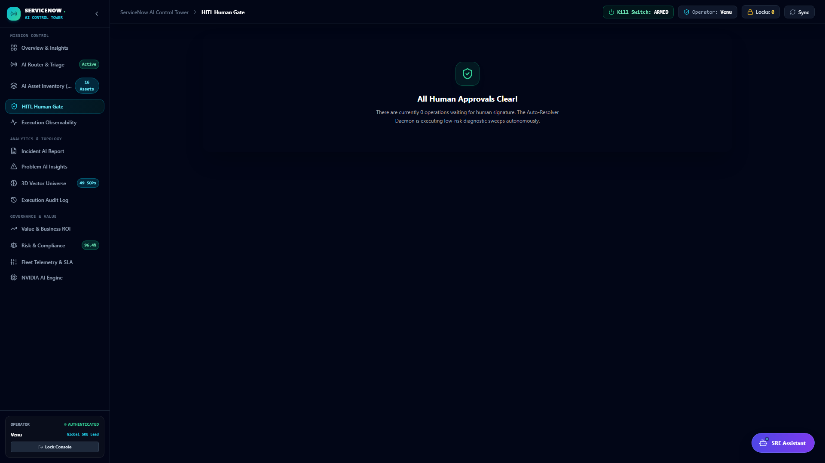
SRE GOVERNANCE
Human-In-The-Loop Governance Queue & Emergency Containment
Strict Governance Controls
🛡️ Pre-Execution Risk Classification
Calculates confidence score (0-100%) and risk level (LOW/MED/HIGH/CRITICAL).
🛡️ HITL Approval Barrier
P1/P2 high-risk modifying actions require explicit human operator approval before SSH execution.
🛡️ Emergency Master Kill Switch
Header toggle immediately terminates active SSH sessions across target hosts.
🛡️ Safety Blacklist Guard
Regex & AST rules prevent destructive commands ('rm -rf /', raw disk overwrites).

Slide 4
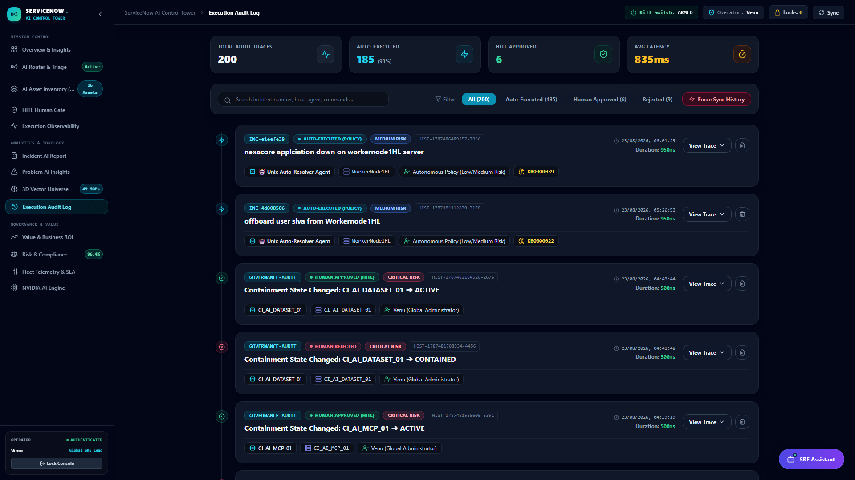
AUDIT LOG & COMPLIANCE
Execution Audit History & Real-Time Ground Truth Persistence
Immutable Execution Proof
📜 Real-Time Execution Capture
Every SSH command, stdout/stderr terminal log, exit code, and duration is logged instantly.
📜 SRE Database Schema (`sre_history`)
Indexed descending on executed_at for sub-millisecond query retrieval by SRE Assistant.
📜 Multi-Agent Diagnostics JSONB
Stores complete router, resolver, and synthesizer thinking traces in PostgreSQL.
📜 Post-Remediation Verification
Automated assertion confirms symptom resolution before closing incident.

Slide 5
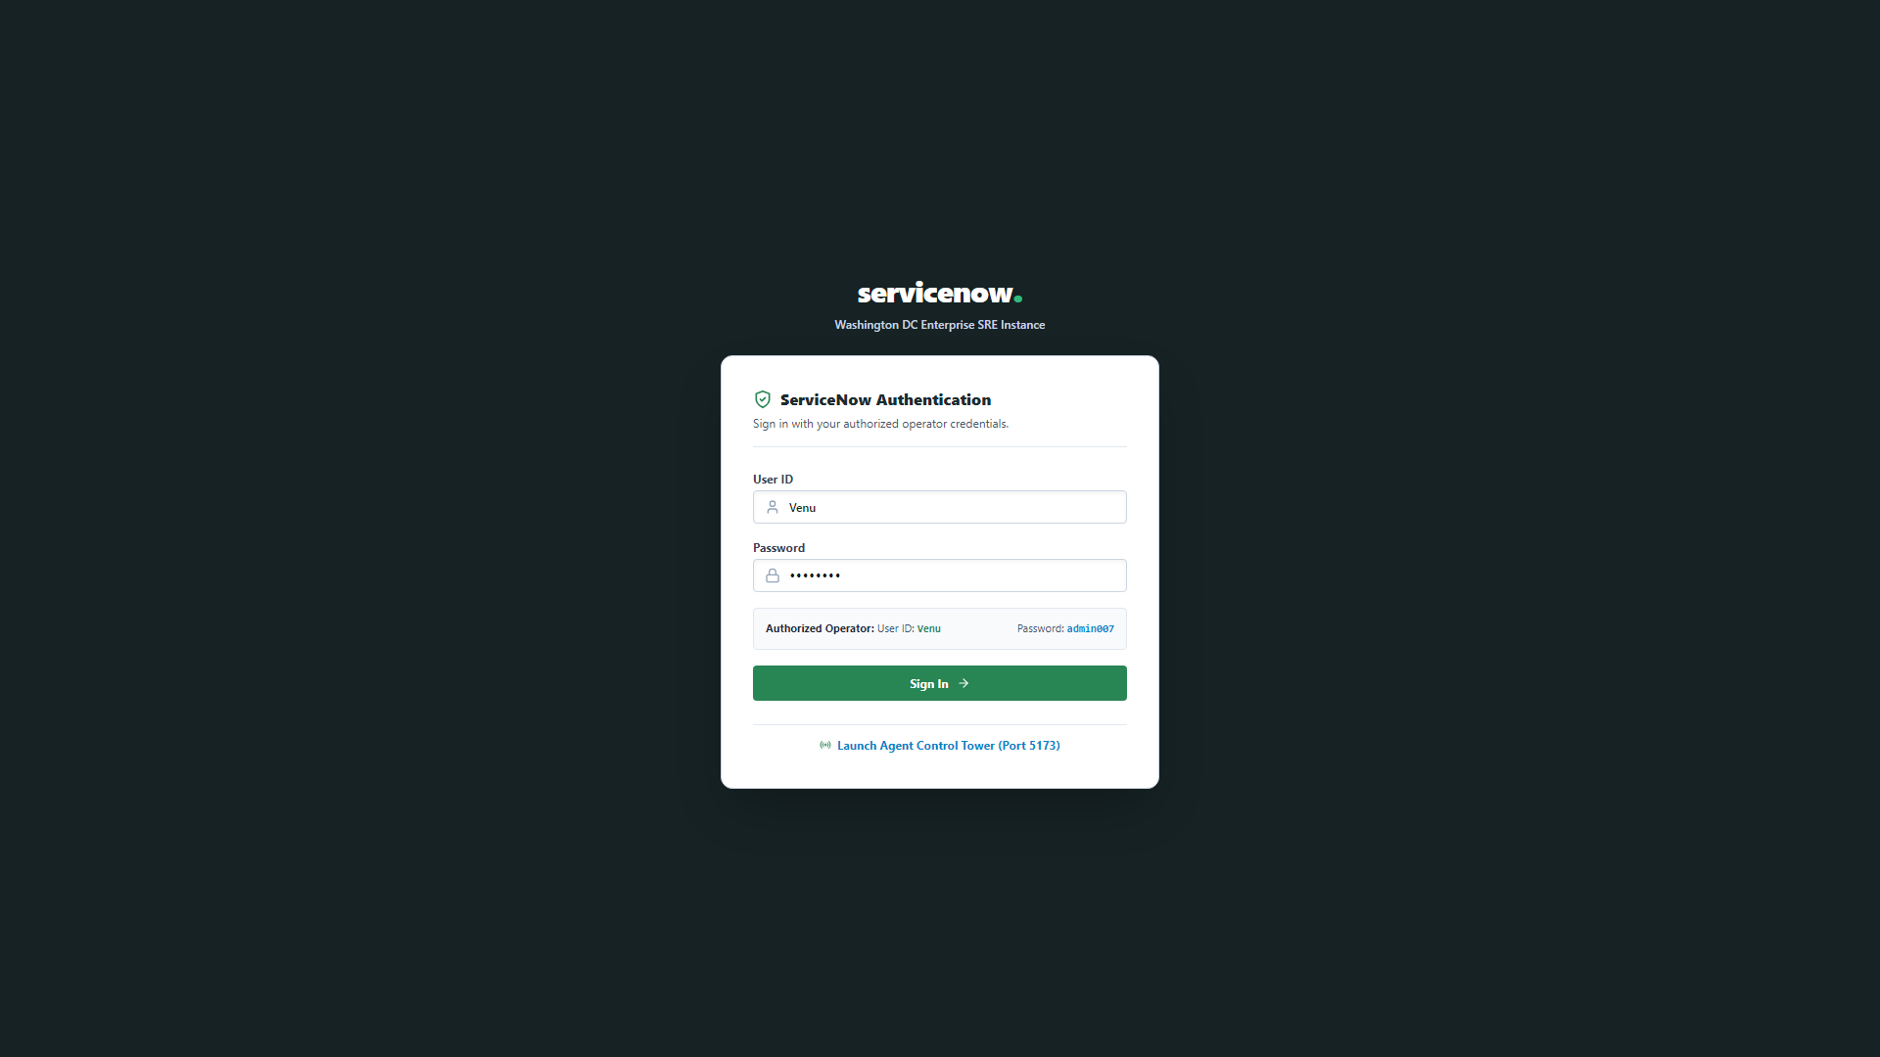
CORE ITSM CONSOLE
Enterprise Helpdesk Console & Bidirectional Status Synchronization
Helpdesk Integration
💻 1,187+ Active Incidents
Full relational ticket lifecycle management with role-based filtering and instant search.
💻 44 Master SOP Articles
Rich knowledge base runbooks with symptoms, root causes, and verification steps.
💻 Bidirectional Sync
Status transitions (NEW -> IN_PROGRESS -> RESOLVED) propagate instantly between Helpdesk and Control Tower.
💻 Activity Timeline Proofs
SRE agent execution notes and terminal logs render cleanly in the ticket work notes.

Slide 6
BUSINESS & SRE METRICS
Demonstrated Production Performance & Value Realization
45 Min → 14.8 Sec
MTTR Acceleration
98.2% reduction in Mean Time To Resolution for common infra failures.
92.4%
Auto-Resolution Rate
Over 90% of routine incidents resolved without human intervention.
0.69s
LLM Routing Latency
Sub-second triage with optimized Nemotron 3.5 non-thinking prompts.
$0.037
Average Incident Cost
Low token consumption per incident using persistent SSH sessions.

