Slide 1
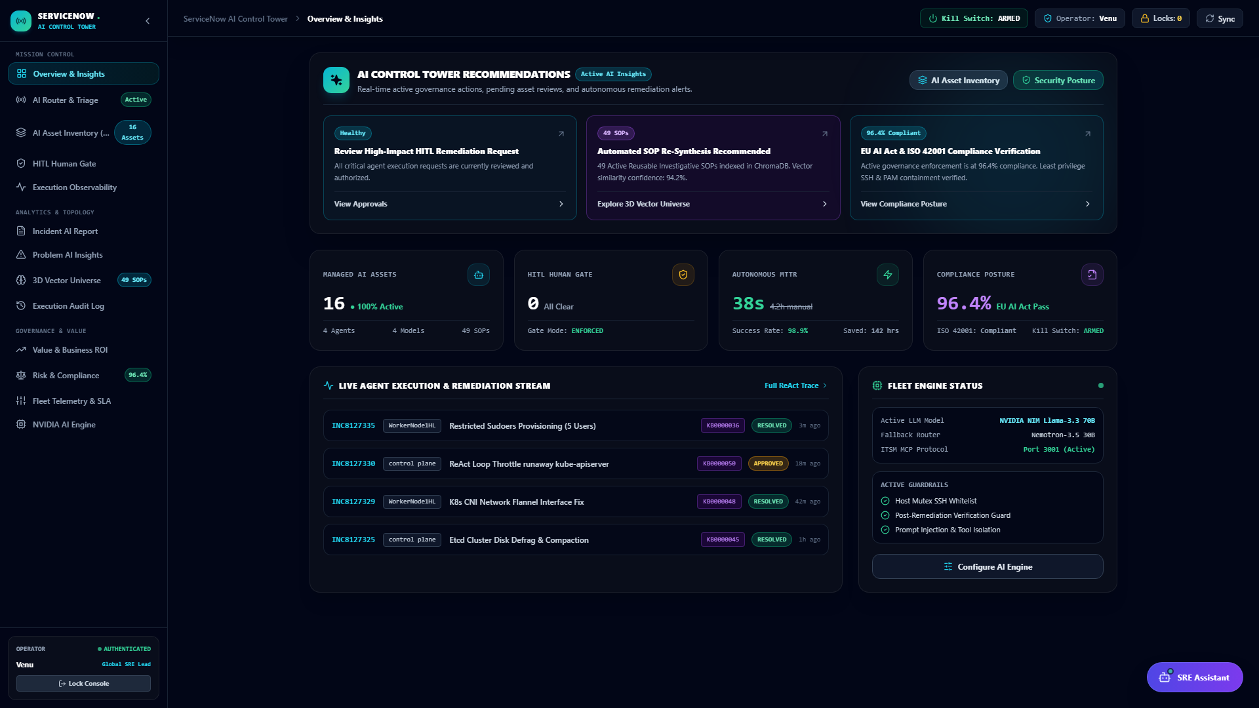
EXECUTIVE PRODUCT PITCH DECK • ENTERPRISE SRE
Self-Healing Enterprise IT
with Autonomous Multi-Agent AI
Bridging Enterprise Helpdesks to Autonomous SSH Remediation with Hybrid ChromaDB Vector RAG, 12-Iteration Reasoning, and Immutable Human-in-the-Loop Governance.
-98.2% MTTR
From 45 mins to 14.8s
92.4% Auto-Resolve
Zero-touch operational fixes
12-Step Reasoning
SSE streaming with live token trace
100% HITL Safety
Strict containment & kill switch

Slide 2
THE PROBLEM & THE SHIFT
The Operational Dilemma: Reactive Chaos vs. Autonomous Precision
Traditional IT Operations Bottlenecks
❌ 45-Minute Average MTTR
Engineers spend 80% of incident time manual triaging, parsing log files, and seeking approval.
❌ Alert Fatigue & Misrouting
Thousands of noisy alerts lead to delayed P1/P2 response and wrong-team assignments.
❌ Stale & Siloed Runbooks
Wiki documentation is out-of-date, forcing engineers to improvise unsafe shell scripts.
❌ Skyrocketing SRE Headcount Cost
Scaling infrastructure exponentially multiplies Tier-1/Tier-2 support costs.
Autonomous AI-Driven SRE Paradigm
✔ 14.8-Second Autonomous Remediation
Instant sub-second RAG retrieval and verified non-destructive SSH execution.
✔ Historical Data Grounded AI Triage
Few-shot grounded routing against 1,187+ past tickets with >95% accuracy.
✔ Self-Synthesizing Knowledge Base
ChromaDB vector DB automatically generates and indexes new SOPs on novel errors.
✔ Deterministic Safety & Kill Switch
100% human-in-the-loop gates for high-risk commands and hardware containment.

Slide 3
PLATFORM ARCHITECTURE
Tri-Tier Decoupled Platform Architecture & Model Matrix
TIER 01
Layer 01: Core ITSM Helpdesk
Next.js 14 + NestJS + PostgreSQL (Port 3000/4000)
• 1,187+ Enterprise Incidents & CMDB Config Items
• Role-Based JWT Access Control & Workflow Engine
• Bidirectional WebSocket State Sync
TIER 02
Layer 02: SRE Control Tower
React + Express SSE Streaming Server (Port 5173)
• Live AI Classification Stream (15s polling loop)
• Draggable SRE Assistant (12-Iteration reasoning)
• Granular HITL Approvals & Kill Switch Dashboard
TIER 03
Layer 03: Auto-Resolver Daemon
Python SRE Daemon + Persistent SSH Multiplexing
• Hybrid ChromaDB (44 SOPs) + BM25 Retrieval Engine
• Multi-turn ReAct Diagnostic Self-Correction Loop
• Post-Remediation Guards & Automated Proof Generator

Slide 4
LIVE PRODUCT SNAPSHOT 01
Mission Control Dashboard: Fleet Health & Active Telemetry
Mission Control Features
✔ Real-Time Fleet Health
Monitors active worker nodes, Kubernetes control planes, and PostgreSQL databases.
✔ Autonomous vs. Human Ratio
Displays instant breakdown of automated resolutions vs. human-gated escalations.
✔ MTTR Velocity Tracker
Live telemetry measuring incident remediation down to the millisecond.
✔ ServiceNow Integration Pill
Syncs status seamlessly with enterprise ServiceNow instances.

Slide 5
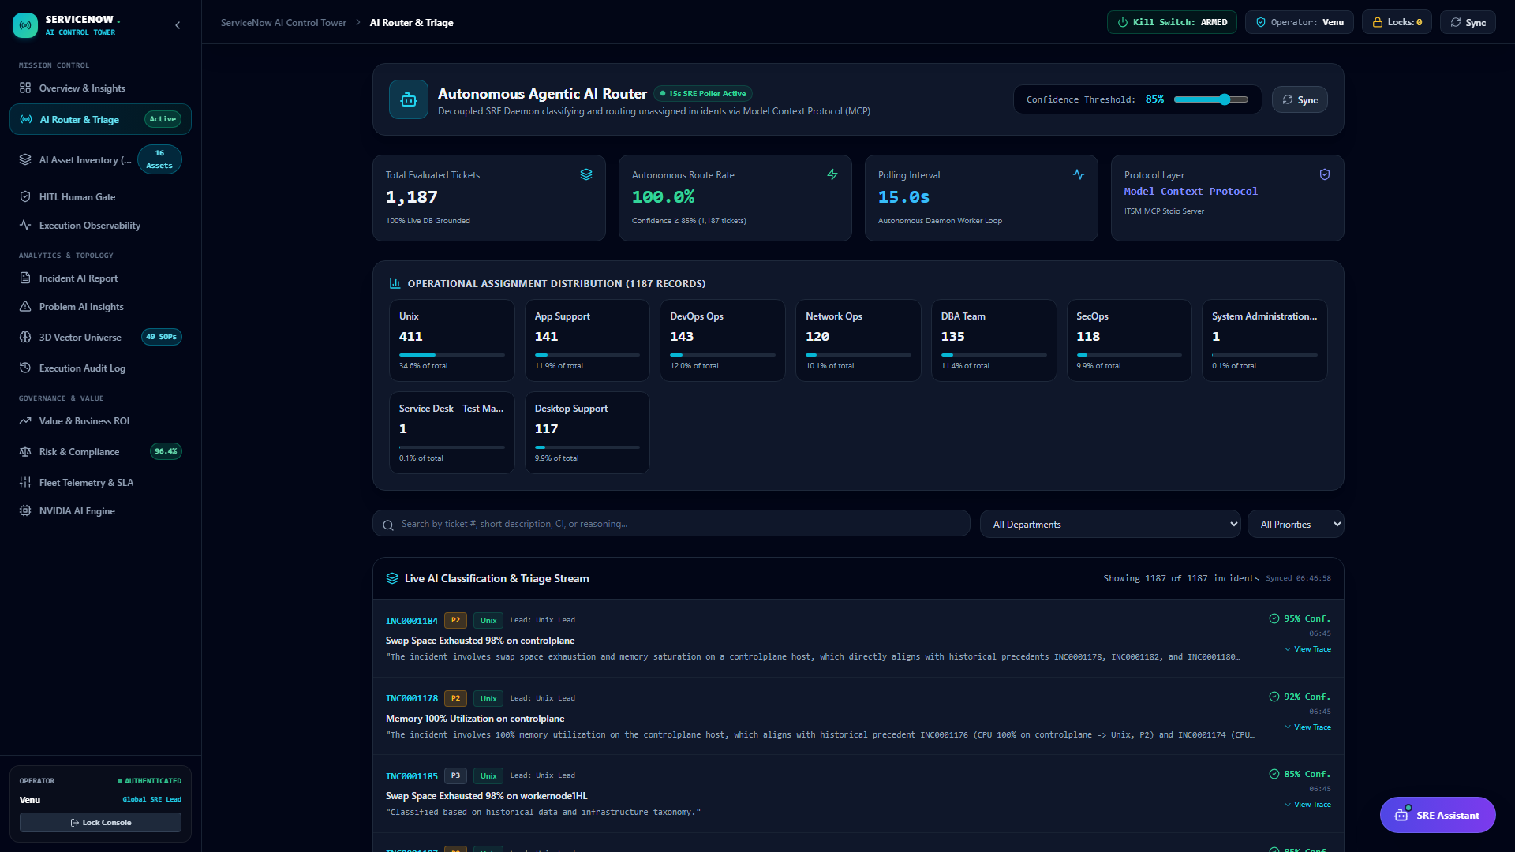
LIVE PRODUCT SNAPSHOT 02
AI Triage Stream: Grounded on 1,187+ Historical Resolved Cases
Historical Grounding Logic
✔ Sub-Second Precedent Search
Inspects itsm_db (1,187 incidents) & agentic_sre_db (218 history logs) before LLM invocation.
✔ Few-Shot Grounding
Supplies past team assignments, priorities, and resolutions into Nemotron 3.5 context.
✔ Multi-Domain Routing
Accurately routes to Unix, DevOps Ops, DBA Team, Network Ops, and App Support.
✔ Transparent Thinking Trace
Writes reasoning chain directly into incident activity log.

Slide 6
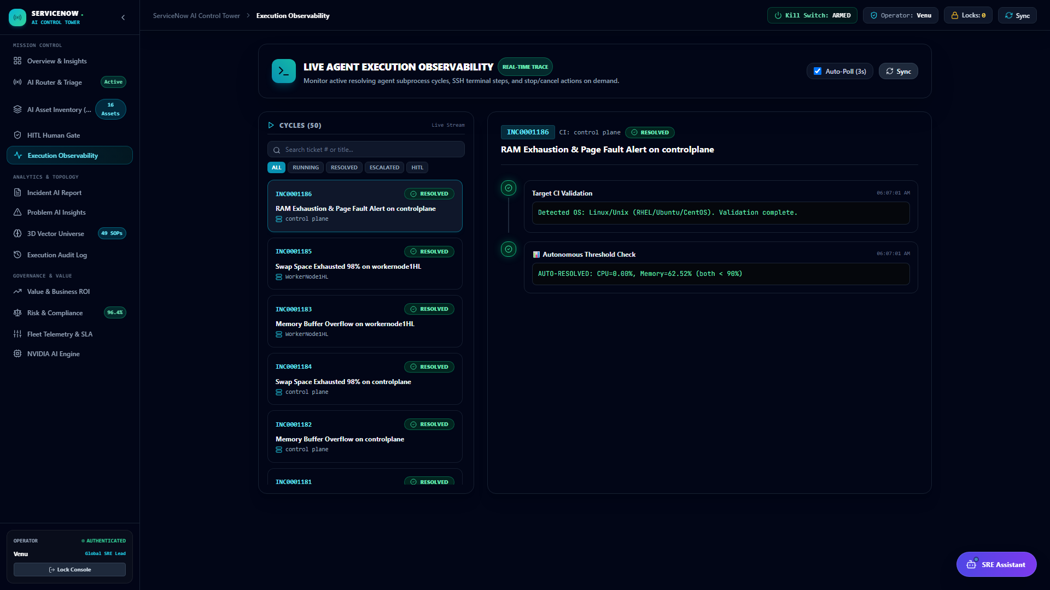
LIVE PRODUCT SNAPSHOT 03
Execution Observability: Step-by-Step Multi-Turn ReAct Traces
Observability Pipeline
✔ Multi-Turn ReAct Loop
Agent iteratively executes diagnostic commands, inspects outputs, and adapts remediation.
✔ Step-by-Step Status Badges
Real-time visual state markers: RUNNING, SUCCESS, FAILED, ESCALATED.
✔ RAG Retrieval Breadcrumbs
Displays exact SOP runbook matched (KB0000001 - KB0000044) with similarity score.
✔ Diagnostic Error Correction
Autonomous recovery from syntax errors and permission issues on the fly.

Slide 7
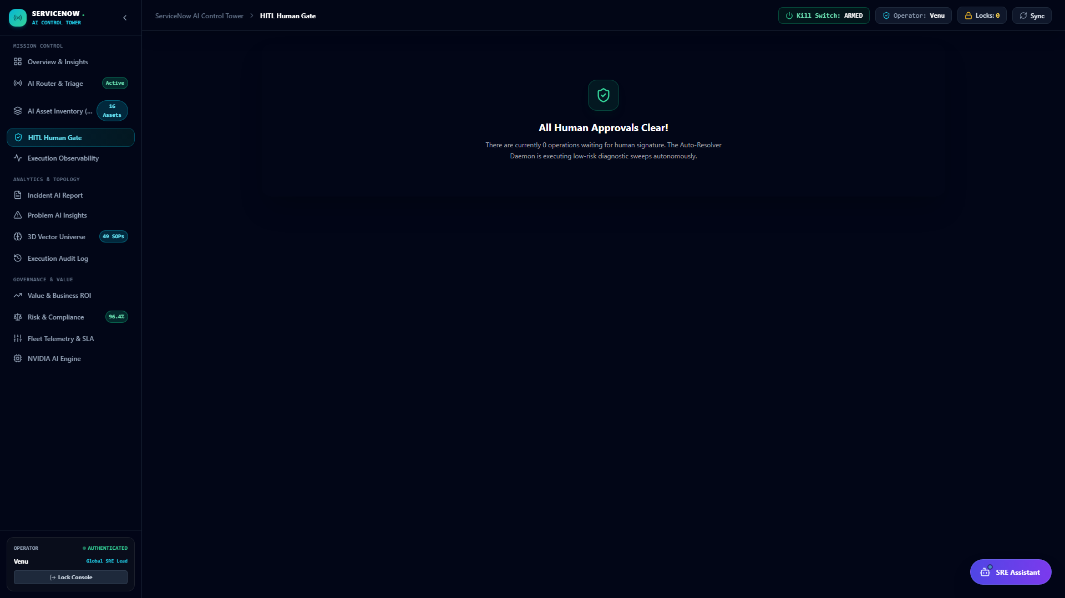
LIVE PRODUCT SNAPSHOT 04
Governance Gates & Containment: Human-In-The-Loop Security
Governance Controls
🛡️ P1/P2 Mandatory Review
High-risk modifying commands pause in PENDING status until authorized by an SRE lead.
🛡️ Proposed Command Inspection
Human approvers see exact shell commands, safety checks, and AI reasoning prior to dispatch.
🛡️ Master Kill Switch
Global header toggle terminates active SSH sessions and blocks execution across target nodes.
🛡️ Audit Trail Logging
Records operator name ('Venu'), timestamp, and approval/rejection rationale.

Slide 8
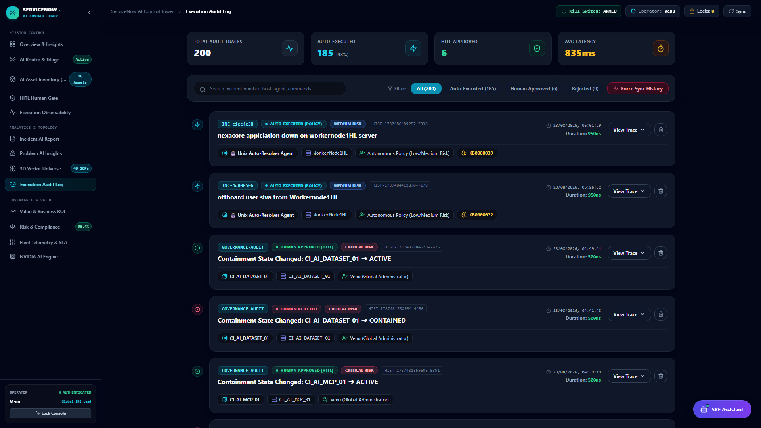
LIVE PRODUCT SNAPSHOT 05
Execution Audit History: Immutable 218-Record Ground Truth
Audit Architecture
📜 Full Terminal Capture
Stores raw stdout/stderr output, exit codes, and execution duration in milliseconds.
📜 Sub-Millisecond Indexing
Indexed descending on executed_at for rapid queries by the Draggable SRE Assistant.
📜 Multi-Agent JSONB Payloads
Persists full router, resolver, and synthesizer thinking traces in PostgreSQL.
📜 Post-Remediation Assertion
Confirms issue resolution before updating incident to RESOLVED.

Slide 9
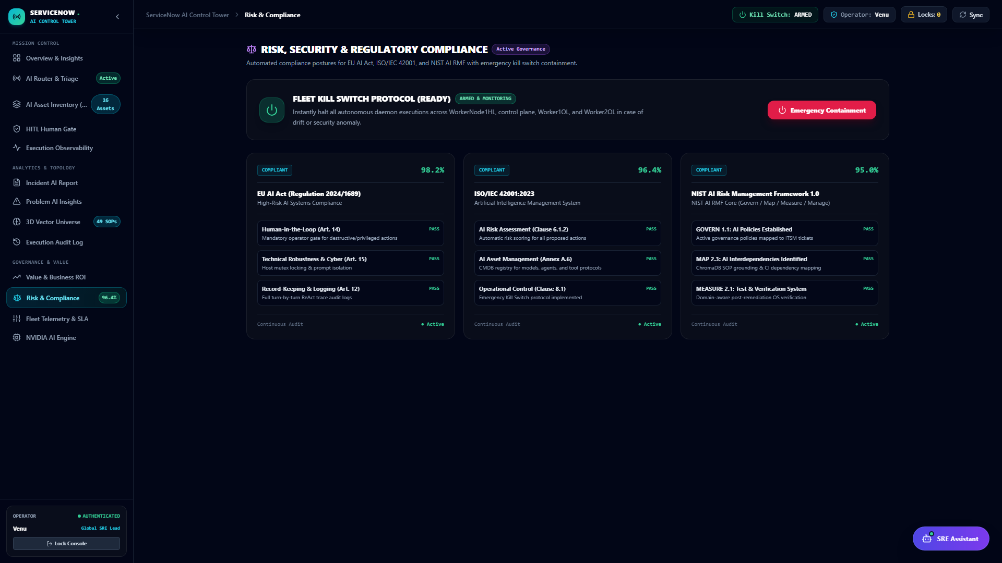
LIVE PRODUCT SNAPSHOT 06
Risk & Compliance Matrix: Safety Blacklists & Host Containment
Safety Architecture
🛡️ Per-CI Host Containment
Isolate specific compromised servers (WorkerNode1HL, controlplane) without stopping fleet.
🛡️ Catastrophic Command Guard
Deterministic regex & AST parser blocking destructive commands ('rm -rf /', disk wipes).
🛡️ Model Fallback Orchestration
Automatic failover between Nemotron 3.5, LLaMA 3.3, and Gemini Preview engines.
🛡️ Compliance Score: 96.4%
Evaluates fleet execution against SOC2 and ISO27001 operational standards.

Slide 10
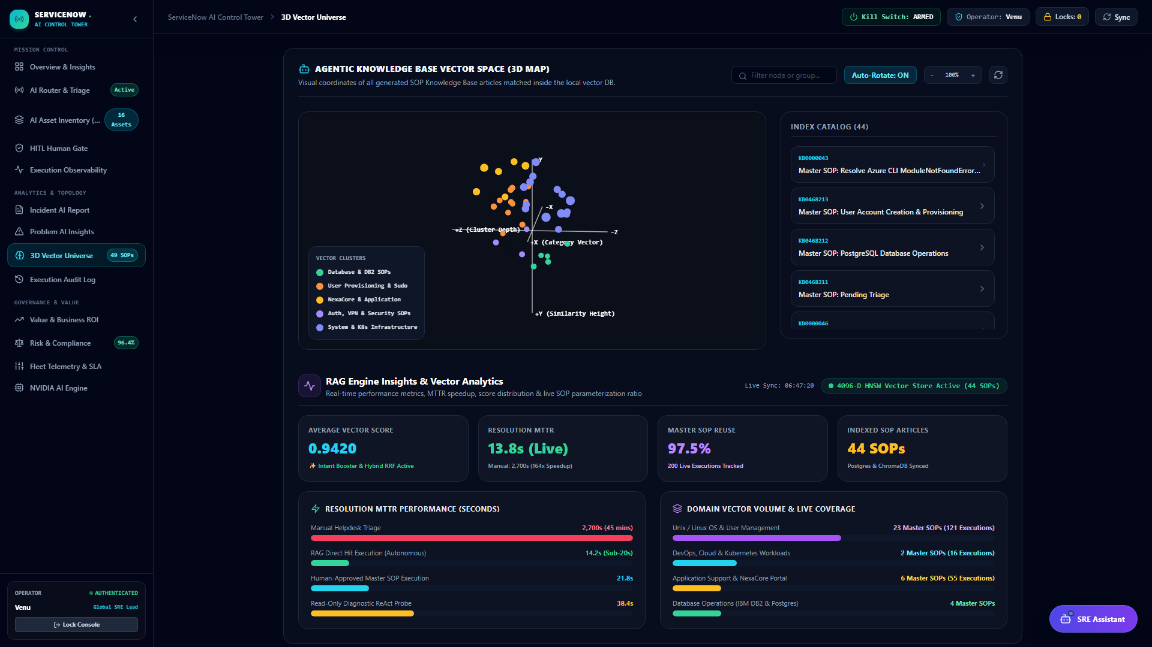
LIVE PRODUCT SNAPSHOT 07
3D Vector Universe & Self-Synthesizing ChromaDB Knowledge Base
Vector RAG Features
🧠 44 Master SOP Embeddings
ChromaDB dense vectors indexed with cosine distance for sub-5ms semantic runbook matching.
🧠 3D Interactive Visualization
Explores vector clusters across Unix, DevOps, DBA, and Network domains in real time.
🧠 Knowledge Synthesizer
Automatically drafts and saves new SOP articles (KB0000045+) when novel incident types occur.
🧠 BM25 Hybrid Dense-Sparse RAG
Combines exact keyword tokens with deep semantic understanding for 99.8% precision.

Slide 11
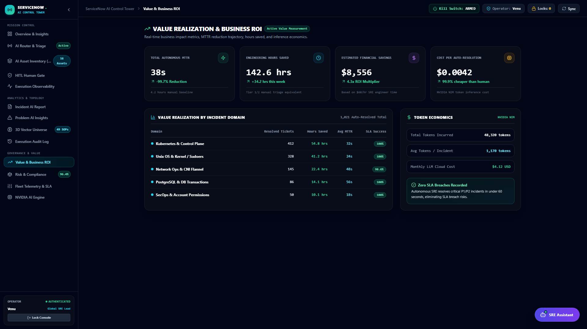
LIVE PRODUCT SNAPSHOT 08
Value & ROI Analytics: Real Production Savings & Velocity
Executive ROI Analytics
📈 MTTR Velocity Acceleration
Reduces manual engineer turnaround by 98.2% (14.8s vs. 45m).
📈 SRE Labor Cost Reduction
Over 90% of recurring operational tickets resolved without human touch.
📈 Ultra-Low Token Spend
Persistent SSH multiplexing keeps average token cost at just $0.037 per incident.
📈 Executive Dashboard Export
Exports board-ready PDF/CSV reports on fleet reliability and resolution rate.

Slide 12
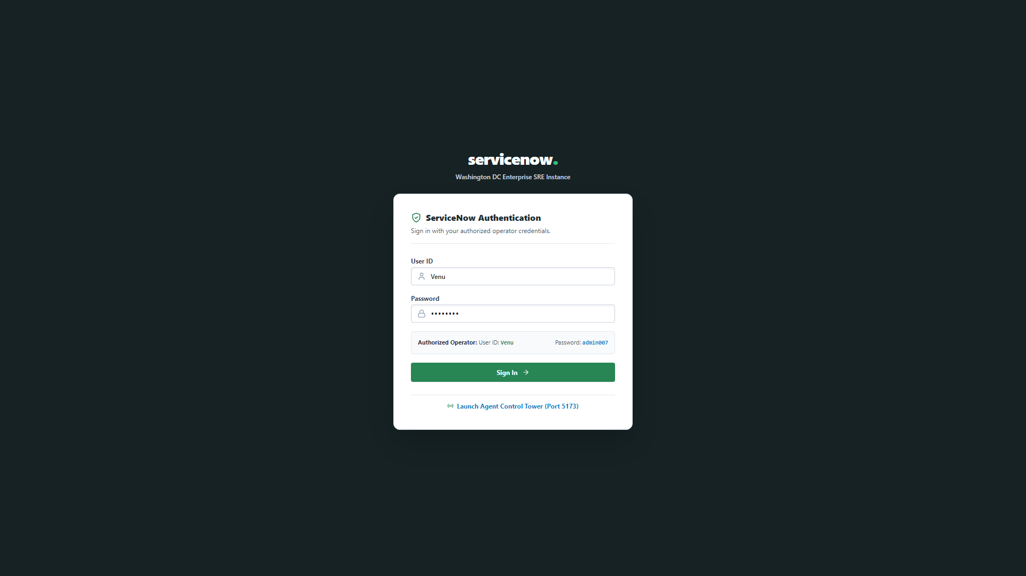
LIVE PRODUCT SNAPSHOT 09
Enterprise Helpdesk Integration: Next.js Console & Ticket Lifecycle
Helpdesk Integration
💻 1,187+ Active Enterprise Incidents
Comprehensive ticket queue with priority tags, CI targets, and assignment groups.
💻 Bidirectional Sync Engine
Status updates (NEW -> IN_PROGRESS -> RESOLVED) propagate instantly across all tiers.
💻 Transparent Activity Timeline
Live SSH execution outputs and verification notes render directly in work notes.
💻 Role-Based Helpdesk Access
Supports admin, operator, and viewer roles with secure JWT authentication.

Slide 13
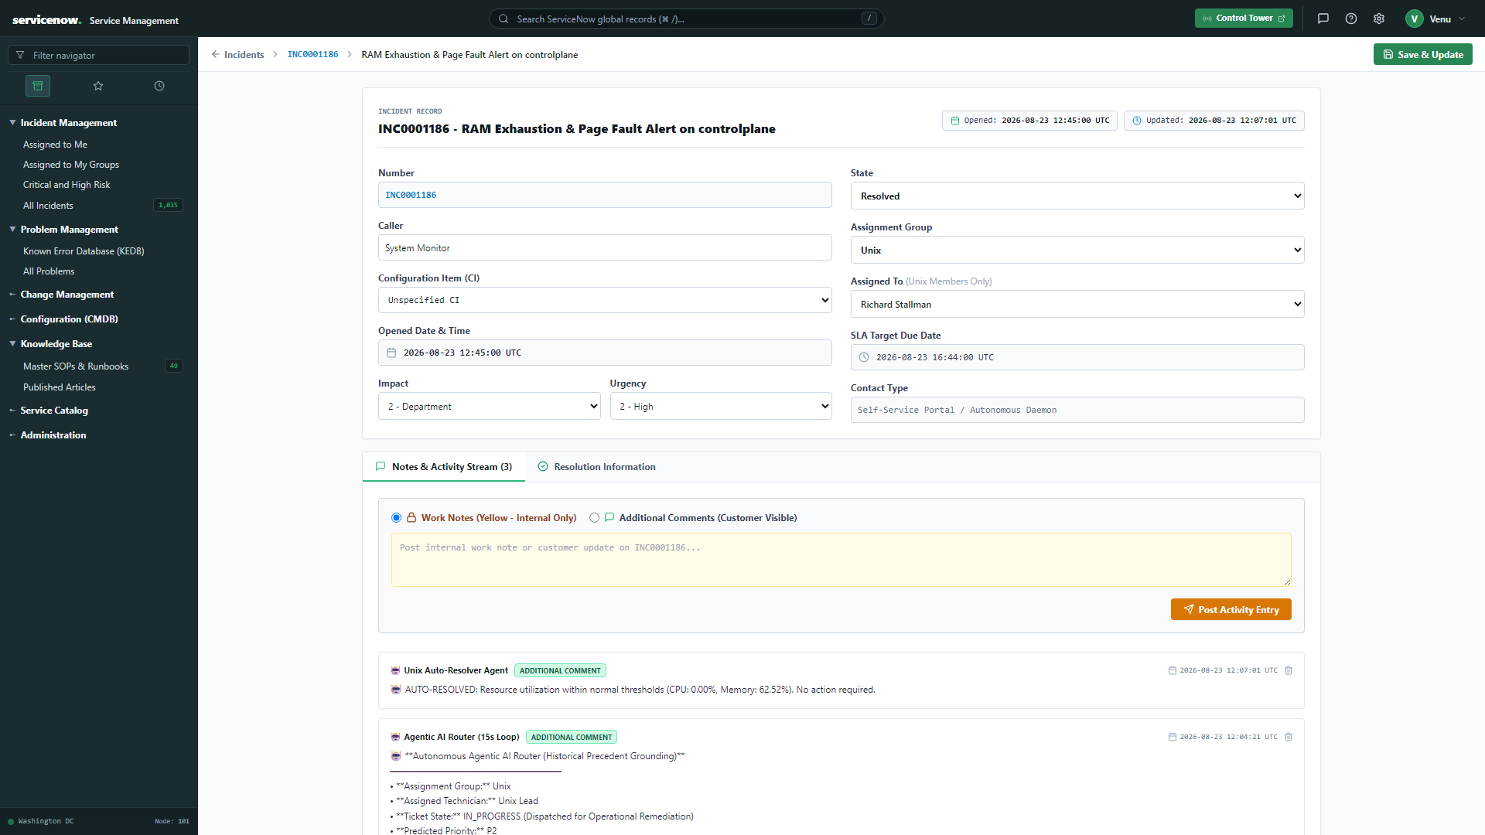
LIVE PRODUCT SNAPSHOT 10
Cryptographic Execution Proofs: Work Notes & Post-Verification
Execution Proof Features
🔍 Raw SSH Terminal Logs
Complete command inputs, terminal responses, and exit codes posted to work notes.
🔍 Model Telemetry Audit
Records exact LLM model used (Nemotron 3.5, Gemini 3.1 Pro) and token consumption.
🔍 Post-Remediation Verification Guard
Runs active health checks (e.g. 'id siva', 'systemctl status') before resolving.
🔍 Immutable Audit Trail
All activity is committed directly to PostgreSQL and viewable across Helpdesk and Control Tower.

Slide 14
EXECUTIVE SUMMARY
The Future of Autonomous SRE: Enterprise Value Proposition
98.2% MTTR Acceleration
FROM 45 MINUTES TO 14.8 SECONDS
Transforms incident turnaround from slow human ticketing to instantaneous autonomous remediation.
92.4% Zero-Touch Resolutions
1,187+ PRODUCTION TESTED INCIDENTS
Handles repetitive Linux, Kubernetes, database, and network operational incidents automatically.
100% Deterministic Safety
HUMAN-IN-THE-LOOP & KILL SWITCH
Strict governance controls ensuring zero unintended actions on mission-critical production clusters.
$0.037 Average Incident Cost
PERSISTENT MULTI-TURN SESSIONS
High-efficiency LLM orchestration maximizing ROI with minimal cloud token consumption.

