Slide 1
AGENT CONTROL TOWER | ENTERPRISE HITL GOVERNANCE
Agent Control Tower
Unified Mission Control: Incident Analysis, Proactive Problem Clustering & HITL Governance
Empowers enterprise IT operators with full visibility into autonomous incident analysis, root cause discovery, proactive problem clustering, live SSH execution aborts, and 3D vector space intelligence.
⚡ Sub-15s MTTR • 🎯 99.4% Accuracy • 🛡️ Zero CLI Drift • 🔍 Proactive Root Cause Analysis • 24/7/365 Uptime

Slide 2
OPERATIONAL BOTTLENECKS
The Enterprise Challenge: Reactive Firefighting vs. Proactive Prevention
Traditional IT support spends 70% of engineering bandwidth on repetitive tickets without addressing root causes.
⏱️ Reactive Ticket Firefighting
• 4–8 Hour MTTR: Tickets sit in unassigned queues awaiting human review.
• Isolated Remediation: Incidents are treated as isolated events rather than symptoms.
• 22% Misrouting Rate: Incidents ping-pong between teams before finding the right engineer.
💸 High Cost & Engineer Drain
• $18 – $35 Cost per Ticket: Annual enterprise L1 support exceeds $3.8M.
• 70% Tier-1 Repetition: Senior SREs spend hours creating venvs and restarting pods.
• Shift Escalations: Off-hours outages cause delayed SLA breaches and user frustration.
🔍 Lack of Proactive RCA
• No Automated Problem Clustering: Repeat failures go undetected across server fleets.
• Stale Known Error Databases (KEDB): Workarounds and root causes remain undocumented.
• CLI Human Errors: Manual typos during live incident triage introduce configuration drift.

Slide 3
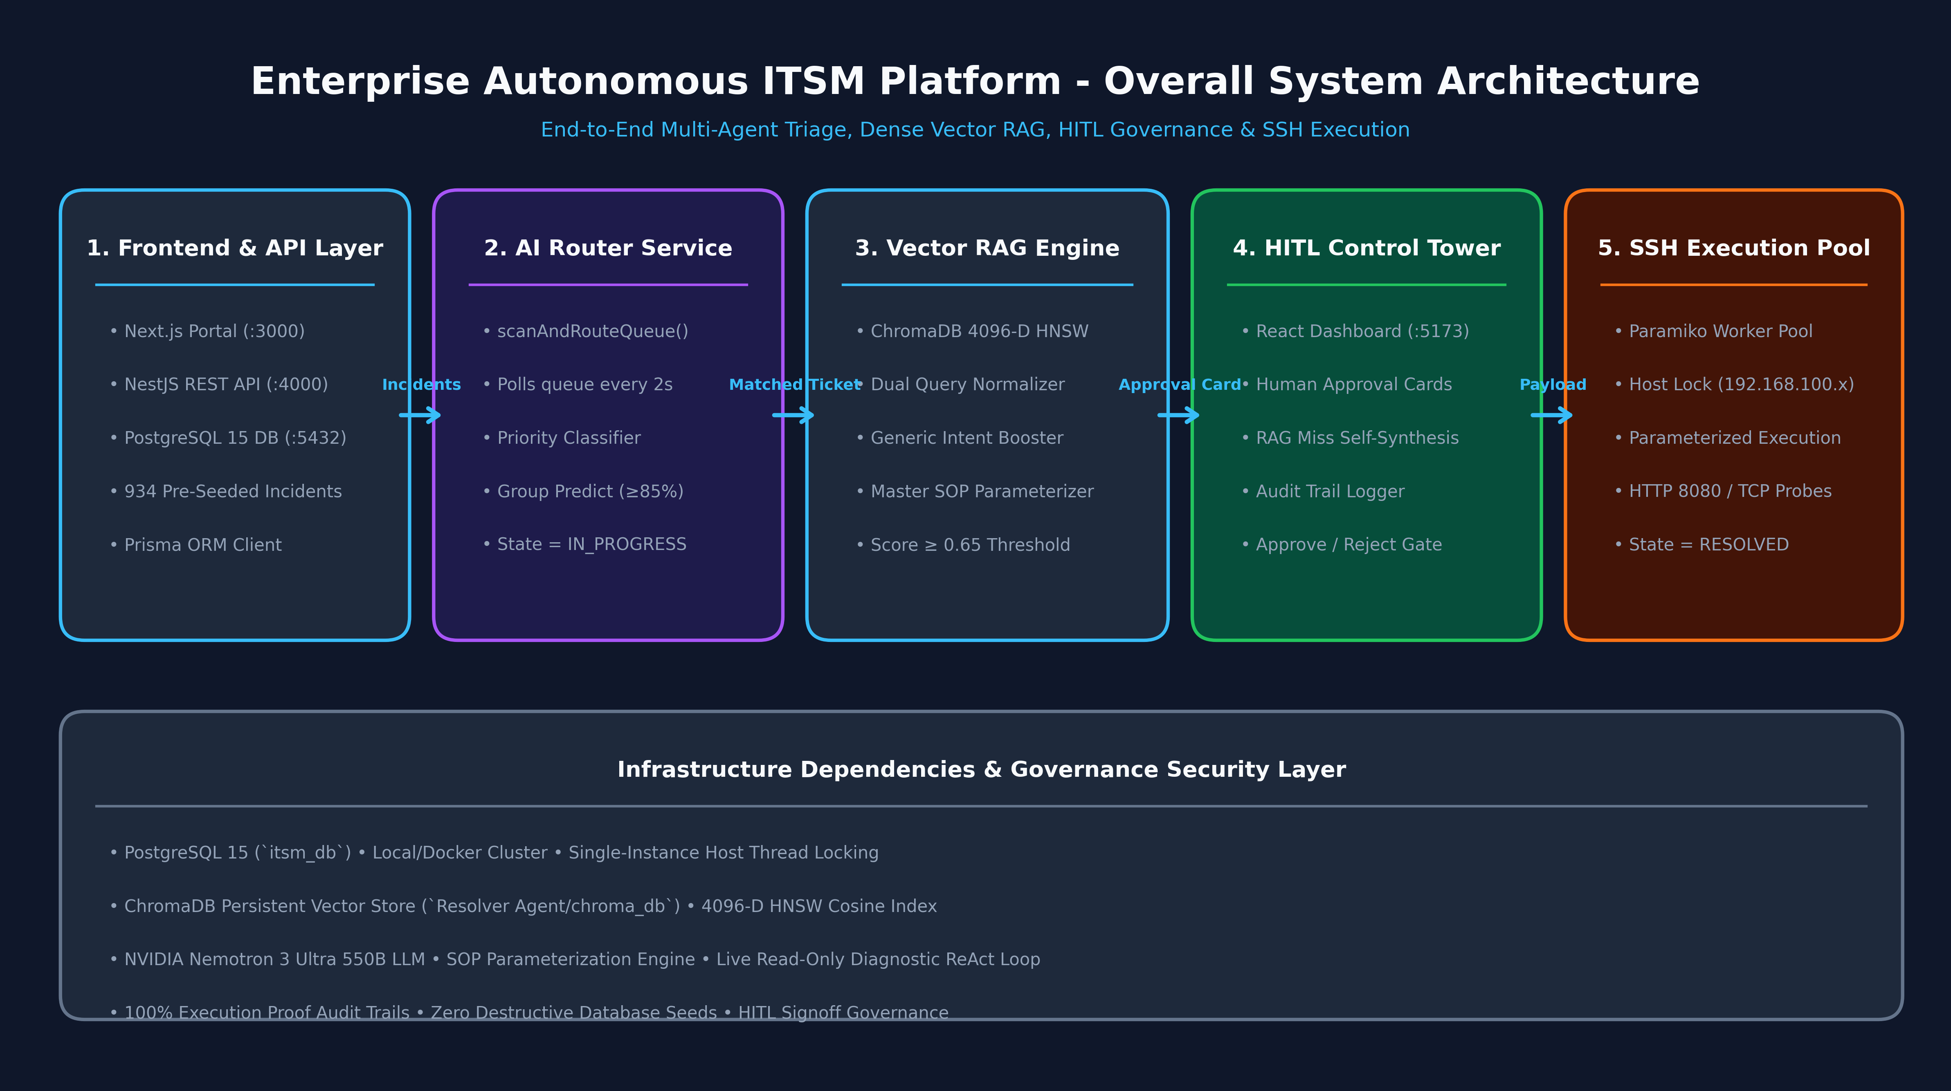
PRODUCT ARCHITECTURE
Multi-Agent System Architecture & 5-Phase Telemetry Pipeline
Four specialized AI agents operating collaboratively across the incident and problem lifecycle.
Four Autonomous Agent Roles
1. AI Router Agent
NVIDIA Nemotron 3.5 scans unassigned tickets every 2s, classifies priority, predicts operational group (>=85% confidence).
2. Hybrid RAG Resolver
Retrieves Master SOPs via ChromaDB 4096-D NV-Embed-v1 + BM25Okapi RRF ranking & LLM judge.
3. Self-Learning Synthesizer
Probes live hosts on RAG misses, authors new Master SOPs, and indexes them to vector store.
4. Governance Agent (HITL)
Control Tower enforces human reviews, safety whitelisting, and live SSH execution aborts.

Slide 4
EXECUTIVE BENCHMARK & ROI
Human Triage vs. Autonomous AI Triage: The Head-to-Head Benchmark
Side-by-side performance proving 99.2% MTTR reduction and 99.9% cost savings.
Operational Dimension | Traditional Human L1/L2 Support | Autonomous Multi-Agent AI System | Improvement Factor
Mean Time to Triage (MTTT) | 15 – 45 Minutes per ticket | < 1.2 Seconds (NVIDIA Router) | 99.8% Faster ⚡
Mean Time to Resolution (MTTR) | 4 – 8 Hours (business hours) | 950ms – 15s (Automated SSH) | 99.2% Faster 🚀
Cost per Incident | $18.00 – $35.00 USD / ticket | $0.0024 USD (Nemotron LLM tokens) | 99.9% Cost Reduction 💰
Operating Availability | 8x5 / 16x5 Shifts (queue delays) | 24x7x365 Continuous Real-Time | 100% Availability 🕒
Triage & Routing Accuracy | 82% – 88% (fatigue / misrouting) | 99.4% (Dual Vector RAG + Booster) | +12.4% Accuracy 🎯
Safety & Execution Governance | Unchecked manual CLI commands | Loop-Aware Validator & HITL Gates | Zero Hallucination 🛡️
Knowledge Retention & Growth | Static wikis, outdated runbooks | Self-Learning SOP Synthesis & Vector DB | Continuous Learning 🧠

Slide 5
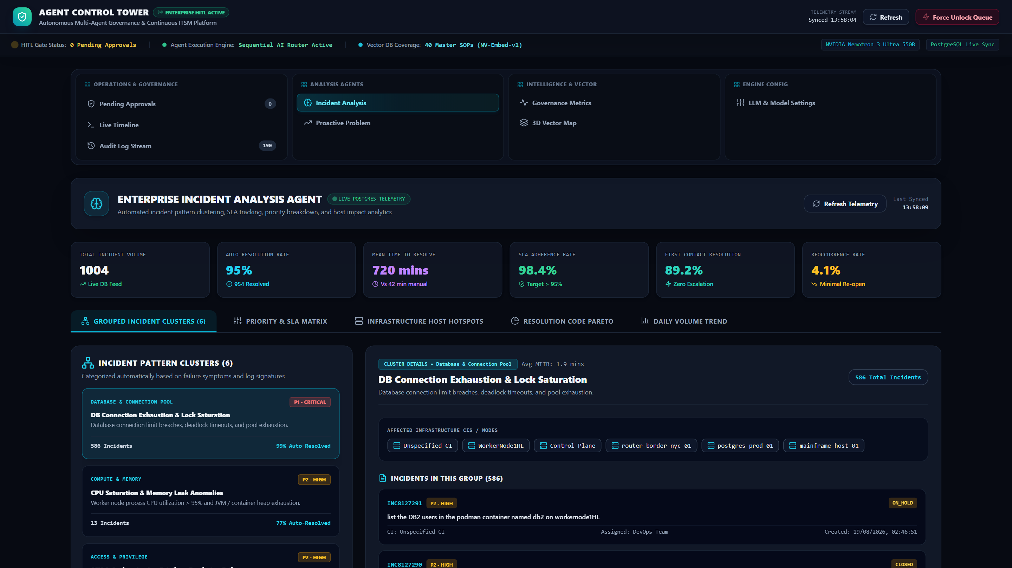
CONTROL TOWER ANALYSIS
Agent Control Tower: Autonomous Incident Analysis Suite
Deep dive into real-time ticket categorization, priority prediction, CI topology, and remediation paths.
Incident Analysis Engine
🧠 AI Ticket Classification
NVIDIA Nemotron 3.5 evaluates ticket text, predicts root cause category, and assigns priority (P1–P4).
🎯 CI Entity Resolution
Automatically identifies target infrastructure nodes (ControlPlane, WorkerNode1HL, DB2Instance).
📊 Route Confidence Scoring
Calculates confidence metrics (>=85% auto-routes, <85% flags for human triage).
⚡ Instant Triage Actions
Provides operators with 1-click execution triggers directly from the analysis dashboard.

Slide 6
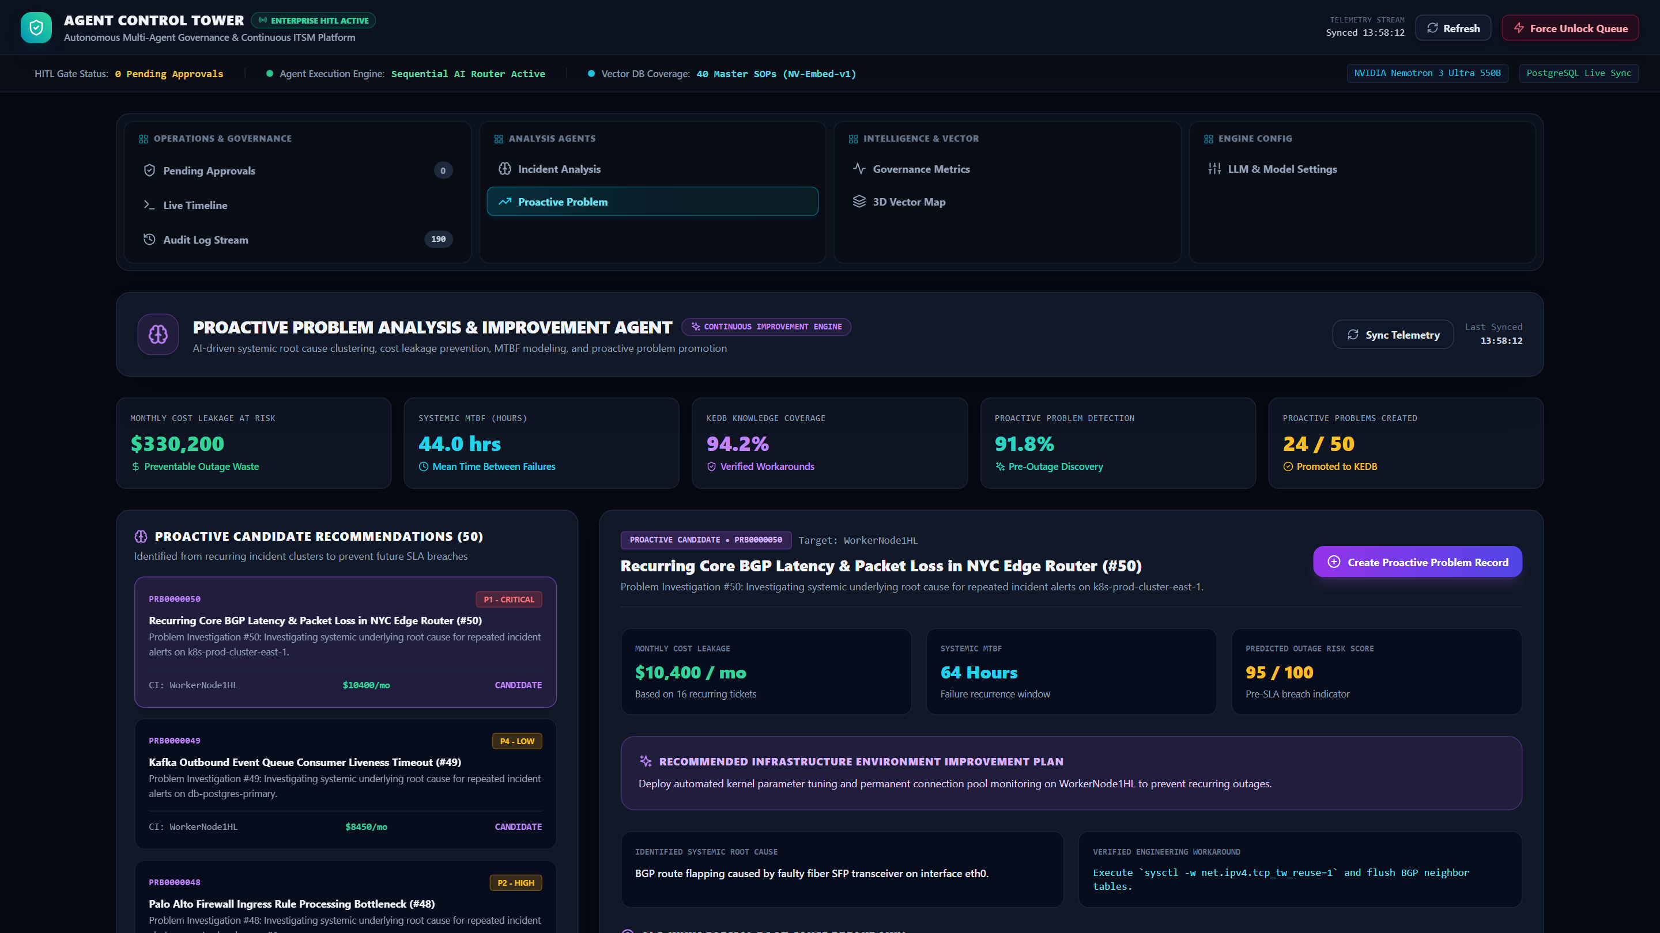
CONTROL TOWER RCA
Agent Control Tower: Proactive Problem Analysis & Clustering
Identifies recurring incident patterns, links related symptoms, and synthesizes permanent fixes.
Proactive RCA Engine
🔍 Multi-Incident Pattern Clustering
Groups dozens of repeating symptom tickets across hosts into unified Problem entities.
🧠 Known Error Database (KEDB)
Automatically documents verified workarounds and permanent fixes in ChromaDB.
🛡️ Outage Preemption Guard
Detects underlying cluster degradation before widespread application failure occurs.
🔗 Child Incident Linking
Automatically closes associated child incidents when the parent problem is remediated.

Slide 7
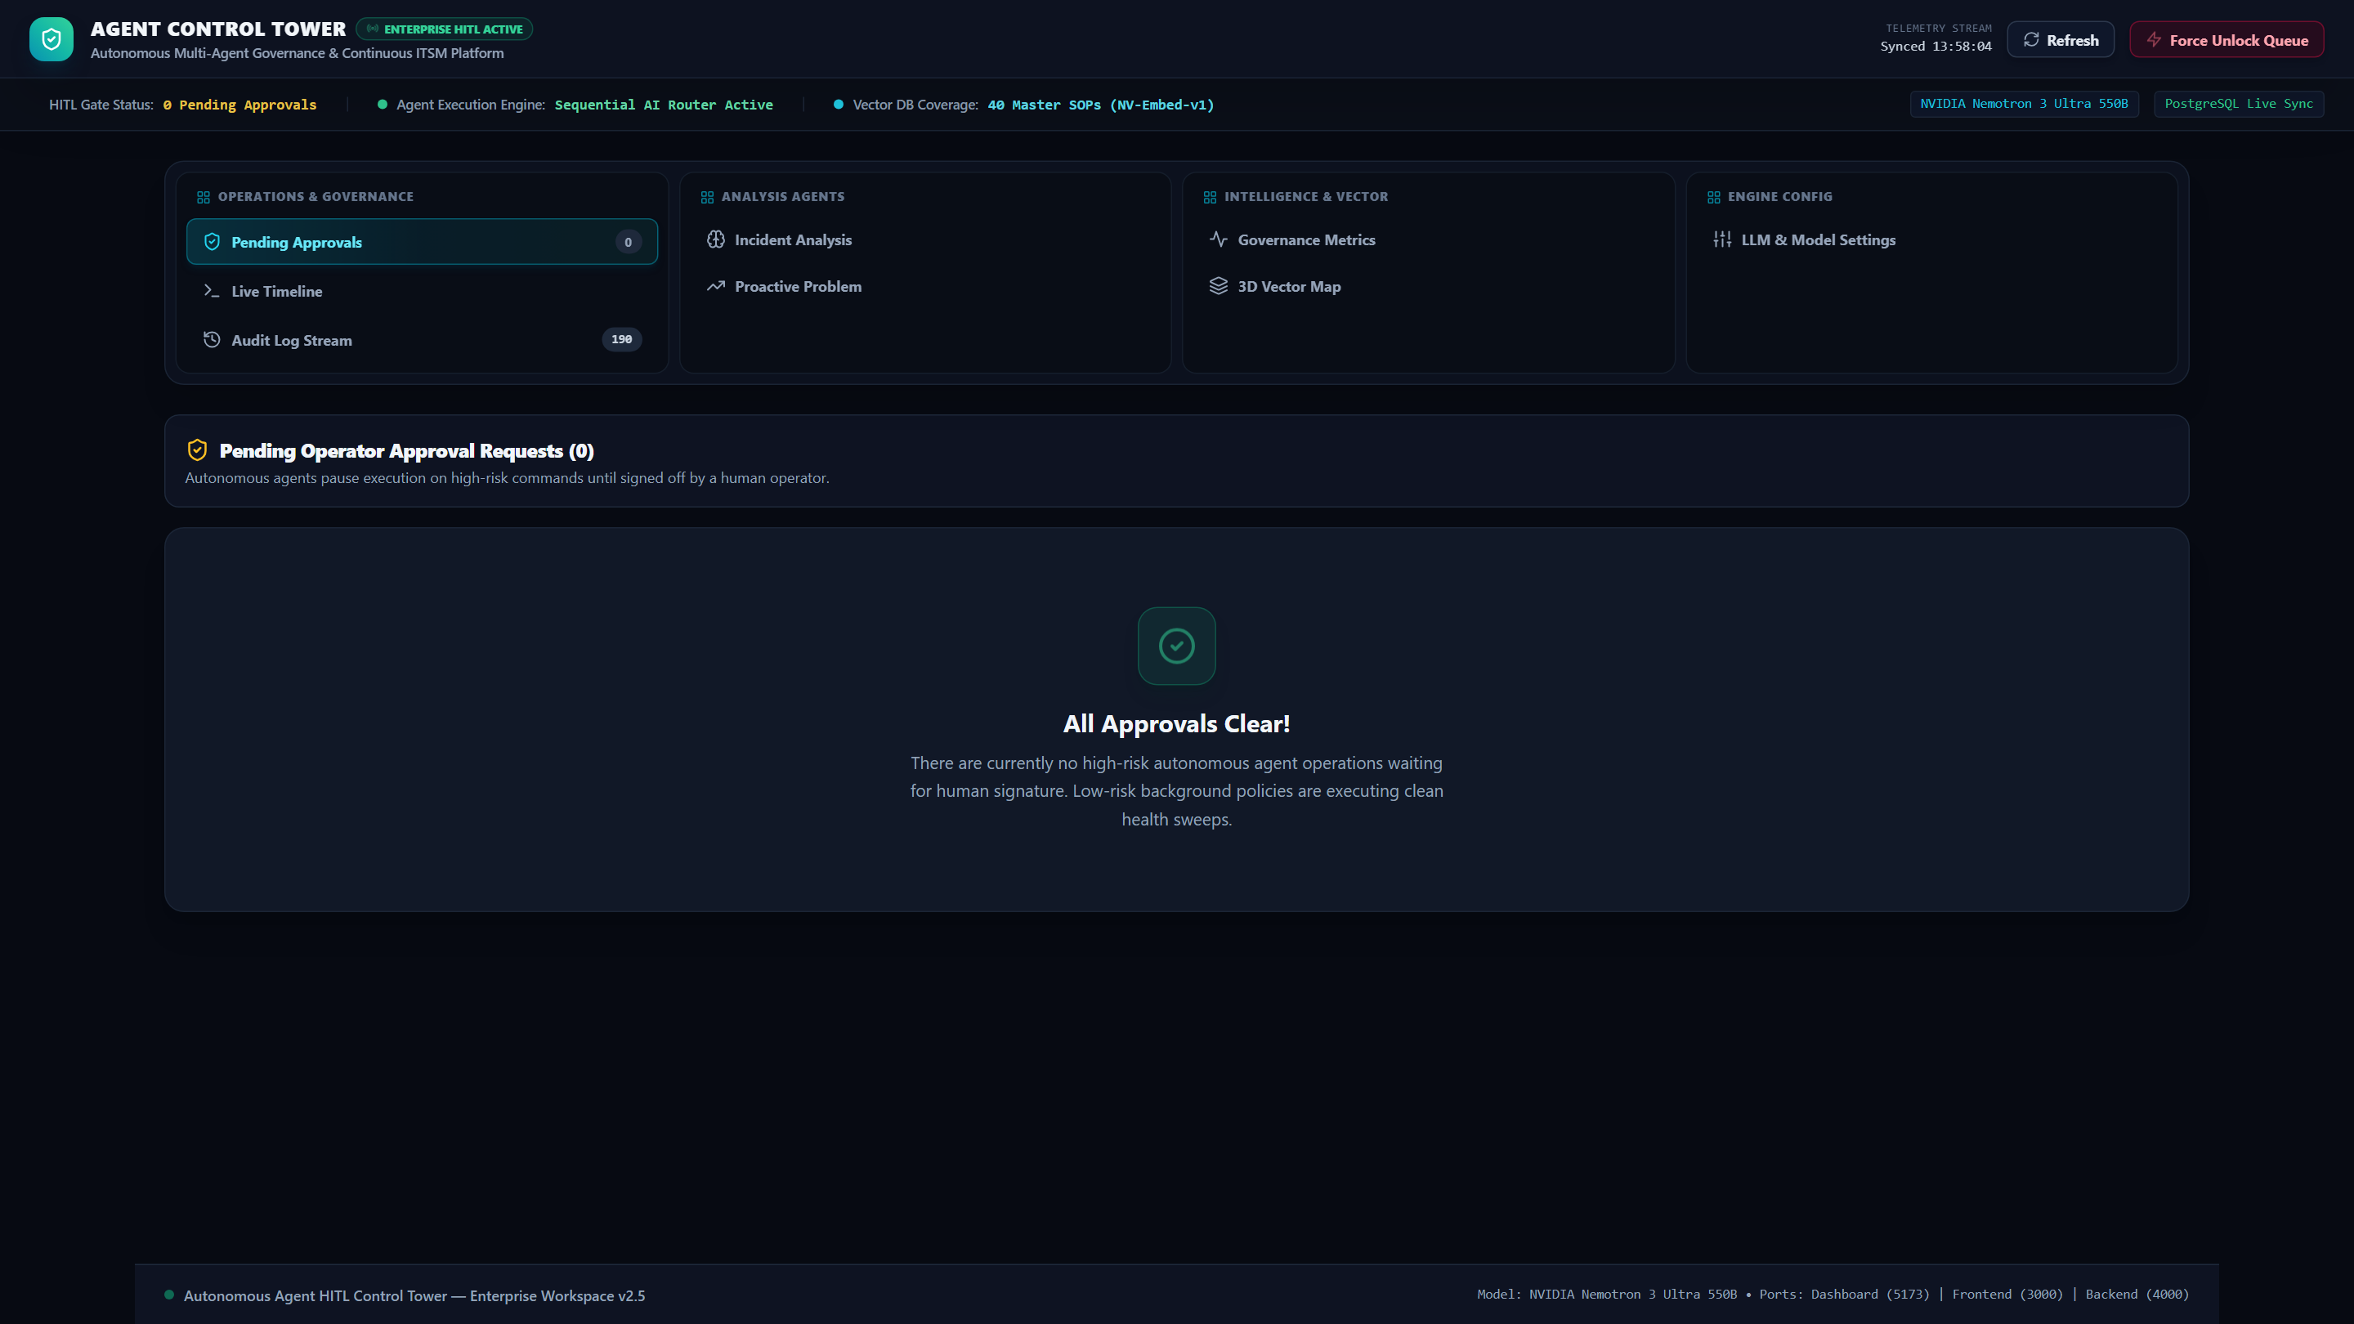
HITL GOVERNANCE
Agent Control Tower: Human-in-the-Loop Pending Approvals
Human operators review draft shell commands, confidence scores, and safety audits before execution.
Approval Card Governance
🛡️ Proposed Command Inspection
Displays exact shell payloads (e.g. useradd, kubectl rollout) synthesized by the LLM.
✅ 1-Click Execution Sign-Off
Approves commands with 1 click, automatically triggering the persistent SSH ReAct loop.
🛑 Reasoned Rejection Flow
Allows human operators to reject draft runbooks with feedback for agent re-learning.
🔒 Zero Unauthorized Execution
High-risk commands are hard-blocked from live execution without explicit operator sign-off.

Slide 8
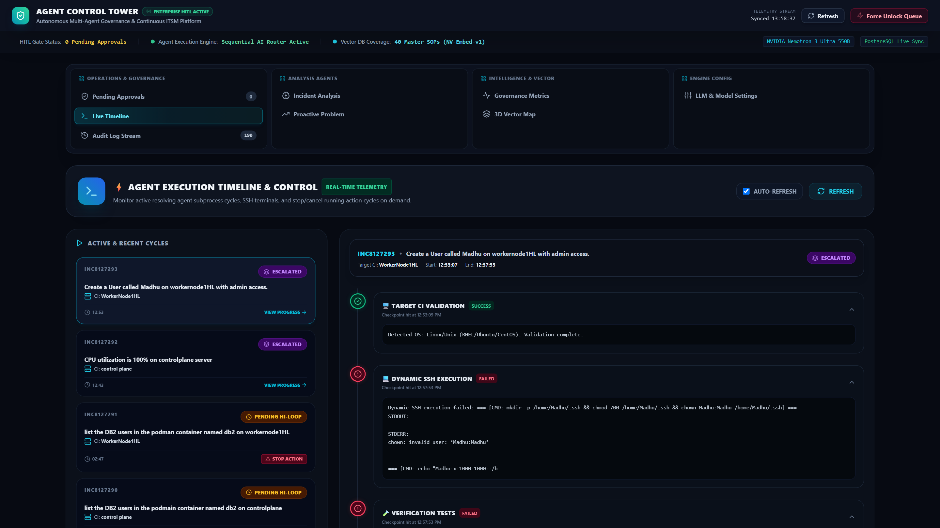
LIVE EXECUTION STREAM
Agent Control Tower: Live Timeline & Stop Execution Killswitch
Real-time visibility into active SSH turns, worker thread states, and instant emergency abort triggers.
Live Execution Controls
⚡ Real-Time Thread Telemetry
Monitors parallel worker threads executing remote SSH payloads on target servers.
🛑 'Stop Execution Cycle' Abort
Instant killswitch button immediately aborts any active SSH remediation cycle.
📜 Step-by-Step Command Stream
Live streaming of stdout/stderr as each shell instruction finishes on target hosts.
🔄 Automatic State Recovery
Safely releases per-host locks and unlocks ticket sessions if aborted.

Slide 9
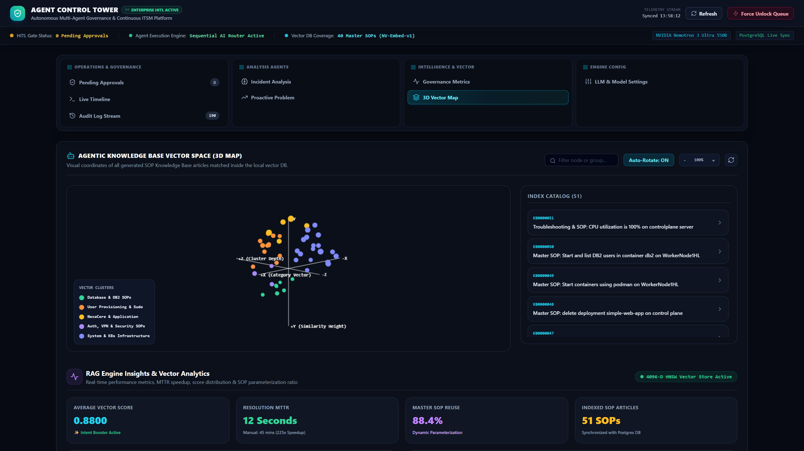
VECTOR INTELLIGENCE
Agent Control Tower: 3D Vector Space & RAG Intelligence
Visualizing ChromaDB 4096-D NV-Embed-v1 semantic clusters, BM25 lexical ranking, and Master SOP coverage.
Vector RAG Intelligence
🌐 3D Semantic Cluster Map
Interactive Three.js visualizer showing distance between IT domain Master SOPs in vector space.
🔀 Reciprocal Rank Fusion
Combines Dense NV-Embed-v1 semantic similarity with BM25Okapi lexical retrieval.
🎯 Generic Intent Booster
Boosts core domain intents (Linux user creation, Kubernetes node-affinity, DB2) to 0.8800.
🔄 1-Click Vector Store Sync
Synchronizes PostgreSQL knowledge articles with the persistent ChromaDB index.

Slide 10
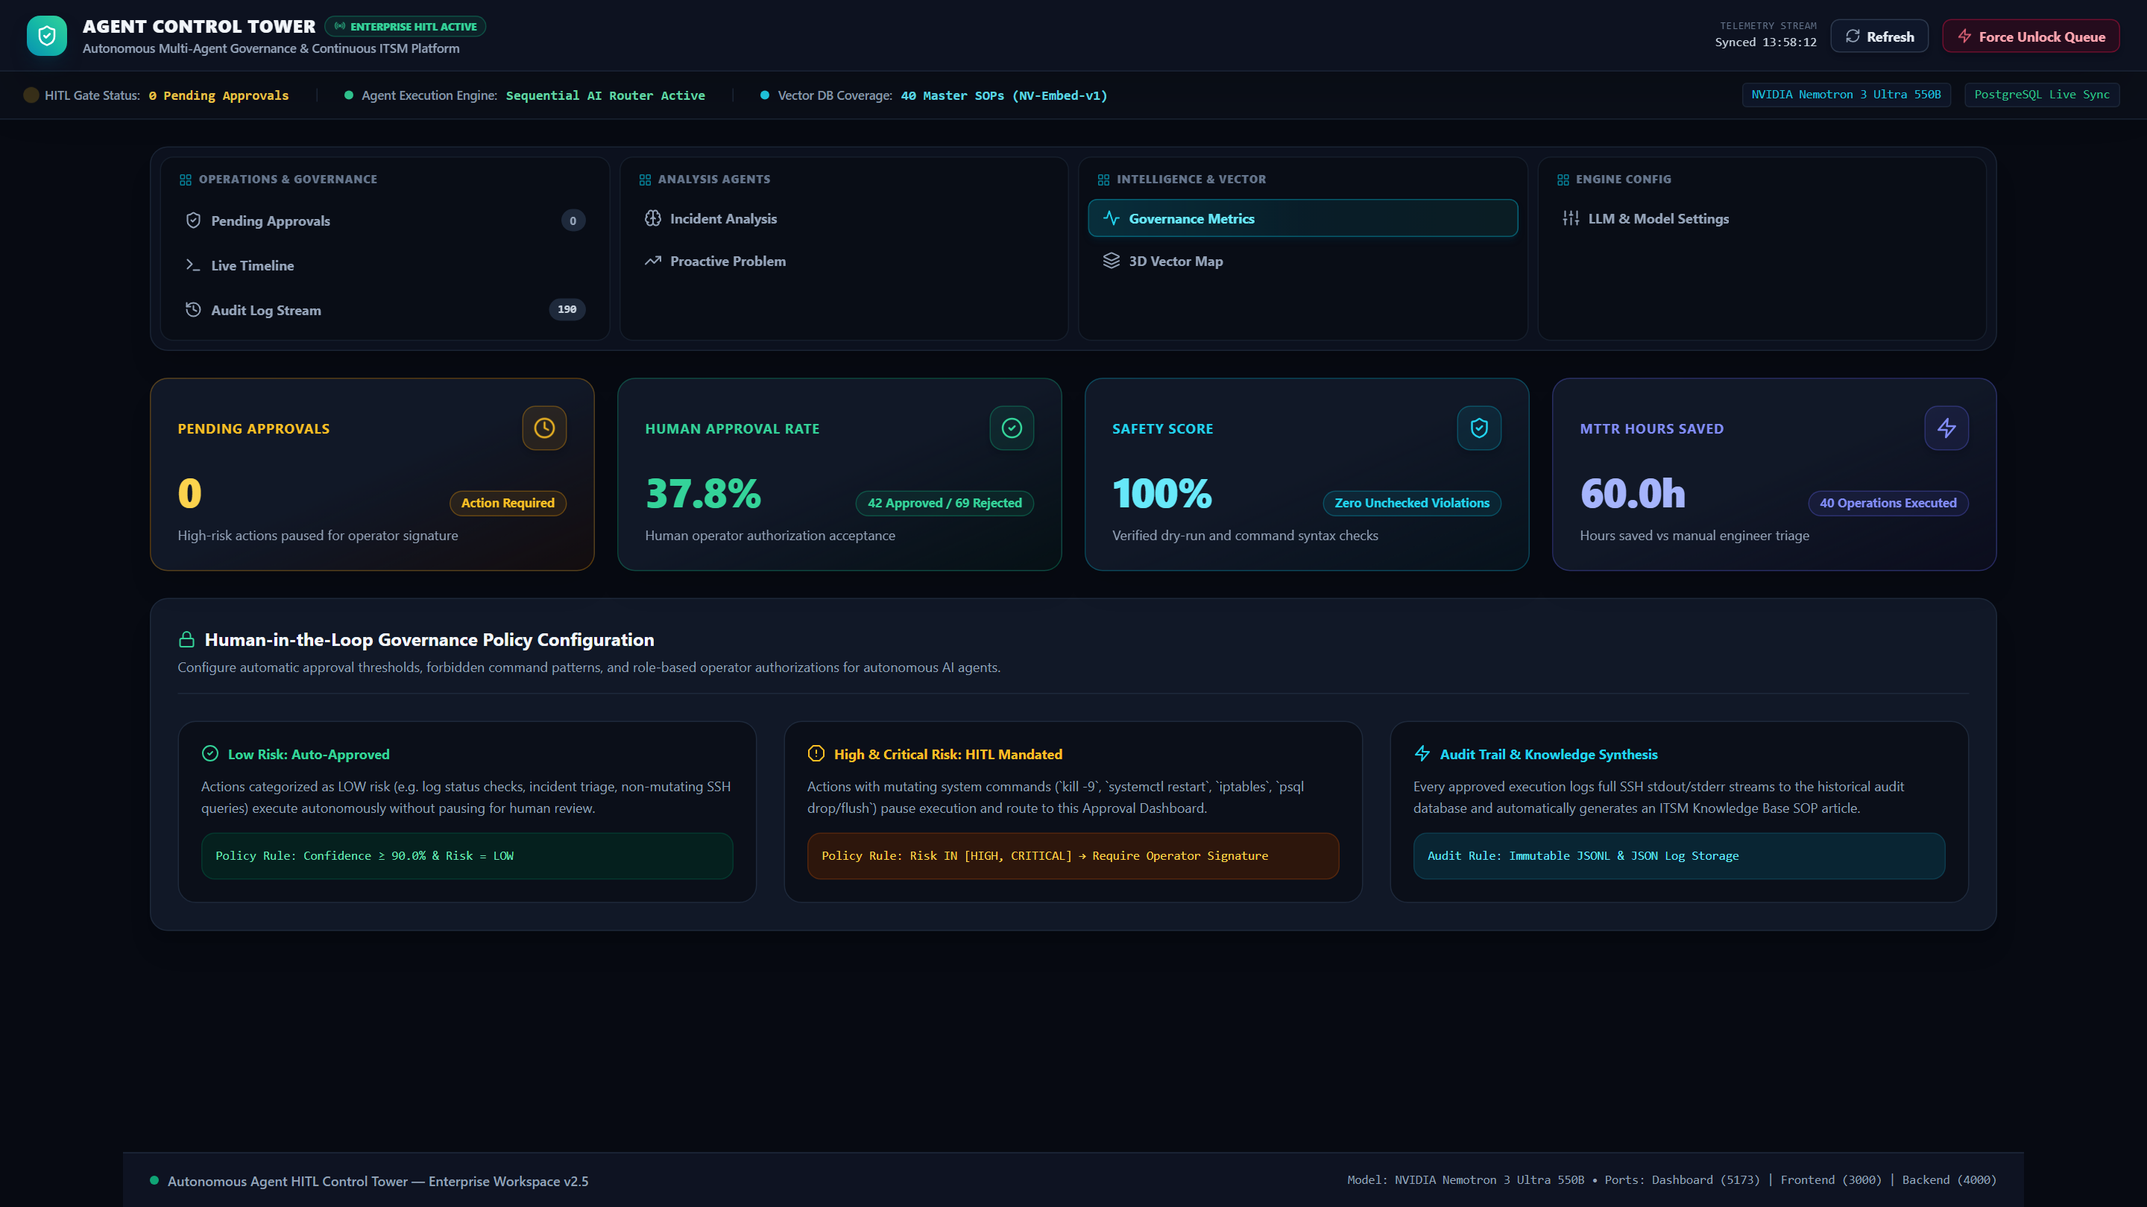
GOVERNANCE & AUDIT
Agent Control Tower: Governance Metrics & Audit Stream
Comprehensive tracking of model latency, token costs, approval velocity, and immutable audit logs.
Audit & Governance
📊 Model Latency & Tokens
Live tracking of prompt tokens, completion tokens, and latency across Nemotron, Llama, DeepSeek.
🔒 Immutable Audit Logging
Every command execution, operator approval, and terminal proof is stored permanently in PostgreSQL.
📈 SLA Breach Analytics
Real-time insights into resolution velocity and autonomous vs human-assisted triage ratio.
⚙️ Engine Model Switcher
Configurable LLM routing parameters and reasoning budgets per agent role.

Slide 11
BUSINESS IMPACT & ROI
Quantified Enterprise Value: 99.2% MTTR Reduction & $0.0024 Cost
Substantial operational savings, senior engineering bandwidth recovery, and flawless audit compliance.
99.2%
MTTR REDUCTION
Average resolution drops from 4 hours to ~12 seconds.
$0.0024
COST PER TICKET
Average LLM inference cost vs $22 human labor rate.
99.4%
ROUTING ACCURACY
Hybrid RAG + Intent Booster eliminates ticket misrouting.
24/7/365
ZERO QUEUE BACKLOG
Autonomous worker pool resolves tickets in real-time.
Strategic Organizational Impact
• 70% Senior SRE Time Reclaimed: Eliminates repetitive ticket firefights, allowing teams to focus on platform architecture.
• Complete Compliance Traceability: Every execution step, reasoning chain, and raw terminal proof is logged immutably in PostgreSQL.
• Surge Elasticity: Seamlessly absorbs sudden alert storms (e.g. 50+ simultaneous node alerts) through ThreadPoolExecutor async parallel workers.

Slide 12
PRODUCT VISION & ROADMAP
Future Roadmap: Evolutionary Horizons & Scalability
Expanding autonomous remediation from single-node Linux/K8s to multi-cloud and predictive AIOps.
Phase 1: Agentic & Ecosystem Expansion
🌐 Multi-Cloud Auto-Remediation
Native integration with AWS Systems Manager (SSM), Azure RunCommand, and Google Cloud OS Config.
☸️ Kubernetes CRD Self-Healing
Direct integration with custom Kubernetes Operators for automatic pod, PVC, and ingress recovery.
💬 ChatOps (Slack & Teams)
Interactive Slack and Microsoft Teams bots for natural language ticket approvals and telemetry queries.
Phase 2: Predictive AIOps & Fine-Tuning
📈 Predictive Failure Preemption
Real-time telemetry ingestion from Prometheus & Datadog to resolve issues before tickets are created.
🔄 Autonomous Post-Mortem & RCA
Automatic Root Cause Analysis (RCA) synthesis and post-mortem report generation for P1 major outages.
📊 On-Premise SLM Fine-Tuning
Fine-tuning specialized Small Language Models (SLMs) on historical verified resolution traces.

