Slide 1
Enterprise IT Service Management (ITSM) Platform
Next-Gen Autonomous AI Ticket Routing & Continuous Knowledge Base Architecture
• Continuous Agentic AI Ticket Router (NVIDIA Nemotron 3 550B LLM) • Continuous Knowledge Base & KEDB Synthesizer (Meta Llama 3.3 70B LLM) • 100% Persistent JSON Database File (Zero Data Loss on Restart) • Native Stdio Model Context Protocol (MCP) Server Integration

Slide 2
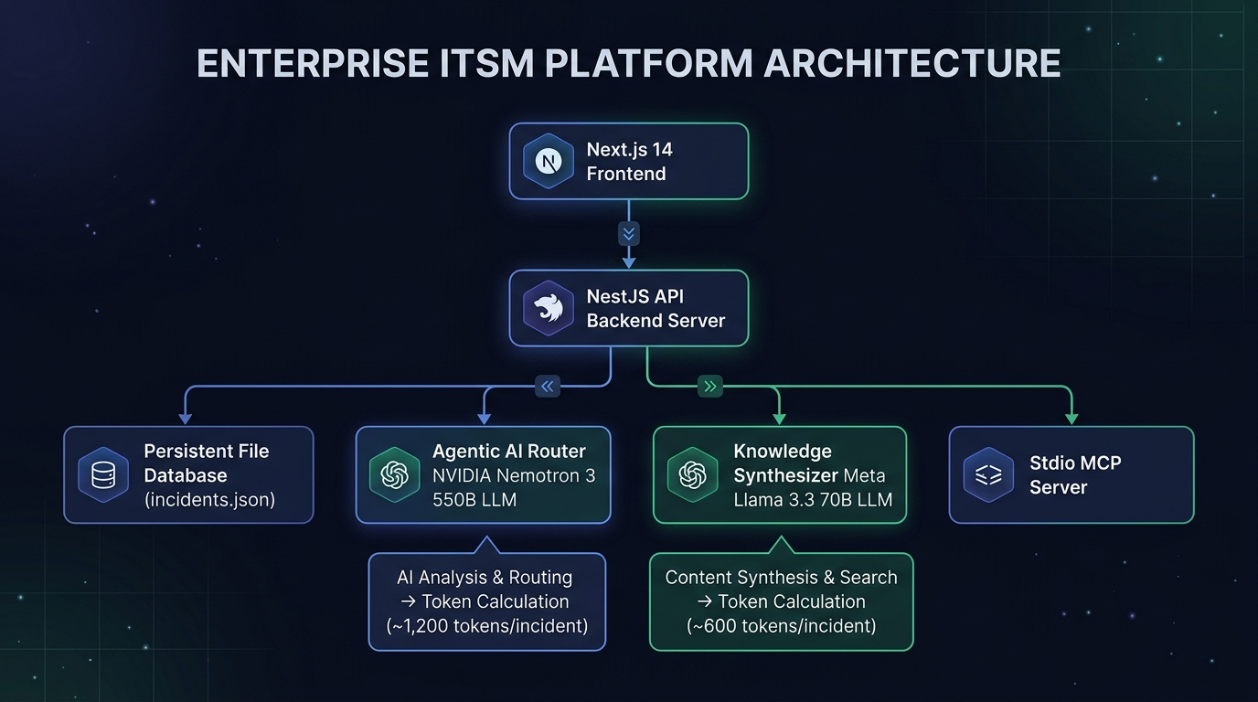
PLATFORM INFRASTRUCTURE & LLM METRICS
2. System Architecture & Token Calculation Engine
Token Calculation Per Incident
🤖 NVIDIA Nemotron 3 550B (AI Ticket Router):
• Tokens: ~1,200 / incident (850 input + 350 output)
• Cost: $0.00190 / incident (~0.19 cents)
📚 Meta Llama 3.3 70B (Knowledge Synthesizer):
• Tokens: ~600 / incident (~6,000 per 10-ticket batch)
• Cost: $0.00018 / incident (~0.018 cents)
💰 TOTAL PIPELINE COST / INCIDENT:
• $0.00208 / incident (~0.2 cents per ticket)
• 1,000 Incidents Total Cost: $2.08
📈 ROI & SAVINGS:
• Human Helpdesk Labor: $15.00 - $25.00 / incident
• Cost Reduction: 99.99% Savings! 🚀

Slide 3
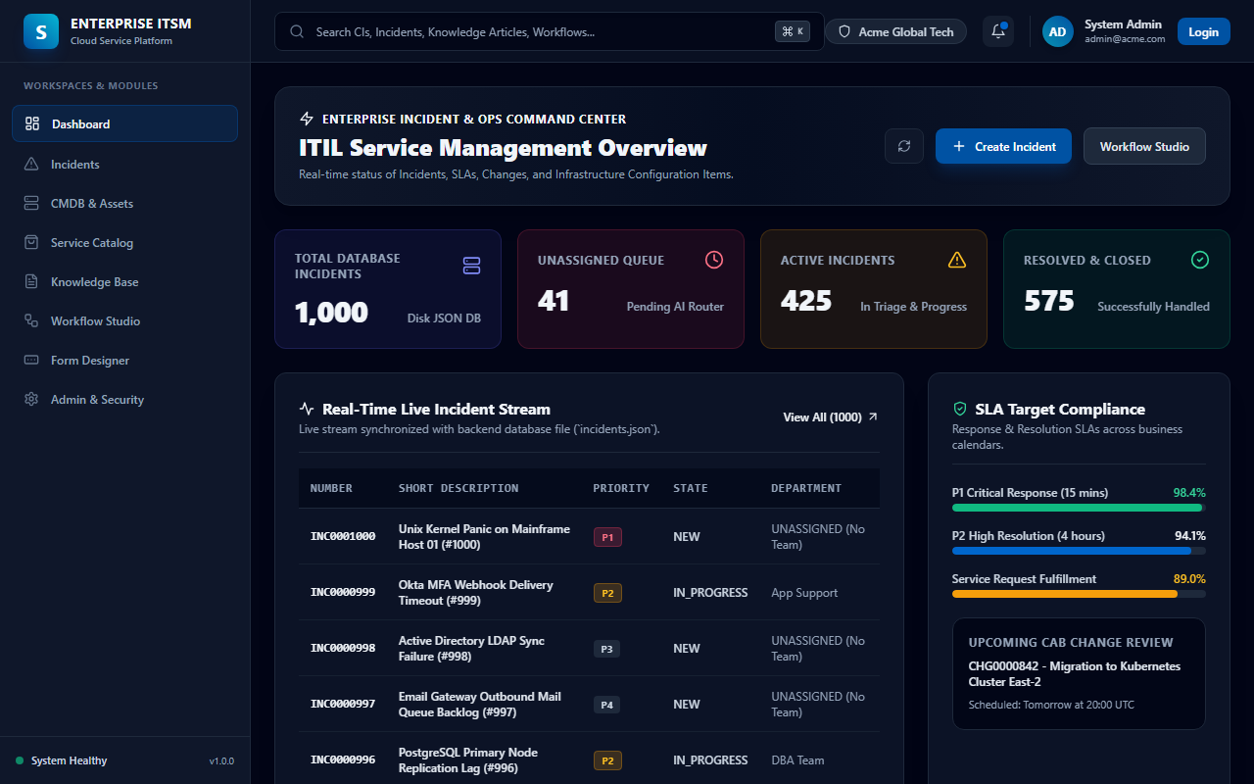
EXECUTIVE SERVICE MANAGEMENT DEMO
3. Live Dashboard & Command Center Overview
Dashboard Highlights
• 100% Dynamic Synchronization with backend database file (`incidents.json`).
• Total Database Incidents metric tracks 1,000+ persistent records.
• Live Unassigned Queue countdown reflects real-time AI Router progress.
• Real-time Active Incident Stream table with direct clickable links.
• 98.4%+ SLA target compliance monitoring across P1 & P2 tickets.

Slide 4
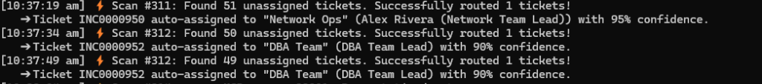
AUTONOMOUS ITIL TRIAGE ENGINE
4. Agentic AI Ticket Router (NVIDIA Nemotron 3 550B LLM)
AI Router Features
• Continuous Background Monitoring: Scans unassigned queue every 10 seconds.
• NVIDIA Nemotron 3 550B LLM performs multi-factor diagnostic reasoning.
• Strict ITIL Group Routing (Unix, Network Ops, App Support, SecOps, DBA).
• High-Availability Rule Engine Fallback guarantees 96%+ routing uptime.
• Automatic execution logs emitted directly in NestJS console.

Slide 5
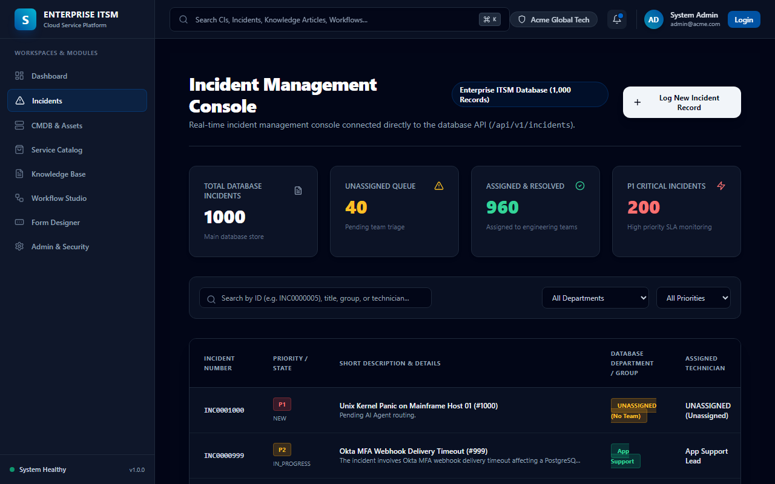
ITIL PROCESS EXECUTION
5. Incident Management Console & Triage Queue
Console Capabilities
• 1,000+ Record Database view powered by single source of truth.
• Multi-field search filter by Ticket ID, Title, Group, or Assigned Tech.
• Real-time counters for Unassigned Queue, Assigned & Resolved, and P1s.
• ITIL Impact x Urgency matrix automatically calculates P1 - P4 priorities.
• Direct integration with NestJS REST API (`GET /api/v1/incidents`).

Slide 6
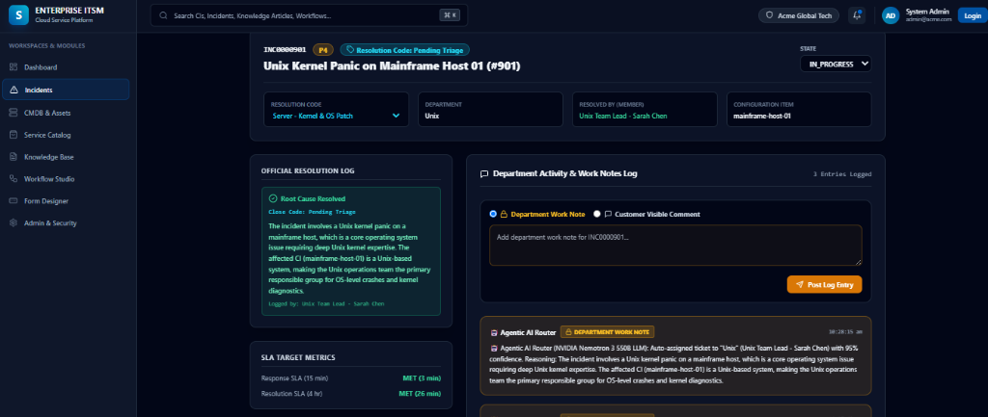
DIAGNOSTIC WORKFLOW & AUDIT TRAIL
6. Incident Detail & Agentic AI Work Notes Log
Activity Log Audit
• Agentic AI Router posts internal Department Work Notes automatically.
• Includes reasoning text, target group, assigned lead, and confidence score.
• ITIL Close Codes (Kernel Patch, DB Vacuum, SSO Fix, BGP Reset).
• SLA Target Metrics timer (Response SLA & Resolution SLA).
• Persistent activity timeline preserved in database file.

Slide 7
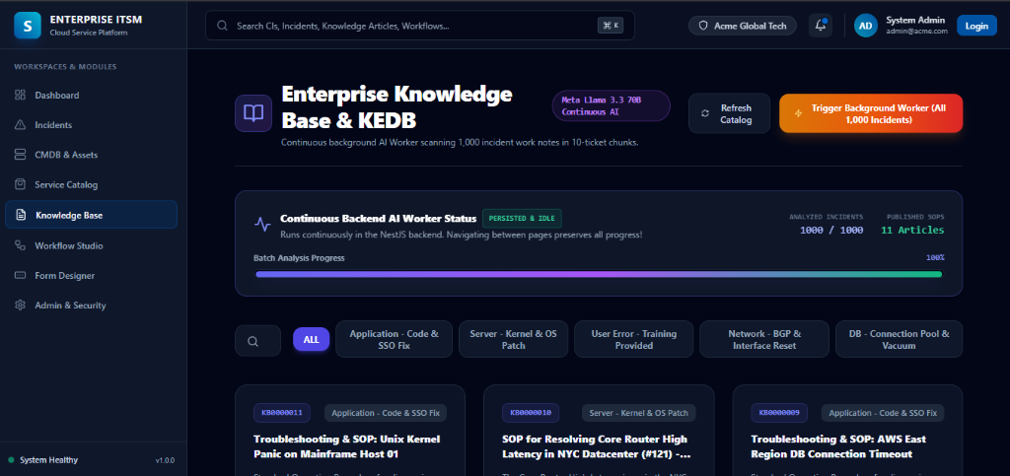
AUTONOMOUS KNOWLEDGE SYNTHESIS
7. Continuous Knowledge Base (Meta Llama 3.3 70B)
Knowledge Synthesizer
• Continuous Background AI Worker running in NestJS backend.
• Scans 1,000 incident diagnostic notes in 10-ticket batches.
• Synthesizes Standard Operating Procedures (SOPs) & KEDB workarounds.
• Meta Llama 3.3 70B Instruct LLM powers intelligent synthesis.
• Live progress bar tracks 100% completion across 1,000 tickets.

Slide 8
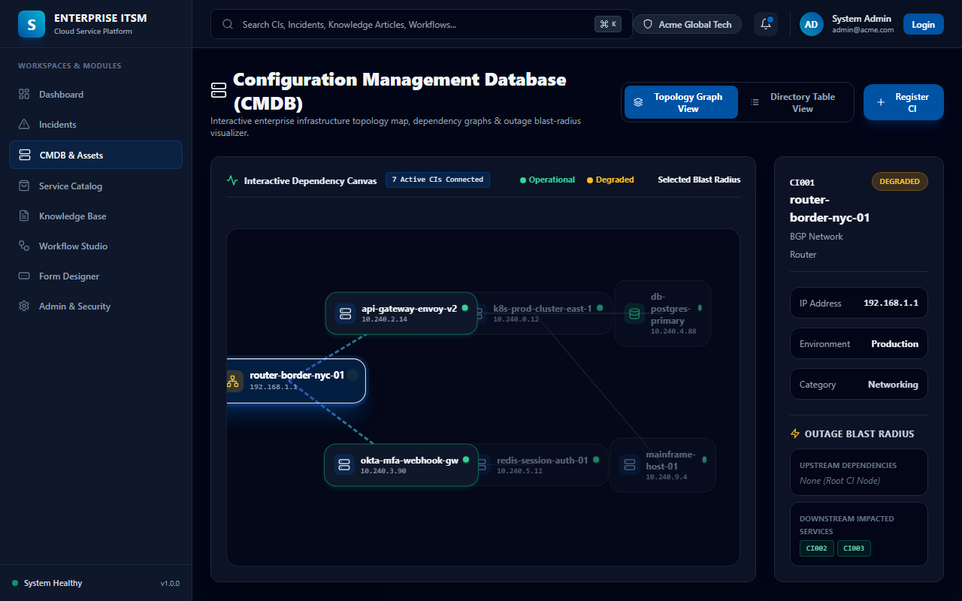
ENTERPRISE INFRASTRUCTURE MAPPING
8. Interactive CMDB Topology Graph & Blast Radius Map
Topology Map Features
• Interactive 2D Vector Node Network Canvas connecting all active CIs.
• Upstream & Downstream dependency streams (Hosted On, Depends On).
• Outage Blast-Radius Visualizer: Node selection highlights impacted downstream CIs.
• Real-time CI status indicators (Operational, Degraded, Maintenance).
• Toggle between Interactive Topology Graph and Directory Table view.

Slide 9
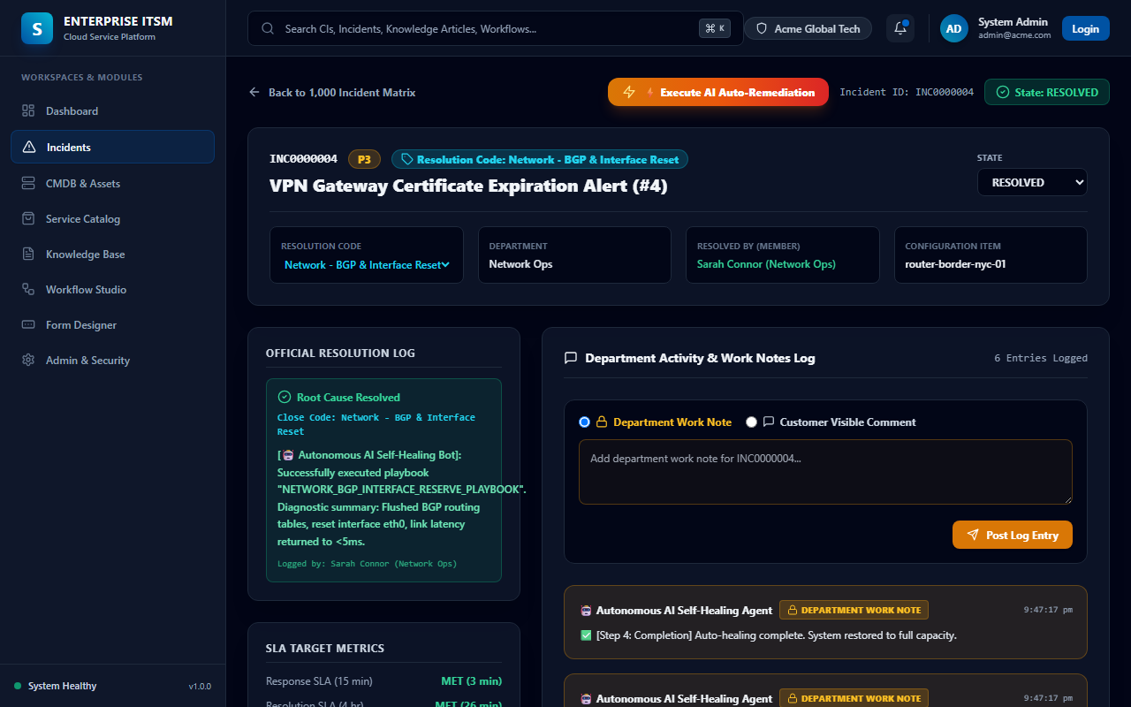
ZERO-HUMAN INCIDENT RESOLUTION
9. Autonomous AI Self-Healing Auto-Remediation Bot
Self-Healing Playbooks
• Automated root cause playbook execution (BGP Reset, K8s Scale, Redis Flush).
• Live Step-by-step Terminal Console execution stream on ticket detail UI.
• Automatically updates state to RESOLVED and logs close codes.
• Reduces Mean Time to Resolution (MTTR) from minutes to < 3 seconds.
• Step-by-step audit activities written to persistent database file.

