Slide 1

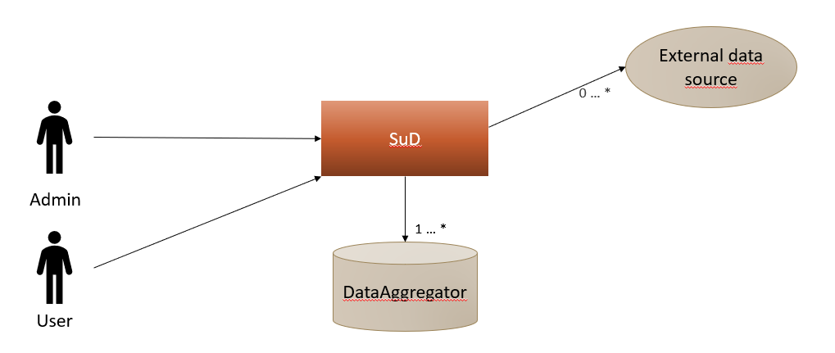
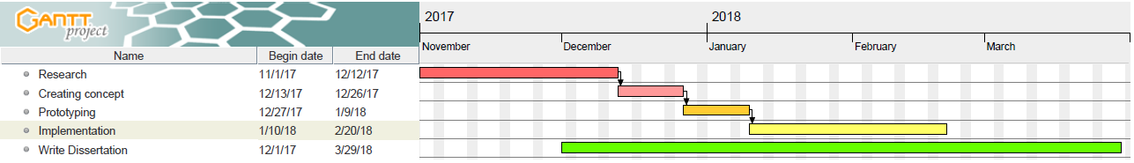
Conception and implementation of a cloud-based platform for generic data analysis and data visualization
Student: Markus Just | Course: Distributed Computing Systems Engineering | Supervisor: Alireza Mousavi
Background
Aims and Objectives
Because of different factors the risk of droughts in the UK increases steadily and there have also been some droughts during the last 40 years which were worse than those that had been used as the basis of planning.
Improve overall resilience in the WWTP
Identify relations between different aspects
Develop a reusable cloud service which is use case independent
Enable report mechanism for different abstraction levels
Methodology and experimental work
Data simulation and sample data
Data models
Mock-Ups
User feedback
Manage Data Sources
Manage Users
Manage User Roles
Configure GUI-Components
Basic concepts
Real-time data
Historical data
Data integration
Data analysis
Data visualization
Create individual web-view
Engineering level
Strategic Level
Future Work and Project Plan
Architecture
Prototyping
Feedback
Implementation
TODO
Integrate data sources
Deploy to cloud environment
Write dissertation
Implement user management
Kontextview
WWTP context
Poster presentation (24.02.2018)
Documentation
Analyse Feedback
Write Dissertation
Summary & Outlook

