Slide 1

Lecture Adaptive Filters
Lecture 5: Adaptation procedures (I): The RLS algorithm

Slide 2
Adaptive algorithms: today and in the next lectures
Introductory remarks
Recursive Least Squares Algorithm (RLS Algorithm)
Least Mean Squares Algorithm (LMS Algorithm)
The filtered-x LMS algorithm
Affine Projection Algorithm (AP Algorithm)
Kalman Filter
Particle Filter
Notes:
2

Slide 3
Content
Repetition of the Wiener filter solution with its main property: The identification of a static optimum filter.
Derivation of the Least Squares (LS) solution based on the minimization of a deterministic error criterion.
Generalized concept of adaptation rules and error criteria.
The derivation of the Recursive Least Squares (RLS) adaptation procedure.

Slide 4
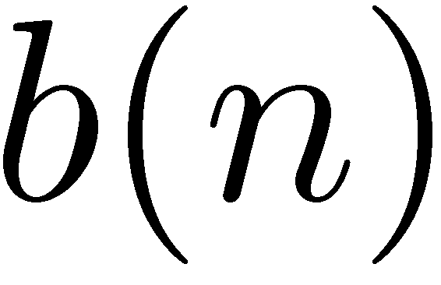
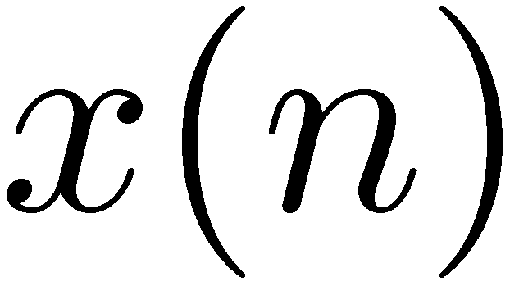
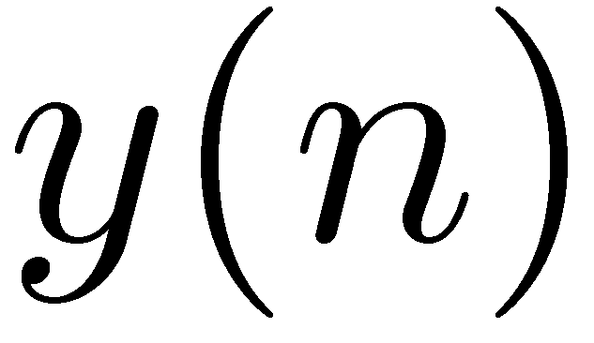
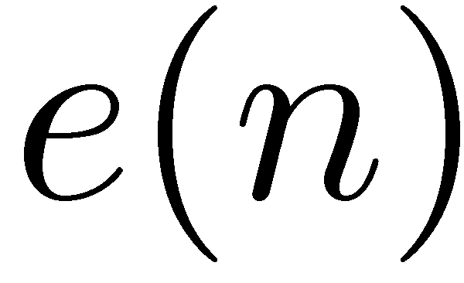
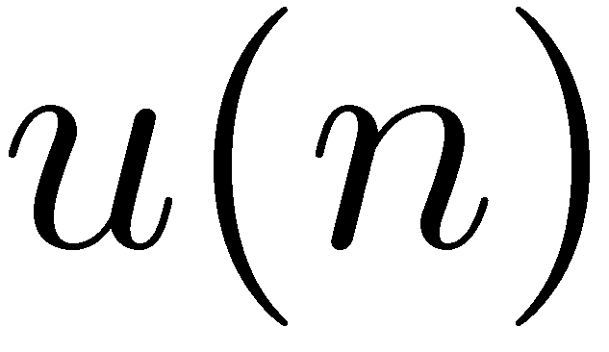
Repetition of different applications of adaptive filters
System identification:
Unknown
system
+
+
Adaptive
filter
Inverse modeling:
Unknown
system
Adaptive
filter
+
Delay
Reference
signal

Slide 5
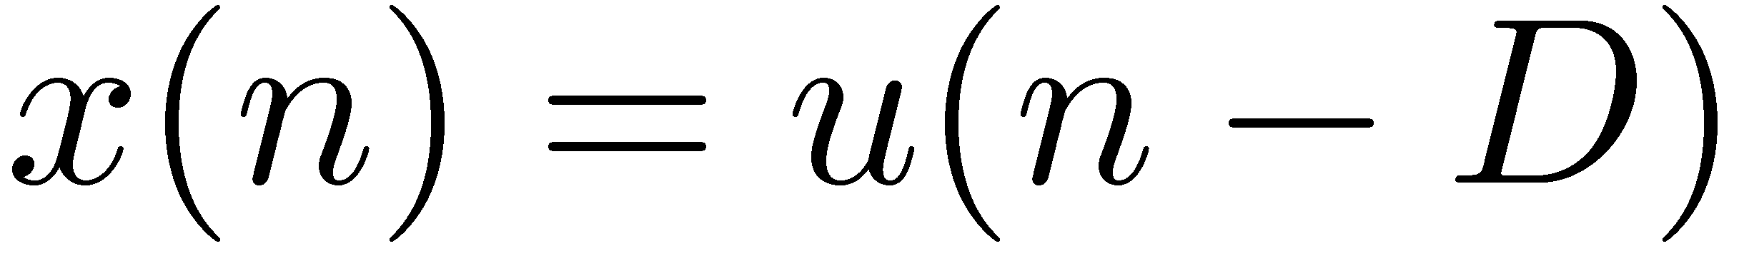
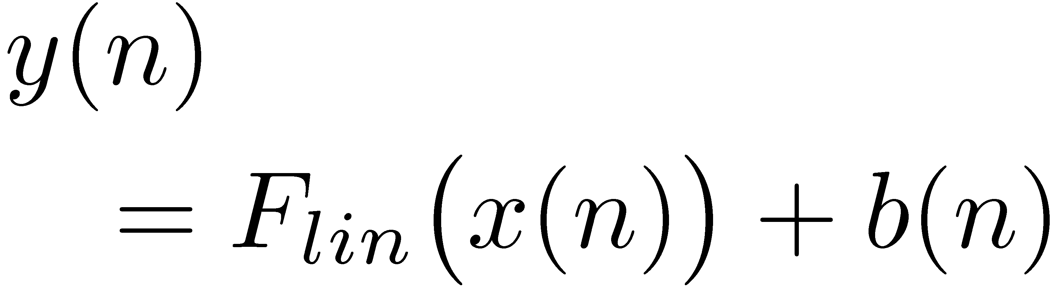
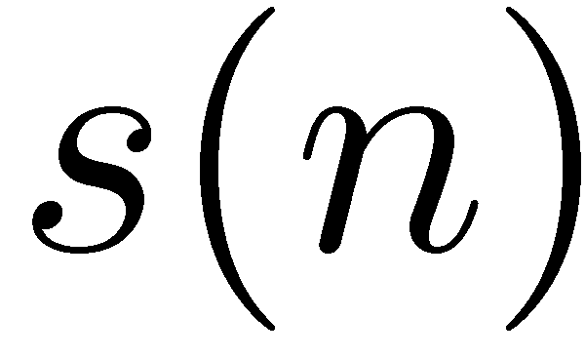
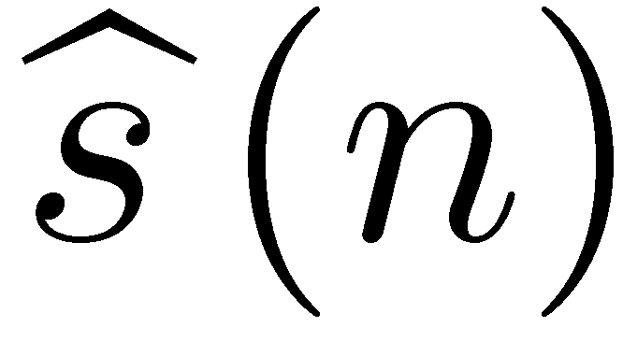
Repetition of different applications of adaptive filters
Prediction:
Delay unit
Adaptive
filter
+
Noise reduction with / without noise reference:
+
+
Adaptive
filter
+
Adaptive
filter

Slide 6

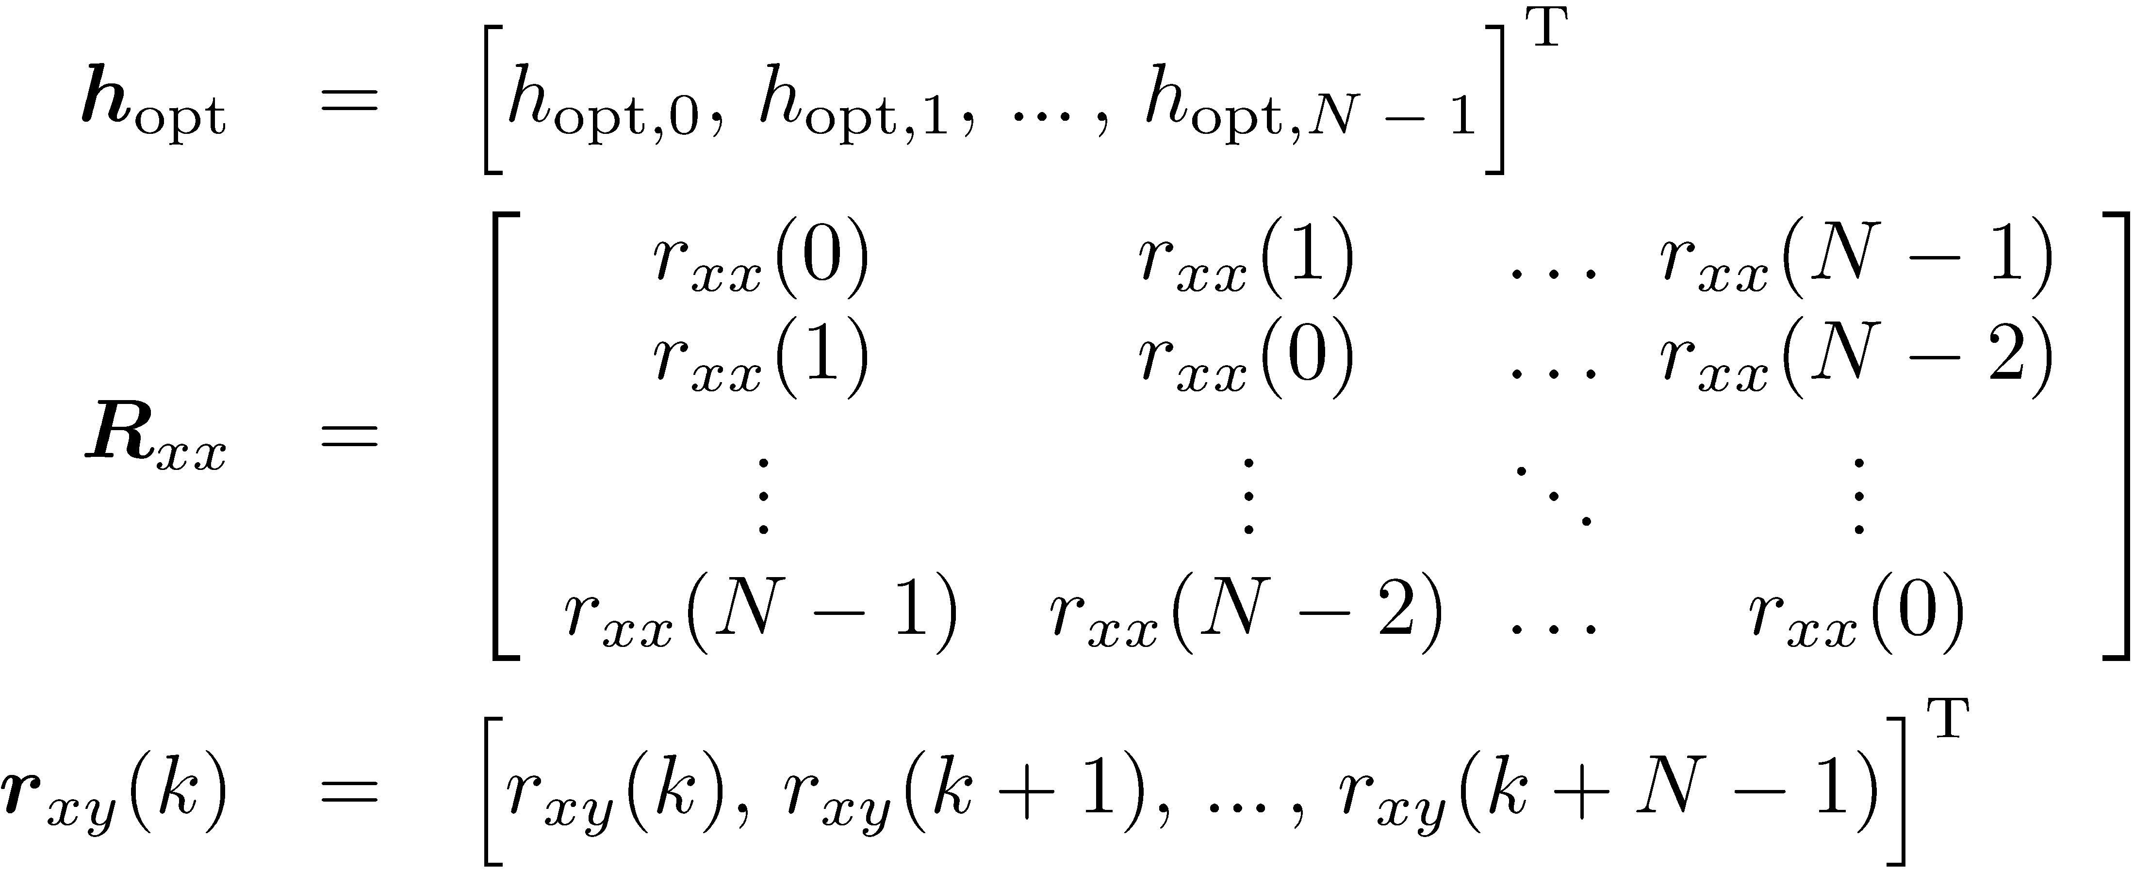
Repetition of the Wiener filter solution
Based on the example of “system identification”:
Unknown
system
+
+
Adaptive
filter
Wiener solution:
Based on the assumption that
all signals are stationary
the system to identify is time-invariant

Slide 7
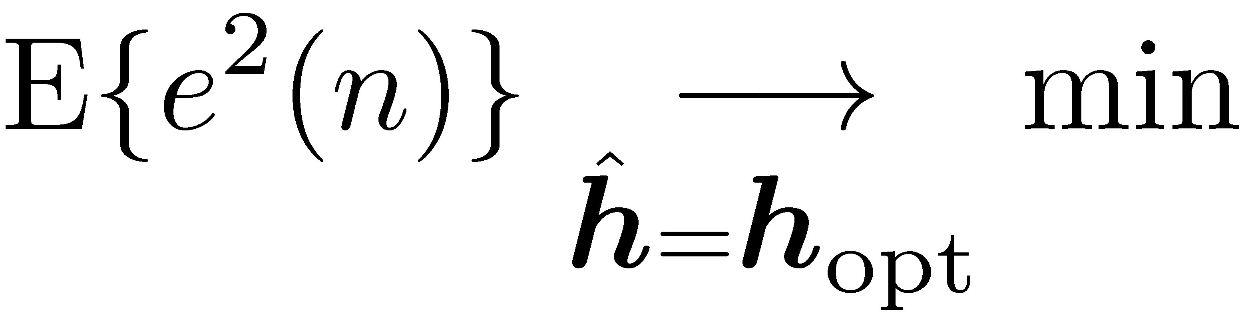
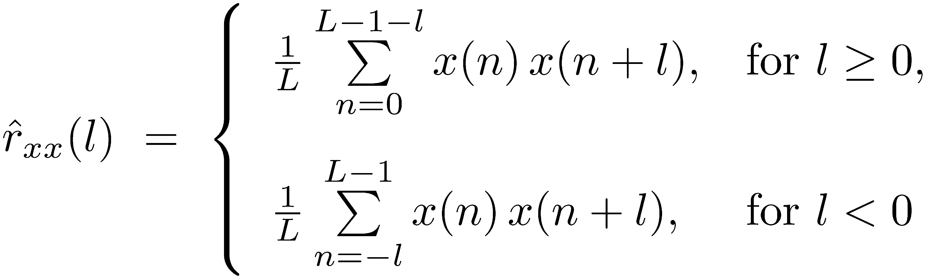
Wiener filter: Calculation of a stationary solution
The solution was obtained based on the minimization of the mean square error:
Estimation of the correlation values:
Typically for stationary signals: The longer the window length L is the more reliable is the estimate.
Allows to estimate a fixed filter only.
A block-wise optimal filter calculation is possible by a block-wise estimation of the correlation functions or the power spectral densities, respectively.
Computationally demanding, esp. due to the ACF-matrix inversion.

Slide 8
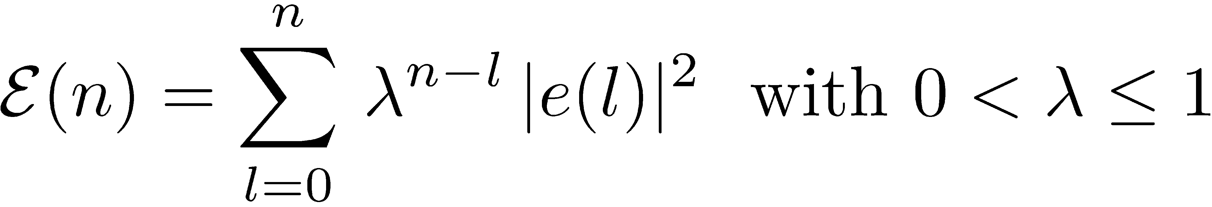
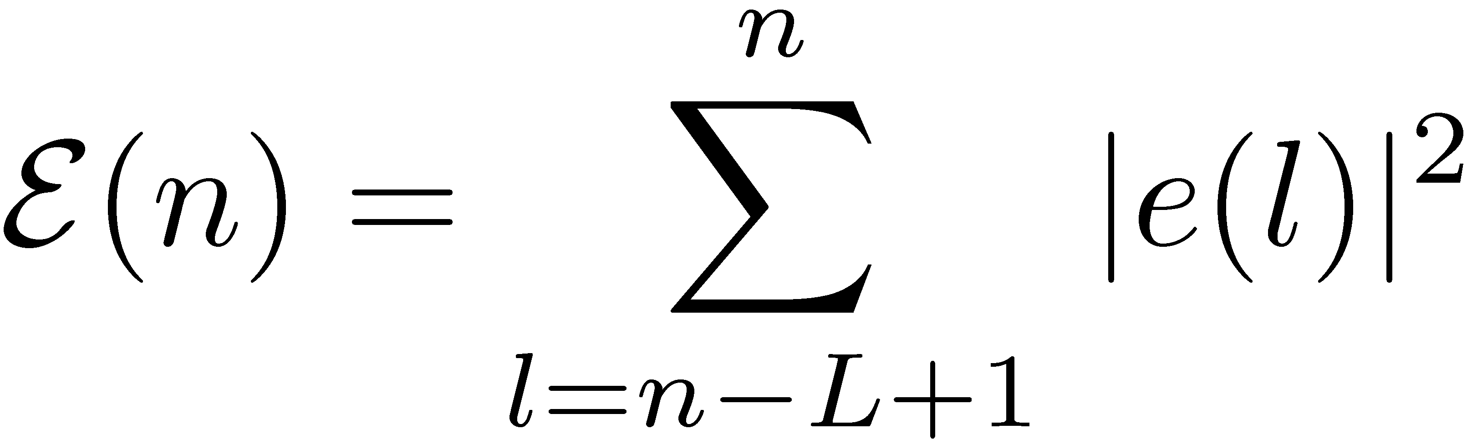


Least squares (LS) solution
The basis for the adaptive “recursive least squares” (RLS) procedure, which we will consider as first adaptive procedure, is the least squares (LS) solution.
Here, a deterministic solution is calculated based a deterministic error criterion which is the squared error, averaged over previous error signal samples:
Exponential weighting window:
Rectangular weighting window (a possible but not further considered alternative):
forgetting factor
Weighting of the error values:
Weighting of the error values:
Time
Time

Slide 9
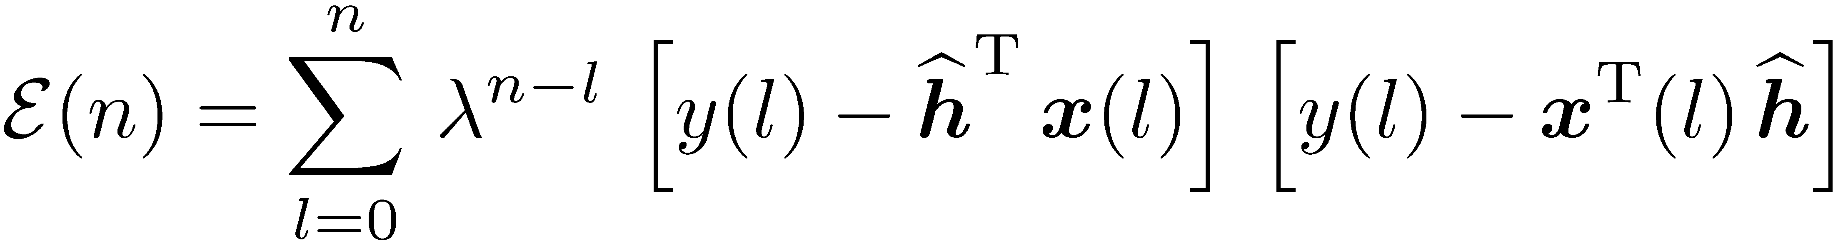
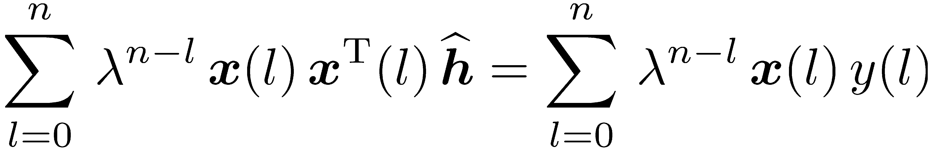
Least squares solution
The error is calculated as follows:
Insertion of the error leads to (for the exponential window):
Differentiation with respect to the filter coefficients and setting result to zero leads to:

Slide 10
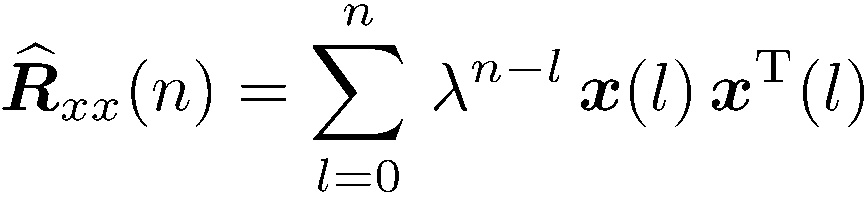
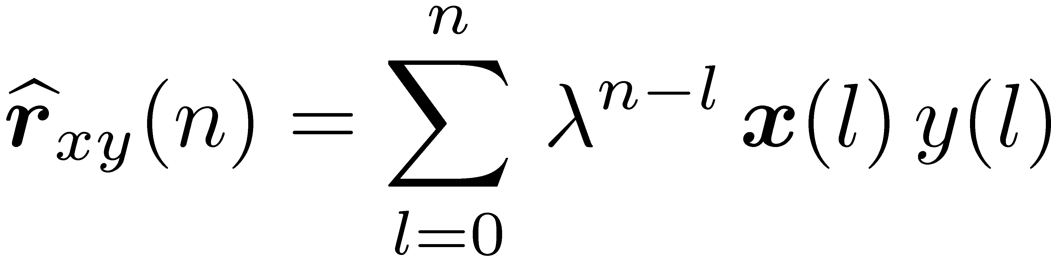
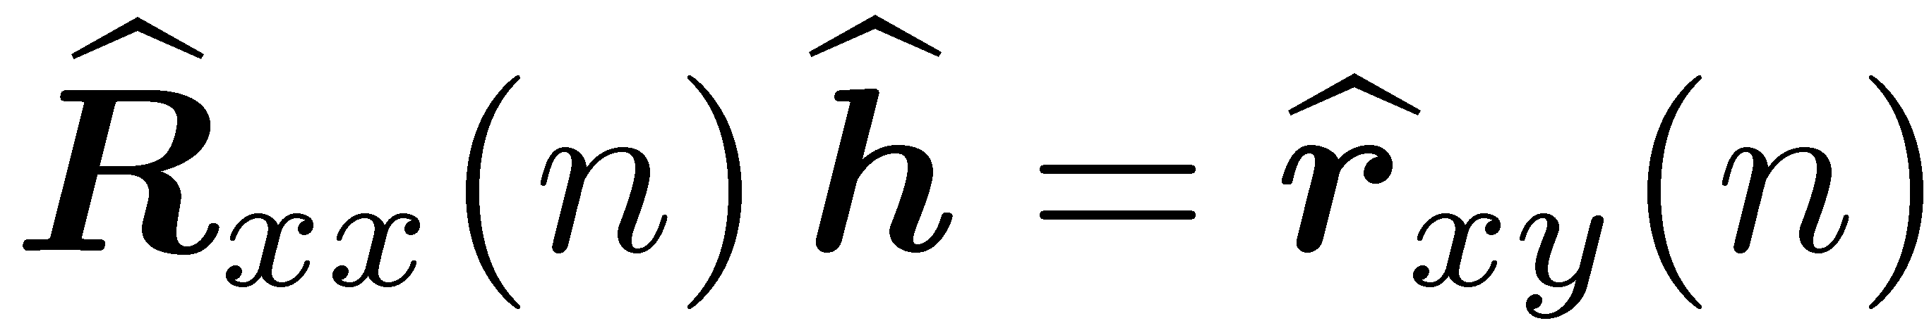
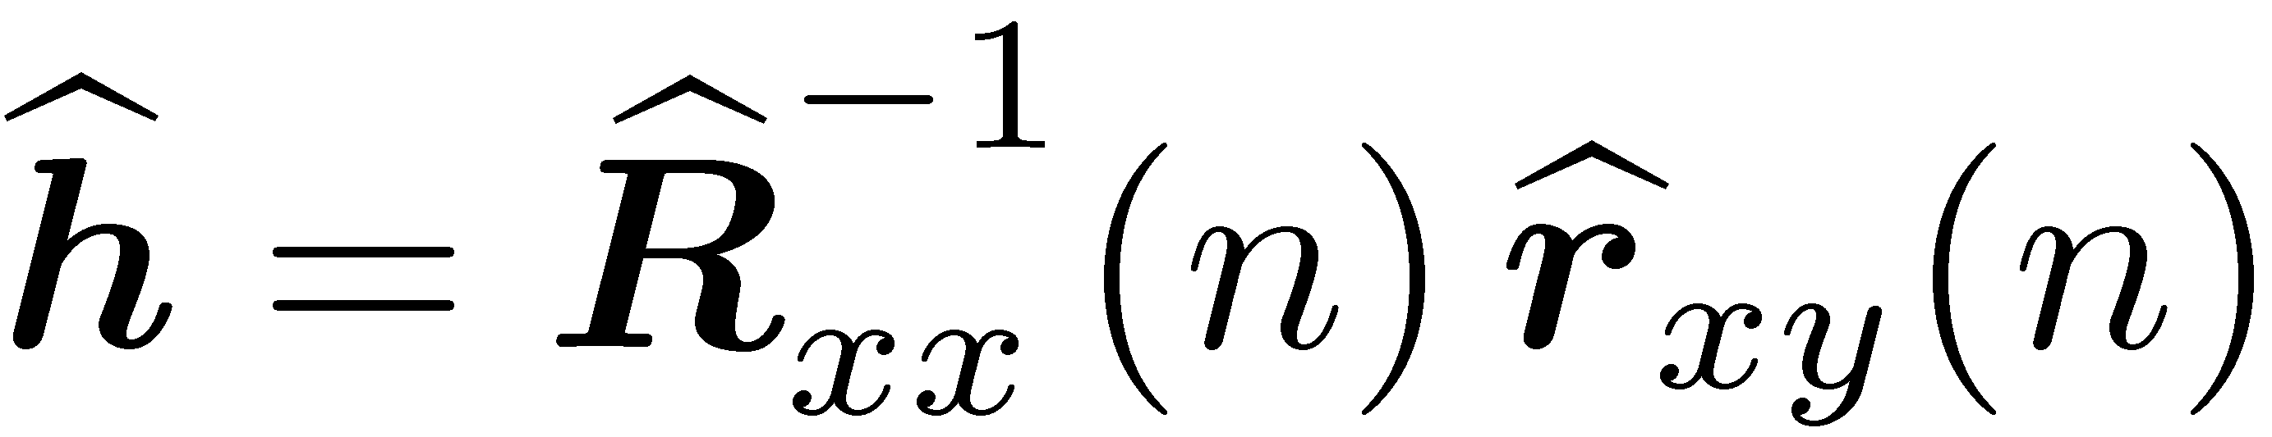
Least squares solution
Previous matrix-vector equation:
The differentiation and matrix-vector settings are defined analog to the derivation for the Wiener filter.
Definitions:
Estimate for the auto-correlation matrix:
Least squares solution:
Estimate for the cross-correlation vector:

Slide 11
Comments about the forgetting factor
Review: Exponential weighting window of the error signal:
forgetting factor
Weighting of the error values:
Time
The least squares solution is based on the following calculations:
with:
Suppose the linear system which has to be identified is changing over time: => past components correspond to the previous impulse response of the linear system and the newer ones to the current impulse response.

Slide 12


Comments about the forgetting factor
Suppose the linear system which has to be identified is changing over time at time instance : => Past components of the correlation estimates correspond to the previous impulse response of the linear system and the newer ones to the current impulse response.
Weighting of the error and the correlation estimates
=> The smaller the forgetting factor is the faster the system can estimate the new impulse response => The faster is the tracking
Time
Weighting of the old
Impulse response
Weighting of the new
Impulse response
=> However, the forgetting factor smoothes the estimate and attenuates disturbing noise components => More reliable estimate in stationary situations for a large (close to 1) forgetting factor.

Slide 13
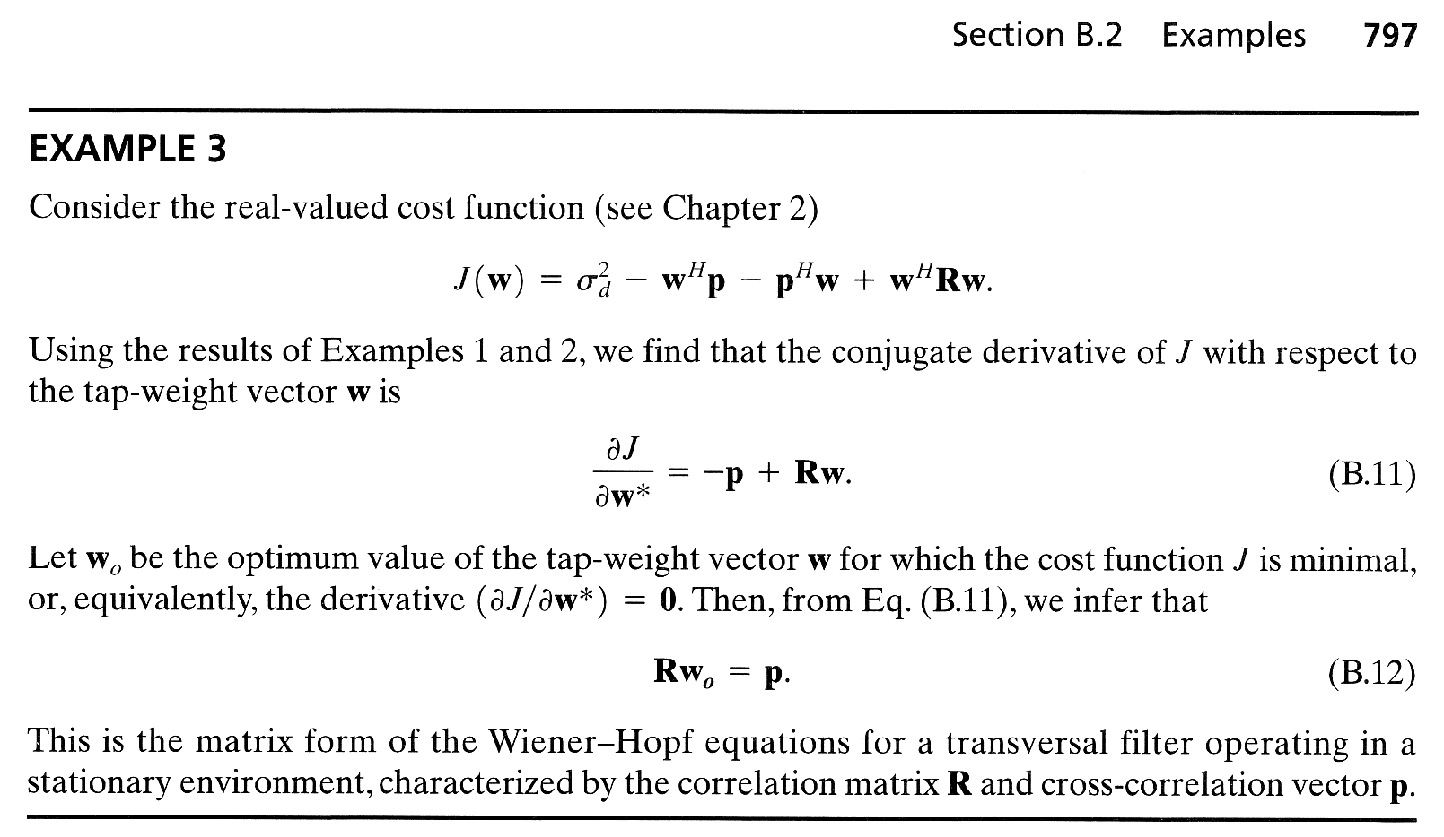
Least squares solution
The derivation of the least squares equations can be found here:
1) Simon Haykin, „Adaptive Filter Theory“, Prentice Hall, 2002:
2) The Matrix Cookbook [http://orion.uwaterloo.ca/~hwolkowi/matrixcookbook.pdf]

Slide 14
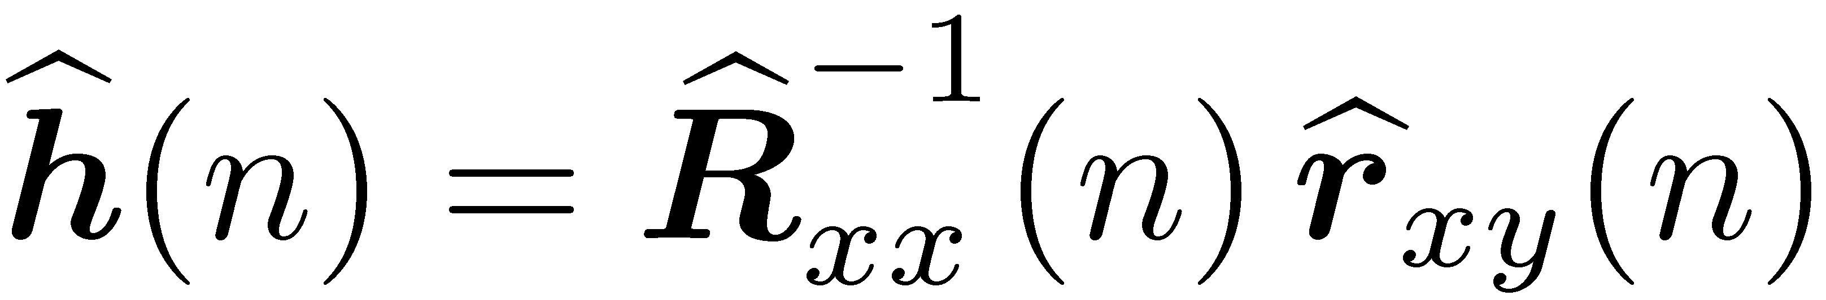
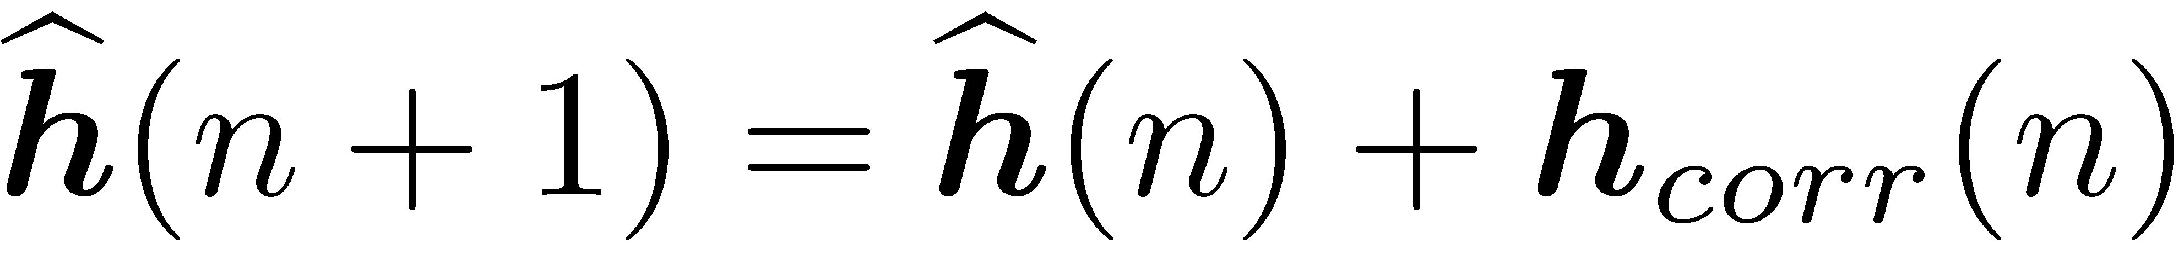
Least squares: Going the step to a non-static solution
Analyzing the least squares solution:
one can see that in general this solution also offers a tracking of varying systems, since the estimates are updated at each time index:
However, then at each step a computational complex inversion of the auto-correlation matrix would be necessary where the estimate
has non-Toeplitz structure.
Therefore, recursive methods are developed which allow an update of the previous estimate which requires less computational effort.

Slide 15
Adaptive filters - Generals

Slide 16
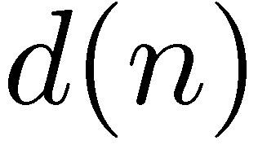
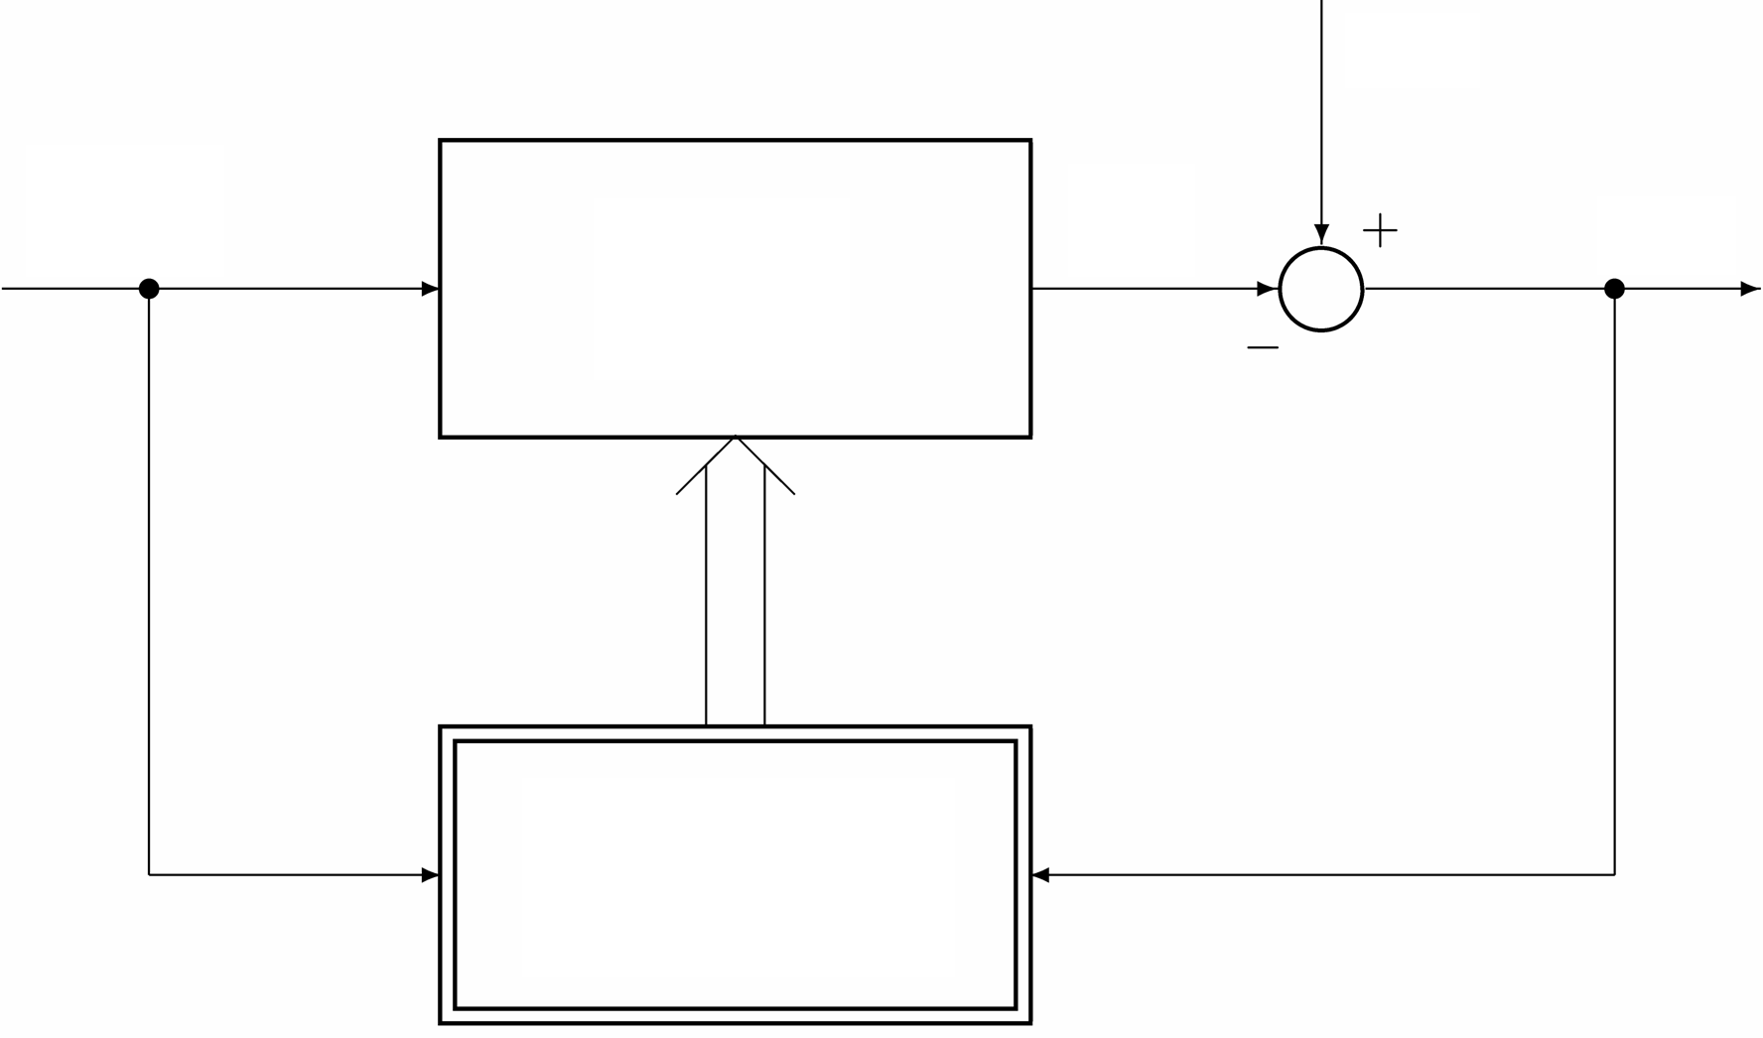
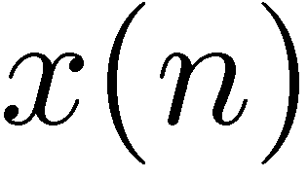
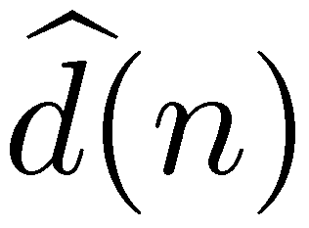
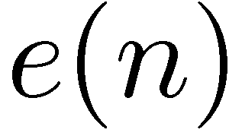
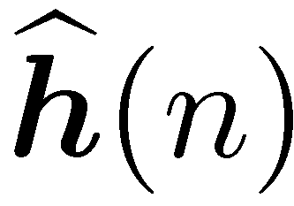
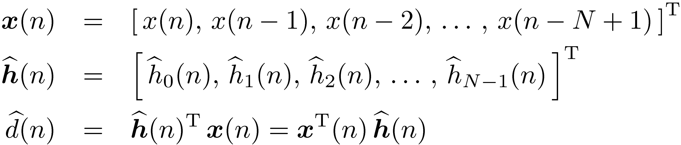
Adaptive filters
Adaptive filters are necessary in varying environments with changing systems to identify:
Desired output signal
Adaptive filter
Adaptive algorithm

Slide 17
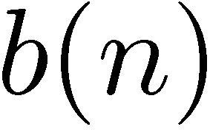
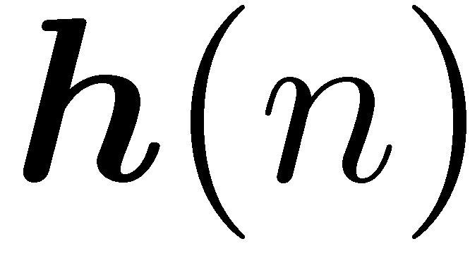
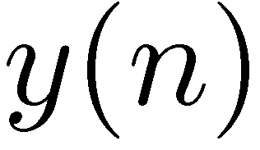



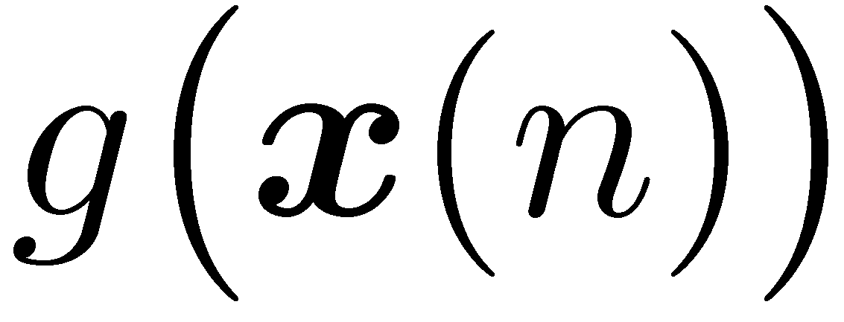
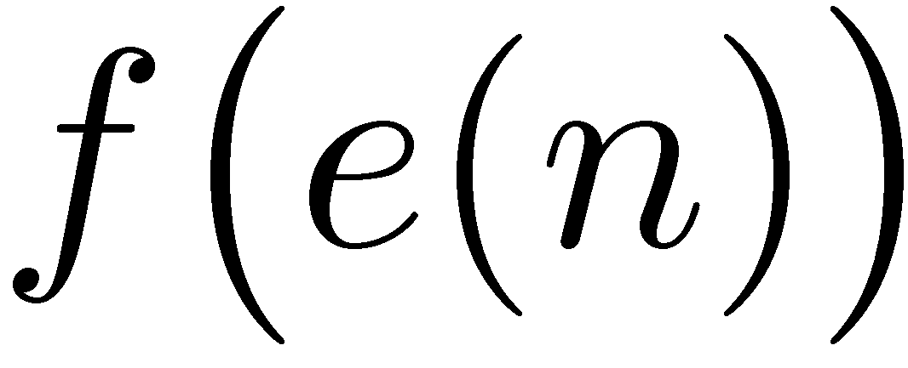
Basic adaptation principle
Basic adaptation principle:
Local noise
new coefficients = old coefficients + correction
+
+
Properties:
„Correction“ depends on the input signal and the error signal
Procedures differ by the functions and .
Step size

Slide 18
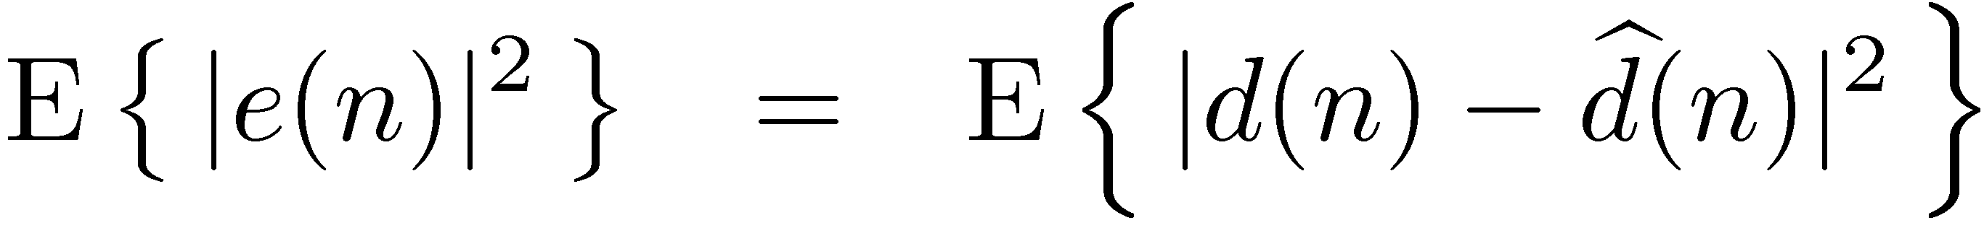
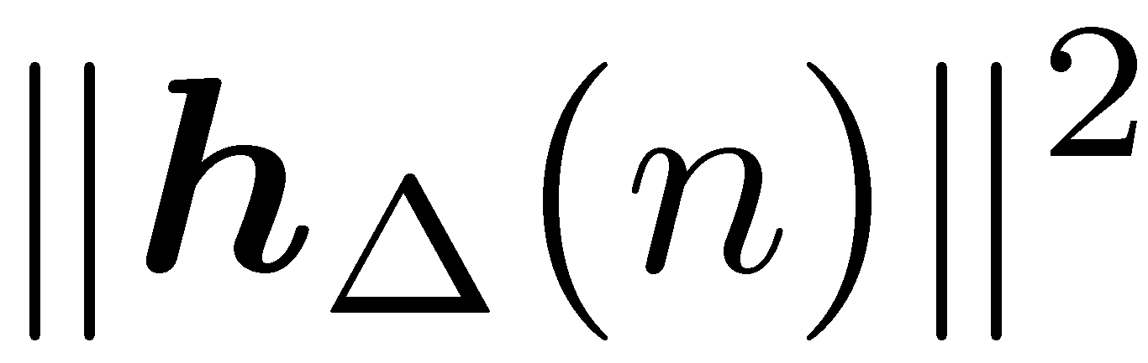
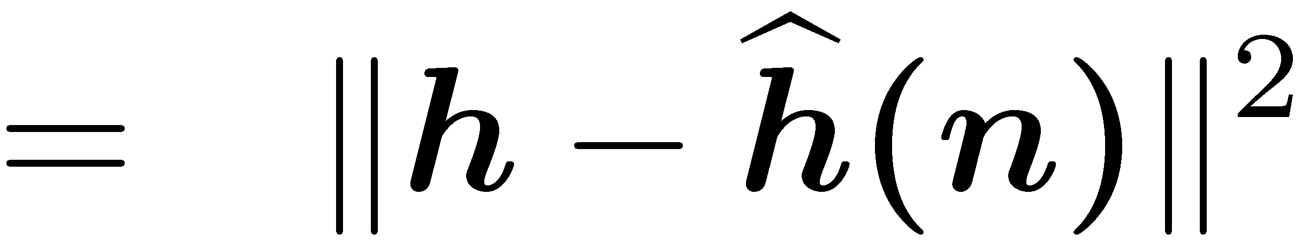
Error measures
Error measures are important when analyzing the performance of adaptive filters and designing adaptation control methods
No local noise
+
Mean square (signal) error :
System distance:

Slide 19
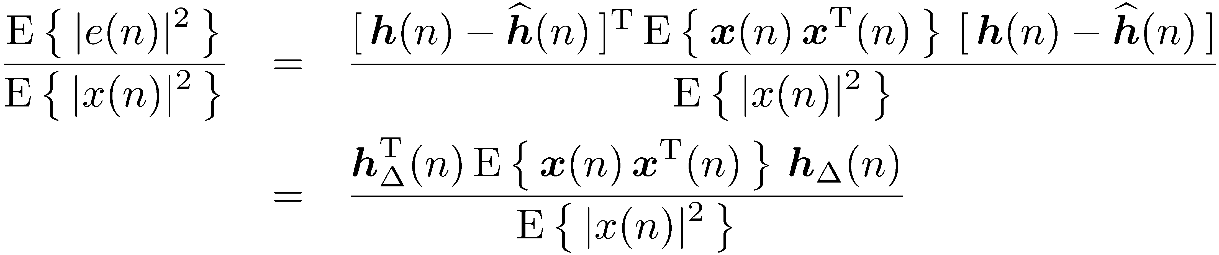
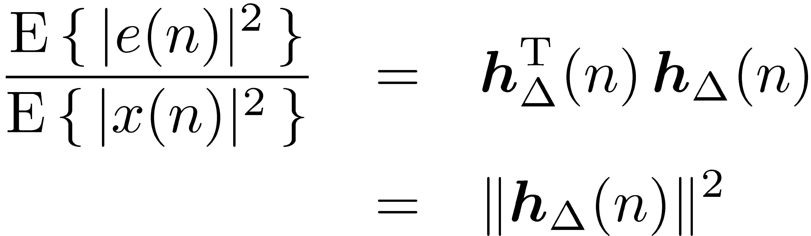
Error measures
Relation of the
“normalized mean square (signal) error power” and “the system distance”.
Let be white noise:
=> The normalized mean square (signal) error and the system distance are identical for white noise as input signal .

Slide 20
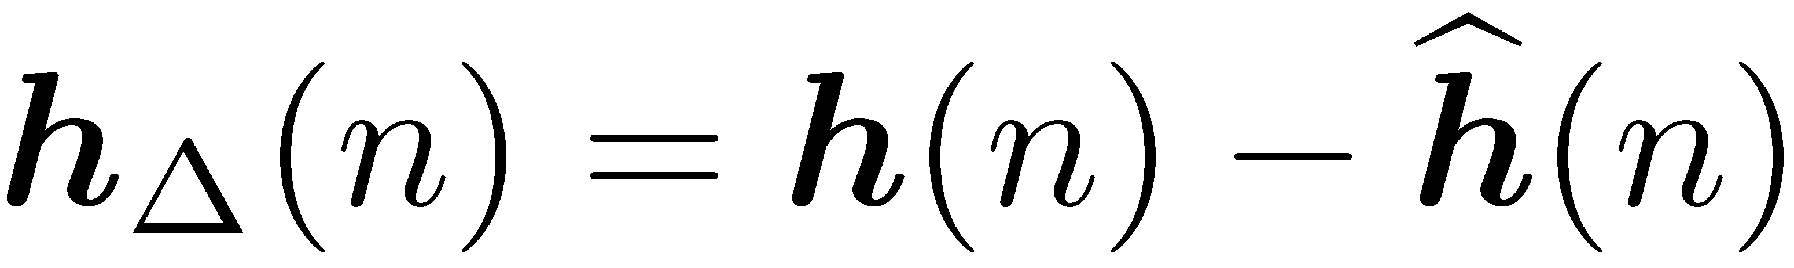
Error measures
Different error measures are considered during the adaptation:
System distance vector:
A posteriori error, i.e., error used for the adaptation:
A priori error, error based on the previous coefficients:
Data index
Filter index

Slide 21
Recursive least squares (RLS) algorithm

Slide 22
The Recursive Least Squares (RLS) algorithm
Analyzing the least squares solution
Definitions:
Estimate for the auto-correlation matrix:
a computational efficient solution would be nice where a recursive calculation of the inverse auto- correlation matrix and the cross- correlation vector could be used.
Estimate for the cross-correlation vector:

Slide 23
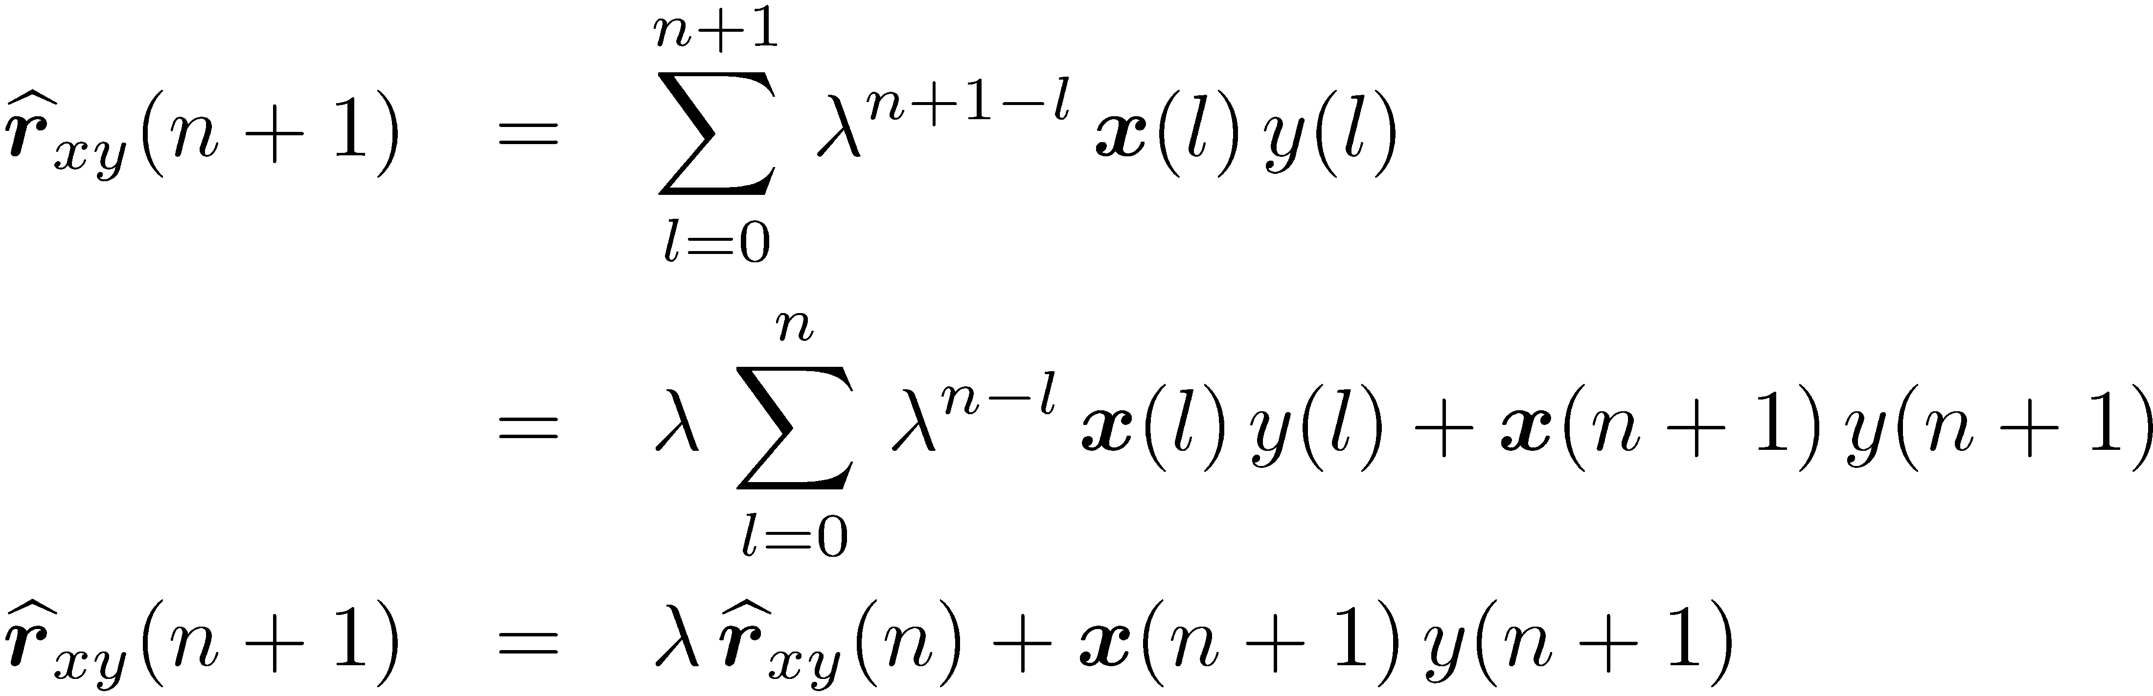
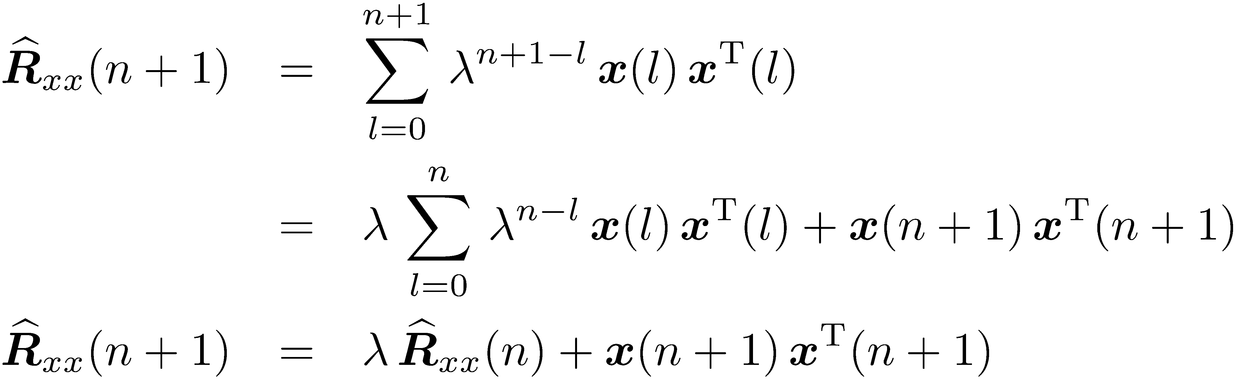
Recursion – vector and matrix recursion
Recursion of the cross-correlation vector over time:
Recursion of the auto-correlation matrix over time:
However, a recursion for the inverse is necessary!

Slide 24


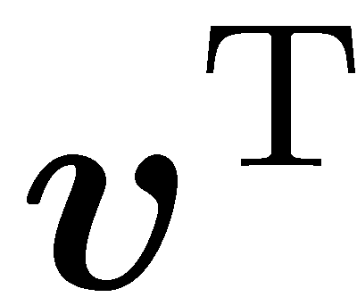
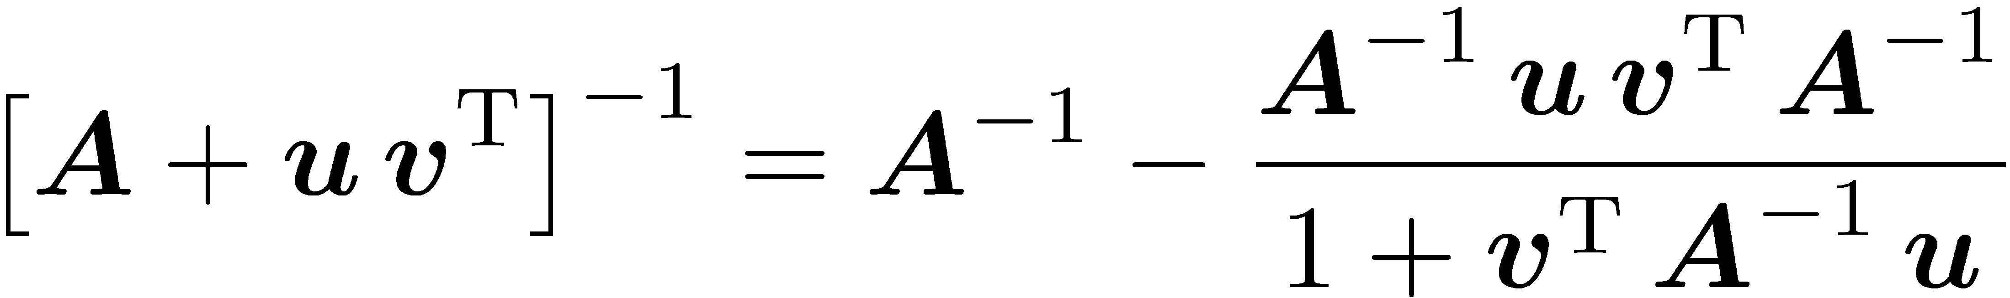
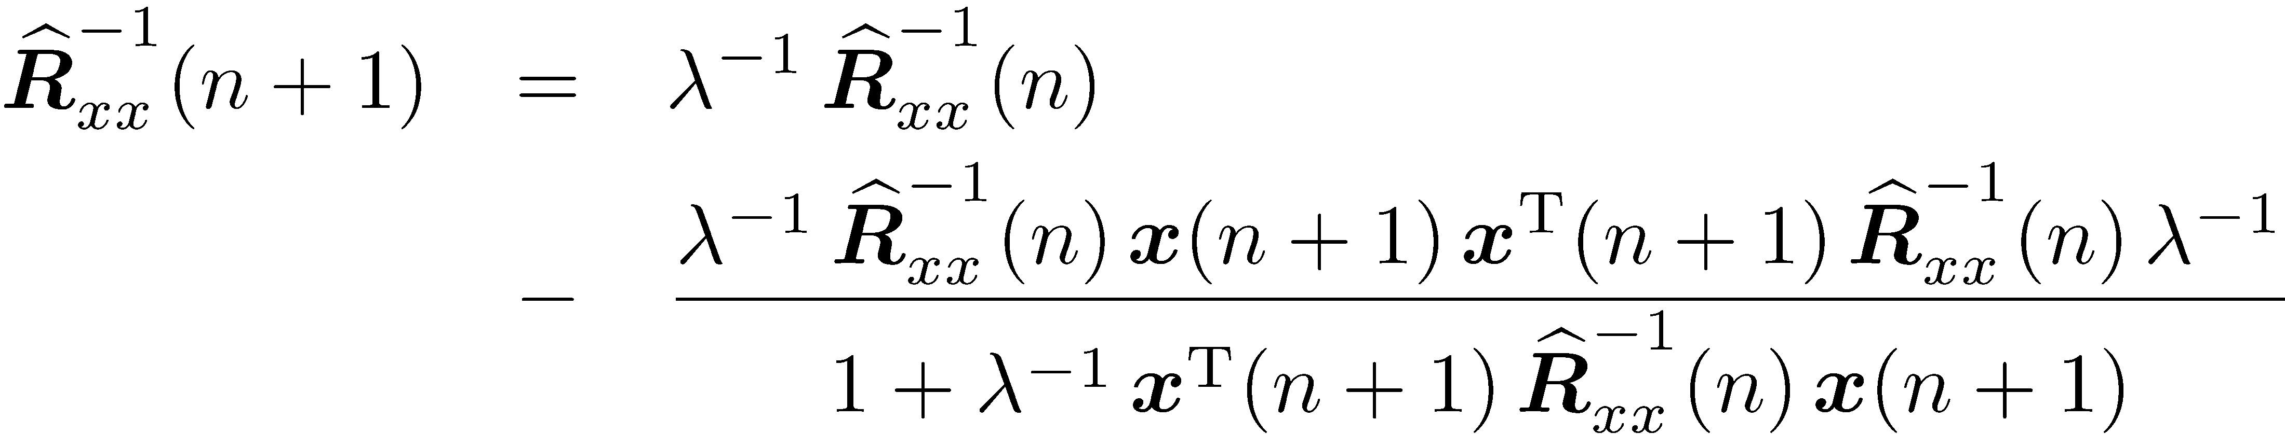
Recursion – inverse matrix recursion
Recursion of the auto-correlation matrix over time:
Using the matrix inversion lemma…
one obtains a recursion for the inverse auto-correlation matrix:

Slide 25
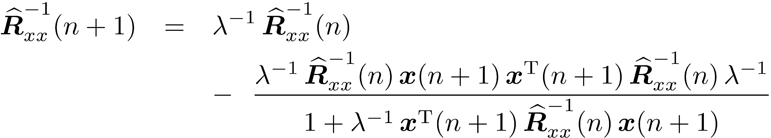
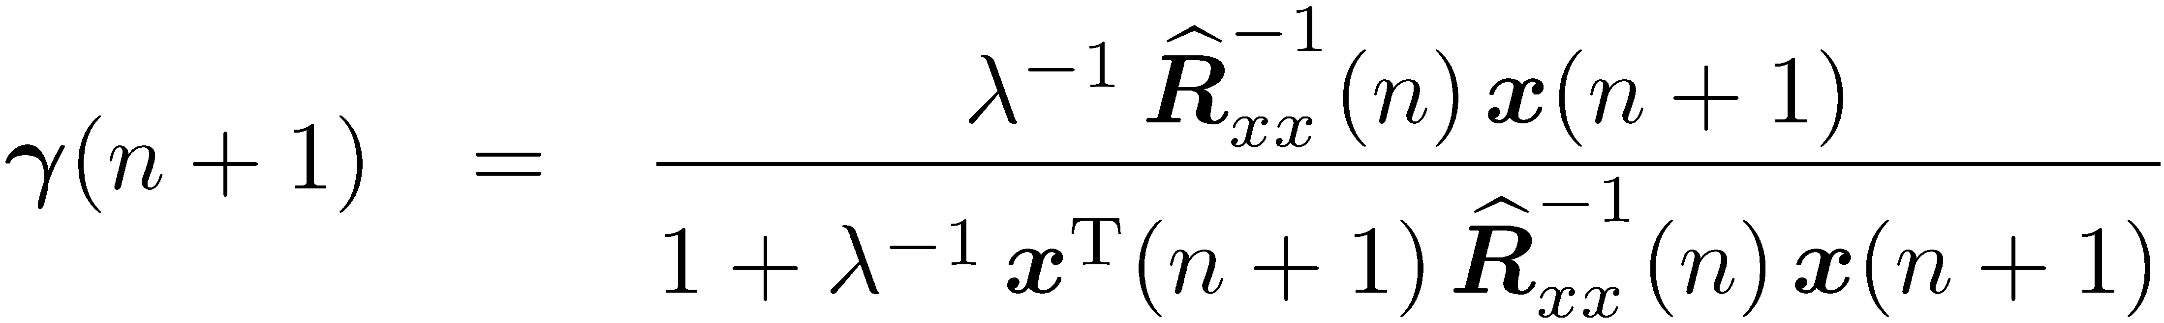
Recursion – inverse matrix recursion
Repetition of the recursion:
One can define a gain vector:
And one can simplify the recursion formula:

Slide 26

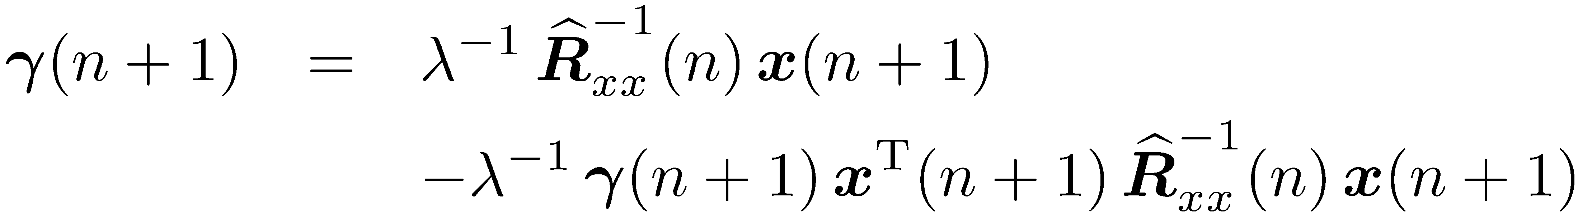
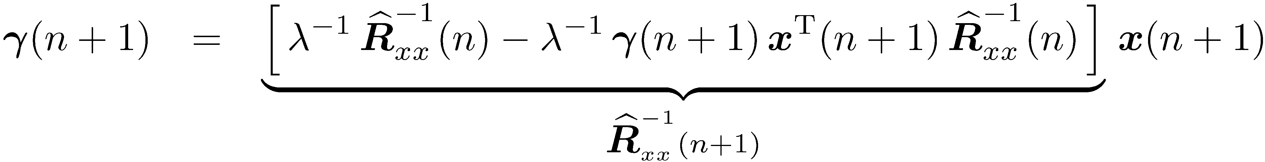

Recursion – gain factor reformulation
Definition of the gain vector:
Multiplication with the denominator leads to:
Rewriting (2. term to the right):
(s. previous page)

Slide 27

Recursion – filter coefficient recursion (I)
Recursion of the filter coefficients vector:
Step from n to n+1:
Replacing the right-hand side by:
one obtains the following recursion for the filter coefficients:

Slide 28


Recursion – filter coefficient recursion (II)
So far, we have:
We insert the recursive calculation:
and obtain:

Slide 29




Recursion – filter coefficient recursion (III)
So far, we have (first formulation with a recursion for ):
We insert the gain factor :
and obtain:
Gain vector
Error: old filter with new data

Slide 30



Recursion – filter coefficient recursion (IV)
Inserting the previous results…
…leads to the following adaptation rule:

Slide 31

Summary of the Recursive Least Squares Algorithm (RLS)
1) Computation of a gain vector (complexity prop. to N²):
2) Update of the inverse auto-correlation matrix (complexity prop. to N²):
3) Computation of the error signal (complexity prop. to N):
4) Update of the filter vector (complexity prop. to N):
Step size (0 … 1) will be considered later

Slide 32


Interpretation of Recursive Least Squares Algorithm (RLS)
The update term…
… has the direction determined by:
Meaning: If the signal is white, the direction of the update goes along the excitation vector
The non-white signals are whitened by multiplying with the inverse ACF matrix. Changes the direction of the vector
This ensures that the direction of the update term changes randomly and not a direction is dominant. This could lead to a decreased adaptation speed.

Slide 33



Interpretation of Recursive Least Squares Algorithm (RLS)
Remember the error term and the error surfaces:
Quadratic equation results
in a unique minimum
White noise:
Colored noise:

Slide 34
Summary
This week:
The Recursive Least Squares (RLS) algorithm.
First, the properties of the Wiener filter solution have been explained, esp. the calculation of a stationary solution.
Then the Least Squares (LS) solution has been derived mainly based on a deterministic error criterion.
The LS solution was the starting point for the derivation of a recursive update formula: The RLS algorithm.
Next week:
Adaptive filters: Least Mean Squares (LMS) algorithm

