Slide 1
EECS 482 Discussion 1
NOAH CROCKER
(NECROCKE@UMICH.EDU)

Slide 2

About
Me
CS Senior – Distributed systems and Databases
Efficiency
See my dotfiles repo
Commandline addict – ZSH
Opinionated cynic – CS degree != programmer
Weekend hacker
EECS 482
The (partial) exception
Crucial material – Interview questions
“Surface” class

Slide 3
Admin
Office Hours
CTools
[6]7-9PM Tuesday
(All) office hours extended 2 hours on project days
Weekly Homework
Not graded
Help further immerse you in exam material
Answers only given in discussion

Slide 4
Overview
Git + GitHub
Git
Setting up SSH keys for GitHub
GDB
Basic usage
Core dumps
Valgrind
Makefiles
Bonus? Productivity tips

Slide 5
Source Control
Records changes to files
See file history – Find regressions using tagging
Allows you to revert
Enables simple and conflict-free collaboration
Everyone uses version control
Blame your teammates

Slide 6
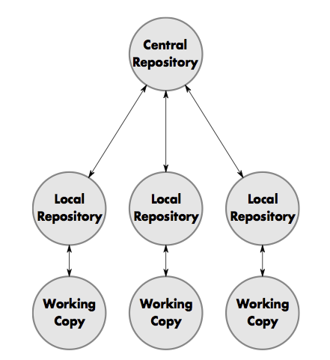
Source Control – Git
Decentralized versioning system
Everyone has a copy of the repository
“Remotes” allow for multiple “central” repositories
Massive feature set
Make “commits” from working copy to local
Push commits from local to remote
Pull teammates commits from remote to local
Push
Pull
You

Slide 7
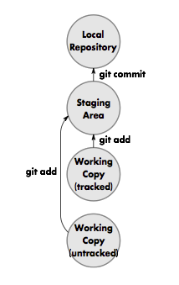
Source Control – Git
git add <file or directory>
Add untracked or tracked files to staging area
git rm <file or directory>
Stage a “delete” directive for file
Delete file from working copy as well
git commit
Commit staged changes to local repository
Flags
-m “<Message>”
-a (add all changed tracked files to staging area and commit)

Slide 8
Source Control – Git
git log
View commit history
--oneline –graph -pretty
git status
Shows current state of your local repository
-s
git diff
Show diff between working copy and HEAD
Can use SHA1 of commits to compare commits instead of working copy
Find regressions!

Slide 9
Source Control – Git
git checkout <file>
Revert your working copy of the file
Remote Workflow
git push
Push changes to currently tracking remote
For EECS 482, this is GitHub by default
git pull [--rebase]
Pull changes from currently tracking remote and automatically merge or rebase

Slide 10
Source Control – Git
Merge Conflicts
Sometimes merge is arbitrary
Run “git status” and resolve all conflicting files in an editor
“git add” all of the resolved files
“git commit” (with no arguments)

Slide 11
Source Control – GitHub
Hosts your remote repositories
Autograder/Office Hours
Are you registered on Github and CTools yet? You should be.

Slide 12
Source Control – GitHub
SSH keys
Used to authenticate without a password – much more secure
Already have SSH keys?
ls –alh ~/.ssh
Generate keys
ssh-keygen –t rsa –C “<githubEmail>”
Add PUBLIC key to GitHub server
https://github.com/settings/ssh

Slide 13
Source Control – GitHub
Local Git config
Git wants to know about you
I have a nice gitconfig made for you (autocorrect, color, etc.)
curl –L http://goo.gl/4dLBfA > ~/.gitconfig
(Edit ~/.gitconfig “AUTHOR” lines)
Manual git config
git config --global user.name “Noah Crocker”
git config --global user.email “github.email@something.com”

Slide 14
Source Control – GitHub
Get a “clone” of a remote repository
cd <EECS482 project directory>
git clone git@github.com:eecs482/UNIQUENAME.0.git [p0]
cd p0 (or uniquename.0 if you didn’t spec folder location)
http://try.github.io
http://gitimmersion.com
DEMO

Slide 15
CAEN the Dinosaur
CAEN won’t load C++11-cabable G++ or corresponding GDB by default.
module load gcc (which loads g++ too)
module load gdb
You can add these to any of your RC scripts
~/.profile

Slide 16
GDB
GNU Debugger
Start with gdb <program>
Commands
run (r) <args> -- Run program with args
break (b) [file:]line -- Break at line
break (b) [file:]func -- Break at function
continue (b) -- Continue until next break
step (s) -- Execute next line, step into calls
next (n) -- Execute next line, step over calls
backtrace (bt) -- Stack trace
info [locals|args|threads|break] -- Show information
frame [n] -- Switch to frame n (use with bt)
thread [n] – Switch to thread n (use with info threads)

Slide 17
GDB
Handle SIGUSR1 nostop noprint – Don’t do anything on user signal 1 (project 1 and 2)
Automatically run commands in file (like the one above) at gdb start
gdb <executable> –x <file>
GDB DEMO

Slide 18
GDB Core Dumps
Postmortem debugging
ulimit –c unlimited
<run your app and let it crash> (core.* file will be created and saved in working directory)
gdb <exec> core.<?>
Force a dump with ctrl-\ (useful for finding infinite loops)
CORE DUMP DEMO

Slide 19
Valgrind
Please don’t leak memory… Smart pointers.
Valgrind + multithreading = bad time (especially in p2)
Use to find undefined behavior instead
Unintialized values
Memcpy
Potential segfaults
Incorrect memory freeing
Valgrind <flags> <exec> <args>
--tool=helgrind (dataraces in multithreaded applications)
VALGRIND DEMO

Slide 20
Makefiles
Use them
Love them
Simplified project 2 Makefile on github
Refactor for projects 1, 3, and 4
http://goo.gl/6Tv7SA
Make with –j <num cores> to parallelize your build
Make with just –j <nothing> to run with maximum concurrency

Slide 21
THE END
I’ll stick around and answer questions

