Slide 1

Social Network Analysis
Feygina Vera
National Research University,
“Higher School of Economics”
Moscow, 2019

Slide 2

Information about graph
Number of nodes: 121
Node attributes: Label (Surname and Name), Gender, City, Relation
Number of edges: 1461
Edge attributes: None
Diameter: 8
Average clustering coefficient: 0,606
Average path length: 3,212

Slide 3
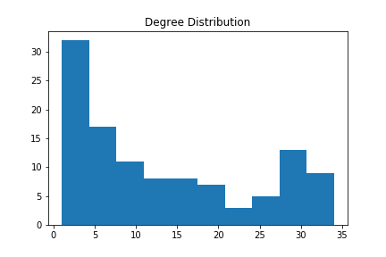
Degree Distribution

Slide 4
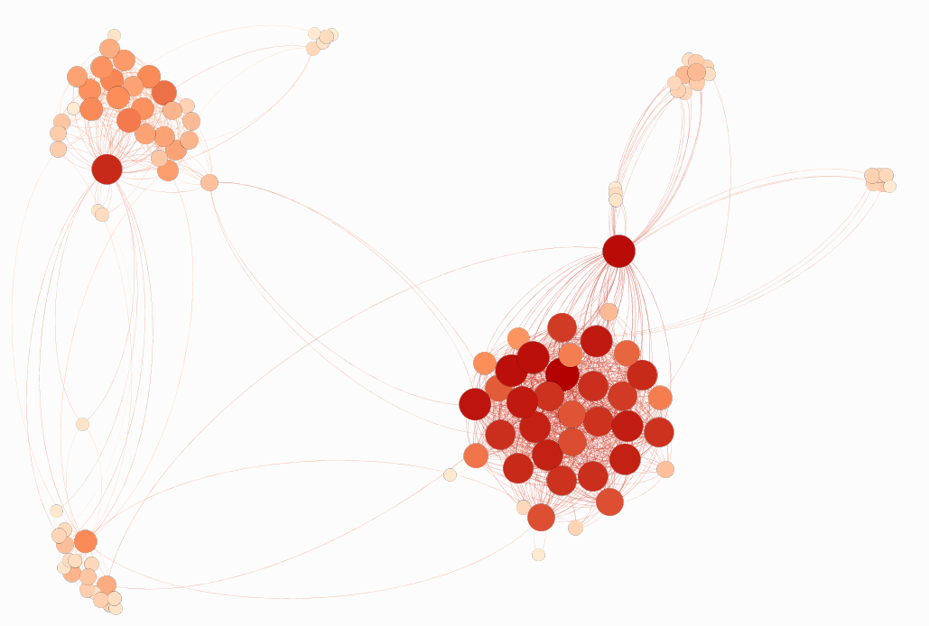
Degree Centrality
Top-5:
Арсений Чуйков
Анна Воронкова
Екатерина Малыгина
Александр Назаров
Ксения Медведевских

Slide 5
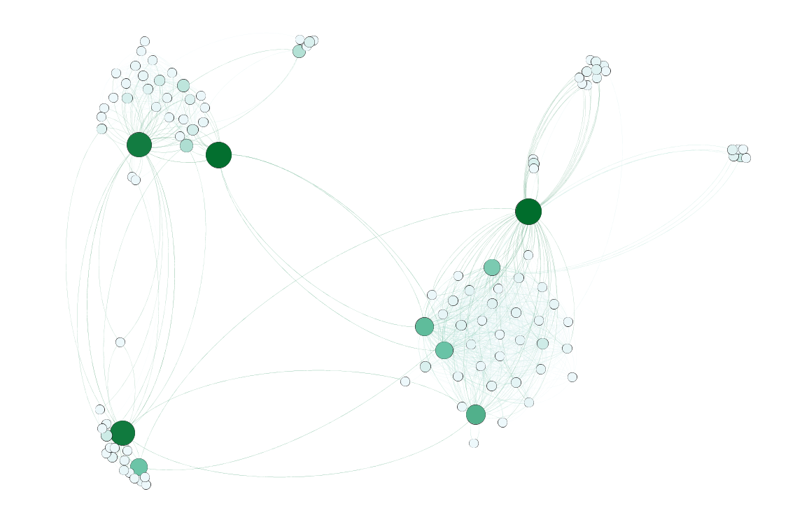
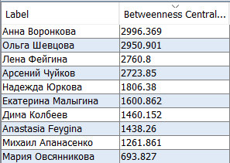
Betweenness centrality

Slide 6
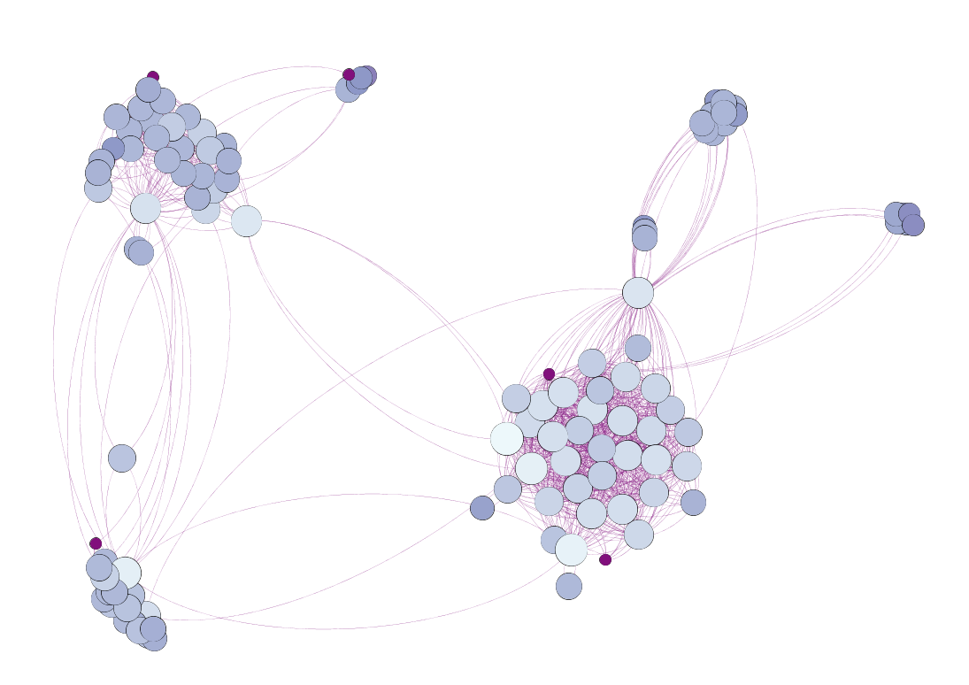
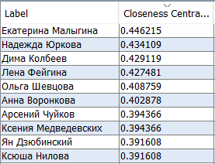
Closeness centrality

Slide 7
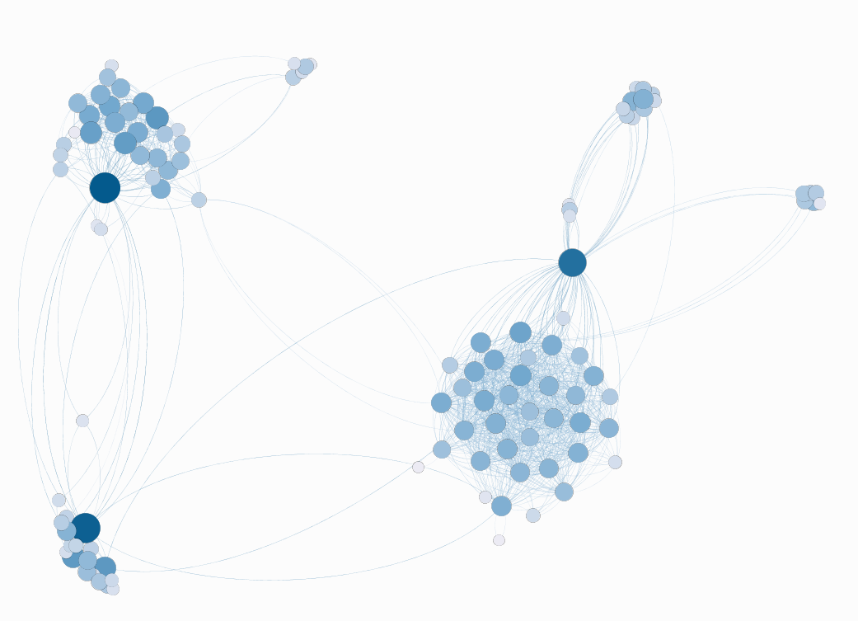
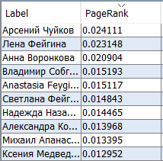
Page Rank

Slide 8
Centralities: conclusions
Degree centrality shows the people, who share the greatest amount of friends with me (my boyfriend, connected to my family and school, and guys from HSE History, connected to friends from dormitory and HSE Data Journalism).
Betweenness centrality represents those, who connect different groups of my vk friends (the darkest nodes: HSE History girl from my dormitory, the girl from the school, who studied in HSE, my sister, connected to my school/university friends and my boyfriend, connected to my family.
Closeness centrality gives the people, knowing other friends of my network indirectly (the most active guys from university, my boyfriend, my best friend and my sister).

Slide 9
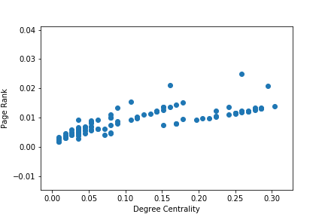
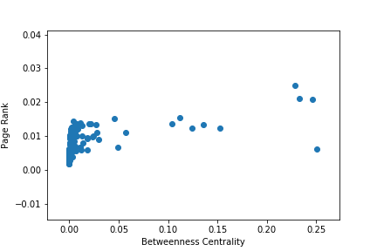
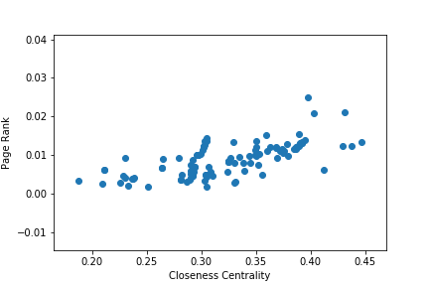
Page rank and Centralities

Slide 10
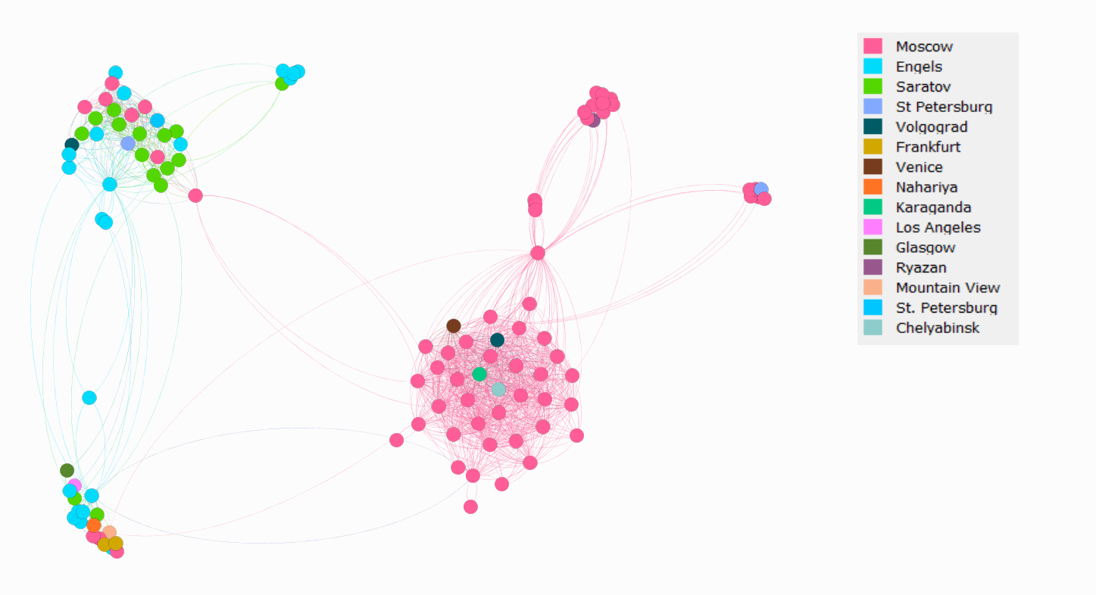
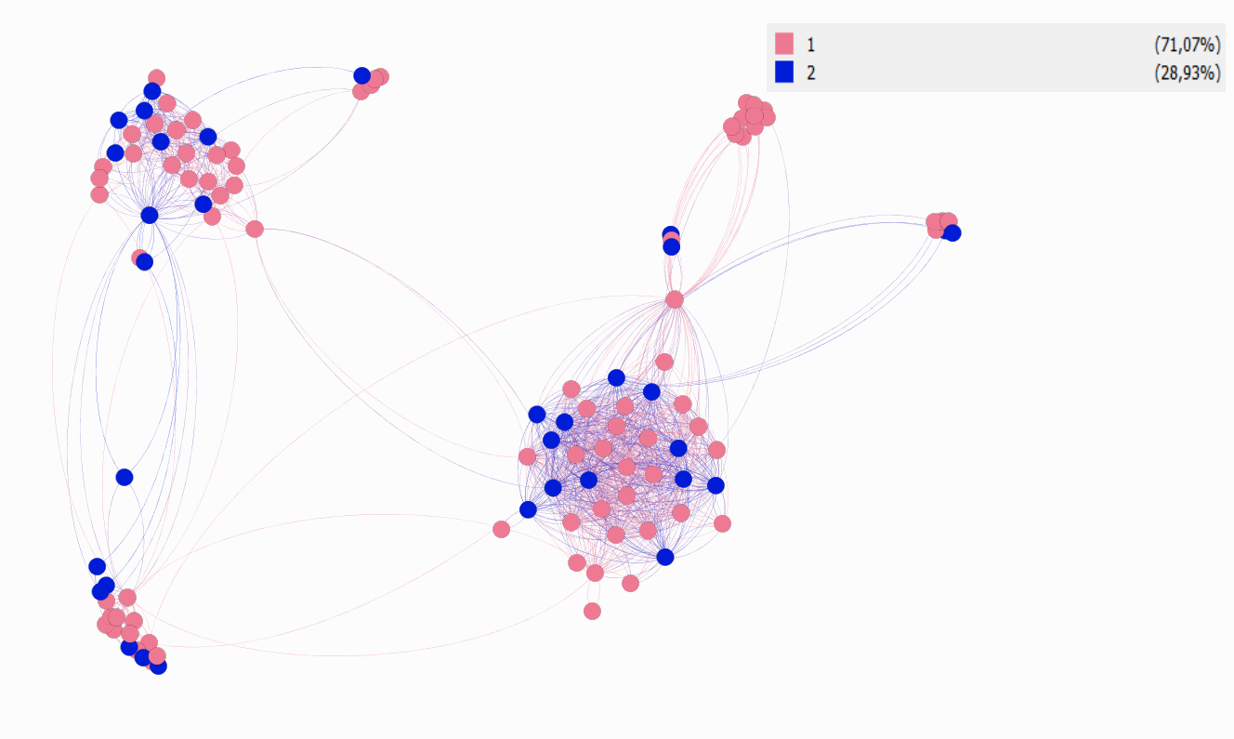
City
Assortative mixing
Gender: 0.0197
Label: -0.0146
Relation: -0.007
City: 0.3027 – the strongest dependency,
no missing values
Gender

Slide 11
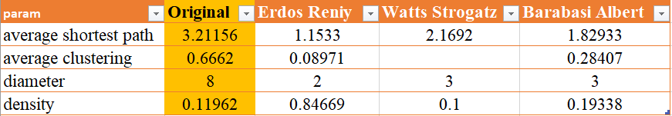
Random graph

Slide 12
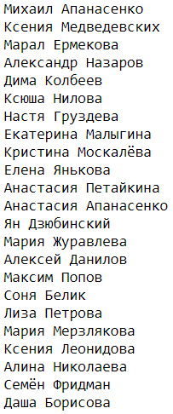
CLIQUES
The number of max. cliques: 299
Size of max. clique: 18
Friends, which are in all max. cliques (without repetition): 23
Nodes in max. clique – HSE History friends.

Slide 13
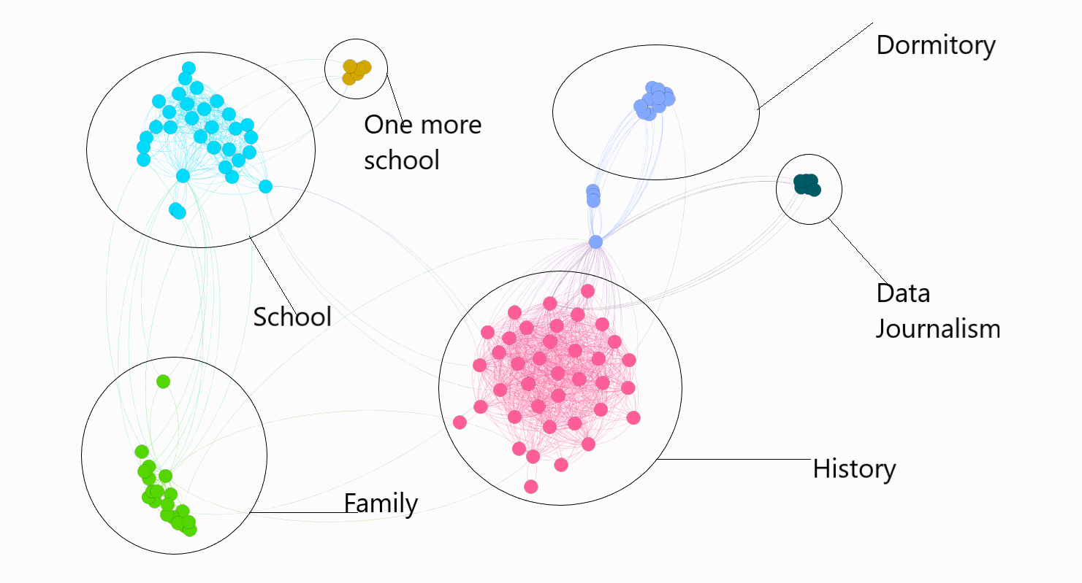
Modularity

Slide 14
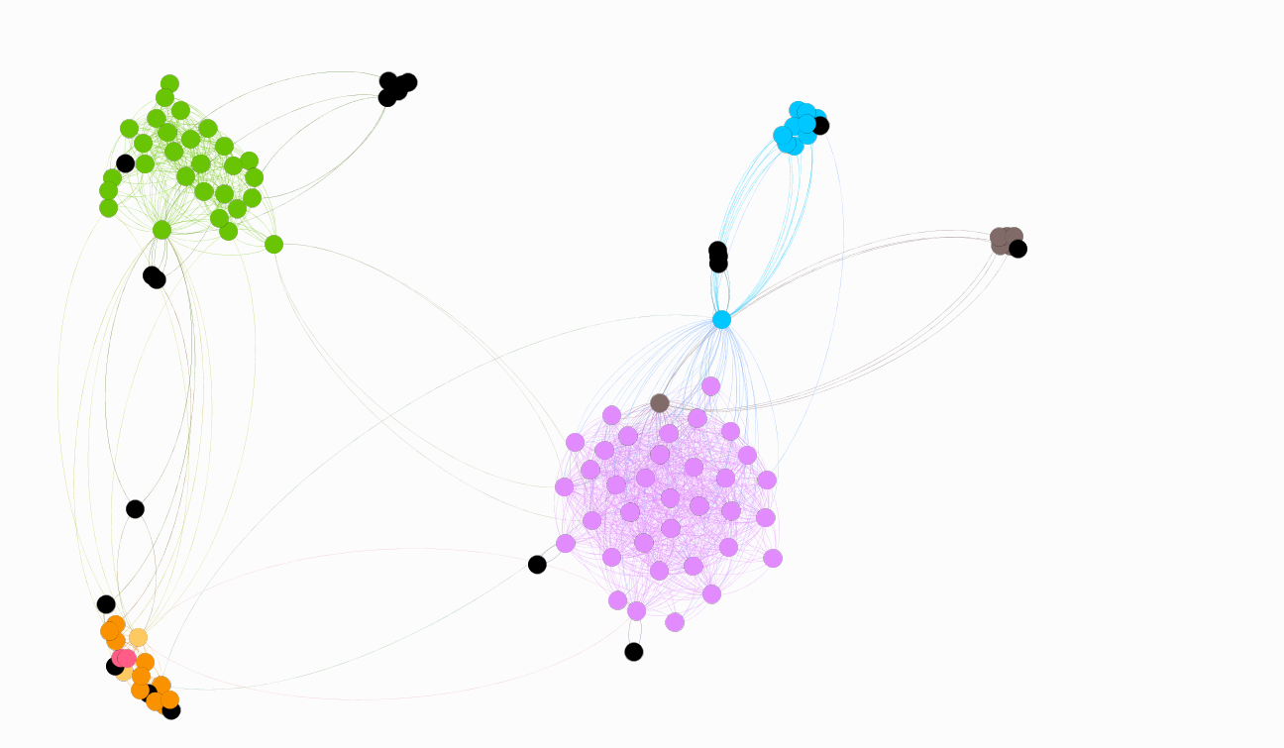
K-clique (k = 4)

Slide 15
Thank you!

