Slide 1

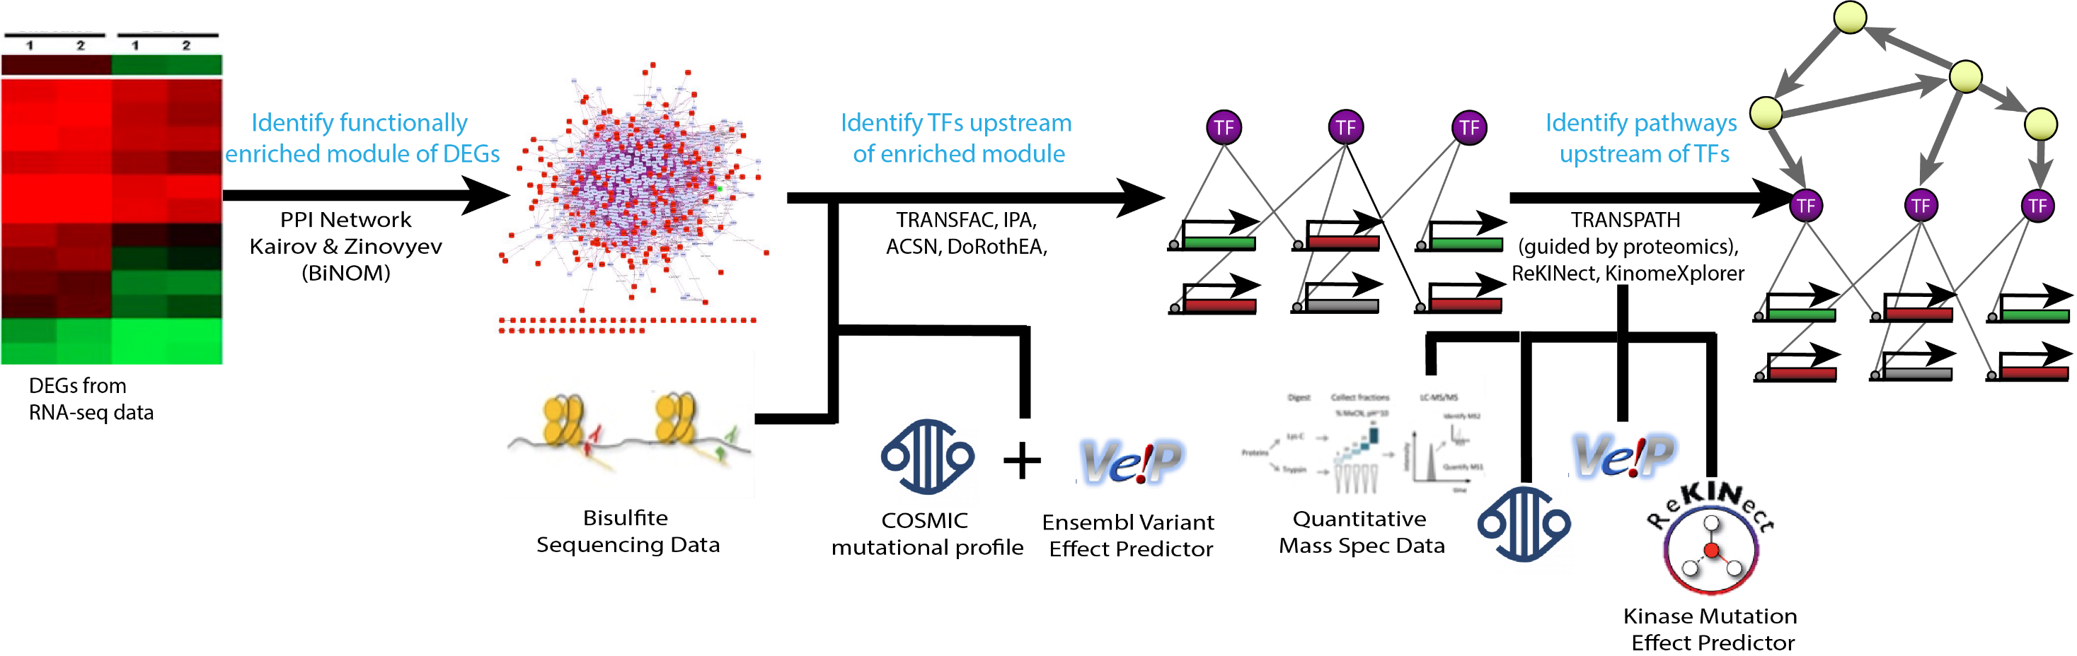
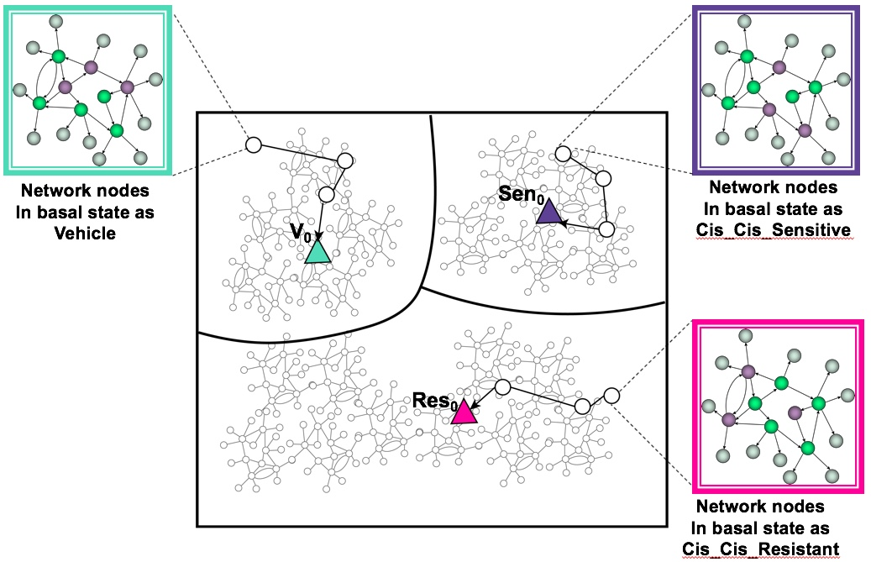
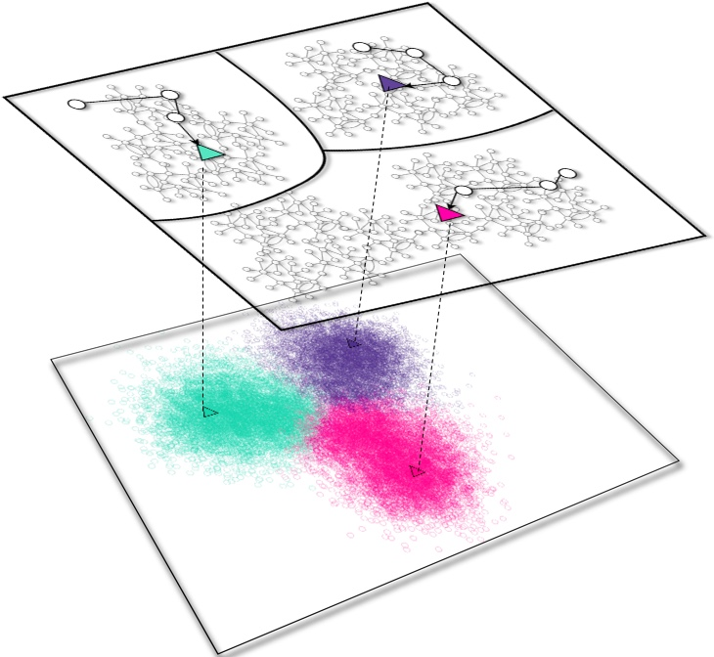
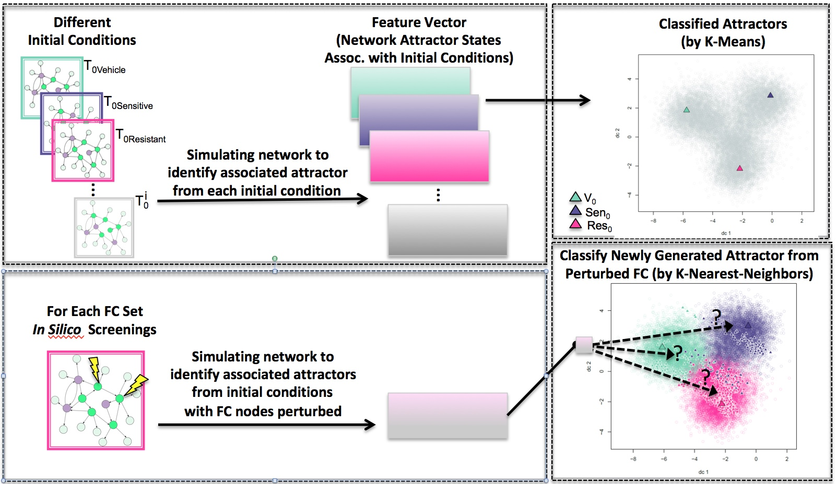
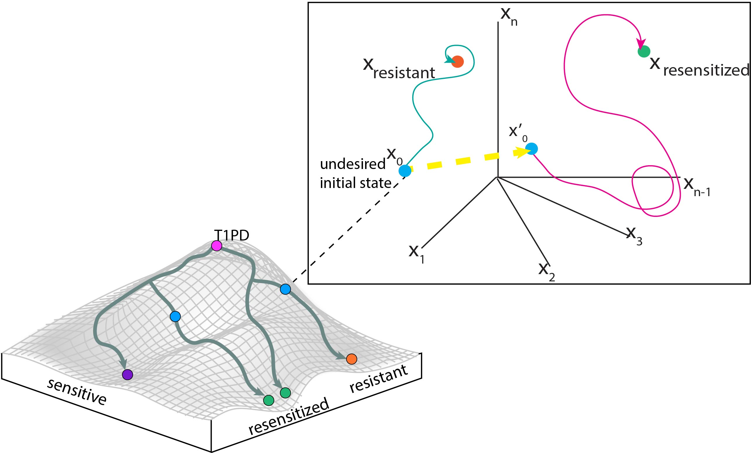
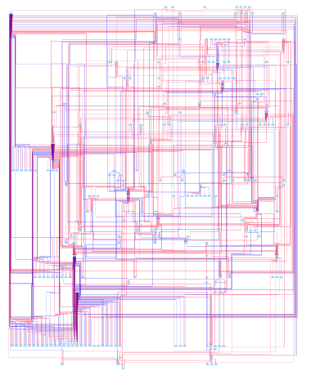
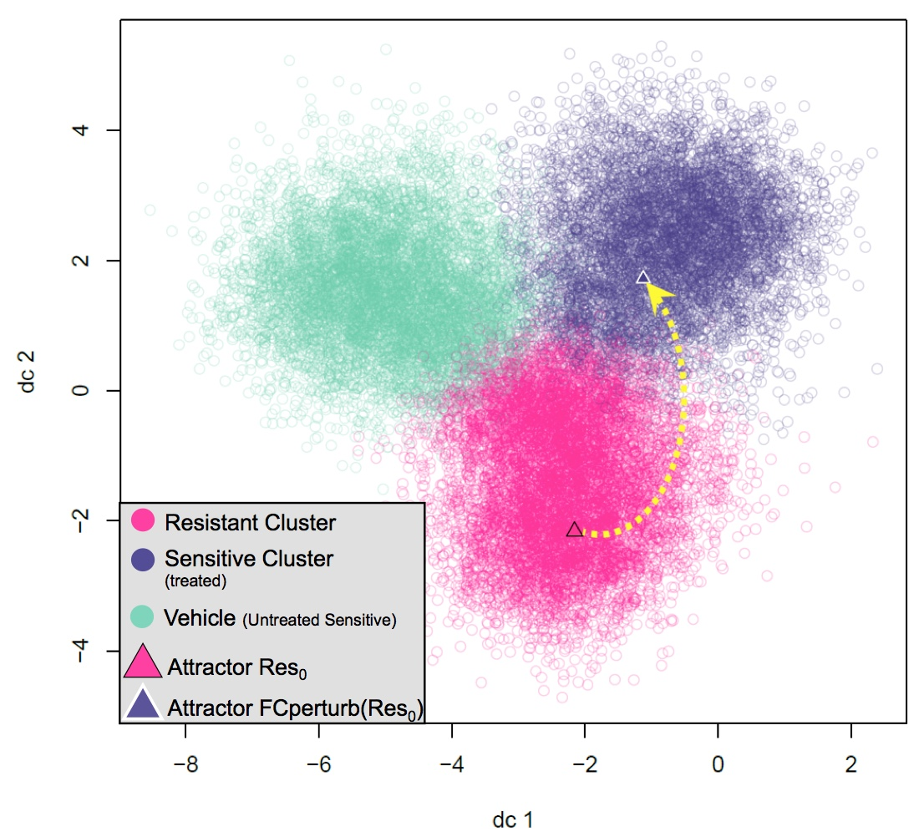
Identification of Combinations of Targets for Claudin-Low Triple Negative Breast Cancer
Madeleine S. Gastonguay¹, Lauren Marazzi¹, Paola Vera-Licona¹
Center for Quantitative Medicine, UConn Health, Farmington CT 06030
INTRODUCTION
METHODS
Triple Negative Breast Cancer (TNBC) is an aggressive, heterogenous subtype of breast cancer (BC) accounting for 20% of BC cases¹. Unlike other subtypes of BC which are characterized by the presence of estrogen receptors, progesterone receptors, or HER2 amplification, TNBC is characterized by the lack of all three of these markers. As a result, it is difficult to treat TNBC with current targeted therapies. Claudin-low (CL) TNBC is a subtype of TNBC making up 7-14% of invasive breast cancers diagnoses². It is characterized by low expression of tight junction proteins Claudin 3, 4, and 7 and the cell adhesion molecule E-cadherin^{2,3,4}. CL tumors are prone to epithelial to mesenchymal transition (EMT) as well as exhibiting stem-cell like characteristics, two hallmarks of cancer marking high metastasis rates^{2,5}. The low proliferation rate of the subtype sets it apart from most tumors, making it difficult to treat with cytotoxic drugs². CL TNBC has a poor prognosis and a clear need for new treatment options.
One potential therapeutic strategy is tumor reversion, the biological process by which tumor cells lose a significant fraction of their malignant phenotype⁷. Tumor reversion has been observed for over a century (SOURCE). It has also been achieved both in vitro, in vivo, and ex vivo. In particular, tumor reversion has been achieved in vitro with the CL cell line MDA-MB-231, and in vivo in a mice xenografted with MDA-MB-231 cells⁸⁻¹³.
At the cellular level, the development of cancer can be seen as a systems-level dynamical process driven by an intracellular signaling network. Attractors of this network correspond to cell phenotypes¹⁴. Cancer attractors are attractors presenting a malignant phenotype that are pre-existing in the network but not typically accessible and therefore not occupied by cells¹⁴. They can be accessed through genetic mutations or changes in the tumor microenvironment. Cancer reversion can be viewed as an optimal control problem in dynamical systems where the objective is to shift the system away from a cancerous attractor and towards normal-like attractors.
Structure-based control methods study the controllability of systems based solely on the structure of the network¹⁵⁻¹⁸. Attractor-based control methods focus on the controllability of the system by restricting the target states to attractors. Recently, structure-based attractor-based methods for non-linear systems have been proposed^{17,18}(Fig 1). The newly proposed Feedback Vertex Set Control (FC) framework is especially suited for systems with non-linear dynamics⁸. The objective of FC is to identify combinations of network nodes that drive the network from an arbitrary initial state to any desired dynamical attractor of the system by perturbing the initial state of identified nodes.
Objectives: Develop and apply a computational systems biology pipeline for the construction and control of an intracellular signaling network of reversion of Claudin-Low Triple Negative Breast Cancer. The ultimate goal is to identify and experimentally validate combinations of therapeutic targets to aid in the reversion of CL TNBC.
STEP 1. Reconstruction of Resistance Network. Using pairs of RNA-Seq data of the TDP TNBC PDX model ATAC-seq data of its derived cell line, with and without treatment, and after the development of resistance to cisplatin together with SNV and CNV profiles of the PDX tumor model across treatment, we will construct an intracellular signaling network of cisplatin resistance (Fig 3).
Figure 3. Pipeline for the Data-Driven Reconstruction of the Resistance signaling Network
STEP 2. Estimating Attractor Landscape with Topological Signal Flow Analysis (SFA). We apply SFA¹⁹ to Network to estimate the attractor landscape (Fig 4).
STEP 3. Estimating Phenotype Landscape with Unsupervised Machine Learning. We applied K-Means algorithm to cluster the identified attractors (Fig 5).
STEP 4. Applying FC Control and In-Silico Screenings. We apply FC control⁸ to Resistance Network to identify combinations of control sets (FCs). We perform in-silico screenings and applied a K-Nearest Neighbors (KNN) classifier to identify combinations of perturbations of nodes in each FC set that can shift attractors from Resistant to Sensitive basin of attraction (Fig 6). These combinations of perturbations of FC nodes are Resistance Revertant Sets which will be then prioritized.
V₀
Sen₀
Res₀
Figure 4. Attractor Landscape. Attractor landscape including the associated attractors for the 3 different experimental conditions: Vehicle, Cis_Cis_Sensitive and Cis_Cis_Resistant.
Figure 5. Phenotype Landscape After
Unsupervised Clustering.
RESULTS
Figure 6. Perturbation of FC sets and their Supervised Classification.
Clauding-Low TNBC Network. The constructed network has 230 nodes and 583 edges (Fig ). 90 of the nodes are hallmarks of cancer, 27 are breast disease ontology associated, and 4 are claudin-low markers. 142 of the network nodes are in the ACSN.
Attractor Landscape Estimation and Unsupervised Attractor Classification. We initialized the network with basal expression levels for MCF10A and MDA-MB-231, and ran SFA to estimate the corresponding attractors. We generated 100,000 random initial states of the system and simulated their corresponding attractors with SFA to estimate the attractor landscape of the network. All attractors were classified with K-Means. The MCF10A and MDA-MB-231 attractors appeared in different clusters (Fig).
FC Control Analysis. We identified 6 FC sets in network. Each FC set contained 28 source nodes and 14 FVS nodes. We identified a subset of FVS nodes that were present in all 6 FC set. This FVS subset consists of 11 nodes: MAP2K6, MAP2K3, MAPK1, AURKA, CTNNB1, FOXM1, JUN, RELA, STAT3, TCF3, and AKT1. We applied all (3¹¹=177,147) perturbations on the FVS nodes parting from the cancerous state. INCLUDE KNN RESULTS
An example of a combination of perturbations on the FVS subset that can shift from Resistant to the Sensitive Attractor is:
Downregulation: CREB1,CUX1, PAX5, TWIST1
Upregulation: RBPJ
TWIST1 has been shown to increase Cisplatin resistance²⁰. CREB1 is a member of CBP/ß-catenin/FOXM1 transcriptional complex and it was shown to be a molecular driver of TNBC²¹. CUX1 expression may lead to TNBC via repression of the estrogen receptor alpha²². Finally, inhibition of PAX5 increased cisplatin sensitivity in bladder cancer cells.
The Resistant associated attractors and the newly shifted Sensitive associated attractor are shown in Fig 8.
FC₁={
}
Figure 1. Waddington’s Epigenetic Landscape and Optimal Control on State Space Portrait
DATA
Figure 7. Tumorigenic Network. 230 nodes and 583 edges. Edges in red are activating edges, while blue edges are inhibitory.
Figure 8. Shifting Resistance Attractor Towards Sensitive Attractor. Applying the perturbations of FC₁ to the system, successfully shifted the resistant associated attractor Res₀ to sensitive associated attractor Fcperturb(Res₀). The classification of Fcperturb(Res₀) was done via KNN clustering with K=30
Multi-Omics Profiling Data. For xenografts treated with Cisplatin, we have RNA-Seq on residual tumors after 21 days of vehicle or drug treatment (T1) to capture the population of cells from the original tumor bulk that is relatively insensitive to the individual agents. To quantify the accompanying epigenetic changes, we have ATAC-seq data at T1 on the CRCs derived from in vivo vehicle or drug treated T1 residual tumors. We have a second treatment cycle (T2) of Cisplatin with the same PDX model and observed that 3 out of 7 tumors grew despite Cisplatin retreatment. We have RNA-seq data on residual tumors at T2. Finally, we have whole genome sequencing of T1 and T2 residual tumors to obtain Single Nucleotide Variation (SNV) and Copy Number Variation (CNV) profiles of across treatment.
DISCUSSION
We have successfully constructed a pipeline for the development of an acquired-resistance to cisplatin signaling network. Based on preliminary data, we were able to capture known TNBC dysregulated genes, Cisplatin resistance associated genes and genes associated with breast diseases/ neoplasms in all three layers of the intracellular signaling network.
Our in silico screenings and perturbation experiments did generate different Resistance Revertant Sets.
Future work includes the prioritize of FC sets to select few top sets for experimental validation. Finally, we plan to extend our analysis with dynamical modeling to compare results or possibly to obtain additional therapeutic targets.
REFERENCES
Boyle P. Ann Oncol. 2012;23(suppl 6).
Menghi F, Inaki K, Woo X, et. al,. Proc Natl Acad Sci. 2016;113(17).
Roche P, Olesen HG, Hussain F, et. al. 2018:389122.
Thu KL, Silvester J, Elliott MJ, et. al. 2018;115(7).
Ching-Tai Lin. Structural controllability. 1974;19(3).
Liu Y-Y, Slotine J-J, Barabási A-L Nature. 2011;473(7346).
Mochizuki A, Fiedler B, Kurosawa G, Saito D. J Theor Biol. 2013;335
8.Zañudo JGT, Yang G, Albert R. 2016. doi:10.1073/pnas.1617387114.
9. Kairov U, Karpenyuk T, Ramanculov E, Zinovyev A 2012;8(16):773-776.
Kolpakov F, Poroikov V, Selivanova G & Kel A. 2011;22, S16.
Matys V, Kel-Margoulis O V., Fricke E, et. al,. 2006;34(90001).
Schmidt, F. et al. 2017; 4: 54–66.
Forbes SA, Beare D, Boutselakis H, et al. 2017;45, D777–D783.
Krull M, Voss N, Choi C, Pistor S, Potapov A, Wingender E. 2003;31(1).
Creixell P et al. 2015;163, 202–217.
Creixell, P. et al 2015;163, 187–201.
Horn H et al. 2014;11, 603–604.
Kuperstein I, et. al,. Nature oncsis. 2015
Lee D, Cho K-H. Sci Rep. 2018;8(1):5262
Shen,D.-W. et al. (2012); 64, 706–21.
Ring A, Nguyen C, Smbatyan G, et al. (2018);10(12):525.
Burton LJ, Hawsawi O, Sweeney J, et al. 2019;14(4):e0214844
Dong BW, Zhang W, Qi S, Yan C, Gao J (2018);503,4:2293-2300.
Objectives: Develop and apply a computational systems biology pipeline for the construction and control of an intracellular signaling network of reversion of Claudin-Low Triple Negative Breast Cancer. The ultimate goal is to identify and experimentally validate combinations of therapeutic targets to aid in the reversion of CL TNBC.
Objectives: Develop and apply a computational systems biology pipeline for the construction and control of an intracellular signaling network of reversion of Claudin-Low Triple Negative Breast Cancer. The ultimate goal is to identify and experimentally validate combinations of therapeutic targets to aid in the reversion of CL TNBC.
[M1]Just to vary structure since it says accounting for in the first sentence
[M2]Add citations?
[M3]Add citations?
[M1]Just to vary structure since it says accounting for in the first sentence
[M2]Add citations?
[M3]Add citations?

Slide 2
Figure 6. Perturbation of FC sets and their Supervised Classification.

