Slide 1
SFA

Slide 2
Last Time
We simulated an attractor with SFA and BoolNet
We weren’t sure how to discretize the SFA results to compare to BoolNet so we tried multiple ways:
Anything >= 0 goes to 1, anything < 0 goes to 0
Anything < 0 goes to 1, anything >= 0 goes to 0
Several ways with GED protools using Discreetest to determine the best method
We wanted to get a better idea of whether or not we can tell when SFA gives reliable results/ get an intuition for what we can use it for.

Slide 3
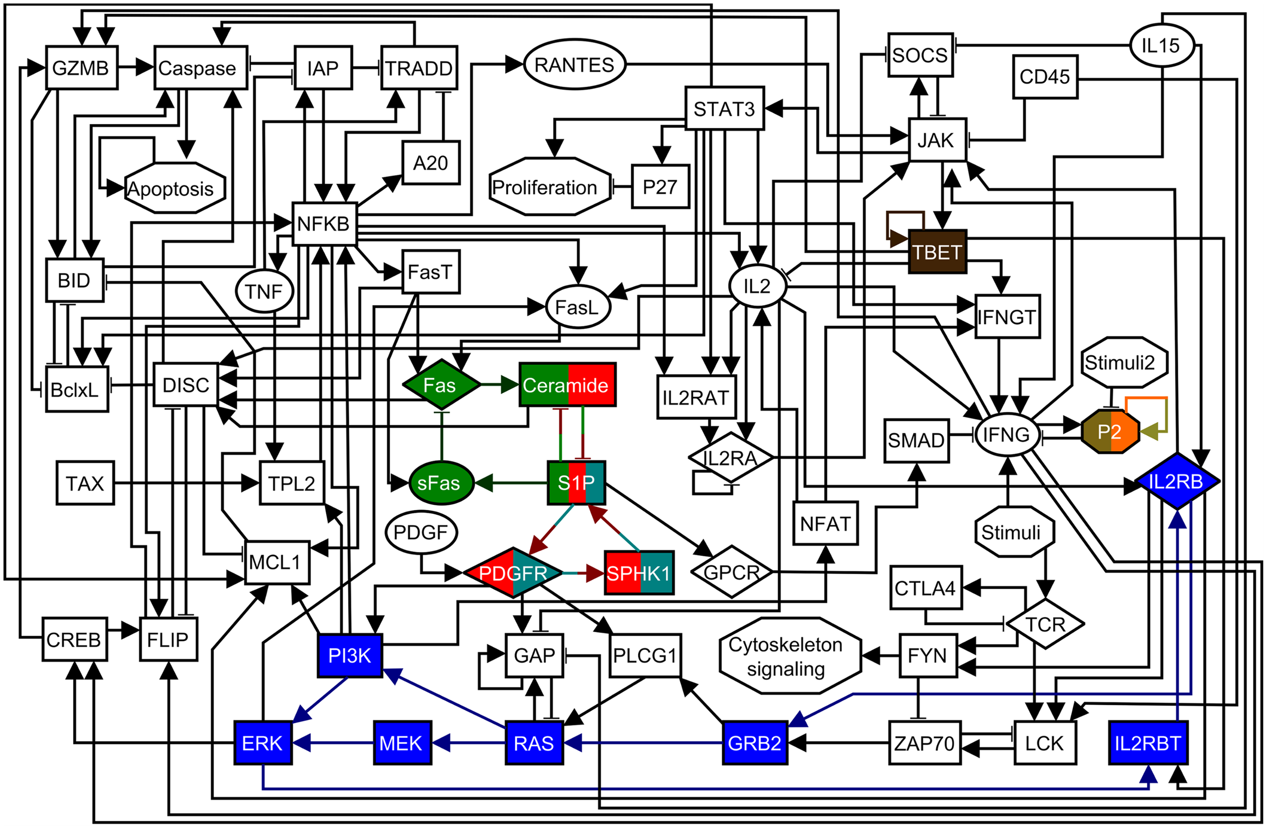
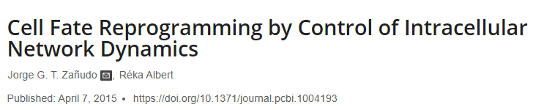
Zañudo 2015- T-cell large granular lymphocyte (T-LGL)
60 nodes, 142 edges
2 phenotypes
Apoptosis
Leukemia (Proliferation)

Slide 4
Procedure
1. Boolnet
Simulated the attractor landscape of the Boolean Network
Chose one attractor (attractor 15) to examine
Found the basin of attractor 15
Chose 4 of the states in this basin to run with SFA
2. SFA
Ran SFA iteratively with the 4 chosen states
Used tolerance level= machine epsilon
Used alpha = 0.5

Slide 5
Goal:
The 4 initial states result in the same attractor when estimated using SFA
The number of time steps it takes to reach the attractor using SFA is similar to the number of time steps the same initial state takes to reach the attractor with BoolNet
The network state determined by BoolNet and SFA is similar at each time step
We need to compute DAC to interpret SFA results

Slide 6
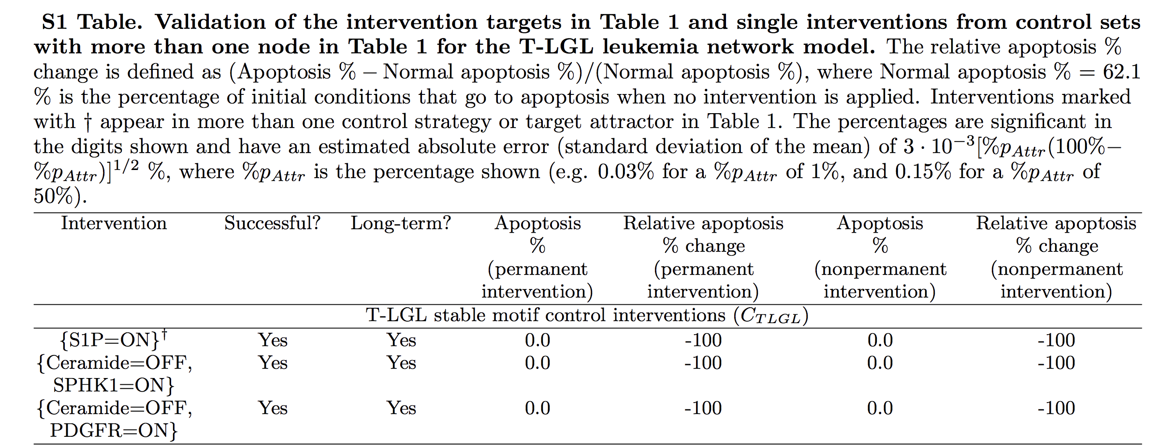
Zañudo Identified 3 interventions that result in the Leukemia phenotype:

Slide 7
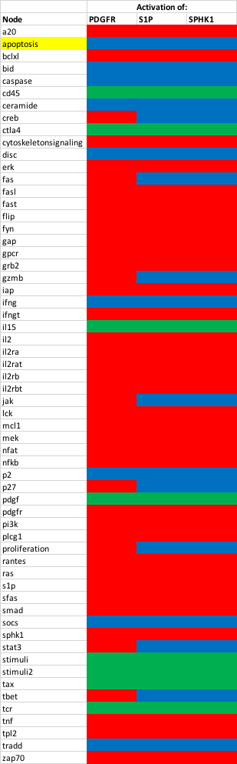
Leukemia Attractors with SFA
We chose activation of SPHK1 as our leukemia reference attractor. This reached the attractor after 35 time steps.
We used SFA to compute the Leukemia attractors.
Red indicates a positive steady state log value
blue indicates negative steady state log value
green is 0 steady state log value
Activation of S1P and SPHK1 had the same patterns of negative, positive, and 0 steady state values

Slide 8
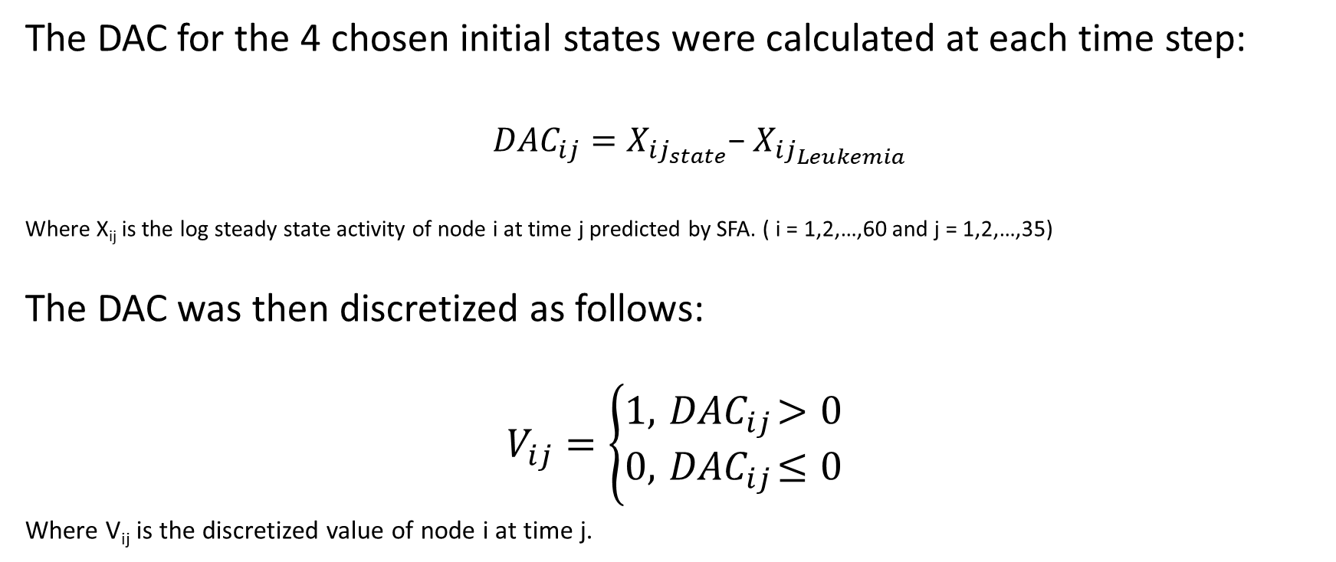
Interpreting SFA Results
The DAC for the 4 chosen initial states were calculated at each time step:
${DAC}_{ij}=X_{{ij}_{state}}\text{− }X_{{ij}_{Leukemia}}$
Where X_{ij} is the log steady state activity of node i at time j predicted by SFA. ( i = 1,2,…,60 and j = 1,2,…,35)
The DAC was then discretized as follows:
$$V_{ij}=\left\{\begin{aligned}1,{ DAC}_{ij}>0 \\ &0,{ DAC}_{ij}≤0\end{aligned}\right.$$
Where V_{ij} is the discretized value of node i at time j.

Slide 9
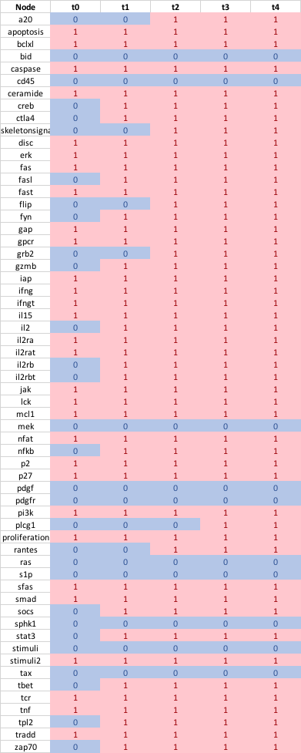
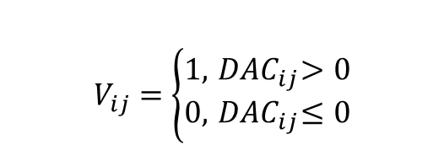
Example: Discretized SFA Trajectory of Initial State 1
…
$$V_{ij}=\left\{\begin{aligned}1,{ DAC}_{ij}>0 \\ &0,{ DAC}_{ij}≤0\end{aligned}\right.$$

Slide 10
Initial State | Iterations to convergence with SFA | Steps away from attractor with discretized SFA trajectory | Steps away from attractor with BoolNet
1 | 37 | 3 | 33
2 | 38 | 2 | 4
3 | 38 | 3 | 13
4 | 38 | 3 | 7

Slide 11
Comparing Attractors

Slide 12
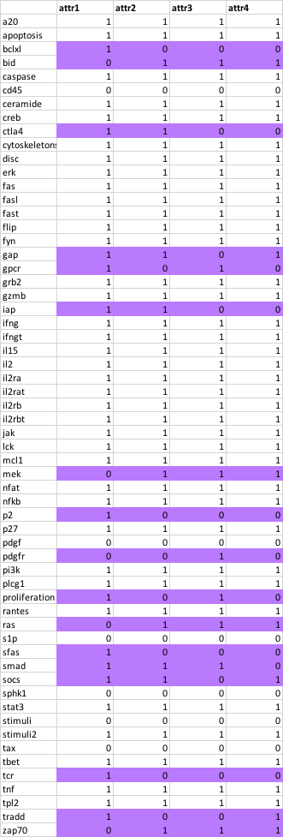
43 out of 60 nodes (~71%) are the same in all 4 SFA attractors
Nodes highlighted in purple differ in at least one attractor

Slide 13
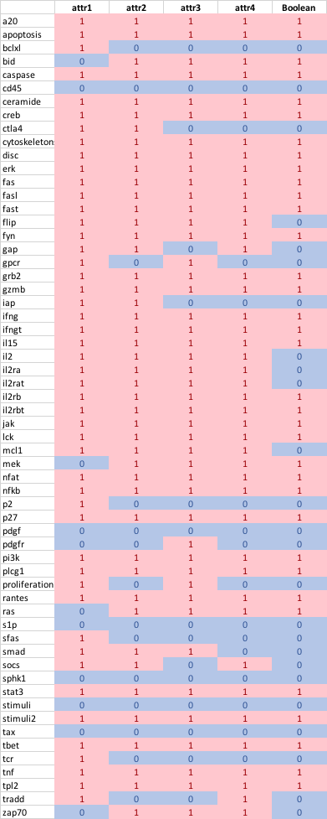
65-85% of the nodes in the SFA attractors were in the same orientation as the nodes in the Boolean attractor
Attractor | Number of nodes in same orientation as boolean attractor | Percent of nodes in same orientation as boolean attractor
1 | 39 | 65%
2 | 50 | 83.33%
3 | 50 | 83.33%
4 | 51 | 85%

Slide 14
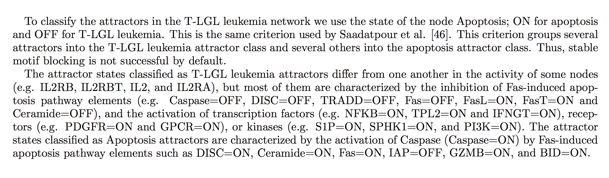
19 Readout Nodes
apoptosis, bid, caspase, ceramide, disc, fas, fasl, fast, gpcr, gzmb, iap, ifngt, nfkb, pdgfr, pi3k, s1p, sphk1, tpl2, tradd,

Slide 15
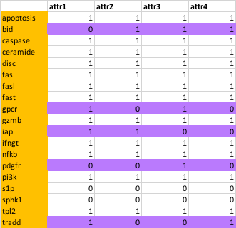
14 out of 19 readout nodes (~74%) are the same in all 4 attractors

Slide 16
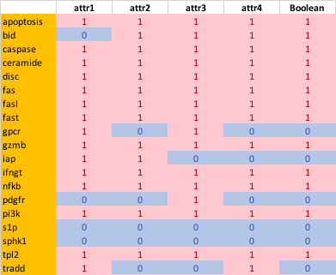
Attractor | Number of RONs in same orientation as boolean attractor | Percent of RONs in same orientation as boolean attractor
1 | 15 | 78.9%
2 | 18 | 94.7%
3 | 17 | 89.5%
4 | 18 | 94.7%

Slide 17
Conclusions

Slide 18
Other Explorations
If we simulate other attractors with SFA, would these 4 attractors cluster together? How many clusters would there be?
Repeat results using a different reference for DAC?
Use more than 4 initial states?

Slide 20
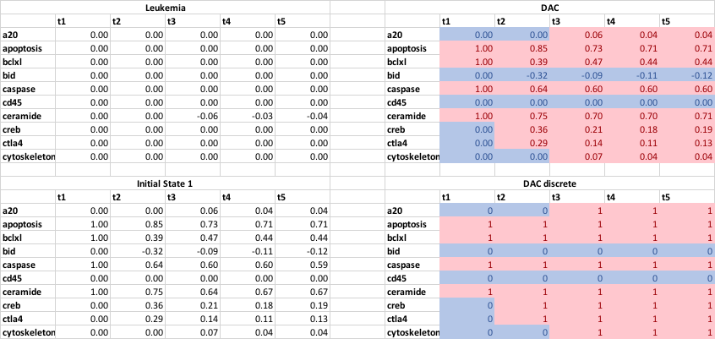
Example: Initial State 1

