Slide 1
CZ2001 Lab Project 1- Searching Algorithms
Notes:
Good morning everyone, I’m Chen Fei and here are my teammates, Tiviatis, Li Rong and Shuwen. We will be presenting our group project.

Slide 2
Objectives
To propose algorithms that solve string searching problems on genome sequences
The algorithms should return positions of occurrences of a query sequence in the source sequence and the number of occurrences
Notes:
The objective is to propose a few algorithms that solve string searching problems on real genome sequences.

Slide 3
Table of Contents
Brute Force Algorithm
Design and Execution
Complexity Analysis
BMH Algorithm
Design and Execution
Complexity Analysis
KMP Algorithm (modified)
Design and Execution
Complexity Analysis
Comparison
&
Conclusion
Notes:
Besides the brute force algorithm, 2 more algorithms will also be discussed, which were inspired by BMH algorithm and KMP algorithm respectively. We will also be comparing and summarizing the time and space complexities of them in the end.

Slide 4
01
Brute Force
Naive String Searching Algorithm
Notes:
First, let’s start with brute force

Slide 5
Concept
Walk through the source sequence from the beginning till the end
Check at each position if the resulting substring equals the query sequence
A
C
C
G
T
A
T
Source
C
G
T
Pattern
Notes:
The logic of brute force is to simply walk through the source sequence from the beginning till the end, and check at each position if the resulting substring equals the query sequence.
Let us look at an example, we want to search the pattern CGT in this source string.

Slide 6
Concept
Walk through the source sequence from the beginning till the end
Check at each position if the resulting substring equals the query sequence
A
Source
A
C
C
G
T
A
T
C
Pattern
C
G
T
Notes:
We just compare the characters one by one, and move the position of the pattern by 1 after a mismatch

Slide 7
Concept
Walk through the source sequence from the beginning till the end
Check at each position if the resulting substring equals the query sequence
A
C
Source
C
C
G
G
T
A
T
C
Pattern
C
G
C
T

Slide 8
Concept
Walk through the source sequence from the beginning till the end
Check at each position if the resulting substring equals the query sequence
A
C
C
Source
C
G
G
T
A
T
C
Pattern
C
G
G
T

Slide 9
Concept
Walk through the source sequence from the beginning till the end
Check at each position if the resulting substring equals the query sequence
A
C
C
Source
C
G
G
T
T
A
T
C
Pattern
C
G
G
T
T

Slide 10
Concept
Walk through the source sequence from the beginning till the end
Check at each position if the resulting substring equals the query sequence
A
C
C
G
Source
G
T
A
T
C
Pattern
C
G
T

Slide 11
Concept
Walk through the source sequence from the beginning till the end
Check at each position if the resulting substring equals the query sequence
A
C
C
G
T
Source
T
A
T
C
Pattern
C
G
T
Notes:
Until reaching the last possible substring comparison, the first character is a mismatch. Searching ends here.

Slide 12
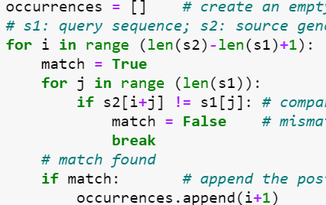
Implementation
Nested for-loop
Outer loop: check along all possible substrings
Inner loop: compare characters between the substring and the query sequence
Notes:
As for how to implement, the implementation makes use of a nested for-loop, for outer loop, we check along all possible substrings, and as for inner loop, we compare characters between the substring and the query sequence.
And here is part of the code.

Slide 13
Time Complexity
let n denote the length of the source genome sequence, and m be the length of the query sequence, where (n>>m)
To analyze the time complexity of brute force algorithm, we will be looking at the number of character comparisons
Notes:
To analyse the time complexity of brute force algorithm, we will be looking at the number of character comparisons.
Let n be the length of the source sequence and m be the length of the query sequence

Slide 14

Time Complexity - Best Case Scenario
Every first-character comparison between possible substring and query sequence results in a mismatch
The total number of comparisons is only determined by the number of outer-loop iterations, which is (n-m+1), or O(n)
Notes:
In best case scenario, every first-character comparison results in a mismatch, so the total number of comparisons is only determined by the number of outer-loop iterations, which is n-m+1, or 0(n)
This example shows a possible best case, where the first character B of query sequence does not even appear in the source string

Slide 15


Time Complexity - Worst Case Scenario
The total number of comparisons is the product of the number of outer-loop comparisons and inner-loop comparisons, which is m(n-m+1), or O(mn)
Notes:
In worst case scenario, basically the outer-loop iterates (n-m+1) times and the inner loop iterates m times, so overall worst case time complexity is O(mn)
And Both of the 2 examples give possible worst cases

Slide 16
Time Complexity - Average Case Scenario
Outer loop: it will always be executed (n-m+1) times
Inner loop: assume each number of comparisons (from 1 to m) is equally likely, expected number of comparisons = (1+m)/2
The average number of comparisons = (n-m+1)[(1+m)/2] = O(mn)
Notes:
As for average case scenario, we know that the outer loop will be executed the same number of times, whereas for inner loop, we assume that each number of comparison is equally likely to happen, so that will be a sum of ap from 1 to m, times the probability 1/m, after some calculations, the average number of comparisons is found to be still O(mn)
That’s all for brute force, i’ll now pass the time to Li Rong

Slide 17
02
BMH
Boyer Moore Horspool Algorithm
Notes:
Slide 18: Now I will be talking about the boyer Moore horspool algorithm. *Click*

Slide 18
Concept
Reduce searching time by comparing pattern with text sequences from end to start of pattern
Comparisons between first few characters can be skipped when there is a mismatch in the last few characters
Text:
AATTAAA
AATTAAA
Pattern
AAA
AAA
Notes:
Slide 19: So, the concept of the Boyer Moore Horspool Algorithm is to reduce search time by comparing the pattern with the text from end to start of the pattern. This way comparisons between the first few characters can be skipped when there is a mismatch in the last few characters. Let’s look at this example, we start comparing from the last character of the pattern, which is A with the character T in text. T cannot be found in the pattern hence we know that all other characters before A would not match. Hence, we can just skip 3 positions like this. And this would save 2 comparisons between the first 2 characters if we were to use brute force algorithm.
*Click*

Slide 19
Searching in BMH
Bad Match Table: Records number skips to do after mismatch with respect to the rightmost character compared in the text
Bad Match Table
Text:
AATTAAA
AATTAAA
A | C | G | T
1 | 3 | 3 | 3
Pattern
AAA
AAA
1
Skip 1
Notes:
Slide 21: Now I will explain how searching works. To determine number of skips to do after a mismatch, we refer to the bad match table which records the number of skips with respect to the rightmost character compared in the text. Continuing from the previous example, we compare all characters starting from the rightmost character of the pattern. *Click* It’s a match, *Click* it’s a match, *Click* and this is a mismatch. When we find a mismatch/after we compared all characters in the pattern, we will now look at the rightmost character in the text which is this A. *Click* and we look for the shift for A in the bad match table. Which is 1. *Click* Hence we *Click* shift the sequence to the right by 1. *Click*

Slide 20
Time Complexity: Preprocessing
Counting the number of character comparisons.
For all cases: O(m+σ)
Assign position to alphabet in Bad Match Table (σ)
Calculate number of skips (m)
n: Length of text
m: Length of pattern
σ: Number of alphabets
Notes:
Slide 21: Now I will go through the time complexity of this algorithm starting from preprocessing. For the analysis purposes, we will be comparing the number of character comparisons. For preprocessing, the time complexity is O(n+σ) since we have to iterate through all alphabets to assign each to a position on the bad match table (σ) and iterate through the pattern to calculate the number of skips. (n) *Click*

Slide 21
Time Complexity: Searching
n: Length of text
m: Length of pattern
σ: Number of alphabets
: Comparison
Best Case Scenario: O(n/m)
When the first compared character is always not found in the pattern
1 Comparison and m skips per outer loop
Skip 3
Skip 3
A | C | G | T
1 | 2 | 3 | 3
Text:
Pattern:
AATTCGCAA
CAA
AATTCGCAA
CAA
AATTCGCAC
CAA
Notes:
Slide 24: The best-case scenario for this algorithm occurs when the first compared character is always not found in the pattern this means that it does the least number of comparisons which is 1 and the greatest number of skips which is m. Hence, the best case time complexity is just O(n/m) *Click*

Slide 22
Time Complexity: Searching
n: Length of text
m: Length of pattern
σ: Number of alphabets
: Comparison
Worst Case Scenario: O(nm)
When all characters in the pattern matches or when all but the last match
m comparisons and 1 skips per outer loop
Skip 1
Skip 1
A | C | G | T
1 | 2 | 3 | 3
Text:
Pattern:
AAAAA
CAA
AAAAA
CAA
AAAAA
CAA
Notes:
Slide 25: The worst-case scenario for this algorithm occurs when all characters in the pattern match or when all but the last match and we only skip by 1 each time this means that it does the greatest number of comparisons which is m and the smallest number of skips which is 1. Hence, the best case time complexity is just O(nm)

Slide 23
Time Complexity: Searching
Average Case Scenario: O(n)
n: Length of text
m: Length of pattern
σ: Number of alphabets
E (Number of comparisons)
= E(Times outer loop executed) * E(Comparisons per outer loop)
= n/E(Skips per outer loop) * E(Comparisons per outer loop)
= n = O(n)
Assume each skip (from 1 to m) is equally likely
E(Skips per outer loop) = (1+m)/2
Assume each number of comparisons (from 1 to m) is equally likely
E(Comparisons per outer loop) = (1+m)/2
Notes:
Slide 25: To get average time complexity, we have to calculate the average number of comparisons. Which is the average number of times outer loop is executed multiplied by the average number of comparisons per outer loop. With the following assumptions, the average number of skips is equivalent to average number of comparisons per outer loop. Hence, average number of comparisons is n and average time complexity is O(n) *Click*

Slide 24
03
Modi-KMP
Modified Knuth–Morris–Pratt algorithm

Slide 25
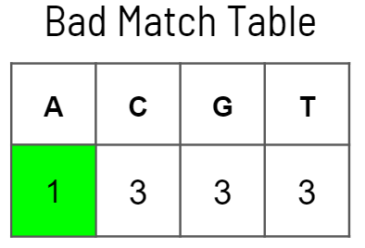
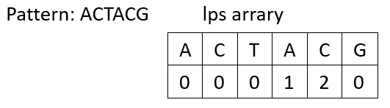
Concept
Uses two preprocessing techniques to reduce comparisons:
Bad match table(BMT) & Longest Prefix-Suffix array(LPS)
Implements bad character heuristic within KMP algorithm, which initially use only lps array.

Slide 26
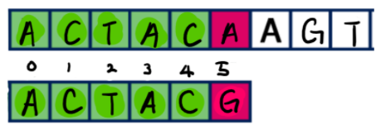




Lps array

Slide 27
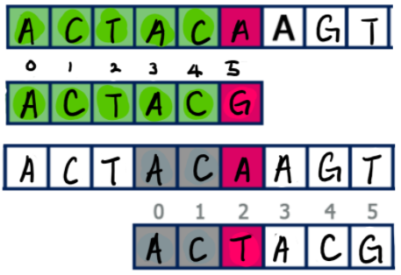

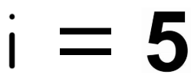
Lps array

Slide 28
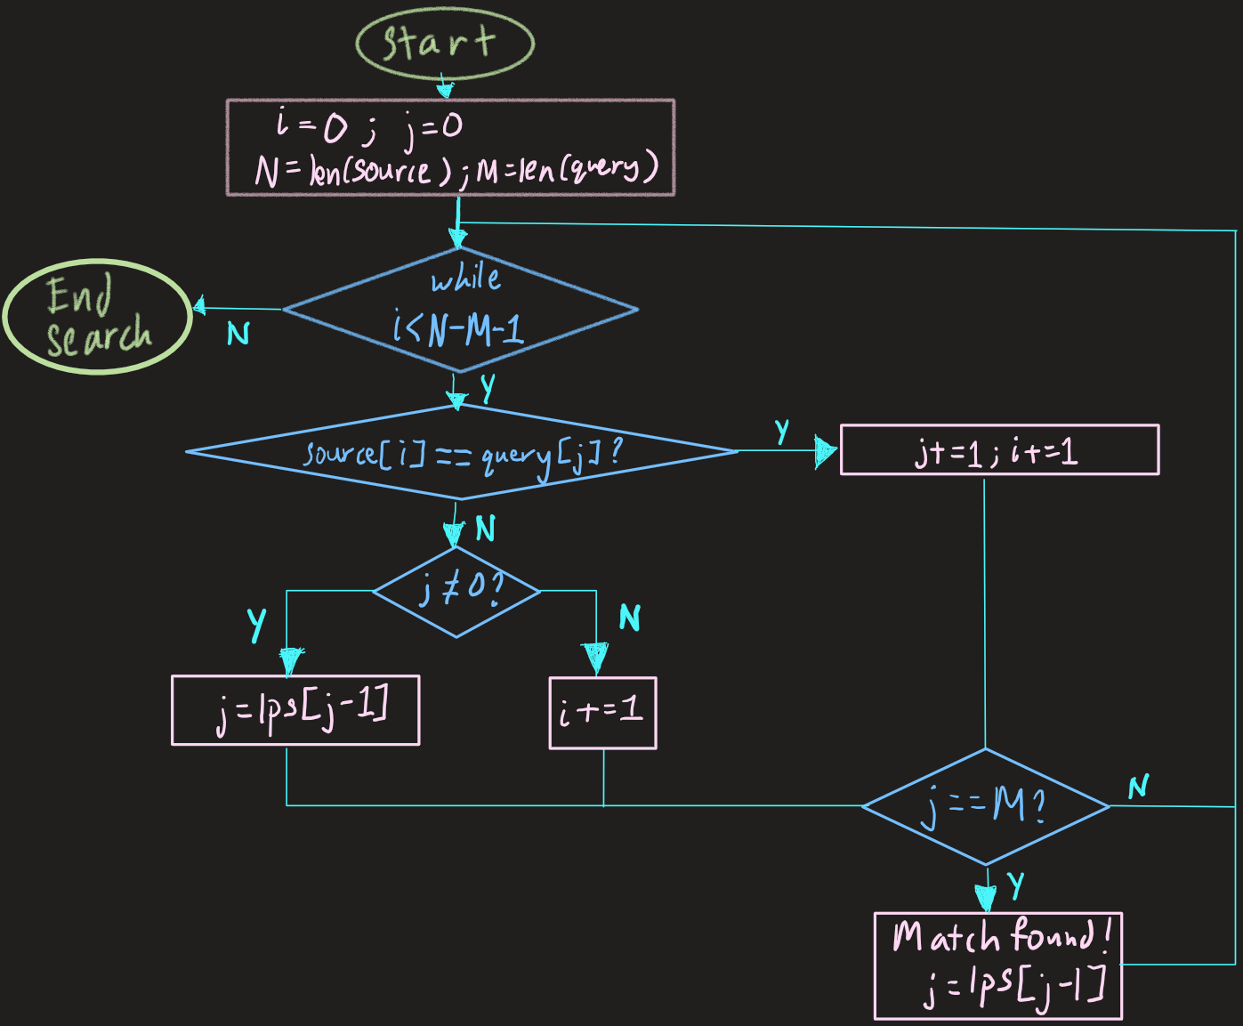
Normal KMP

Slide 29
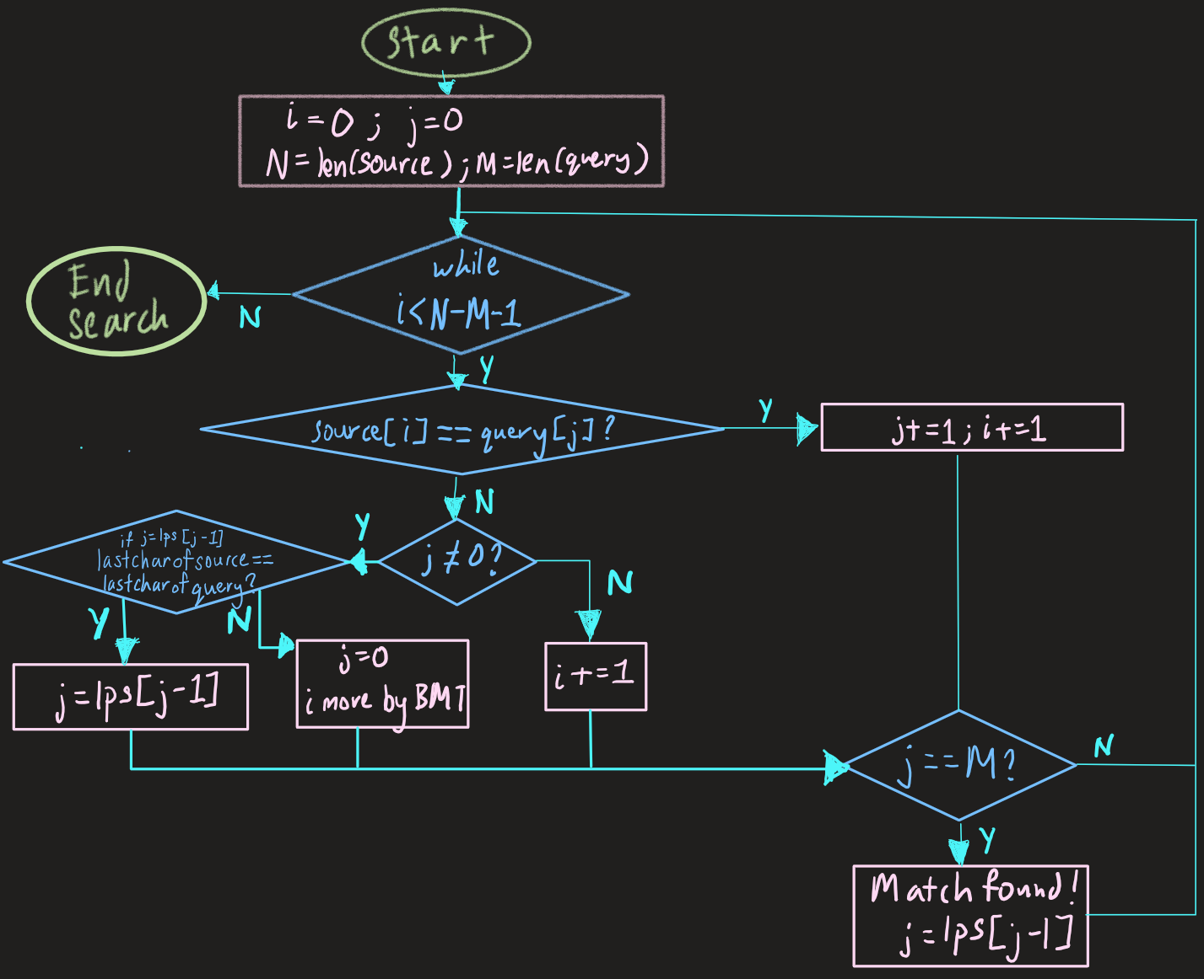
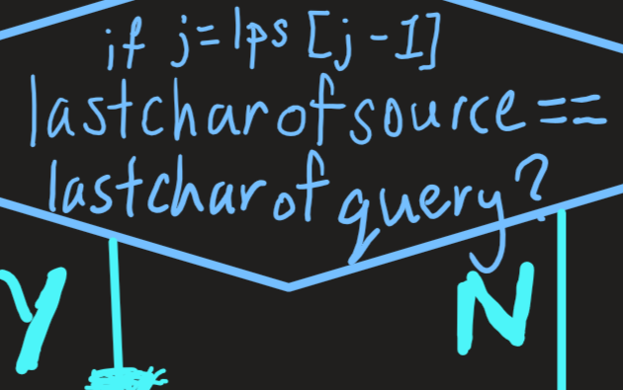
Normal KMP
Modified KMP

Slide 30
Time Complexity: Preprocessing
n is length of Source DNA, m is length of query pattern
Bad Match Table: For all cases: approx. O(m)
LPS: For all cases O(m)

Slide 31

Time Complexity:
Best Case Scenario: O(n/m)
Occurs when if-else allows BMT⇒ causing algorithm to run like Boyer-Moore
Pointer i signifying pattern moving along source code increments by m each time, causing only n/m comparisons

Slide 32
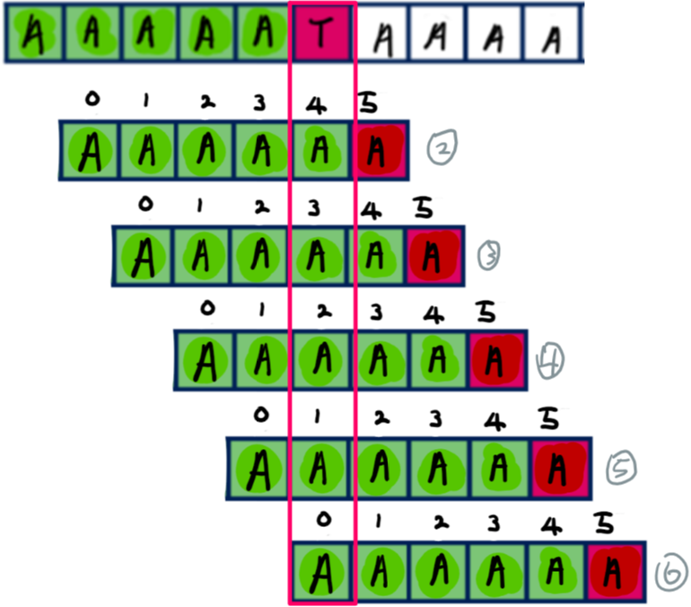
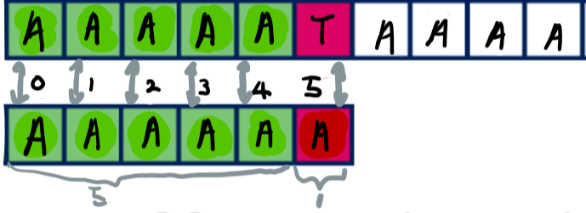
Time Complexity:
Worst Case Scenario: O(n)
Text=AAAAATAAAAATAAAAATAAAA…
Pattern=AAAAAA , length of pattern = 6
Compares approx. 2n times: has complexity of O(n)

Slide 33


Time Complexity:
Average Case
Scenario: O(n)
Expected i shifts
per iteration:
Expected number of comparisons:

Slide 34
04
Conclusion
Comparison between algorithms

Slide 35
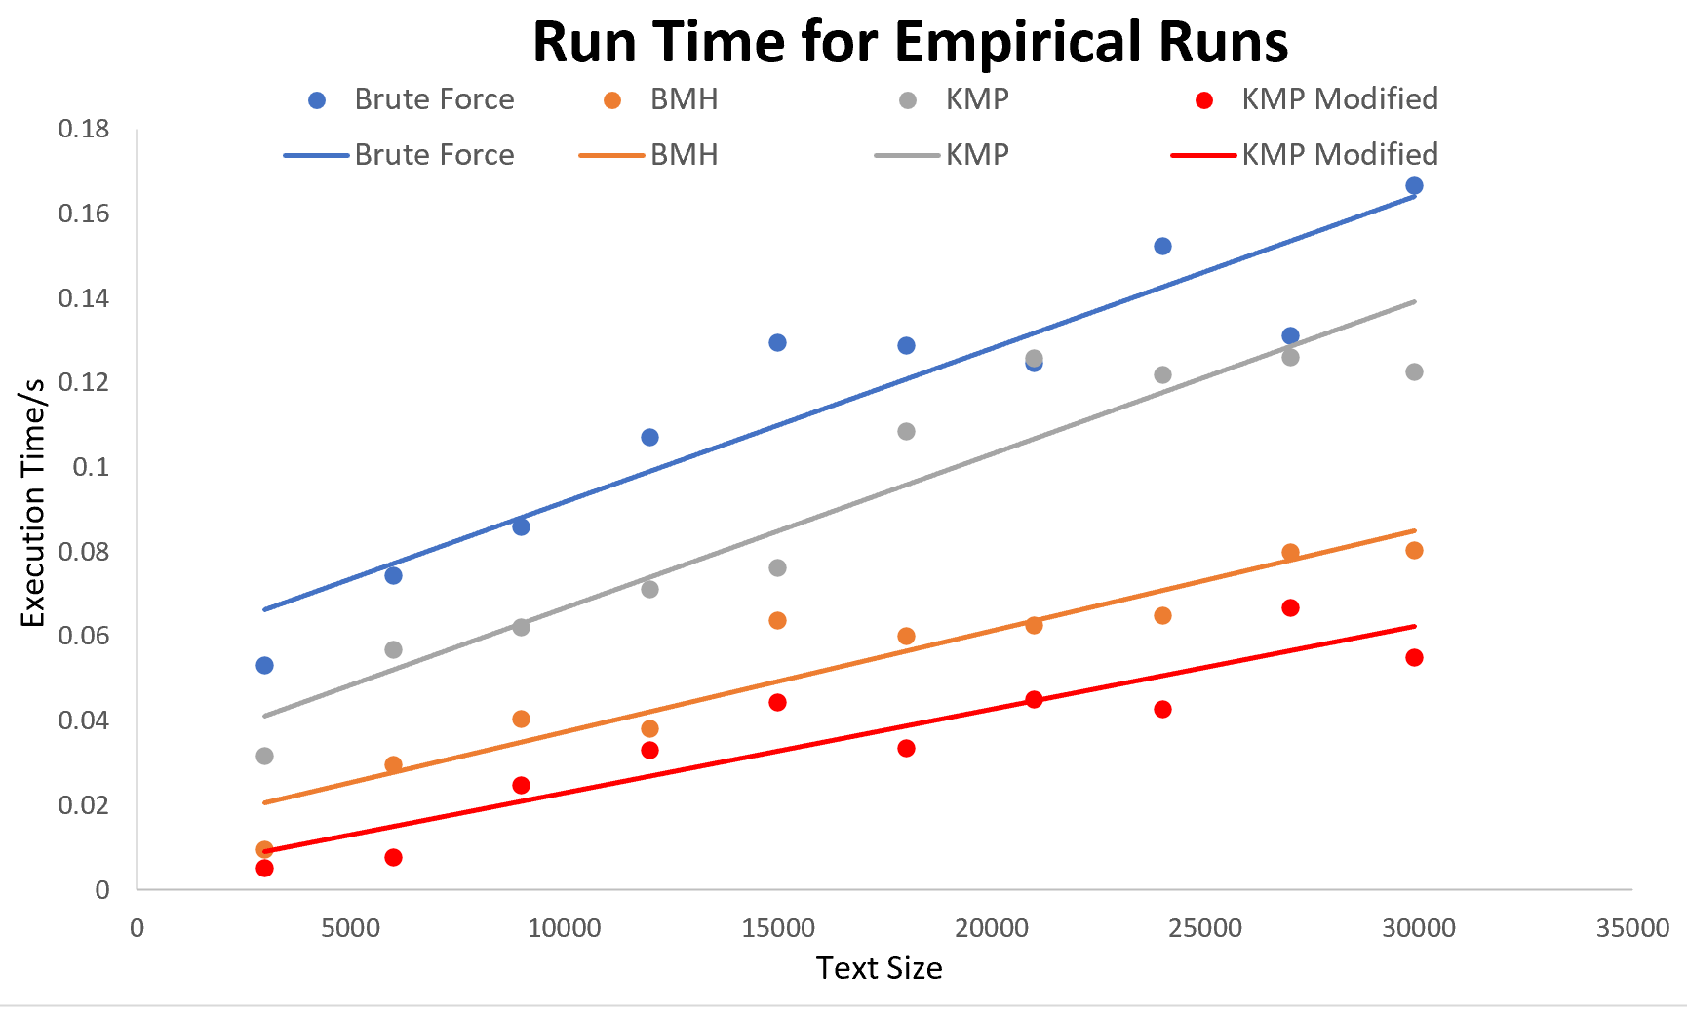
Comparison for empirical runs

Slide 36
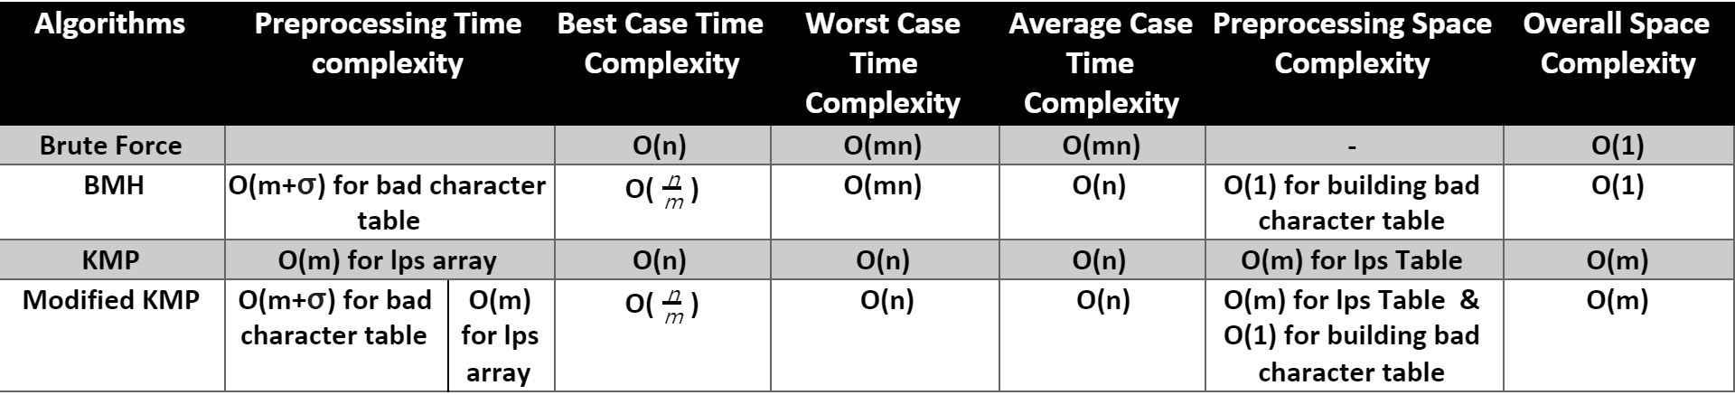
Theoretical Complexity
* n: Length of text, m: Length of pattern, σ: Number of alphabets

Slide 37
Thank You :)

