Slide 1
Zee Movies
Created by:
Brandon Williams, Robert Kilmer, Will Alonzo & Brain antalek

Slide 2
About the project
We set out to create an interface for viewing trailers and cast lists, preordering tickets, and reserving seats from a selection of current hit movies.
The interfaces had to be simplistic and efficient, to limit the time it would take between movie selection and checkout.
Users can create an account to save their information for future purchases and receive a 1-time discount code.

Slide 3
Creating the Project
We used a combination of Java Swing and Derby databases for creating the interfaces and saving user information.
This would mimic an actual web server handling user signup and login, as well as keeping track of what seats are already reserved by other users.
Seat Reservation was created with a myriad of buttons that acted as seats, with each selected seat being “reserved” into the seat database.
An Admin account was created for ease of price adjustment to account for inflation.

Slide 4
Many of the interfaces that require user input, such as login and checkout, have rudimentary features to insure proper use.
For example, no two accounts with the same email may be created. A credit card entered at checkout must be 16 numbers. A CCV must only be 3 numbers.
When selecting the amount of seats you are purchasing, you cannot select more than the amount you input.

Slide 5
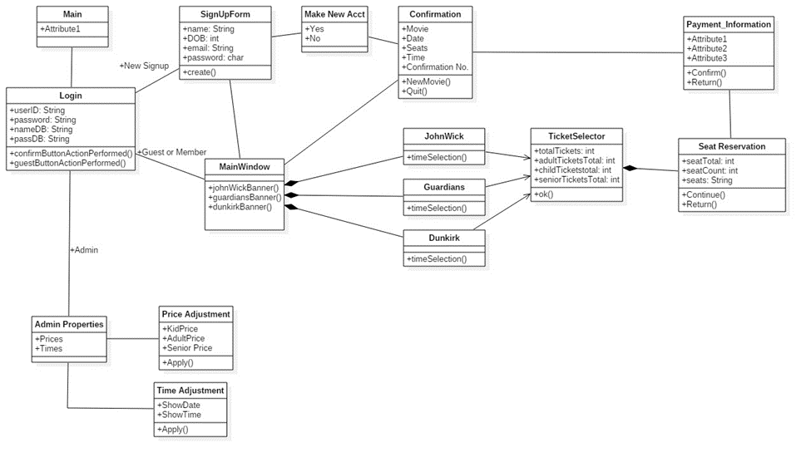
Sequence Diagram

Slide 6
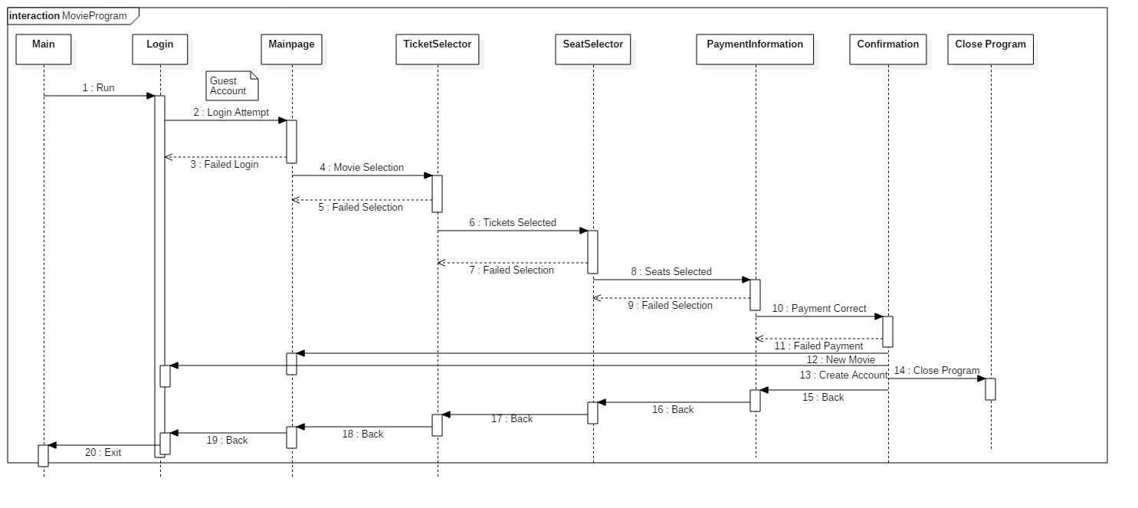

Slide 7

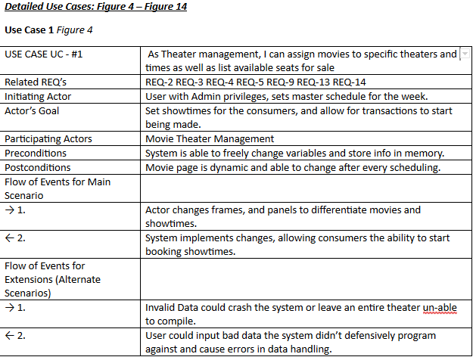
Use Cases & Requirements

Slide 8

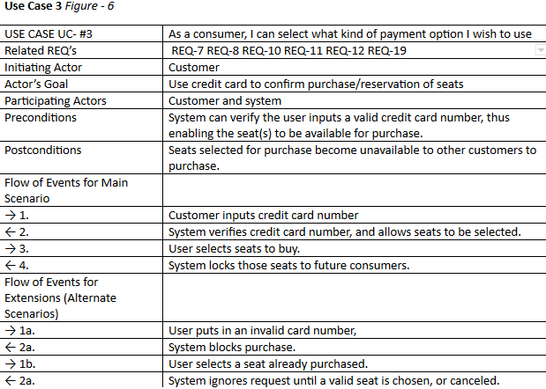
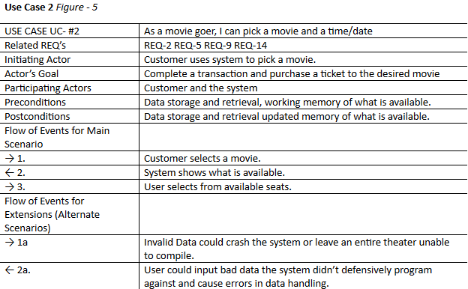

Slide 9
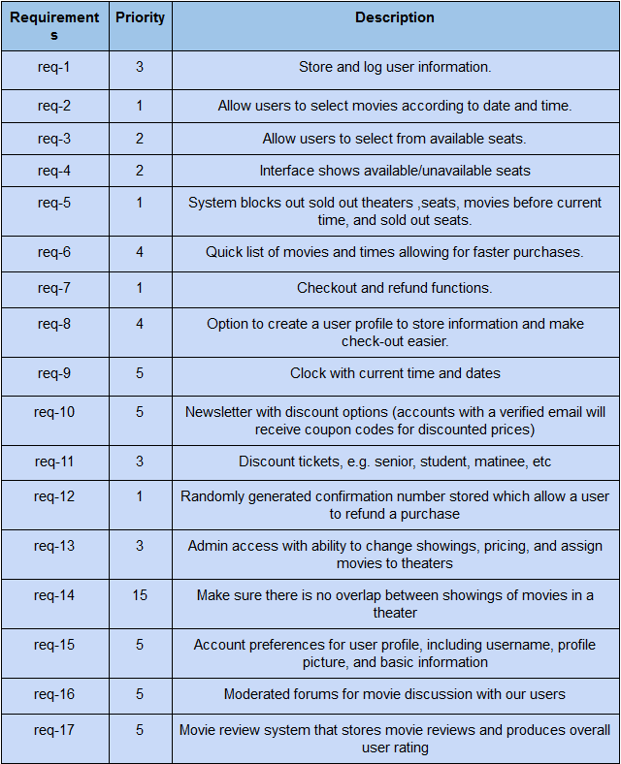

Slide 10
