Slide 1
Coffee POS
Josh Stephenson • T1A3 Application

Slide 2
Overview
A simple point of sale(pos) application that will run through terminal where the user will be able to create coffee orders, track and manage inventory and loyalty programs and view sales data .
Expected delivery
April 11, 2021

Slide 3
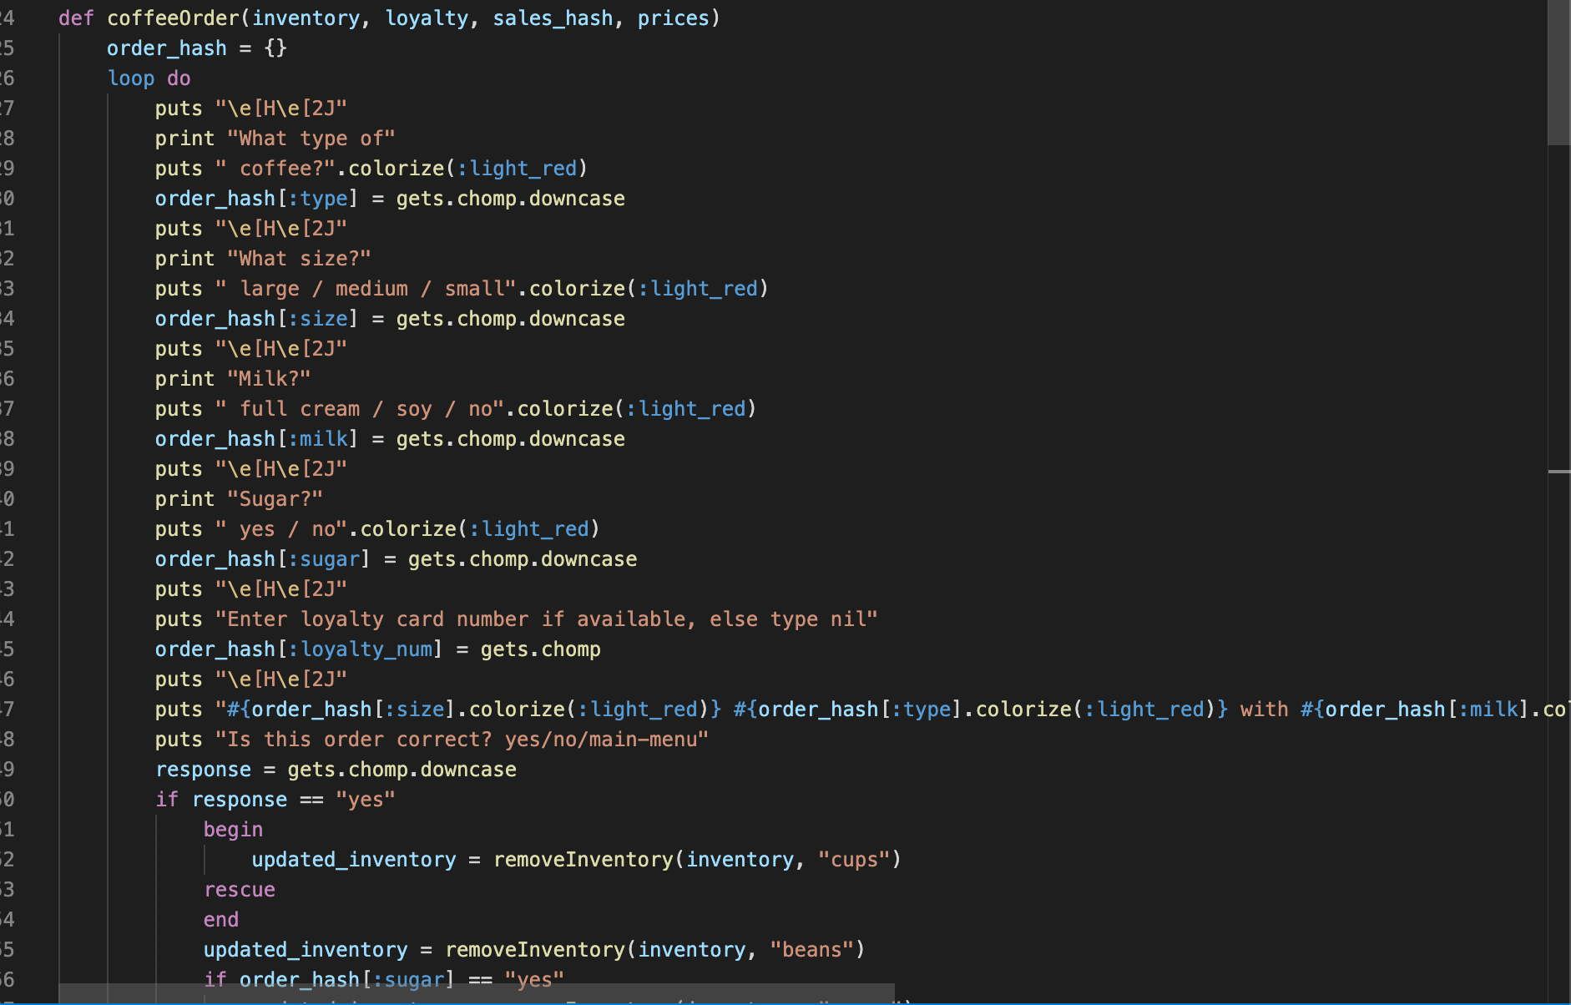
Feature 1 - Create Coffee Order

Slide 4
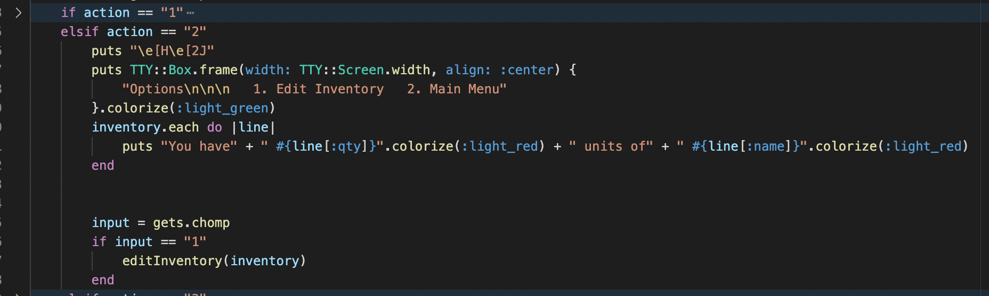
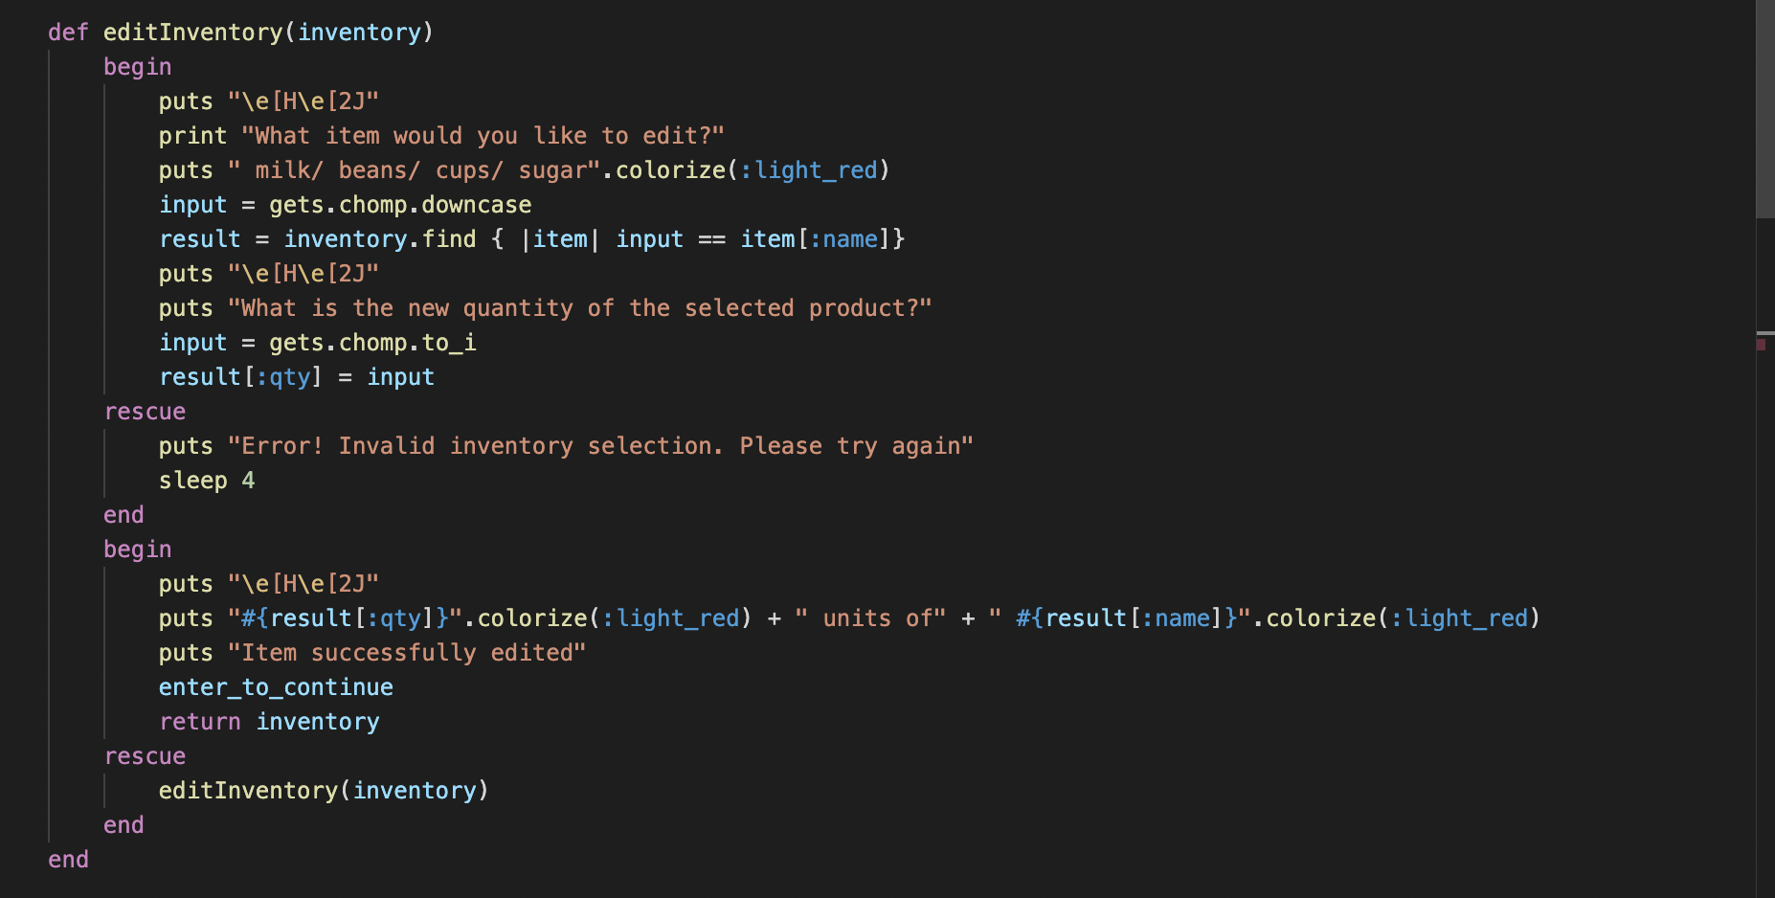
Feature 2 - Read/write to inventory

Slide 5
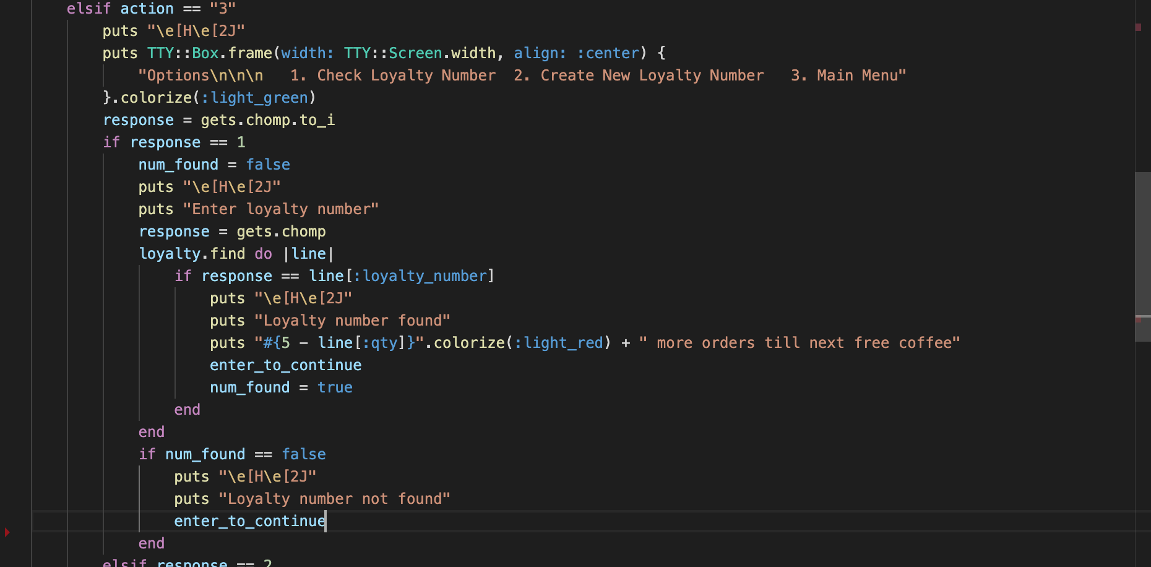
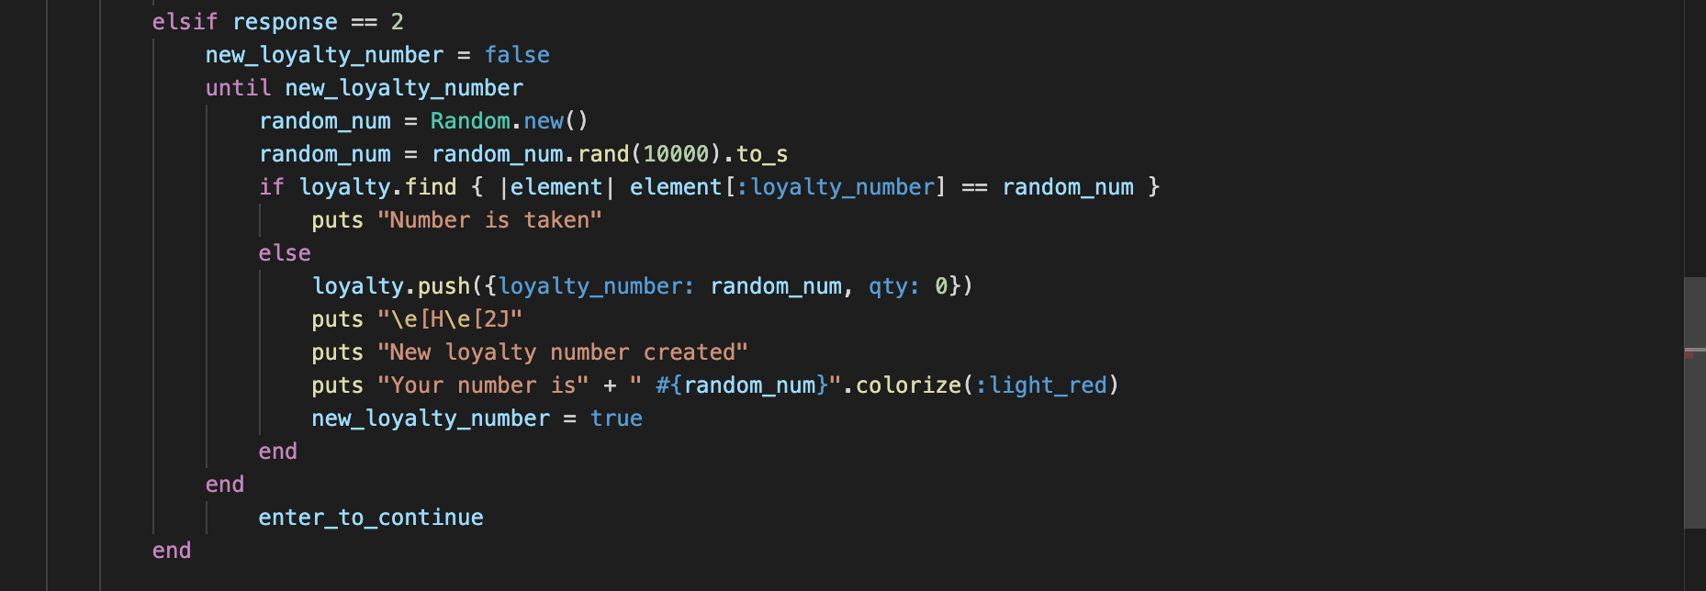
Feature 3 - Check Loyalty progress/Create Loyalty Number

Slide 6
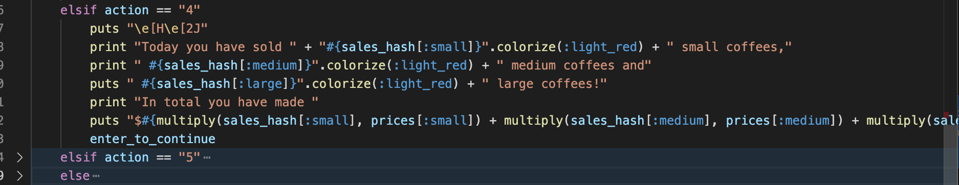
Feature 4 - Check sales data

Slide 7
Build Process - Favourite Parts
Restarting project on day two
Becoming more familiar with Trello Board
Hitting a critical amount of useful methods which made adding new functionality really simple

Slide 8
Build Process - Challenges
Working with .csv over JSON
Being too trigger happy with methods

Slide 9
Build Process - Ethical Issues
Using the gems of others

Slide 10
Thank you

