Slide 1
Blockchain development I
Hyperledger Composer

Slide 2

overview
Introduction to Hyperledger Composer
Architecture
Business network concepts
Modelling language
Example CTO file
Exercise
Solution

Slide 3

Who?
Benjamin Verhaegen
Lecturer/ Researcher Applied Informatics– Howest
Research: Blockchain Development
Bachelor Computer & Cyber Crime Professional
benjamin.verhaegen@howest.be

Slide 4

Hyperledger composer
Open toolset/framework
Time to value
Model business networks
Integrate existing systems
Supports Hyperledger Fabric blockchain infrastructure
Pluggable blockchain consensus protocols

Slide 5
Hyperledger composer
Set of tools:
Modelling language: CTO (Concerto)
User interface: Hyperledger Composer Playground
Command-Line Interface tools

Slide 6


Hyperledger composer: Architecture
Generates Skeleton Angular app
Calls a REST API
Hyperledger Composer components
CLI
composer-cli
Composer-rest-server
Web Playground
Loopback connector
SDK
Use ID Cards to connect to a distributed ledger
Supported runtimes
Hyperledger
Fabric
Web
Embedded
Node.js

Slide 7
Hyperledger composer: Architecture
Execution Runtimes
Hyperledger Fabric v1.2 => state stored on distributed ledger
Web / Playground => state stored in browser local storage
Embedded Node.js => state stored in-memory key-value store
Connection Profiles
Specify how to connect to an execution runtime
TCP/IP addresses & ports + certificates
Part of Business network cards

Slide 8
Hyperledger composer: Architecture
JavaScript SDK
Enables developers to create applications
2 npm modules
Composer-client => submit transactions / CREATE, READ, UPDATE, DELETE
Composer-admin => manage business networks
REST server
Open API (Swagger) REST API
Based on LoopBack technology
Converts Composer business network into an Open API definition
Notes:
REST Server automatically generates a Open API (Swagger) REST API for a business network.
The REST Server (based on LoopBack technology) converts the Composer model for a business network into an Open API definition
and at runtime implements Create, Read, Update and Delete support for assets and participants and allows transactions to be submitted for processing or retrieved.

Slide 9
Hyperledger composer: Architecture
LoopBack connector
Used by Composer REST Server
Can be used standalone by integration tools
Playground Web User Interface
Define and test business networks
Quickly import samples and prototypes
Executes on Web or Hyperledger Fabric runtime
Yeoman Code Generators
Angular web application
Node.js web application
Skeleton business network

Slide 10
Business network concepts
Business network: group of entities who work together
Exchanged goods and services ( Assets)
Method of exchange ( Transactions)
Participating members & authorizations (Participants + ACL’s)
Blockchain State Storage
All transactions => ledger
Current state => blockchain state database
Historian registry
Records successful transactions
Participants + identities
“HistorianRecord” assets
Distributed between set of peers

Slide 11
Business network concepts
Identities
Digital certificate + private key
Mapped to a participant
Business network card
Business network card
Identity + connection profile + metadata

Slide 12
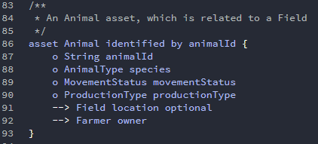
Business network concepts
Assets
Tangible & intangible goods, services or properties
Stored in asset registries
Can be related to other assets / participants
Must have an unique identifier !!

Slide 13
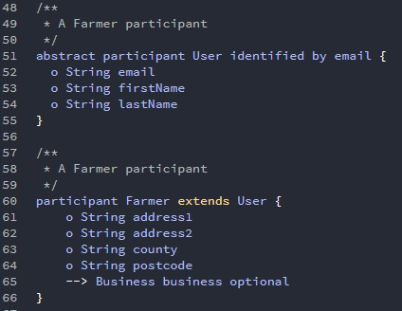
Business network concepts
Participants
Members of business network
Stored in participant registries
Can be mapped to one or multiple identities
Must have an unique identifier !!

Slide 14
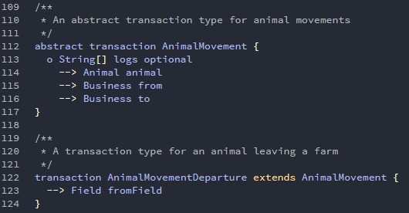
Business network concepts
Transactions
Interaction from participants with assets
Affects blockchain state database
== Business logic ( or smart contracts)
Internal process

Slide 15
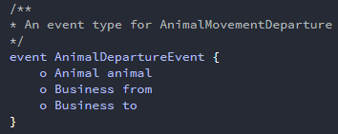
Business network concepts
Events
Notification produced by blockchain application
Publish/subscribe
Emitted by transaction processor functions
Indicates changes on the state / ledger => external systems
Sent through the ‘composer-client’ API

Slide 16
Business network concepts
Queries
Return data about blockchain state database
Within business network
Variable parameters => customization
Sent through ‘Hyperledger Composer’ API

Slide 17

Business network concepts
Query Syntax
Description => describes the function of the query
Statement => contains defining rules of the query
SELECT => defines registry + asset / participant to be returned
FROM => defines a different registry to query
WHERE => defines conditions to be applied to the registry data
AND => defines additional conditions
OR => defines alternative conditions
CONTAINS => defines conditions for array values
ORDER BY => defines the sorting

Slide 18
Business network concepts
Access Control Language
Provides access control over the elements of the domain model
Which users/roles are permitted to create/read/update/delete
2 types
Resources within business network ( == business access control)
Network administrative changes ( == network access control)
Both defined in access control file (.acl)

Slide 19
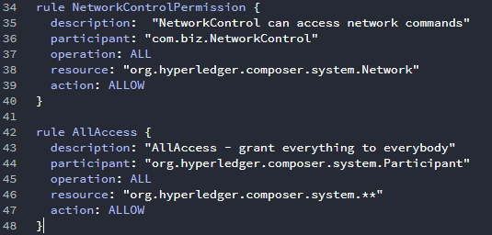
Business network concepts
Network access control
Uses system namespace
‘org.hyperledger.composer.system.Network’ => network access
‘org.hyperledger.composer.system’ => all access
Access to certain network-level operations
E.g. ‘composer identity issue’

Slide 20
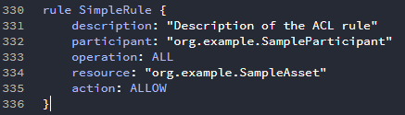
Business network concepts
Access Control Rule Grammar
2 Types
Simple ACL rules => used to control access to namespace/asset by participant type/instance

Slide 21
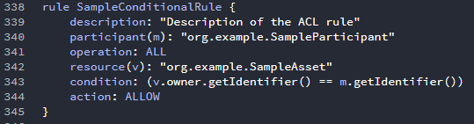
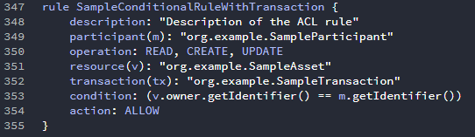
Business network concepts
Access Control Rule Grammar
2 Types
Conditional ACL rules => variable bindings for participant/resource & Boolean Javascript expression (TRUE/FALSE)
Can also specify optional transaction clause

Slide 22
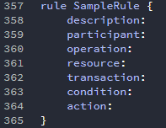
Business network concepts
Access Control Rule Grammar
Person / entity submitting transaction for processing
The action a rule governs
Things the ACL rule applies to
The transaction which has to be submitted to perform operation
Boolean JavaScript expression over bound variables
Action of the rule

Slide 23
Modeling Language
Object-oriented modeling language
Hyperledger Composer CTO file contains:
Single namespace
Set of resource definitions
Optional import declarations
Organization namespace => defined in namespace line of model
For defining new classes of assets, participants, events and transactions
System namespace
Contains base definitions of an asset, participant , event and transaction
Asset / participant => no required values
Event, transaction => ID and timestamp required

Slide 24
Modeling Language
Resource declarations includes:
Assets/ Participants/ Transactions and Events
Enumerated Types
Concepts
Primitive Types
String: UTF8 encoded string
Double: double precision 64 bit numeric value
Integer: 32 bit signed whole number
Long: 64 bit signed whole number
DateTime: ISO-8601 compatible time instance
Boolean: Boolean value (true/false)

Slide 25
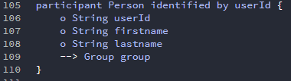

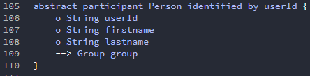
Modeling Language
Resource definition
A namespace => implicitly applies to all resources in .cto file
A name + identifying field
Optional super-type
Optional ‘abstract’ definition

Slide 26
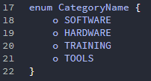
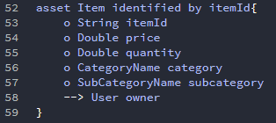
Modeling Language
Enumerated types
Used to specify a type that may have 1 or N possible values

Slide 27
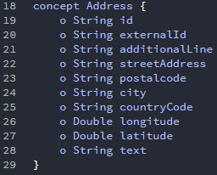
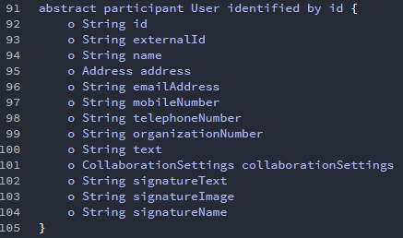
Modeling Language
Concepts
Abstract classes that are not assets/participants/transactions

Slide 28
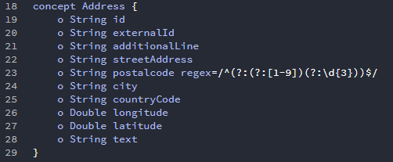
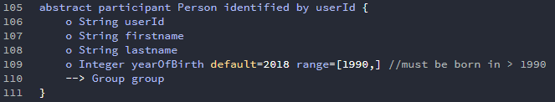
Modeling Language
Field Validators
Used to validate the contents of the field
Double, Long or Integer field may include an optional range expression

Slide 29


Slide 30
example
Make a vehicle trading system
Vehicle can be of type “NEW” / “USED”
Person gets identified with email and has an address

Slide 31
Exercise PArT 1
https://composer-playground.mybluemix.net/editor
Create a smart contract
That symbolizes a market where users can add items and can order items
2 participants: User & Bank
User needs to buy tokens from the bank
Item has 4 different categories (SOFTWARE, HARDWARE, TRAINING, TOOLS)
Order has 4 states (PENDING, SEND, CANCELLED, COMPLETED)
Transfer of item is done (COMPLETED) when buyer confirms getting the item
Add an escrow system (Buyer sends tokens to safe account when placing the order, seller gets the tokens when order is completed and safe account is deleted)
NO NEED TO IMPLEMENT LOGIC.. YET!

