Slide 1
Blockchain development
Transaction processors

Slide 2

overview
Solution exercise 1
Transaction processors
Example script file
Exercise
Solution

Slide 3

Transaction processor functions
Business Network Definition = set of model files + scripts
Scripts = transaction processor functions
!!! LOGIC !!!
Automatically invoked using BusinessNetworkConnection API

Slide 4
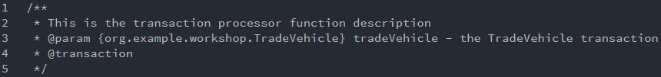
Transaction processor functions
Structure includes decorators and metadata
!!! REQUIRED TO WORK !!!
Declaration parameters
Human readable description
Identifies transaction processor function

Slide 5

Transaction processor functions
Javascript function => powers the transaction (LOGIC)
Must include parameter defined in comment

Slide 6
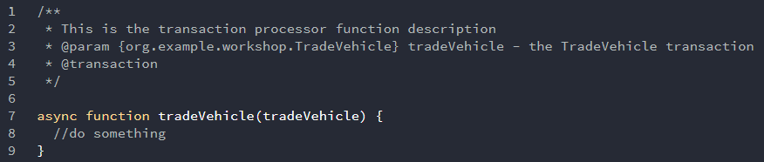
Transaction processor functions
Complete transaction processor
Asynchronous function:
Function operates asynchronously via event loop
Uses an implicit Promise to return the result
Syntax & structure of the code similar to synchronous functions

Slide 7
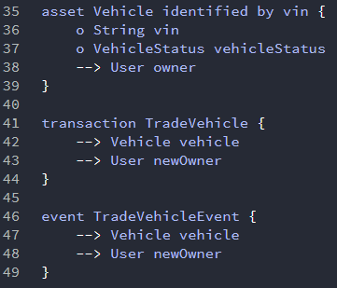
Transaction processor functions
Transaction processor function = logical operation of a transaction defined in a model file

Slide 8
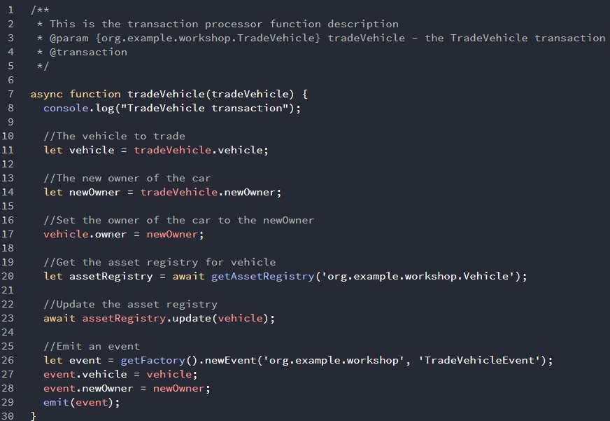
Description, parameters, metadata
Defines tradeVehicle transaction with parameter “tradeVehicle”
Declaration properties
Add logic
Update registries
Emit event

Slide 9
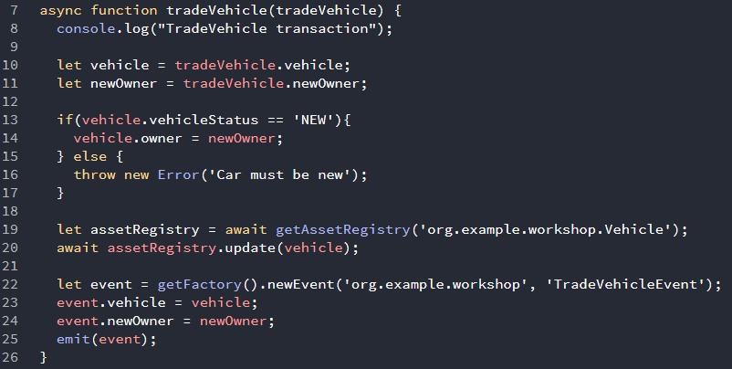
Transaction processor functions
Error handling in transaction processor functions
If error → rollback any changes, transaction fails

Slide 10
Transaction processor functions
Runtime API
Api: contains the root of the transaction processor API
AssetRegistry: manage a set of assets
Factory: create instances of Resource
ParticipantRegistry: manage a set of participants
Query: represents a built query

Slide 11
Transaction processor functions
Api: contains the root of transaction processor API
Methods made available as global functions
https://hyperledger.github.io/composer/latest/api/runtime-api

Slide 12
Transaction processor functions
Factory: creates instances of resource -> Transactions/participants/Assets
https://hyperledger.github.io/composer/latest/api/runtime-factory

Slide 13
Programmatic access control
Implement access control in transaction processor
Check current participant
Check current identity
modelled participant BND
‘org.hyperledger.composer.system.NetworkAdmin’
‘org.hyperledger.composer.system.Identity’
Identity on a deployed business network

Slide 14
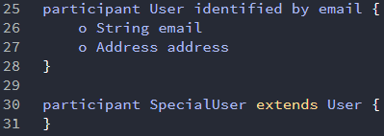
Programmatic access control
Step 1: model participant in model file

Slide 15
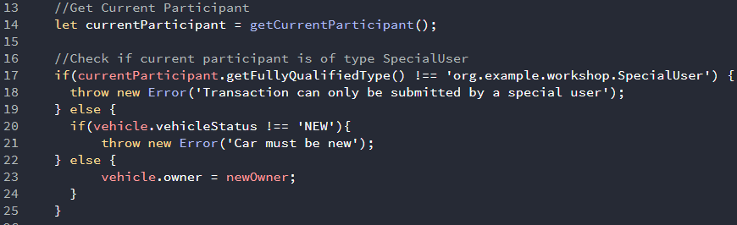
Programmatic access control
Step 2: add programmatic access control to transaction processor function
Checks if TYPE current participant meets the requirements

Slide 16
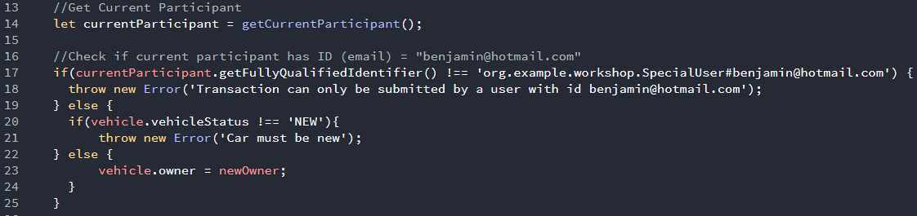
Programmatic access control
Step 2: add programmatic access control to transaction processor function
Checks ID current participant

Slide 17
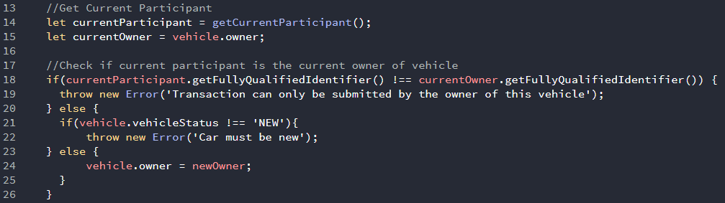
Programmatic access control
Step 2: add programmatic access control to transaction processor function
Checks if current participant is owner of the asset

Slide 18
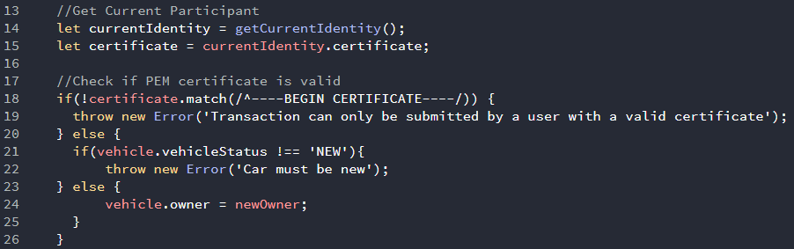
Programmatic access control
Step 2: add programmatic access control to transaction processor function
Checks if certificate current identity is valid

Slide 19


Slide 20
Example Vehicle trade
Implement the logic for the TradeVehicle transaction
Publish event after execution

Slide 21
exercise
Implement logic on the following transactions:
OrderItem
CompleteOrder
CancelOrder
BuyTokens
Example: https://github.com/VerhaegenBenjamin/Blockchain4SME.git

Slide 22
Composer-rest-server
Used to generate REST interface
Used Loopback framework to dynamically create a REST API
Interact and co-operate with code

