Slide 1

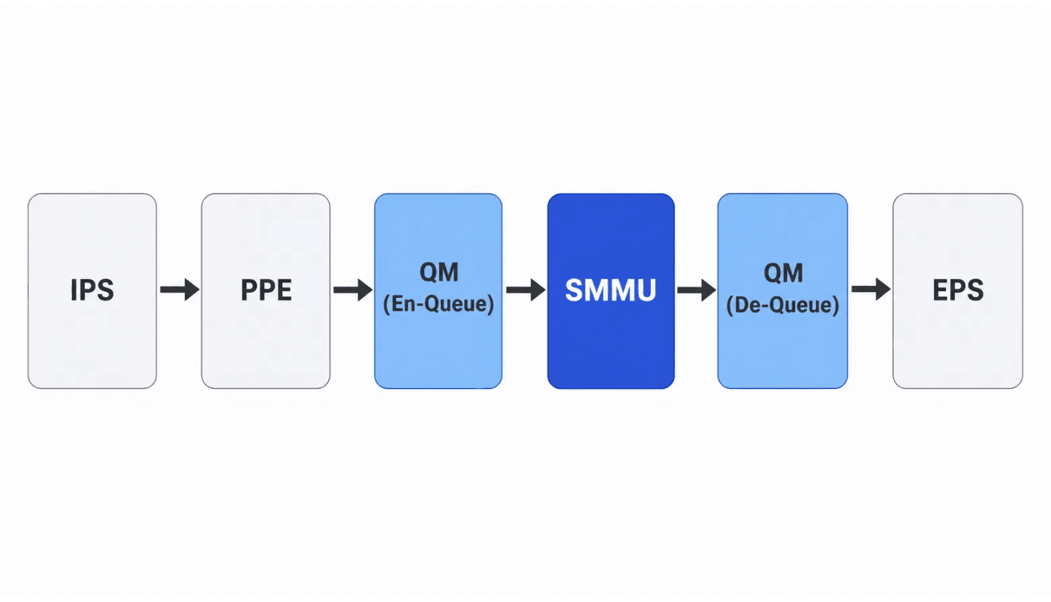
Simplified Block Diagram of the Main Packet-Processing Path
SMART MMU (SMMU) Design Module Overview
Flexible Shared SRAM Address Management Module
Project: 4-Port 2.5G/1G/100M Ethernet Switch
Clock Domain: clk_core, 300 MHz Single Clock Domain
Date: July 16, 2026
QM–SMMU interaction: SMMU manages addresses only and does not move payload data.
CONFIDENTIAL TECHNICAL REVIEW

Slide 2

AGENDA
01
Design Context and Positioning
02
Top-Level Architecture and ModulePartitioning
03
Core Data Structures (Cells / Linked Lists / Dual Pools)
04
Six Core Workflows (Initialization / Enqueue / Dequeue, etc.)
05
Key Modules (LLE / Occupancy, etc.)
06
Multicast Logic Stitching
07
Flow Control and Alerts (PAUSE / PFC)
08
Timing and Performance
09
Parameterization and Configurability
10
Summary and Outlook
SMMU Design Review
Page 02

Slide 3
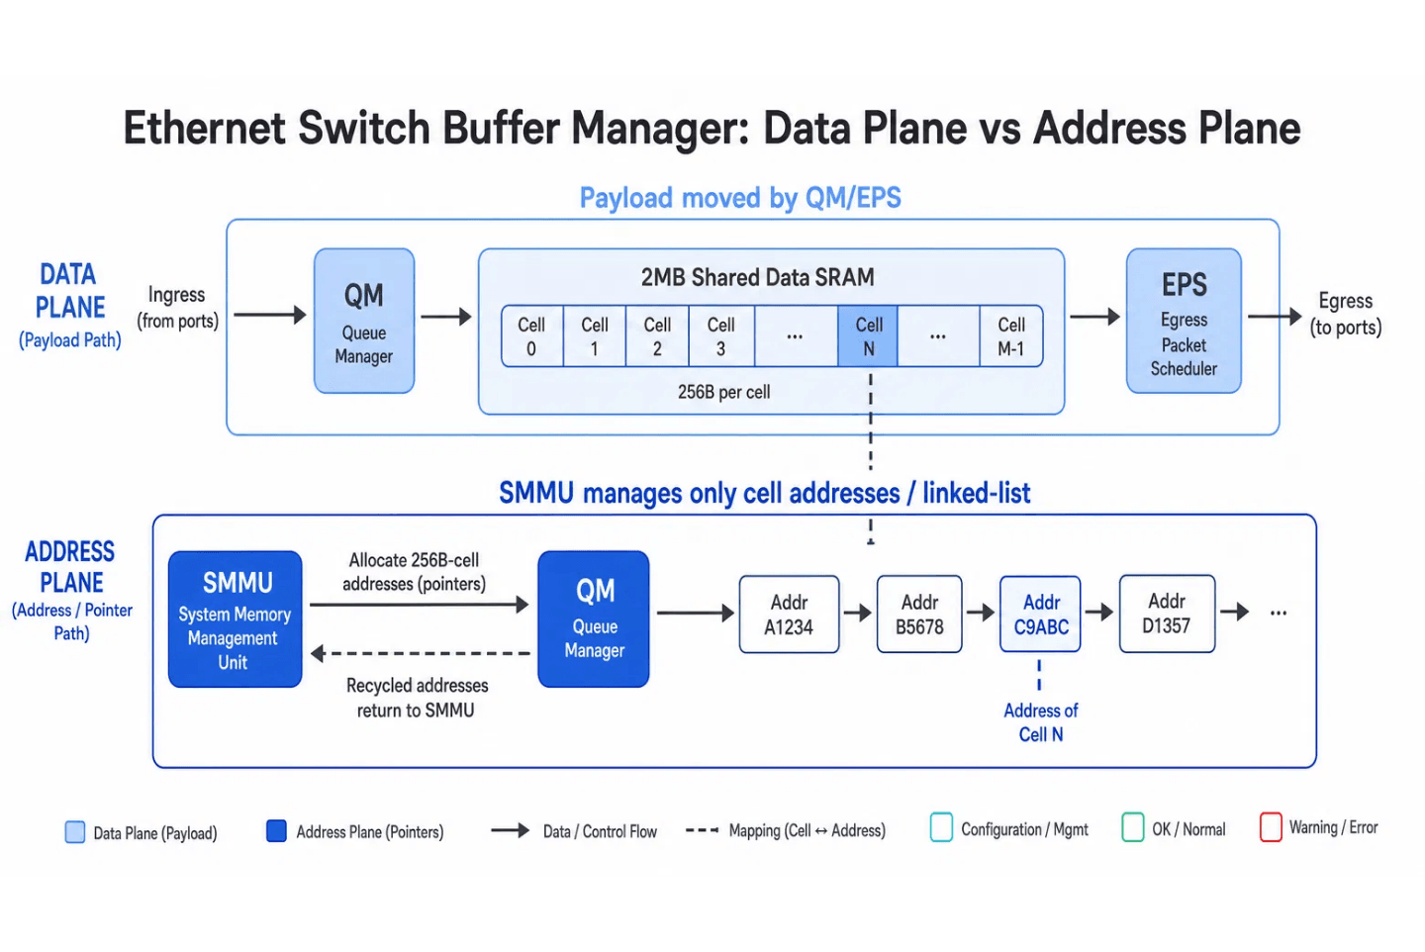
Design Context — MMU in the Switch ASIC
Data Plane (Payload) vs. Address Plane Comparison
Core Responsibilities and Positioning
The MMU is the address-management submodule of the QM (Queue Manager). It centrally allocates addresses and organizes linked lists for the 2 MB shared data SRAM at a granularity of 256-byte cells.
Capacity Derivation
Item
Value
Description
Shared Data SRAM
2 MB
Packet payload buffer
Cell Granularity
256 B
Minimum management unit
Total Cells
8192
2MB / 256B
Address Width
13 bit
$clog2(8192)
QM/EPS moves the data; SMMU only allocates and reclaims 256-byte cell addresses (pointers) and manages their linked lists.
SMMU Design Review
Page 03

Slide 4

Linked Lists vs. Static Partitioning
Static Partitioning
Linked-List Approach
Low utilization: idle cells cannot be borrowed across queues.
•
Fully shared: any cell can be assigned to any queue, approaching 100% utilization.
•
Inflexible: changing queue quotas requires repartitioning physical addresses.
•
O(1) complexity: enqueue and dequeue update only head and tail pointers.
•
Fragmentation: scattered free space cannot be utilized.
•
Native dual pools: reserved guarantees plus dynamic sharing.
•
SMMU Design Review
Page 07

Slide 5
Core Design Constraints
1. Maximum Performance
2. Unicast and Multicast
3. Flow Control
Enqueue and dequeue complete in exactly one cycle (request at T0, result at T1), sustaining back-to-back throughput of one cell per cycle.
Supports both unicast and multicast. Multicast uses one shared data copy across multiple ports and reclaims storage automatically through reference counting.
Supports PAUSE (802.3x) and PFC (802.1Qbb), with per-queue, per-port, and global max/near-full feedback for enqueue gating.
4. Storage Optimization
5. Dual Buffer Pools
6. Configuration Plane
Linked-list pointers reside in Next-Ptr SRAM. Two-stage prefetch registers absorb the one-cycle read latency and keep the pipeline running without stalls.
A statically reserved pool (per-queue guarantee) plus a dynamically shared pool balances QoS fairness with buffer utilization.
CSRs bypass a slow bus. Configuration signals are sampled directly in the clk_core domain for immediate updates and simpler integration.
SMMU Design Review
Page 04

Slide 6

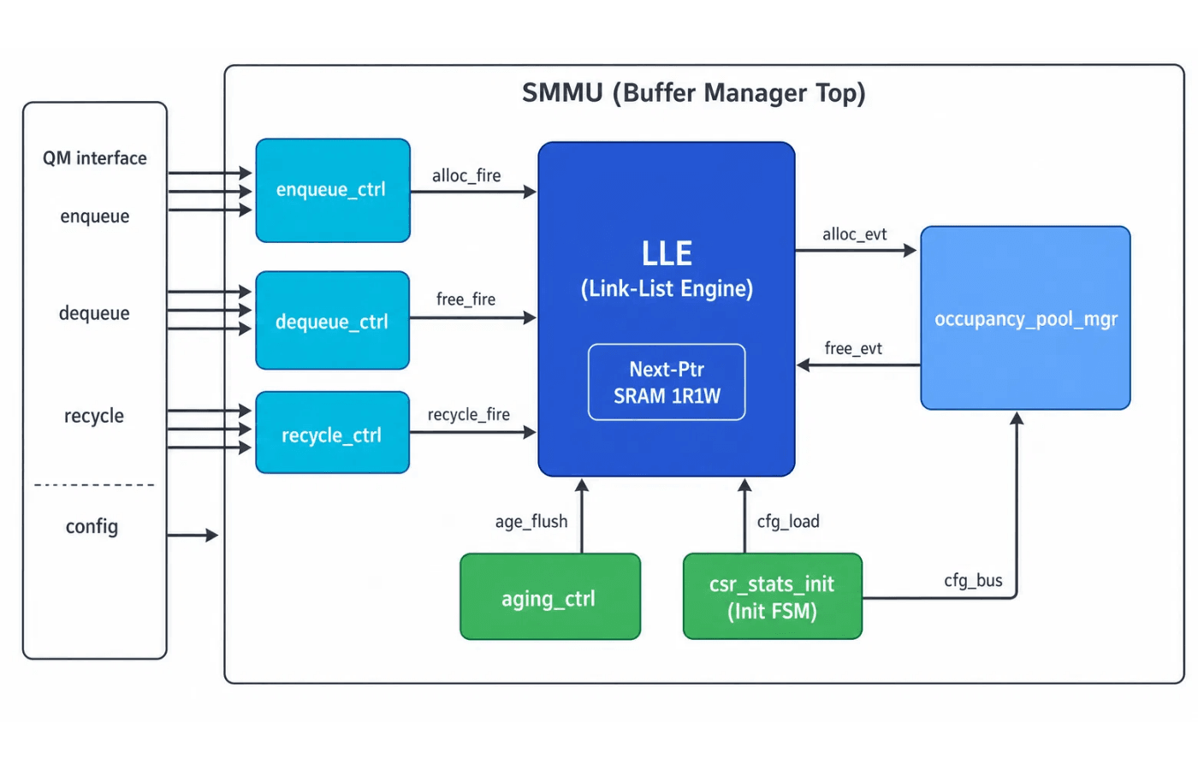
Top Level Arch
Submodule
Plane
Primary Responsibility
M
Linked-list engine; sole accessor of Next-Ptr SRAM
LLE
Ctrl
One-cycle enqueue command; whole-frame drop FSM
enqueue_ctrl
Ctrl
One-cycle dequeue command; backpressure check
dequeue_ctrl
Ctrl
Thin pass-through for returning cells to the free list
recycle_ctrl
Cnt
Occupancy counters + dual-pool decision + PAUSE/PFC
occupancy_mgr
Ctrl
Queue aging flush to prevent zombie queues
aging_ctrl
Cfg
Configuration sampling + initialization FSM (free-list construction)
csr_stats_init
Inter-Module Interface Conventions:
All control modules allocate and release addresses through the LLE
Core:
Seven modules center on
LLE (Link-List Engine)
and link via
occ_query
,
alloc_fire
The Occupancy module provides real-time watermarks for enqueue gating
to decouple control and storage planes.
The Init FSM builds the linked list in Next-Ptr SRAM after power-up
SMMU Design Review
Page 05

Slide 7
Parameterized Design
All widths are derived consistently from CELL_NUM, PORT_NUM, and TC_NUM across all submodules, ensuring design consistency and scalability.
Top-Level Parameters
Derived Constants (Localparams)
Parameter
Default
Description
Derived Value
Expression
Value (Default)
CELL_NUM
8192
Total cells (2 MB / 256 B)
QUEUE_NUM
PORT*TC+1
33
PORT_NUM
4
Number of physical egress ports
ADDR_W
$clog2(CELL)
13
TC_NUM
8
Traffic classes per port
QID_W
$clog2(QN)
6
STAT_W
32
Statistics counter width
PORT_W
$clog2(PN)
2
PKT_CELL_W
4
Packet cell number width
CNT_W
ADDR_W+1
14
REF_W
PORT_W
2
SMMU Design Review
Page 06

Slide 8



LLE Linked List
Physical Implementation: Next-Ptr SRAM
Head/Tail Pointer Registers
The linked list is stored in Next-Ptr SRAM, which records the successor pointer for every cell.
q_head[33]: points to the first cell address of each queue.
Parameter
Specification
q_tail[33]: points to the last cell address of each queue.
Memory Depth
8192 (CELL_NUM)
free_head/free_tail: maintain the head and tail of the free-address pool.
q_cell_cnt[33], free_cell_cnt: Counter of cell number.
Data Width
13 bit (ADDR_W)
Interface Type
1R1W (independent read/write ports)
All pointers are implemented as registers for single-cycle access and update.
Read Latency
1 cycle (absorbed by prefetch registers)
Operations and Free-List Maintenance
Enqueue
Dequeue
Free List
Pop an address from free_head, append it after the target queue's q_tail, and update that queue's tail pointer.
Pop the address at q_head and update the head with next_ptr read from SRAM. On reclamation, append the released address to free_tail.
At initialization, all 8,192 unused cells form one long singly linked list, enabling O(1) address allocation.
SMMU Design Review
Page 08

Slide 9
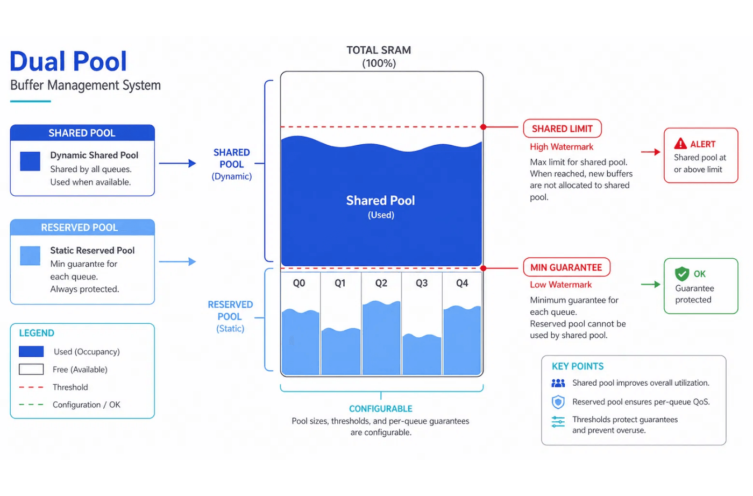
Dual-Pool Buffer Management
Dual-Pool Watermarks and Thresholds
Mechanism
Reserved Pool: guarantees capacity for each queue so basic forwarding remains available under congestion and QoS starvation is prevented.
Shared Pool: all active queues dynamically compete for the remaining buffer, greatly improving absorption of burst traffic.
Allocation Decision Logic
// Prefer reserved capacity use_reserved = (q_usage < q_min); // Request shared capacity after the reserve is exhausted use_shared = (q_usage >= q_min) && (shared_usage < shared_limit);
Configurable q_min (guarantee) and shared_limit (shared cap) enable fine-grained buffer-resource scheduling.
SMMU Design Review
Page 09

Slide 10
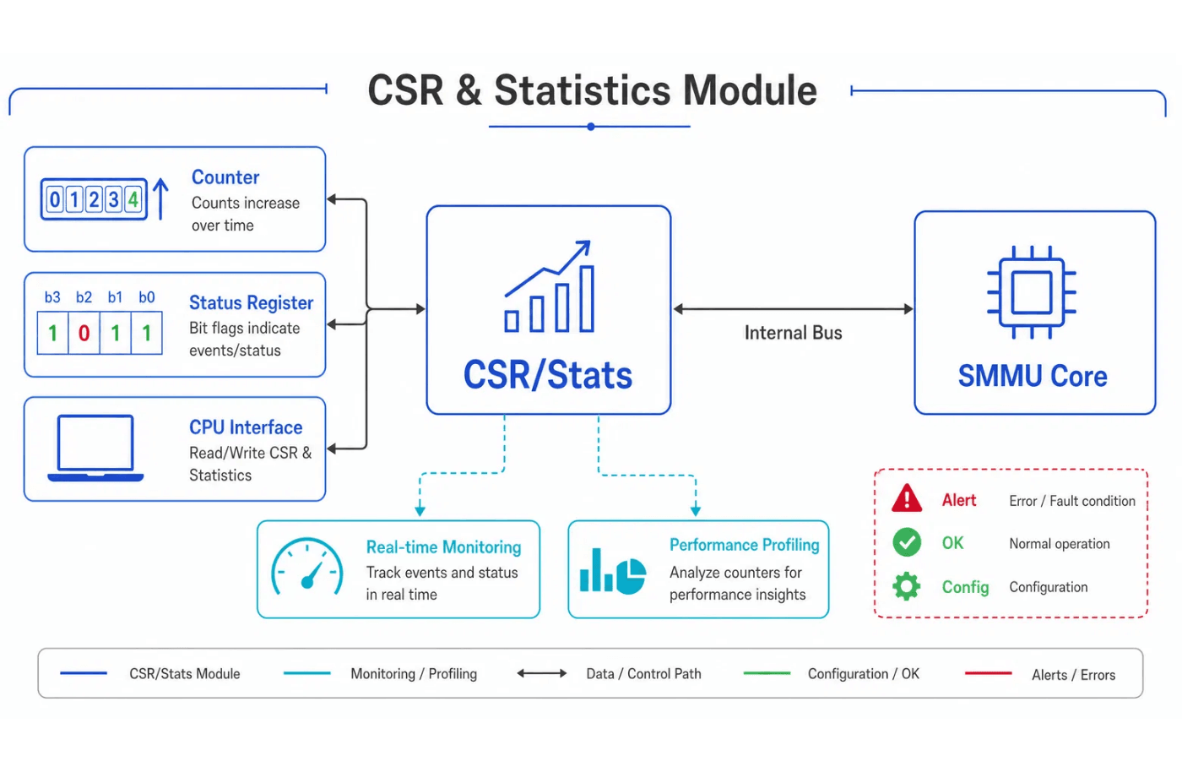
CSR
CSR and Statistics Module Architecture
CSR Configuration Interface
The CPU can adjust core parameters in real time, including flow-control thresholds (XOFF/XON), dual-pool reserve ratios, and the aging-timer period, enabling dynamic performance tuning.
Performance Monitoring and Statistics
• Real-time counters: accurately track total enqueued/dequeued packets and dropped cells. • Watermark tracking: sample peak queue and global buffer occupancy in real time. • Exception reporting: interrupt system software on SRAM ECC errors, illegal address accesses, and other faults.
Strong observability provides solid data support for system debugging and performance tuning.
SMMU Design Review
Page 27

Slide 11
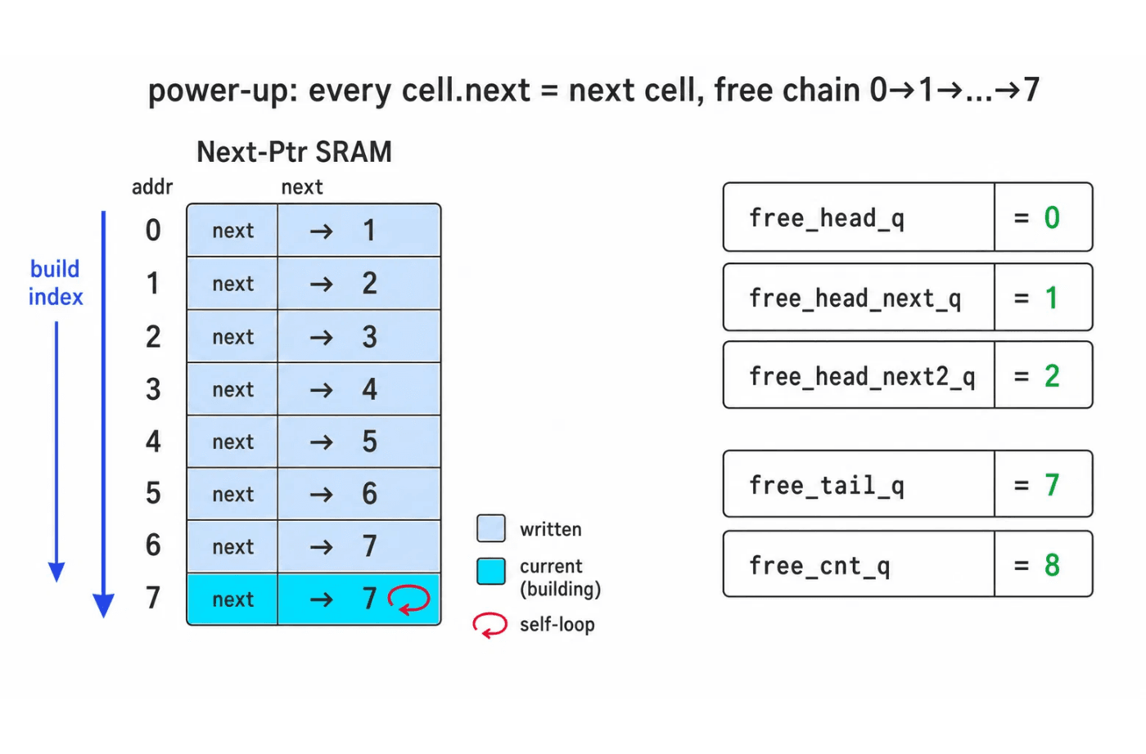
Process — Power-Up Init FSM
Automatic Next-Ptr SRAM List Construction
Init FSM State Transitions
•
IS_IDLE: wait for reset release or init_start↑.
•
IS_BUILD: LLE builds the free list, one link per cycle.
•
IS_DONE
: assert init_done and enter Ready.
Automatic List Construction in the LLE
•
Write
: write SRAM[idx].next = idx + 1 each cycle.
•
Self-Loop
: last cell.next points to itself, marking the list end.
•
Reg Sync
: init pointers and prefetch; allocate on cycle one.
Hardware initialization makes the free list deterministic and brings the system to Ready quickly after power-up.
SMMU Design Review
Page 12

Slide 12
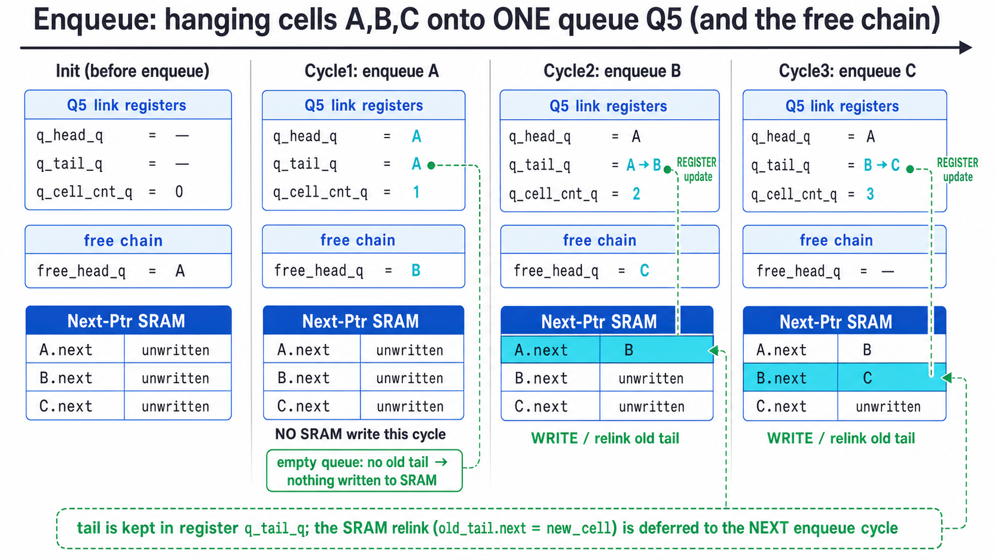
Process — Enqueue
Enqueue Linking (A→B→C): Register and SRAM Evolution
T0/T1 Timing and Handshake
•
T0
: accept enq_req; Occupancy returns a same-cycle decision.
•
T1
: register alloc_valid and alloc_cell_addr, providing an exact
one-cycle command response.
Tail-in-Register Linking
•
Relink Delay
: keep q_tail_q in a register; defer
SRAM[old_tail].next = new_cell until
the next enqueue.
•
Benefits
: no write for empty links; ≤1 write/cycle; tail in reg.
Caching the tail in a register enables efficient list appends and deterministic SRAM access timing.
SMMU Design Review
Page 13

Slide 13
Process — Whole-Frame Drop
1. Predictive Watermark Logic
2. Whole-Frame Drop Policy
3. FSM State Control
When the first cell (SOF) of a packet arrives, the system predicts occupancy from packet length instead of deciding cell by cell.
If predicted occupancy exceeds the configured threshold, Early Drop is triggered:
enqueue_ctrl
maintains the enqueue state machine:
• IDLE: wait for an SOF request. • DROP: prediction fails; discard subsequent cells through EOF. • ACCEPT: prediction passes; accept subsequent cells through EOF.
predict_occ = current_occ + pkt_cell_num;
• Accept all or drop all: all cells of a packet receive the same disposition. • Resource protection: prevents fragmented packets from consuming valuable SRAM capacity.
This up-front prediction prevents packet truncation caused by buffer exhaustion mid-frame.
SMMU Design Review
Page 14

Slide 14
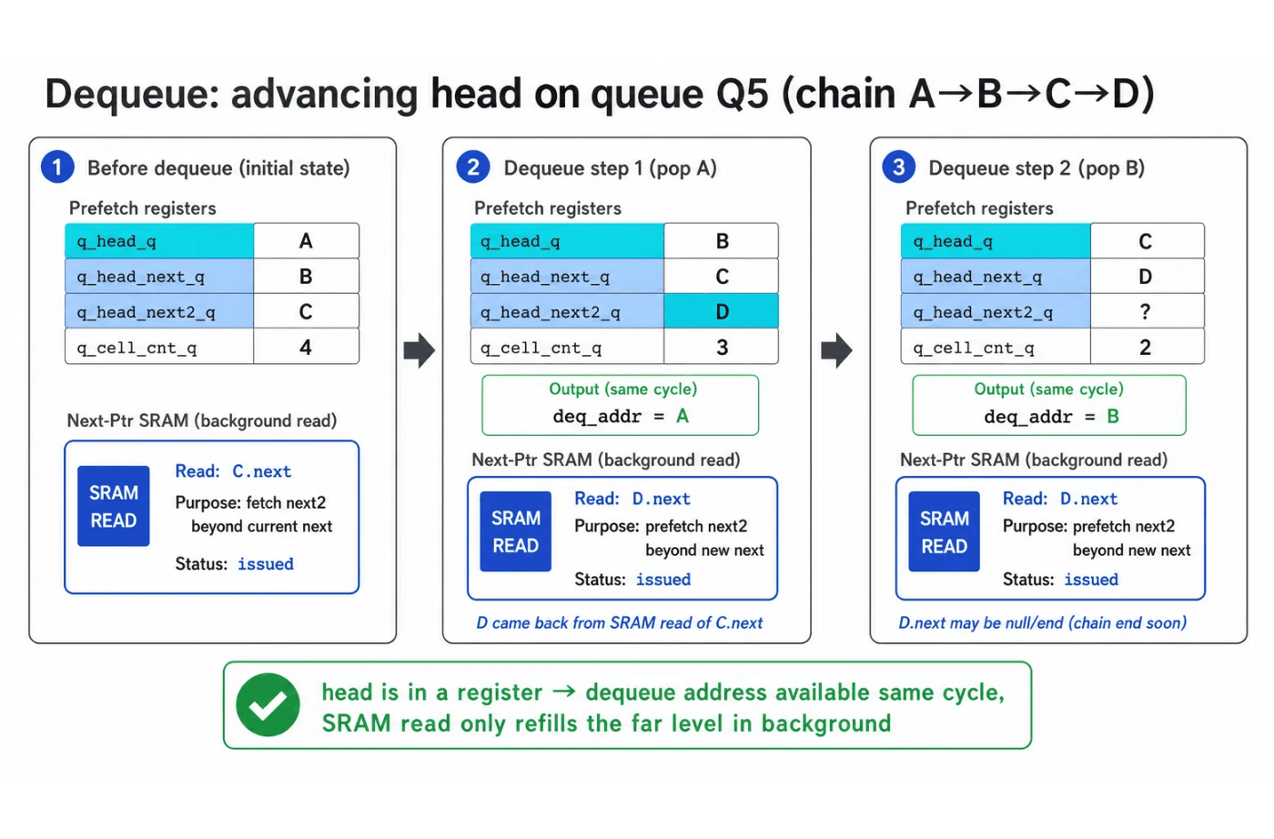
Process — Dequeue
Queue-Head Sliding Window
Dequeue Logic and Handshake
•
T0
: deq_req; check BP/non-empty; address = lle_qhead.
•
T1
: output deq_cell_valid/deq_cell_addr after exactly one cycle.
Three-Stage Prefetch Register Scheme
•
Window
: head/next/next2 slide forward on each dequeue.
•
Refill
: if len≥3, background-read next2.
•
Gain
: absorbs SRAM latency; line-rate back-to-back dequeue.
The head address is always visible in a register, so the dequeue address is available immediately without waiting for an SRAM read response.
SMMU Design Review
Page 15

Slide 15
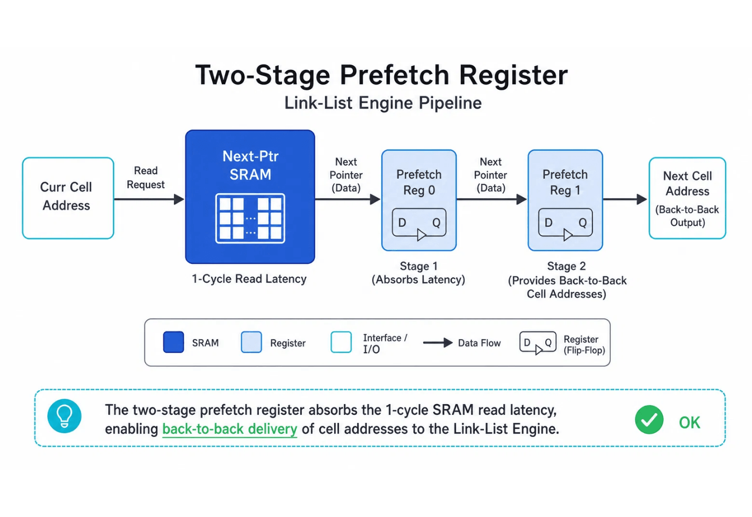
Process — Two-Stage Prefetch
LLE Prefetch Pipeline Architecture
Design Challenge
Next-Ptr SRAM has a one-cycle read latency. During continuous dequeue, waiting for the next pointer would create pipeline bubbles and prevent full throughput.
Solution
Prefetch Reg 0 and Prefetch Reg 1 form a two-stage prefetch pipeline:
• Issue read requests for subsequent cell addresses in advance. • Cache returned pointers in registers to absorb SRAM latency completely. • Sustain back-to-back dequeue performance.
The two registers ensure that the LLE always has the next valid address available.
SMMU Design Review
Page 15

Slide 16
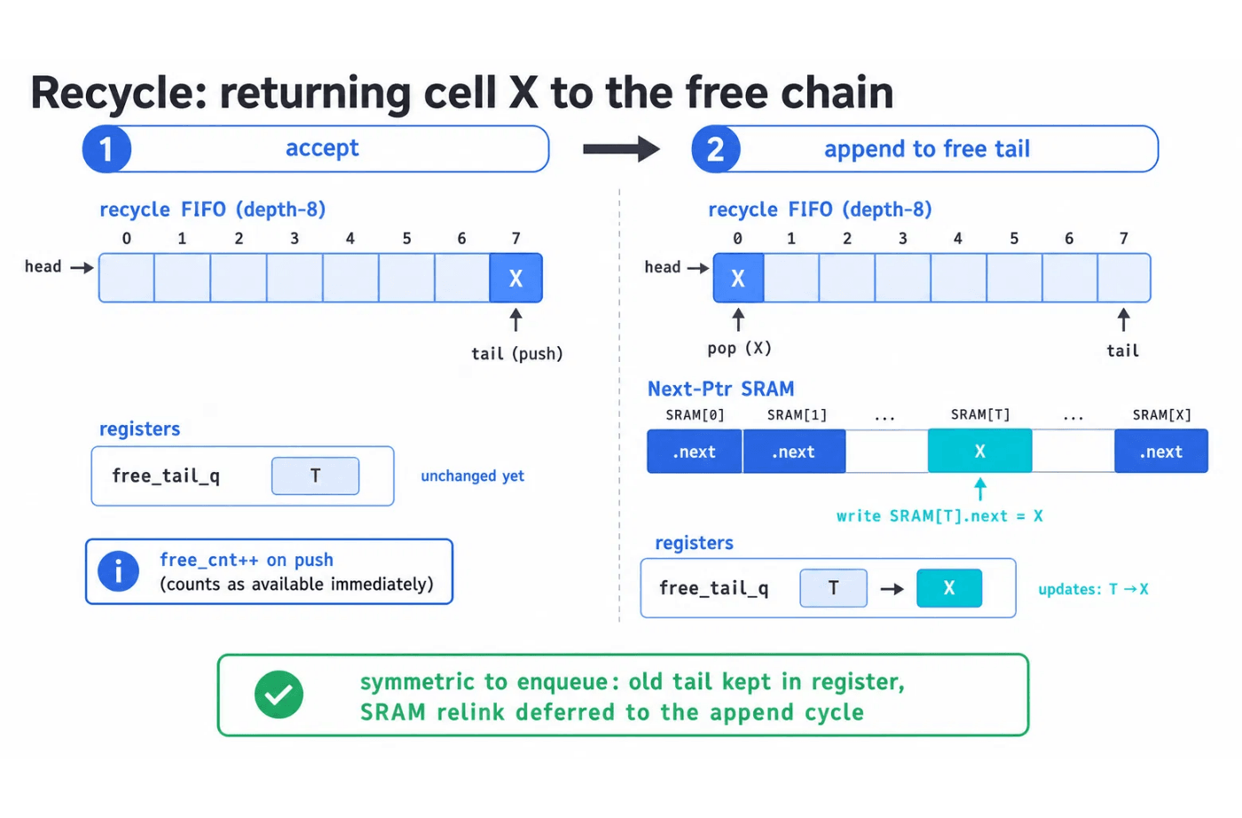
Process — Recycle
Two-Stage Address Reclamation
Reclamation Paths
•
Unicast
: push directly to the free list and decrement the
queue count.
•
Multicast
: decrement the reference count on each return;
push only when the count reaches zero.
•
Thin Path
:
recycle_ctrl
is a type-independent interface;
the LLE handles the difference internally.
Two-Stage Symmetric Reclamation
•
Stage 1
: address → FIFO;
free_cnt
++ now
(logically free).
•
Stage 2
: on FIFO pop, write
SRAM[old_tail].next = X
→
free_tail_q
.
•
Sym.
: same Tail-in-Register method as enqueue;
keeps SRAM writes ordered.
Reclamation and enqueue share the same tail-register handling, greatly simplifying SRAM access arbitration.
SMMU Design Review
Page 16

Slide 17

LLE Arbitration and SRAM TDM
As the sole module accessing Next-Ptr SRAM, the LLE (Link-List Engine) coordinates requests from multiple control planes through efficient arbitration.
Arbitration Priority
SRAM Time-Division Multiplexing
Priority
Operation
Design Rationale
Single-Port SRAM
: TDM arbitration makes a single-port SRAM appear to support multiple concurrent requesters.
H
Prevents address-read stalls at the transmitter and preserves line-rate forwarding.
Dequeue
Conflict
: simultaneous requests are resolved by priority, and losing requests retry in the next cycle.
M
Uses idle slots for writes; packet-level enqueue locking preserves atomicity.
Enqueue
Pipeline
: the arbitration result directly drives the SRAM address lines; prefetch registers enable seamless switching.
L
Recycle
FIFO
SMMU Design Review
Page 17

Slide 18
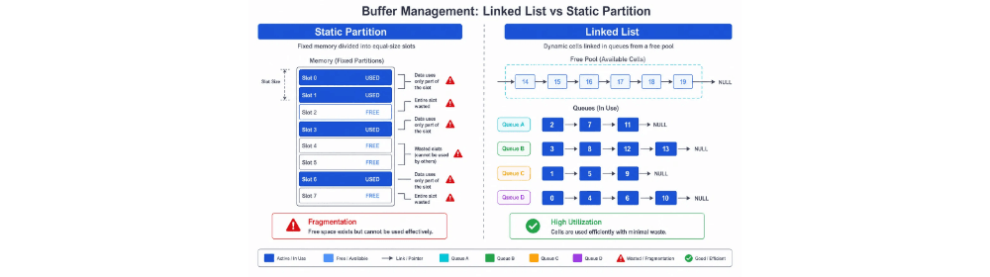
Flow Control (2) — Feedback
1. Queue-Level Feedback
Key Feedback Signals
q_max_reached[33]
: high queue level; QM applies WRED or gating.
Signal
Width
Consumer
Prevents queue monopolization.
q_max_reached
33
QM
port_max_reached
4
QM / MAC
2. Port-Level Feedback
global_max_reached
1
QM / MAC
port_max_reached[4]
: aggregate port level; triggers port PAUSE.
q_empty
32
QM Scheduler
Backpressures peer.
q_pkt_empty
32
QM Scheduler
3. Global-Level Feedback
global_max_reached
: critical SRAM level; global PAUSE prevents overflow.
Low-Latency Feedback Path
The Occupancy module drives decisions directly to QM, bypassing complex bus arbitration so flow control takes effect within 1–2 cycles and minimizes packet loss.
A dynamically shared linked-list architecture requires precise three-level flow-control feedback to maintain system stability.
SMMU Design Review
Page 19

Slide 19
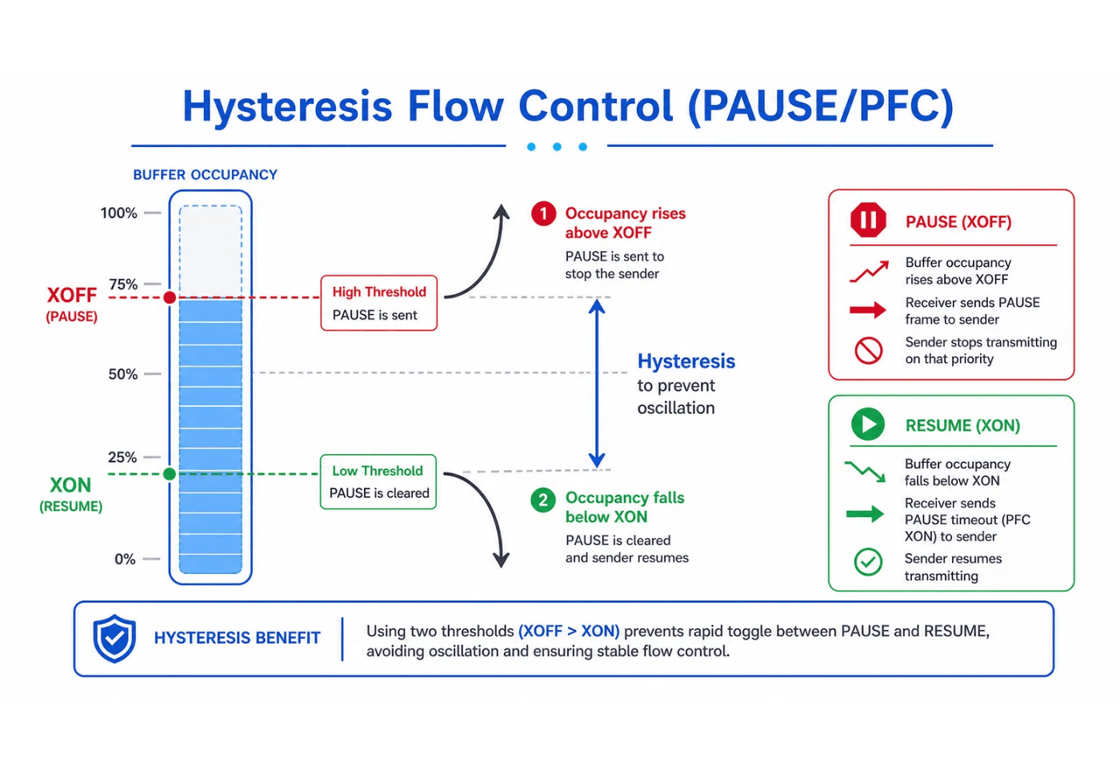
Flow Control (1) — PAUSE/PFC Hysteresis
PAUSE/PFC Hysteresis Control
Decision Logic
XOFF (Stop): assert PAUSE when buffer occupancy rises above the high threshold, instructing the peer to stop transmitting.
XON (Resume): deassert PAUSE only after occupancy falls below the low threshold, allowing the peer to resume.
Benefits of Hysteresis
Setting XOFF > XON creates a hysteresis band between the thresholds. This prevents frequent oscillation near the threshold and stabilizes the control plane.
The hysteresis band absorbs traffic fluctuations, reduces control-frame frequency, and improves link efficiency.
SMMU Design Review
Page 18

Slide 20



Multicast (1) — Overview
Single-Slot Model
Zero Copy
Logical Stitching
To simplify hardware implementation, SMMU uses a single-slot processing model.
The primary goal is storage conservation.
Multicast data does not form a separate linked list; it is logically stitched into the unicast flow.
A multicast frame has only one physical copy in Next-Ptr SRAM. Multiple logical pointers read that copy concurrently, substantially reducing buffer consumption.
Only one multicast frame is stitched at a time, keeping state-machine transitions deterministic and efficient.
From QM's perspective, multicast frames transparently interleave with the unicast queue, enabling seamless integration with existing service logic.
SMMU Design Review
Page 20

Slide 21
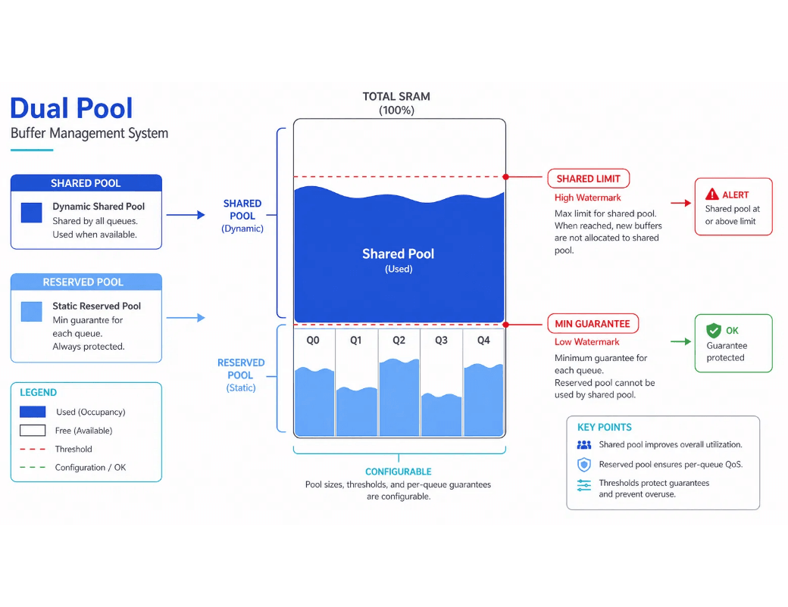
Multicast (2) — State
Resource Context: Dual-Pool Management
Key State Registers
Register
Function
mc_valid_q
Multicast-slot valid flag; indicates whether the current B2 slot contains a multicast frame.
mc_dst_bitmap_q
Destination-port bitmap recording every physical port targeted by the multicast frame.
mc_cells_q[16]
Mirror of the frame's cell-address list, allowing each port to read the complete multicast frame.
mc_rd_idx_q[4]
Per-port private read pointers advance independently.
mc_pend_uni_q[4]
Per-port pending-unicast flag indicating that the port is still processing a preceding unicast frame.
Multicast traffic is also governed by dual-pool watermarks. In B2 mode, a multicast frame consumes only one copy in the shared pool, greatly improving memory utilization.
SMMU Design Review
Page 21

Slide 22
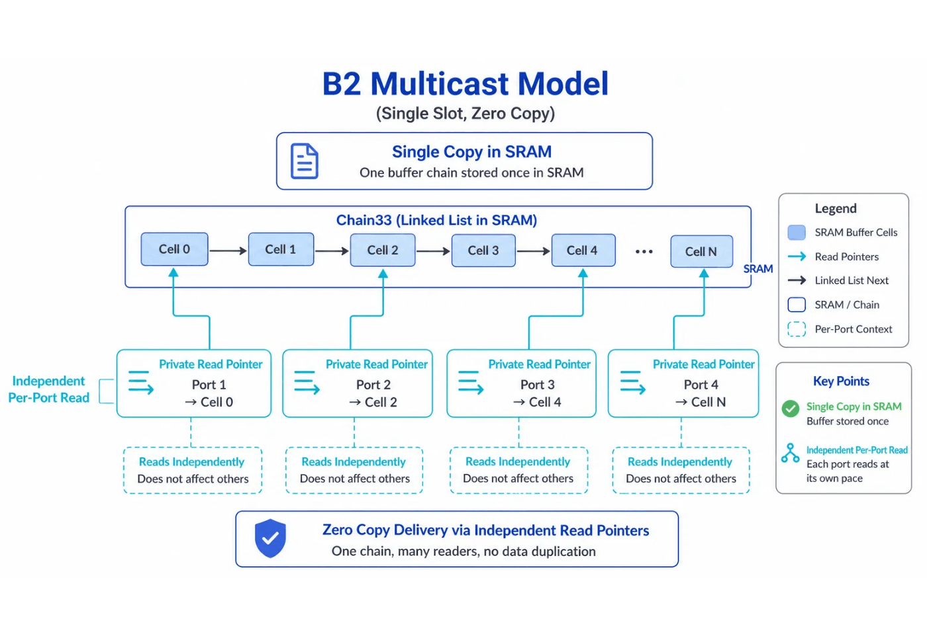
Multicast (3) — Private Pointers
B2 Multicast Private-Read-Pointer Model
Mechanism
In the B2 multicast model, each destination port has an independent mc_rd_idx_q[p] register.
Port A may be reading cell 2 while backpressured port B is still on cell 1. This decoupling preserves per-port independence.
Key Benefits
• One copy, multiple readers: SRAM stores only one packet copy. • Zero-copy forwarding: no per-destination duplication, saving internal bandwidth and storage. • Independent pacing: a slow port does not block a fast port's read progress.
Per-port private read pointers provide logically concurrent access to a single physical copy.
SMMU Design Review
Page 22

Slide 23
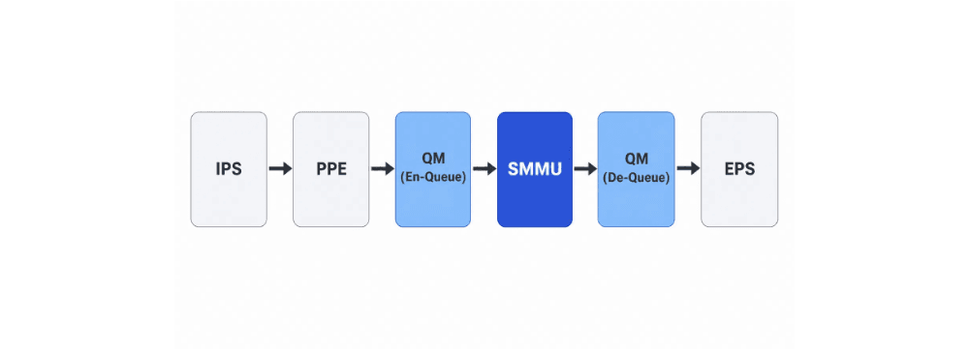
Multicast (4) — Dequeue
Stitching Trigger Conditions
QM Perspective and Transparent Processing
1. Unicast Frame Dequeue Completes
Transparency: QM always sees an ordinary unicast queue. Internally, SMMU inserts multicast cells between unicast frames through logical selection.
When the port's preceding unicast frame is fully transmitted (mc_pend_uni_q[p] == 0), the stitching check is triggered.
2. Multicast Slot Is Ready
Seamless switching: once stitching conditions are met, the LLE switches from the SRAM linked list to the multicast mirror registers mc_cells_q with zero added latency.
The multicast slot is valid (mc_valid_q == 1) and the port is set in the destination bitmap (mc_dst_bitmap_q[p] == 1).
3. Read Pointer Is In Range
mc_rd_idx_q[p] is below the frame's cell count.
SMMU Design Review
Page 23

Slide 24

Multicast (5) — Ref-Count Reclaim
Reference-Count Mechanism
Cell-Level Reclamation
To support zero-copy multicast, SMMU maintains an independent reference counter for each multicast cell:
Resources are reclaimed per cell rather than per frame for finer-grained release:
// Initialization: ref_count = count_ones(mc_dst_bitmap); // Port p completes its read: ref_count = ref_count - 1;
1. Port A completes Cell 0:
ref_count[0]--
.
2. Port B completes Cell 0:
ref_count[0]--
.
3.
ref_count[0] == 0
.
Whole-Frame Release and Slot Clearing
Closed resource loop: the frame is fully released after every destination port has read and reclaimed every cell.
Slot:
clear
mc_valid_q
flag, reset the multicast-slot state machine, and prepare for the next multicast frame.
Performance benefit: backpressure on one port cannot hold global buffer resources indefinitely.
SMMU Design Review
Page 24

Slide 25
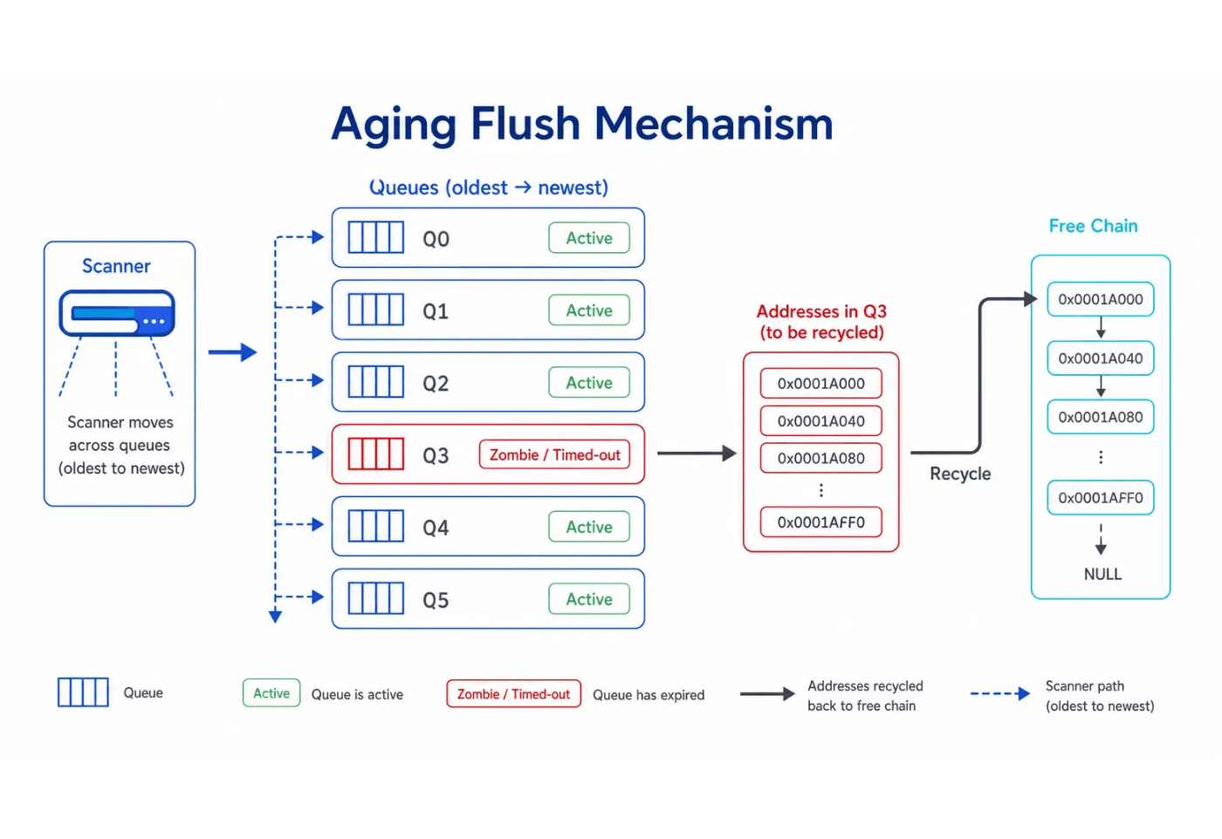
Aging (1) — Zombie Cleanup
Aging-Flush Scan Mechanism
Design Context
In a switch ASIC, abnormal traffic, a stalled peer, or configuration changes can leave packets buffered without dequeue activity. These zombie queues consume valuable SRAM resources.
Scanning Logic
•
Timer
: SMMU maintains a high-precision aging timer.
•
Scan
:
aging_ctrl
polls every non-empty queue periodically.
•
Detect
: no dequeue activity by timeout;
mark the queue aged for forced reclaim.
Active scanning ensures that deadlocked queues cannot hold shared-buffer resources indefinitely.
SMMU Design Review
Page 25

Slide 26
Aging (2) — Forced Reclamation
1. Execution
2. Safety
Once a queue is marked as aged, the LLE starts a Forced Dequeue process:
Aging flush is a sensitive resource operation, so SMMU applies multiple safeguards:
• Enqueue Lock: enqueue to the affected queue is locked during the flush to prevent new address conflicts. • Atomic operation: the entire frame is reclaimed atomically to protect linked-list integrity. • Lower-priority execution: aging reclamation has medium LLE arbitration priority and does not disrupt normal dequeue traffic.
• Drop packets: aged packets are discarded inside the MMU instead of being sent to an egress port. • Return addresses: occupied cell addresses are read out one by one and appended to the free list. • Close the resource loop: all capacity held by stale packets re-enters the available pool.
SMMU Design Review
Page 26

Slide 27




Design Highlights
High Performance
High Efficiency
An exact one-cycle command response plus a two-stage prefetch pipeline fully absorbs SRAM latency, sustaining line-rate, bubble-free packet forwarding.
Separating data from addresses and managing buffers through linked lists enables dynamic sharing, substantially improving SRAM density and utilization.
Flexibility
Robustness
Full parameterization supports configurable queue count, buffer depth, and port width, allowing rapid adaptation to switch ASICs with different specifications.
Three-level flow-control feedback, whole-frame drop protection, and proactive aging flush keep the system stable under severe congestion and abnormal conditions.
SMMU Design Review
Page 30

Slide 28


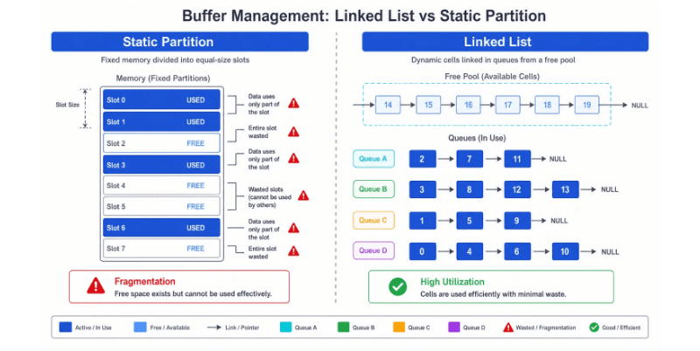
Conclusion
Thank You
Q & A
Core Design Recap: Linked-List-Based Dynamic Buffer Management
Smart MMU (SMMU) Design Module Overview | 2026

