Slide 1
Presentation

Slide 2
Outline

Slide 3
Executive Summary

Slide 4
Introduction
Background
The commercial space industry is expanding rapidly. SpaceX currently dominates the market with competitive pricing ($62 million vs. $165 million per launch), largely due to its ability to recover and reuse the first stage of its rockets. To compete, SpaceY aims to develop similar capabilities.
Meanwhile, urban migration is increasing, with many people relocating to new neighborhoods in search of better housing, schools, and facilities. In cities like Scarborough, Toronto, newcomers need insights on housing prices, crime rates, school ratings, healthcare, and recreational facilities to make informed decisions.
Problem Statement
To support SpaceY's competitiveness, we must develop a machine learning model that predicts the likelihood of a successful first-stage rocket recovery. Additionally, to assist individuals migrating to new neighborhoods, an analytical framework will be created to compare different areas based on key features such as affordability, safety, infrastructure, and accessibility to essential services.
This project aims to provide valuable insights for both the aerospace industry and urban planners, helping businesses innovate and people make informed relocation choices.

Slide 5
Methodology
To develop a robust machine learning model and comparative analysis framework, we use a combination of publicly available and structured data sources:
SpaceX Rocket Recovery Analysis
Gather data from the SpaceX public API and Wikipedia pages.
Clean and preprocess data through wrangling techniques.
Classify first-stage landings as successful or unsuccessful.
Conduct exploratory data analysis (EDA) using SQL and data visualization.
Create interactive visual analytics using Folium and Plotly Dash.
Build predictive models to assess the probability of successful landings.
Neighborhood Comparison Analysis
Collect data on housing prices, crime rates, school ratings, infrastructure, and accessibility.
Perform data wrangling and transformation to ensure consistency.
Utilize geospatial visualization tools like Folium for interactive mapping.
Apply machine learning techniques to identify optimal neighborhoods based on user preferences.
This dual approach ensures an insightful analysis for both the aerospace industry and urban planning, providing actionable insights for businesses and individuals.

Slide 6
Data Collection Overview
Data Collection Process
The data collection methodology involves a combination of API requests from the SpaceX public API and web scraping from Wikipedia to ensure comprehensive and structured datasets.
1. SpaceX API Data Collection
The API used: SpaceX API v4.
This API provides data on multiple types of SpaceX rocket launches.
The dataset is filtered to include only Falcon 9 launches.
Missing values are replaced with the mean of their respective columns.
The final processed dataset contains 90 rows (instances) and 17 columns (features).
Columns extracted from the API: FlightNumber, Date, BoosterVersion, PayloadMass, Orbit, LaunchSite, Outcome, Flights, GridFins, Reused, Legs, LandingPad, Block, ReusedCount, Serial, Longitude, Latitude.

Slide 7
2. Web Scraping from Wikipedia
The data is scraped from Wikipedia’s Falcon 9 & Falcon Heavy launches page.
The dataset includes only Falcon 9 launches.
Categorical features are encoded using one-hot encoding.
A new column ‘Class’ is added:
0 → Unsuccessful launch
1 → Successful launch
The processed dataset contains 90 rows and 83 features.
Columns extracted from Wikipedia: Flight No., Launch Site, Payload, PayloadMass, Orbit, Customer, Launch Outcome, Booster Version, Booster Landing, Date, Time.
This dual approach ensures a high-quality dataset, suitable for training a machine learning model to predict successful Stage 1 rocket landings.

Slide 8
Data Wrangling
Create a training label with landing outcomes where success = 1 and failure = 0. The "Outcome" column contains two components: 'Mission Outcome' and 'Landing Location'. Add a new training label column called 'class', with a value of 1 if 'Mission Outcome' is True, and 0 otherwise. Value Mapping: True ASDS, True RTLS, and True Ocean -> 1 None None, False ASDS, None ASDS, False Ocean, False RTLS -> 0.
Exploratory Data Analysis was performed on the variables Flight Number, Payload Mass, Launch Site, Orbit, Class, and Year. The plots used include:
Flight Number vs. Payload Mass
Flight Number vs. Launch Site
Payload Mass vs. Launch Site
Orbit vs. Success Rate
Flight Number vs. Orbit
Payload vs. Orbit
Success Yearly Trend

Slide 9
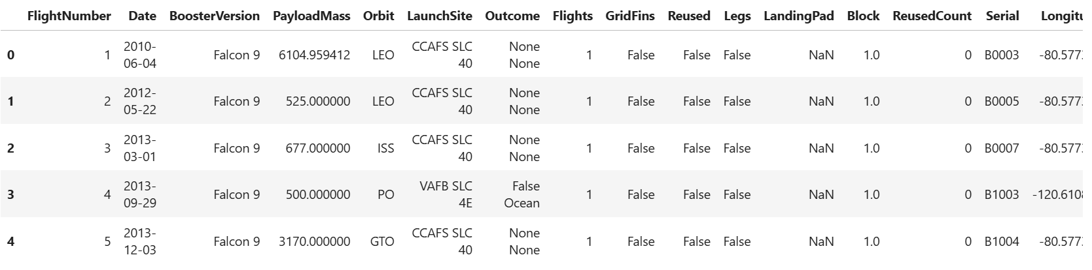
Scatter plots, line charts, and bar plots were used to compare relationships between variables to determine if a relationship exists and if they could be used for training the machine learning model.
The data set was loaded into an IBM DB2 database and queried using SQL-Python integration. Queries were run to gain a better understanding of the dataset, specifically regarding launch site names, mission outcomes, various payload sizes of customers, booster versions, and landing outcomes.
Folium maps were used to mark launch sites, successful and unsuccessful landings, and proximity to key locations such as Railway, Highway, Coast, and City. This allows us to understand why launch sites are located where they are, while also visualizing successful landings relative to location.
The dashboard includes a pie chart and a scatter plot. The pie chart can be selected to show the distribution of successful landings across all launch sites, or individual launch site success rates. The scatter plot takes two inputs: All sites or an individual site, and payload mass on a slider between 0 and 10,000 kg. The pie chart is used to visualize the launch site success rate, while the scatter plot helps us observe how success varies across launch sites, payload mass, and booster version categories.

Slide 10
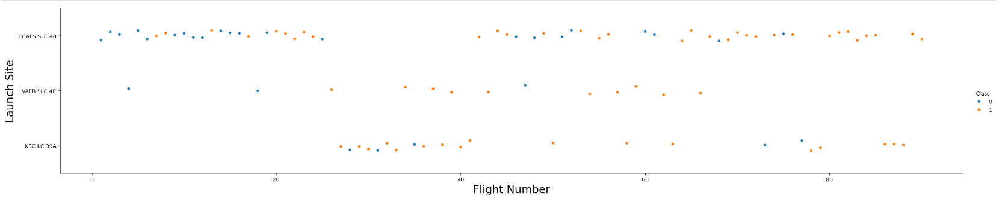
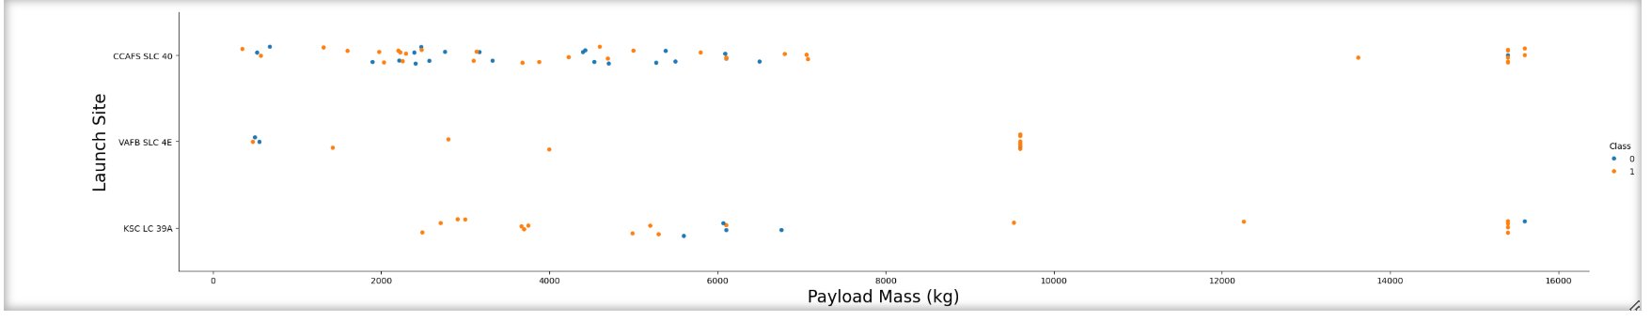

Slide 11
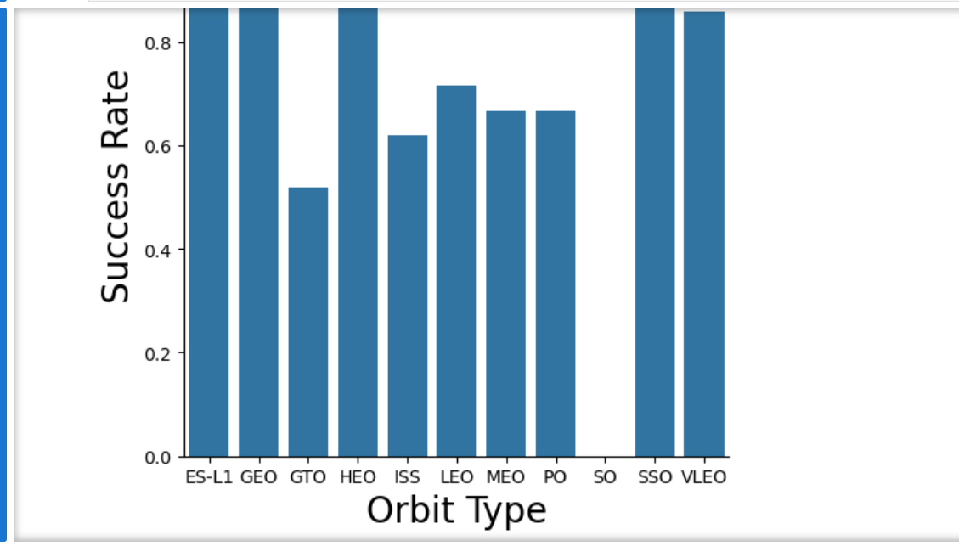

Slide 12
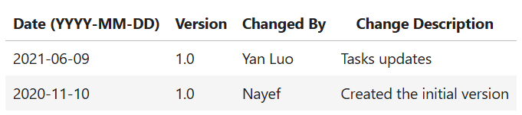

Slide 13
Retrieve unique launch site names from the database. CCAFS SLC-40 and CCAFSSLC-40 likely refer to the same launch site due to data entry errors. CCAFS LC-40 was the previous name. There are likely only three unique launch site values: CCAFS SLC-40, KSC LC-39A, and VAFB SLC-4E

Slide 14
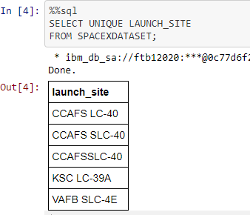

Slide 15
Analysis of Launch Site CCAFS LC-40 and Machine Learning Model Performance
The pie chart below illustrates the launch outcomes for CCAFS LC-40.
0 represents failed launches, while 1 represents successful launches.
73.1% of launches at CCAFS LC-40 resulted in failure.
Additionally, a scatterplot is shown for payload mass values ranging between 2000 kg and 8000 kg.
In this plot, Class 0 represents failed launches and Class 1 represents successful launches.
Machine Learning Model Performance
Several models were trained and evaluated for predicting launch success:

Slide 16
1. Logistic Regression
GridSearchCV best score: 0.8464
Accuracy on test set: 0.8333
Confusion matrix available
2. Support Vector Machine (SVM)
GridSearchCV best score: 0.8482
Accuracy on test set: 0.8333
Confusion matrix available
Comparison of Model Performance
When comparing the four models, all produced the same accuracy and confusion matrix on the test set. Thus, the GridSearchCV best score is used to rank them:

Slide 17
In this project, we try to predict if the first stage of a given Falcon 9 launch will land in order to determine the cost of a launch. • Each feature of a Falcon 9 launch, such as its payload mass or orbit type, may affect the mission outcome in a certain way. • Several machine learning algorithms are employed to learn the patterns of past Falcon 9 launch data to produce predictive models that can be used to predict the outcome of a Falcon 9 launch. • The predictive model produced by decision tree algorithm performed the best amongthe 4machine learning algorithms employed

Slide 18
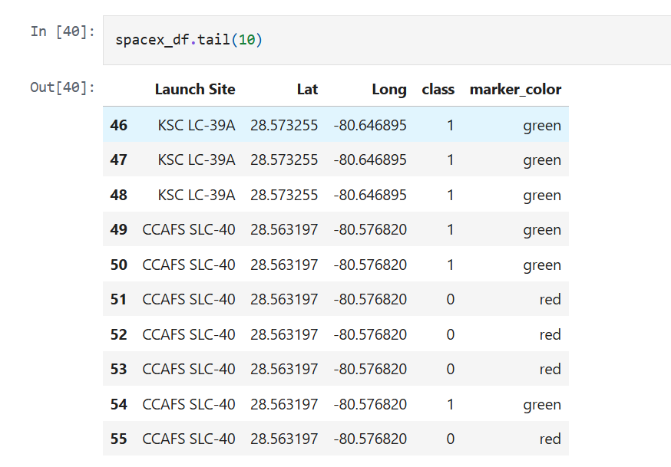

Slide 19
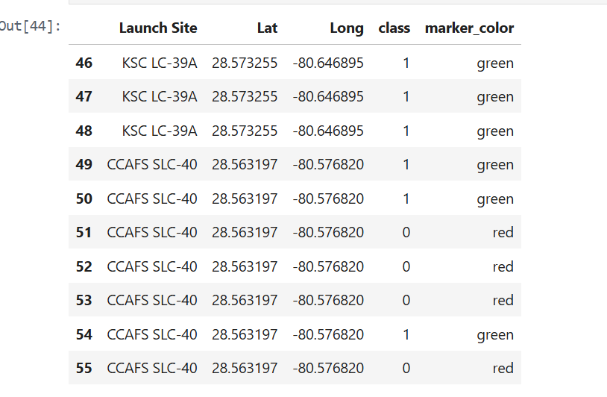

Slide 20
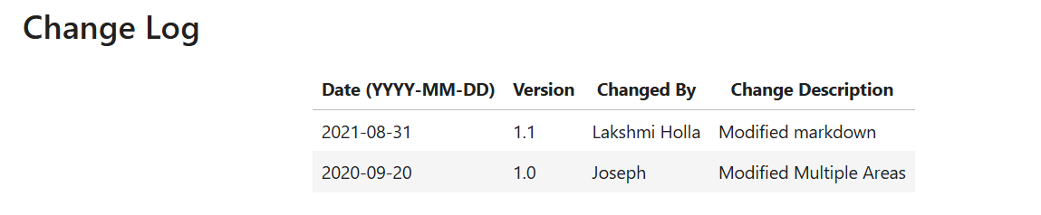

Slide 21
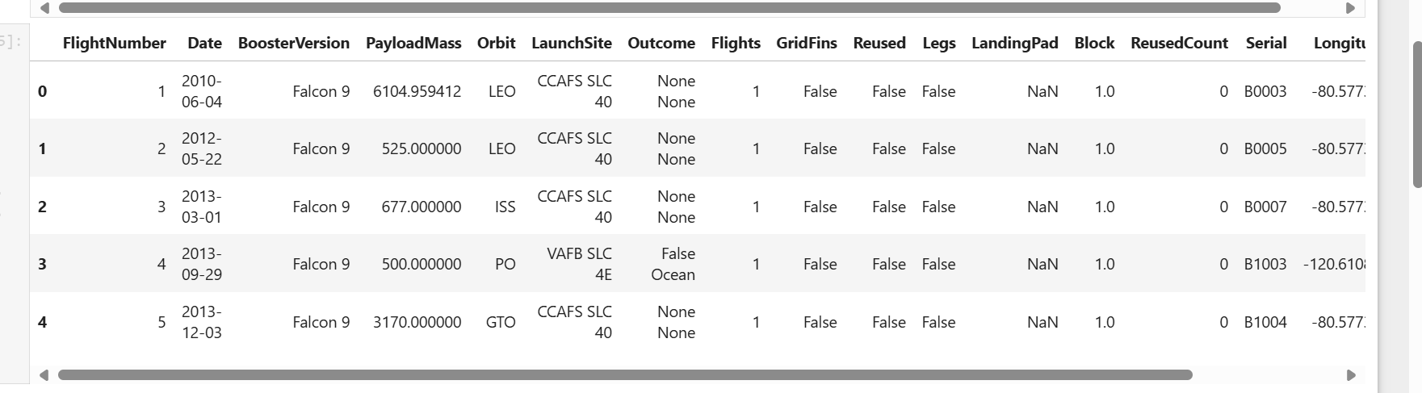

Slide 22
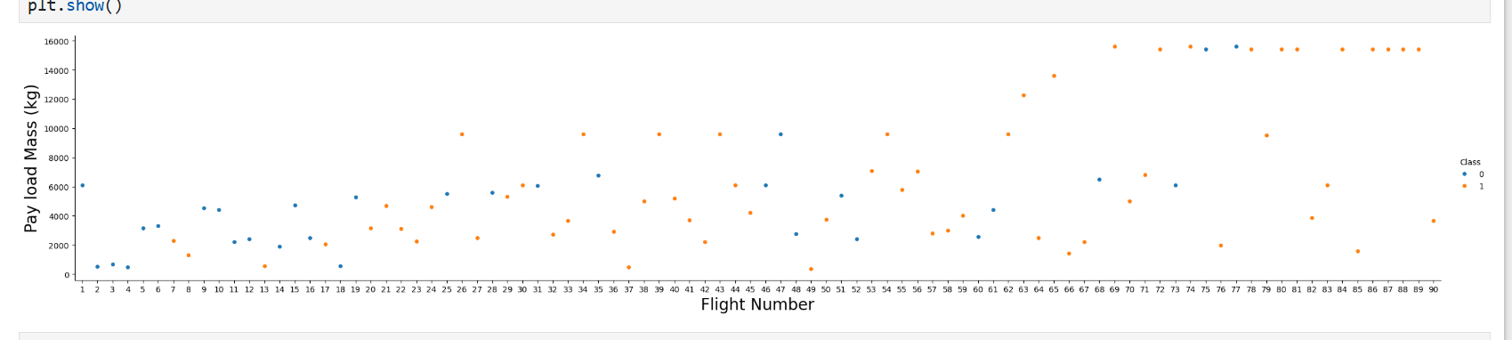
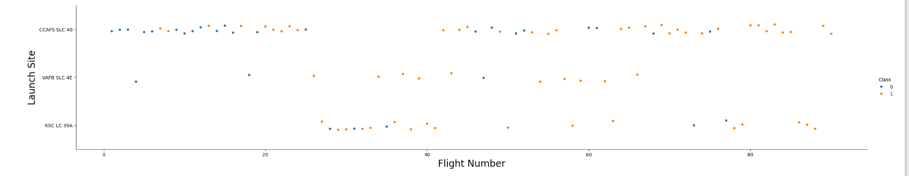

Slide 23
