Slide 1
Physics-Informed Deep Learning for Environmental Parameter Estimation using Earth Observation Data
Goal: to develop and apply physics-informed neural networks (PINNs) for estimating environmental parameters from grid-structured EO data, enforcing physical consistency via governing equations to improve accuracy and generalization over purely data-driven models.
Tasks:
Review of existing solutions
Select an environmental parameter (e.g. land surface temperature, moisture, pollution, …)
Implement a baseline machine learning or deep learning model operating on grid-structured EO data
Implement a PINN-based estimation pipeline using DL
Compare baseline and PINN models using quantitative metrics and visual analysis.
Evaluate and discuss the results
Task progress tracking: recommend to use a Github repository
Contact info.: m.bizjak@um.si (visiting at HCAI)

Slide 2
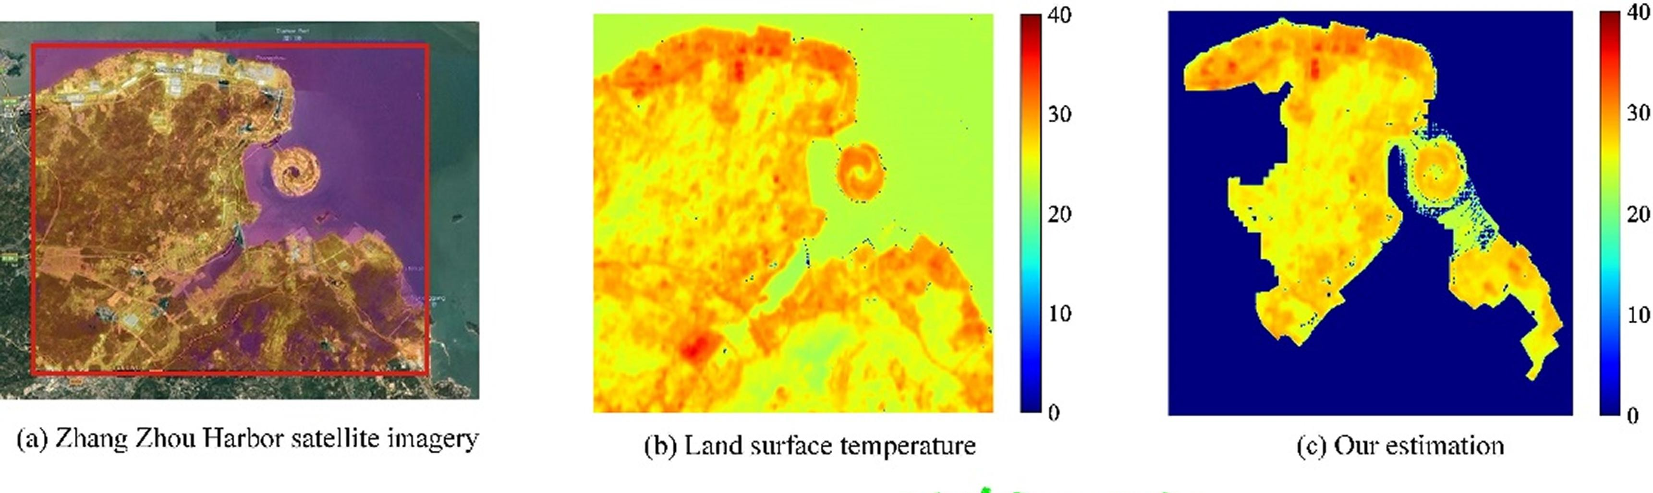
Physics-Informed Deep Learning for Environmental Parameter Estimation using Earth Observation Data
Example :
Source: Chen et al., DeepUrbanDownscale: A physics informed deep learning framework for high-resolution urban surface temperature estimation via 3D point clouds
https://www.sciencedirect.com/science/article/pii/S0303243421003573

Slide 3
Physics-Informed Deep Learning for Environmental Parameter Estimation using Earth Observation Data
Literature:
DeepUrbanDownscale: A physics informed deep learning framework for high-resolution urban surface temperature estimation via 3D point clouds: https://ieeexplore.ieee.org/abstract/document/8947948
Physics-informed neural networks enhanced by data augmentation: a novel framework for robust soil moisture estimation using multi-source data fusion: https://www.sciencedirect.com/science/article/pii/S0022169425016609
Physical informed neural network improving the WRF-CHEM results of air pollution using satellite-based remote sensing data: https://www.sciencedirect.com/science/article/pii/S1352231023004570
Prerequesete knowledge: Python/C++ or other, GIT, basic knowledge of ML/DL
Data:
https://scihub.copernicus.eu/ (Sentinel, Landsat)
https://cds.climate.copernicus.eu (ERA5, environmental parameters)
https://clss.si
Tools:
PyTorch or TensorFlow, DeepXDE
https://www.meshlab.net/
QGIS

Slide 4
Physics-Informed Graph Neural Networks for Environmental Parameter Estimation using Earth Observation Data
Goal: to develop and apply physics-informed graph neural networks (PIGNNs) for estimating environmental parameters parameters from EO data represented as a spatial or spatio-temporal graphs.
Tasks:
Review of existing solutions
Select an environmental parameter (e.g. land surface temperature, moisture, pollution, …)
Implement a baseline GNN model for parameter estimation
Implement a PIGNN-based estimation pipeline using DL
Compare baseline and PIGNN models using quantitative metrics and visual analysis.
Evaluate and discuss the results
Task progress tracking: recommend to use a Github repository
Contact info.: m.bizjak@um.si (visiting at HCAI)

Slide 5
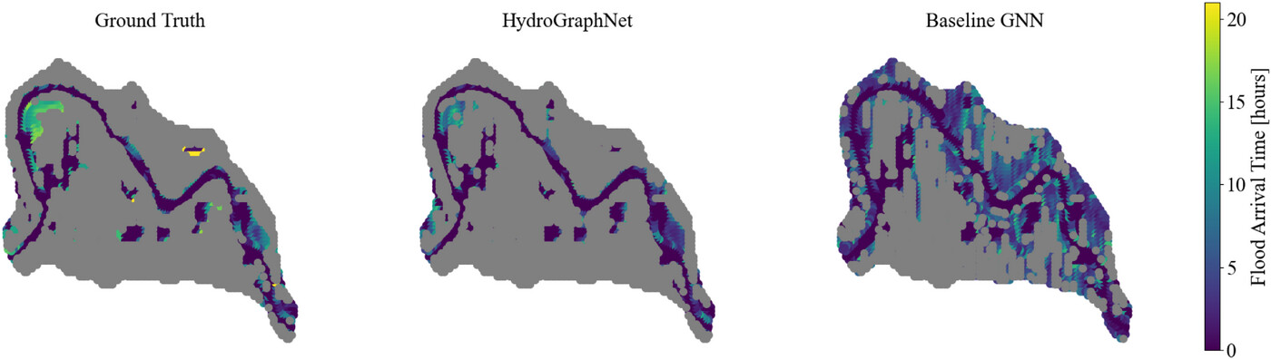
Physics-Informed Graph Neural Networks for Environmental Parameter Estimation using Earth Observation Data
Example :
Source: Xin et al., Interpretable physics-informed graph neural networks for flood forecasting
https://onlinelibrary.wiley.com/doi/full/10.1111/mice.13484

Slide 6
Physics-Informed Graph Neural Networks for Environmental Parameter Estimation using Earth Observation Data
Literature:
Xin et al., Interpretable physics-informed graph neural networks for flood forecasting : https://onlinelibrary.wiley.com/doi/full/10.1111/mice.13484
Xin et al., UrbanGraph: Physics-Informed Spatio-Temporal Dynamic Heterogeneous Graphs for Urban Microclimate Prediction: https://arxiv.org/abs/2510.00457
Thermal Earth model for the conterminous United States using an interpolative physics-informed graph neural network: https://link.springer.com/article/10.1186/s40517-024-00304-7
Prerequesete knowledge: Python/C++ or other, GIT, basic knowledge of ML/DL
Data:
https://scihub.copernicus.eu/ (Sentinel, Landsat)
https://cds.climate.copernicus.eu (ERA5, environmental parameters)
https://openaq.org (Air quality monitoring stations)
https://clss.si
Tools:
PyTorch Geometric or TensorFlow, DeepXDE
https://www.meshlab.net/
QGIS

