Slide 1
Kenya Institute Of Software Engineering
WEB DEVELOPMENT
UNIT 1
SESSION 1
INTRODUCTION:
HTML FORMS

Slide 2
FORMS
For a website to be successful, it is important to be able to get feedback from visitors to your site. This could be a request for information, general comments on your site or even a product order. This could be done with a MAILTO: link but providing a form has several advantages over a simple email.
  􀂃 It makes it easier for people to send the information
  􀂃 A form gives you greater control over the information that is sent.
  􀂃 Form results can be organised in a way that makes them easy to store in a spreadsheet or database.

Slide 3
The FORM Tag
Forms are placed in your document using a <FORM> tag which must have a closing </FORM> tag.
NB: You can have more than one form in a document as long as they don’t overlap.
<FORM>
</FORM>

Slide 4
CREATING FORMS-ELEMENTS
Your form may contain several elements that enable a user to input information.
They include
  <INPUT>
  <SELECT>
  <TEXTAREA>.

Slide 5
Input fields
Specified using the <input>tag
Input fields can have the following attributes. <INPUT >
input being used is specified by the TYPE attribute.
TYPE=“THETYPE“>

Slide 6
Input attributes
The attributes required will depend on the type of input being used.
ALIGN=If the input type is an image, this is used the same as for an IMG tag.
CHECKED For checkbox and radio input types, this attribute will cause the option to be pre-selected by default.
MAXLENGTH=Determines the maximum number of characters that can be typed into this field.
NAME=Provides a name for the field. This is used to identify the contents of this field in the form results.
SIZE=Sets the width of the field in characters.

Slide 7
Cont…Attributes
SIZE=Sets the width of the field in characters.
SRC=If the input type is an image, this specifies the location of the image file the same as the SRC attribute in an <IMG> tag.
TYPE=Specifies the type of the input field. The choices are text, password, checkbox, radio, submit, image, reset, file and hidden.
VALUE=For text fields, an optional attribute that sets an initial value for the field (if you want it to already be filled in). For check boxes and radio buttons, this specifies what to send with the form results if the option is selected.

Slide 8
Text controls
Used for entry of data/values
Text fields
Text area fields
Password fields

Slide 9
TYPE="text" attribute
A text input element is for entering a small amount of text. It uses an <INPUT> tag with a TYPE=”text” attribute. It uses the NAME=, SIZE=, MAXLENGTH= and VALUE= attributes.
Example
Name: <INPUT TYPE="text" NAME="name" SIZE="40" MAXLENGTH="80" VALUE=”the text/value here”>

Slide 10
Password fields
<INPUT TYPE="password" NAME="password" SIZE="40" MAXLENGTH="80">

Slide 11
TYPE=“button"
Creates a button
<INPUT TYPE=”button” NAME=”open” VALUE=”click to open”>

Slide 12
TYPE="checkbox"
A checkbox input can be used for boolean fields where there are only two choices. It can use the NAME=, VALUE= and CHECKED attributes. When several checkbox inputs share the same name, their results will be put into the same field. This allows users to select more than one value for a category.
<INPUT TYPE=" checkbox " NAME="password" SIZE="40" MAXLENGTH="80">

Slide 13
TYPE=“radio"
Radio inputs allow a user to select from several options where only one can be selected. Each option in a list has its own <INPUT> tag and each must have the same name. One option can be pre-selected with the CHECKED attribute.
<BR>Age &lt;=20: <INPUT TYPE="radio" NAME="age" VALUE="20">
<BR>Age 21-30: <INPUT TYPE="radio" NAME="age" VALUE="21-30" CHECKED>
<BR>Age 31-40: <INPUT TYPE="radio" NAME="age" VALUE="31-40">
<BR>Age &gt;40: <INPUT TYPE="radio" NAME="age" VALUE="40">

Slide 14
TYPE="hidden"
Some CGI scripts make use of hidden fields within the form to accept additional parameter information (such as an email address to send the results to or a subject for the email). These are passed to the server when the form is submitted. Normally they will contain a NAME= and VALUE= attribute
<INPUT TYPE=”hidden” NAME=”subject” VALUE=”feedback”>

Slide 15
Select Menus
As the name implies, select menus allow a user to select from a list of options. The menu begins with a <SELECT> tag and ends with a </SELECT> tag.

Slide 16
The select tag has the following attributes.
MULTIPLE This attribute enables more than one option to be selected by holding down the [CTRL] key, which is useful for certain types of forms. Particularly when used with an online database.
NAME= Name of the list that will be used in the results to identify the field.
SIZE= Number of rows to appear in the list. The default is 1, which will mean that one option will be visible but an arrow will appear to the right. This arrow will bring down a list when clicked. If values of more than 1 are set, the list will show that number of rows with a scroll bar on the side.

Slide 17
Cont…
Within the select tag, each item in the list is set with an <OPTION> tag. An option tag may have the following attributes. SELECTED One option in the list can have this attribute, which will mean that particular option will be initially selected.
VALUE= Value that will be submitted with the form. If no value is specified, the text in the list itself will be used.

Slide 18
Select examle-combobox
<SELECT NAME="state">
<OPTION SELECTED>select country
<OPTION>kenya
<OPTION>uganda
<OPTION>tanzania
<OPTION>south africa
<OPTION>south sudan
<OPTION>nothern sudan
<OPTION >zambia
</SELECT>

Slide 19
Text Areas
Text areas are used where a large amount of text needs to be entered. Common examples are where you want to provide a space on the form for comments to be entered. Text areas begin with a <TEXTAREA> tag and end with a </TEXTAREA> tag. Anything between the start and end tag will appear in the field on the page.
attributes
COLS= Width of the field in characters. The width of a text area will be quite different in Internet Explorer and Netscape Navigator so don’t count on getting them consistent.
ROWS= Number of rows that will appear.
NAME= Name of the text area that will be used in the results to identify the field.

Slide 20
Text area: Example
Comments:
<TEXTAREA NAME="comments" ROWS=3 COLS=35>
Enter your comments here
</TEXTAREA>

Slide 21
TYPE="file"
This field allows a user to specify the name of a file to be sent as an attachment with the form results. Normally a browse button will appear next to the field to allow the user to browse for the location of the file on their computer. The NAME=, SIZE= and MAXLENGTH= attributes may be used. File inputs are not widely supported in browsers.
File to send: <INPUT TYPE="file" NAME="file" SIZE="40">

Slide 22
TYPE="image"
This type of input can be used in place of a submit button. Instead of a button, it will show an image, which will submit the form results when it is clicked. This type of input typically has a NAME= and SRC= attribute but it can also include attributes common to IMG tags such as ALIGN=. Although an image can look a lot better than a plain submit button, image inputs can cause difficulties with text browsers.
<INPUT TYPE="image" NAME="Submit" SRC="submit.gif" WIDTH=“100" HEIGHT=“30">

Slide 23
Submit button
These inputs both provide buttons that affect the results of the form. Both have a VALUE= attribute which determines the text to appear on the button. A submit button can also have a NAME= attribute. When a user clicks a submit button, the results of the form will be sent.
<INPUT TYPE="SUBMIT" NAME="Submit" VALUE="Submit">

Slide 24
Reset button
When a user clicks a reset button, the contents of the form’s fields are set to their initial state.
<INPUT TYPE="RESET" NAME="Reset" VALUE="Reset">

Slide 25
Form Layout
Note:
A common technique with form layout is to place the form components in a transparent table so everything lines up neatly.

Slide 26
A <FORM> tag usually contains the following attributes.
ACTION= Specifies the location of a program to process the results of the form. An email address can also be specified, though this is only supported by some browsers and can give you messy results. Eg.
ACTION=”MAILTO:email@address.com” would send the form results to this address.
METHOD=get / post - Specifies the method used to submit the form results. Get for search forms and forms where results need to be retrieved. Post for feedback forms and forms where results need to be sent.
NAME=Name that can identify the form (E.g. in scripts).

Slide 27
example
<FORM NAME="feedback" ACTION="http://www.xyz.com/bin/mail" METHOD="POST">
<INPUT TYPE=“submit" NAME="subject" VALUE="feedback">
<INPUT TYPE="hidden" NAME="destination" VALUE=“testmail@ymail.com">
</form>

Slide 28
EXAMPLE2
<FORM NAME="feedback" ACTION=“mailto: testmail@ymail.com " METHOD="POST">
<INPUT TYPE=“submit" NAME="subject" VALUE="feedback">
<INPUT TYPE="hidden" NAME="destination" VALUE=“testmail@ymail.com">
</form>

Slide 29
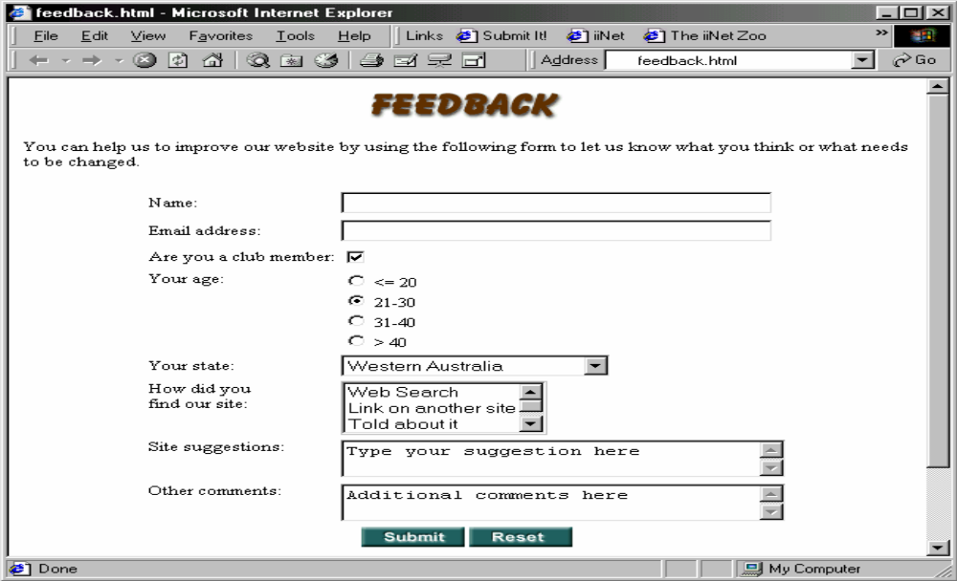
TASK-CREATE THE FORM BELOW

Slide 30
end

