Slide 1
Mirror News Summarizer

Slide 2
1. What is your project? – Aims and Objectives.
Create a summary website with a similar interface to the target news website, such as a mock version of the Sky news/BBC.
Automatically extract news content and generate concise summaries after choosing the website.
Provide users with a similar experience to a real news website, but with a refined summary of the content.

Slide 3
2. Why is it an important project? -- Motivation
With the massive growth of news and information, it is difficult for people to obtain important information quickly. By providing summaries, we help users digest content more efficiently.
Unlike traditional news summary apps, this project also provides a unique user interface experience similar to the real news websites, thereby increasing user interaction and engagement.

Slide 4
3. Literature review – what people have done already.
NLP based Machine Learning Approaches for Text Summarization
--- Rahul; Surabhi Adhikari; Monika
CoVShorts: News Summarization Application Based on Deep NLP Transformers for SARS-CoV-2
--- Hunar Batra; Akansha Jain; Gargi Bisht; Khushi Srivastava; Meenakshi Bharadwaj; Deepali Bajaj; Urmil Bharti
Content Aggregator site
Welcome to Feedly
Panda (usepanda.com)

Slide 5
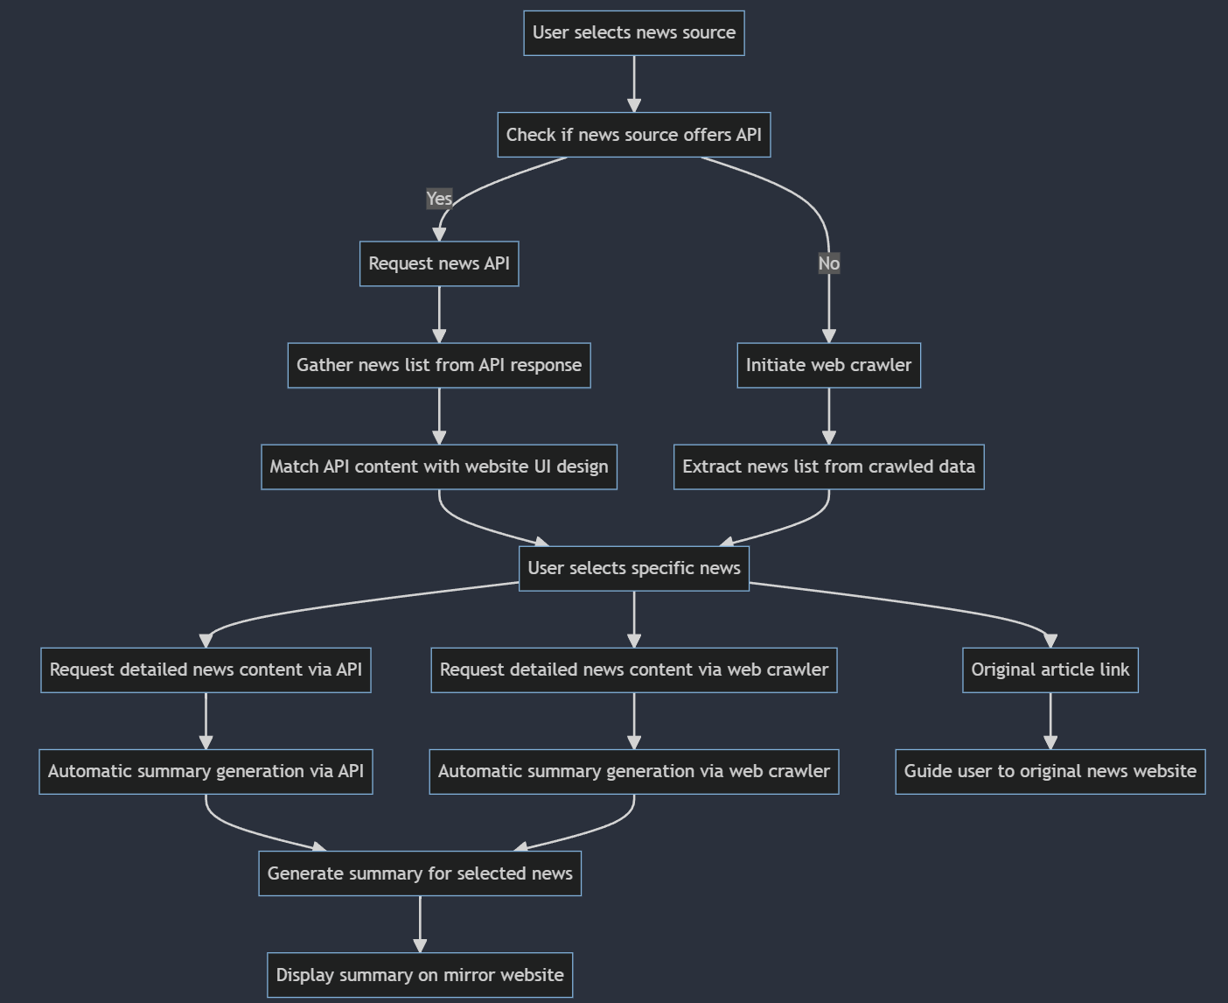
4. Methodology – how you are going to address the challenge(s).

Slide 6
4. Methodology – how you are going to address the challenge(s).
User selects news source: User chooses the news source they wish to browse on the website.
Check if news source offers API: The system first checks if the selected news source offers an API.
If Yes: It proceeds to Request the news API for a list of news.
If No: The system will Initiate a web crawler to scrape the selected news source's site.
Gather news list:
If via API: Gather news list from API response and then Match API content with website UI design.
If via crawler: Extract news list from crawled data.
User selects specific news: Regardless of the source, when a user clicks on a news headline,
For API: Request the detailed news article via API.
For crawler: Request the detailed news article via web crawler.
Automatic summary generation:
For API: Generate summary for selected news via API.
For crawler: Generate summary for selected news via web crawler.
Display summary on mirror website: Show the generated news summary to the user.
Original article link:
Guide user to original news website: Provide a link for the user to navigate to the original news website and read the complete news article.

Slide 7
5. Evaluation – how you are going to evaluate your result(s).
Automatic evaluation: Automatically evaluate the generated summary using evaluation indicators such as ROUGE, BLEU and so on.
User Feedback: Collect user evaluations on summary quality through user surveys and feedback mechanisms.
Performance Evaluation: Test the website's response speed, summary generation speed, and user interface fluency.

Slide 8
Challenge(s)
API limitations and reliability
The stability and legal risks of web crawlers
Quality of content summary
UI design matches content
user experience
Data storage and management

Slide 9
News Knowledge Graph and Summarization System

Slide 10
1. What is your project? – Aims and Objectives.
aims to create a platform that fetches real-time news from diverse sources, produces concise summaries, and visualizes key concepts and relationships via a knowledge graph.

Slide 11
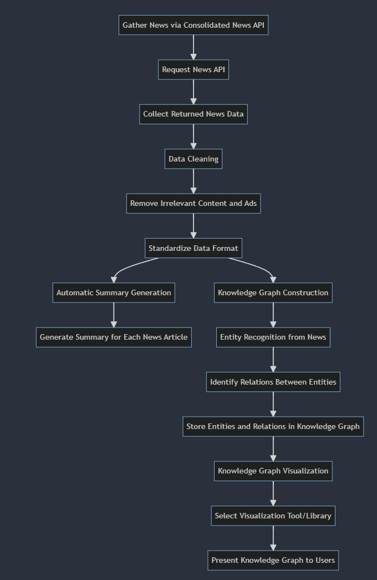
4. Methodology – how you are going to address the challenge(s).

Slide 12
4. Methodology – how you are going to address the challenge(s).
Gather News via Consolidated News API: The initial data collection step.
Request News API: Send a request to the API to fetch news data.
Collect Returned News Data: Store the data returned by the API into a formatted dataset.
Data Preprocessing:
Data Cleaning: Remove duplicates, clean incomplete or corrupted data.
Remove Irrelevant Content and Ads: Strip out any non-relevant information such as advertisements or comments.
Standardize Data Format: Ensure all data adheres to a consistent and uniform format.
Automatic Summary Generation:
Generate Summary for Each News Article: Use NLP tools or API to produce concise summaries for each news article.
Knowledge Graph Construction:
Entity Recognition from News: Identify key entities within the news such as names, places, and events.
Identify Relations Between Entities: Determine the relationships between entities based on context.
Store Entities and Relations in Knowledge Graph: Use a graph database or other tools to store this information.
Knowledge Graph Visualization:
Select Visualization Tool/Library: Pick an appropriate visualization tool based on project needs.
Present Knowledge Graph to Users: Use the chosen tool to display the knowledge graph to the users.
交互性、定制化和集成其他系统

