Slide 1
The university of Hong Kong Department of electronical and electronic engineering Mid-term Review
Mobile Web Application – Electronic Payment System
Final Year Project 2017-2018
Supervisor: Dr. W. H. Lam
Name: ZHU Zicong
UID: 3035142132
Curriculum: BEng(Computer Engineering)

Slide 2
content
Introduction
System Design
Demonstration
Further Improvement
Conclusion
Q&A

Slide 3
1. Introduction - BACKGROUND
Definition of Electronic Payment
Users send payment orders to bank systems directly or indirectly via electronic devices, to achieve currency payment and fund transfer.

Slide 4
1. Introduction - BACKGROUND
Categories of Electronic Payment
Internet
Telephone
Point of Sale (POS)
Mobile Device

Slide 5



1. Introduction - BACKGROUND
Products of Electronic Payment
PayPal
AliPay
WechatPay

Slide 6
1. Introduction - objectives
To build an electronic payment system with features:
Multi-functional
Safety & Stable
Convenient & User-friendly
Project is named as “Free Yeah Payment”

Slide 7
2. System Design - overview
Uses URL for locating resources and HTTP actions for behaviors
Android front-end application
Java server with RESTful API
MySQL database
GCM
Google Clouding Messaging

Slide 8
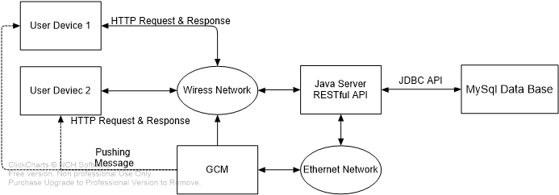
2. System Design - Architecture

Slide 9
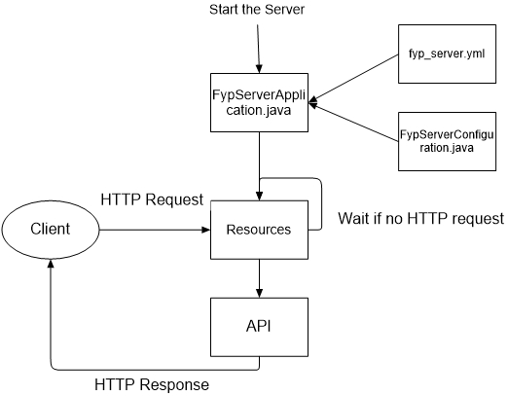
2. System Design – flow of server

Slide 10
2. System Design – DATABASE
Field/Attribute | Data Type | Description
user_id | int, not null | Primary key, auto increment
user_name | varchar(10), not null | Set to be unique
user_password | varchar(20), not null
user_emailAddr | varchar(20) | user’s email address
user_balance | int | user’s current balance
user_createTime | timestamp, not null | this account’s created time
user_lastModifiedTime | timestamp, not null
user_valid | char, not null | 1 for valid, 0 for invalid
user_bankAccount | varchar(20) | user’s bank account
user_ip | varchar(16) | user’s last login IP address
user_qrValidNum | varchar(6) | 6-bit random string for current QR Code generated by this user
user_qrValue | int | value information shall be contained be the current QR Code generated by this user
Table of user

Slide 11
2. System Design – DATABASE
Field/Attribute | Data Type | Description
trans_id | int, not null | Primary key, auto increment
trans_fromID | int, not null | user id of payment side
trans_toID | int, not null | user id of gathering side
trans_fromName | varchar(10), not null | user name of payment side
trans_toName | varchar(10), not null | user name of gathering side
trans_fromBalance | int, not null | user’s balance of payment side
trans_toBalance | int, not null | user’s balance of gathering side
trans_value | int, not null | value of this transaction
trans_creatTime | timestamp, not null
Table of transaction

Slide 12
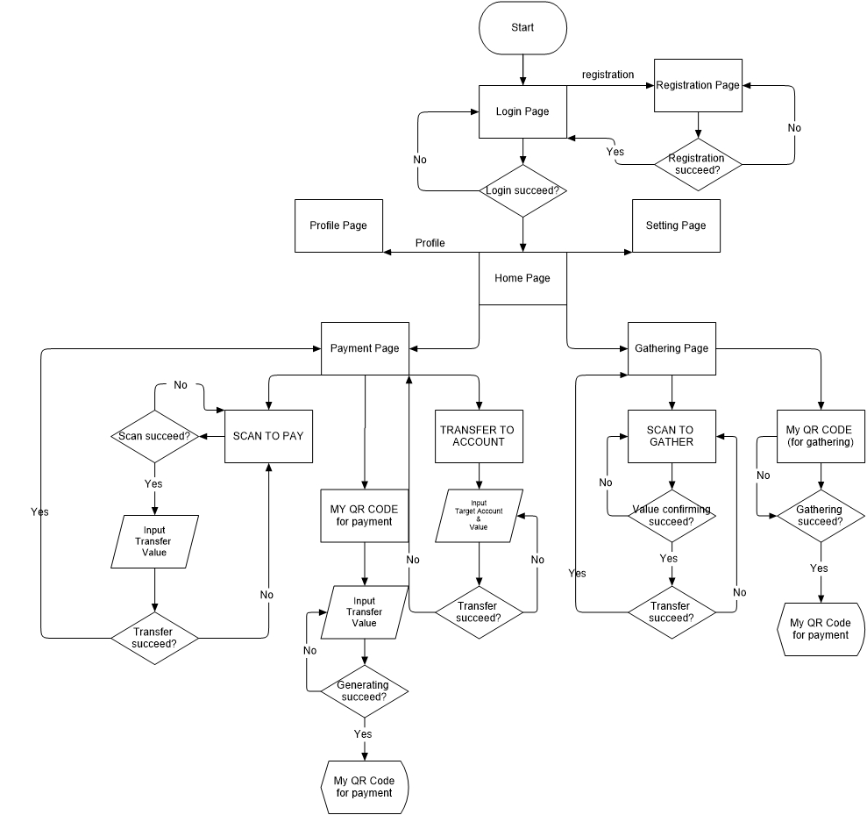
2. System Design – Program flow

Slide 13
2. System Design – Function list
Data flow is designed according to function list
Scenario Name | Description
Login | Users login with necessary information
Registration | Users register with necessary information
Payment_byScan | Users scan a QR Code to pay. Transfer value input is required
Payment_byQRCode | Users generate a QR Code which is able to be scanned by others. Transfer value input is required before generating
Payment_byAccount | Users directly type in target and value to transfer
Gathering_byScan | Users scan a QR Code to gathering. Transfer value is defined in the QR Code
Gathering_byQRCode | Users generate a QR Code which is able to be scanned by others to transfer

Slide 14
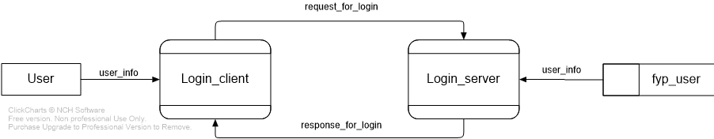
2. System Design – DATA FLOW
Login

Slide 15
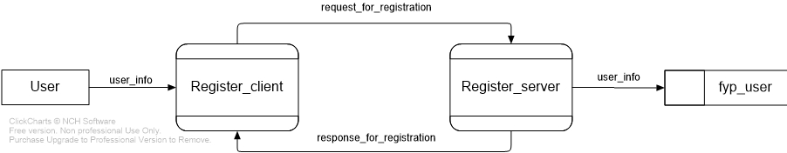
2. System Design – DATA FLOW
Registration

Slide 16
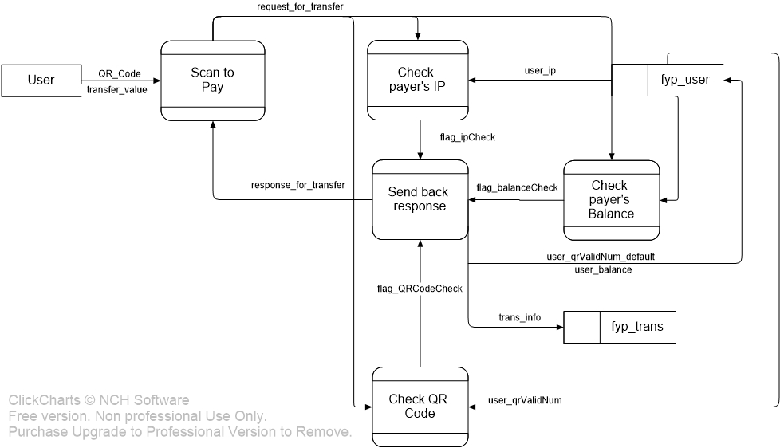
2. System Design – DATA FLOW
Payment_byScan

Slide 17
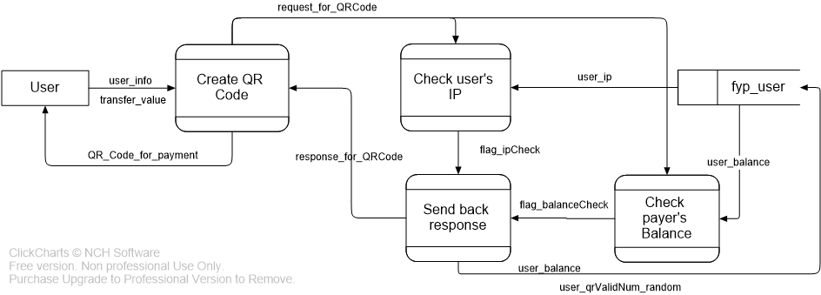
2. System Design – DATA FLOW
Payment_byQRCode

Slide 18
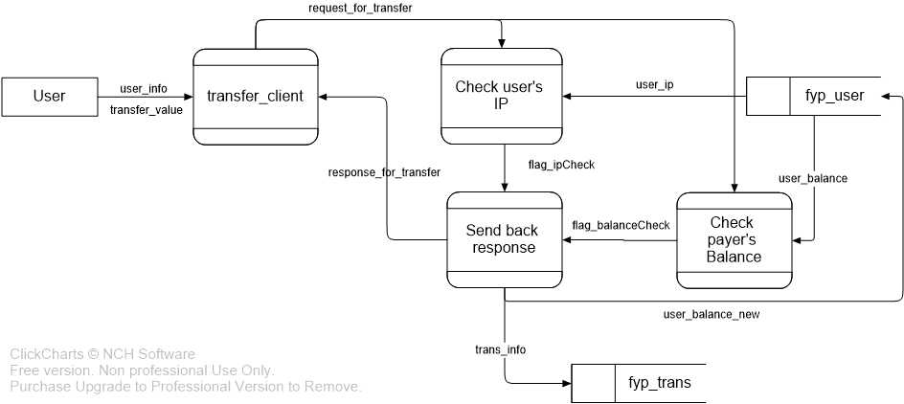
2. System Design – DATA FLOW
Payment_byTransfer

Slide 19
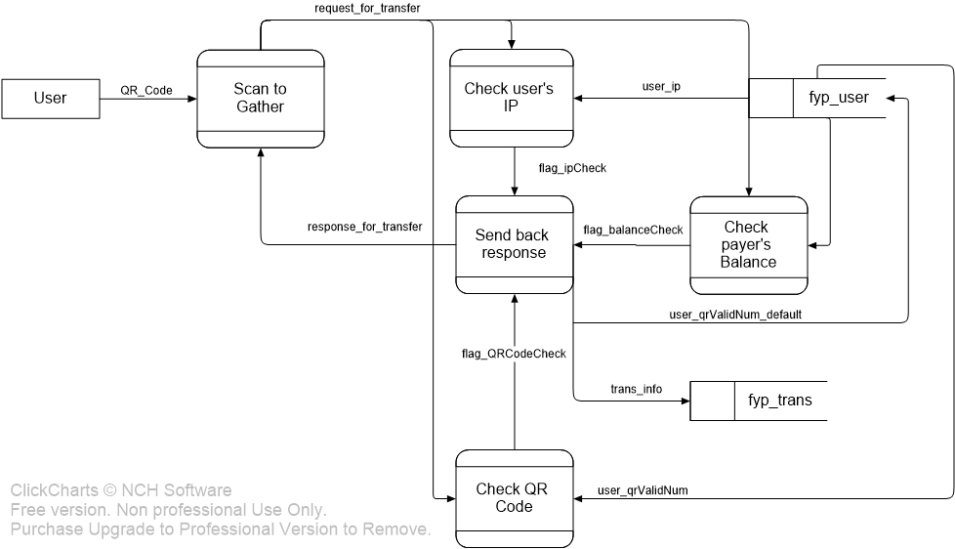
2. System Design – DATA FLOW
Gathering_byScan

Slide 20
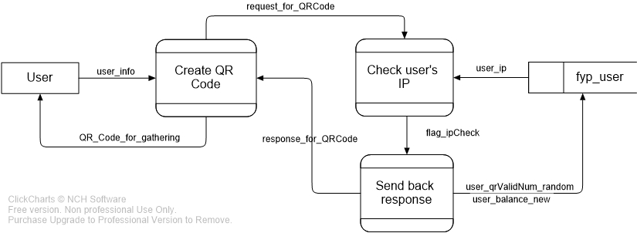
2. System Design – DATA FLOW
Gathering_byQRCode

Slide 21
3. Demonstration

Slide 22
4. Further improvement
UI Design
Function of scanning items
Implementation of GCM
Implementation of Geolocation by WIFI
Database Issue
Security Issue

Slide 23
5. Conclusions
Scenarios with payments are already implemented
Design may be kind of changed while modification
Still many works to do later

Slide 24
Q & A

