Slide 1
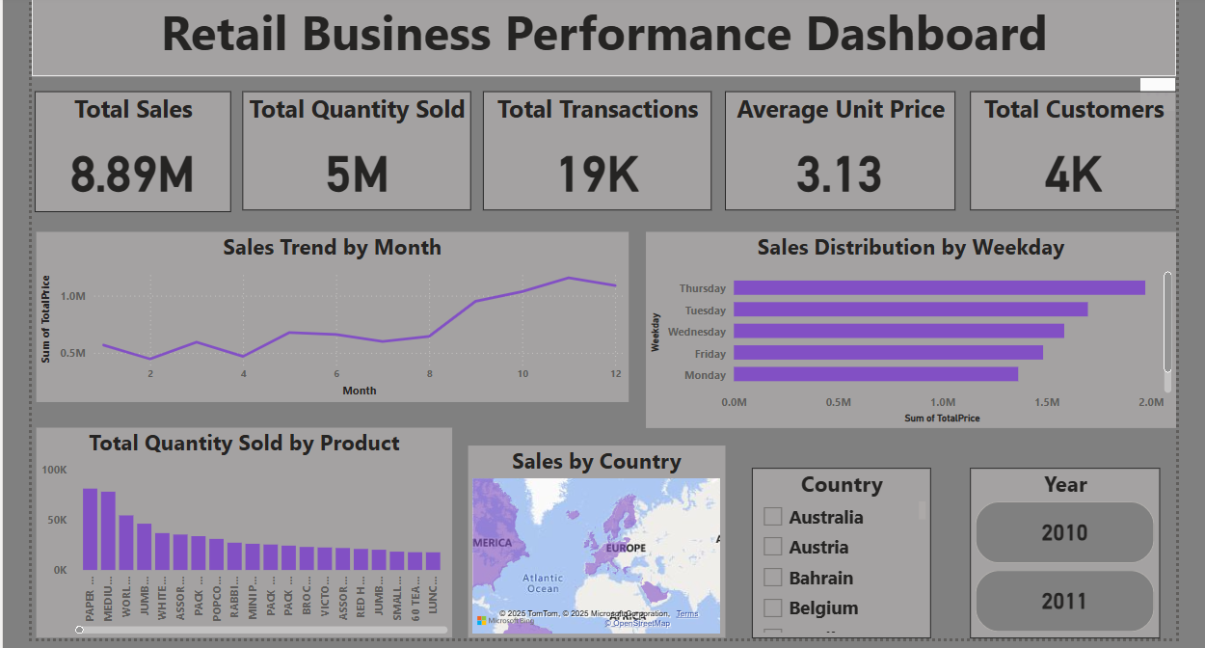
Retail Business Performance & Profitability Analysis

Slide 2
Introduction:
Retail businesses generate vast amounts of transactional data daily. Proper analysis of this data can uncover hidden trends, identify underperforming products, and improve operational efficiency. This project aims to analyze historical retail transactions to evaluate sales performance, inventory turnover, and customer behavior, ultimately supporting strategic decision-making.
Abstract:
This project focuses on analyzing an online retail dataset using Python, SQL, and Power BI. The primary goal is to detect profit-draining products, monitor inventory movement, and reveal seasonal or regional trends. Through effective data cleaning, exploratory analysis, and dashboarding, key insights are generated to support retail business optimization.
Tools Used:
Python (Pandas, Matplotlib, Seaborn): Data cleaning, feature engineering, correlation analysis
SQL (MySQL): Querying key metrics like profit, product performance, and customer data
Power BI: Interactive dashboard creation with KPIs and visual trends
Steps Involved in Building the Project:
1. Data Cleaning in Python:
Removed null values, duplicates.
Created new features: Total Price, Month, Year, Weekday.

Slide 3
2. Exploratory Data Analysis:
Visualized slow-moving products using quantity vs. product.
Analyzed sales patterns by country, weekday, and month.
Performed correlation between Inventory Days and TotalPrice.
3. SQL Analysis:
Connected cleaned dataset.
Calculated total profit, top customers, product performance by quantity and revenue.
Queried monthly sales and average unit price by country.
4. Power BI Dashboard Creation:
Created KPI cards (Total Sales, Quantity Sold, Avg. Price, Transactions, Customers).
Built visualizations for:
* Monthly sales trend
* Quantity by product
* Sales by weekday and country
Added slicers for country and year.
Conclusion:
This analysis highlighted valuable insights into product sales trends and regional demand variations. Slow-moving items and peak sales days were identified, helping to guide inventory and promotional strategies. By leveraging Python, SQL, and Power BI, this project demonstrates the potential of data-driven decision-making in the retail industry.

