Slide 1
Zomato Restaurant Analysis Dashboard

Slide 2
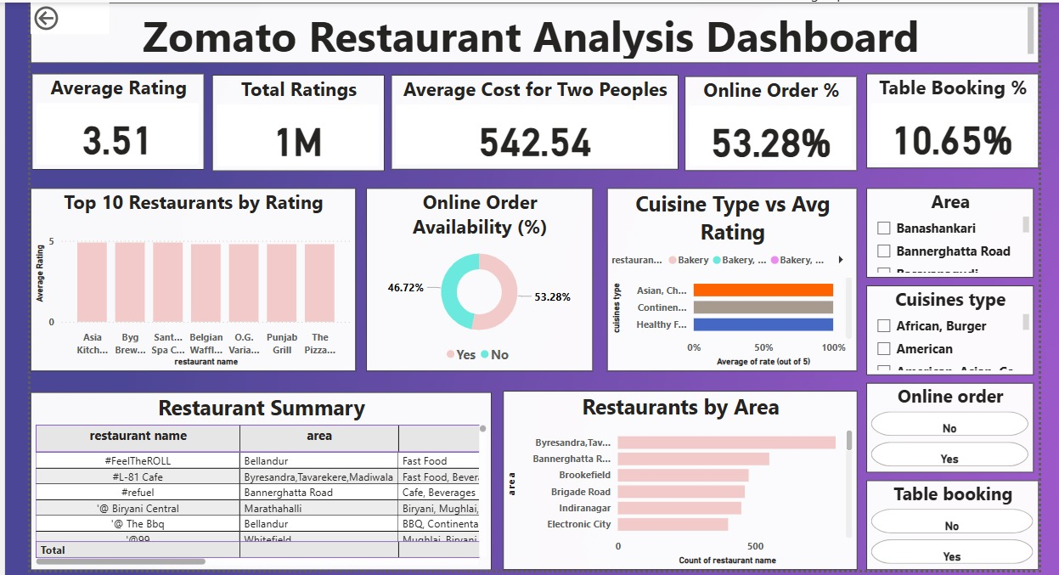

Slide 3
Objective:
Analyze restaurant data to uncover patterns in ratings, cost, online order trends, cuisine popularity, and area-wise restaurant density to support strategic business decisions.
Key KPIs Overview:
Average Rating: 3.51 (Out of 5) ⭐
Total Ratings: 1M (Customer engagement is high)
Avg. Cost for Two: ₹542.54 (Moderate pricing across restaurants)
Online Order Availability: 46.72% offer online ordering
Table Booking Availability: 10.65% offer table reservations

Slide 4
Dashboard Insights:
Rating Insights:
The average restaurant rating is 3.51, indicating overall customer satisfaction is slightly above average.
Top-rated restaurants are consistent across multiple cuisine types, especially Asian and Continental.
Restaurants with both online ordering and table booking tend to have slightly higher average ratings.
Cuisine Insights:
Asian and Continental cuisines consistently receive higher ratings compared to other cuisines.
Bakery and Fast Food are among the most frequently occurring cuisine types.
Some unique combinations (like Healthy Food + Chinese) show high user approval but limited availability.

Slide 5
Online Order Insights:
About 46.72% of restaurants offer online ordering.
Restaurants with online ordering enabled tend to cluster in urban areas like Byresandra and Madiwala.
Online order availability correlates with higher footfall and popularity based on rating counts.
Area-Based Insights:
Byresandra, Madiwala, Tavarekere has the highest number of restaurants, followed by Bannerghatta Road and Brookefield.
Residential and tech park areas have denser restaurant presence, likely due to demand from working professionals.
Some areas have a high concentration of low-rated restaurants, indicating potential improvement zones.
Table Booking Trends:
Only 10.65% of restaurants offer table booking — indicating it’s still a niche feature.
Fine dining and premium cuisine types are more likely to offer table booking.
Areas with higher income demographics offer more booking-enabled restaurants.

Slide 6
Business Insights:
Areas with high online ordering tend to correlate with better ratings.
Online Order-enabled restaurants are more concentrated in tech hubs and urban zones.
Low table booking availability shows room for premium experience development.
Niche cuisines have growth potential in low-competition areas.
Recommendations:
Promote underrepresented cuisines in popular areas to increase customer options.
Encourage table booking options for premium and casual dining types.
Target marketing towards areas with high Quick Bites density for app-based growth.
Enhance visibility of highly rated, online-enabled restaurants.

