Slide 1


Slide 2
Amazon Sales Performance Dashboard – Product, Region & Time Analysis(2025)
Dashboard Components:
Total Sales: Displays cumulative revenue generated.
Units Sold: Total quantity of items sold.
Sales by Month: Line chart representing monthly sales trends.
Sales by Product: Top-selling products based on total revenue.
Sales by Category: Donut chart indicating category-wise contribution.
Sales by Location: Map showing sales density across regions.
Order Fulfillment Funnel: Breakdown of order statuses – Completed, Pending, and Cancelled.

Slide 3
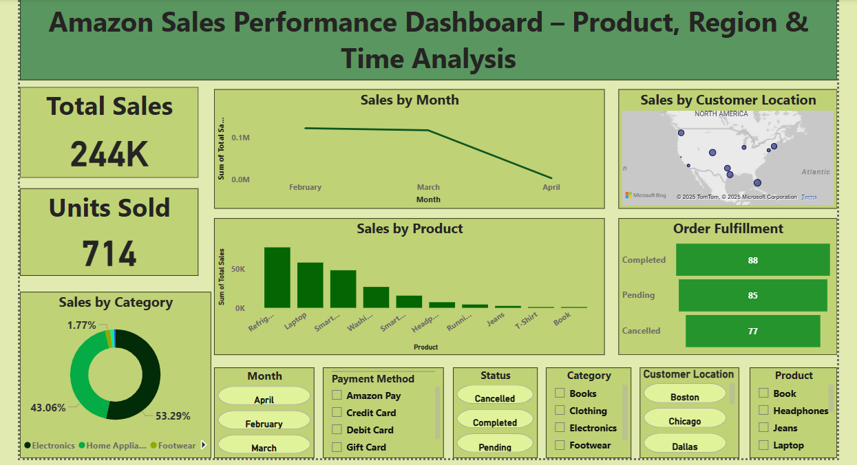

Slide 4
Key Insights:
Top Performing Products:
Refrigerators and Laptops are the highest revenue-generating products, together contributing a significant portion of overall sales.
2. Sales Trend Over Time:
Sales showed a decline from February to April, with the highest revenue recorded in February and a noticeable drop by April.
3. Customer Distribution:
Sales are geographically concentrated in major U.S. cities like Chicago, Dallas, and Boston, indicating strong regional customer bases.
4. Order Fulfillment Overview:
Out of all orders, 88 were successfully completed, 85 are still pending, and 77 were cancelled — suggesting an opportunity to improve order processing and reduce cancellations.

Slide 5
Interactivity Features:
List of filters used: Month, Payment Method, Product, Status, Category, and Customer Location.
These slicers allow users to filter the visuals dynamically, enabling deeper insights by time period, location, and product category.
Conclusion:
The dashboard provides actionable insights into sales performance and customer behavior.
Enables identification of high-performing products and underperforming categories.
Future improvements could include customer segmentation.

