Slide 1
IBM HR Attrition Case Study
Submitted by-
Vartika Patel
Batch-ML(6 july)
ID: ESMach1720204W1765071

Slide 2
Business Problem
Attrition has always been a major concern in any organization. The time, money and effort invested in training new employees, the work dependency and other factors leads to a massive overall loss to the firm when an employee leaves. Also, attrition causes distrust among existing employees which can itself become a major difficulty for the management of the organization.

Slide 3
Objective Statement
The IBM HR Attrition Case Study is a fictional dataset which aims to identify important factors that might be influential in determining which employee might leave the firm and who may not. It includes in-depth analysis as well as predictive modeling to understand important factors and make accurate predictions.

Slide 4
Process Description
Understanding the problem and objective
Data Cleaning
Feature Selection
Model Fitting
Training and Testing
Model Evaluation
Model Comparison
Recommendation and Conclusion

Slide 5
Model Selection
Among the various Classification Models applied , Logistic Regression yields the highest accuracy with low bias and low variance.
Model Name | Accuracy | Bias /Variance | Recall
Logistic Regression | 88.88% | bias= 0.8662 variance= 0.0001 | 0 0.97 1 0.38
Random Forest | 87.52% | bias= 0.9474 variance= 0.0026 | 0 0.98 1 0.26
Naïve Bayes | 86.62% | bias= 0.8297 variance= 0.0003 | 0 0.95 1 0.39
SVC | 85.03% | bias= 0.9497 variance= 0.0049 | 0 0.92 1 0.00
KNN | 84.58% | bias= 0.8429 variance= 9.4606 | 0 0.99 1 0.00
Decision Tree | 77.55% | bias= 0.9251 variance= 0.0111 | 0 0.86 1 0.30

Slide 6
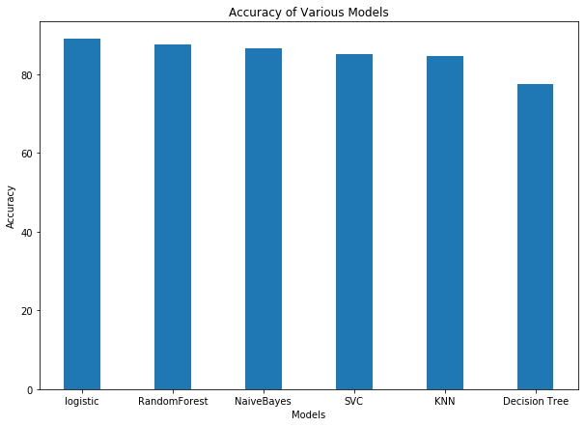
Model Comparison
Visualization
88.88
87.52
86.62
85.03
84.58
77.55

Slide 7
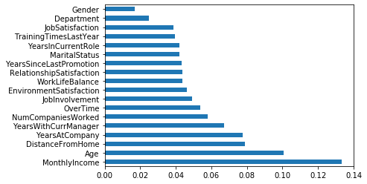
Conclusion
In HR attrition, recall value is very important because we do not want to miss at-risk employees. Recall value (for Attrition =Yes ) tells us the number of employees which might leave the organization.
The various factors which contribute the most in attrition are:

Slide 8
Thank You

