Slide 1
Automated Test Generation for REST APIs
Pritom Rajkhowa

Slide 2
Over the past decade
❖ Explosion of cloud services (in Azure and AWS)
❖ Rapidly evolving ecosystem
❖ REST APIs is the standard way to use cloud services
➢ What about testing?

Slide 3
Challenges and Opportunities for automated testing
These APIs present unique challenges and opportunities for automated testing.
The recent development of many techniques and tools that generate test cases for API endpoints using various strategies.
Understanding how these techniques compare to one another is difficult, as they have been evaluated on different benchmarks and using different metrics.
Through a systematic selection process, a set of 10 state-of-the-art REST API testing tools that included tools developed by both researchers and practitioners.
Notes:
The last decade has seen a tremendous growth in the availability of web APIs—APIs that provide access to a service through a web interface. This increased popularity has been driven by various industry trends, including the advent of cloud computing, the broad adoption of microservices, and newer value propositions enabled by the “API economy”. A majority of modern web APIs adhere to the REpresentational State Transfer (REST) architectural style and are referred to as RESTful APIs, whose popularity is reflected in the availability of thousands of APIs in public directories (e.g., ProgrammableWeb [65] and APIs guru ).

Slide 4
What does these tools do?
These techniques take as input a description of the API, in the OpenAPI specification format or API Blueprint.
Employ various strategies to generate test cases for exercising API endpoints defined in the specification.

Slide 5
Tools
One white-box tool:
EvoMasterWB
Black-box tools :
APIFuzzer
BBOXRT
Dredd
EvoMasterBB
RESTest
RESTler
RestTestGen
Schemathesis
Tcases

Slide 6
Selection Criteria
Rely on well-known REST API standards (i.e., OpenAPI, RAML, and API Blueprint)
Produce actual test cases.

Slide 7
Draw Back
Overall, all tools achieved relatively low line and branch coverage on many benchmarks, which indicates that there is considerable room for improvement.

Slide 8
Common Limitations
Inability
(1) generating input values that satisfy specific constraints.
(e.g., parameters that must have a given format)
(2) satisfying dependencies among requests.
(e.g., this endpoint must be called before these other endpoints).
Notes:
In general, we found that accounting for dependencies among endpoints is key to performing effective REST API testing, but existing techniques either do not consider these dependencies or use weak heuristics to infer them, which limits their overall effectiveness.

Slide 9
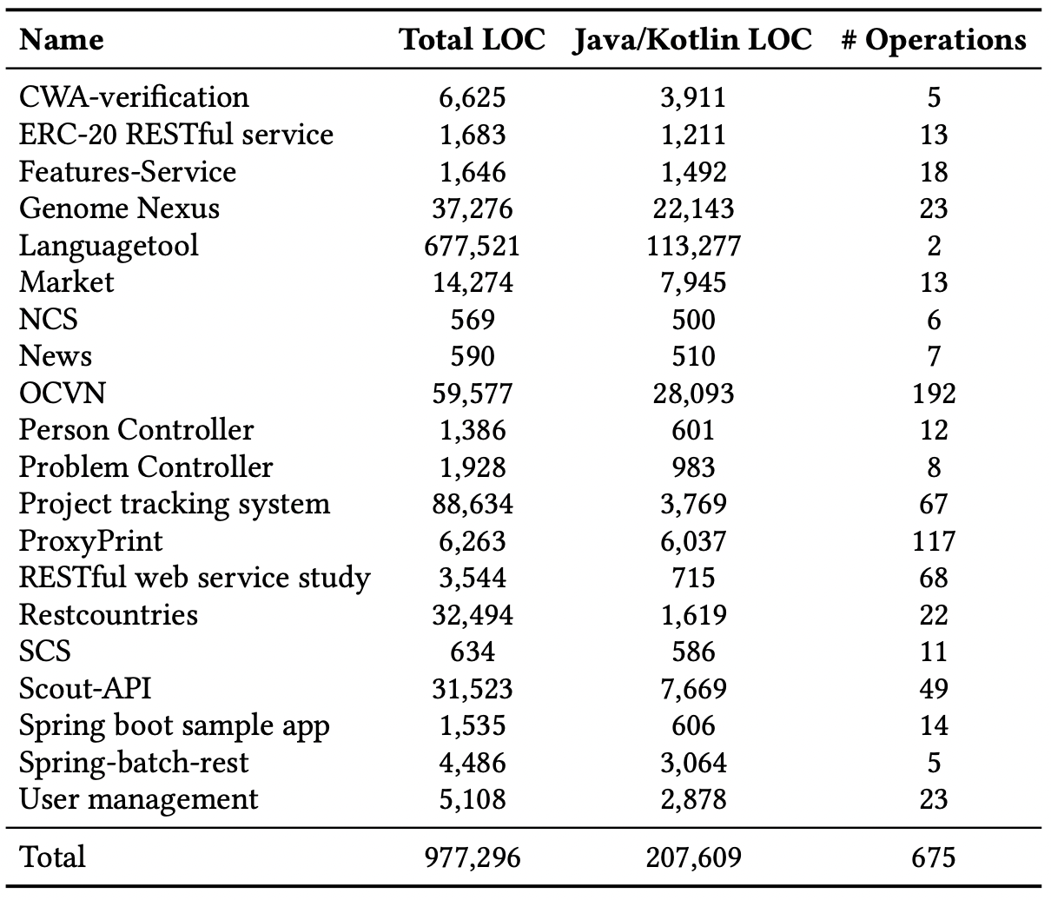
RESTful web services
Notes:
The 20 web services listed in Table , and other software used by the tools and services, including OpenJDK 8, OpenJDK 11, Python 3.8, Node.js 10.19, and .NET framework 5.0. We also set up additional services used by the benchmarks, such as MySQL, MongoDB, and a private Ethereum network. This process was performed by creating an image with all the tools, services, and software installed and then instantiating the image on the cloud machines.
We collected coverage information using the JaCoCo code-coverage library

Slide 10
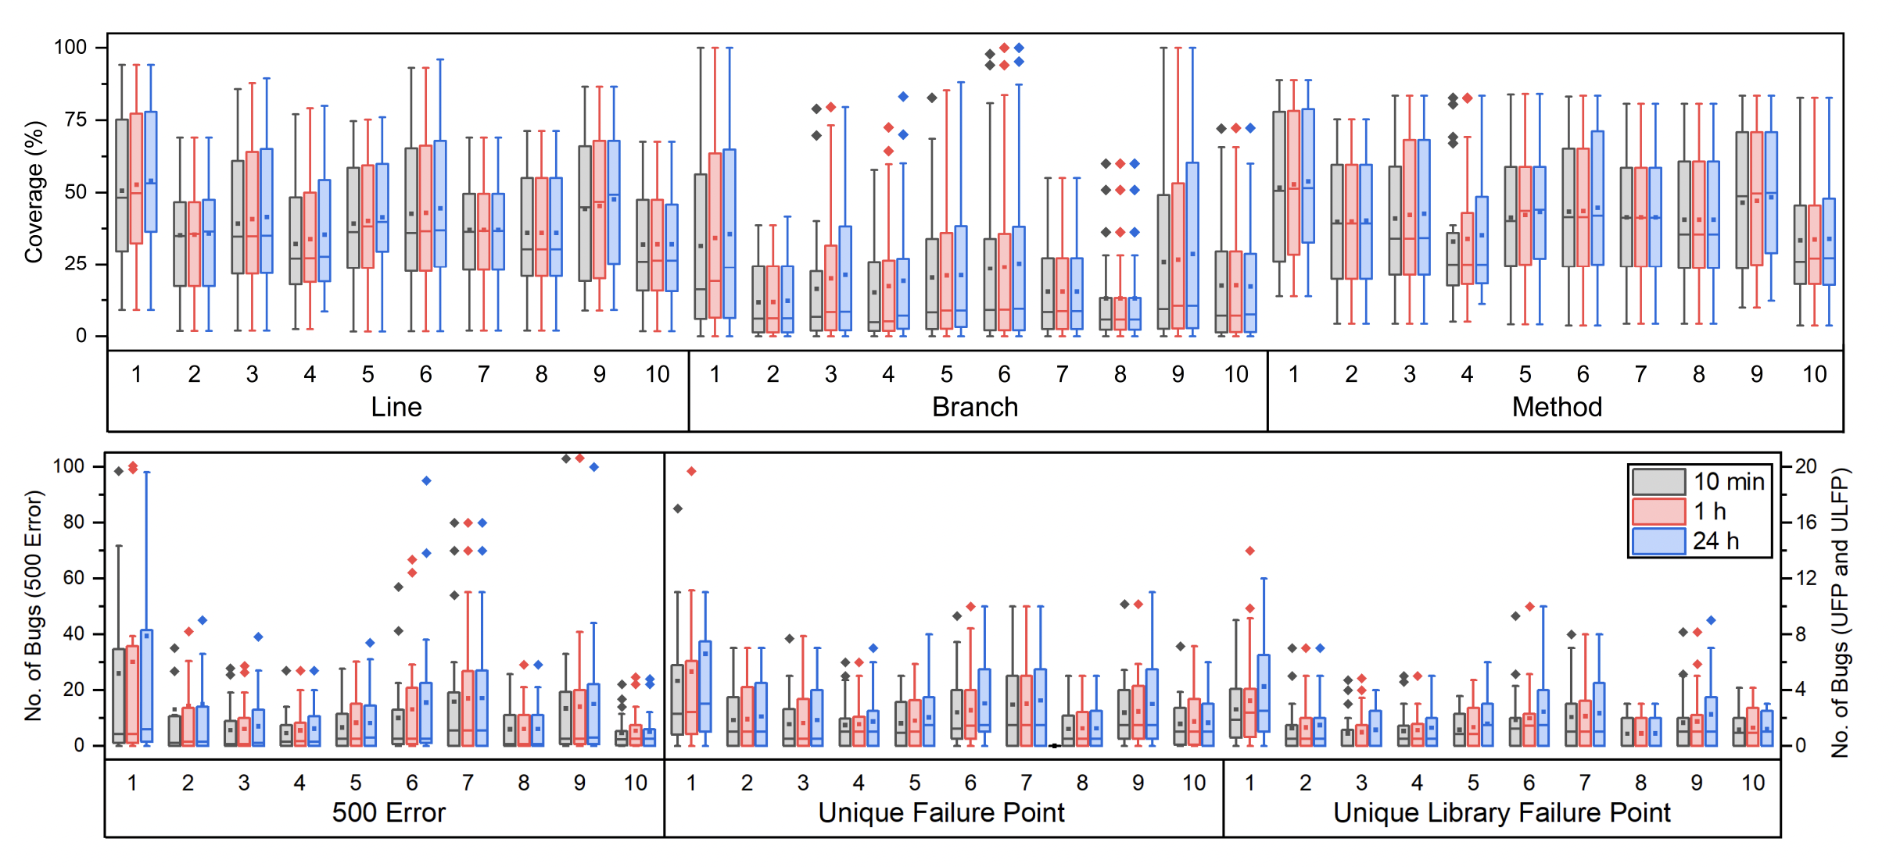
1: EvoMasterWB, 2: RESTler, 3: RestTestGen, 4: RESTest, 5: bBOXRT , 6: Schemathesis, 7: Tcases, 8: Dredd, 9: EvoMasterBB, 10: APIFuzzer
Notes:
Code coverage achieved and number of unique 500 errors, unique failure points, and unique library failure points detected over all services by the ten tools in 10 minutes, 1 hour, and 24 hours (1: EvoMasterWB, 2: RESTler, 3: RestTestGen, 4: RESTest, 5: bBOXRT , 6: Schemathesis, 7: Tcases, 8: Dredd, 9: EvoMasterBB, 10: APIFuzzer).

Slide 11
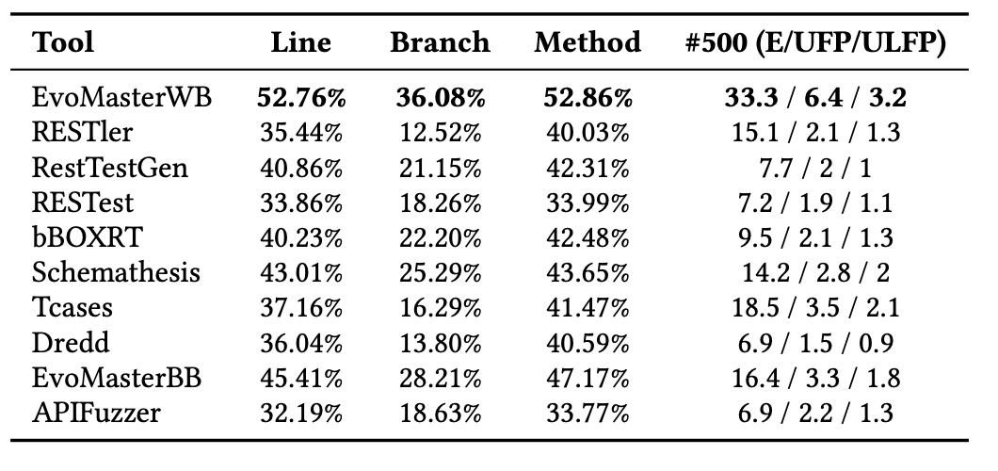
Notes:
Average line, branch, and method coverage achieved and 500 errors found in one hour (E: unique error, UFP: unique failure point, ULFP: unique library failure point).

Slide 12
EvoMaster
Can test a REST API in either white-box or blackbox mode.
Given a REST API and the OpenAPI specification, both tools begin by parsing the specification to obtain the information needed for testing each operation.
EvoMasterWB(v1.3.0)
Testing Approach : White-box
Test-Generation Technique : Evolutionary algorithm
Stateful : Yes
Oracle : Status code
Parameter Generation: Random, Mutation-based, and Dynamic
EvoMasterBB (v1.3.0)
Testing Approach: Black-box
Test-Generation Technique : Random Testing
Stateful : Yes
Oracle : Status code
Parameter Generation: Random
Notes:
EvoMasterBB performs random input generation: for each operation, it produces requests to test the operation with random values assigned to its input parameters.
EvoMasterWB requires access to the source code of the API. It leverages an evolutionary algorithm to produce test cases with the goal of maximizing code coverage. Specifically, for each target (uncovered) branch, it evolves a population of tests by generating new ones while removing those that are the least promising (i.e., have the lowest fitness value) for exercising the branch in each iteration until the branch is exercised or a time limit is reached.

Slide 13
RESTler
RESTler is a black-box technique that produces stateful test cases to exercise “deep” states of the target service.
To achieve this, RESTler first parses the input OpenAPI specification and infers producer-consumer dependencies between operations.
It then uses a search-based algorithm to produce sequences of requests that conform to the inferred dependencies.
RESTler (v8.3.0)
Testing Approach: Black-box
Test-Generation Technique : Dependency-based algorithm
Stateful : Yes
Oracle : Status code
Parameter Generation: Predefined checkers Dictionary-based and Dynamic

Slide 14
RestTestGen
Is another black-box technique that exploits the data dependencies between operations to produce test cases.
RestTestGen(v2.0.0)
Testing Approach: Black-box
Test-Generation Technique : Dependency-based algorithm
Stateful : Yes
Oracle : Status code and response validation
Parameter Generation: Mutation-based, Default, Example-based, Random, and Dynamic

Slide 15
RESTest
Is a model-based black-box input generation technique that accounts for inter-parameter dependencies .
An interparameter dependency specifies a constraint among parameters in an operation that must be satisfied to produce a valid request.
RestTestGen(latest commit)
Testing Approach: Black-box
Test-Generation Technique : Model-based testing
Stateful : No
Oracle : Status code and response validation
Parameter Generation: Constraint-solving-based, Random, and Mutation-based

Slide 16
Schemathesis
Is a black-box tool that performs property based testing (using the Hypothesis library).
It performs negative testing and defines five types of oracles to determine whether the response is compliant with its defined schema based on status code, content type, headers, and body payload.
Schemathesis(v3.12.3)
Testing Approach: Black-box
Test-Generation Technique : Property-based testing
Stateful : Yes
Oracle : Status code and response validation
Parameter Generation: Random and Example-based

Slide 17
Dredd
Is another open-source black-box tool that validates responses based on status codes, headers, and body payloads .
For input generation, Dredd uses sample values provided in the specification (e.g., examples, default values, and enum values) and dummy values.
Dredd( v14.1.0)
Testing Approach: Black-box
Test-Generation Technique : Sample-value-based testing
Stateful : No
Oracle : Status code and response validation
Parameter Generation: Example-based, Enum-based, Default, and Dummy

Slide 18
Tcases
Is a black-box tool that performs model-based testing.
It takes as input an OpenAPI specification and automatically constructs a model of the input space that contains key characteristics of the input parameters specified for each operation (e.g., a characteristic for an integer parameter may specify that its value is negative)
Dredd(v3.7.1)
Testing Approach: Black-box
Test-Generation Technique : Model-based testing
Stateful : No
Oracle : Status code
Parameter Generation: Random or Example-based

Slide 19
bBOXRT
Is a black-box tool that aims to detect robustness issues of REST APIs.
Given a REST API and its OpenAPI specification, the tool produces two types of inputs, valid and invalid, for robustness testing.
It first uses a random approach to find a set of valid inputs whose execution can result in a successful (i.e., 2xx) status code
bBOXRT
Testing Approach: Black-box
Test-Generation Technique : Robustness testing
Stateful : No
Oracle : Status code and behavioral analysis
Parameter Generation: Random and Mutation-based

Slide 20
APIFuzzer
Is a black-box tool that performs fuzzing of REST APIs.
Given a REST API and its specification, APIFuzzer first parses the specification to identify each operation and its properties.
It generates random requests conforming to the specification to test each operation and log its status code.
APIFuzzer
Testing Approach: Black-box
Test-Generation Technique : APIFuzzer
Stateful : No
Oracle : Status code
Parameter Generation: Random and Mutation-based

