Slide 1
Simple Image Filter Application (“Mini Photoshop”)
Course: SEN 281 – Computer Vision
Student Name:
Edwin Beneth Ugochukwu
Matric Number: VUG/SEN/24/11406
Institution: Veritas University Abuja

Slide 2
Problem Statement
Many users require a simple and lightweight application to apply basic image enhancements such as grayscale conversion, blur, sharpening, and edge detection. However, existing image editing tools are complex, expensive, and difficult for beginners.

Slide 3
Proposed Solution
- Develop a Windows desktop application using Python
- Use OpenCV for image processing
- Use Tkinter for graphical user interface
- Provide real-time preview of filters
- Allow saving of edited images

Slide 4
System Workflow / Methodology
1. Launch application
2. Load image
3. Select filter
4. Process image using OpenCV
5. Display output
6. Save image

Slide 5
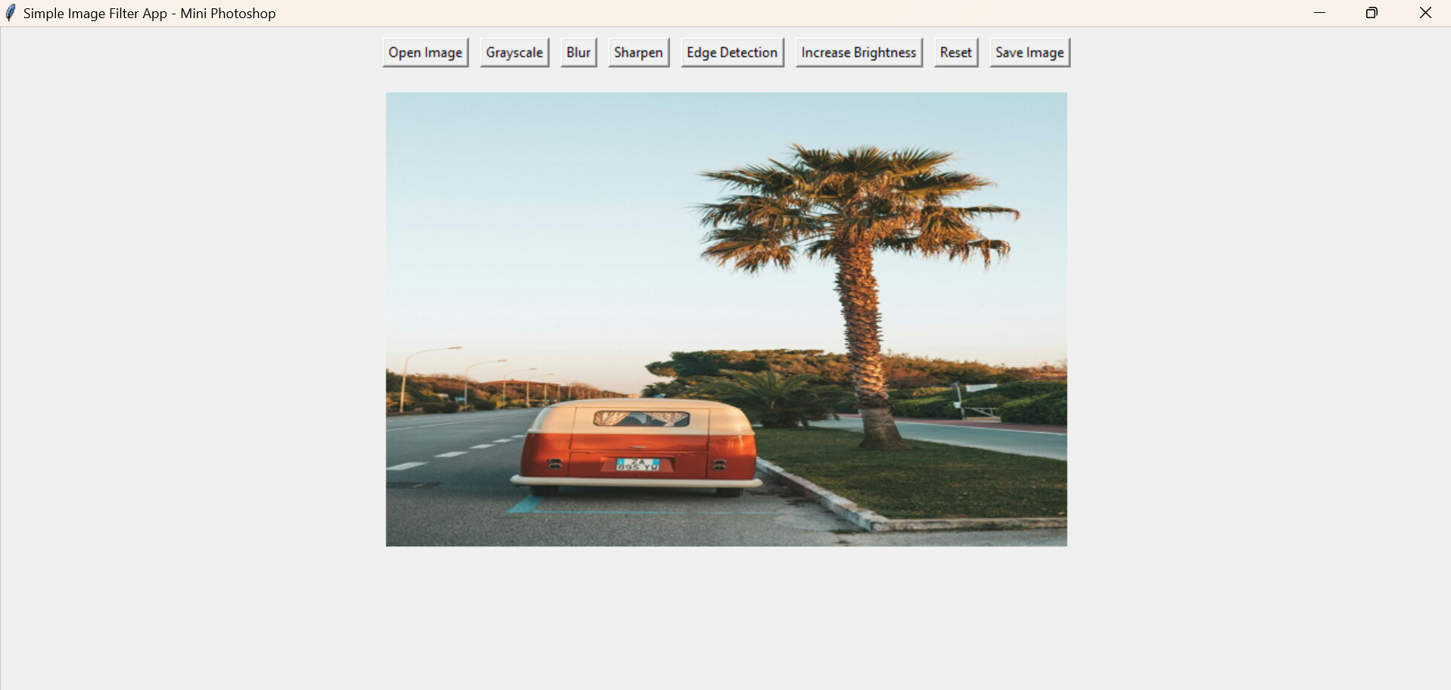
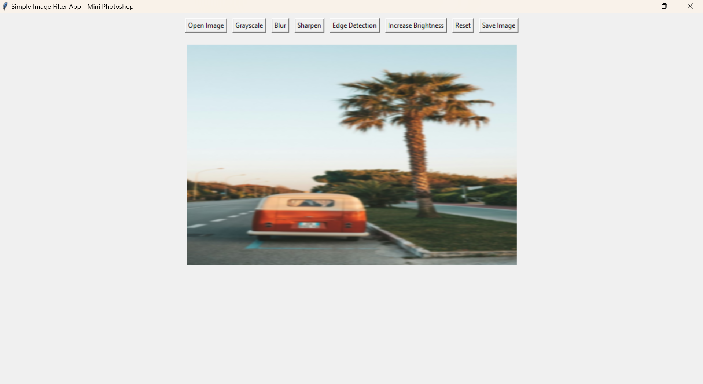
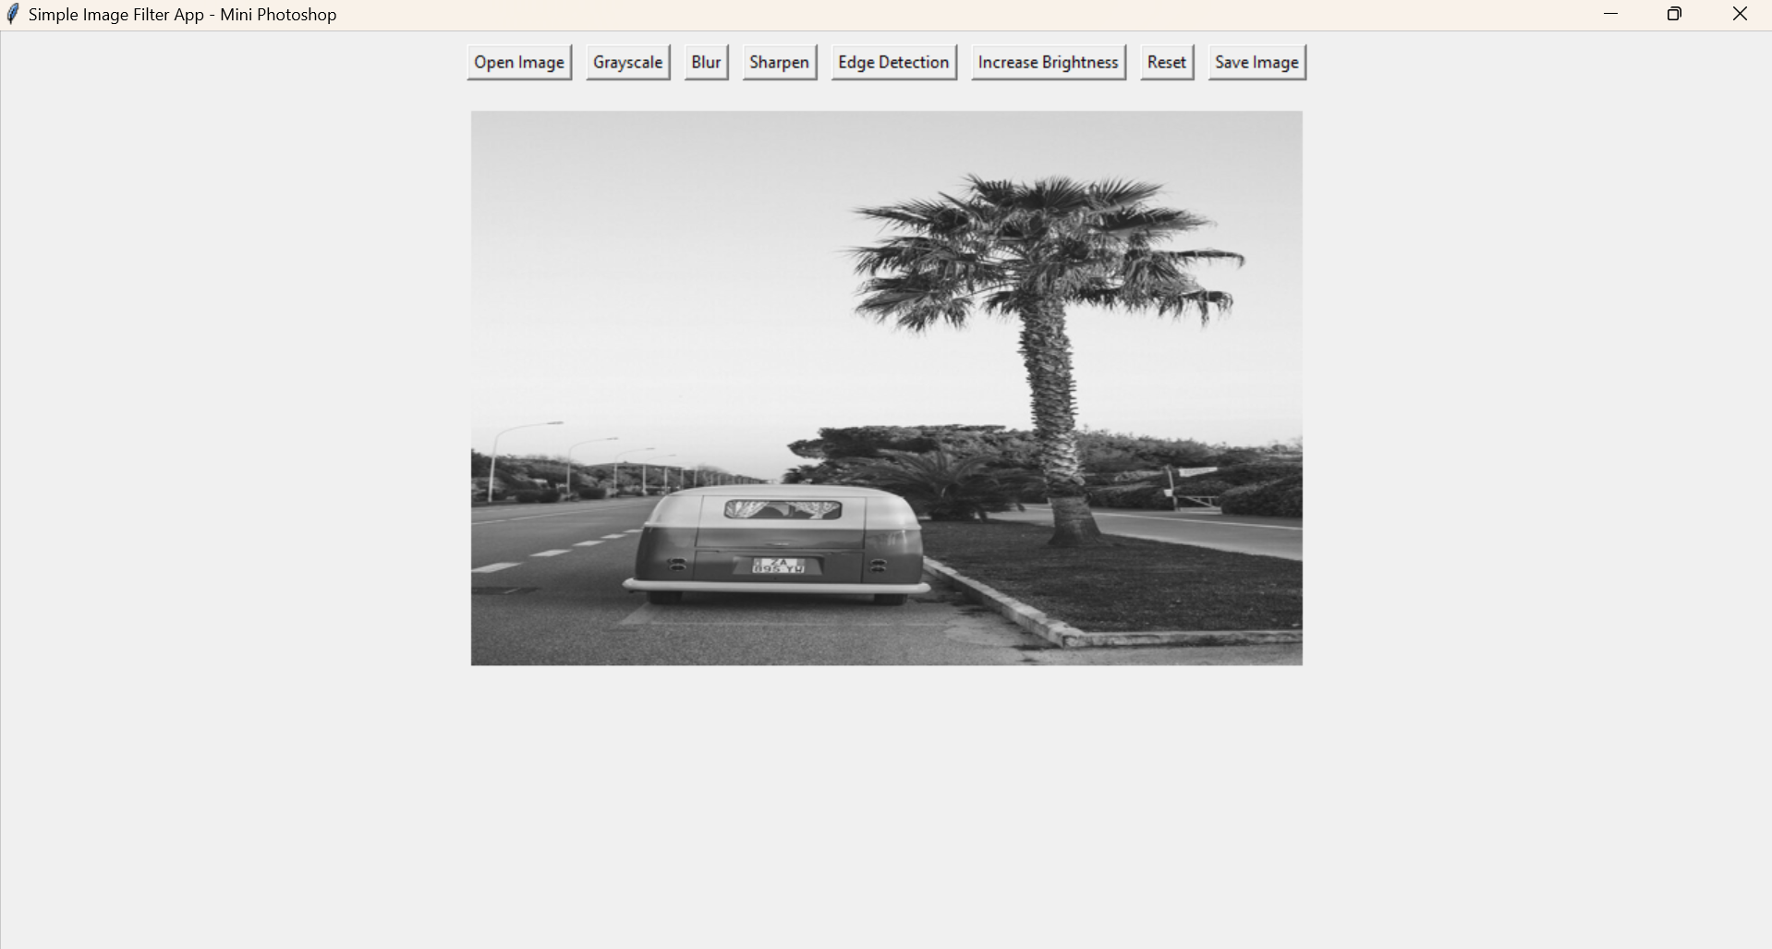
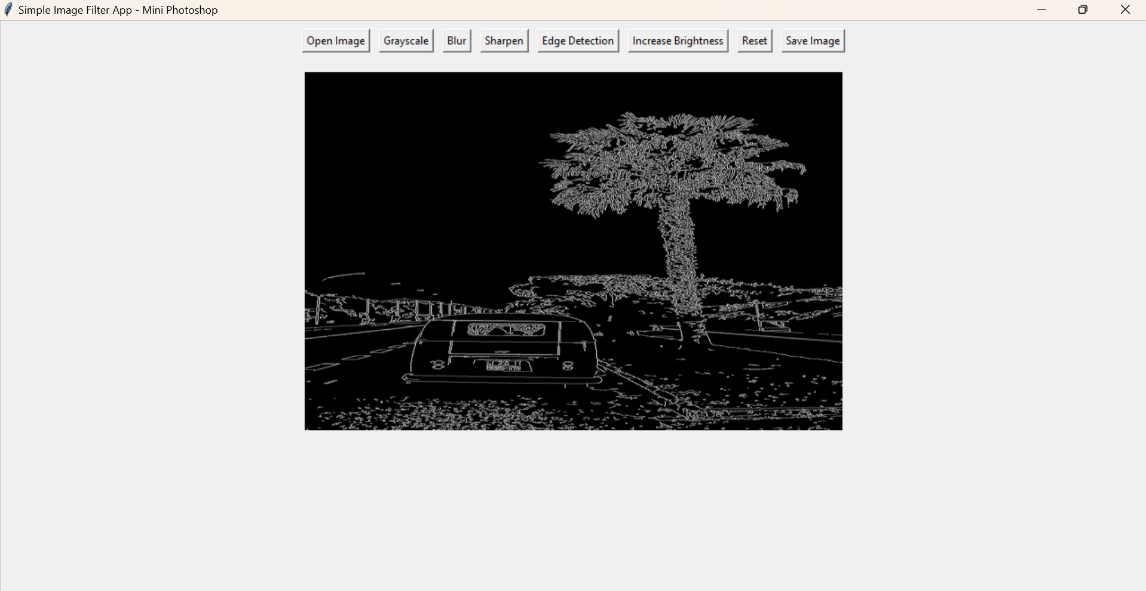
Results and Screenshots
The interface
Blur
Grayscale
Edge Detection

Slide 6
Conclusion
The Simple Image Filter Application successfully demonstrates the application of computer vision techniques for basic image enhancement in a simple and user-friendly manner.

Slide 7
Limitations
- Limited to basic image filters
- No undo/redo functionality
- Desktop application only

