Slide 1
Prediction of different Types of Crops based on soil Nutrients.
Minor Project (IT479M) End-Semester Evaluation
Presented by
Verma Ayush (211IT079-2110505)
Under the guidance of
Dr.Geetha V
Assistant Professor
National Institute of Technology Karnataka, Surathkal
Department of Information Technology
National Institute of Technology Karnataka, Surathkal-575025

Slide 2
CONTENTS
Introduction
Literature Survey
Outcomes of Literature Survey
Problem statement and Objectives
Methodology
Experimental Results and Discussion
User Interface Design
Conclusions and Future Work
References
Timeline of the Major Project

Slide 3
Introduction
1)Soil Nutrient Profiles: Key factors like N, P, K, pH, EC, and trace elements (Cu, Fe, Mn, Zn, B) impact crop yield.
2)Objective: Identifying different types of crops based on given soil nutrients.
3)Machine Learning Role: ML models (e.g., Decision Trees, SVMs) predict crop suitability from soil data.
4)Applications: Enhance resource efficiency, support crop selection, and foster sustainable farming.

Slide 4
Literature Survey
Sr.No | Authors Name | Key-Focus | Findings/Contributions
1. | Rajesh, N. W. G. S. D., and team. Agriculture Systems, vol. 5, no. 2, pp. 48-55, 2022. | IoT-enabled soil nutrient monitoring and machine learning-based crop recommendations. | Demonstrates IoT and AI’s role in precision farming by optimizing fertilizer use and improving productivity.
2. | Liu, A. M. D., L. Wang, and Z. Chen. MDPI Journal of Soil Science, vol. 15, no. 4, pp. 112-125, 2023. [Online]. Available: MDPI.com | Review of machine learning models like SVM and decision trees for predicting soil nutrients. | Highlights the impact of ML on soil management and precision agriculture.
3. | Singh, K. A. S., S. K. Shukla, and A. S. Jain. International Journal of Agricultural Informatics, vol. 23, no. 1, pp. 78-92, 2022. [Online]. Available: JAIagri.com | Application of machine learning for crop suitability prediction based on soil nutrient profiles. | Demonstrates AI's effectiveness in optimizing crop selection, increasing yield, and reducing resource use.

Slide 5
Literature Survey (Contd.)
Sr.No | Authors Name | Key Focus | Findings/Contributions
4. | Patel, J. B., P. R. Sharma, and D. Sharma. Soil Science & Technology, vol. 10, pp. 34-42, 2023. | Machine learning for soil nutrient analysis and crop yield prediction. | Helps farmers assess soil fertility accurately, optimizing fertilizer use and crop production.
5. | Das, G. K., and M. V. R. D. V. Kumar. Journal of Agricultural Sciences, vol. 74, pp. 45-51, 2020. [Online]. Available: ResearchGate.net | Optimization of Extreme Learning Machine (ELM) parameters for soil nutrient classification. | Enhances accuracy of soil nutrient prediction (e.g., nitrogen, phosphorus), improving crop management and soil health.
6. | Prakash, S. T., S. Ravi, and P. Kumar. Sustainable Agriculture Journal, vol. 12, pp. 102-108, 2022. | Integration of AI and machine learning in soil analysis for sustainable farming. | Automates soil nutrient assessments, reducing chemical dependency and improving crop management and sustainability.
7. | Jadhav, M. T., A. R. Rao, and H. P. Singh. Precision Farming Review, vol. 8, no. 6, pp. 201-209, 2021. [Online]. Available: PrecisionAgriculture.com | Machine learning for crop recommendation based on soil nutrient data. | Optimizes crop choice, boosts yield, reduces costs, and showcases practical applications of AI in precision agriculture.

Slide 6
Outcomes of Literature Survey
1)ML and IoT Integration: Advances in machine learning (ML) and IoT optimize soil nutrient management and crop recommendations.
2)ML Models: Decision trees, support vector machines (SVMs), and extreme learning machines (ELMs) predict soil nutrients and improve crop yield predictions.
3)Key Parameters: Analysis of soil pH, nitrogen, and phosphorus supports precise resource allocation and sustainable farming.
4)IoT Systems: Real-time soil monitoring via IoT provides accurate crop and fertilizer recommendations.
5)Sustainable Farming: AI, ML, and IoT convergence enhances productivity, efficiency, and environmental sustainability.

Slide 7
Problem Statement and Objectives
1.Problem Statement:
Determining the optimal crop based on soil and environmental parameters is crucial for maximizing agricultural productivity. This project develops a machine learning-based system to predict suitable crops (Grapes, Mango, Mulberry, Potato, Ragi, Pomegranate) using key soil data through an interactive user interface.
2.Objectives:
a)To design a machine learning-based system that predicts the most suitable crop using soil parameters such as N, P, K, pH, EC, S, Cu, Fe, Mn, Z, B.
b)To develop a user-friendly interface for seamless input of soil data and real-time crop suitability predictions.

Slide 8
Methodology
A. Key Features of the Dataset:
• Dataset Name: Soil Nutrient Profile Dataset for Crop Classification.
• Size: 2,120 * 12 (2,120 rows, 12 columns).
• Features: N (Nitrogen), P (Phosphorus), K (Potassium), pH, EC (Electrical Conductivity), S (Sulfur), Cu (Copper), Fe (Iron), Mn (Manganese), Zn (Zinc), B (Boron), and Label (Crop Type).
• Labels: Grapes, Mango, Mulberry, Potato, Ragi, and Pomegranate.

Slide 9
Methodology (Contd.)
B. Data Preprocessing:
• Statistical Summary: Descriptive statistics were generatedusing df.describe() to understand feature distributions and ranges.
• Label Encoding: The crop labels were encoded into numeric values with LabelEncoder, producing a new column, label encoded. The encoder mapping was displayed to understand the conversion.
• Label encoding mapping: grapes -> 0
mango -> 1
mulberry -> 2
pomegranate -> 3
potato -> 4
ragi -> 5

Slide 10
Methodology (Contd.)
C. Exploratory Data Analysis (EDA):
• For exploratory data analysis (EDA), we began by visualizing the distribution of each feature through histograms, which allowed us to assess their spread and identify any skewness or potential outliers.
• To examine relationships between features, we generated a correlation matrix and visualized it using a heatmap.
• Finally, we used a count plot to display the distribution of crop labels, providing a clear view of the balance across crop types in the dataset.

Slide 11
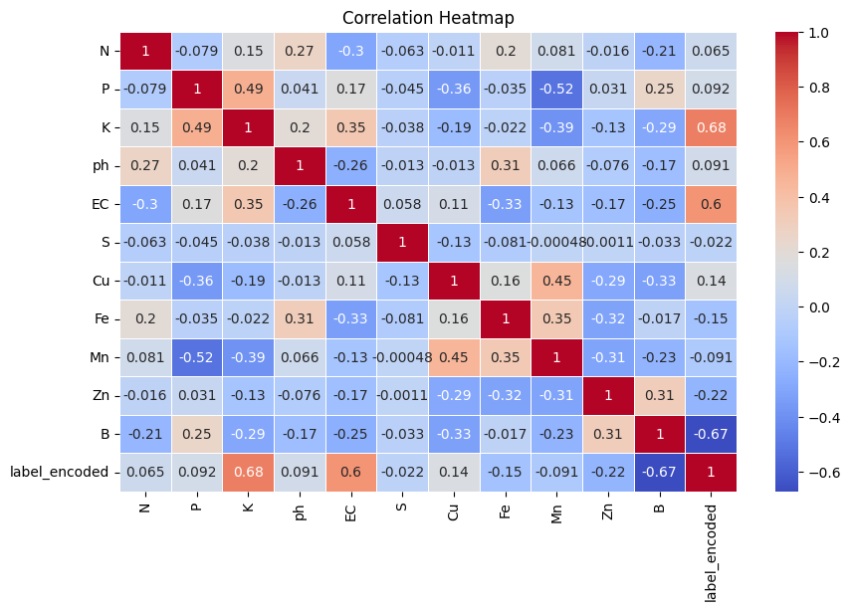
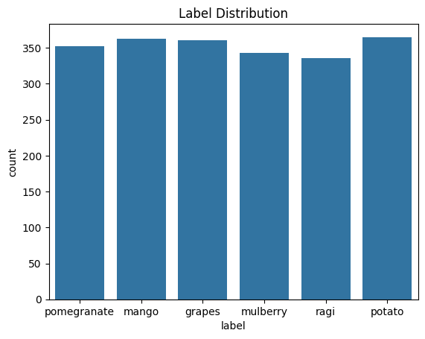
Methodology (Contd.)

Slide 12
Methodology (Contd.)
D. Feature Scaling:
• Feature Standardization: Scaled numerical features using StandardScaler (mean=0, std=1) for better model performance.
• Consistency & Preprocessing: Saved scaler as scalar.pkl and created df_preprocessed with scaled features and encoded labels.
E. Data Spliting:
• Features (X) and labels (y) were separated for model training.
• The data was split into 80% training and 20% testing sets using train test split, ensuring balanced label distribution with stratify=y.

Slide 13
Methodology (Contd.)
F. Model Training and Evaluation:
Five ML algorithms and 1 DL algorithms were trained and evaluated:
• Decision Tree
• Random Forest
• Extra Trees
• XGBoost
• Multilayer Perceptron.

Slide 14
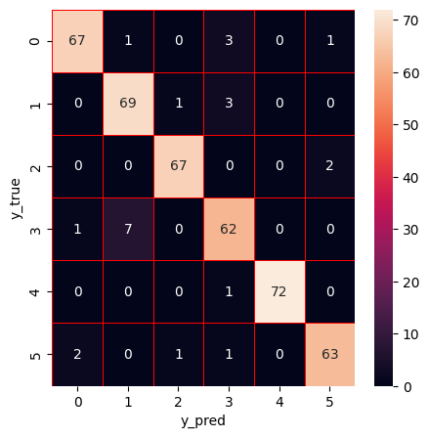
Methodology (Contd.)
Decision Tree:
• This model splits data based on feature thresholds to maximize information gain, creating a tree of decision nodes.
• Each path from root to leaf represents a set of conditions leading to a classification.
• It’s simple and interpretable.Model performance was measured, and a confusion matrix was plotted.

Slide 15
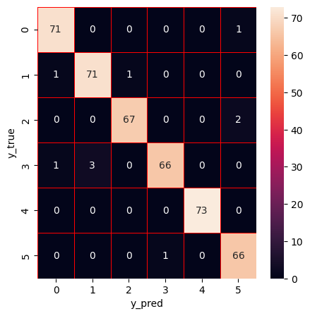
Methodology (Contd.)
Random Forests:
• Random forests build multiple decision trees on random data subsets and features, thencombine their predictions through voting.
• This ensemble approach reduces overfitting and improves accuracy by averaging multiple models.
• Model performance metrics and confusion matrix were obtained.

Slide 16
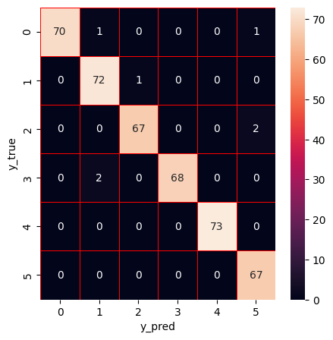
Methodology (Contd.)
Extra Trees:
• Extra Trees create multiple decision trees, but with randomized feature splits for added diversity.
• This randomness reduces variance, making it faster and often more accurate for noisy data than regular decision trees.
• Performance metrics and confusion matrix were analyzed.

Slide 17
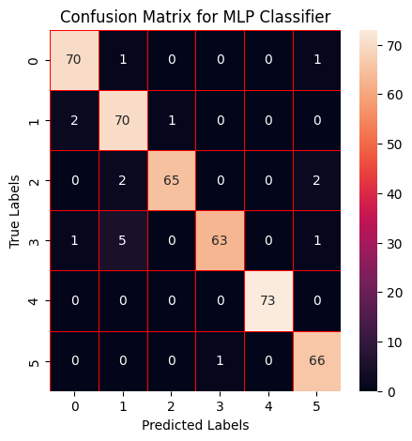
Methodology (Contd.)
Multilayered Perceptron :
• An MLP neural network passes inputs through multiple hidden layers, each applying weights and activations to learn patterns and also uses softmax Functions.
• Backpropagation adjusts weights to minimize errors, allowing it to handle complex data relationships.
• Metrics and confusion matrix were generated for performance assessment.

Slide 18

Methodology (Contd.)
XG Boost:
• XGBoost sequentially builds decision
trees, with each new tree correcting errors of the previous ones.
• It uses gradient boosting to optimize performance,with built-in regularization to reduce overfitting.
• Metrics and confusion matrix were generated for model evaluation.

Slide 19
Methodology (Contd.)
G. Model Stacking for Ensemble Learning:
• Predictions from each of the trained models on the training data were stored in base predictions train.
• This ensemble can be extended to create a stacked model combining predictions from each base learner for improved performance.
H. Model Export:
• Each trained model was serialized using pickle and saved as a .pkl file. This enables reuse without retraining, facilitating model deployment.
• The models were loaded from .pkl files to verify that they could be successfully restored and used for prediction.

Slide 20
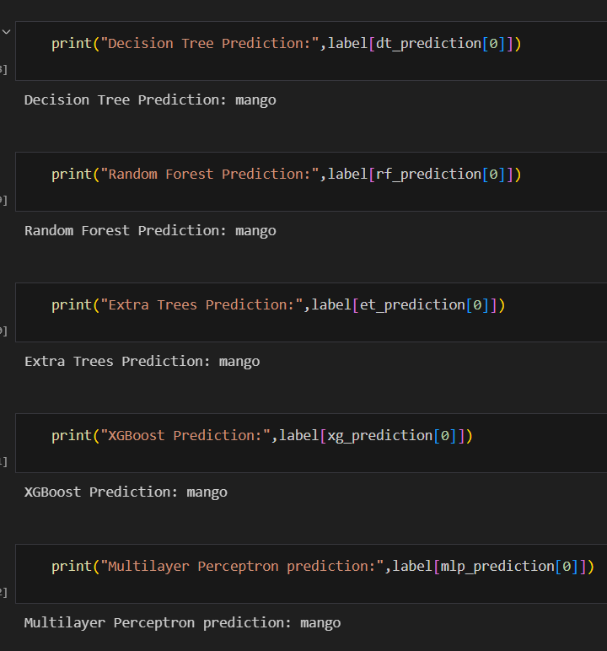
Methodology (Contd.)
I. Model Prediction on sample input:
• A function scale input row was defined to transform new input rows based on the trained scaler.
• A sample input representing soil nutrient levels was scaled.
• Each of the five models was used to predict the crop type based on the scaled sample input.
• The model predictions were outputted, showcasing each model’s suggested crop type for the input conditions.
• sample_input = [106.45360486265058, 85.8445733844807, 195.67329503888843, 7.31083990770808, 1.0060845424896434, 0.2743182155004966, 11.47665277548555, 151.55595469270216, 46.59783810755304, 30.650411458830817, 63.90416308449554]

Slide 21
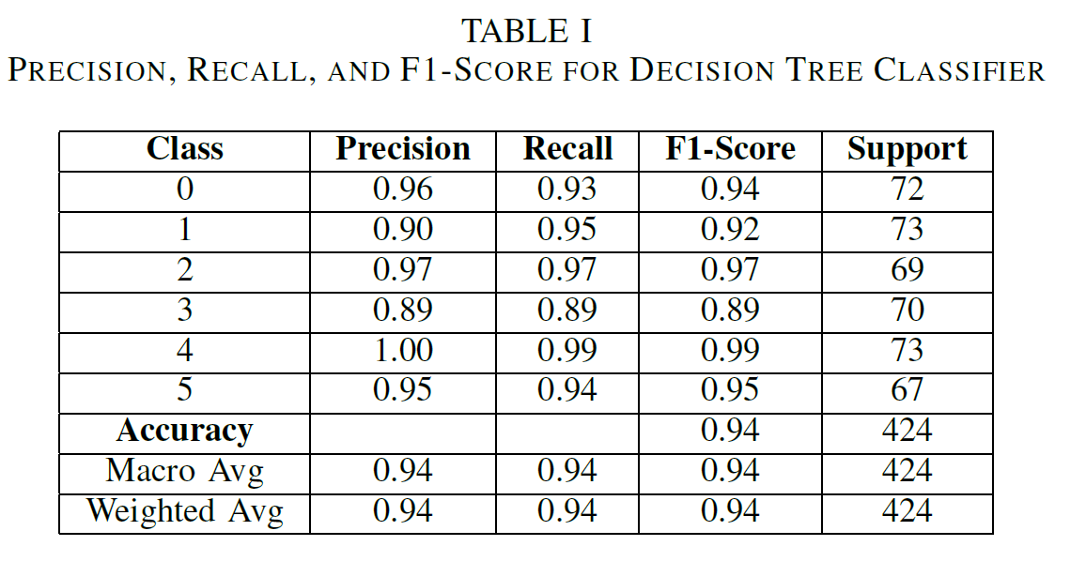
Experimental Result and Discussion
A. Decision Tree:
• Accuracy of Decision Tree: 0.943
• Precision of Decision Tree: 0.94
• Recall of Decision Tree: 0.94
• F1-score of Decision Tree: 0.94

Slide 22
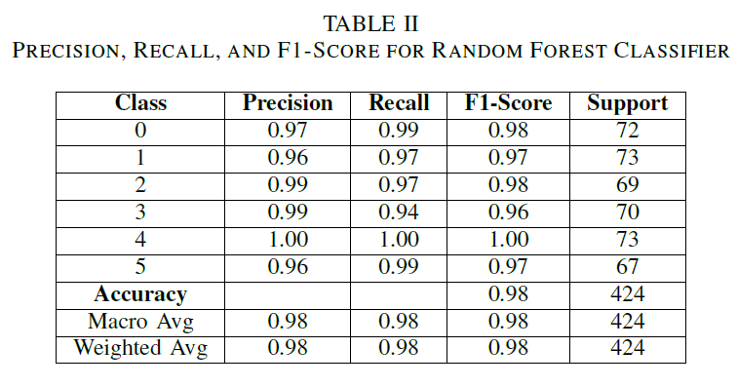
Experimental Result and Discussion
B. Random Forest:
• Accuracy of Random Forest: 0.976
• Precision of Random Forest: 0.976
• Recall of Random Forest: 0.976
• F1-score of Random Forest: 0.976

Slide 23
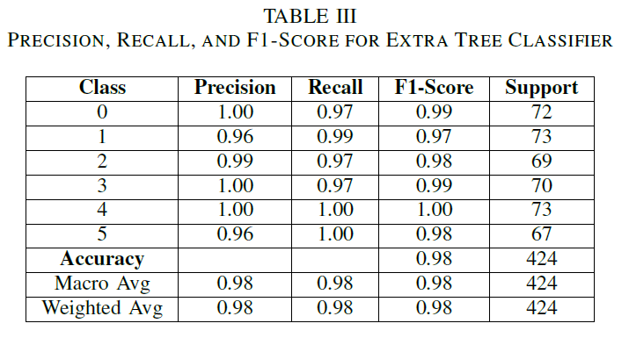
Experimental Result and Discussion
C. Extra Trees:
• Accuracy of Extra Trees: 0.983
• Precision of Extra Trees: 0.983
• Recall of Extra Trees: 0.983
• F1-score of Extra Trees: 0.983

Slide 24
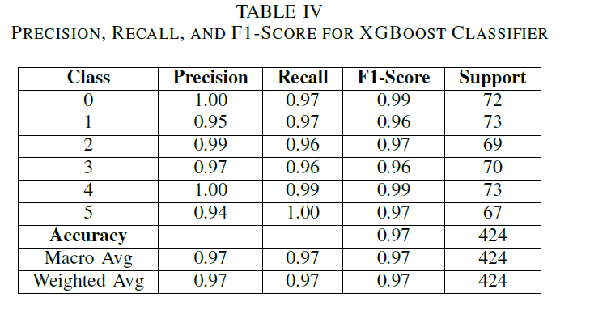
Experimental Result and Discussion
D. XG Boost:
• Accuracy of XGBoost: 0.974
• Precision of XGBoost: 0.974
• Recall of XGBoost: 0.974
• F1-score of XGBoost: 0.974

Slide 25
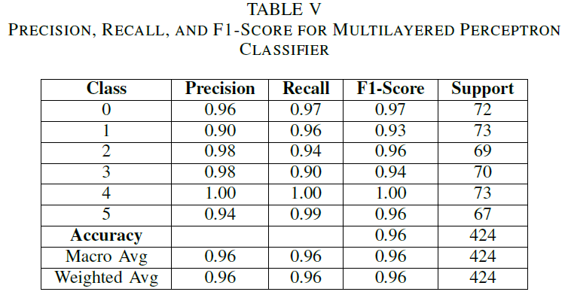
Experimental Result and Discussion
E. Multilayered Perceptron:
• Accuracy of MLP Classifier: 0.959
• Precision of MLP Classifier: 0.961
• Recall of MLP Classifier: 0.959
• F1-score of MLP Classifier: 0.959

Slide 26
User Interface Design
1) Tools Used: The user interface is built using HTML and CSS for design, with Flask as the backend framework to integrate machine learning models and handle data processing.
2) Features: The interface allows users to input soil parameters easily and displays the predicted crop in real-time, ensuring an intuitive and responsive experience.
3) Requirements: A web browser to access the interface, a Flask server for backend operations, and trained machine learning models to process inputs and generate predictions.

Slide 27
User Interface Design
• The input dataset includes key agricultural parameters like N, P, K, pH, EC, S, Cu, Fe, Mn, Zn, and B for crop suitability analysis.
• Machine learning models analyze these features to predict crop types, ensuring data-driven agricultural decisions.
• The 2 Figures illustrate parameter relationships and their influence on crop predictions for enhanced clarity.

Slide 28
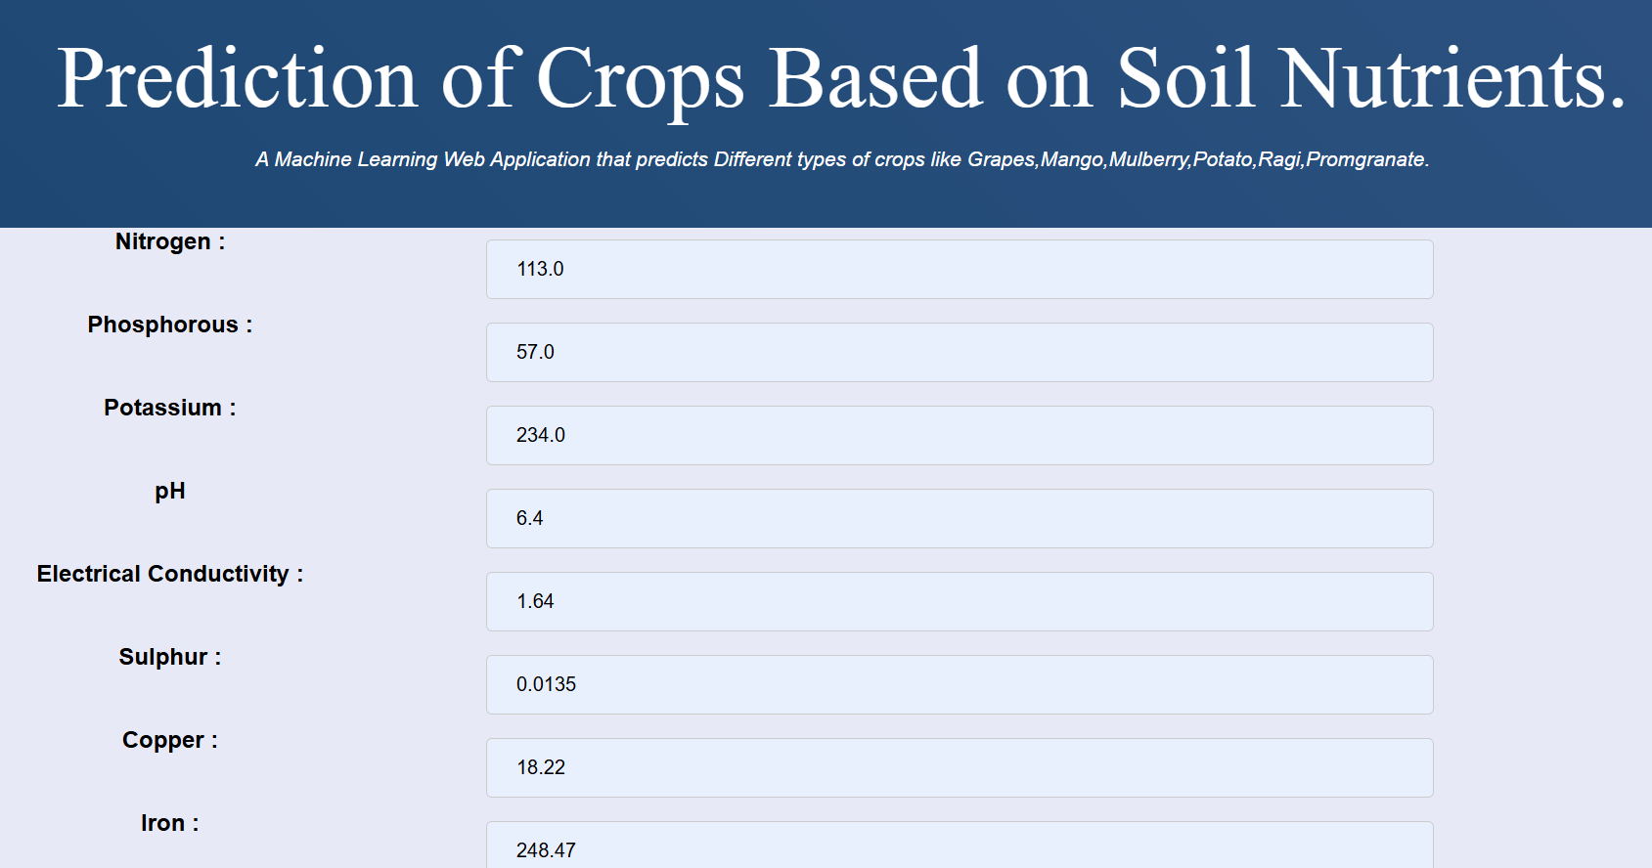
User Interface Design

Slide 29
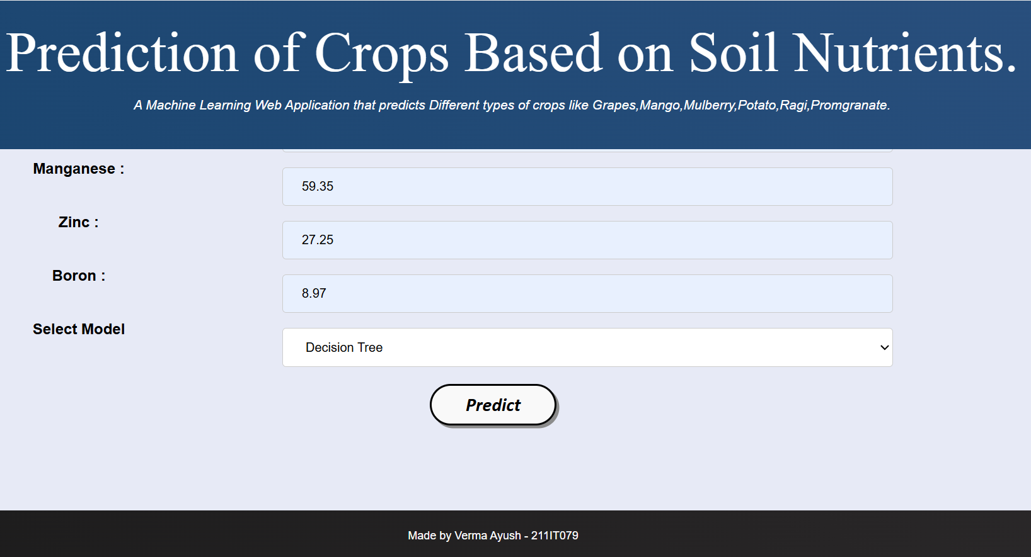
User Interface Design

Slide 30
User Interface Design
1)The system predicts any one out of six crops: Grapes, Mango, Mulberry, Potato, Ragi, and Pomegranate, based on input parameters.
2)Machine learning models like Decision Tree, Extra Trees, Multilayer Perceptron, Random Forest, and XGBoost power the predictions.
3)Output visualizations can be generated for all 5 ML models, showcasing their performance and insights for decision-making.

Slide 31
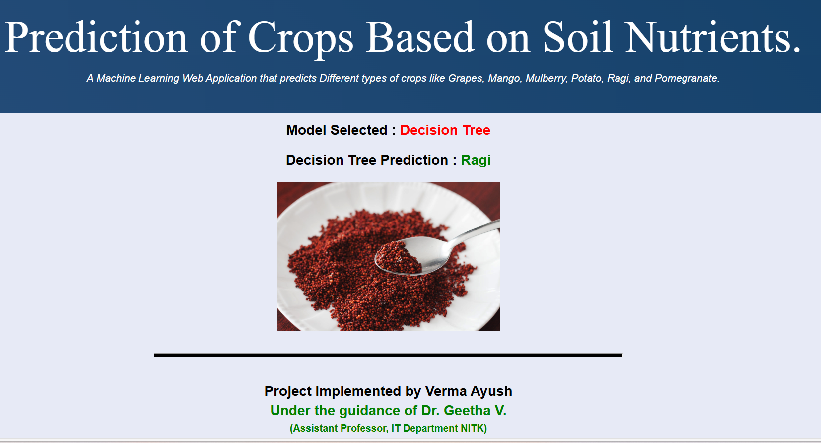
User Interface Design

Slide 32

User Interface Design

Slide 33
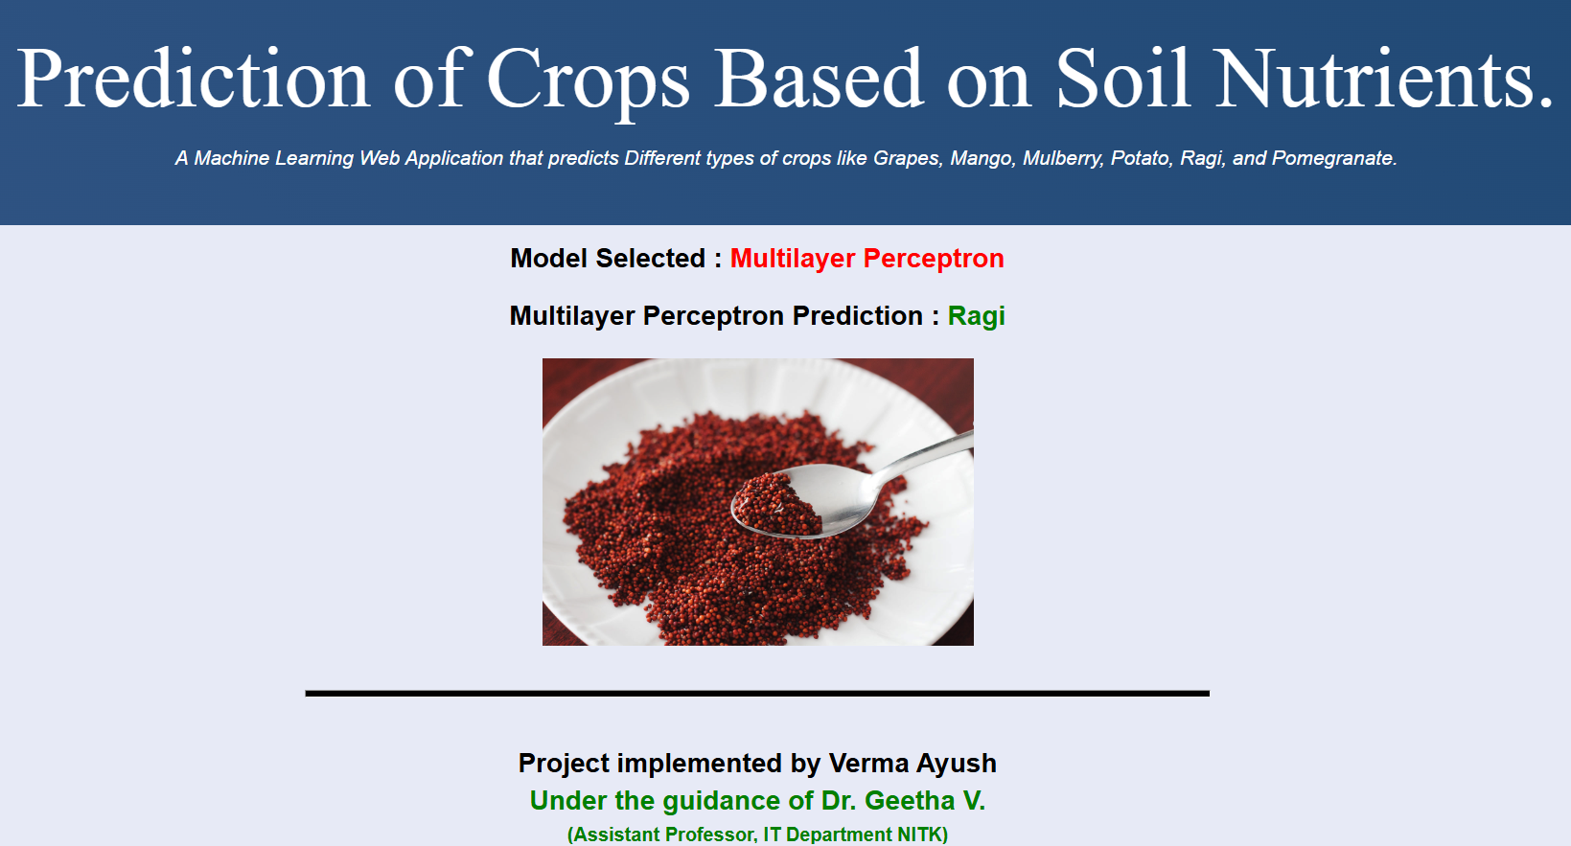
User Interface Design

Slide 34
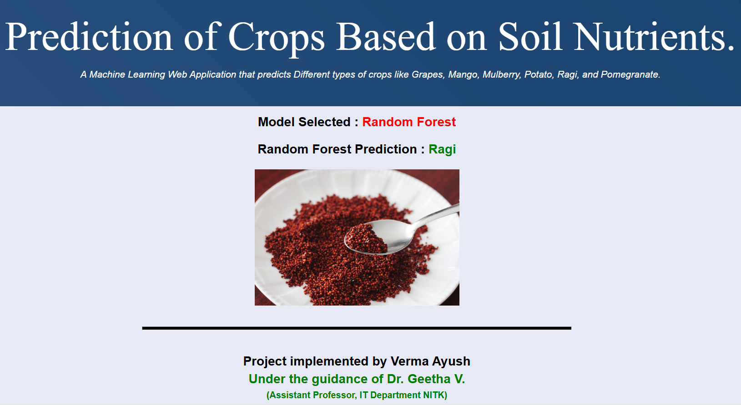
User Interface Design

Slide 35
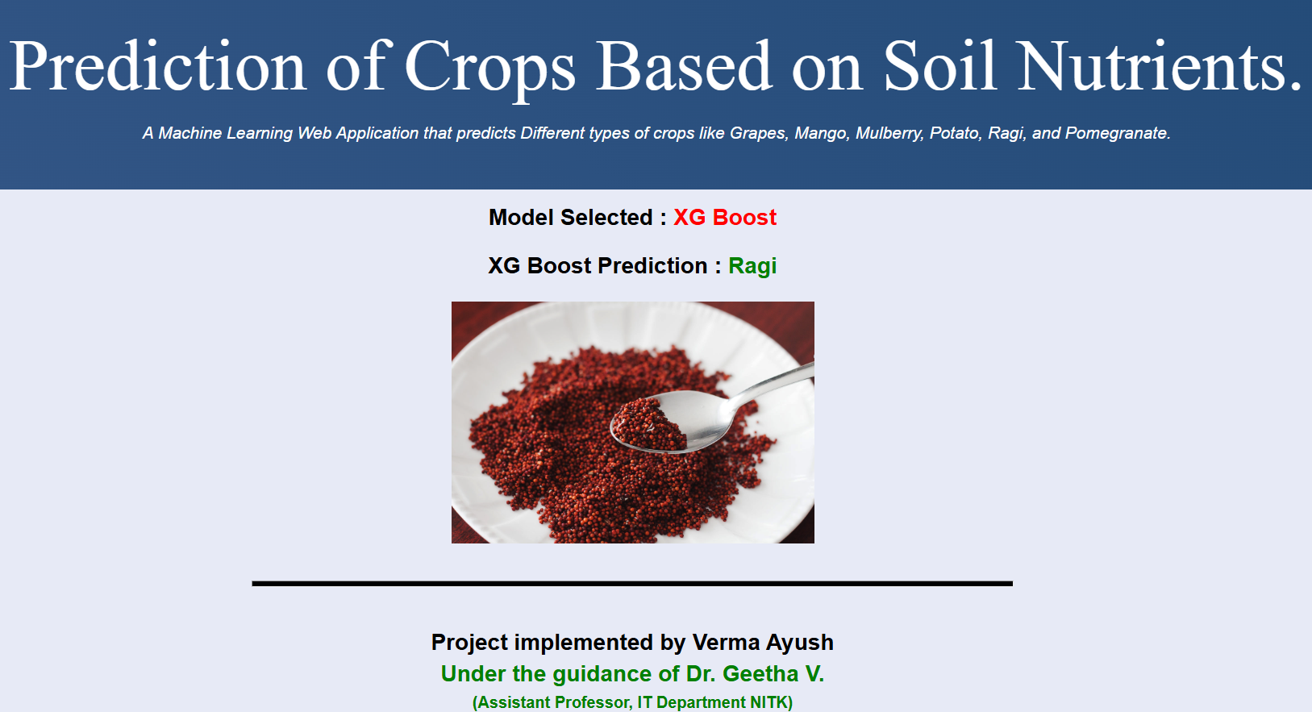
User Interface Design

Slide 36
Conclusion and Future Work
Conclusion:
Machine learning and deep learning models, including Decision Trees, Random Forest, Extra Trees, XGBoost, and Multilayer Perceptron, effectively predicted optimal crops based on soil nutrient data.
Preprocessing steps, ensemble techniques, and evaluation metrics enhanced the models’ prediction accuracy.
The study highlights the potential of AI-driven systems to improve crop management and promote sustainable farming practices.
Future Work:
Incorporate additional data sources like climate, water availability, and real-time IoT inputs for dynamic crop recommendations.
Explore advanced deep learning models such as CNNs and RNNs to improve prediction capabilities.
Broaden the scope to include more crops, regions, and advanced techniques like stacking and boosting for better scalability and accuracy.

Slide 37
References
[1] N. W. G. S. D. Rajesh et al., ”IoT-Enabled Soil Nutrient Analysis and Crop Recommendation Model for Precision Agriculture,” Agriculture Systems, vol. 5, no. 2, pp. 48-55, 2022.
[2] A. M. D. Liu, L. Wang, and Z. Chen, ”Exploring Machine Learning Models for Soil Nutrient Properties Prediction: A Systematic Review,” MDPI Journal of Soil Science, vol. 15, no. 4, pp. 112-125, 2023. [Online]. Available: https://www.mdpi.com/2096-1993/15/4/112.
[3] K. A. S. Singh, S. K. Shukla, and A. S. Jain, ”Crop Classification and Prediction Based on Soil Nutrition Using
Machine Learning,” International Journal of Agricultural Informatics, vol. 23, no. 1, pp. 78-92, 2022. [Online]. Available: https://www.jaiagri.com/soil-classification.
[4] J. B. Patel, P. R. Sharma, and D. Sharma, ”Soil Nutrient Assessment and Crop Estimation with Machine Learning,” Soil Science & Technology, vol. 10, pp. 34-42, 2023.
[5] G. K. Das and M. V. R. D. V. Kumar, ”Improving the Prediction Accuracy of Soil Nutrient Classification by Optimizing Extreme Learning Machine Parameters,” Journal of Agricultural Sciences, vol. 74, pp. 45-51, 2020. [Online]. Available: https://www.researchgate.net/publication/341049861.
[6] S. T. Prakash, S. Ravi, and P. Kumar, ”AI and Machine Learning for Soil Analysis: An Assessment of Sustainable Solutions,” Sustainable Agriculture Journal, vol. 12, pp. 102- 108, 2022.
[7] M. T. Jadhav, A. R. Rao, and H. P. Singh, ”Crop Recommendation by Analyzing Soil Nutrients Using Machine Learning,” Precision Farming Review, vol. 8, no. 6, pp. 201-209, 2021. [Online]. Available: https://www.precisionagriculture.com.

Slide 38
Thank You

