Slide 1
ACTS Management System
Project Portfolio
Divyansh Verma
Project Associate
C-DAC Bangalore
Role: Full-Stack Developer (UI / Backend / Database)

Slide 2
Project Overview
Enterprise-level ERP system for PG-Diploma student lifecycle management.
Developed at C-DAC Bangalore.
Manages registration, verification, document handling, and administrative workflows.
Used by students, verifiers, and administrators.

Slide 3
My Role & Responsibilities
Full-stack development (Frontend + Backend).
Designed responsive UI using React.js & Material-UI.
Developed REST APIs using Node.js & Express.
Integrated MySQL database.
Implemented role-based authentication & authorization.

Slide 4
Technology Stack
Frontend: React.js, Material-UI, React Router v6.
Backend: Node.js, Express.js.
Database: MySQL.
File Handling: Formidable (secure uploads).
Infrastructure: Docker, Nginx, VM Deployment.

Slide 5
Student Registration Module
Multi-step dynamic form.
Qualification & address management (CA/PA handling).
Mandatory & optional document uploads.
Client-side and server-side validation.
Error handling & user-friendly feedback.

Slide 6
Verifier Dashboard
Secure login for verification team.
Student data review & document preview.
Approval / rejection workflow.
Status tracking and update mechanisms.

Slide 7
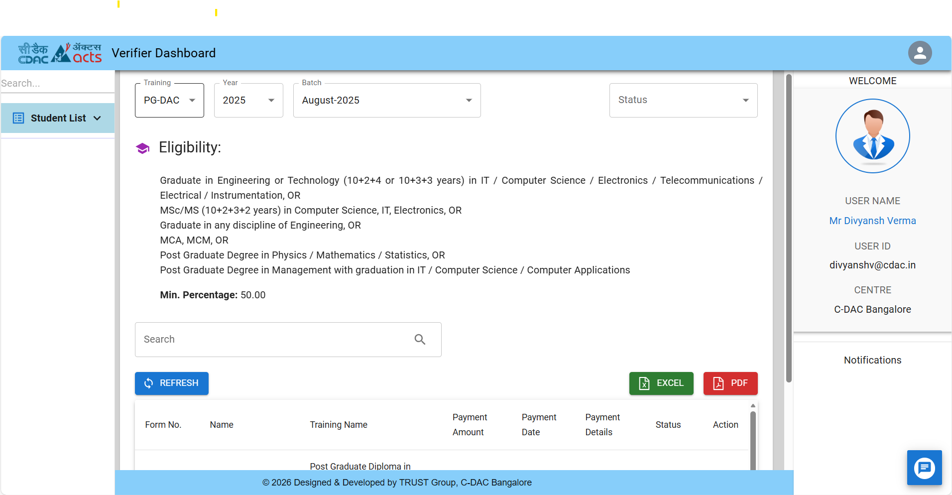

Slide 8
Role-Based Access & Security
Multiple dashboards based on role ID.
Protected routing using React Router v6.
Session management using MySQLStore.
Password hashing & secure authentication.

Slide 9
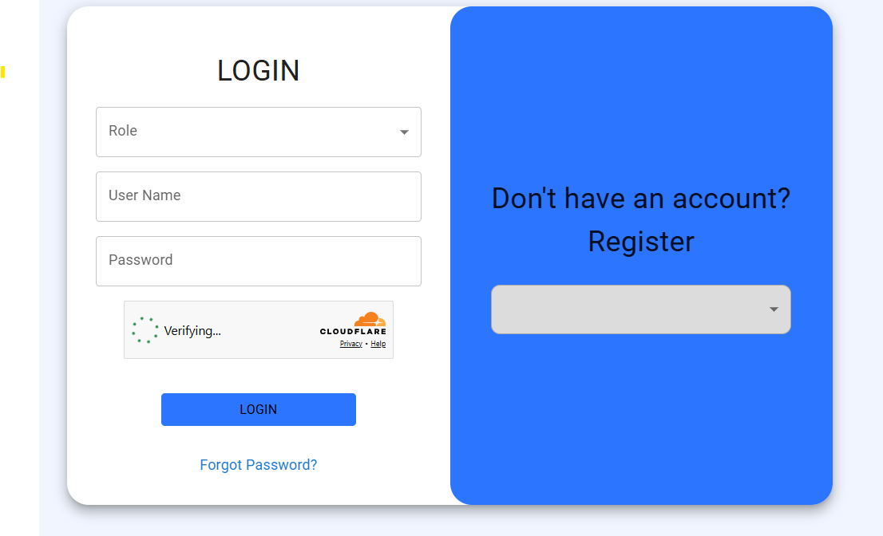

Slide 10
Backend & File Management
Secure file upload handling.
Structured directory storage per student.
Server-side validation before database entry.
Separation of file storage and metadata storage.

Slide 11
Deployment & DevOps Exposure
Dockerized frontend and backend services.
Nginx reverse proxy configuration.
Environment variable management.
VM-based production deployment.
Log handling and monitoring.

Slide 12
Security & Quality Enhancements
Resolved VAPT issues.
Configured CSP headers & SSL.
Improved input validation.
Ensured secure API communication.

Slide 13
Conclusion
Experience in enterprise-grade application development.
Hands-on exposure to full software lifecycle.
Strong UI/UX, backend, and deployment expertise.

