Slide 1
Tableau Analysis of US Police Shooting Data (2015-2022)
Insights into Yearly Trends, State-wise Data, and Demographic Analysis
Notes:
Good Evening, everyone. My name is Harsh, and today I will be presenting my Tableau project on US Police Shooting Data from 2015 to 2022. Through this presentation, I aim to highlight key insights derived from the data, including yearly trends, state-wise distribution, and demographic breakdowns. Let's dive into the findings.

Slide 2
Yearly Trend of Shootings (2015-2022)
This line chart shows yearly counts of police shootings. Numbers were stable (~900 annually) until a sharp decline in 2021 (567 cases) and 2022 (238 cases).
Notes:
Let's start by examining the yearly trend of police shootings from 2015 to 2022. As we can see in this line chart, the number of shootings was relatively stable, hovering around 900 incidents annually from 2015 to 2020. However, a sharp decline is observed in 2021, with a count of 567, followed by a significant drop to 238 incidents in 2022. This decline raises questions about the contributing factors, which could include policy changes, public awareness, or reporting variations.

Slide 3
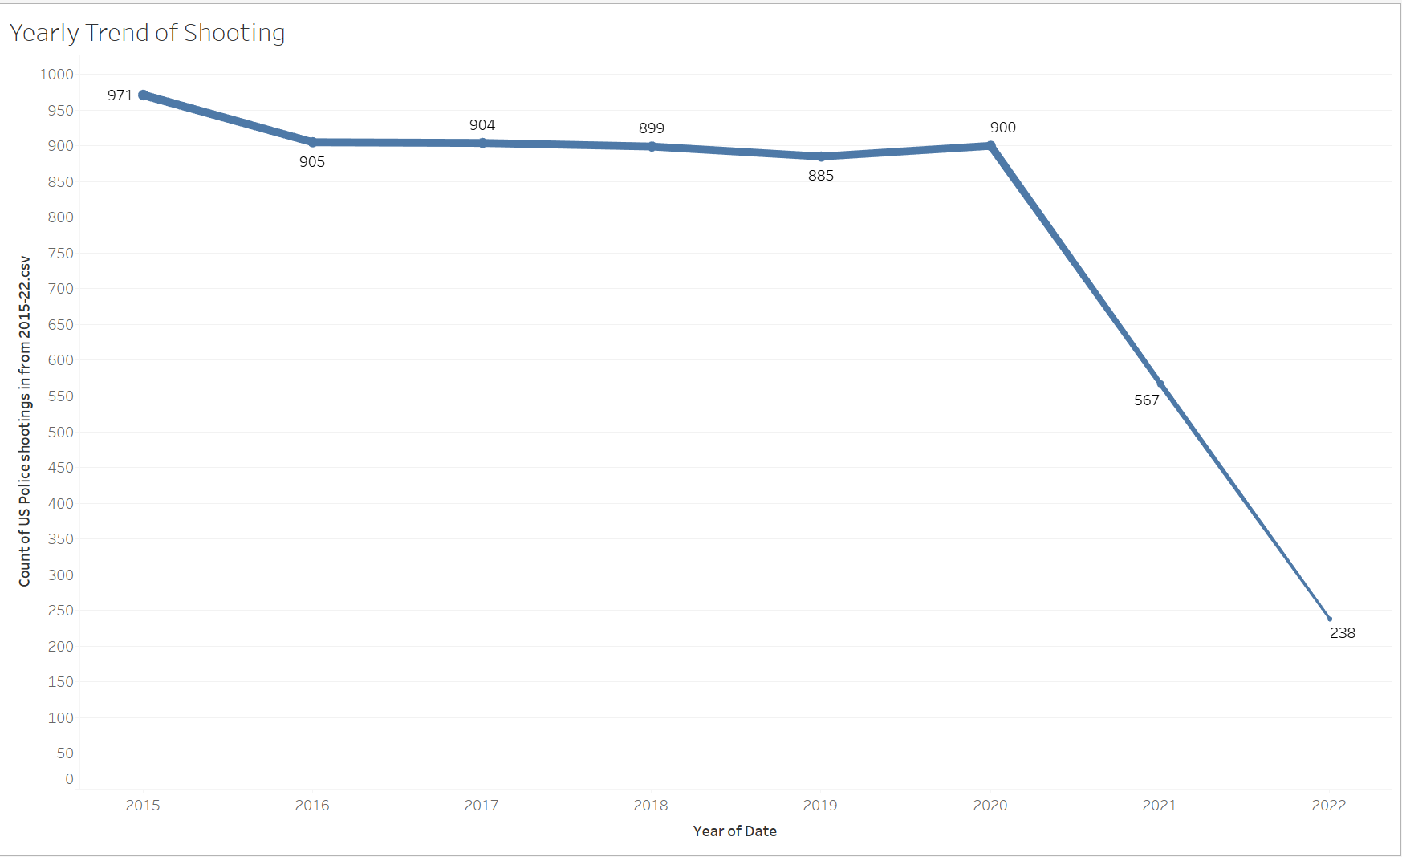
Notes:
Let's start by examining the yearly trend of police shootings from 2015 to 2022. As we can see in this line chart, the number of shootings was relatively stable, hovering around 900 incidents annually from 2015 to 2020. However, a sharp decline is observed in 2021, with a count of 567, followed by a significant drop to 238 incidents in 2022. This decline raises questions about the contributing factors, which could include policy changes, public awareness, or reporting variations.

Slide 4
Geographic Distribution of Shootings
This map highlights state-wise shootings. Higher numbers are seen in states like California, Texas, and Florida, potentially due to their larger populations.

Slide 5
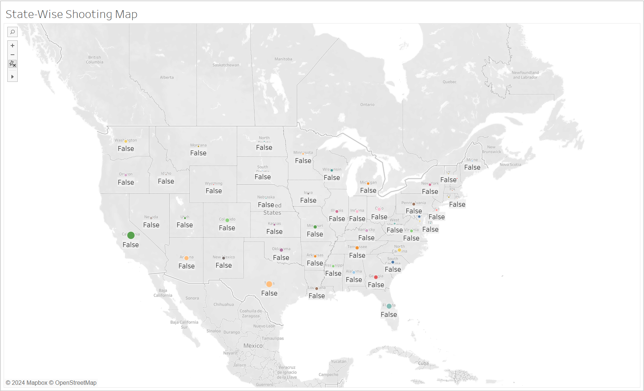
Notes:
Moving on to the geographic distribution, this map highlights the number of police shootings across different states. Larger and more frequent shootings are observed in states like California, Texas, and Florida, which could be due to their higher population densities. Understanding the regional disparities can help identify areas requiring targeted interventions

Slide 6
State-Wise Shooting Breakdown
This bar chart ranks states by their contribution to total shootings. California leads at 13.97%, followed by Texas (8.81%) and Florida (6.83%).

Slide 7
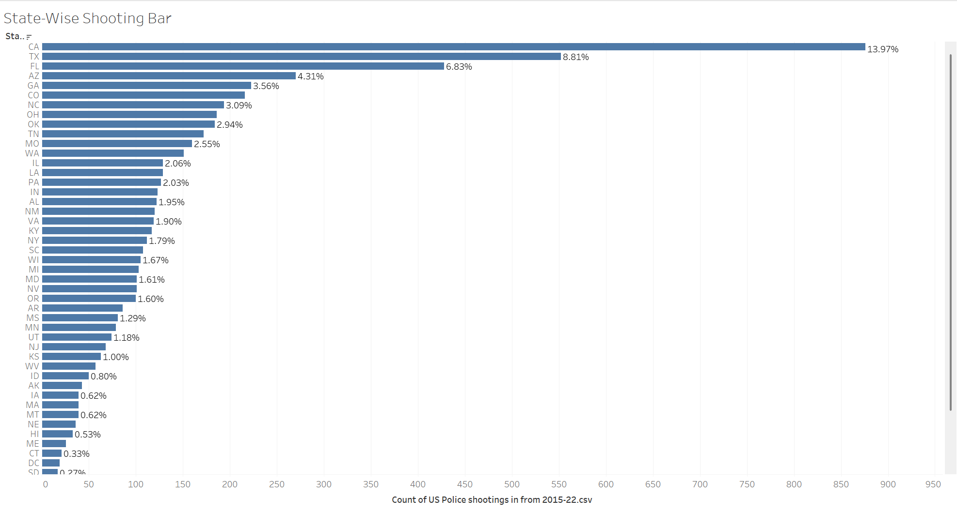
Notes:
To get a clearer picture, this bar chart ranks states by their contribution to the total number of police shootings. California leads at 13.97%, followed by Texas at 8.81%, and Florida at 6.83%. This visualization emphasizes the need to investigate state-specific factors, such as law enforcement practices and socio-economic conditions, contributing to these numbers.

Slide 8
Demographic Breakdown of Victims
The majority of victims are White (W), followed by Black (B) and Hispanic (H). Males (M) are the predominant gender among victims.

Slide 9
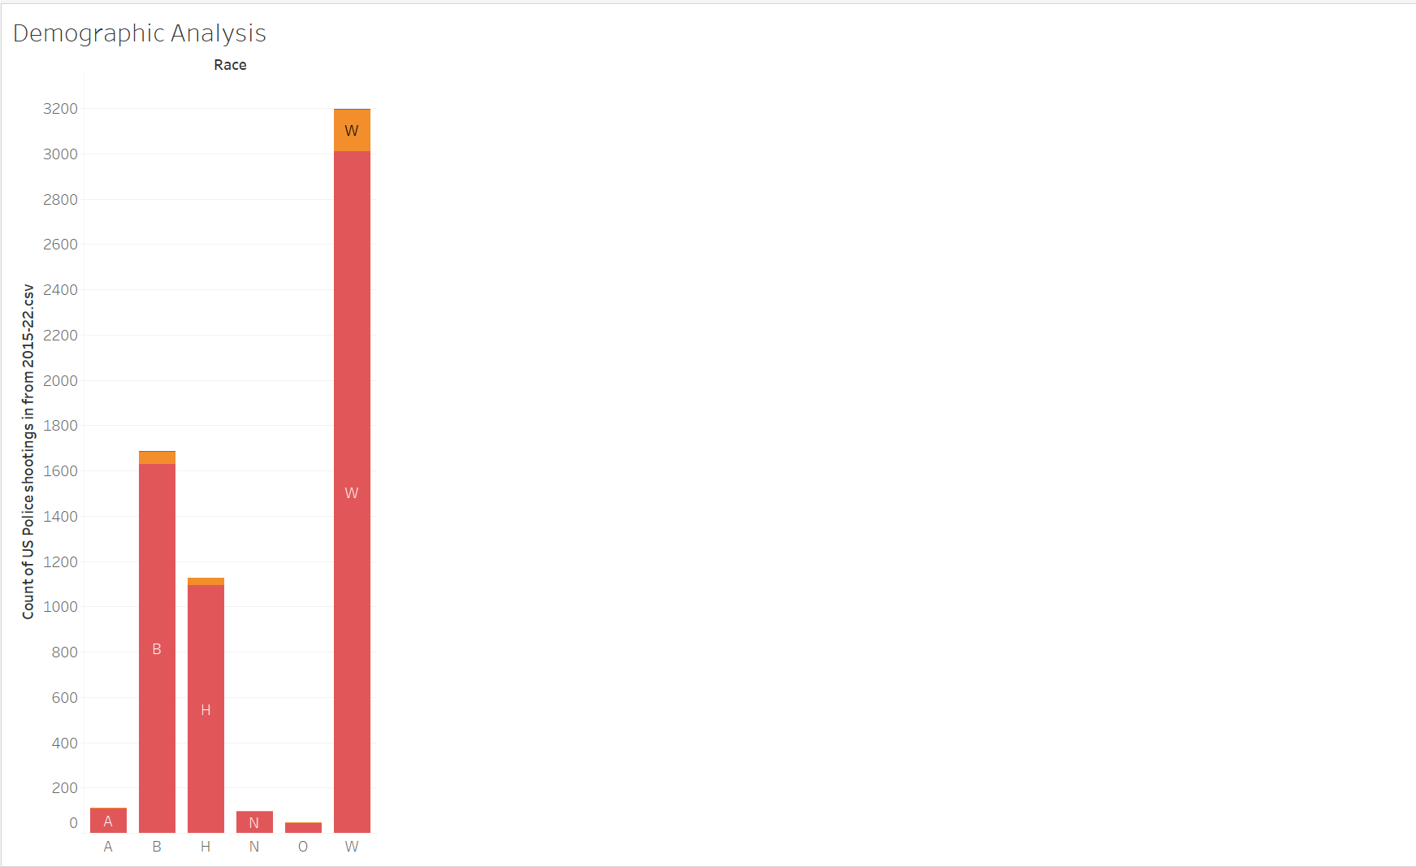
Notes:
Next, let's look at the demographic breakdown. The chart shows that the majority of victims are White (W), followed by Black (B) and Hispanic (H) individuals. Additionally, males (M) form a significant majority of the victims. These insights underline the importance of addressing potential systemic biases in policing.

Slide 10
Causes of Death in Police Shootings
Most victims were shot. A small number experienced both shooting and tasering, highlighting the need for discussions on the use of force and non-lethal alternatives.

Slide 11
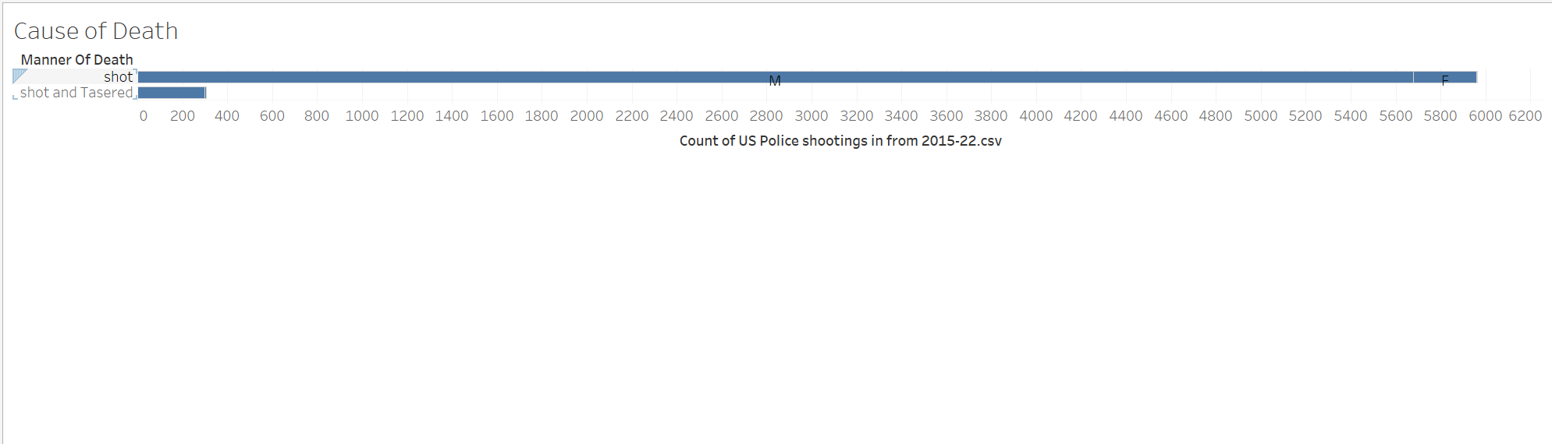
Notes:
Finally, the manner of death data reveals that the vast majority of victims were shot, with only a small proportion experiencing a combination of shooting and tasering. This data can guide discussions around the use of force and the adoption of non-lethal methods by law enforcement.

Slide 12
Conclusion and Key Takeaways
Key findings:
1. Decline in shootings over the years.
2. Geographic concentration in certain states.
3. Demographic patterns warrant further scrutiny.
Recommendations:
1. Investigate high-shooting states.
2. Promote bias mitigation training.
3. Encourage adoption of non-lethal enforcement methods.
Notes:
To summarize, this analysis highlights a decline in police shootings over the years, geographic concentration in certain states, and demographic patterns that warrant further scrutiny. Moving forward, recommendations include:
Conducting detailed investigations into high-shooting states.
Promoting training programs to mitigate biases.
Encouraging the adoption of non-lethal enforcement methods. Thank you for your attention. That’s all from my side have a good day.

