Slide 1
CAPSTONE PROJECT
E-Commerese Website Logs
Presented By:
1. NAME: Priyanshu Verma
2. DEPT: COMPUTER SCIENCE ENGINEERING
3.COLLEGE :GITA Autonomous College

Slide 2
OUTLINE
Problem Statement
Proposed System/Solution
System Development Approach
Algorithm & Deployment
Result
Conclusion
Future Scope
References

Slide 3
PROBLEM STATEMENT
An explanation of the dataset's significance
Analyzing unstructured e-commerce website logs presents
difficulties
To extract meaningful insights, exploratory data analysis and
visualization are required.

Slide 4
PROPOSED SOLUTION
Overview of the suggested remedy:
Making use of exploratory data analysis (EDA) methods
Using data visualization to enhance comprehension
The significance of comprehending consumer behavior and
refining sales tactics

Slide 5
SYSTEM APPROACH
Synopsis of the approach to system development:
Gathering and preparing data
Analyzing exploratory data
Techniques for visualizing data
Interpretation and the creation of insights

Slide 6
ALGORITHM & DEPLOYMENT
Algorithms (if any) employed in data analysis
Methodology for deploying the analysis:
Technologies and tools used for on-premises installation
or cloud-based deployment

Slide 7
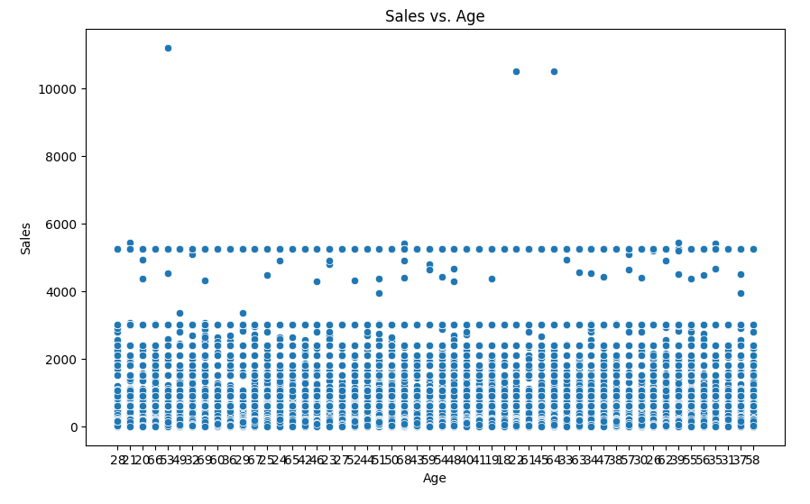
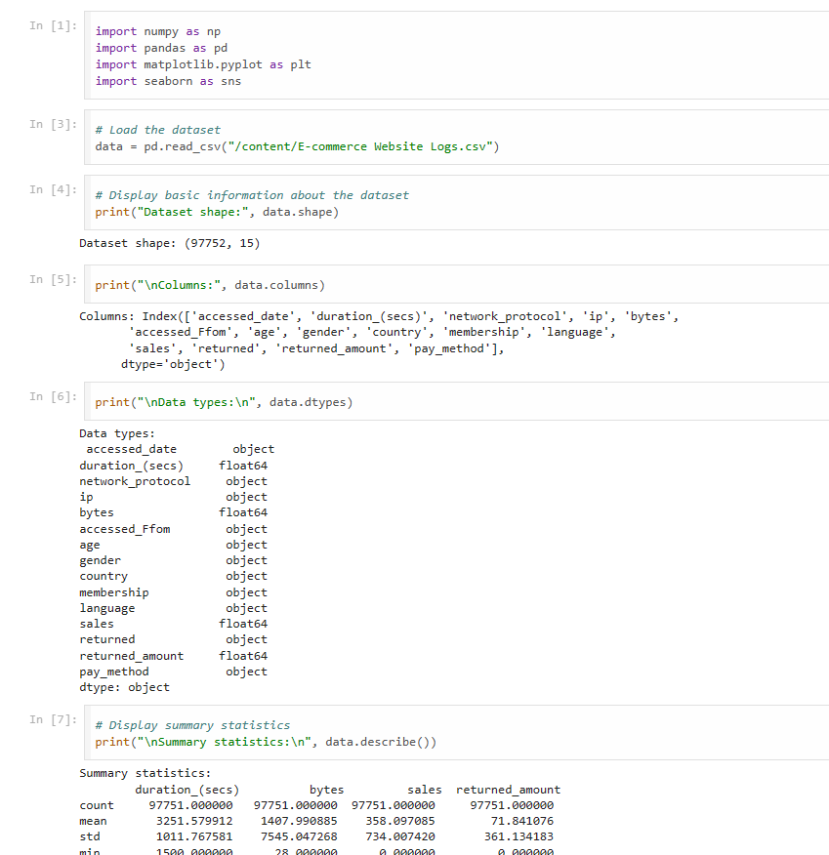
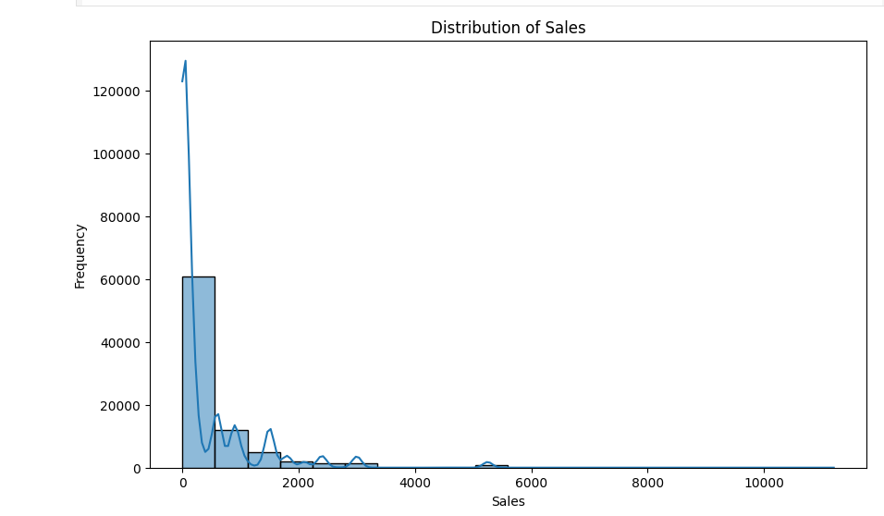
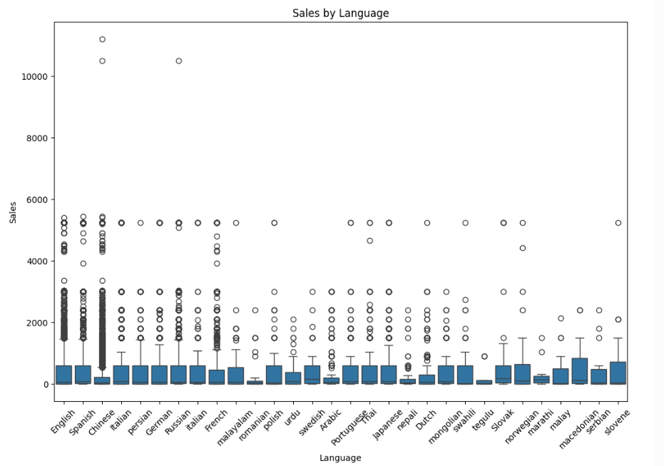
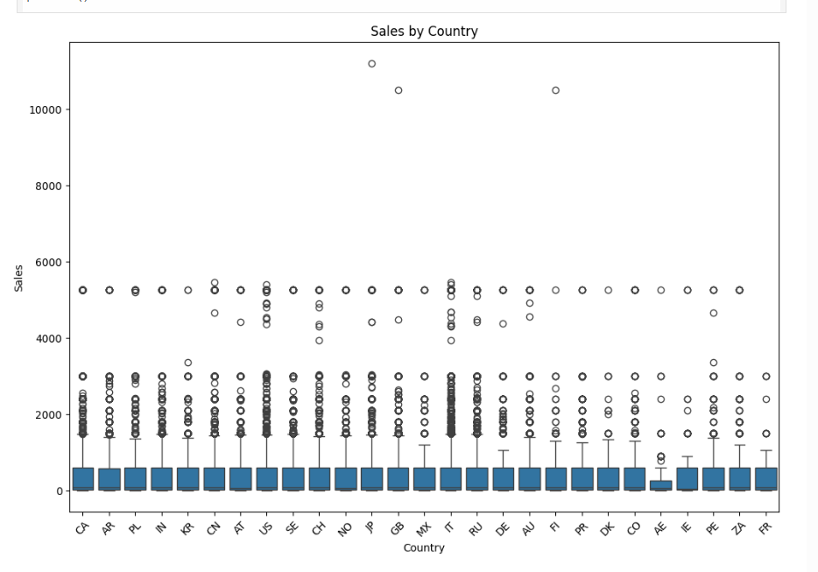
RESULT

Slide 8
CONCLUSION
A synopsis of the main conclusions and observations
The role that data visualization and EDA play in informing
business decisions
consequences for marketing campaigns and e-commerce
strategies

Slide 9
FUTURE SCOPE
Possibilities for more research and development:
sophisticated machine learning methods for forecasting
tracking and analyzing website records in real time
Integration with additional data sources to provide a holistic
perspective

Slide 10
REFERENCES
List of references and sources used in the development of the analysis and presentation
Add scholarly publications, papers, and web resources.

Slide 11
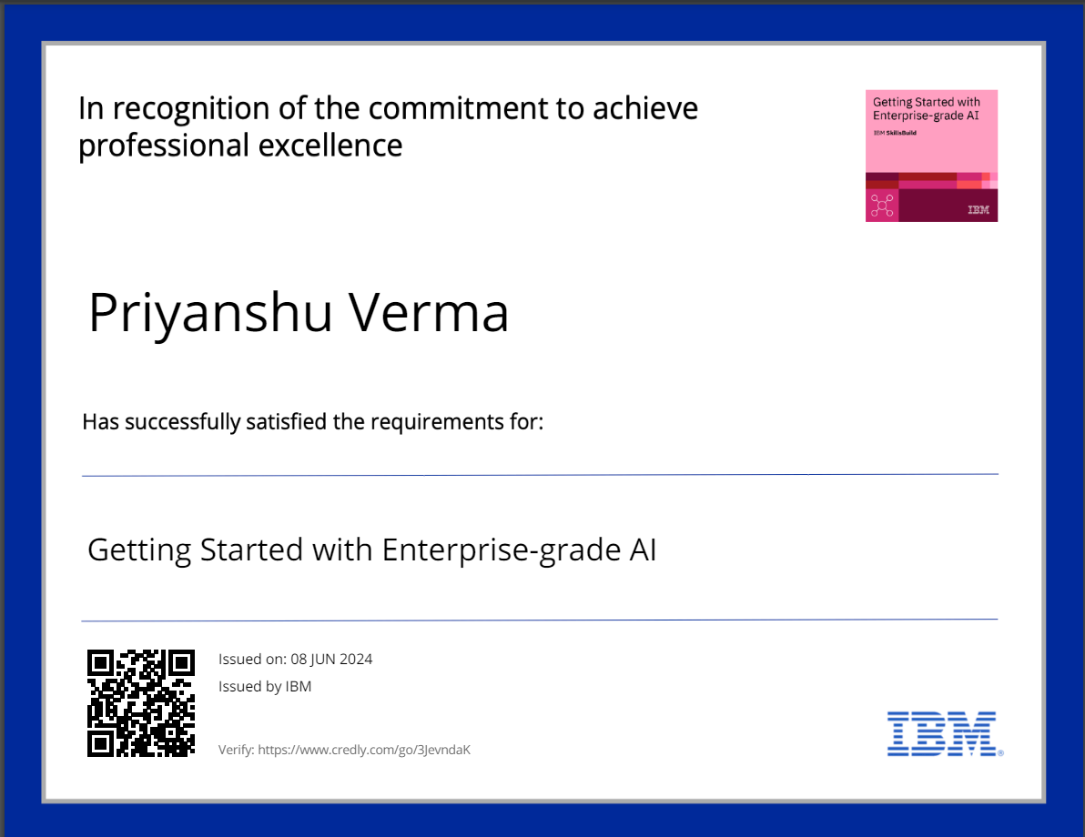
Getting Started with Enterprise-grade AI

Slide 12

Getting Started with Data

Slide 13
THANK YOU

