Slide 1
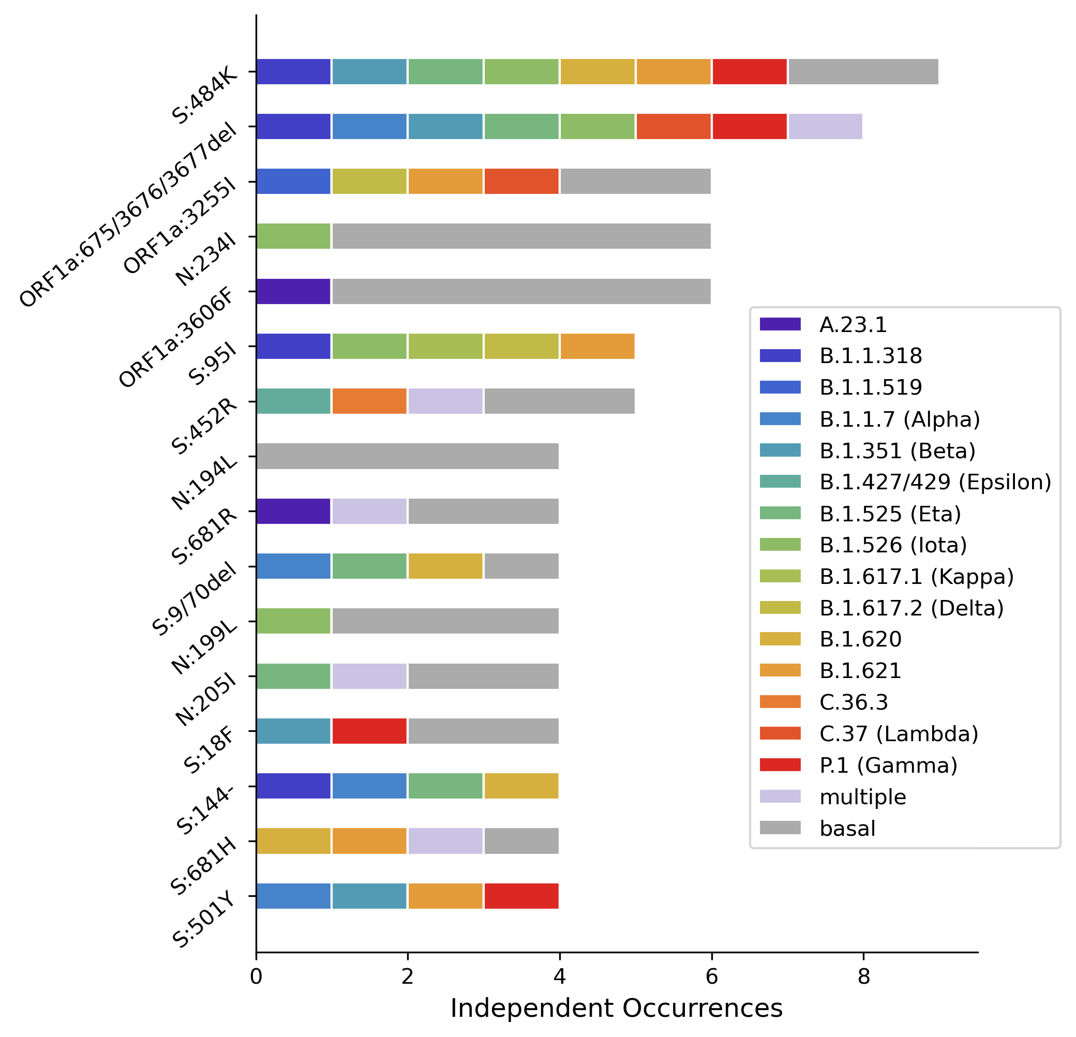
S:484K
ORF1a:3675-3677del
ORF1a:3255I
N:234I
ORF1a:3606F
S:95I
S:452R
N:194L
S:681R
S:69/70del
N:199L
N:205I
S:18F
S:144-
S:681H
S:501Y

