Slide 1
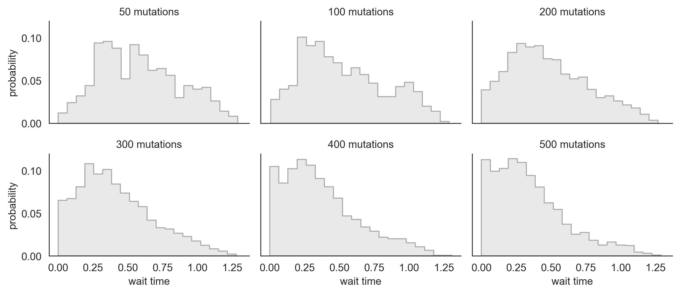
RdRp nonsynonymous: 101 mutations
S1 synonymous: 104 mutations
S1 nonsynonymous: 353 mutations

