Slide 1
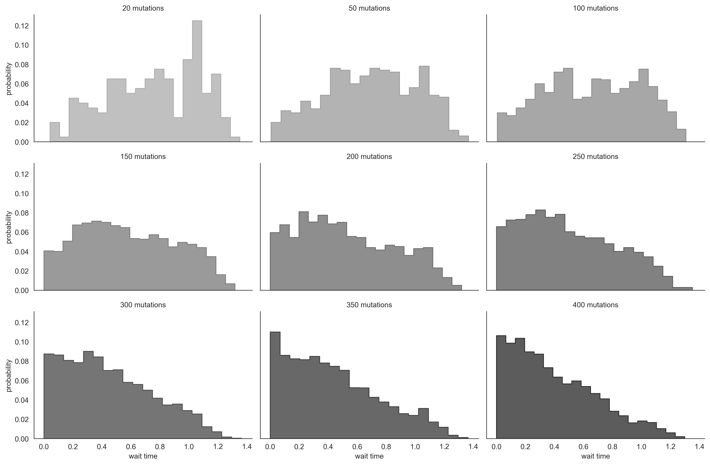
RdRp nonsynonymous: 85 mutations
S1 synonymous: 111 mutations
S1 nonsynonymous: 304 mutations

